Slide 1
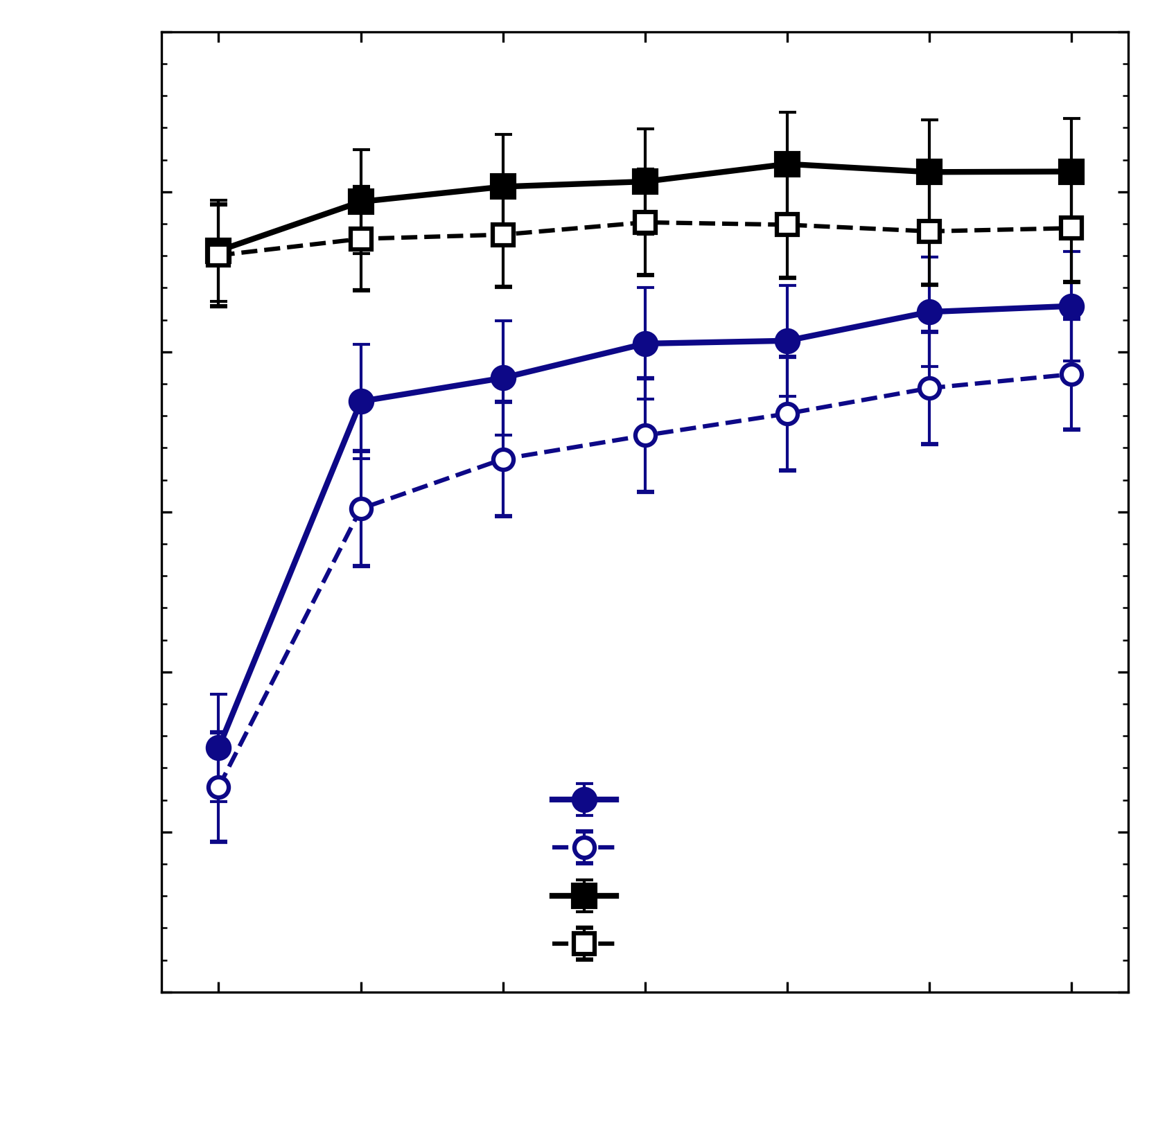
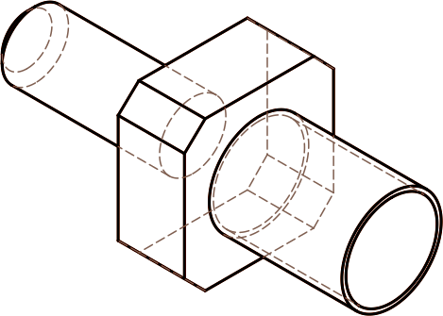
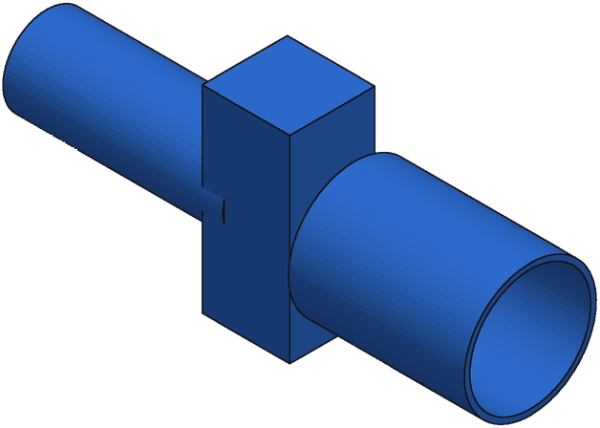
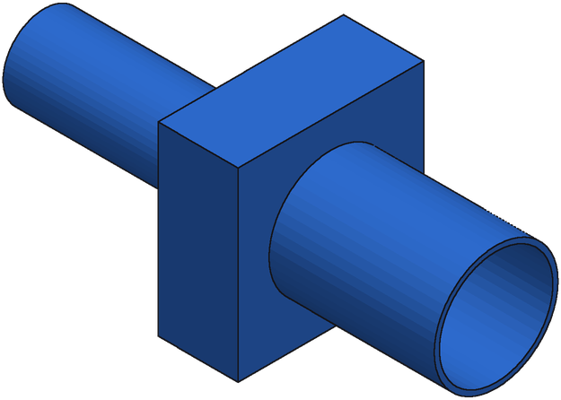
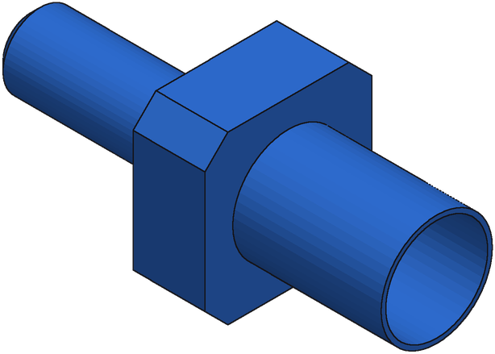
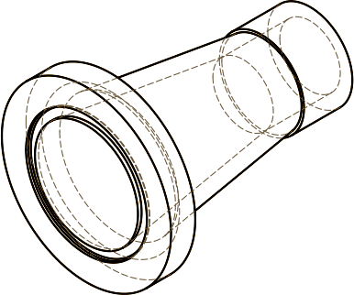
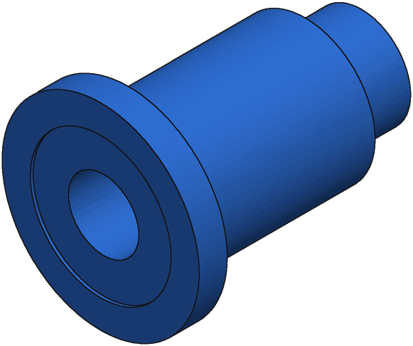
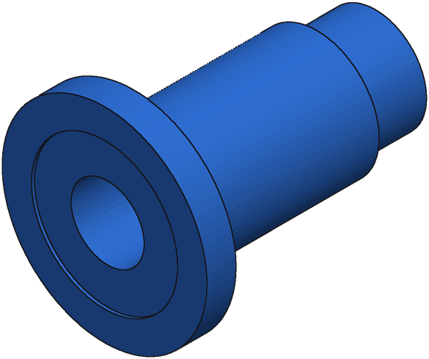
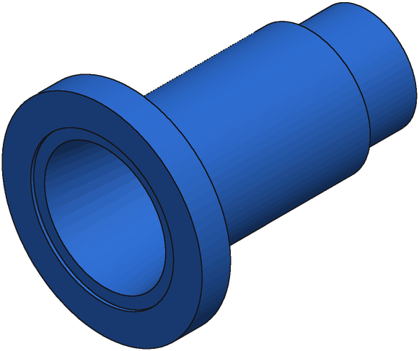
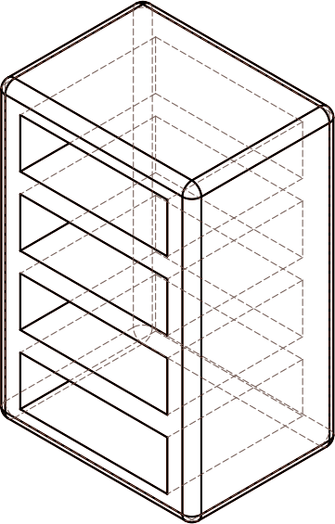


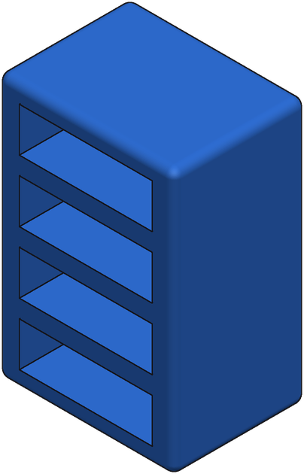
0.75
0.70
Target
Coupling
Start
IoU 0.53
Round 1
IoU 0.95
Round 4
IoU 0.97
0.65
Mean IoU
0.60
0.55
Target
Bushing
Start
IoU 0.52
Round 1
IoU 0.58
Round 6
IoU 0.77
SFT + repair, 3 chains
0.50
SFT + repair, 1 chain
SFT + GRPO + repair, 3 chains
SFT + GRPO + repair, 1 chain
0.45
0
1
2
3
4
5
6
Target
Shelf
Start
IoU 0.85
Round 1
IoU 0.86
Round 2
IoU 0.99
Repair round
Notes:
Row 1: grpo_iso option 1, F_132350_55d48f65_0_x, served repair chain (best render-compare of 3), r0 0.532 -> r1 0.950 -> r4 0.974
Row 2: grpo_iso option 2, F_21969_83e65247_0_x, served repair chain (best render-compare of 3), r0 0.523 -> r1 0.579 -> r6 0.769
Row 3: grpo_iso option 3, A_00433447_bceb4e05aca4db1056a57af5_step_001_x, served repair chain (best render-compare of 3), r0 0.848 -> r1 0.856 -> r2 0.994
Bench B (held-out real). Renders: every adopted program on one camera with the ground truth (same scale).

