Slide 1
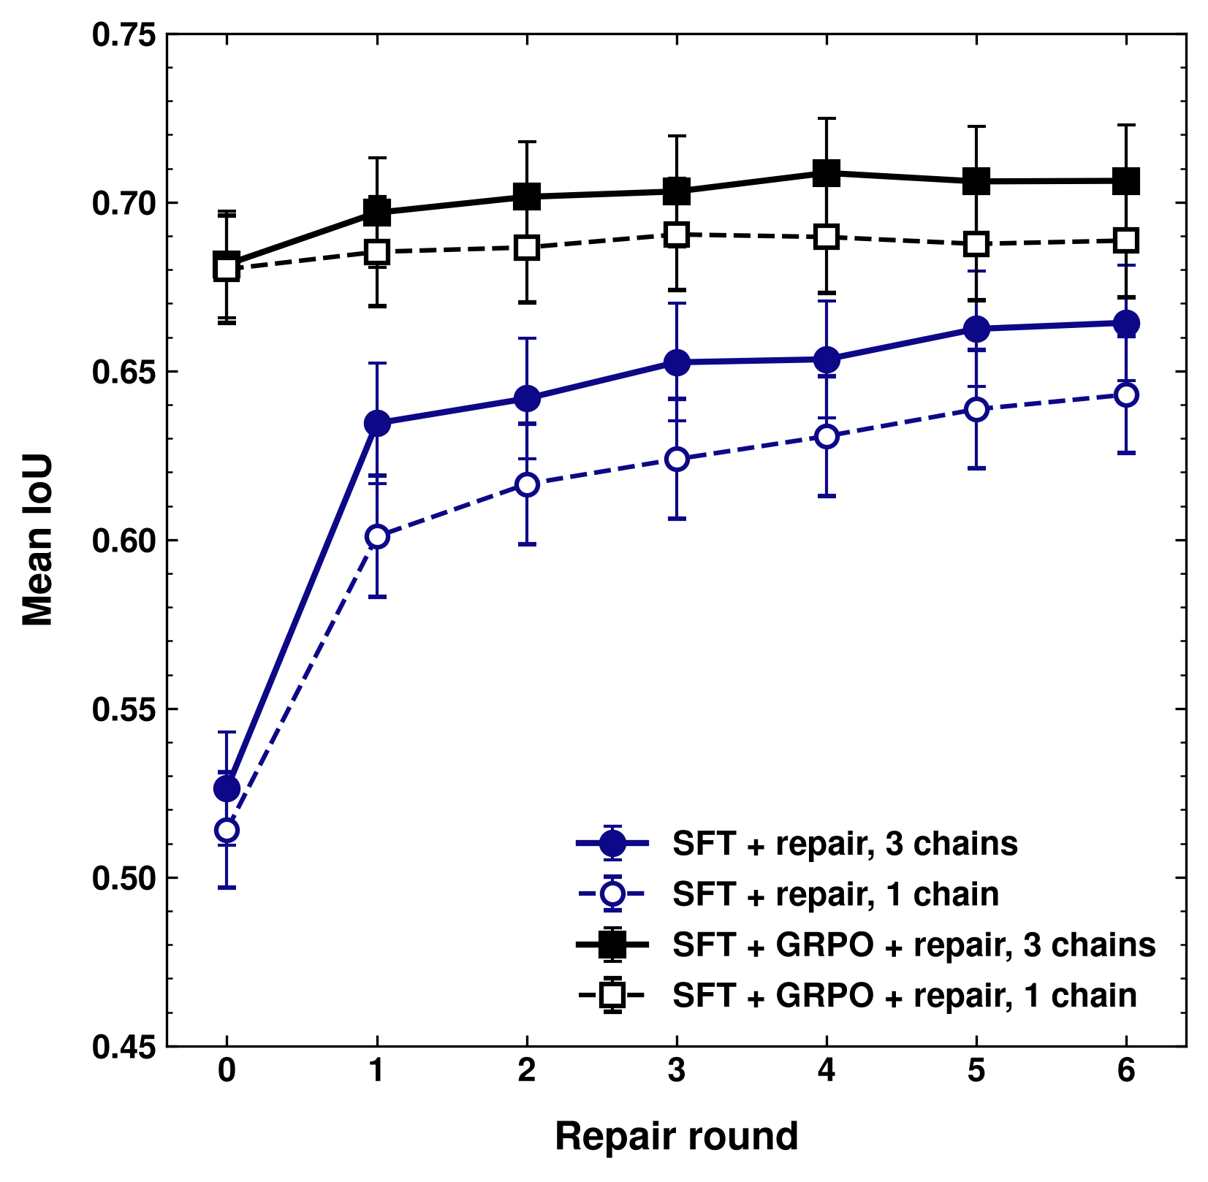
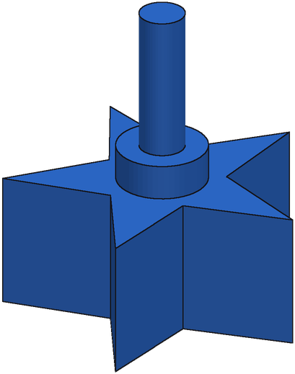
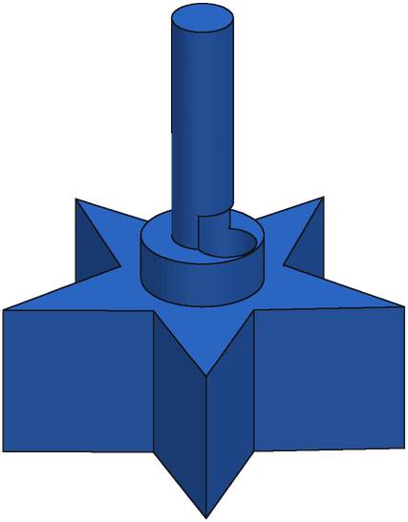
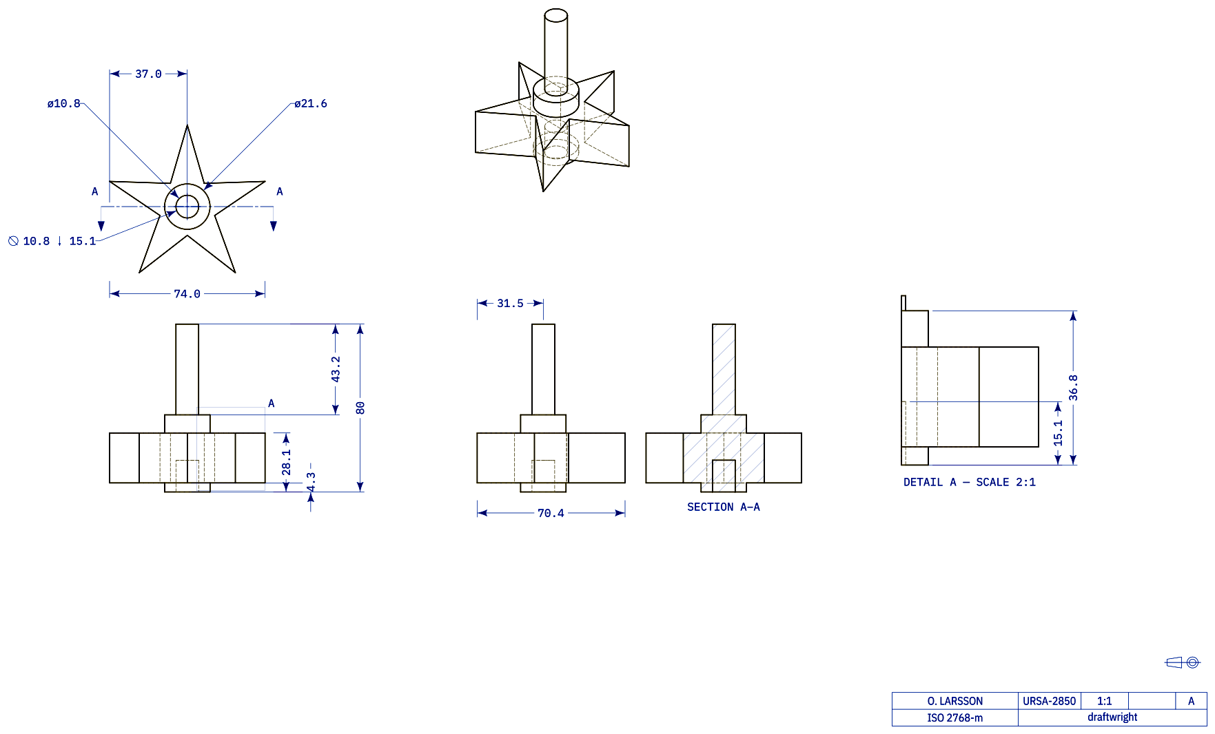
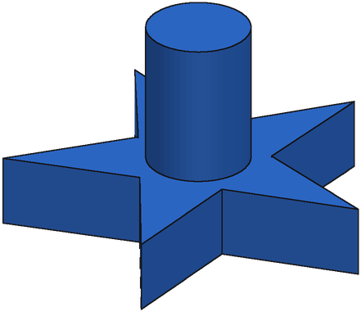
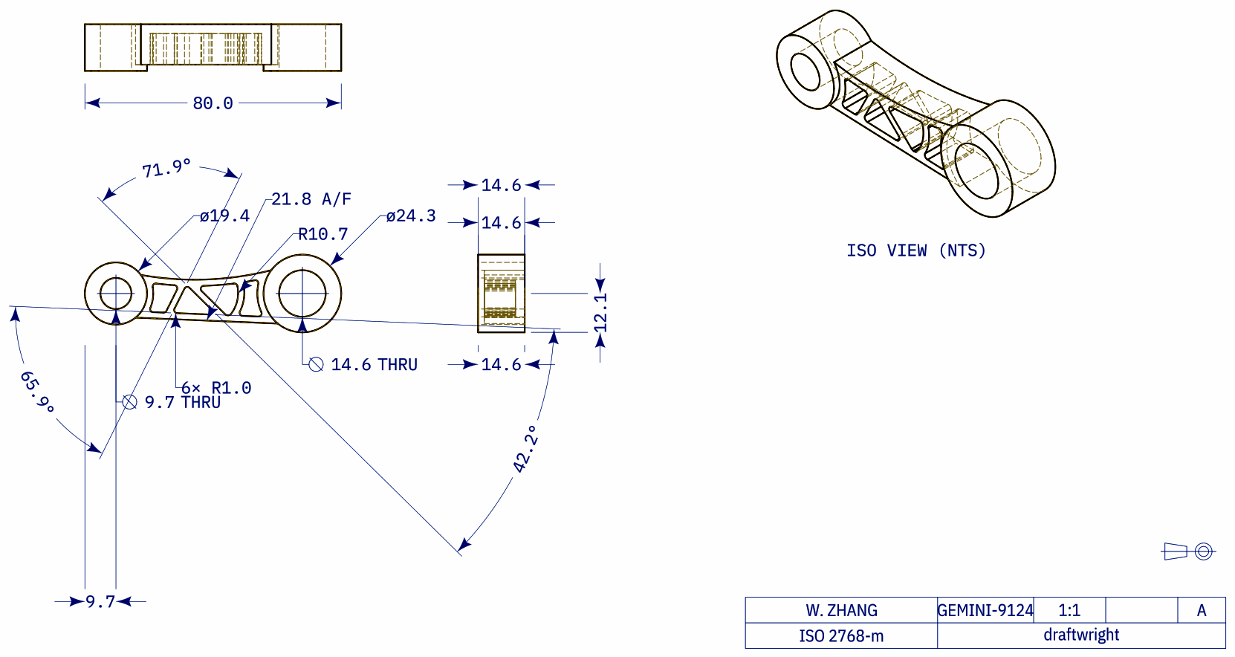
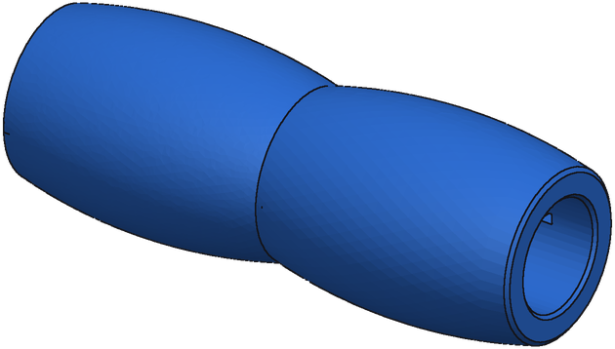
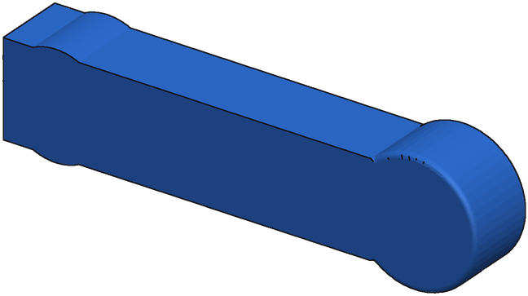
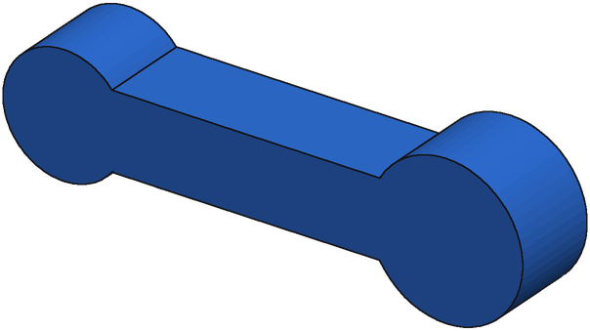
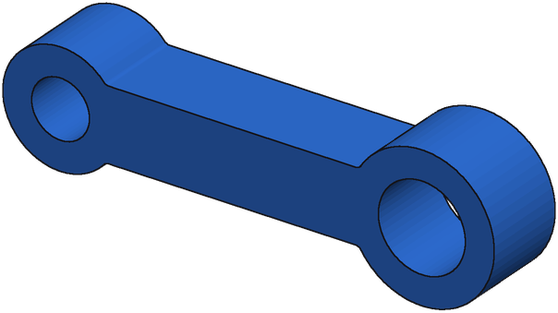
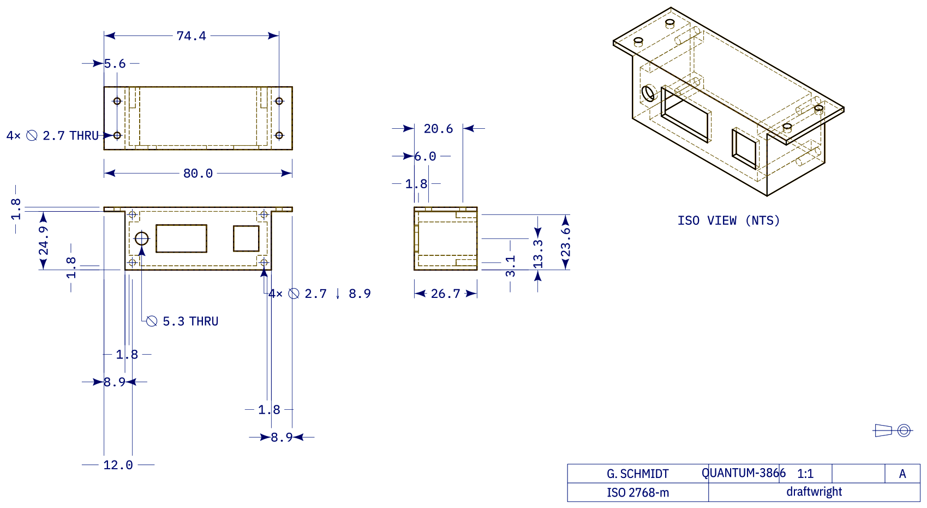
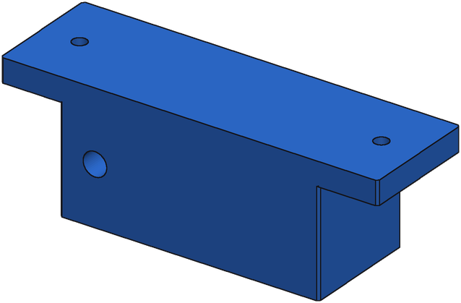
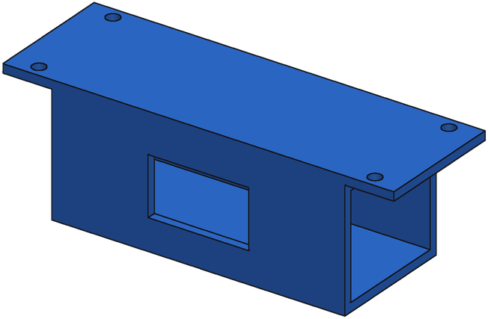
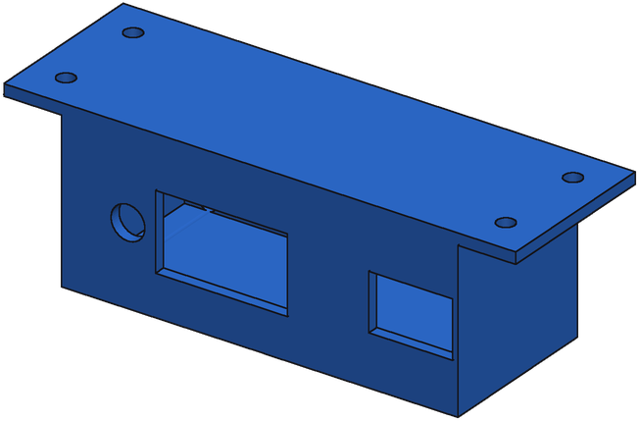
Start
IoU 0.20
Round 1
IoU 0.36
Round 4
IoU 0.79
Start
IoU 0.10
Round 2
IoU 0.44
Round 3
IoU 0.52
Round 4
IoU 0.59
Start
IoU 0.19
Round 1
IoU 0.51
Round 5
IoU 0.61
Notes:
Row 1: sft option 3, F_49134_e9867f8b_4_x, served repair chain (best render-compare of 3), r0 0.201 -> r1 0.358 -> r4 0.793
Row 2: sft option 8, A_00438811_5875a5a729a5ae1773e26d5f_step_000_x, served repair chain (best render-compare of 3), r0 0.100 -> r2 0.439 -> r3 0.517 -> r4 0.588
Row 3: sft option 12, A_00438667_99294c9cfc53922768df426d_step_000_x, served repair chain (best render-compare of 3), r0 0.185 -> r1 0.512 -> r5 0.612
Bench B (held-out real). Renders: every adopted program on one camera with the ground truth (same scale).

