Slide 1
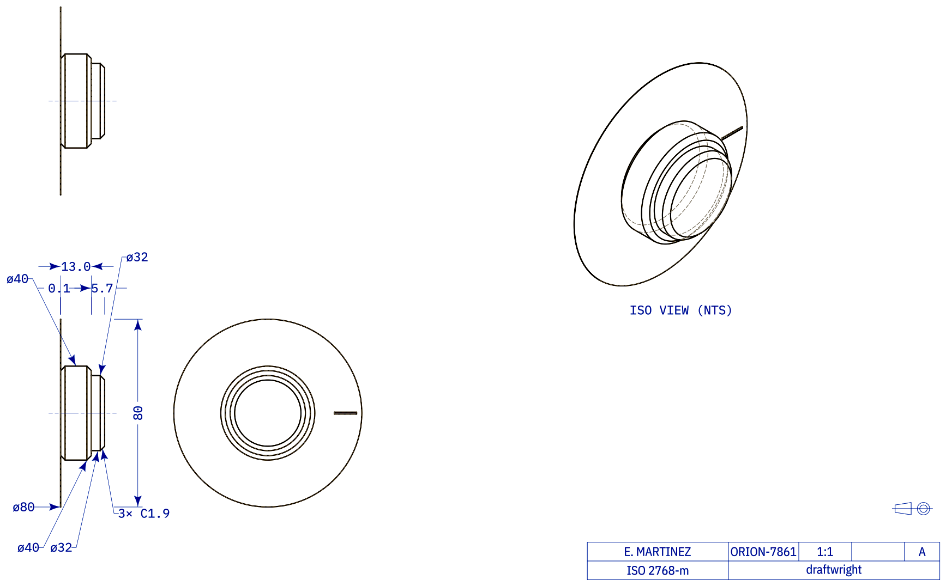
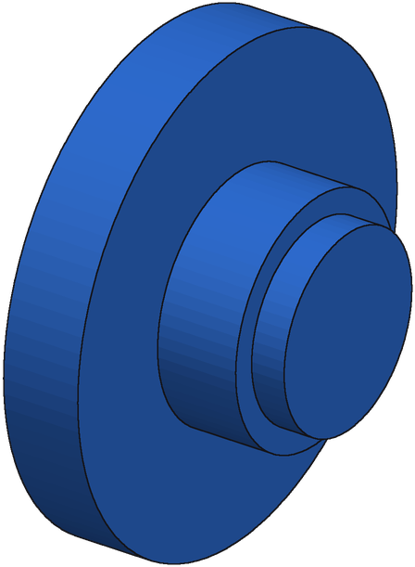
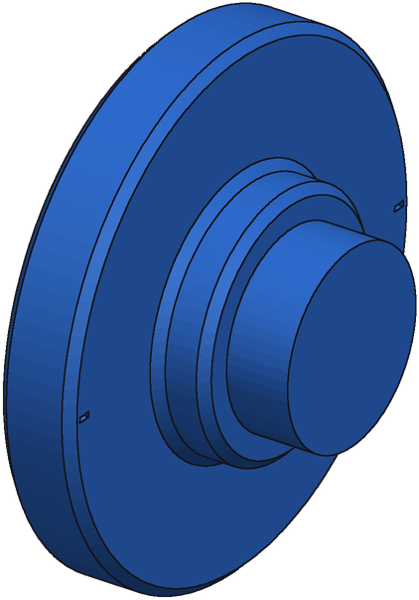
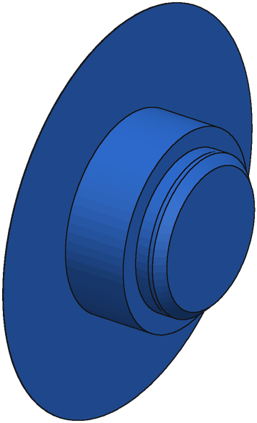
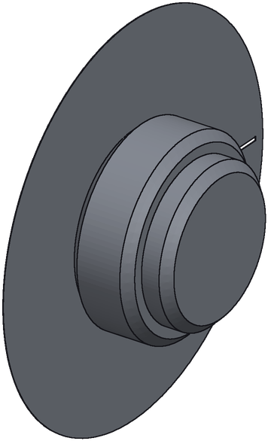
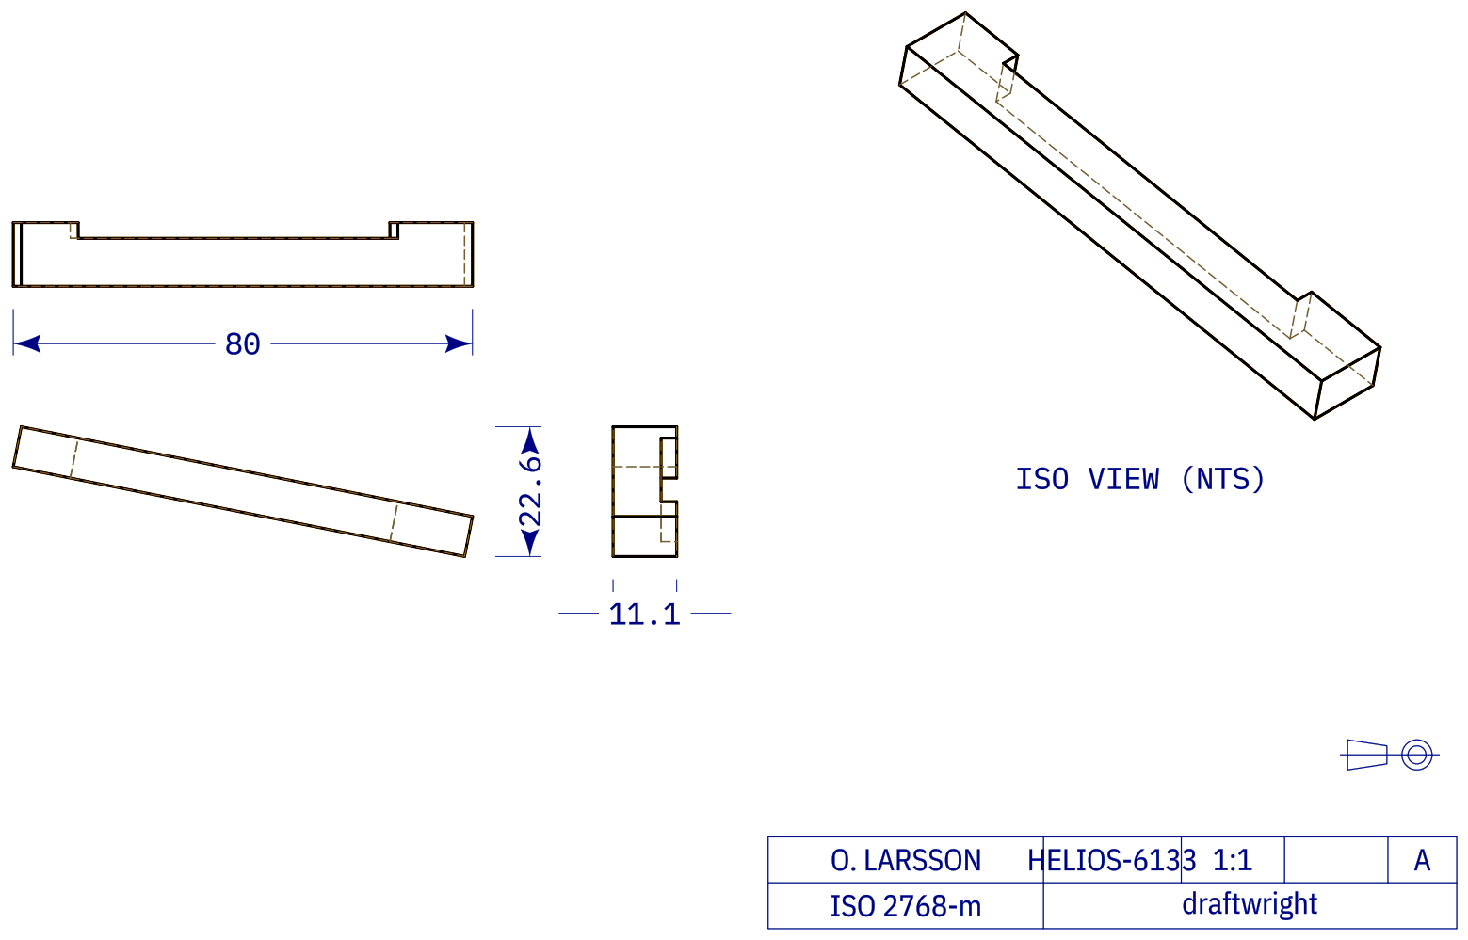
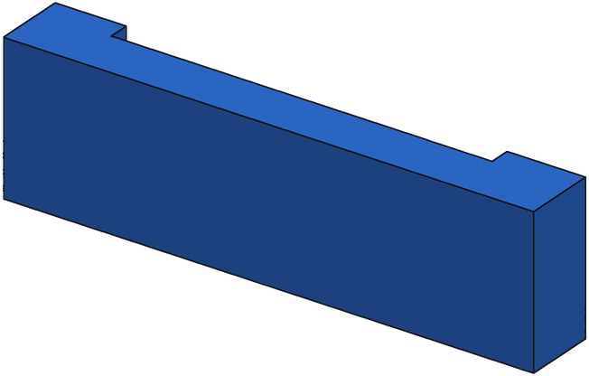
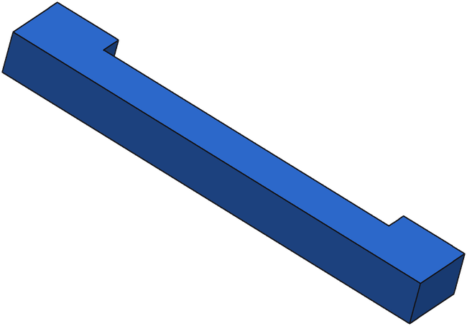
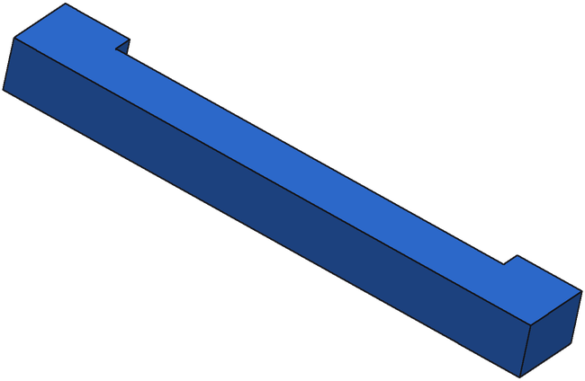
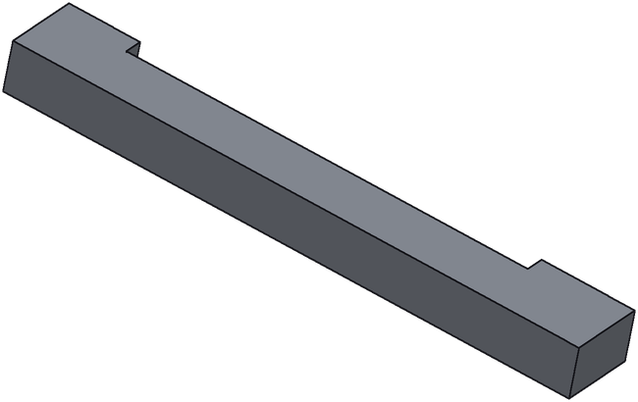
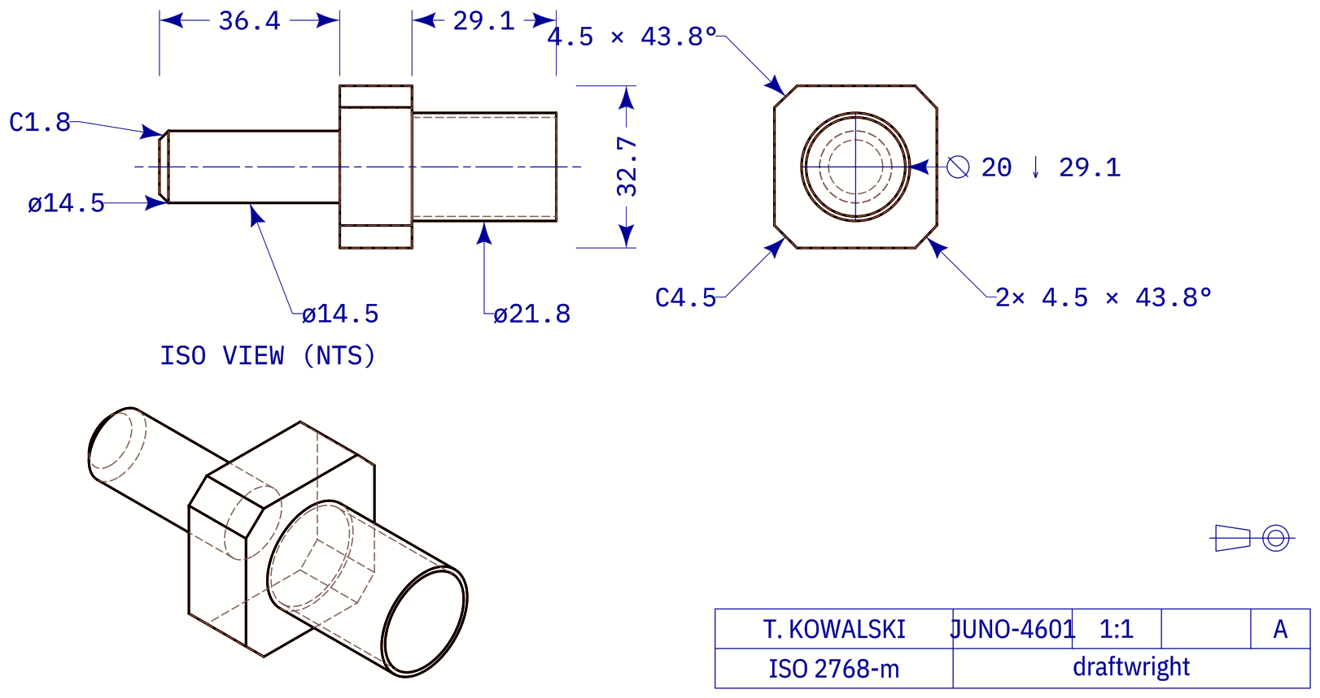
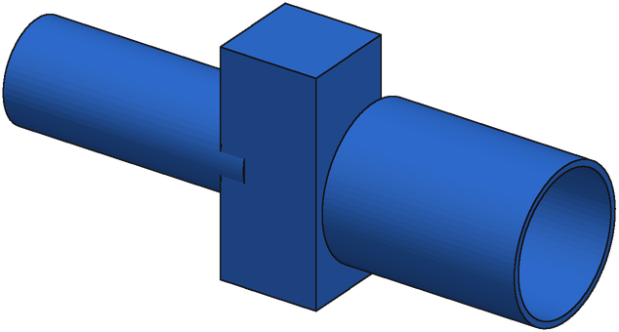
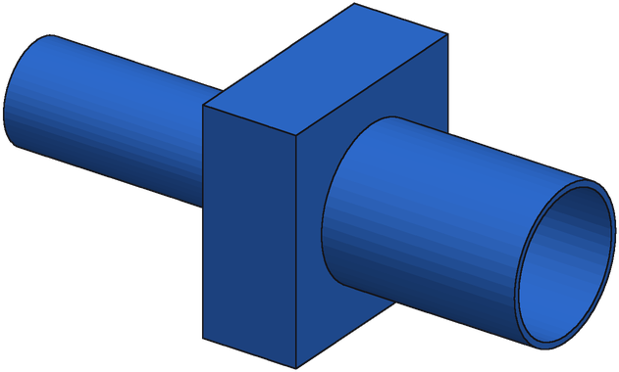
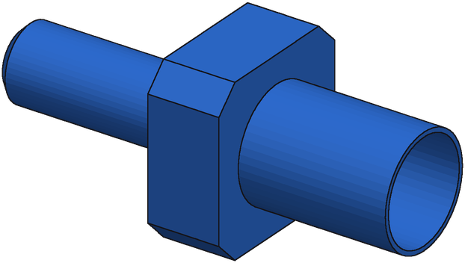
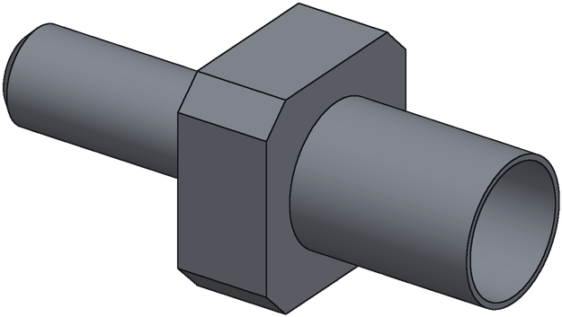
SFT + GRPO + repair: options 1–3
1. F_36088_1ea9c8a9_11_x gain +0.731
Drawing
Start
IoU 0.24
Round 1
IoU 0.27
Round 4
IoU 0.97
Ground truth
2. F_115786_e4499f95_6_x gain +0.549
Drawing
Start
IoU 0.31
Round 1
IoU 0.60
Round 5
IoU 0.86
Ground truth
3. F_132350_55d48f65_0_x gain +0.442
Drawing
Start
IoU 0.53
Round 1
IoU 0.95
Round 4
IoU 0.97
Ground truth

Slide 2
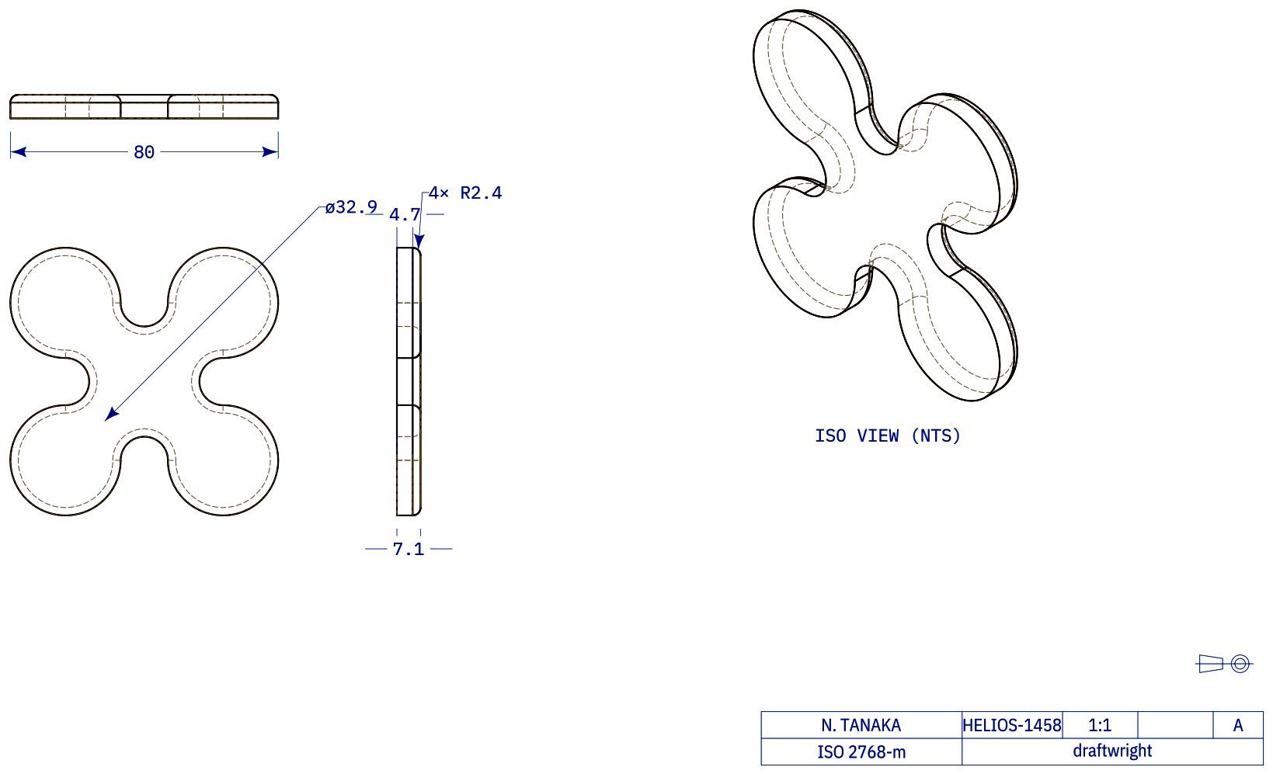
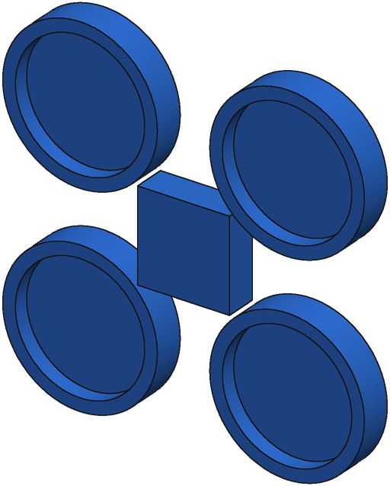
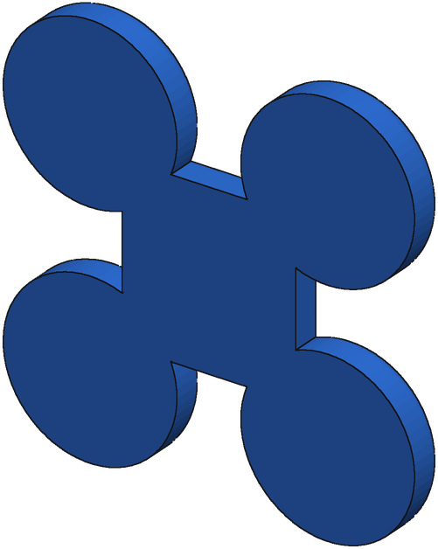
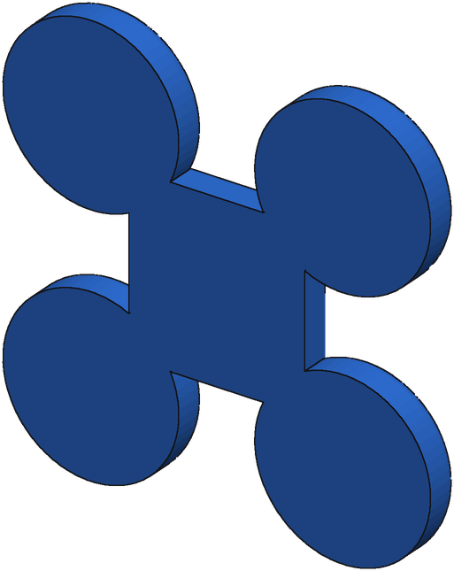
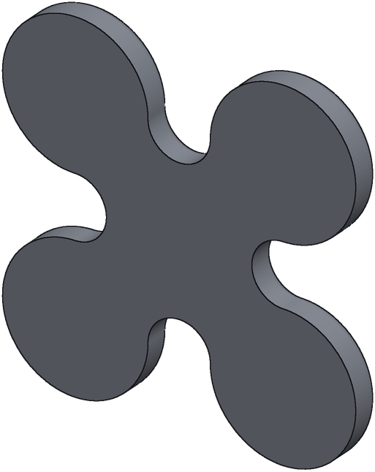
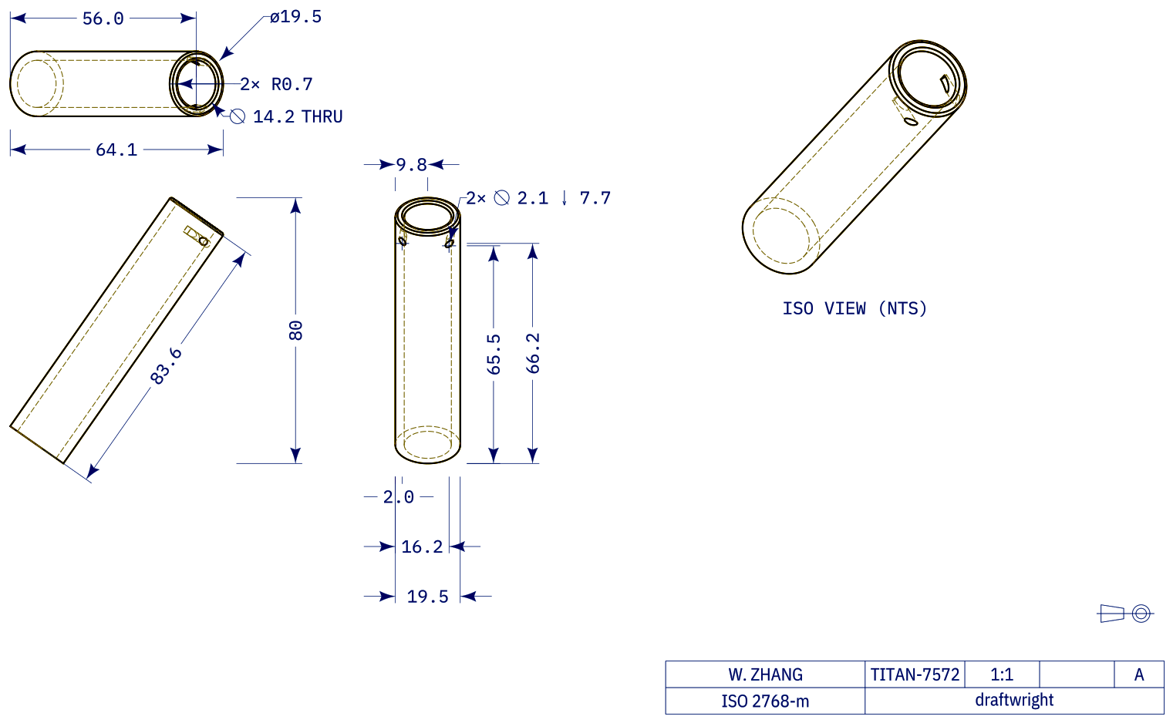
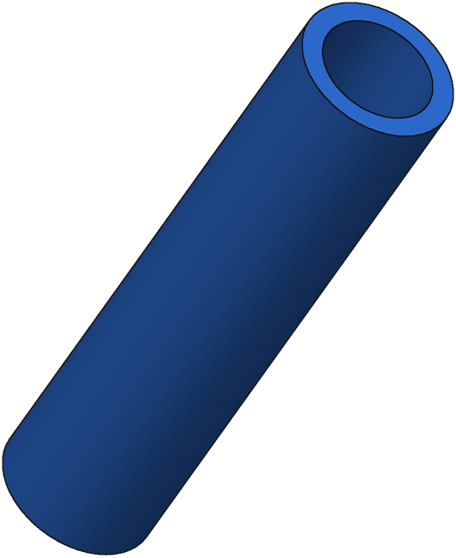
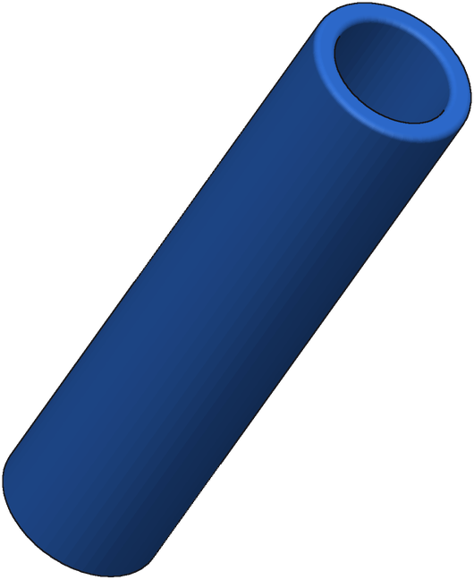

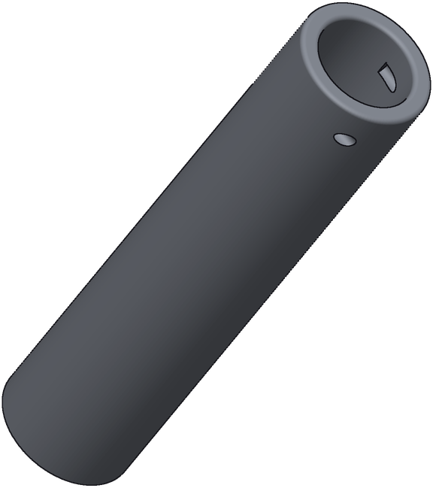
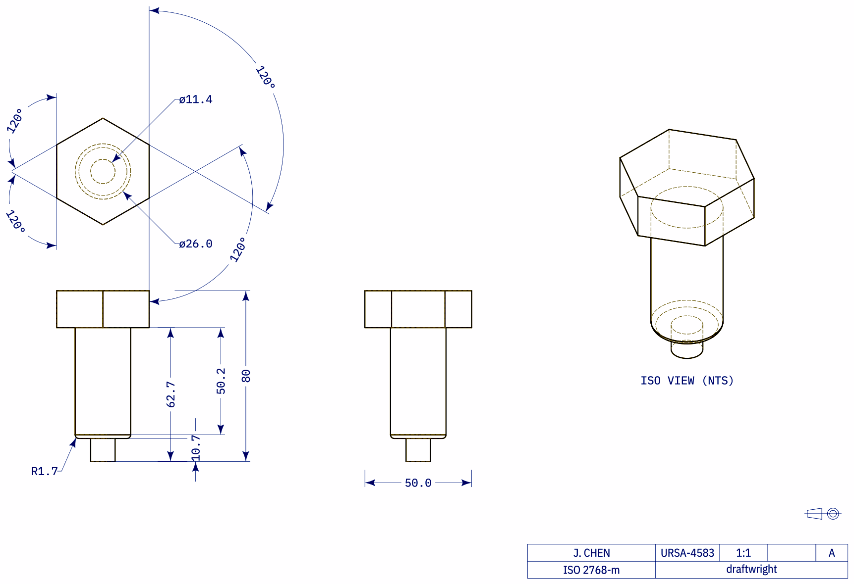
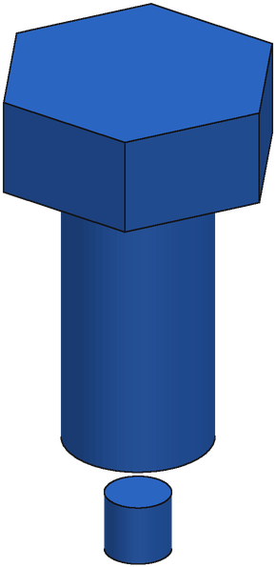
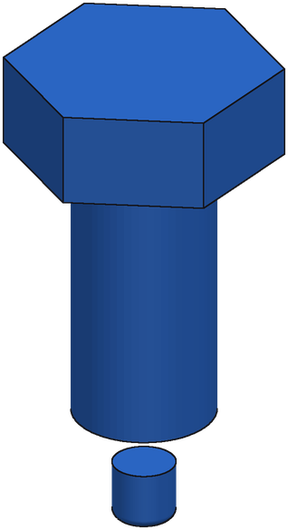
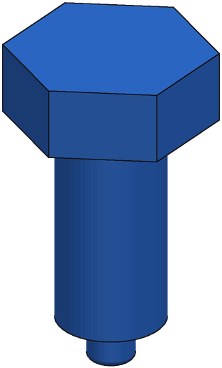
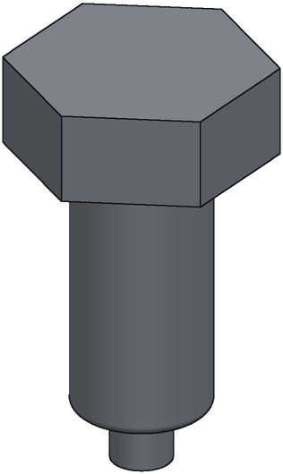
SFT + GRPO + repair: options 4–6
4. F_23809_8576e0c2_0_x gain +0.402
Drawing
Start
IoU 0.56
Round 2
IoU 0.92
Round 3
IoU 0.96
Ground truth
5. F_69470_88ad0eac_2_x gain +0.358
Drawing
Start
IoU 0.57
Round 1
IoU 0.57
Round 2
IoU 0.93
Ground truth
6. F_88491_d1cba920_0_x gain +0.315
Drawing
Start
IoU 0.68
Round 2
IoU 0.72
Round 4
IoU 1.00
Ground truth

Slide 3
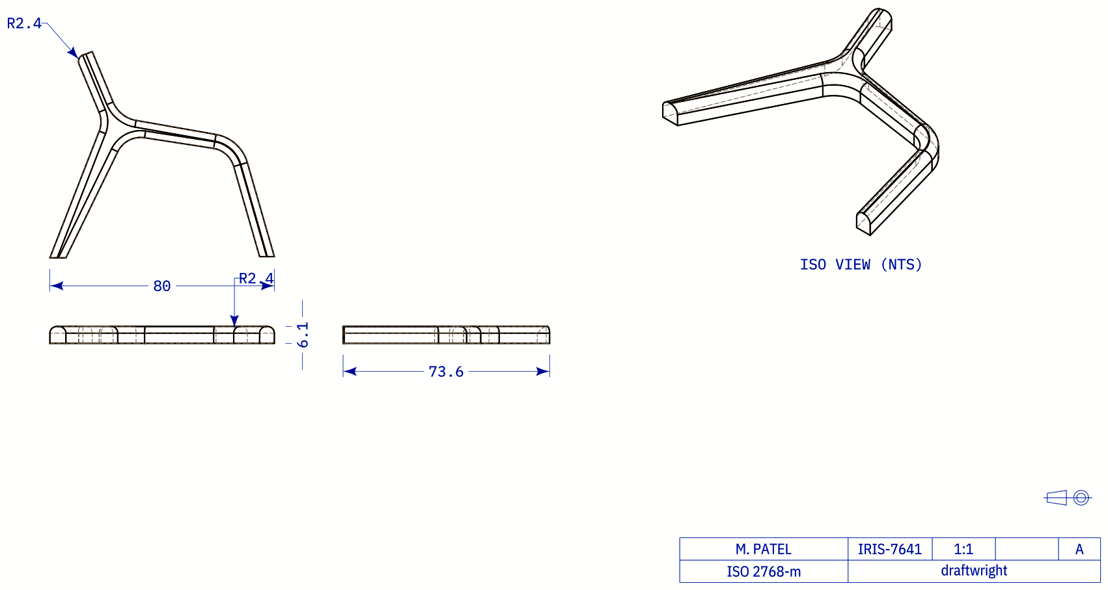
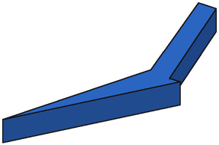
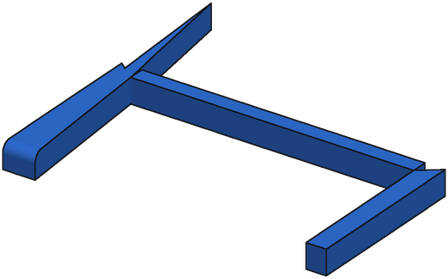
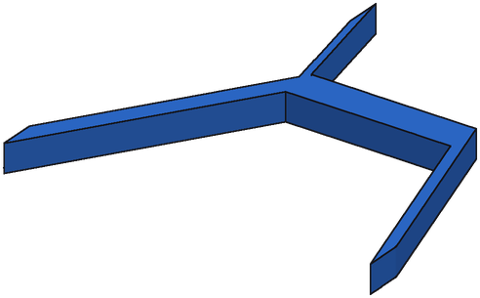
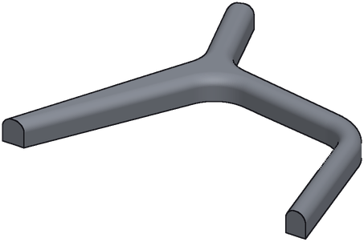
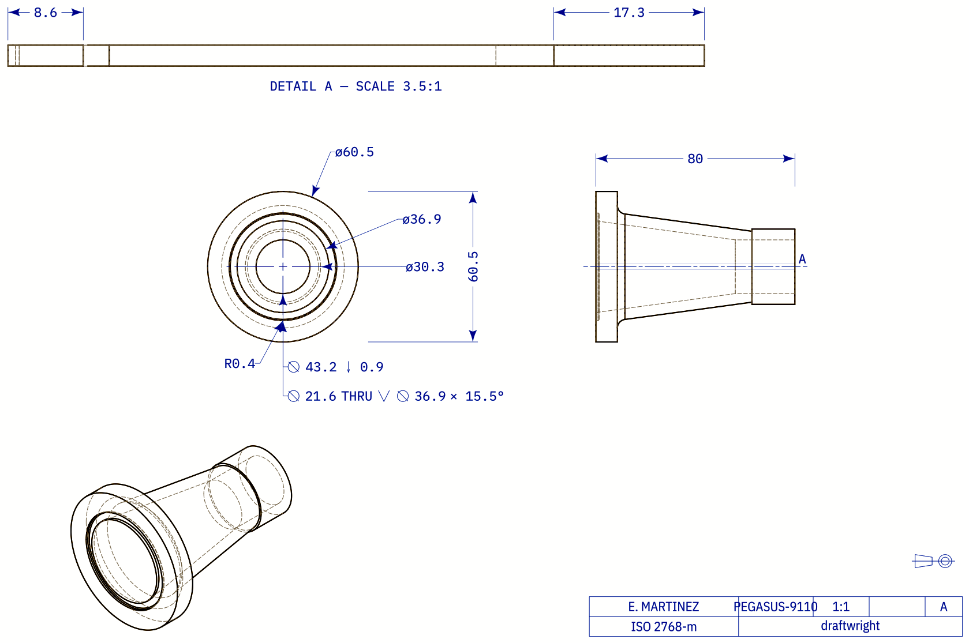
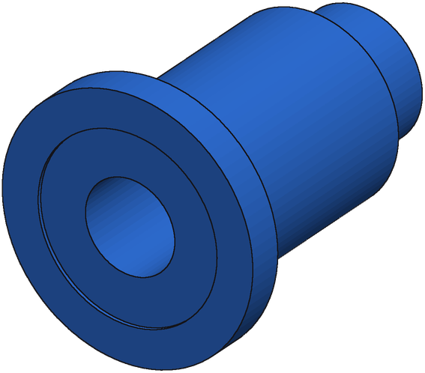
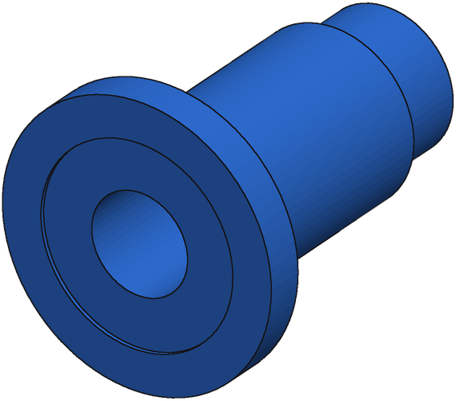
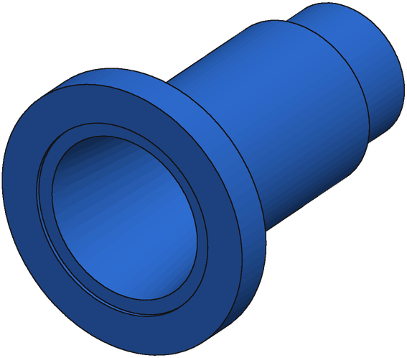
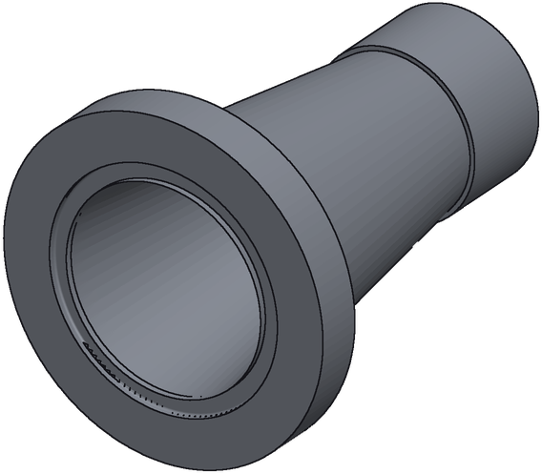
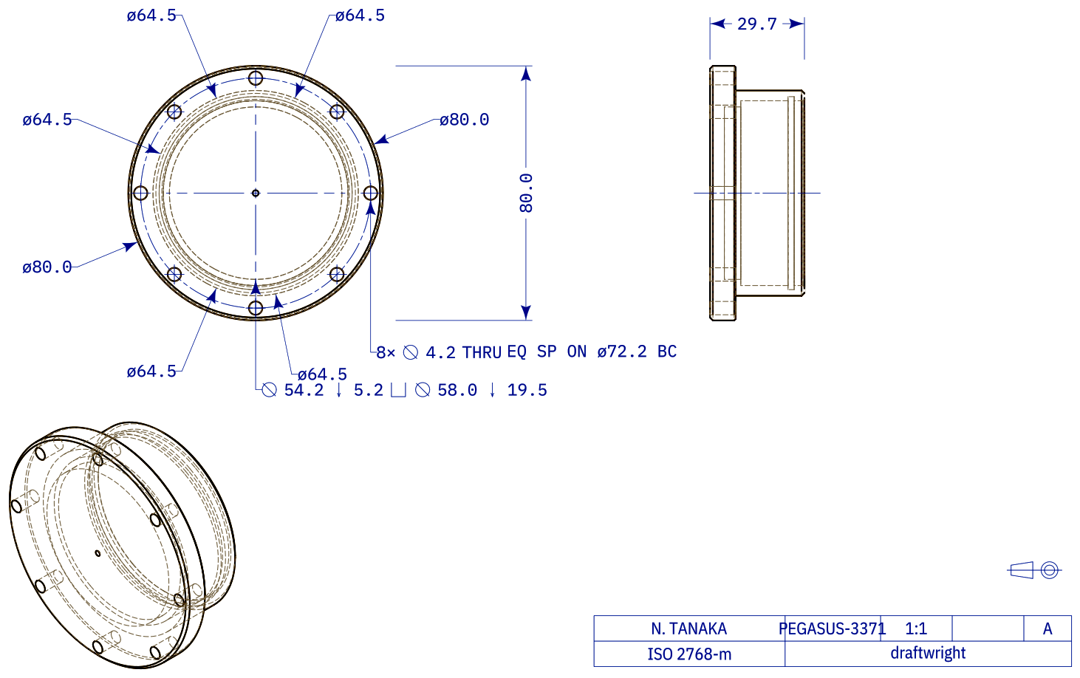
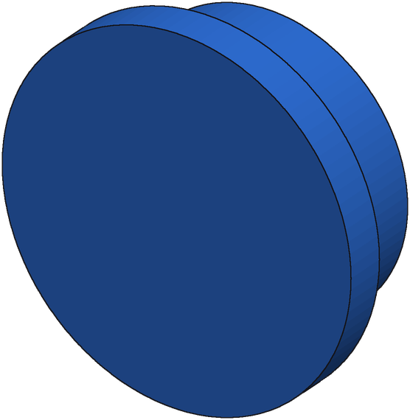
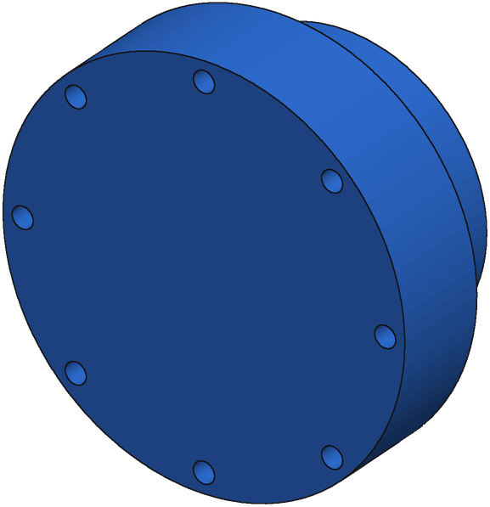
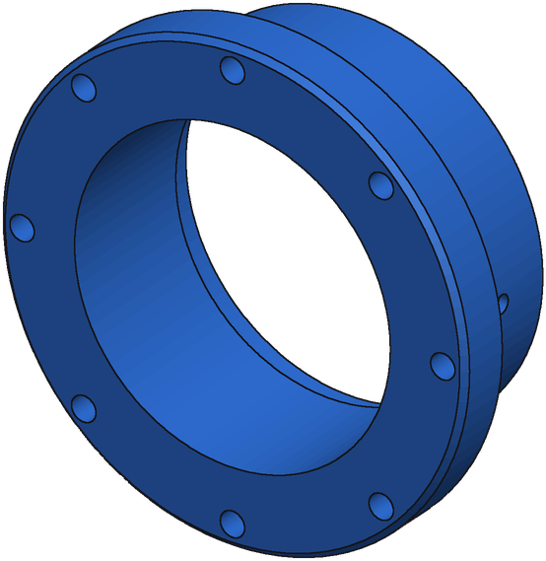
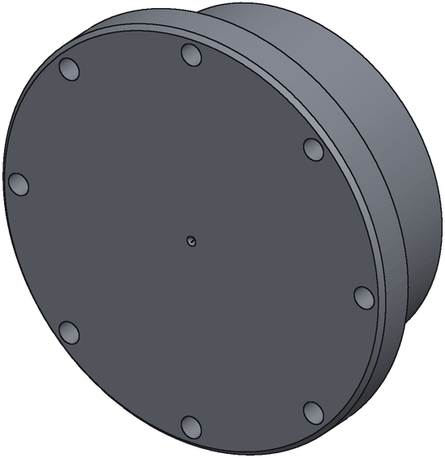
SFT + GRPO + repair: options 7–9
7. F_63065_8eed712c_0_x gain +0.282
Drawing
Start
IoU 0.02
Round 1
IoU 0.13
Round 5
IoU 0.31
Ground truth
8. F_21969_83e65247_0_x gain +0.247
Drawing
Start
IoU 0.52
Round 1
IoU 0.58
Round 6
IoU 0.77
Ground truth
9. A_00435786_303407afdc6 gain +0.244
Drawing
Start
IoU 0.39
Round 1
IoU 0.39
Round 3
IoU 0.64
Ground truth

Slide 4
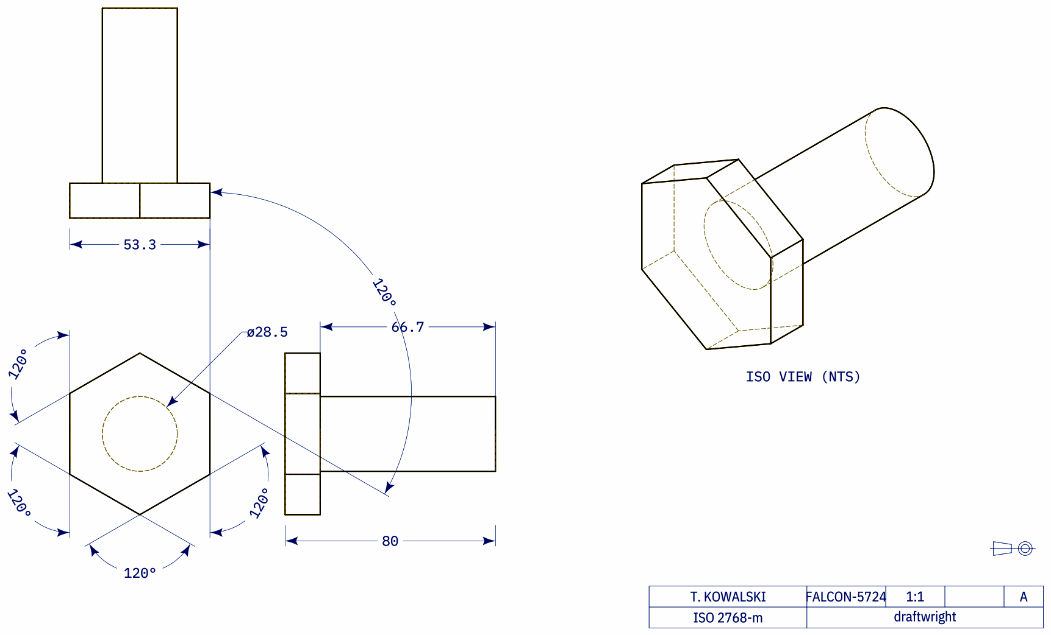
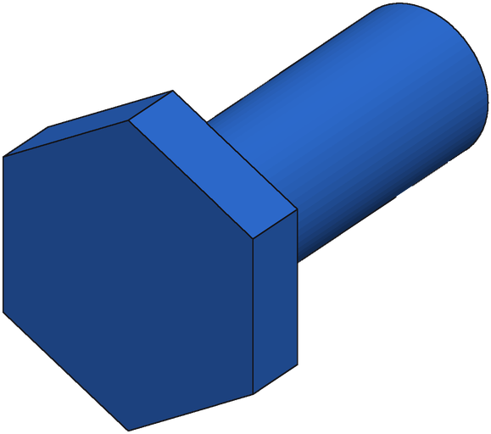
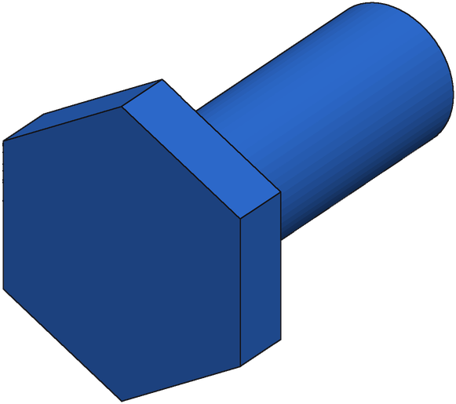
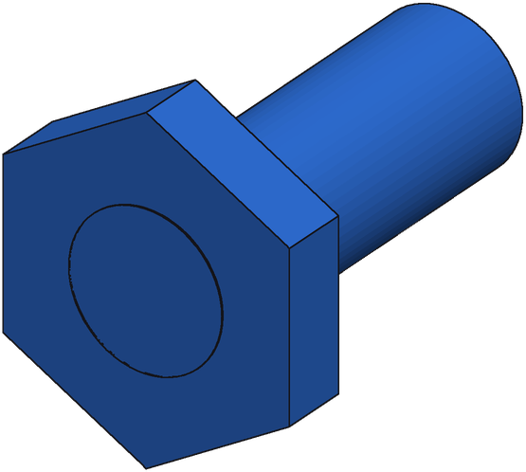
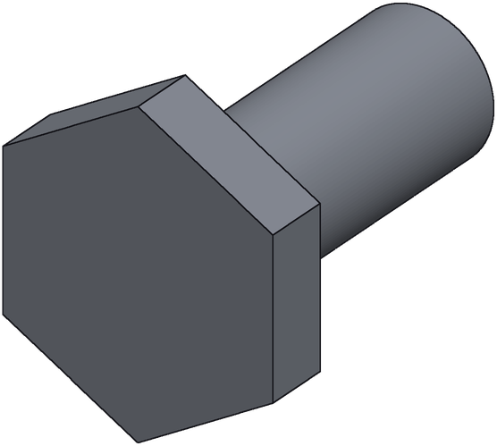
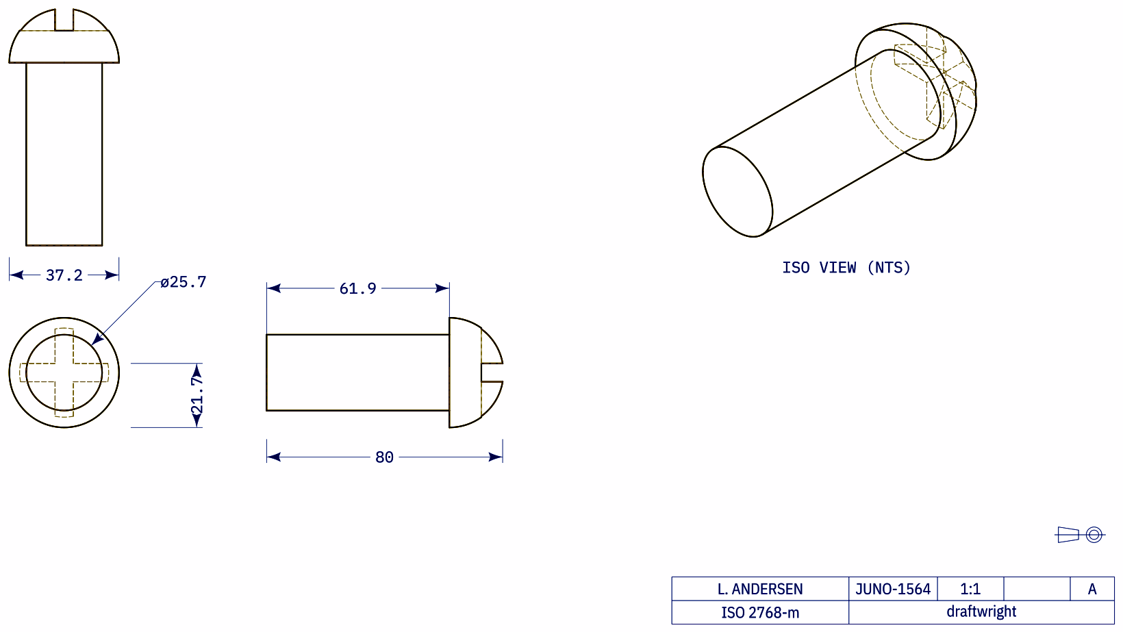









SFT + GRPO + repair: options 10–12
10. F_36735_f4ef1c35_10_x gain +0.244
Drawing
Start
IoU 0.75
Round 1
IoU 0.81
Round 3
IoU 0.99
Ground truth
11. F_29592_d1e941d1_0_x gain +0.164
Drawing
Start
IoU 0.79
Round 1
IoU 0.87
Round 2
IoU 0.95
Ground truth
12. A_00433447_bceb4e05aca gain +0.145
Drawing
Start
IoU 0.85
Round 1
IoU 0.86
Round 2
IoU 0.99
Ground truth

Slide 5





SFT + GRPO + repair: options 13–13
13. F_23675_0aa59777_0_x gain +0.118
Drawing
Start
IoU 0.83
Round 1
IoU 0.90
Round 5
IoU 0.94
Ground truth

Slide 6














SFT + repair: options 1–3
1. F_69470_88ad0eac_2_x gain +0.866
Drawing
Start
IoU 0.07
Round 1
IoU 0.41
Round 6
IoU 0.93
Ground truth
2. F_107467_a8afc51d_2_x gain +0.715
Drawing
Start
IoU 0.10
Round 1
IoU 0.82
Round 4
IoU 0.81
Ground truth
3. F_49134_e9867f8b_4_x gain +0.592
Drawing
Start
IoU 0.20
Round 1
IoU 0.36
Round 4
IoU 0.79
Ground truth

Slide 7















SFT + repair: options 4–6
4. A_00427380_346c16892d7 gain +0.592
Drawing
Start
IoU 0.14
Round 1
IoU 0.58
Round 3
IoU 0.74
Ground truth
5. F_56354_443a5a99_2_x gain +0.592
Drawing
Start
IoU 0.39
Round 1
IoU 0.81
Round 3
IoU 0.99
Ground truth
6. F_24084_71f37c00_3_x gain +0.528
Drawing
Start
IoU 0.41
Round 1
IoU 0.72
Round 5
IoU 0.93
Ground truth

Slide 8















SFT + repair: options 7–9
7. F_57715_f04ab8e3_1_x gain +0.528
Drawing
Start
IoU 0.21
Round 1
IoU 0.40
Round 5
IoU 0.74
Ground truth
8. A_00438811_5875a5a729a gain +0.488
Drawing
Start
IoU 0.10
Round 2
IoU 0.44
Round 3
IoU 0.52
Round 4
IoU 0.59
Ground truth
9. F_36088_1ea9c8a9_11_x gain +0.480
Drawing
Start
IoU 0.00
Round 1
IoU 0.34
Round 2
IoU 0.48
Ground truth

Slide 9















SFT + repair: options 10–12
10. F_31968_b384541d_2_x gain +0.451
Drawing
Start
IoU 0.45
Round 1
IoU 0.91
Round 2
IoU 0.91
Ground truth
11. A_00429445_5870e4ade38 gain +0.448
Drawing
Start
IoU 0.52
Round 1
IoU 0.74
Round 2
IoU 0.97
Ground truth
12. A_00438667_99294c9cfc5 gain +0.427
Drawing
Start
IoU 0.19
Round 1
IoU 0.51
Round 5
IoU 0.61
Ground truth

Slide 10











SFT + repair: options 13–15
13. F_115786_e4499f95_6_x gain +0.426
Drawing
Start
IoU 0.25
Round 1
IoU 0.51
Round 2
IoU 0.68
Ground truth
14. F_136925_70fb0381_2_x gain +0.416
Drawing
Start
IoU 0.35
Round 1
IoU 0.76
Round 3
IoU 0.77
Ground truth
15. F_21969_83e65247_0_x gain +0.393
Drawing
Start
IoU 0.38
Round 1
IoU 0.53
Round 2
IoU 0.58
Round 3
IoU 0.77
Ground truth

Slide 11





SFT + repair: options 16–16
16. F_131371_d8578374_0_x gain +0.388
Drawing
Start
IoU 0.52
Round 1
IoU 0.72
Round 2
IoU 0.91
Ground truth

