Slide 1
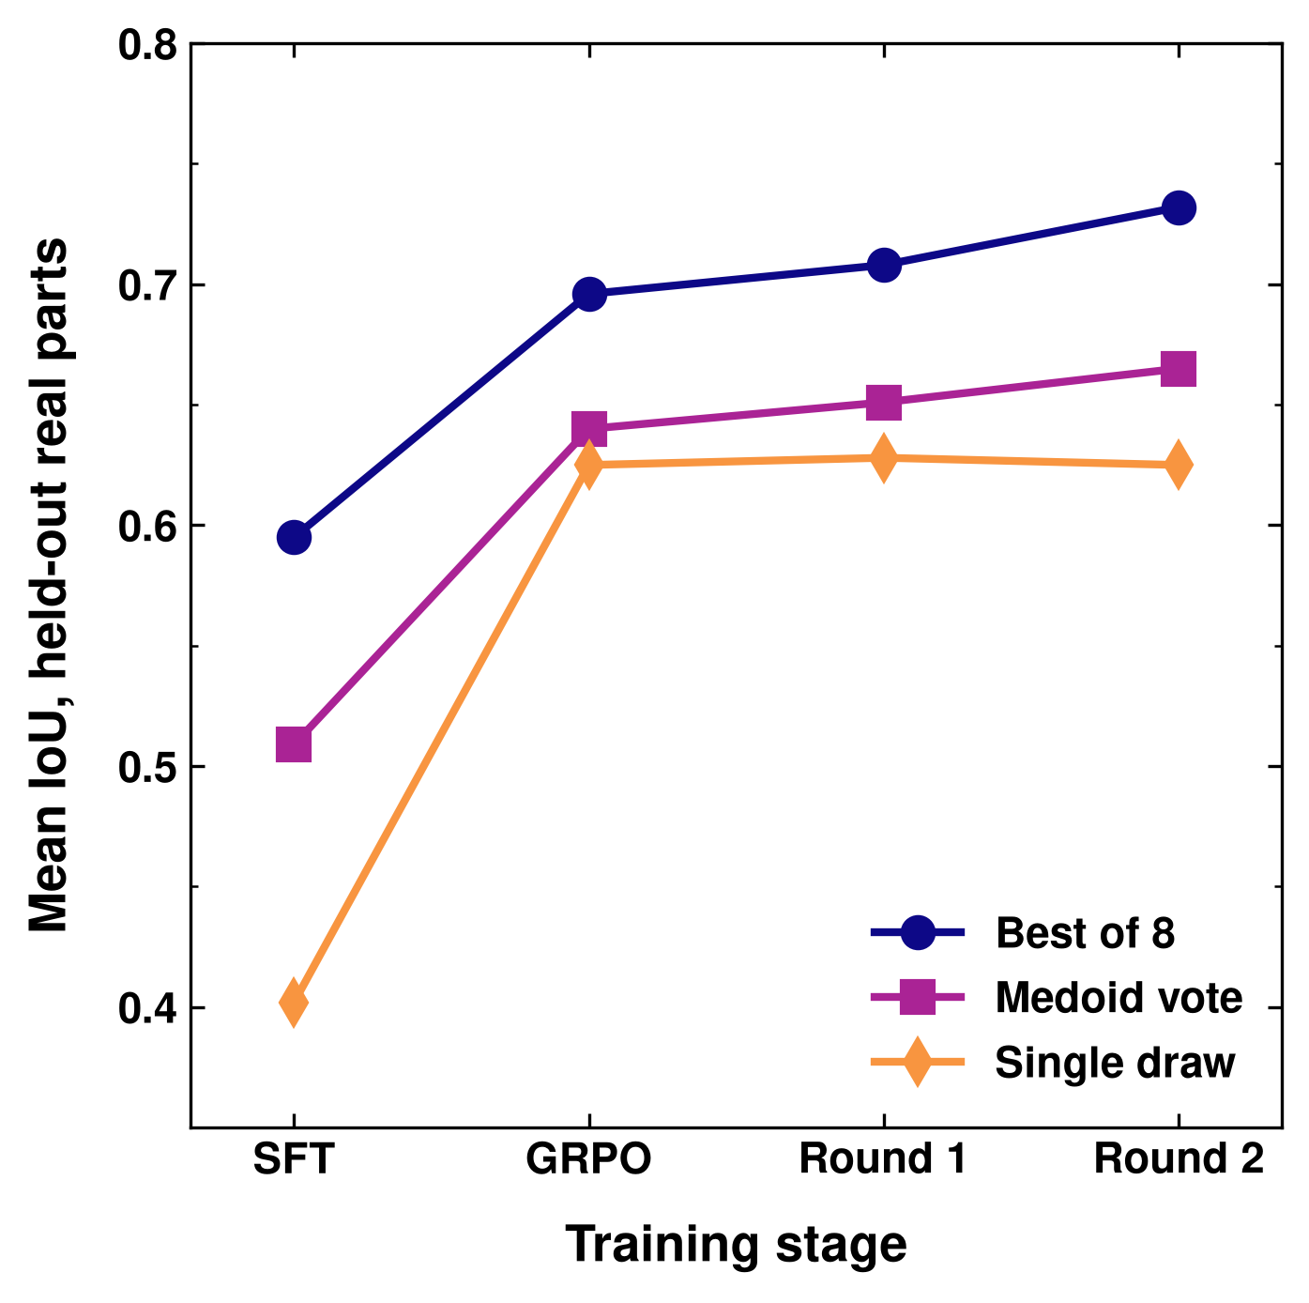
Figure 3: Fine Tuning
1. Supervised FT
2. GRPO Reinforcement Learning
Qwen3.8-27B vision-language model, full fine-tune
Drawing sheet → build123d program pairs (Zero-to-CAD-derived corpus)
Mix: own correct programs (IoU ≥ 0.8) 60%, reasoning traces 20%, ground truth 20%
Sample 8 programs per drawing
Run each; reward = IoU vs ground truth
Update LoRA weights
Compare to the group average
Hard real training parts (CADBench, DeepCAD); LoRA on the SFT model
6% → 80%
Expert iteration, 2 rounds
programs that run
Search 8,121 hard training parts: 16 samples + ground-truth-guided repair
Keep the best programs: 5,502 at IoU ≥ 0.75
SFT on them, then short GRPO
0.08 → 0.51
real-part IoU (vote), base → SFT
Held-out bench B, 280 real parts
Full system with repair: 0.66 → 0.72
Notes:
Box 1: e55 = Qwen3.8-27B full fine-tune (FSDP2, lr 6e-6, seq 5120, batch 64), vision tower frozen; STaR/RFT rounds keep own generations at IoU >= 0.8. Base Qwen3.8-27B with no fine-tune: 6.1% of programs execute, vote 0.082 on bench B (hallucinated build123d API); e55: 79.9% execute, vote 0.509.
Box 2: GRPO on e55 + LoRA r64, G = 8 rollouts per part (vLLM), reward = exact IoU vs ground truth (0 if the program fails), group-normalised advantages, lr 1e-5 to 2e-5, T 1.0, trained on the raw sampled text (fixes a format blind spot behind the late collapses). Expert iteration: RL policy samples 16 programs on 8,121 hard training parts + ground-truth-selected rp3 / DeepSeek repair search -> tier of 5,502 programs >= 0.75 IoU -> LoRA SFT -> short GRPO (rft2_rl step 60).
Chart, bench B (280 parts, frozen before any model saw it, never used to pick checkpoints): SFT e55 / GRPO ent_t10 s120 / round 1 rft1_rl2 s120 / round 2 rft2_rl s60. Vote 0.509 / 0.640 / 0.651 / 0.665; best of 8 0.595 / 0.696 / 0.708 / 0.732; single draw 0.402 / 0.625 / 0.628 / 0.625. Round 2 vs round 1: vote +0.014 [+0.003, +0.025], best of 8 +0.023 [+0.014, +0.032]. The GRPO point is the best of 3 seeds (seed mean on the 144 bench: vote 0.614 vs 0.639). Full system with rp3 multi-start repair: e55 0.664 -> round 2 0.721, +0.057 [+0.036, +0.078]. Gains plateau around vote 0.65-0.68 across all recipes.

