Slide 1







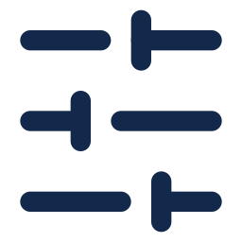

Figure 3: Fine Tuning
1. Supervised FT
2. GRPO
3. Repairer
Drawing → Code
~500k training pairs
Sample 8 Programs
per drawing
Two Drawings In
target + candidate render
Qwen 3.8-27B
full fine-tune
Reward
IoU vs ground truth
Corrected Program
real-part repair pairs
Self-Training
keep own IoU ≥ 0.8
Update LoRA
+ 2 self-improvement rounds
Full Fine-Tune
from the SFT model
IoU 0.509
IoU 0.665
IoU 0.721
IoU: mean volumetric IoU of the selected candidate (medoid of 8) on 280 held-out real parts. Self-improvement: search hard training parts, fine-tune on the best programs found, short GRPO. Stage 3: full system, the stage-2 generator plus three repair chains.
Notes:
Bench B: 280 real parts (171 Fusion 360 + 109 ABC), frozen before any model saw it, never used to pick checkpoints. Vote (medoid of 8): base Qwen3.8-27B 0.082 (6% of programs run), SFT e55 0.509, GRPO with 2 self-improvement rounds (rft2_rl s60) 0.665 (best of 8: 0.595 -> 0.732). Plain GRPO without them (ent_t10 s120, best of 3 seeds) 0.640; the self-improvement rounds add +0.024 [+0.008, +0.041]. Each round: the current policy samples 16 programs on hard training parts, rp3 repair search + DeepSeek-V4.1-Flash teacher improve them using ground truth, the best (IoU >= 0.75) are fine-tuned into the LoRA, then short GRPO; round 2 kept 5,502 programs on 8,121 parts. Stage 4: rft2_rl s60, K=16, verifier + render-compare selection, 3 rp3 repair chains (16 repairs x 6 rounds, render-compare gate, margin 0.1), multi-start pick = 0.721; the same repair on e55 gives 0.664 (+0.057 [+0.036, +0.078]). rp3 = full fine-tune continued from e55 (300 steps, lr 2e-6) on repair pairs (target drawing + candidate's rendered drawing + code -> better program), incl. real-part repairs from a DeepSeek search.

