Slide 1









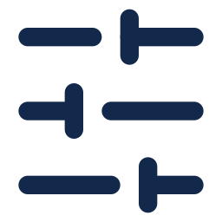


Figure 3: Fine Tuning
1. Supervised FT
2. GRPO
3. Expert Iteration
4. Repairer
Drawing → Code
~500k training pairs
Sample 8 Programs
per drawing
Search Hard Parts
8,121 training parts
Two Drawings In
target + candidate render
Qwen 3.8-27B
full fine-tune
Reward
IoU vs ground truth
Keep Best Programs
5,502 at IoU ≥ 0.75
Corrected Program
real-part repair pairs
Self-Training
keep own IoU ≥ 0.8
Update LoRA
relative to group average
SFT + Short GRPO
two rounds
Full Fine-Tune
from the SFT model
IoU 0.509
IoU 0.640
IoU 0.665
IoU 0.721
IoU: mean volumetric IoU of the selected candidate (medoid of 8) on 280 held-out real parts. Stage 4: full system, the stage-3 generator plus three repair chains.
Notes:
Bench B: 280 real parts (171 Fusion 360 + 109 ABC), frozen before any model saw it, never used to pick checkpoints. Vote (medoid of 8): base Qwen3.8-27B 0.082 (6% of programs run), SFT e55 0.509, GRPO ent_t10 s120 0.640 (best of 3 seeds; 3-seed mean on the 144 bench 0.614 vs 0.639), expert iteration rft2_rl s60 0.665 (best of 8: 0.595 / 0.696 / 0.732). Stage 4: rft2_rl s60, K=16, verifier + render-compare selection, 3 rp3 repair chains (16 repairs x 6 rounds, render-compare gate, margin 0.1), multi-start pick = 0.721; the same repair on e55 gives 0.664 (+0.057 [+0.036, +0.078]). rp3 = full fine-tune continued from e55 (300 steps, lr 2e-6) on repair pairs (target drawing + candidate's rendered drawing + code -> better program), incl. real-part repairs from a DeepSeek search.

