Slide 1












Figure 3: Fine Tuning
1. Supervised FT
2. GRPO
3. Repairer
Data
~500k drawing → build123d pairs (Zero-to-CAD), each program executed and IoU-checked
Rollouts
G = 8 programs per drawing, T = 1.0 (vLLM) · LoRA r = 64 on all linear layers
Input
target drawing + candidate's rendered drawing + candidate code
Mix
60% own programs with IoU ≥ 0.8 · 20% Kimi-K3 reasoning traces (53k) · 20% ground-truth code
Reward
r = IoU(exec(code), ground truth); r = 0 if the program fails
Output
corrected build123d program
Self-Training (RFT)
each new model regenerates the 60% tier from its own correct samples
Objective
A = r − group mean, batch-std scaled · token-level PPO clip 0.2/0.28 · KL 0 · lr 1–2e-5
Data
repair pairs (worse → better program), incl. real-part repairs distilled from a DeepSeek-V4.1 search
Qwen3.8-27B, Full FT
FSDP2 bf16, vision tower frozen · lr 6e-6, batch 64, seq 5,120, 4k steps
Self-Improvement ×2
16 samples + guided repair on 8,121 hard parts → 5,502 programs (IoU ≥ 0.75) → LoRA SFT → 60 GRPO steps
Full FT from SFT Model
300 steps · lr 2e-6, batch 64, seq 7,168
IoU 0.509
IoU 0.665
IoU 0.721
IoU: mean volumetric IoU of the selected candidate (medoid of 8) on 280 held-out real parts; stage 3 = stage-2 generator + three repair chains. Self-improvement: guided repair = rp3 and DeepSeek-V4.1 search scored against ground truth on training parts only.
Notes:
SFT (e55): Qwen3.8-27B full fine-tune, FSDP2 FULL_SHARD, bf16 compute + fp32 master, vision tower frozen, seq 5,120, effective batch 64, lr 6e-6, 4k steps. Mix 60/20/20: RFT rows (own generations kept at exact IoU >= 0.8 with think traces, STaR rounds), certified Kimi-K3 reasoning traces (53k, +-5% reverse-reconstruction gate), plain filtered GT. Base model without fine-tuning: 6% of programs run, IoU 0.082 on bench B.
GRPO: LoRA r64 on e55, G = 8 rollouts via vLLM, T = 1.0 with scaled logits, top_p 1, reward = exact IoU (0 on failure), batch-std advantages, 4 minibatches with PPO clip-higher 0.2/0.28, KL 0, entropy floor, rollback guard; lr 2e-5 from e55, 1e-5 from trained adapters. Plain GRPO (ent_t10 s120, best of 3 seeds): 0.640. Self-improvement (expert iteration) x2 -> rft2_rl s60: 0.665, +0.024 [+0.008, +0.041]; best of 8 0.732.
Repairer rp3: full fine-tune continued from e55 (300 steps, lr 2e-6, batch 64 = 4 ranks x accum 16, seq 7,168), rp2 repair tiers + real repair rows from CADBench corpora (DeepSeek search). Stage 3 = rft2_rl s60 K=16 -> verifier + render-compare pick -> 3 rp3 chains (16 x 6, gate margin 0.1) -> 0.721; same repair on e55: 0.664.

Slide 2








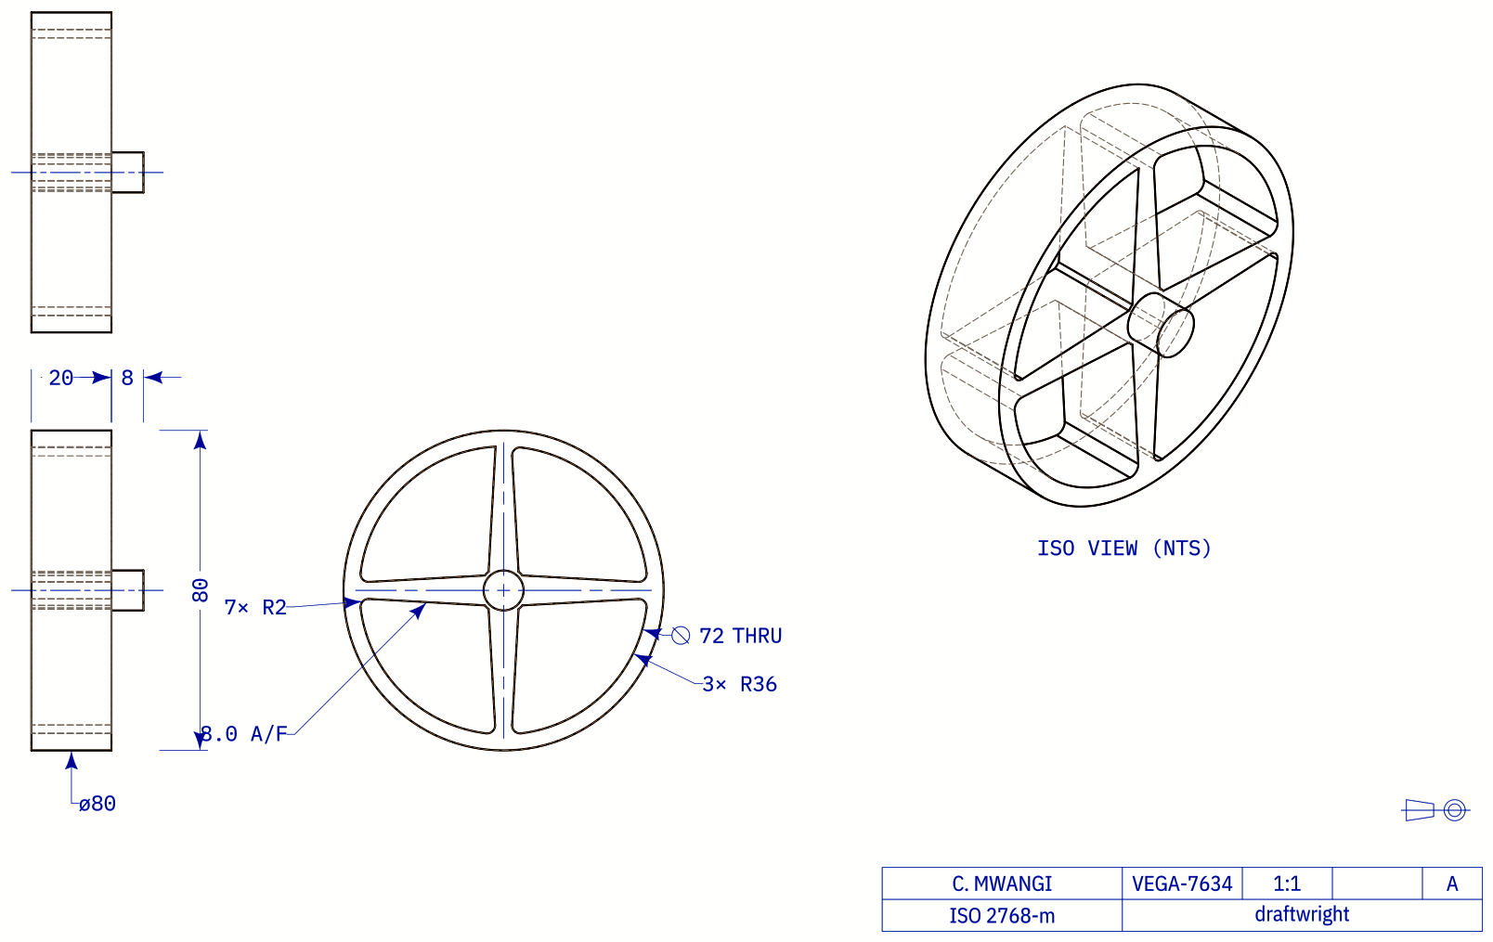
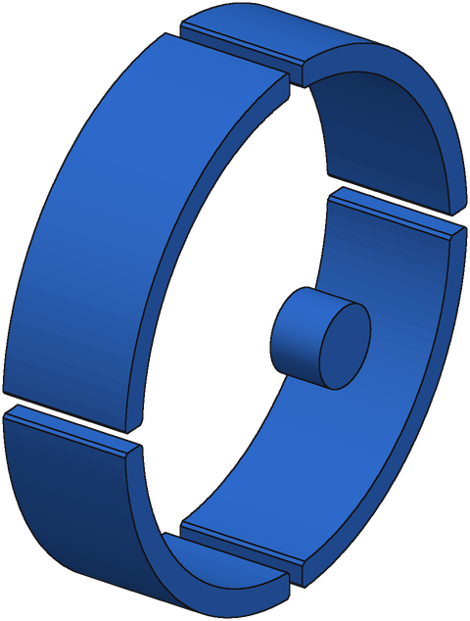
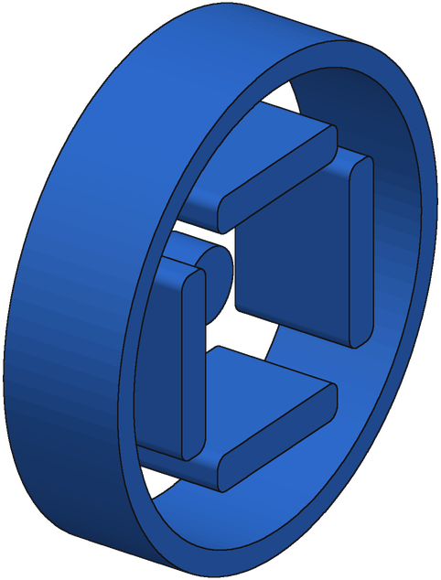
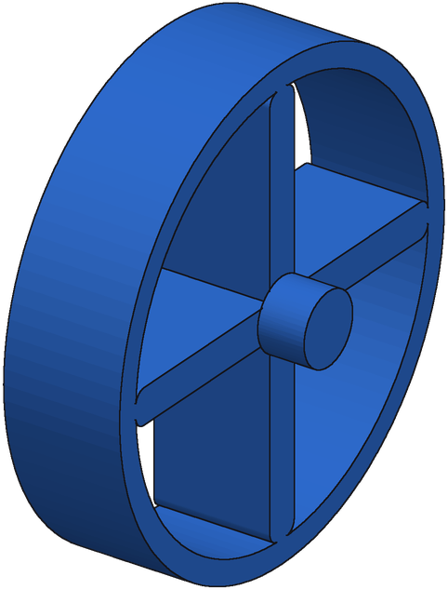
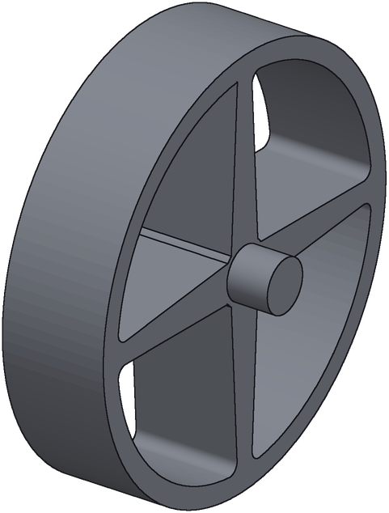
Figure 4: Repair Loop
1. Candidate
2. Repair
3. Score
4. Accept
Start Program
generator's selected pick
Repairer Input
both drawings + code
Execute + Draw
every repair
Gate
keep best only if score +0.1
Execute
build123d → solid
Repairer (rp3)
fine-tuned Qwen3.8-27B
Render-Compare
vs target, view by view
Up to 6 Rounds
restart from last accepted
Draw It
same compiler as the input
16 Repairs
sampled at T = 0.7
No Ground Truth
label-free; r = 0.67 with IoU
3 Chains
top-3 starts, pick best score
next round: accepted program becomes the new candidate
Example: handwheel (real part)
0.537 → 0.695
real parts, e55 + repair
0.925 → 0.929
synthetic parts: safe
Target drawing
Start IoU 0.52
Round 1 IoU 0.35
Round 3 IoU 0.93
Ground truth
Notes:
One round: run the current program, draw it with the same drawing compiler (draftwright 0.4.23) that made the input sheets; the repairer rp3 (full fine-tune of e55) sees the target drawing, the candidate's drawing and its code and samples 16 corrected programs (T 0.7, <= 6,000 tokens). Each is executed and drawn; the render-compare score (v3: per-view comparison with one scale per sheet pair, geometry separated from annotations by colour) measures the match to the target. Pearson r 0.67 with true IoU on the real bench. The best repair is adopted only if its score beats the current program's by 0.1 (fixed a priori); up to 6 rounds. Multi-start: 3 chains from the top-3 distinct starting candidates; final answer = highest render-compare score. Ground truth is never used; the IoU values on the example are for illustration. Real bench (143 parts): e55 medoid pick 0.537 -> one chain 0.667 -> 3 chains 0.695 (e55's own best of 8: 0.591). Synthetic pool: 0.925 -> 0.929. Handwheel = CADBench Fusion 360 part F_73525; this chain started from the generator's third-ranked candidate. Limits: the colour-based score needs draftwright-style sheets (all-black SolidWorks drawings score ~0), and on ABC parts the score tracks IoU less well (r 0.42 vs 0.61 on Fusion 360).

