Slide 1
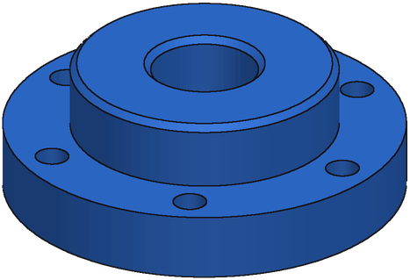
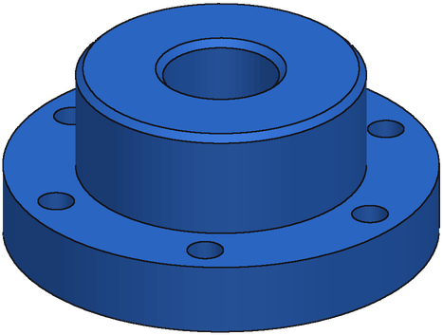
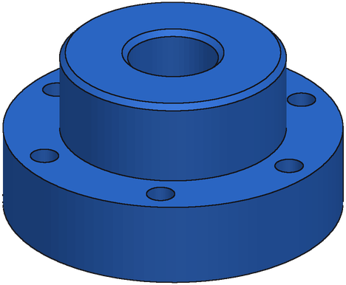
Figure 3: Fine Tuning
1. Base Model
2. Supervised FT
3. GRPO
Qwen3.8-27B
no fine-tuning
invents CAD API calls
Full Fine-Tune
~500k drawing → code pairs
+ self-training rounds
Reinforcement Learning
8 programs per drawing
reward = IoU vs ground truth
part = Box(80, 50, 10,
centered=True)
part -= Cylinder(pos=(0, 0, 5),
r=10)
TypeError: unexpected
keyword 'centered'
only 6% of programs run
Own correct programs 60%
Reasoning traces 20%
0.72
1.00
1.00
1.00
no solid
Ground-truth code 20%
0.76
0
1.00
1.00
IoU 0.08
IoU 0.51
IoU 0.67
IoU: mean volumetric IoU of the selected program on 280 held-out real parts. GRPO includes two self-improvement rounds on hard training parts. Rewards shown for one synthetic part; bold = above the group average, which gets reinforced.
Notes:
Bench B (280 real parts, never used for selection), medoid of 8. Base Qwen3.8-27B: vote 0.082, 6.1% of programs execute (hallucinated build123d API, e.g. Box(centered=...), Cylinder(pos=...)). SFT e55: full fine-tune on ~500k drawing-code pairs, mix 60% own correct programs (IoU >= 0.8) / 20% Kimi-K3 reasoning traces / 20% ground truth; vote 0.509. GRPO: LoRA on e55, 8 rollouts per drawing, reward = IoU (0 if the program fails), advantage = reward - group mean; plus two self-improvement rounds (search hard training parts, fine-tune on the best programs, short GRPO): rft2_rl s60, vote 0.665. Example rewards: synthetic part 1fbfa3c8, e55 candidates (group mean 0.81).

Slide 2
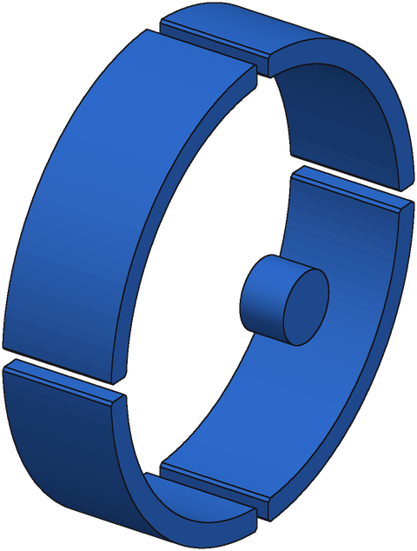
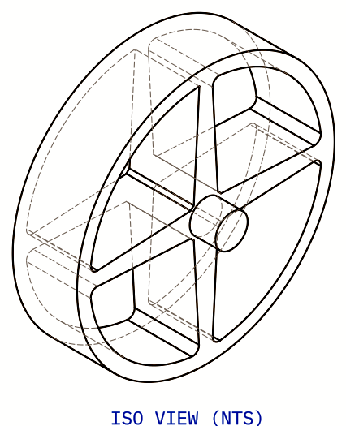
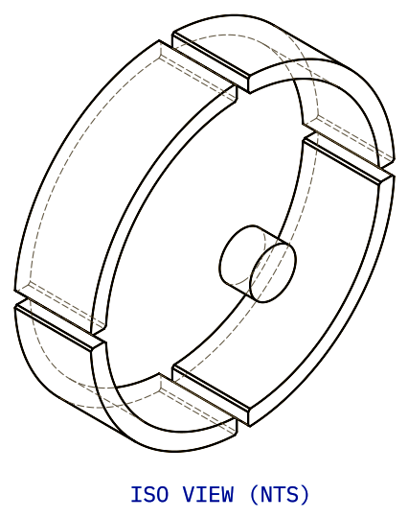
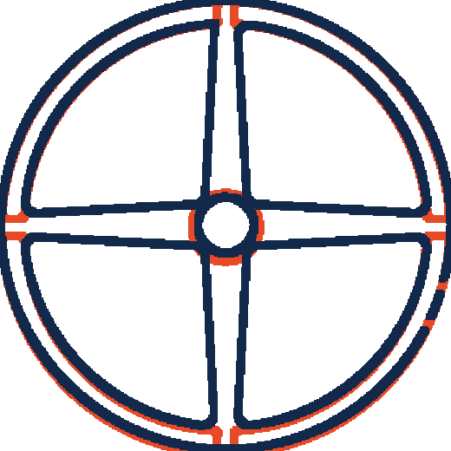
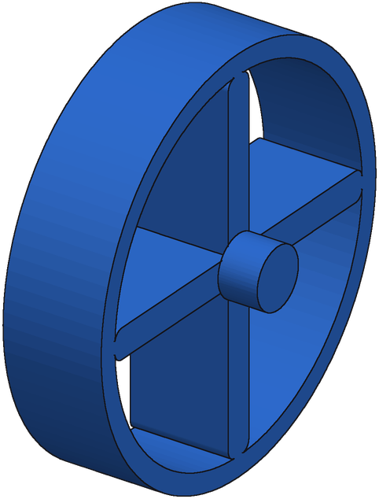
Figure 4: Repair Loop
1. Candidate
2. Repair
3. Score
4. Accept
Generator Pick
best of 8 candidates
run to a 3D solid
Repairer Model
sees target + its drawing
writes 16 fixes
Render-Compare
redraw every fix
match the input drawing
Keep If Better
repeat up to 6 rounds
best of 3 chains
target
candidate
target vs candidate
IoU 0.52
16 Repairs
No Labels
IoU 0.93
Example: handwheel (real part). Over 143 real parts, the loop raises mean IoU from 0.537 to 0.695. Ground truth is never used; IoU is shown for illustration.
Notes:
Handwheel = CADBench Fusion 360 part F_73525. Start = e55 candidate 7 (third distinct start of the served chain), IoU 0.52. Repairer rp3 (full fine-tune of e55) sees the target drawing, the candidate's drawing (same draftwright compiler) and the code, samples 16 repairs per round (T 0.7). Each repair is executed, redrawn and scored by render-compare (v3, per-view match, geometry separated from blue annotations; r = 0.67 with true IoU). The best is accepted only if the score improves by 0.1; up to 6 rounds; 3 chains from the top-3 starts, final = best score. This chain: 0.52 -> 0.35 (round 1) -> 0.93 (round 3). Real bench: e55 medoid 0.537 -> one chain 0.667 -> 3 chains 0.695 (e55 best of 8: 0.591). Overlay: front views of the target (navy) and of the start candidate's drawing (orange where it differs).

