Slide 1
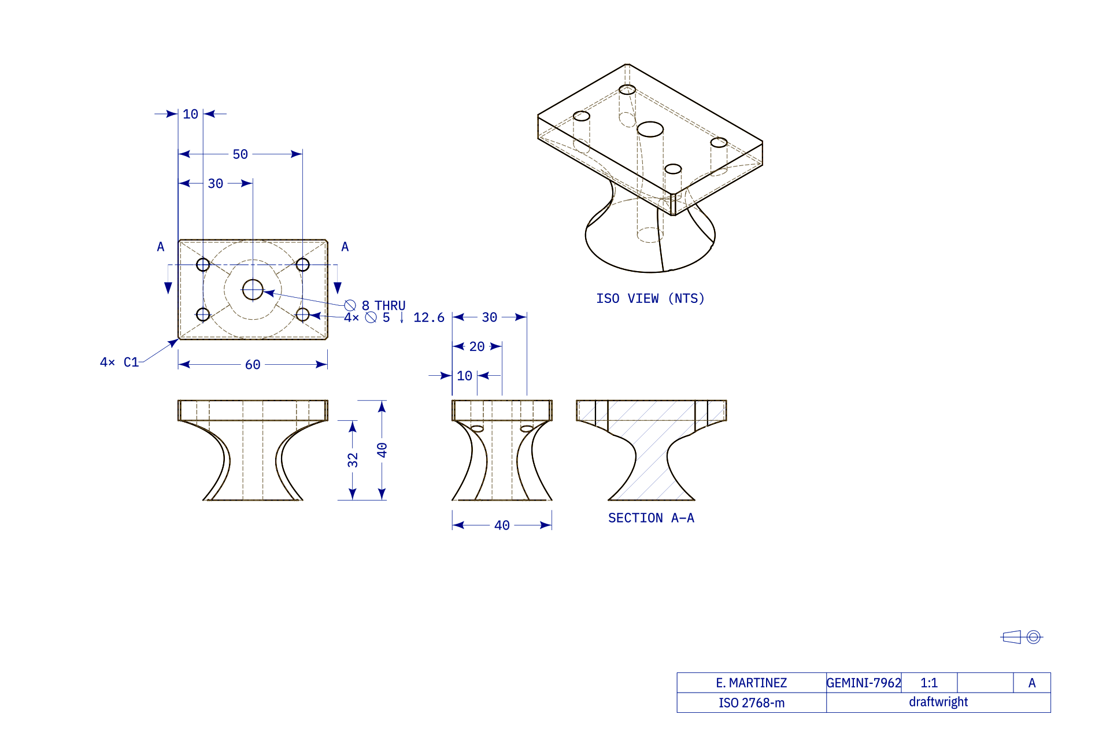
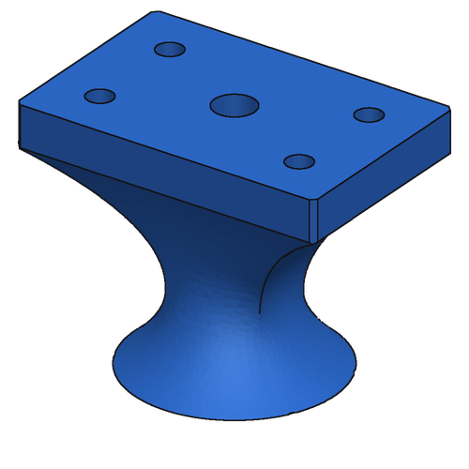
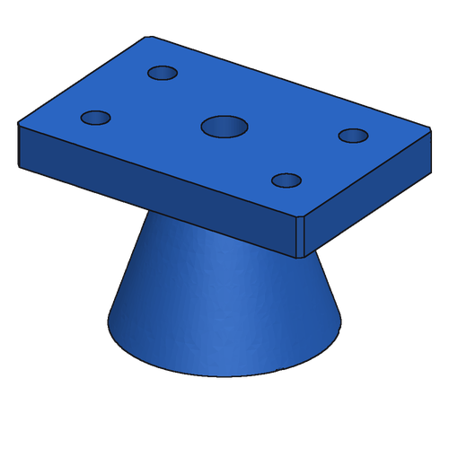
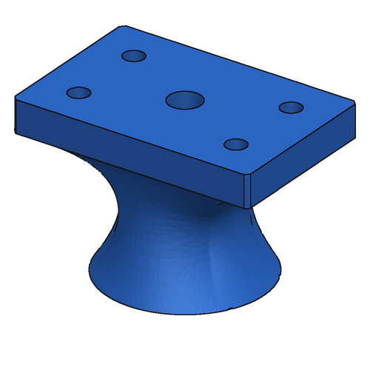
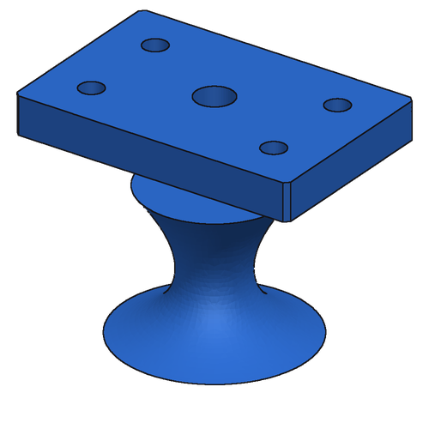
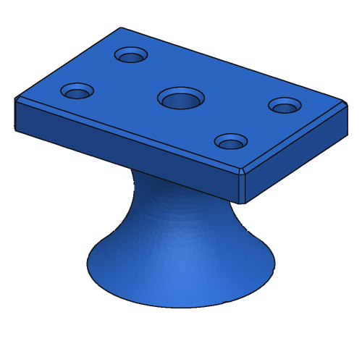
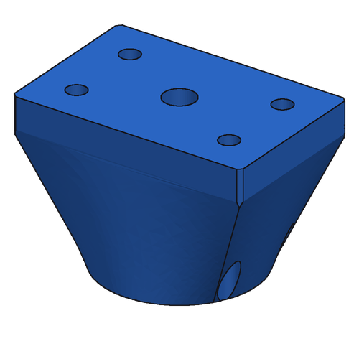
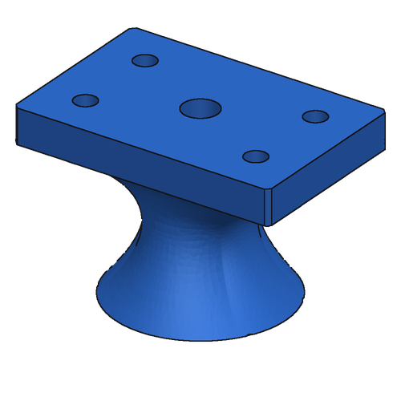
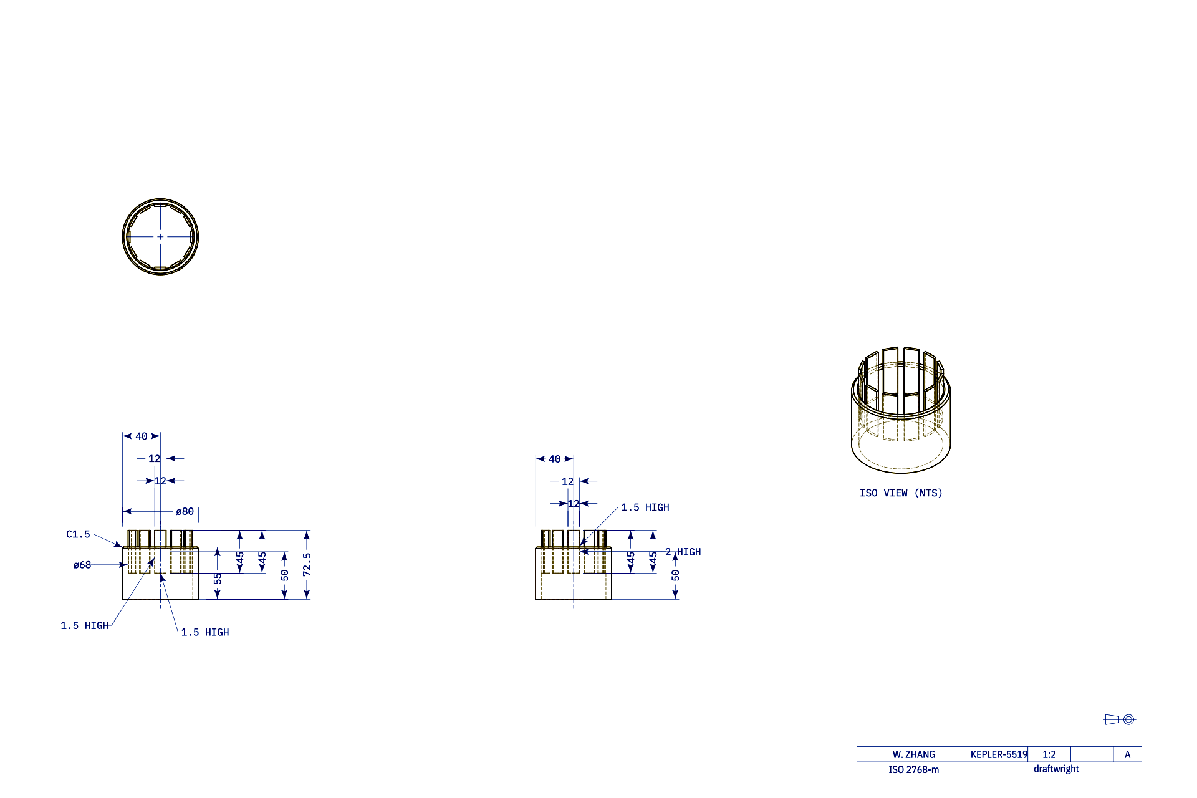
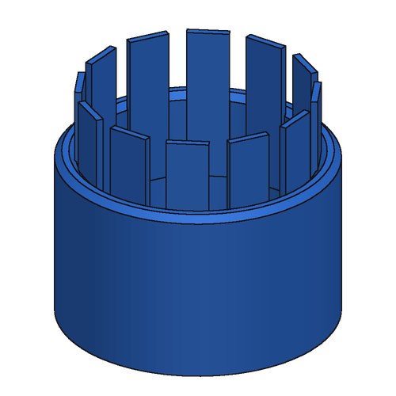
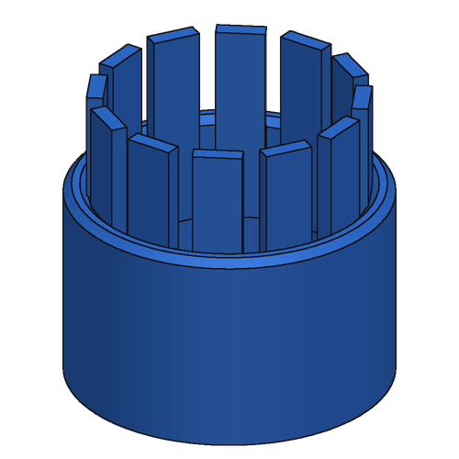
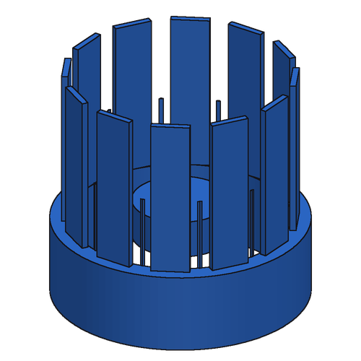

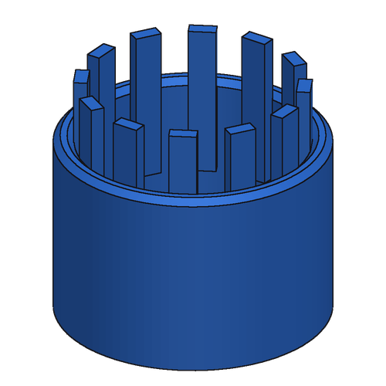
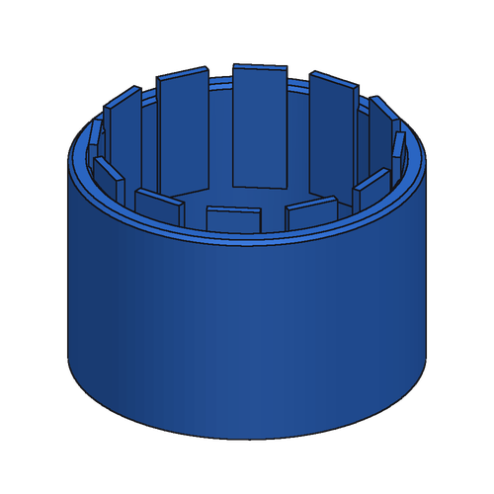
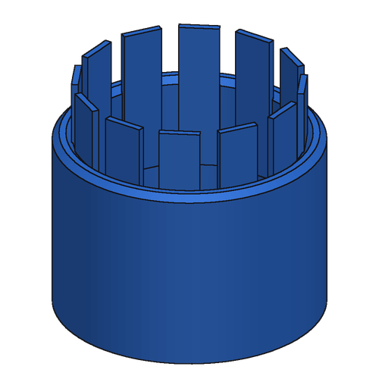
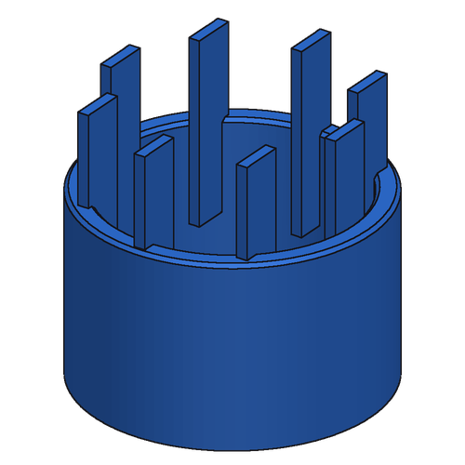
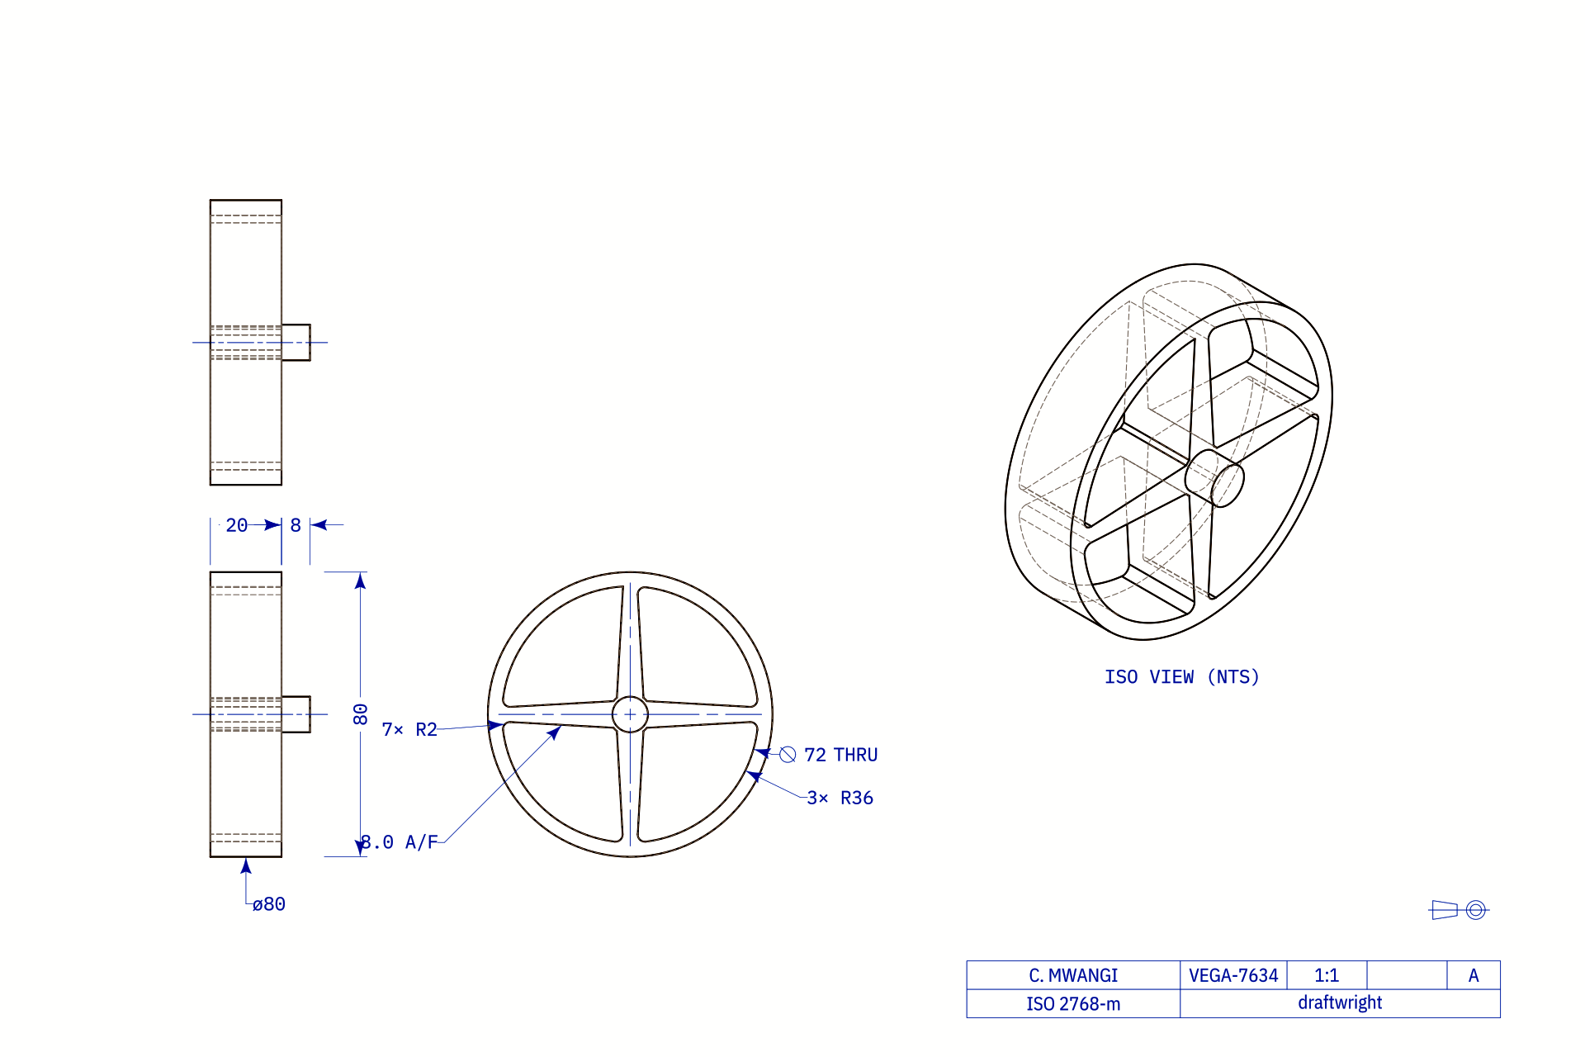
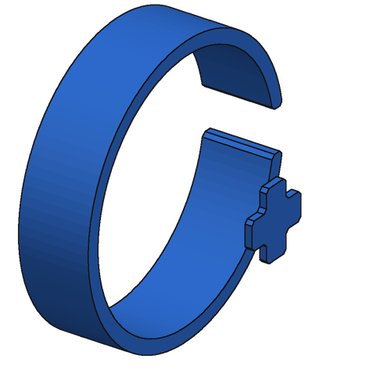
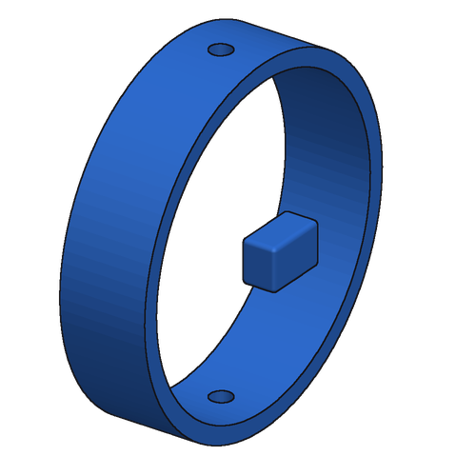
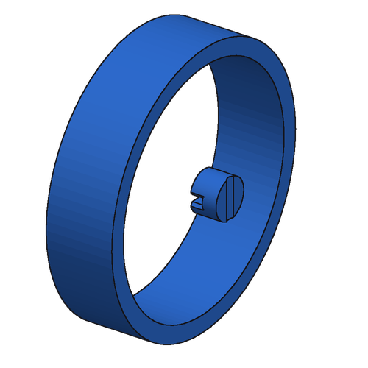
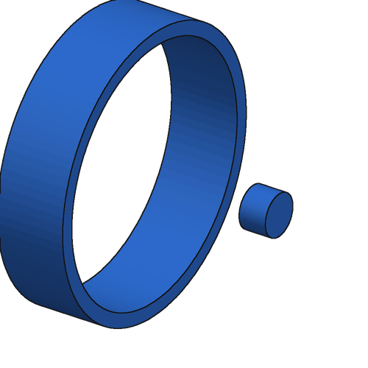
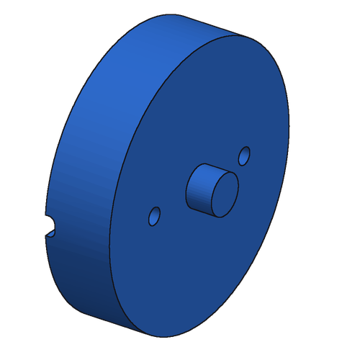

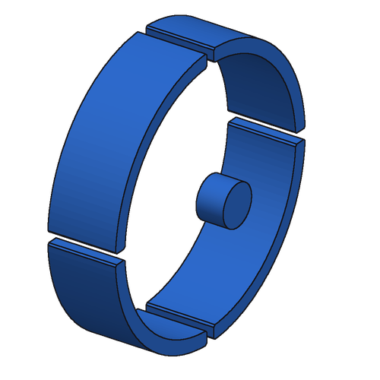
GRPO: Learning From Groups of Samples
8 programs sampled per drawing · reward r = IoU vs ground truth (0 if it fails) · advantage A = r − group mean: reinforced / discouraged
no solid
Flared pedestal mount
r 0.62
r 0.71
r 0.86
r 0.29
r 0.81
r 0.56
r 0.00
r 0.99
group mean 0.61
A +0.01
A +0.10
A +0.26
A −0.31
A +0.20
A −0.04
A −0.61
A +0.38
Slotted cage sleeve
r 0.91
r 0.75
r 0.40
r 0.63
r 0.87
r 0.65
r 1.00
r 0.71
group mean 0.74
A +0.17
A +0.01
A −0.34
A −0.11
A +0.13
A −0.09
A +0.26
A −0.03
no solid
Handwheel (real part)
r 0.00
r 0.21
r 0.53
r 0.50
r 0.09
r 0.40
r 0.54
r 0.52
group mean 0.35
A −0.35
A −0.14
A +0.19
A +0.15
A −0.26
A +0.05
A +0.19
A +0.17
Samples from the fine-tuned starting model (before GRPO). Each update raises the probability of programs with A > 0 and lowers it for A < 0, so the model learns from relative quality even when no sample is exactly right (handwheel).
Notes:
Groups = e55's 8 samples (draw 0 greedy + 7 at T 0.7) for synthetic parts 40a1be28 and 27b61d00 and real bench part F_73525 (CADBench Fusion 360). GRPO training itself samples at T 1.0 from the current policy; these rows illustrate the reward and advantage computation at step 0. Advantage here is r minus the group mean; the training recipe additionally divides by the batch standard deviation (batch-std advantages) and applies token-level PPO clipping (0.2/0.28), no KL term.

