Slide 1
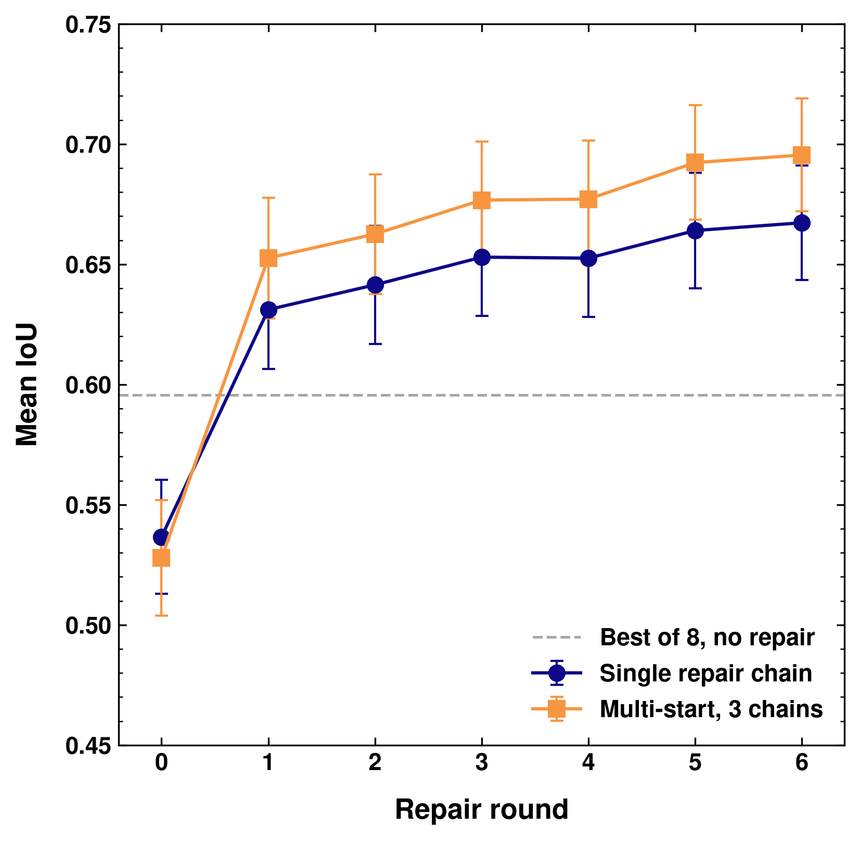
Repair Loop on Real Parts
143 held-out real parts (CADBench Fusion 360 + ABC), starting from the e55 medoid pick: mean IoU 0.537
One repair round: 0.631, already above the generator's own best of 8 (0.596)
After 6 rounds: 0.667 with one chain, 0.695 with 3 chains (multi-start)
Parts at IoU ≥ 0.85: 19% → 45%
Multi-start final by source: Fusion 360 0.757, ABC 0.598
Notes:
Repair: rp3 LoRA, K=16 draws per round, adopt only when the label-free render-compare score improves by 0.1. Multi-start: 3 chains from the top-3 distinct e55 candidates, final pick by render-compare score. Error bars: SEM over parts.

Slide 2
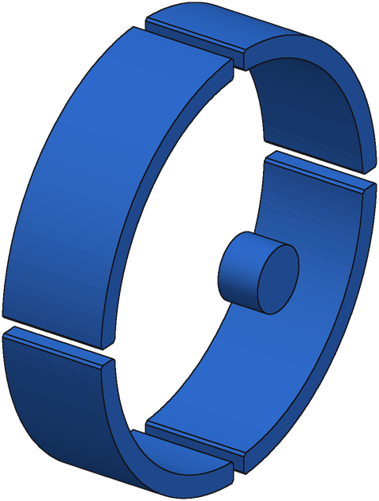
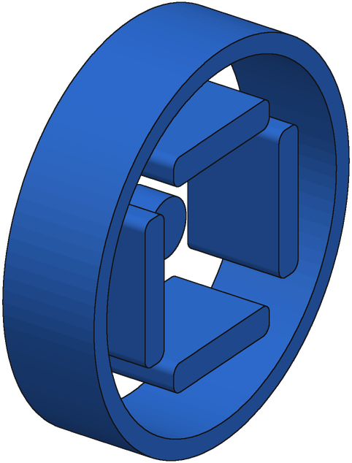
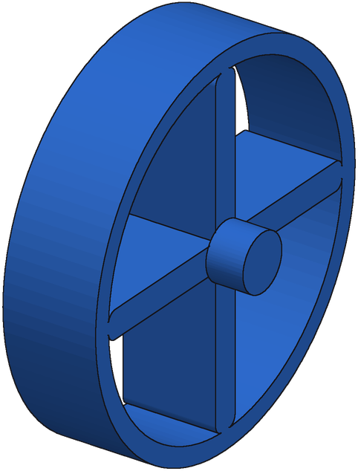
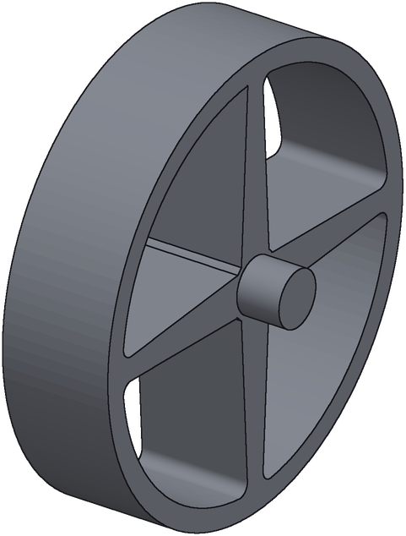
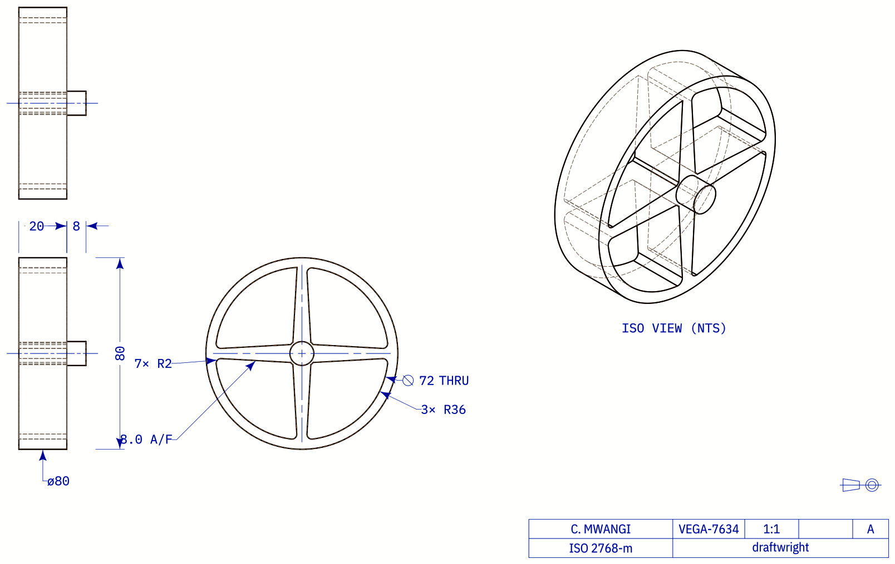
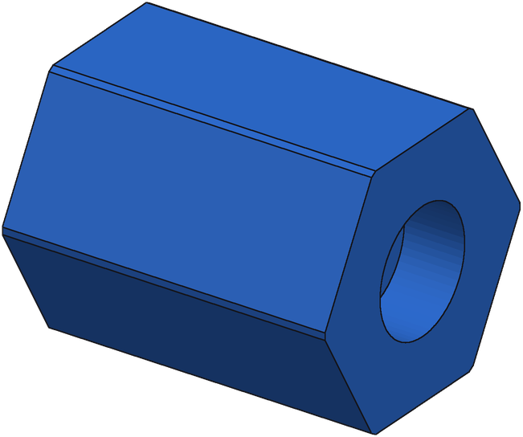
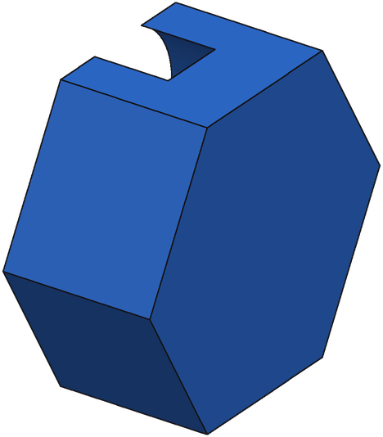
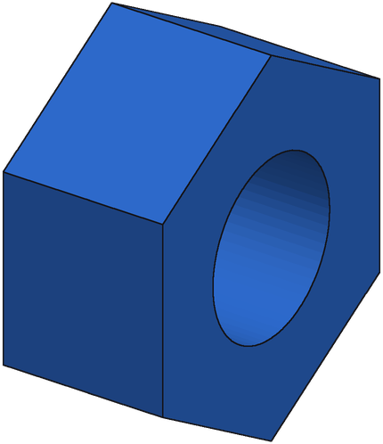
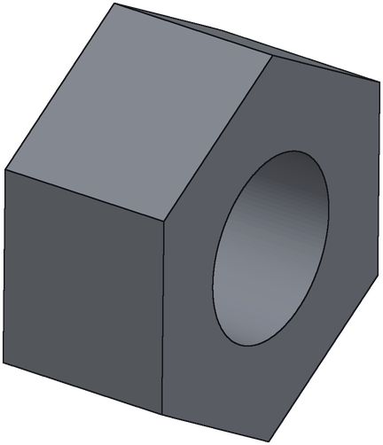
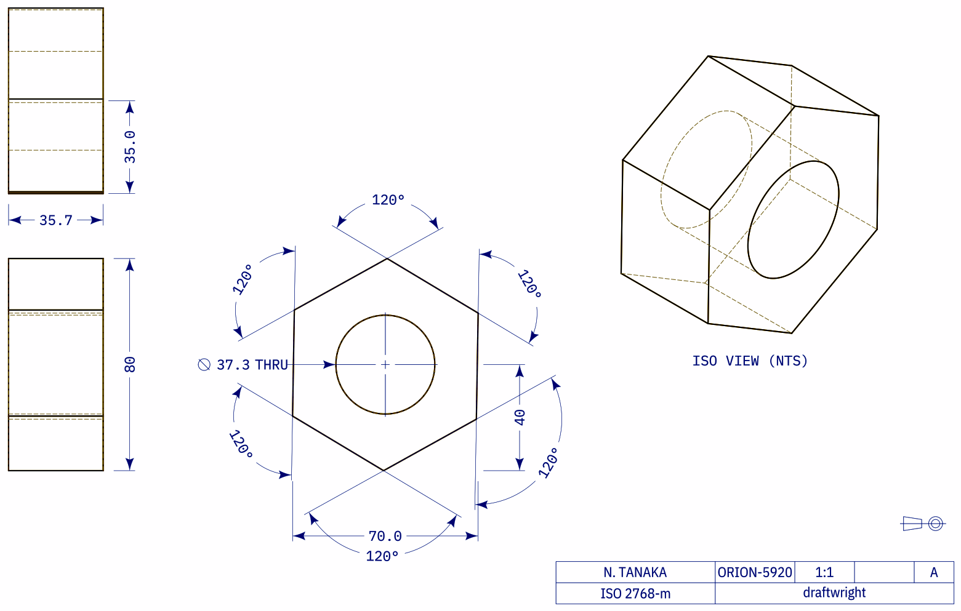
Repair Loop Example
Handwheel
Start IoU 0.52
Round 1 IoU 0.35
Round 3 IoU 0.93
Ground truth
Hex nut
Start IoU 0.32
Round 2 IoU 0.58
Round 5 IoU 0.99
Ground truth
Notes:
Real-bench parts. Each image is a program the repair chain adopted (only adopted when the label-free render-compare score improved by 0.1; IoU is computed afterwards against ground truth). Handwheel: chain started from the third-ranked e55 candidate; hex nut: chain started from the e55 medoid pick.

Slide 3
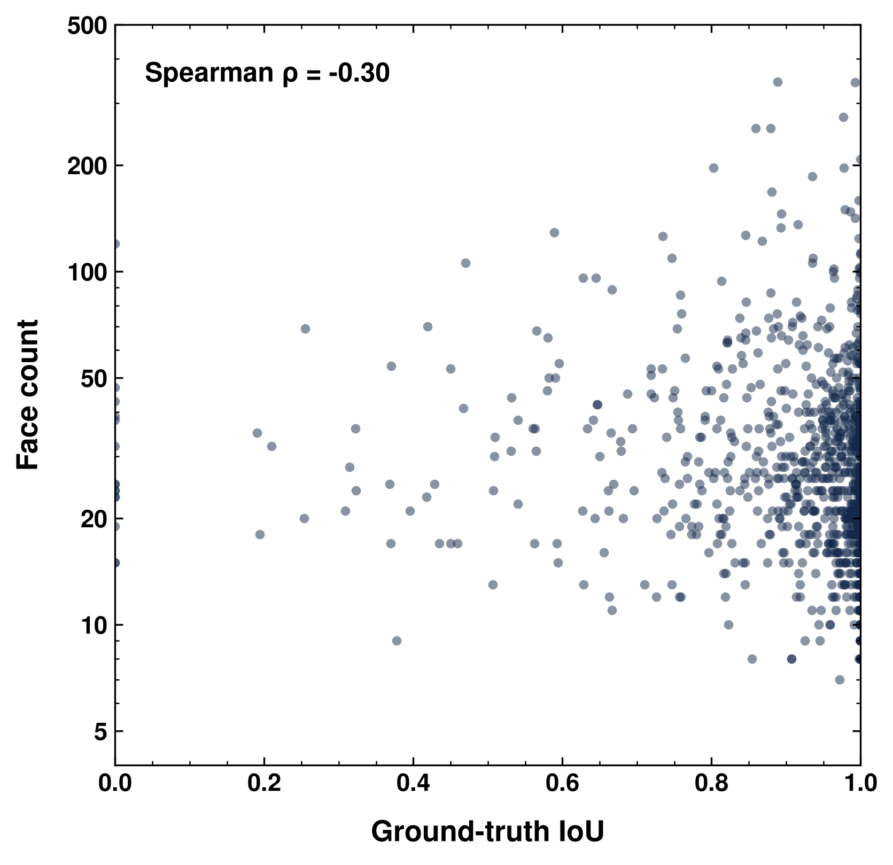
Part Complexity vs Accuracy
1027 synthetic test parts; complexity = face count of the ground-truth B-rep
Spearman ρ = -0.30 between face count and IoU
≤20 faces (n=366): mean IoU 0.937, 86% at IoU ≥ 0.85
21–32 faces (n=321): mean IoU 0.902, 83% at IoU ≥ 0.85
>32 faces (n=340): mean IoU 0.887, 75% at IoU ≥ 0.85
Notes:
IoU of the served medoid (best of 8, consistency vote). Face count from the ground-truth STEP.

Slide 4
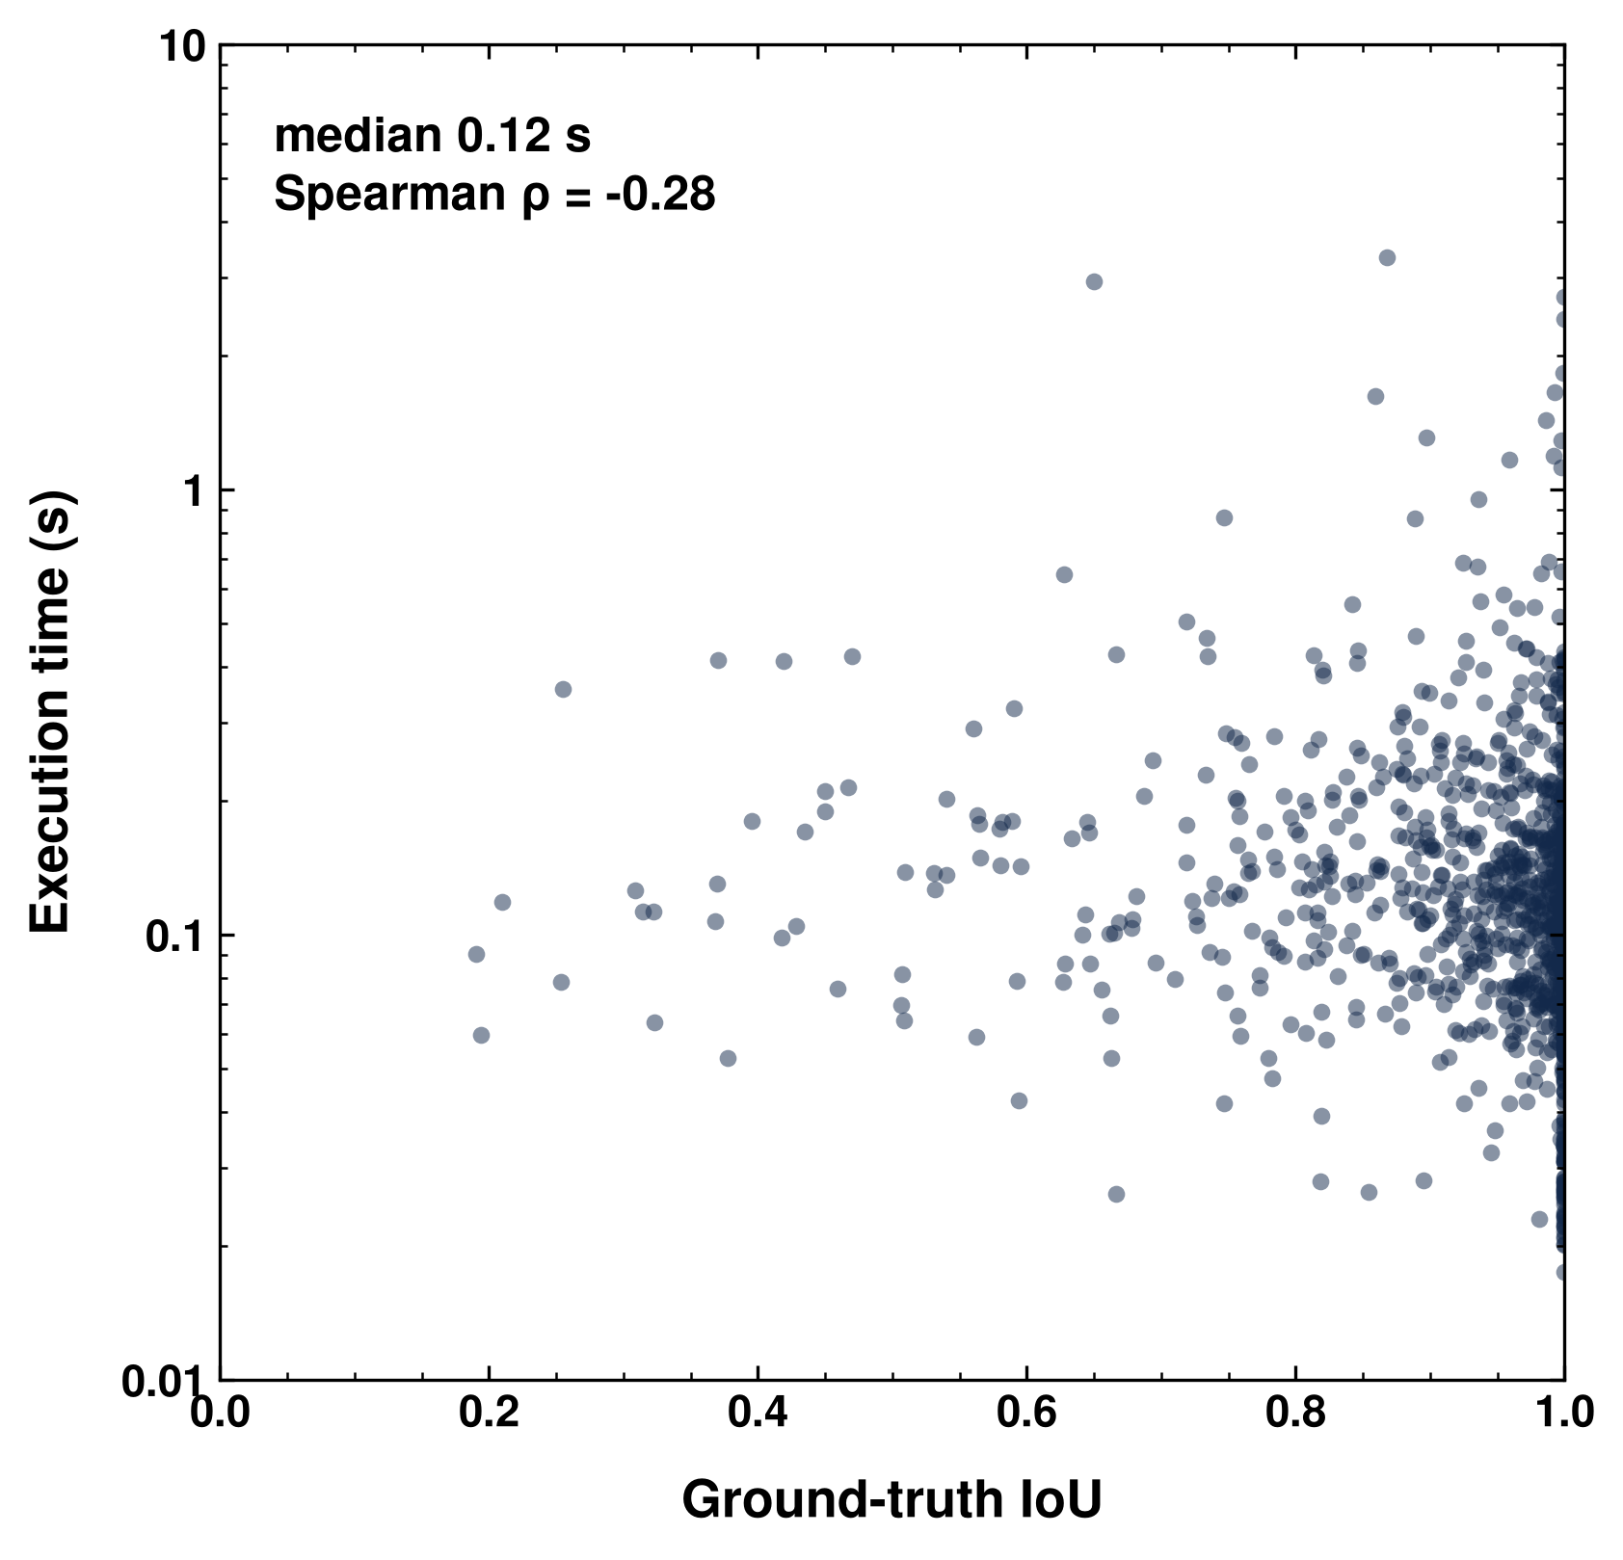
Program Execution Time
Time to execute the served build123d program into a solid (import excluded, STEP export included)
Median 0.12 s, 95th percentile 0.41 s, max 3.3 s (n=1012)
Spearman ρ = -0.28 with IoU
Parts at IoU ≥ 0.85 median 0.11 s vs 0.13 s below
Notes:
Measured on the cluster CPU node (ccc0442), 12 programs in parallel, one subprocess per program.

Slide 5
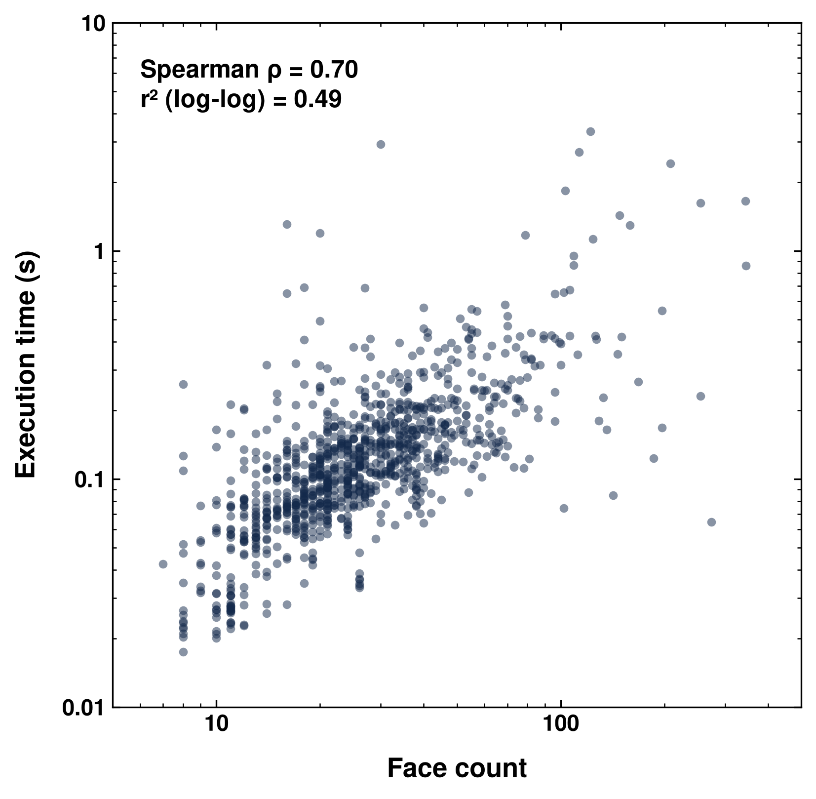
Face Count vs Execution Time
Two complexity measures for the 1012 synthetic test parts: ground-truth face count and the served program's execution time
Spearman ρ = 0.70, r² = 0.49 on log-log axes
≤20 faces (n=363): median 0.07 s, 95th percentile 0.21 s
21–32 faces (n=314): median 0.12 s, 95th percentile 0.24 s
33–60 faces (n=238): median 0.16 s, 95th percentile 0.41 s
>60 faces (n=97): median 0.27 s, 95th percentile 1.63 s
Outliers both ways: some programs with few faces take over a second, and some 100+ face parts build in under 0.1 s
Notes:
Execution time measured with a warm-up run first (the first batch of the original run absorbed a ~1 s cold start; those 12 parts were re-timed).

Slide 6
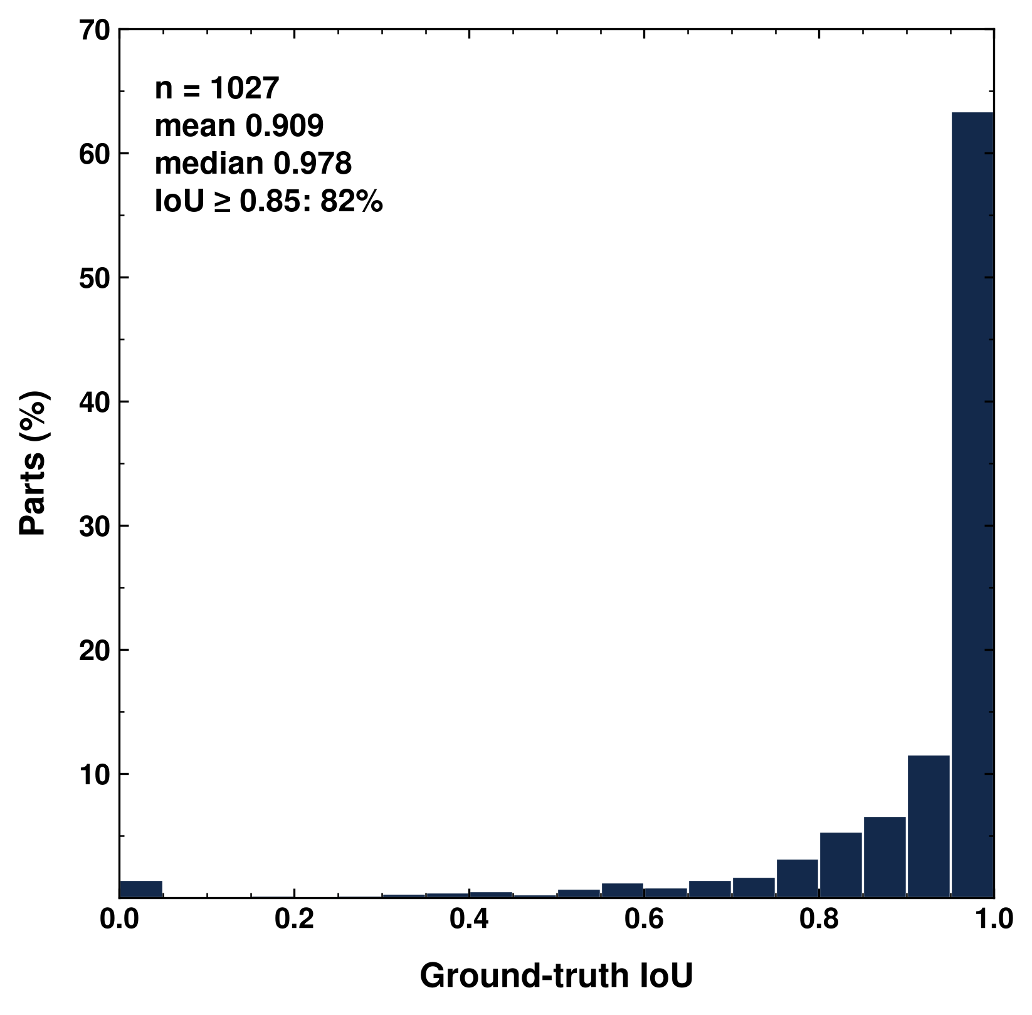
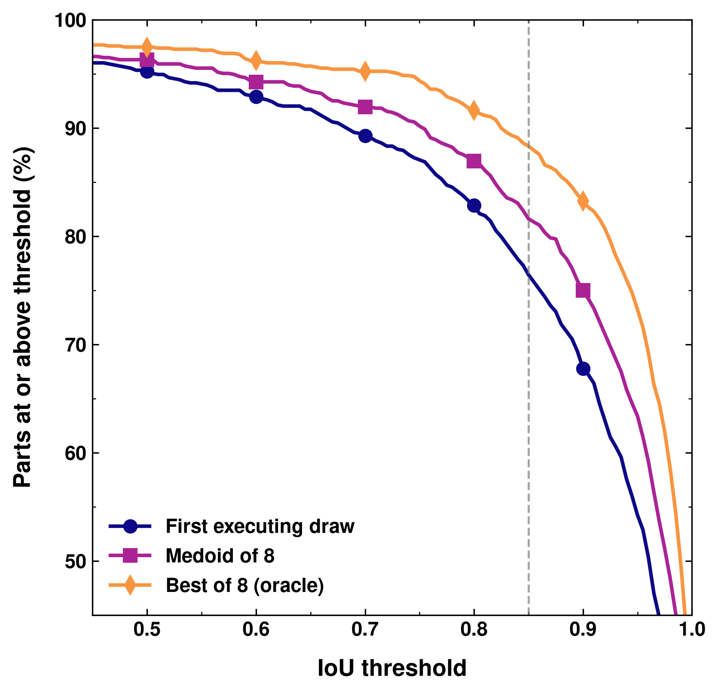
Distribution of IoU
1027 synthetic test parts, e55 best of 8. Medoid: mean 0.909, median 0.978, 82% at IoU ≥ 0.85 (first executing draw 76%, oracle 88%)

Slide 7
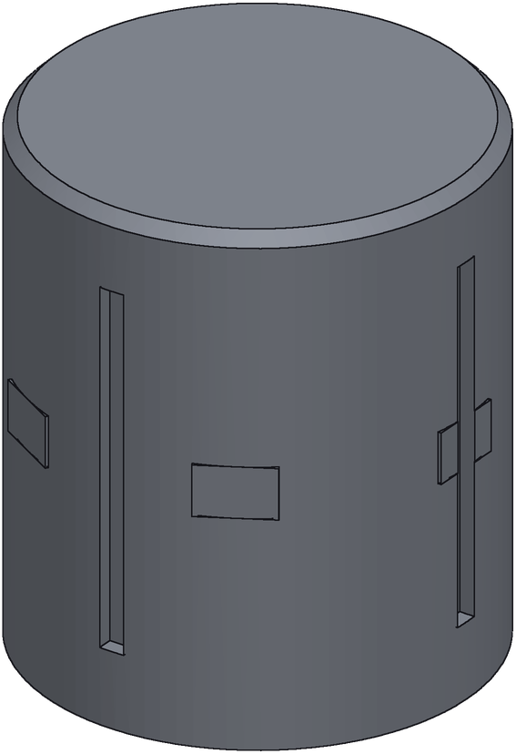
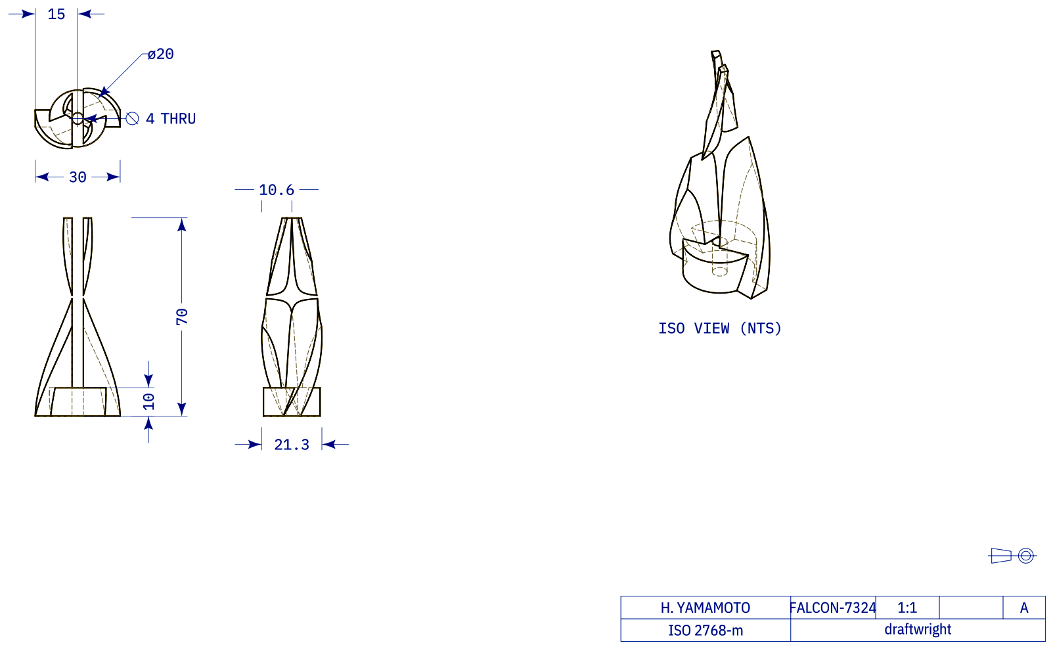
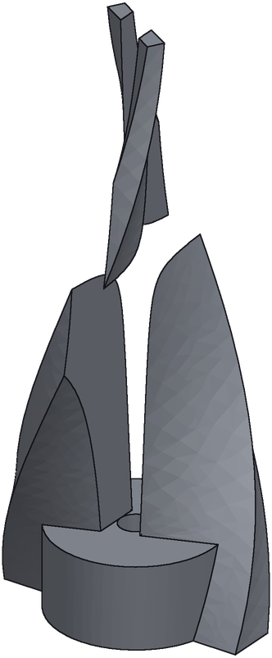
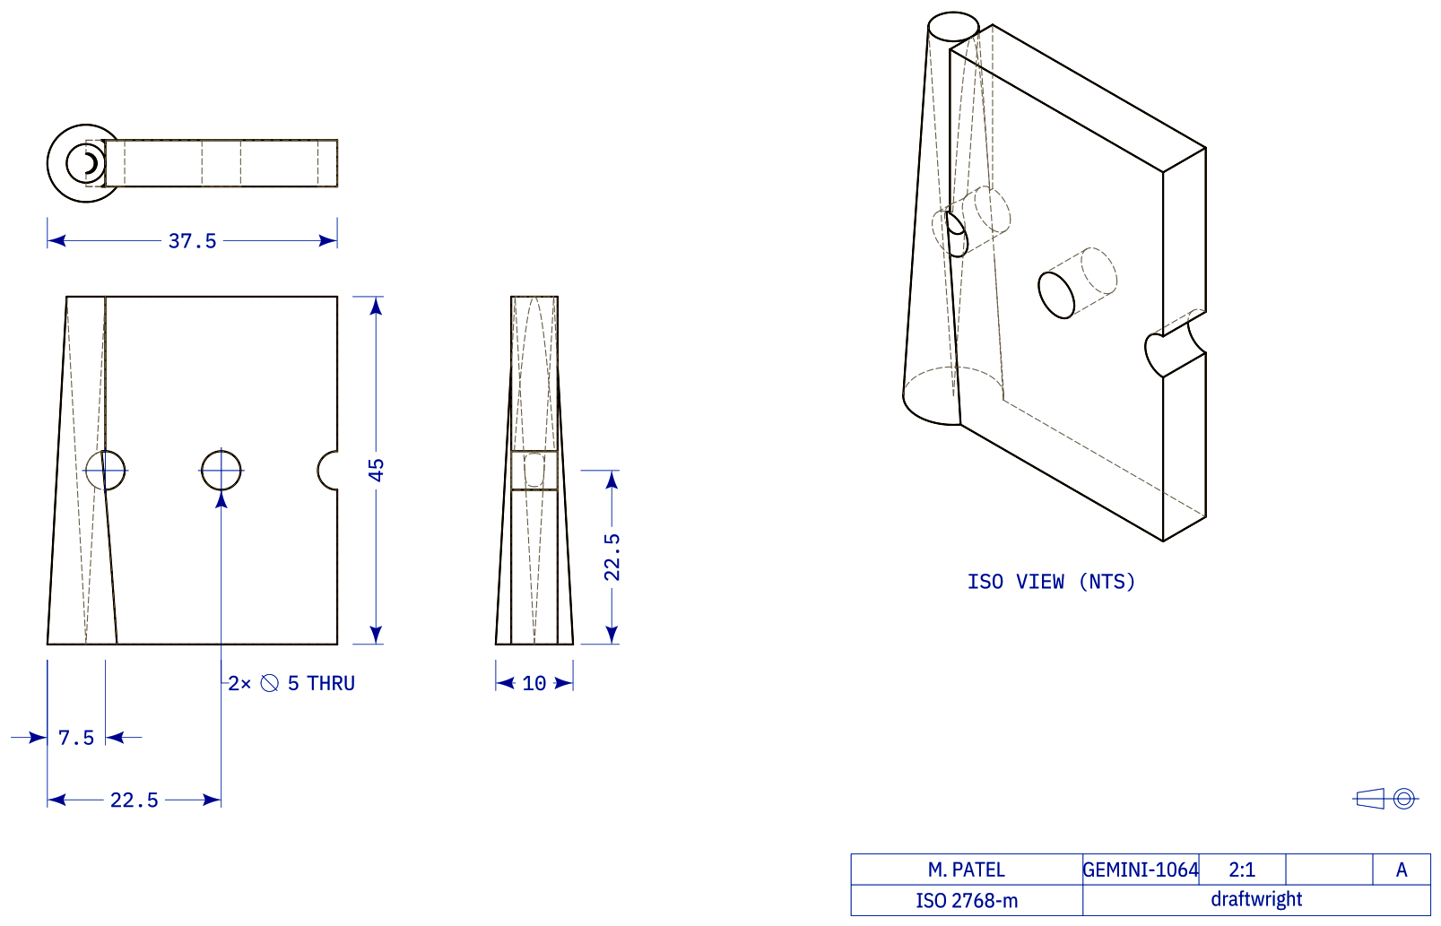
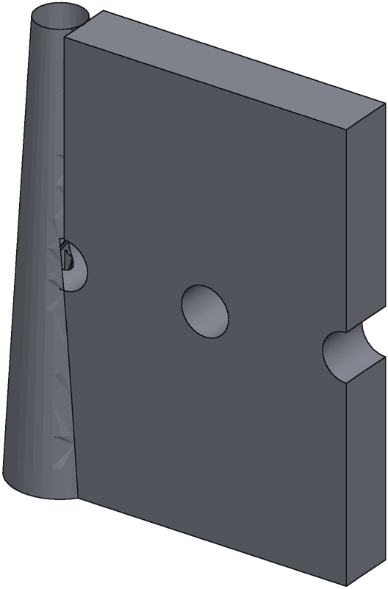
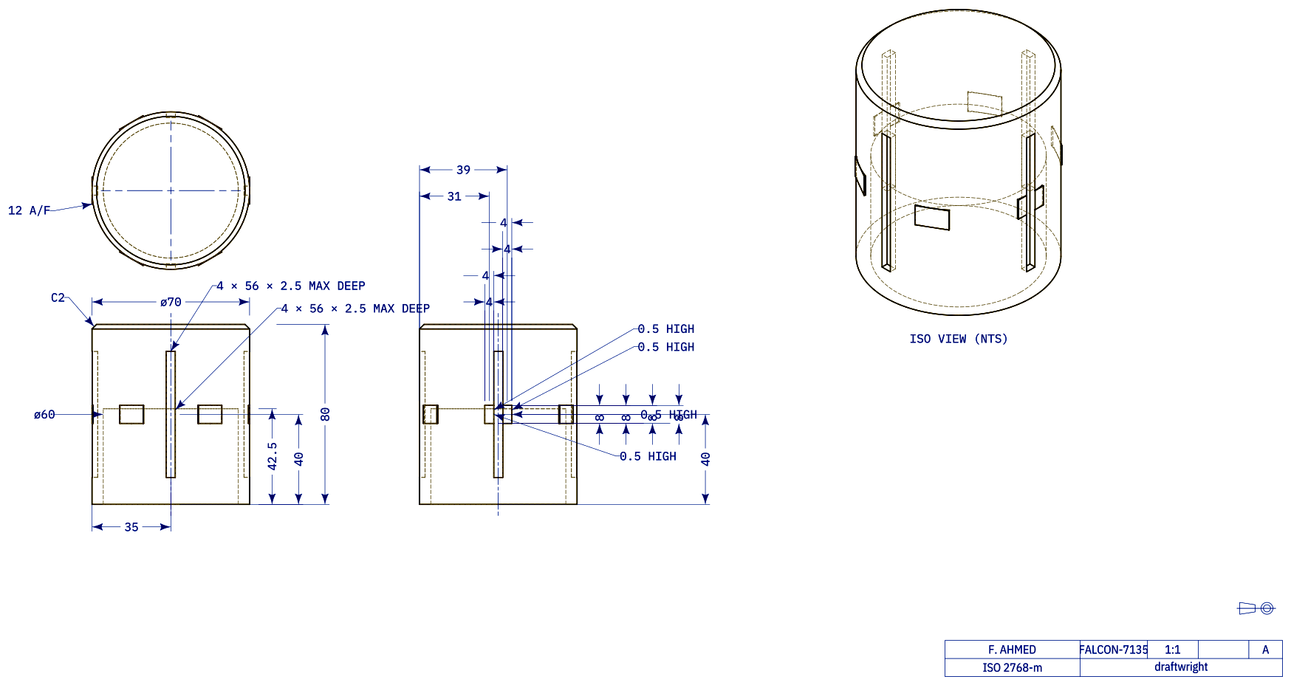
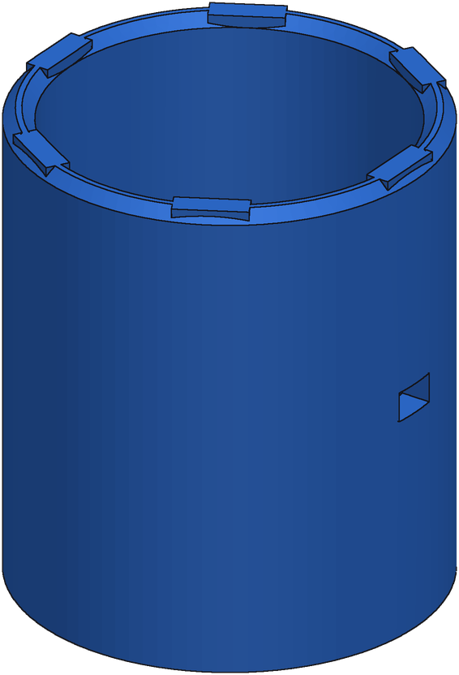
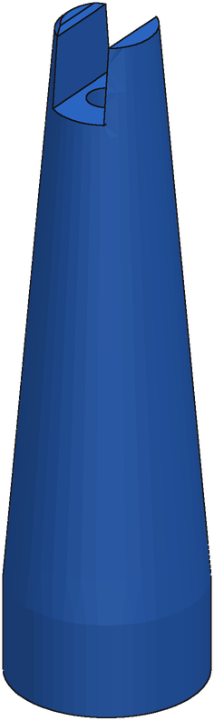
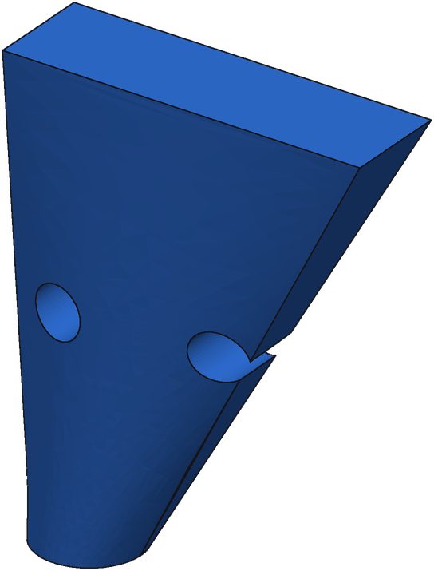
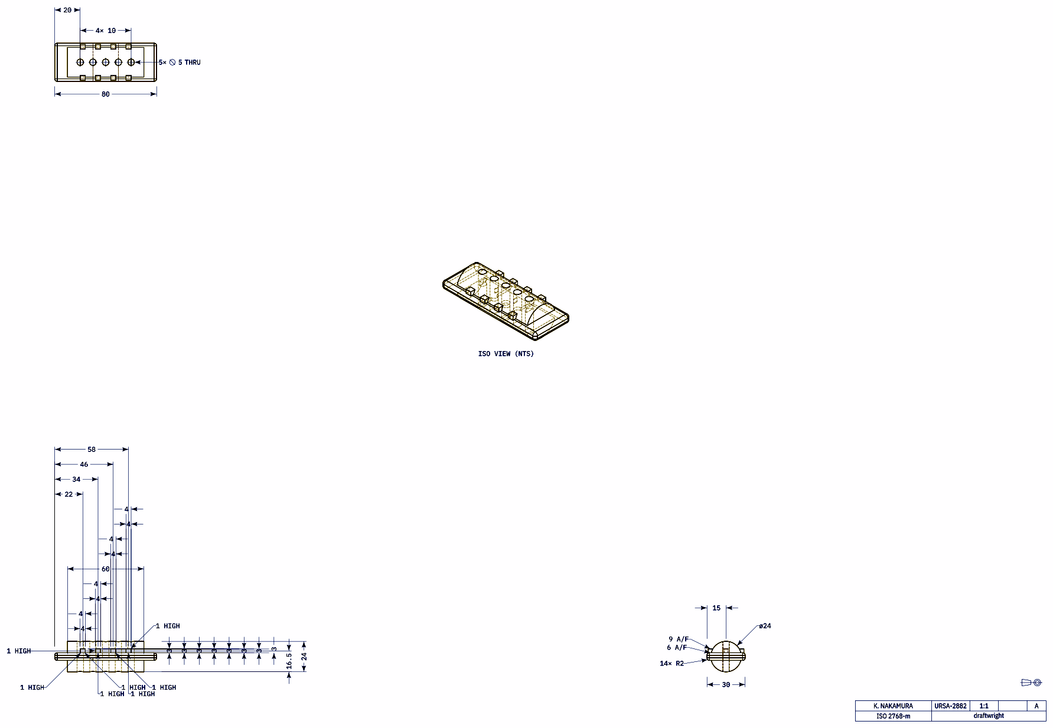
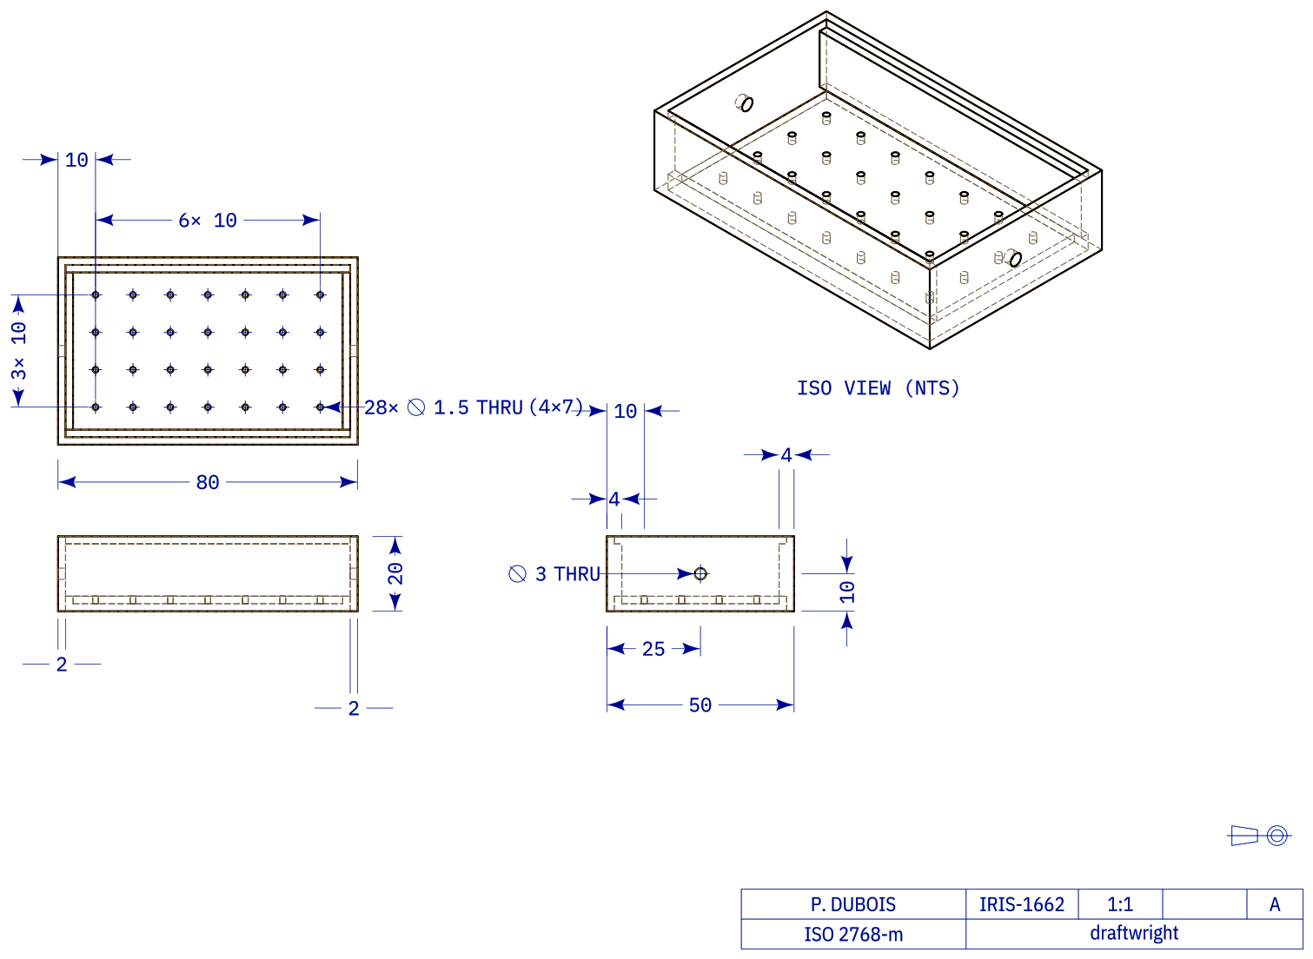
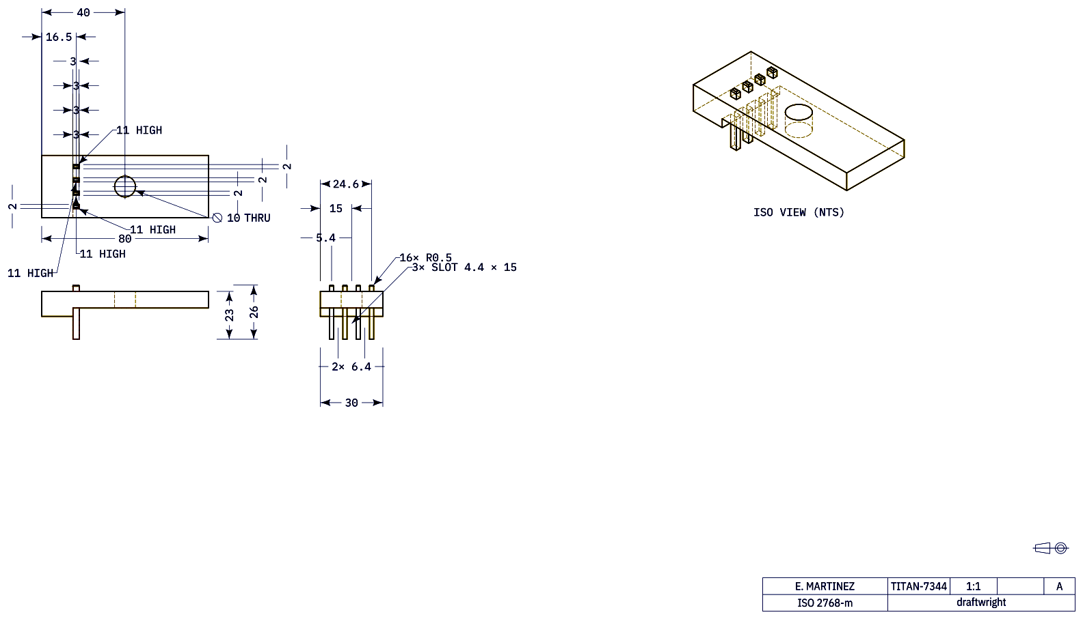
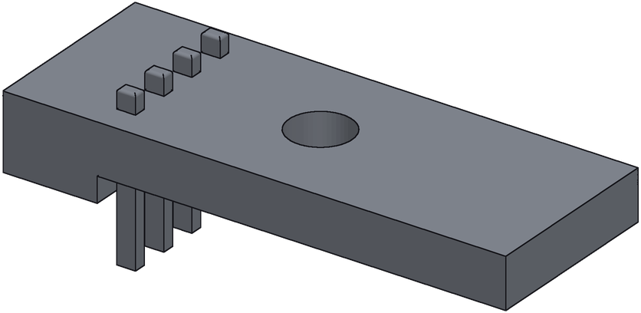
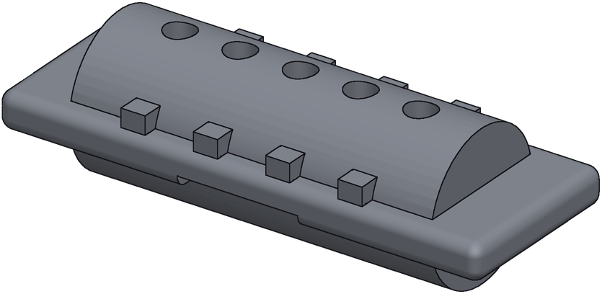
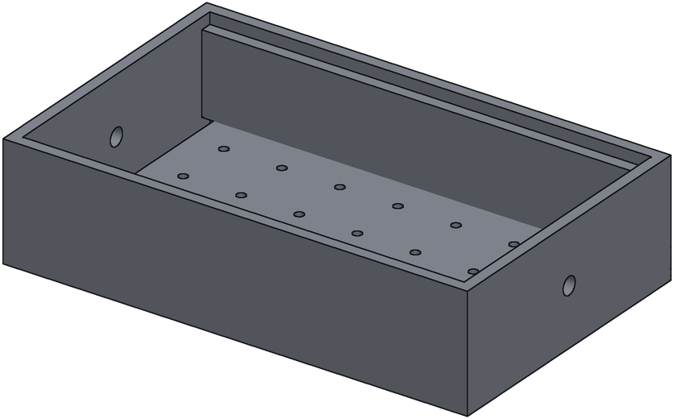
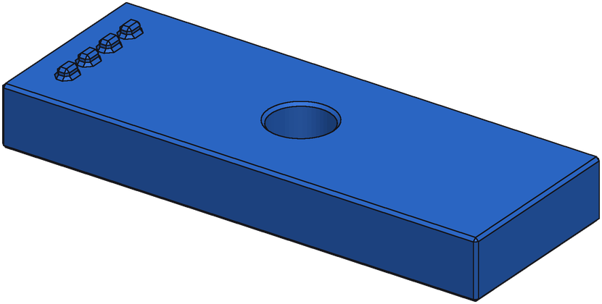
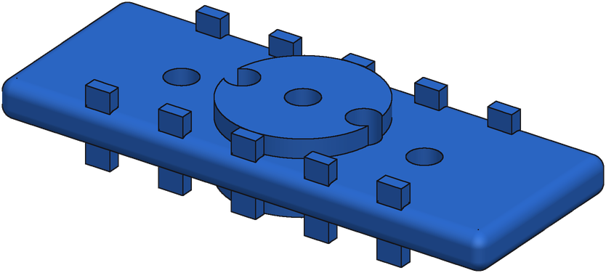
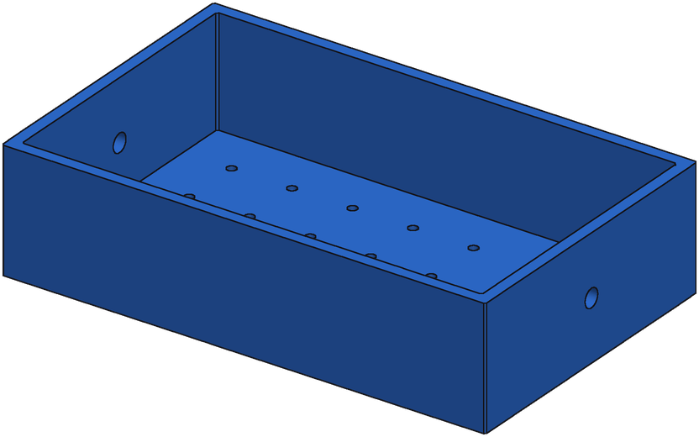
Failure Cases
Ground truth
Generation
Solid read as hollow (8/8 agree)
Freeform surfaces
Wrong base profile
IoU 0.42 best of 8 0.42 · 8/8 executed
IoU 0.32 best of 8 0.34 · 4/8 executed
IoU 0.43 best of 8 0.44 · 5/8 executed
Pins generated as holes
Dense feature layout scrambled
Thin walls: near-miss, low IoU
IoU 0.25 best of 8 0.76 · 8/8 executed
IoU 0.47 best of 8 0.57 · 7/8 executed
IoU 0.37 best of 8 0.59 · 8/8 executed
Notes:
Lowest-IoU served parts on the synthetic test pool (e55 best of 8, medoid shown). Failure-mode labels are by inspection.

