Slide 1
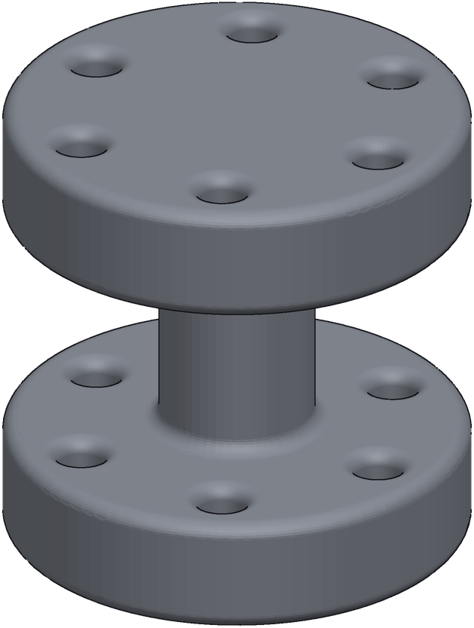
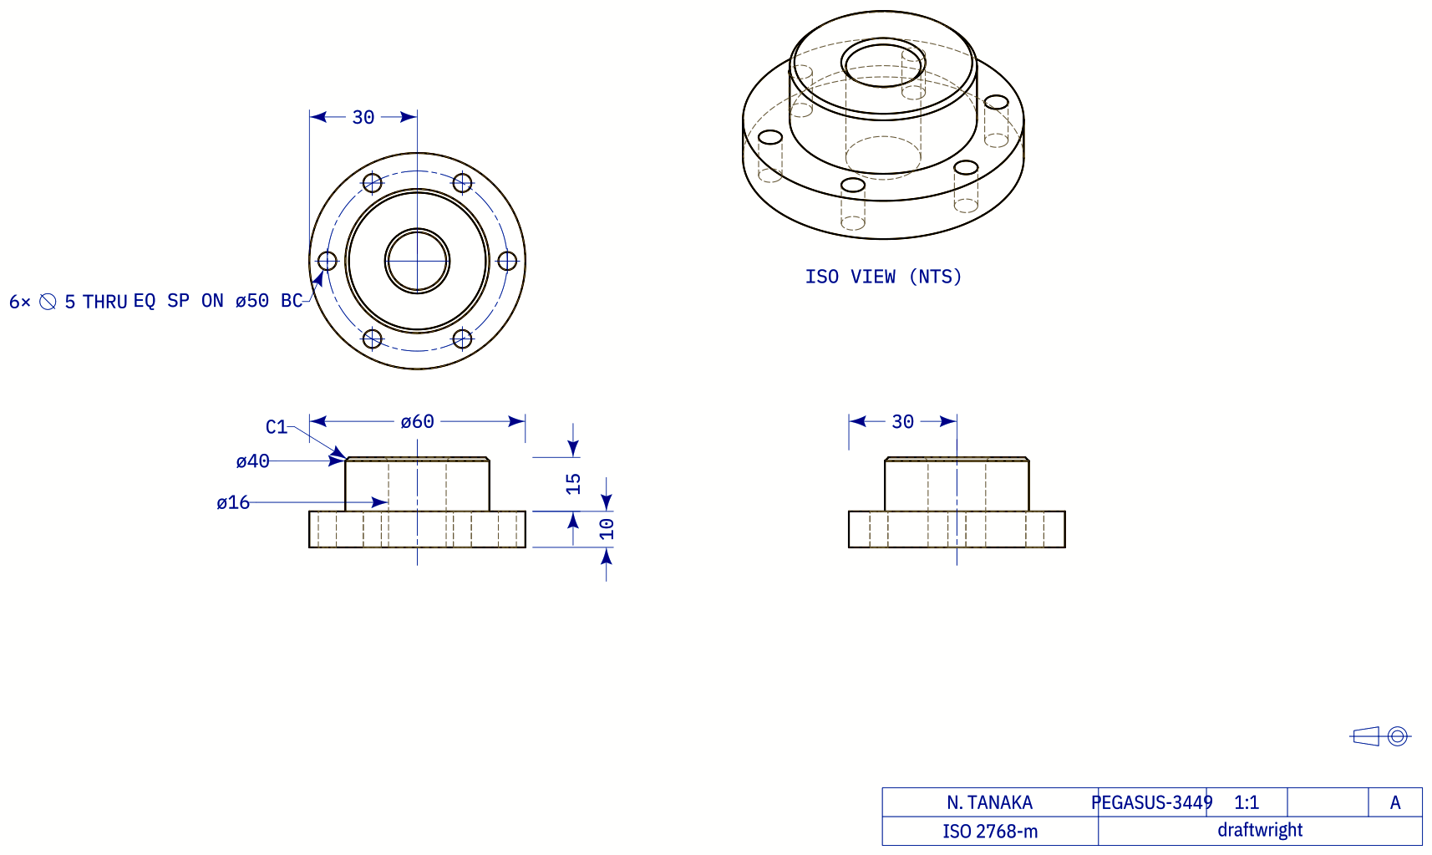
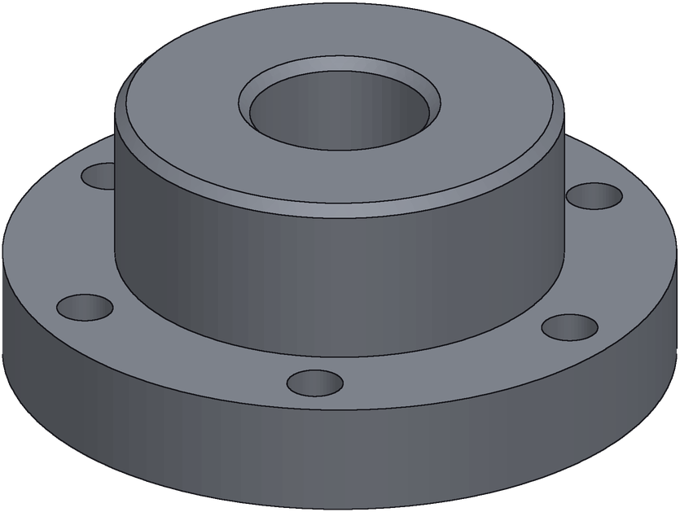
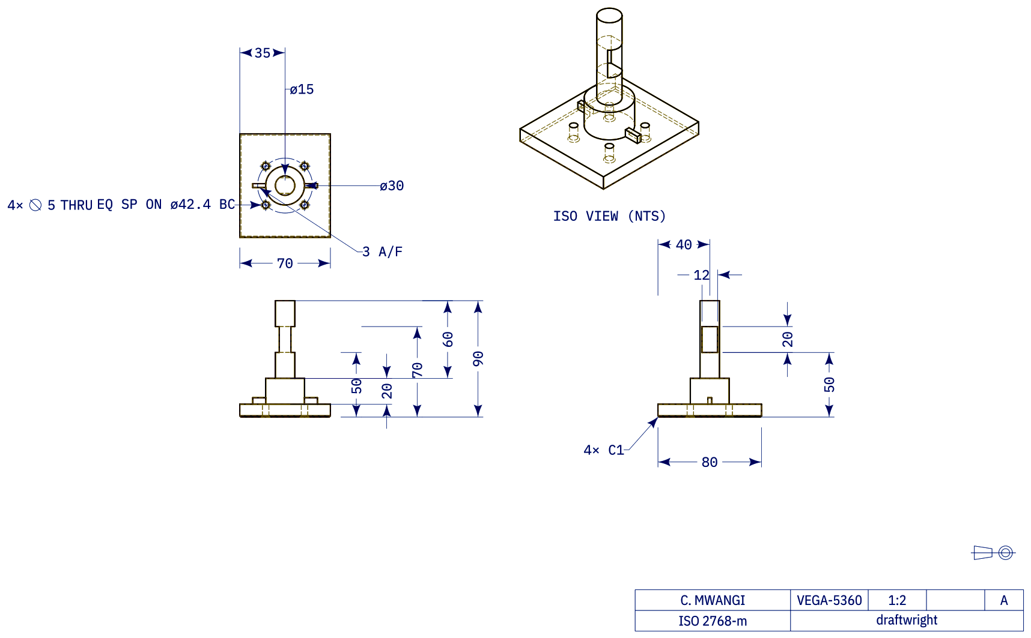
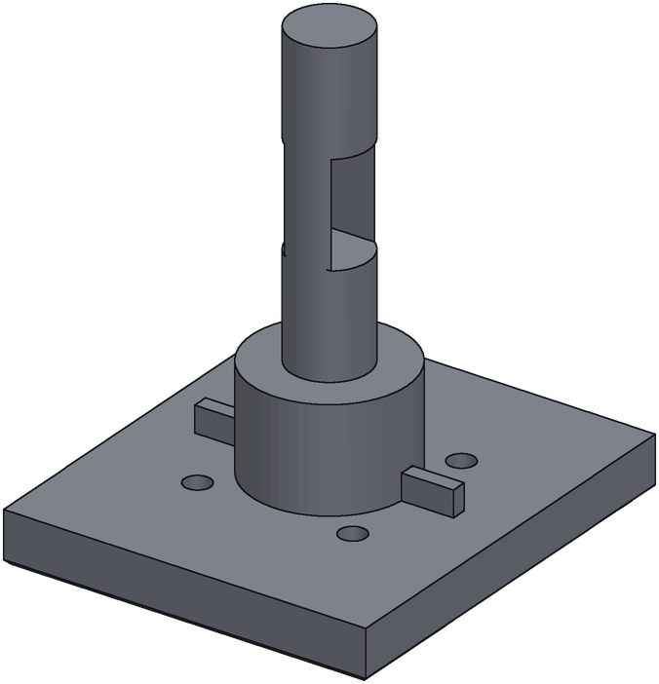
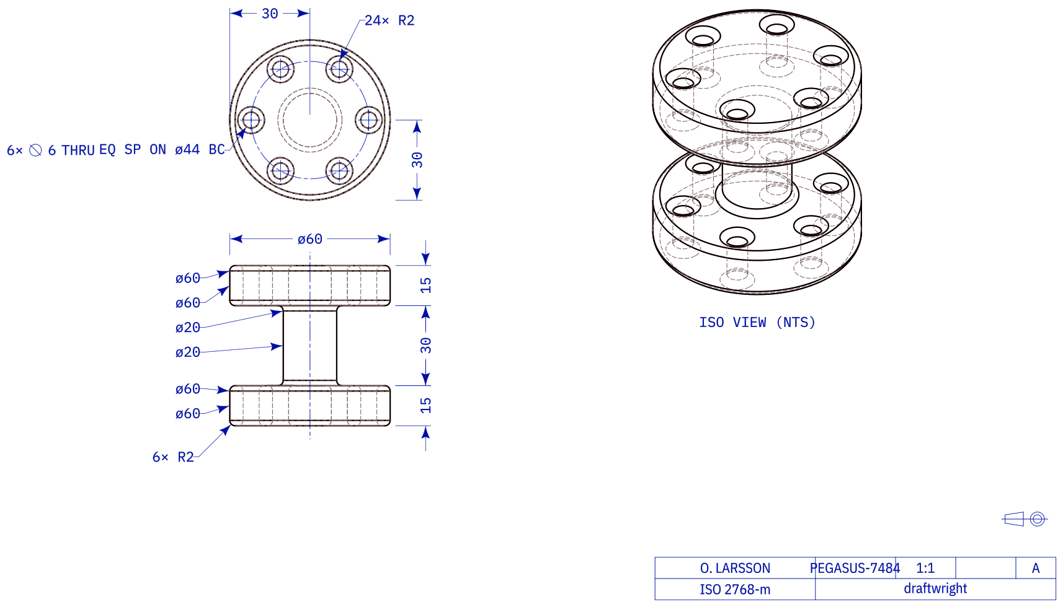
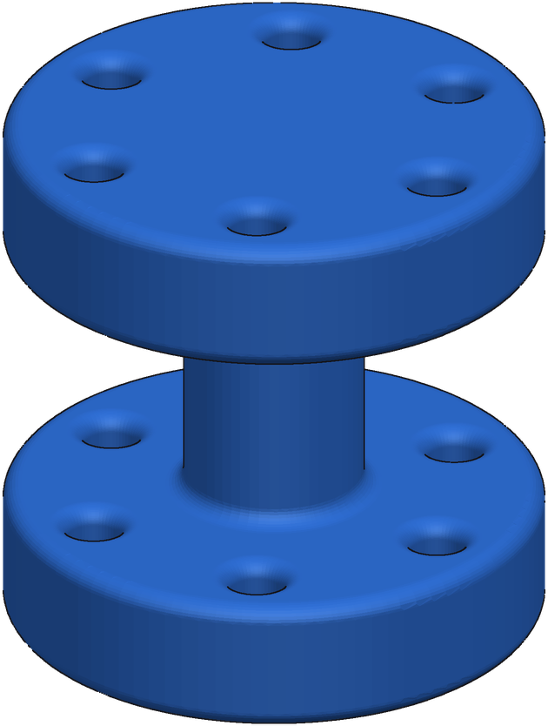
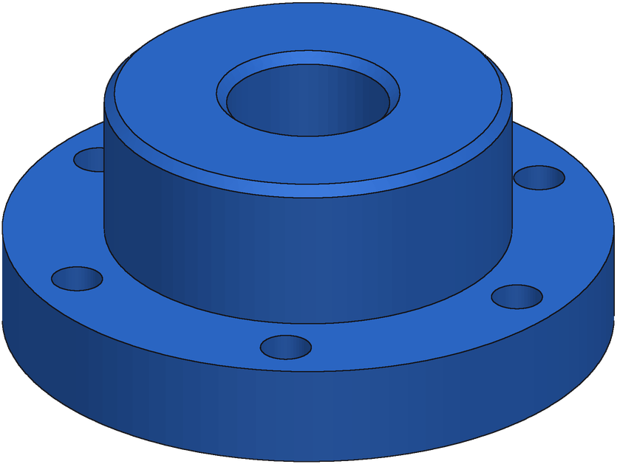
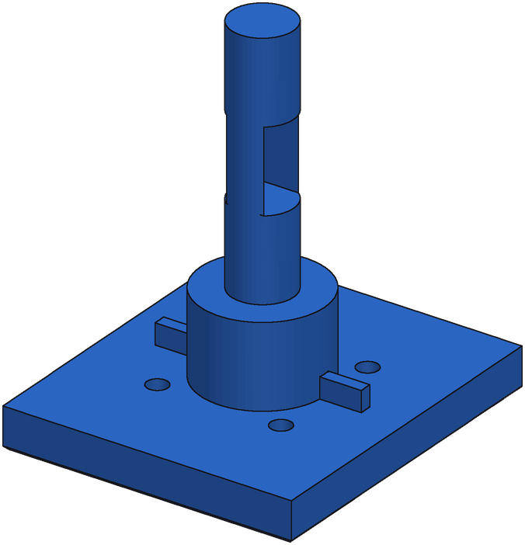
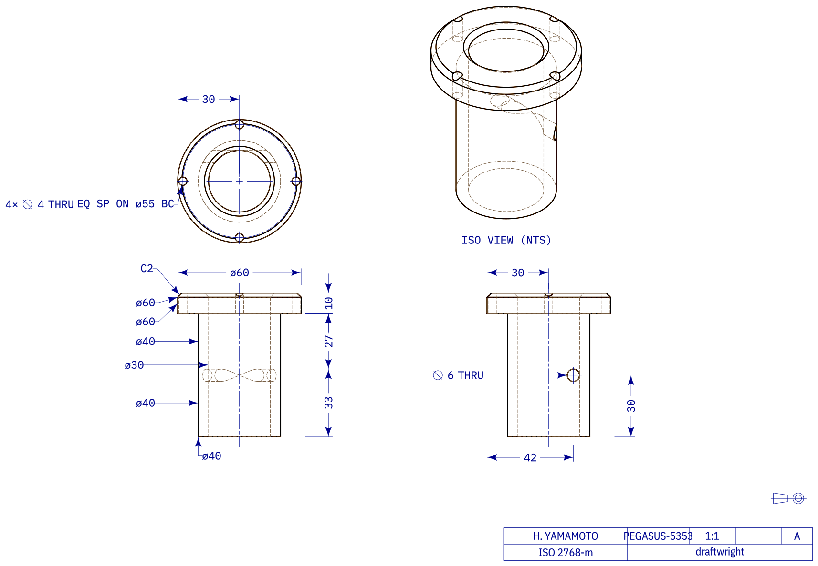
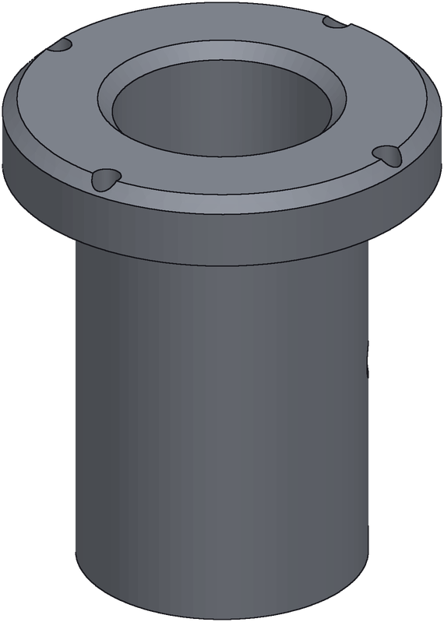
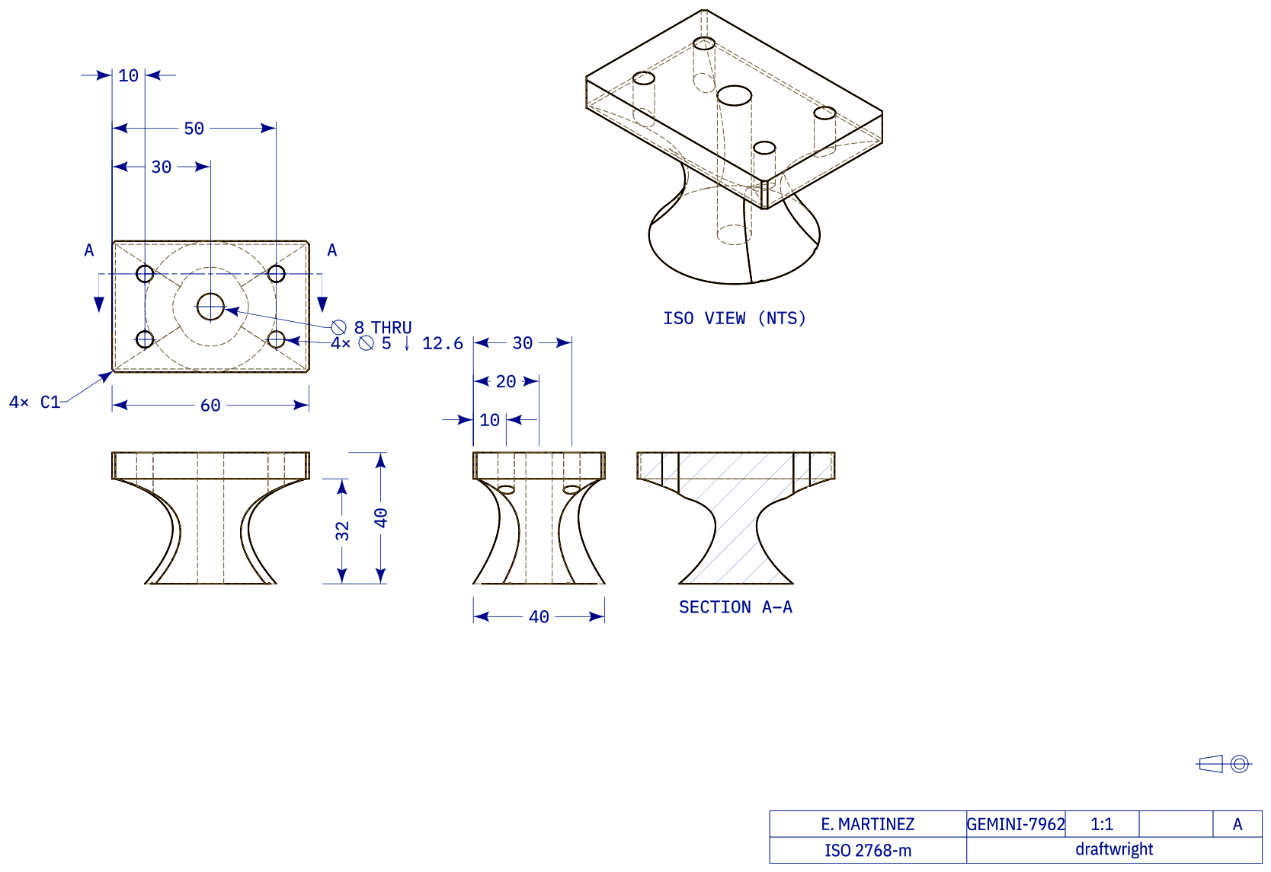
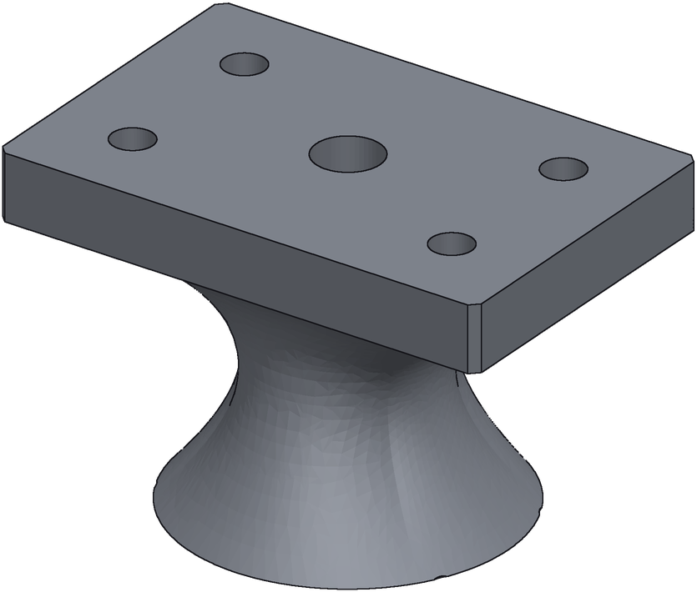
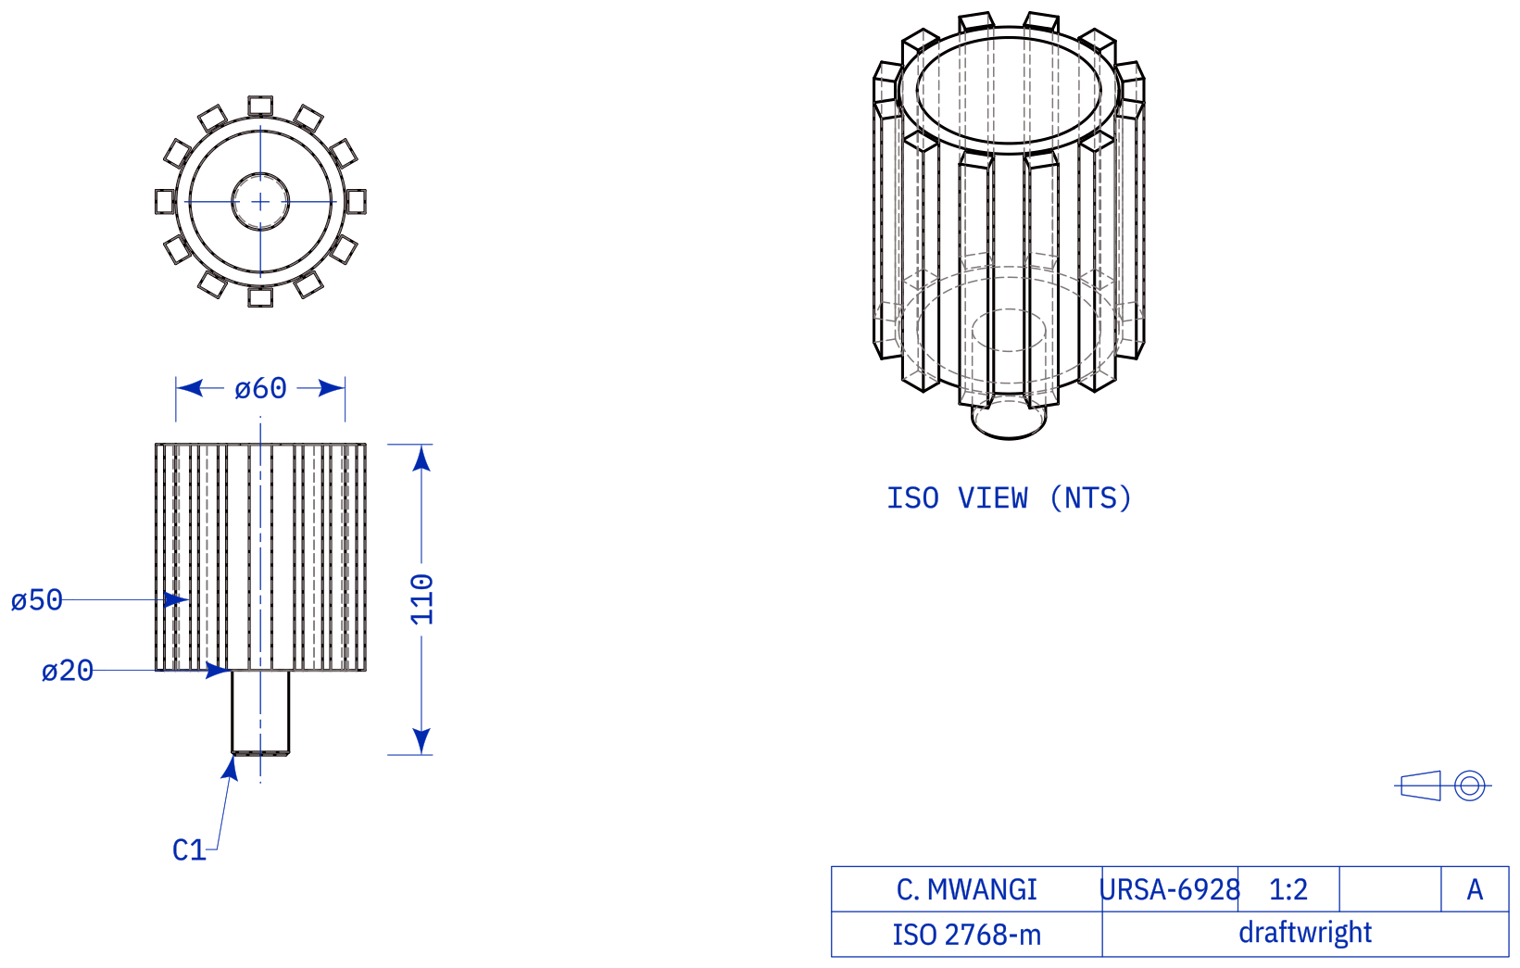
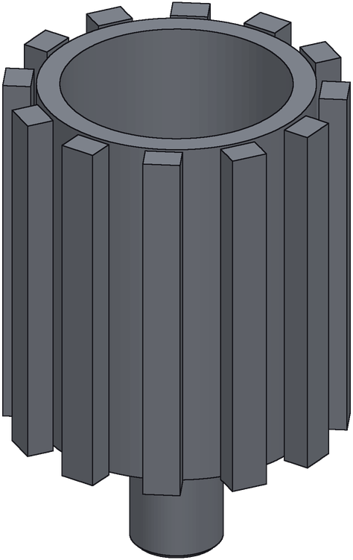
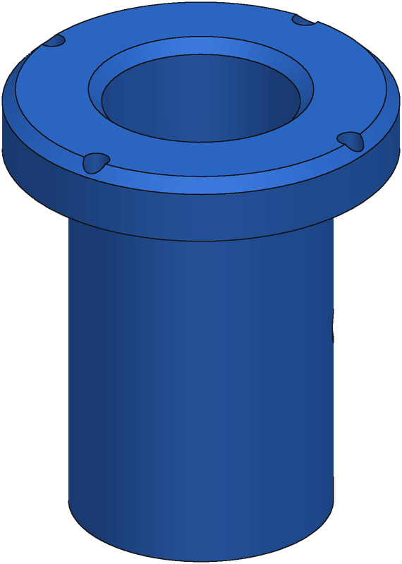
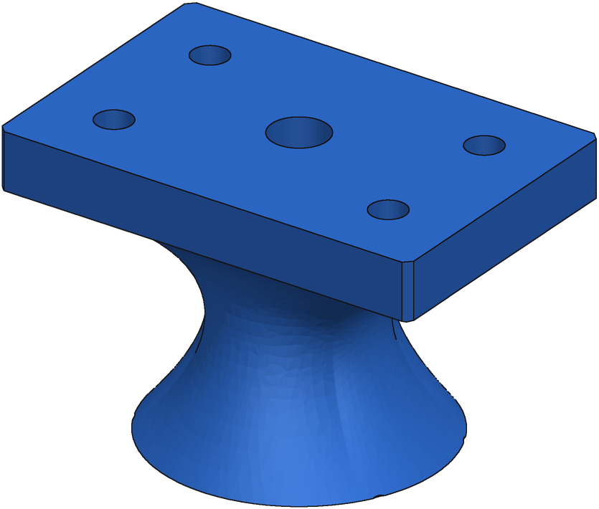
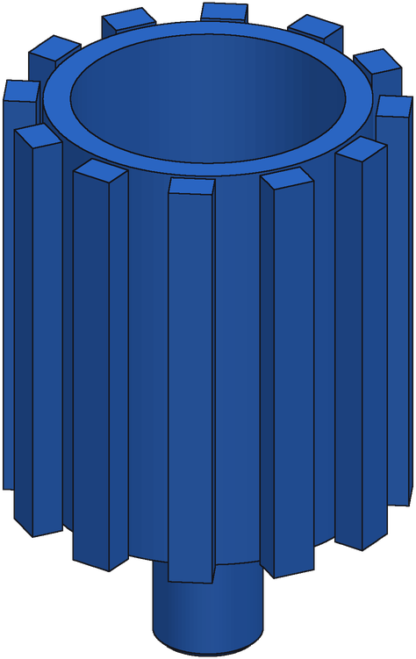
Complex Test Parts
Ground truth
Generation
Double-flanged spool
Flanged hub
Slotted shaft on mounting plate
IoU 1.000 agreement 0.99 · 5/8 executed
IoU 1.000 agreement 0.91 · 7/8 executed
IoU 1.000 agreement 0.47 · 8/8 executed
Flanged bushing
Flared pedestal mount
Splined hub on shaft
IoU 1.000 agreement 0.94 · 8/8 executed
IoU 0.989 agreement 0.64 · 7/8 executed
IoU 1.000 agreement 0.80 · 6/8 executed
Notes:
Best-of-8 e55 generations on the synthetic test pool; the generation shown is the medoid (consistency vote). IoU = exact volumetric IoU vs ground truth; agreement = medoid's mean pairwise IoU with the other executing candidates.

Slide 2
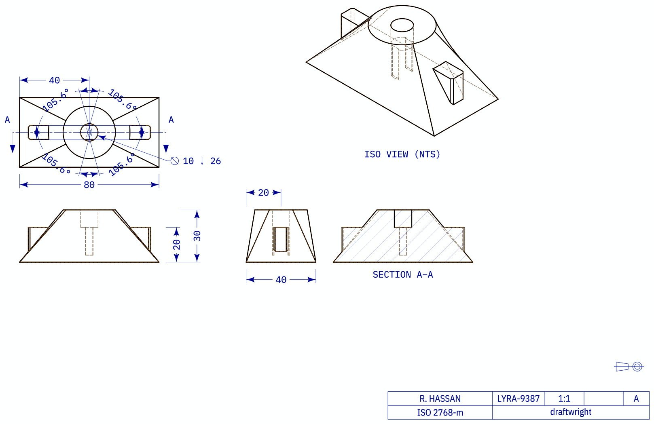
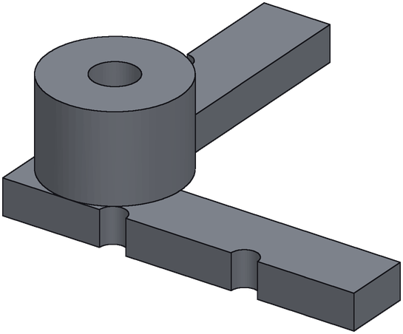
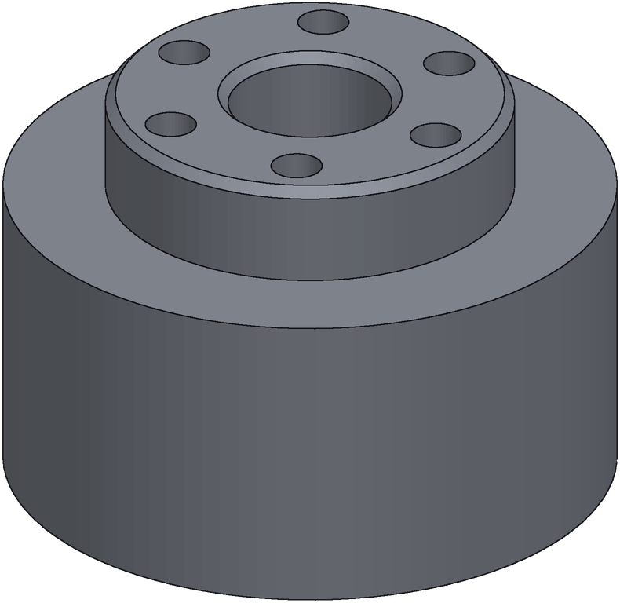
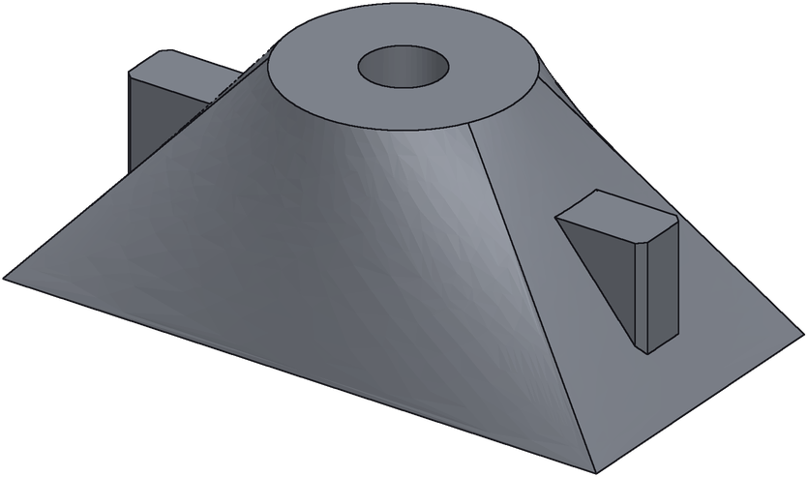
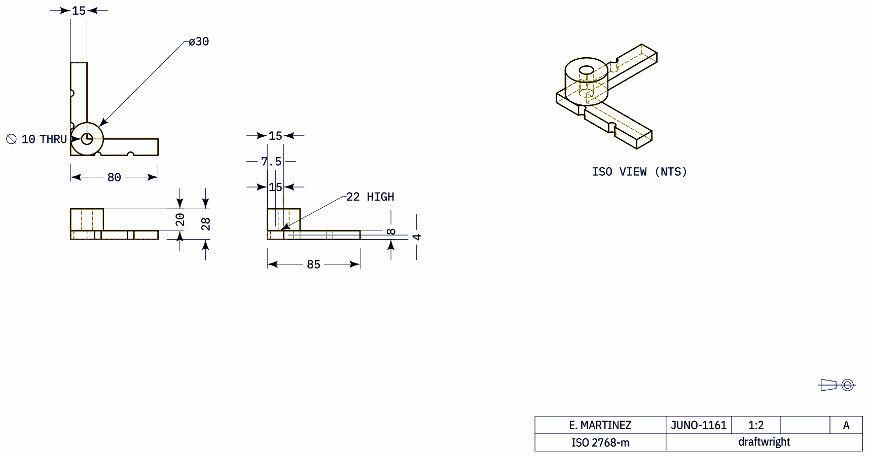
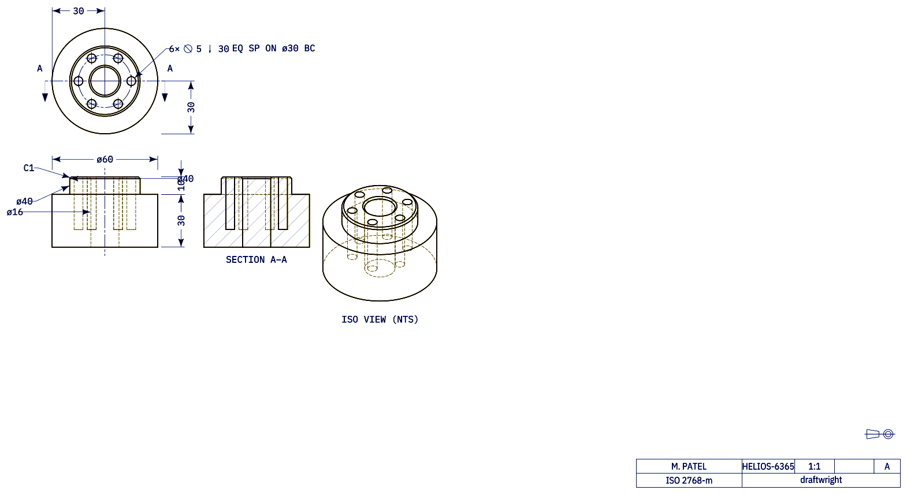

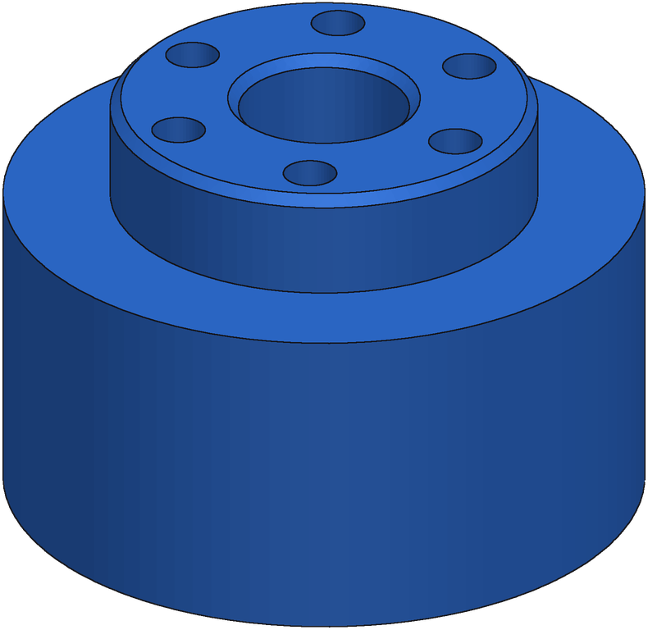
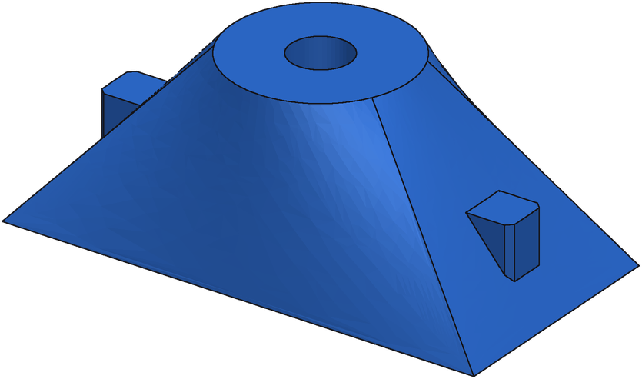
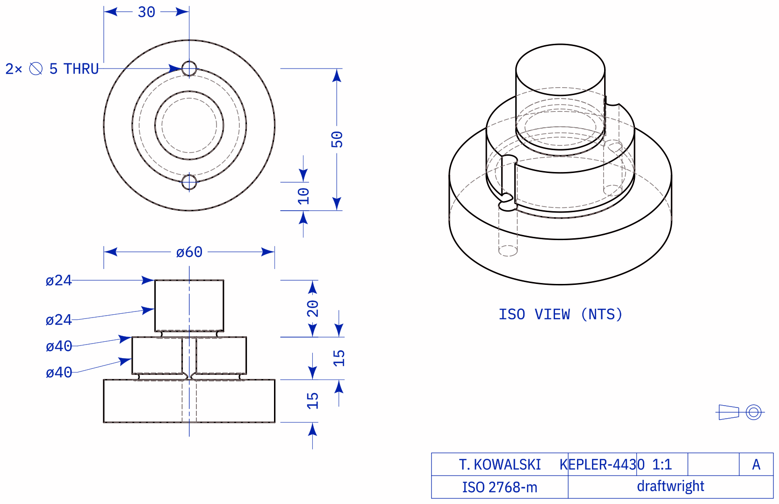
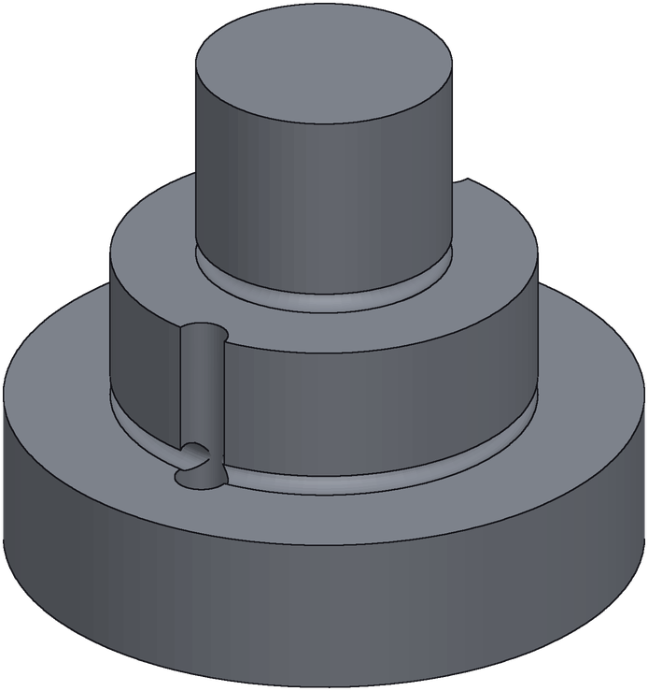
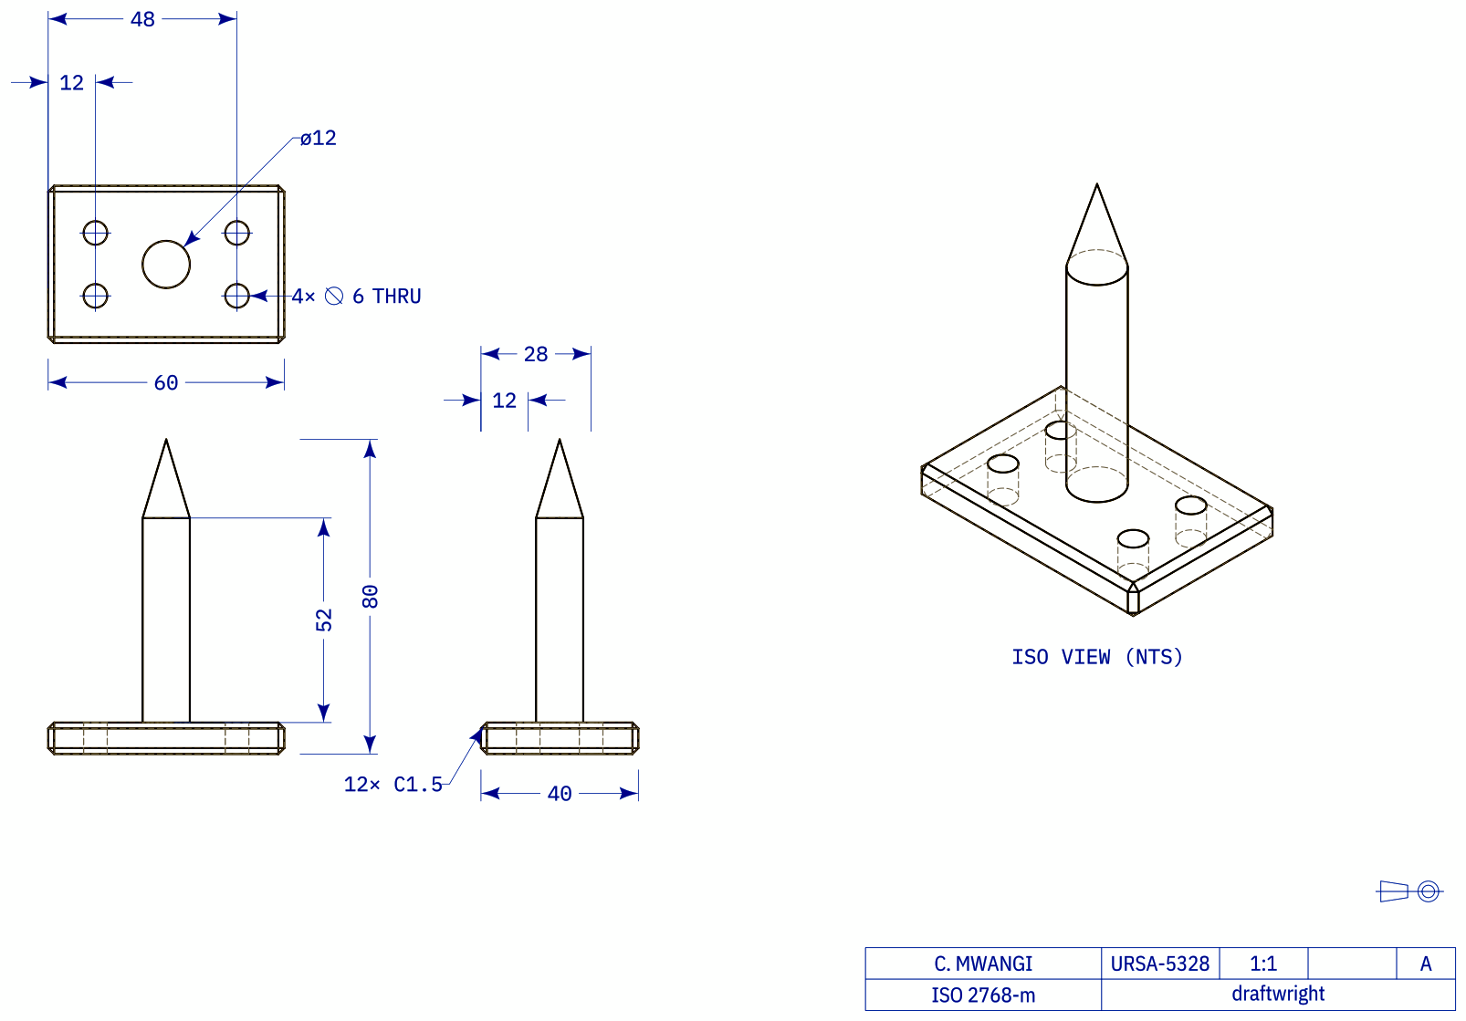
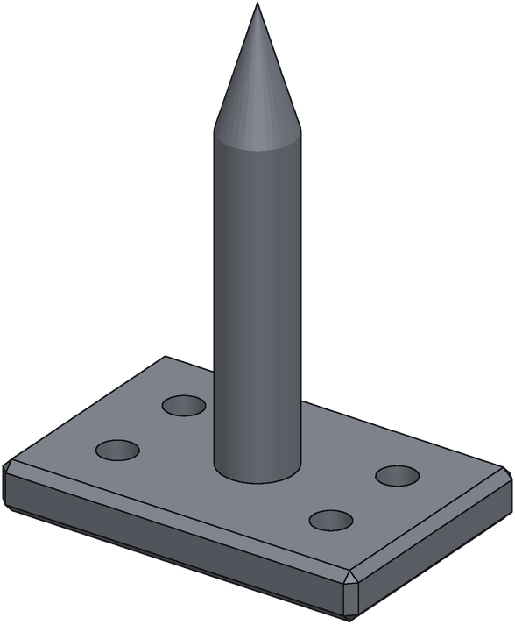
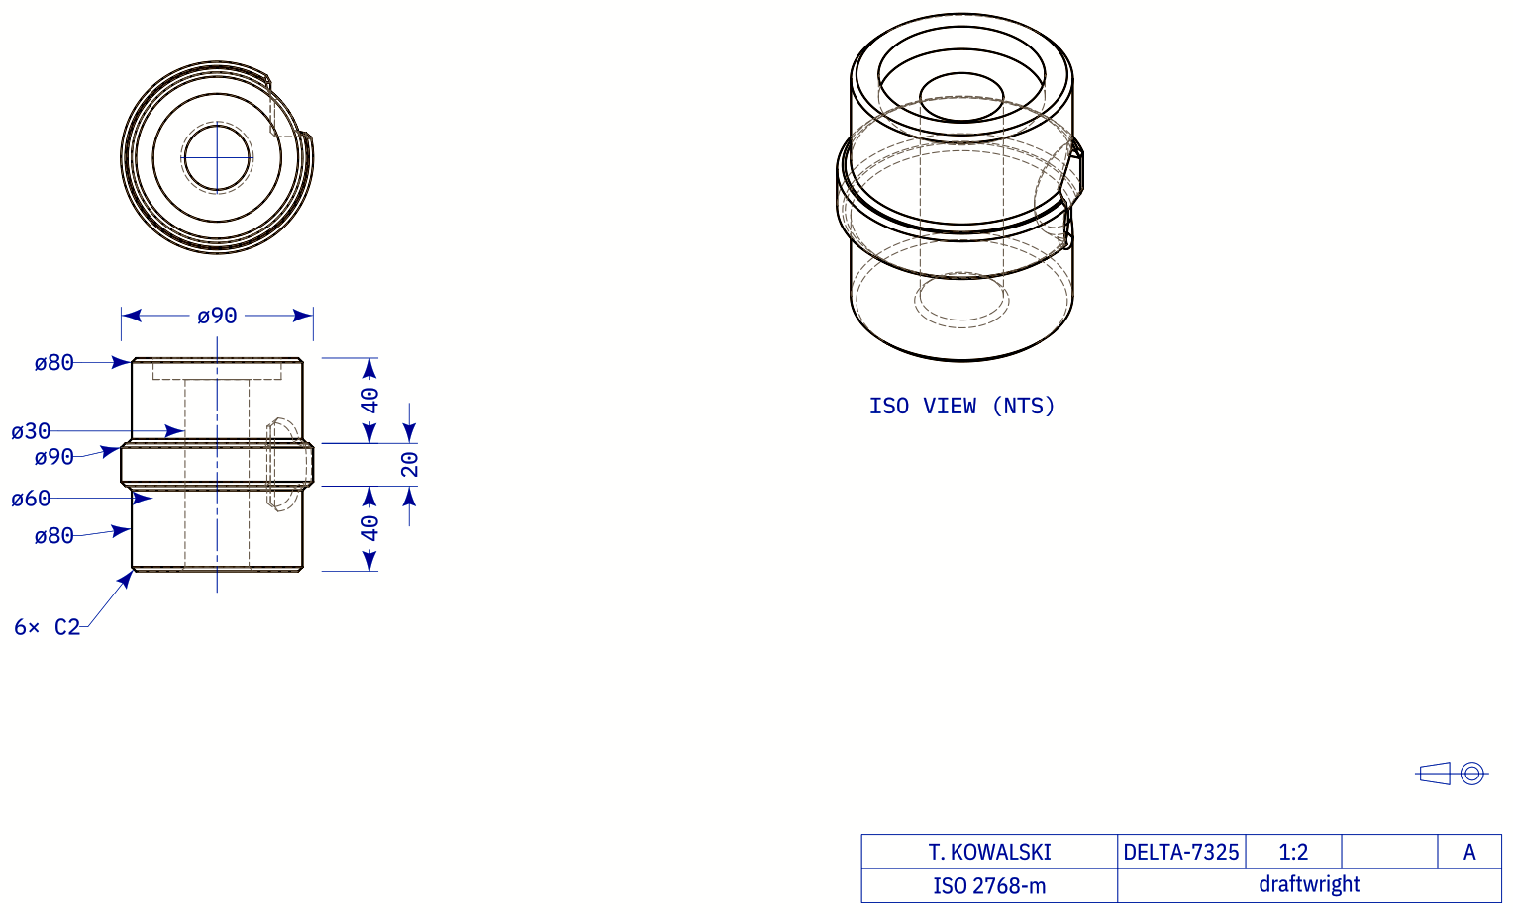
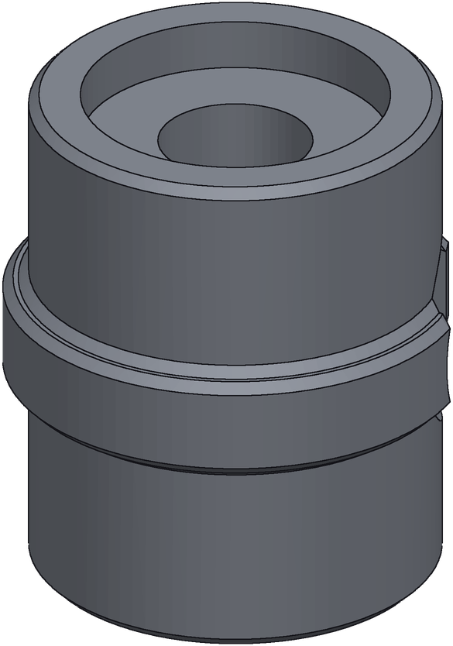
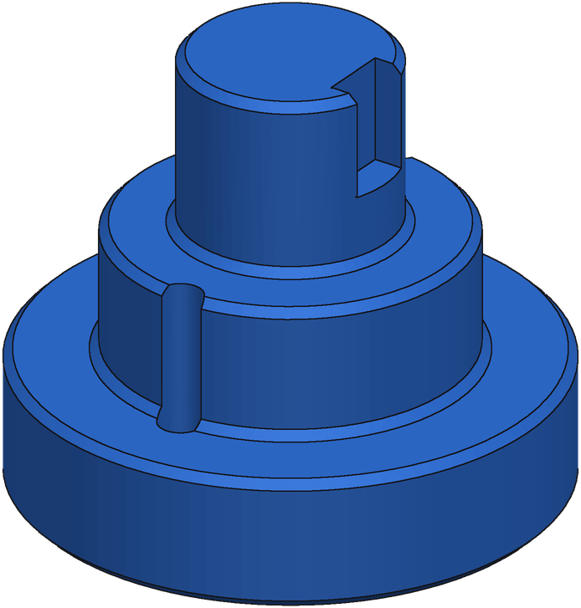

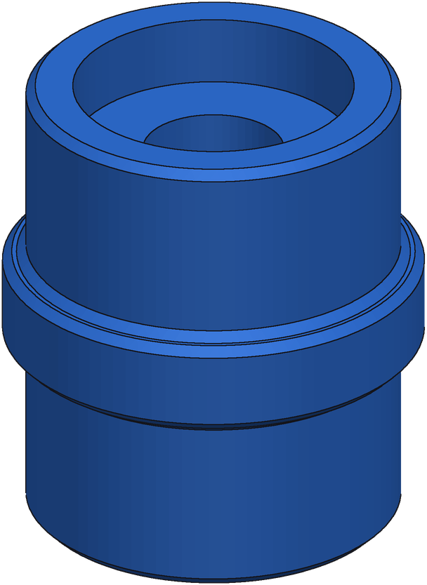
Complex Test Parts (continued)
Ground truth
Generation
Lofted hopper with rib and boss
L-arm with bored boss
Bolted hub housing
IoU 0.965 agreement 0.97 · 7/8 executed
IoU 0.963 agreement 0.69 · 5/8 executed
IoU 1.000 agreement 0.97 · 8/8 executed
Stepped tower with flange
Cone-tipped spike on plate
Grooved spool sleeve
IoU 0.975 agreement 0.96 · 8/8 executed
IoU 1.000 agreement 0.90 · 8/8 executed
IoU 0.956 agreement 0.94 · 7/8 executed
Notes:
Best-of-8 e55 generations on the synthetic test pool; the generation shown is the medoid (consistency vote). IoU = exact volumetric IoU vs ground truth; agreement = medoid's mean pairwise IoU with the other executing candidates.

