Slide 1








Dough to Dollars:
Crafting Pizza Sales Success with Power BI Mastery
Author : Mohammad Ullah
Email :
binshibbirahmed@gmail.com
LinkedIn :
https://www.linkedin.com/in/mohammad-ullah-002974204/
Date : 27 Dec 2023

Slide 2




OUTLINE
Executive Summary
Introduction
Methodology
Results
Visualization – Charts
Dashboard
Discussion
Conclusion

Slide 3

EXECUTIVE SUMMARY
Performance Highlights
Total Revenue: 817.86 K
Average Order Value: 38.31
Total Pizzas Sold: 50 K
Total Orders: 21 K
Trends and Preferences
Busiest Days: Saturdays & Fridays
Peak Months: January & July
Top Pizza Category: Classic (26.91% Sales, Dominant in Orders)
Preferred Size: Large (45.89% Sales, Majority in Orders)
Best & Worst Performers
Top Revenue: The Thai Chicken Pizza
Most Sold: The Classic Deluxe Pizza
Top Orders: The Classic Deluxe Pizza
Underperformer: The Brie Carre Pizza
Insights & Recommendations
Classic pizzas are popular; focus on variations.
Large pizzas hold sway; consider size promotions.
The Brie Carre Pizza needs reevaluation for improvement.
Dashboard Impact
User-friendly interface for intuitive data insights.
Aesthetic enhancements for enhanced comprehension.

Slide 4

INTRODUCTION
This analysis delves into pizza sales data, aiming to decode customer preferences and market trends within the food industry.
Focus
This exploration aims to fill gaps in detailed pizza sales analysis, spotlighting performance indicators and consumer choices in the pizza market.
Objectives
Identify pivotal sales metrics within pizza data.
Illuminate consumer preferences in pizza types and sizes.
Identify top-performing pizzas and their traits.
Purpose-Driven Approach
Beyond data dissection, this analysis crafts a visually engaging, user-friendly dashboard. By blending creativity with data, it ensures insights are not just understood but also embraced for informed decision-making in the competitive market landscape.

Slide 5

METHODOLOGY
Variable Selection
Key variables: total revenue, average order value, pizza categories, sizes, and individual pizza performance.
Rationale: Variables chosen based on established research findings in determining consumer behavior and sales patterns.
Research Methods
Descriptive analytics used for central tendencies and distributions.
Visualization techniques (bar charts, pie charts, funnel charts) employed for intuitive representations.
Comparative analyses to unveil critical insights into pizza sales performance and consumer preferences.
Alignment with Research Questions
Aims to address specific research queries regarding consumer behavior and sales patterns.
Intends to bridge gaps in existing knowledge and inform strategic decisions in the food industry landscape.

Slide 6
RESULTS
The empirical findings from the analysis of pizza sales data reveal compelling insights into consumer behavior and market trends within the food industry. Here are the key highlights:
Total Revenue Insights
The total revenue across the analyzed period amounted to 817.86 K.
Analysis depicts fluctuating revenue trends across different months and days, with notable peaks in January and July Month, Saturday and Friday basically in Holiday.
Consumer Preferences
Pizza categories: The Classic category emerged as the top performer, contributing 26.91% to overall sales.
Pizza sizes: Large-sized pizzas accounted for 45.89% of total sales, reflecting a prevalent customer preference.
Top-Performing Pizzas
The Thai Chicken Pizza emerged as the leader in revenue generation.
The Classic Deluxe Pizza secured the highest quantity sold and most orders.
Underperforming Pizza
The Brie Carre Pizza exhibited minimal contributions in revenue, total orders, and quantity sold, signaling lower popularity.

Slide 7
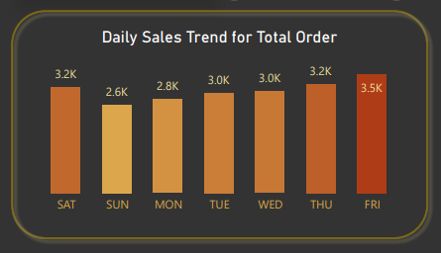
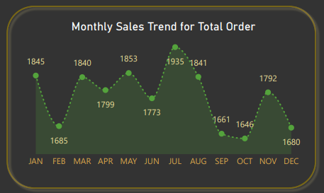
TRENDS
Daily Trends
Monthly Trends

Slide 8
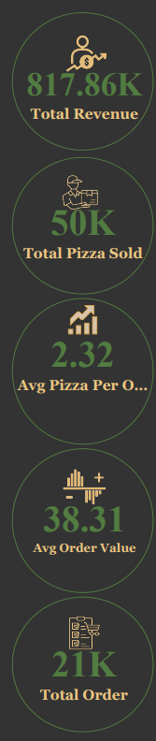
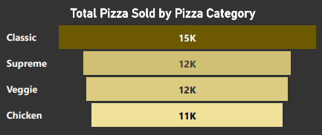
KPIs

Slide 9

DASHBOARD
The permanent link of the read-only view of the Cognos dashboard :
https://eu-de.dataplatform.cloud.ibm.com/dashboards/dad72b41-e043-4e18-8d4b-1ba0118dacb6/view/703ede35059e17e969efe6e4079c2e552c622654e6bbd755d2d17b490b697097f06d4796c8264a5bd914506ba7ba460ace

Slide 10
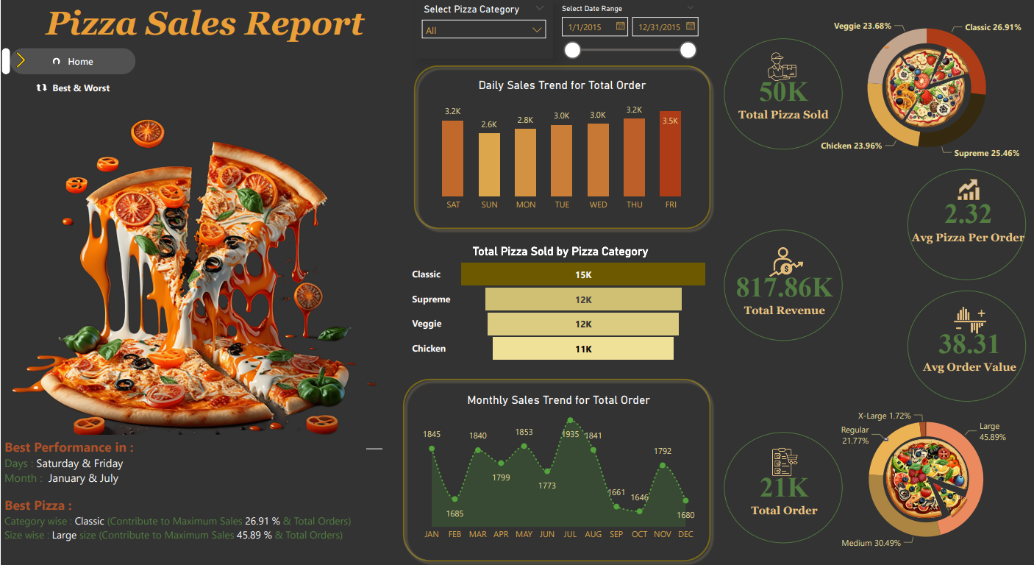
Home-Page

Slide 11
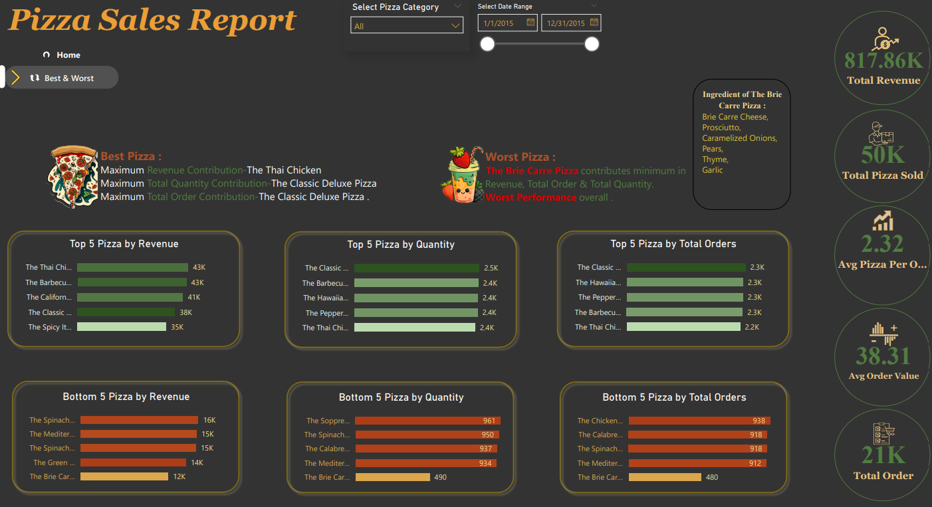
Best & Worst-Page

Slide 12
DISCUSSION
The analysis provides valuable insights into pizza sales, aligning consumer preferences with revenue trends. While Classic pizzas and Large sizes dominate, the underperformance of the Brie Carre Pizza underscores the complexity of consumer taste. These findings offer a partial answer, guiding strategic product placement and innovation.

Slide 13

CONCLUSION
Despite limitations, these insights drive strategic decisions. Leveraging Classic and Large-sized pizzas offers marketing opportunities. Future research could delve deeper into customer segmentation and evolving trends for sustained market relevance. Ultimately, this analysis lays the foundation for informed decision-making in the dynamic food industry.

