Slide 2
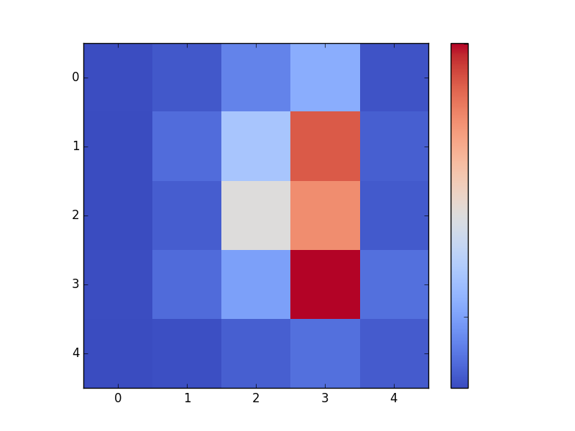
-2 ← Valence → 2
1200
-2 ← Arousal → 2
Count
0

