Slide 1





Feedback on RNA-seq data Analyses (Part 1)
Lijiao NING (lijiao.ning@cnrs.fr) Mathilde BOISSEL (mathilde.boissel@cnrs.fr)
2019-05-28

Slide 2
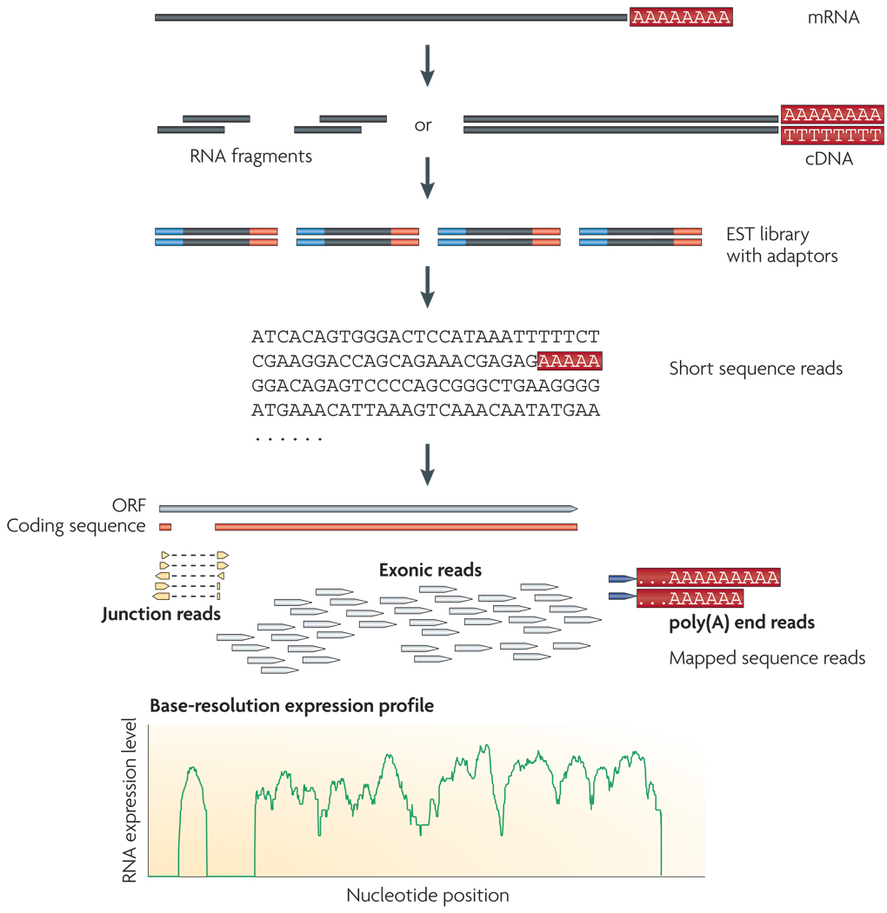
RNA sequencing
RNA-Seq:
Identify and quantify of RNA in a biological sample at given moment
Results (bioInfo)
RSEM : “a software package for estimating gene and isoform expression levels from RNA-Seq data”.
Gene and isoform (transcript) quantification files
(Source Wang, Gerstein and Snyder, Nat Rev Genet. 2009 Jan; 10(1): 57–63. )
Notes:
A typical RNA-Seq experiment
Briefly, long RNAs are first converted into a library of cDNA fragments through either RNA fragmentation or DNA fragmentation (see main text). Sequencing adaptors (blue) are subsequently added to each cDNA fragment and a short sequence is obtained from each cDNA using high-throughput sequencing technology. The resulting sequence reads are aligned with the reference genome or transcriptome, and classified as three types: exonic reads, junction reads and poly(A) end-reads. These three types are used to generate a base-resolution expression profile for each gene, as illustrated at the bottom; a yeast ORF with one intron is shown.

Slide 3
RSEM file
Example of sample’s isoforms count file
transcript_id | gene_id | length | effective_length | expected_count | TPM | FPKM | IsoPct
ENST00000373020 | ENSG00000000003 | 2206 | 2047.38 | 1545.26 | 26.63 | 18.45 | 95.95
ENST00000494424 | ENSG00000000003 | 820 | 661.38 | 0.00 | 0.00 | 0.00 | 0.00
ENST00000496771 | ENSG00000000003 | 1025 | 866.38 | 1.95 | 0.08 | 0.05 | 0.29
ENST00000612152 | ENSG00000000003 | 3796 | 3637.38 | 107.79 | 1.05 | 0.72 | 3.77
ENST00000614008 | ENSG00000000003 | 900 | 741.38 | 0.00 | 0.00 | 0.00 | 0.00
ENST00000373031 | ENSG00000000005 | 1339 | 1180.38 | 1.56 | 0.05 | 0.03 | 25.90
ENST00000485971 | ENSG00000000005 | 542 | 383.45 | 1.44 | 0.13 | 0.09 | 74.10
… | … | … | … | … | … | … | …
Notes:
IsoPct: the percentage of this transcript's abundance over its parent gene's abundance. If its parent gene has only one isoform or the gene information is not provided, this field will be set to 100.

Slide 4
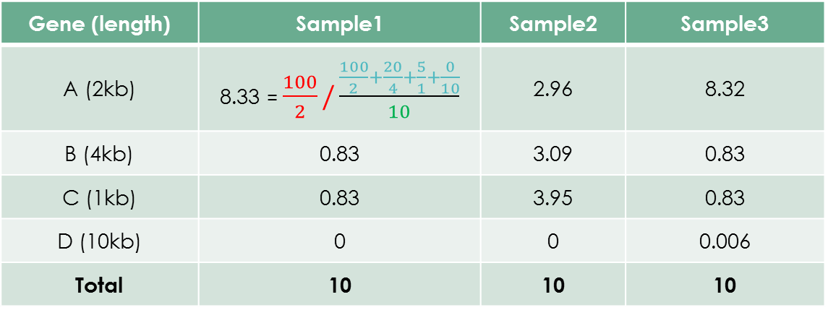
Expression units: TPM
Transcripts Per kilobase Million
Gene (length) | Sample1 | Sample2 | Sample3
A (2kb) | 100 | 12 | 300
B (4kb) | 20 | 25 | 60
C (1kb) | 5 | 8 | 15
D (10kb) | 0 | 0 | 1
Total | 125 | 45 | 376
( 1 ) Divide the read counts by the length of each gene in kilobase
=> reads per kilobase (RPK)
( 2 ) Count up all the RPK values in a sample and divide this number by 1,000,000 (here 10)
=> “per million” scaling factor
( 3 ) Divide the RPK values by the “per million” scaling factor
N.B.: the sum of all TPMs in each sample are the same.
Length normalized total counts / 10
Gene (length) | Sample1 | Sample2 | Sample3
A (2kb) | 8.33 = $\frac{100}{2}/\frac{\frac{100}{2}+\frac{20}{4}+\frac{5}{1}+\frac{0}{10}}{10}$ | 2.96 | 8.32
B (4kb) | 0.83 | 3.09 | 0.83
C (1kb) | 0.83 | 3.95 | 0.83
D (10kb) | 0 | 0 | 0.006
Total | 10 | 10 | 10
Source https://www.rna-seqblog.com/rpkm-fpkm-and-tpm-clearly-explained/
Notes:
https://www.rna-seqblog.com/rpkm-fpkm-and-tpm-clearly-explained/
These three metrics attempt to normalize for sequencing depth and gene length

Slide 5
Expression units: RPKM
Reads Per Kilobase Million (single-end)
Gene (length) | Sample1 | Sample2 | Sample3
A (2kb) | 100 | 12 | 300
B (4kb) | 20 | 25 | 60
C (1kb) | 5 | 8 | 15
D (10kb) | 0 | 0 | 1
Total | 125 | 45 | 376
( 1 ) Count up the total reads in a sample and divide that number by 1,000,000 (here 10)
=> “per million” scaling factor
( 2 ) Divide the read counts by the “per million” scaling factor
=> reads per million (RPM)
( 3 ) Divide the RPM values by the length of the gene
N.B: FPKM (Fragments Per Kilobase Million) is made for paired-end RNA-seq
Total counts / 10
Gene (length) | Sample1 | Sample2 | Sample3
A (2kb) | 4=100/((100+20+5+0)/10)/2 | 1.33 | 3.99
B (4kb) | 0.4 | 1.39 | 0.40
C (1kb) | 0.4 | 1.78 | 0.40
D (10kb) | 0 | 0 | 0.0027
Total | 4.8 | 4.5 | 4.79
Source Mortazavi et al. (2008) "Mapping and quantifying mammalian transcriptomes by RNA-Seq" Nat. Meth. 5 Source https://www.rna-seqblog.com/rpkm-fpkm-and-tpm-clearly-explained/

Slide 6
Analysis tools
Bioconductor Project
Collection of R packages for high throughput genomic data analysis
Free access
Some packages :
{ tximport } Import and summarize transcript-level estimates for transcript- and gene-level analysis
{ DESeq2 }, { edgeR }, { limma } Differential gene expression analysis
{ biomaRt } Interface to BioMart databases, e.g.: Ensembl
{ ggplot2 } data visualization
Notes:
Article tximport (Dec 2015): https://f1000research.com/articles/4-1521/v1
Article DESeq2 (Dec 2014): https://genomebiology.biomedcentral.com/articles/10.1186/s13059-014-0550-8
Article BiomaRt (2009): https://www.nature.com/articles/nprot.2009.97

Slide 7
Analyses Pipeline
Data import
Quality control
Annotation
Normalization
Differential expression analysis
Further analyses:
PCA, Classification, Enrichment analysis …

Slide 8
Import Data
Sample sheet
suppressMessages(library(tidyverse)) ## read sample sheet and add file path df_sample <- rbind( utils::read.csv("/disks/RUN/run_364/samplesheet.csv") %>% mutate(run = "364"), utils::read.csv("/disks/RUN/run_365/samplesheet.csv") %>% mutate(run = "365") ) %>% mutate( concentration = gsub(" mM glucose", "", Description) %>% as.factor(.) %>% relevel(., ref = "5"), gene_path = paste0( "/disks/RUN/run_", run, "/rnaseq_analysis_noTrim/Sample_", SampleID, "/RSEM/", SampleID, ".genes.results" ), isoform_path = gsub("genes", "isoforms", gene_path), FileExists_Genes = file.exists(gene_path), FileExists_Isoforms = file.exists(isoform_path) ) %>% as_tibble()
Notes:
Lire la liste d’échantillons :
utils::read.csv(file, header, sep, ...)
readxl::read_excel(path, sheet, col_names, ...)
concentration => variable d’intérêt utilisée comme un facteur, et réorganiser le niveau en considérant la concentration 5 milli molaire comme le niveau de référence
gene_path => le chemin entier vers le fichier de comptage par gène
isoform_path => le chemin entier vers le fichier de comptage par transcript
FileExists*** => vérification de l’existence des fichiers

Slide 9
Import Data
Sample sheet
head(df_sample) ## # A tibble: 6 x 16
## FCID Lane SampleID SampleRef Index Description Control Recipe Operator
## <fct> <int> <fct> <fct> <fct> <fct> <fct> <fct> <fct>
## 1 H5NC… 1 hum57-2 humain GAAT… 5 mM gluco… Y " 2x7… ed
## 2 H5NC… 1 hum57-3 humain GAAT… 8 mM gluco… Y multi… ed
## 3 H5NC… 1 hum57-4 humain GAAT… 20 mM gluc… Y multi… ed
## 4 HKFC… 1 mbe4-2 humain ATTC… 5 mM gluco… Y " 2x7… ed
## 5 HKFC… 1 mbe4-3 humain ATTC… 8 mM gluco… Y multi… ed
## 6 HKFC… 1 mbe4-4 humain ATTC… 20 mM gluc… Y multi… ed
## # … with 7 more variables: SampleProject <fct>, run <chr>,
## # concentration <fct>, gene_path <chr>, isoform_path <chr>,
## # FileExists_Genes <lgl>, FileExists_Isoforms <lgl>

Slide 10
Import Data
Sample sheet
RSEM files (by gene or transcript)
## import count data my_files <- df_samplcount datae$gene_path names(my_files) <- df_sample$SampleID ## to keep samples names dta_raw <- tximport::tximport( files = my_files, type = "rsem", txIn = FALSE, txOut = FALSE, countsFromAbundance = "no", geneIdCol = "gene_id", abundanceCol = "TPM", countsCol = "expected_counts", lengthCol = "effective_length" )
Notes:
Arguments de tximports:
files: chemin de fichiers de comptage
type: « rsem»
txIn: si les fichiers d’entrée sont au niveau de transcript?
txOut: nécessaire quand le fichier est uniquement valable pour les transcripts (logiciel salmon/sailfish/kallisto) et vous avez besoin de résumé le comptage au niveau des gènes.
countsFromAbundance: s’il faut générer de comptages bruts à l’aide de la colonne abondance?
xxCol: les arguments pour spécifier le nom de la colonne correspondante
(PS: si le type est spécifié, pas besoin de préciser les noms de colonnes, car c’est déjà défini dans tximport, https://github.com/mikelove/tximport/blob/master/R/tximport.R)
Derrière c’est readr::read_tsv()

Slide 11
Import Data
Sample sheet
RSEM files (by gene or transcript)
str(dta_raw)
## List of 4
## $ abundance : num [1:58137, 1:14] 7.07 0 35.01 7.77 ...
## ..- attr(*, "dimnames")=List of 2
## .. ..$ : chr [1:58137] "ENSG00000000003" "ENSG00000000005" "ENSG00000000419" ...
## .. ..$ : chr [1:14] "hum57-2" "hum57-3" "hum57-4" "mbe4-2" ...
## $ counts : num [1:58137, 1:14] 388 0 856 667 119 ...
## ..- attr(*, "dimnames")=List of 2
## .. ..$ : chr [1:58137] "ENSG00000000003" "ENSG00000000005" "ENSG00000000419" ...
## .. ..$ : chr [1:14] "hum57-2" "hum57-3" "hum57-4" "mbe4-2" ...
## $ length : num [1:58137, 1:14] 2094 794 933 3274 2042 ...
## ..- attr(*, "dimnames")=List of 2
## .. ..$ : chr [1:58137] "ENSG00000000003" "ENSG00000000005" "ENSG00000000419" ...
## .. ..$ : chr [1:14] "hum57-2" "hum57-3" "hum57-4" "mbe4-2" ...
## $ countsFromAbundance: chr "no"
Notes:
Objet importé par tximport (dta_raw) est une liste,
qui contient une matrice pour les abondances (ici TPM),
une matrice pour les comptages bruts,
une matrice pour la longueur attendue des gènes,
et un élément « countsFromAbundance » qui rappelle l’argument utilisé dans tximport.

Slide 12
Construct DESeq dataset
From a tximport object
From a matrix object
model.matrix(~ concentration, data = df_sample)
## (Intercept) concentration2 concentration20 concentration8
## 1 1 0 0 0
## 2 1 0 0 1
## 3 1 0 1 0
## 4 1 0 0 0
## 5 1 0 0 1
## 6 1 0 1 0
## 7 1 1 0 0
## 8 1 0 0 0
## 9 1 0 0 1
## 10 1 0 1 0
## 11 1 0 0 0
## 12 1 0 0 1
## 13 1 0 1 0
## 14 1 1 0 0
## attr(,"assign")
## [1] 0 1 1 1
## attr(,"contrasts")
## attr(,"contrasts")$concentration
## [1] "contr.treatment"
dta_raw$length[dta_raw$length == 0] <- 1
dds <- DESeq2::DESeqDataSetFromTximport( txi = dta_raw, colData = df_sample, design = ~ concentration )
count_mat <- apply(dta_raw$counts, 2, as.integer) rownames(count_mat) <- rownames(dta_raw$counts) dds_fromMat <- DESeq2::DESeqDataSetFromMatrix( countData = count_mat, colData = df_sample, design = ~ concentration )
Notes:
construire l’objet DESeqDataSet à partir d’objet crée par tximport
Attention, la fonction « DESeqDataSetFromTximport» ne autorise pas qu’il y a des 0 dans la matrice des longueurs,
Parce que lors de la normalisation par la longueur de gène, 0 ne peut pas être le dénominateur,
Donc, on va d’abord changer les gènes avec longueur à 1 (le minimum positif entier)
colData: le dataframe qui contient plein d’information phéno, covariables, etc.
Les lignes doivent correspondre aux colonnes de la matrice de comptage
design: une formule qui explique comment les comptages de chaque gène dépendent des variables dans colData
possible de mettre plusieurs variables ou même des termes d’interaction dedans
A noter qu’il est aussi possible de construire le DESeqDataSet par une matrice d’entiers directement,
d’où il faut convertir les comptages en mode d’entier

Slide 13
Quality control
Gene (or transcript) level
Remove genes with 0 read count in all samples
Recommend : remove low count genes, e.g.:
Keep genes with at least 1 count per sample
Check the distribution of the average counts and remove extremes
Sample level
Duplicated samples (technical replicates)?
Select the best one according to sample’s quality, no missing phenotype data , etc.
keep <- rowSums(DESeq2::counts(dds)) > 0 # remove zero count genes dds <- dds[keep,]
low_reads <- rowSums(DESeq2::counts(dds)>1) < nrow(col_dta) # tag low reads genes

Slide 14
Annotation
biomaRt based on Ensembl
# list_dataset <- biomaRt::listDatasets(biomaRt::useMart('ensembl')) ensembl <- biomaRt::listEnsemblArchives() %>% as_tibble() %>% filter(version == "94") %>% .[["url"]] %>% biomaRt::useMart( biomart = "ensembl",
dataset = "hsapiens_gene_ensembl", host = . )
# list_feature <- biomaRt::listAttributes(ensembl, page="feature_page")
list_gene_ids <- rownames(dta_raw$counts) annot <- biomaRt::getBM( attributes = c( "ensembl_gene_id", "external_gene_name", "chromosome_name", "start_position", "end_position", "description", "gene_biotype" ), filters = "ensembl_gene_id", values = list_gene_ids, mart = ensembl )
Notes:
listDatasets() : lister les datasets d’annotation disponible dans la base de données BioMart, selon l’espèce (humain, souris, porc… )
listEnsemblArchives() : renvoie une table contenant les versions archivées dispo d’Ensembl, ainsi que leurs dates de création et l’URL utilisée pour y accéder => sera a utiliser pour l’argument « host »
useMart() : se connecter à la base d’annotation sélectionnée
listAttributes(): lister les attributs dispo dans le dataset sélectionné
getBM() : récupérer les données d’annotation dans l’environnement R.

Slide 15

Normalization
Aim : $↓$ technical bias / remove non biological variation
With house keeping genes:
Those genes should have steady level of expression across all samples, So we can use them to calibrate our counting data
Example : HPRT1 seems to be a good candidate in the role of house keeping gene, with a low variability at both levels (gene and transcripts). In analysis based on genes results we propose to normalize data on HPRT1. In analysis based on transcripts results we propose to normalize data on the geometric mean of the HPRT1's transcripts. But, notice that this normalization can not be so robust being based on one gene only.

Slide 16
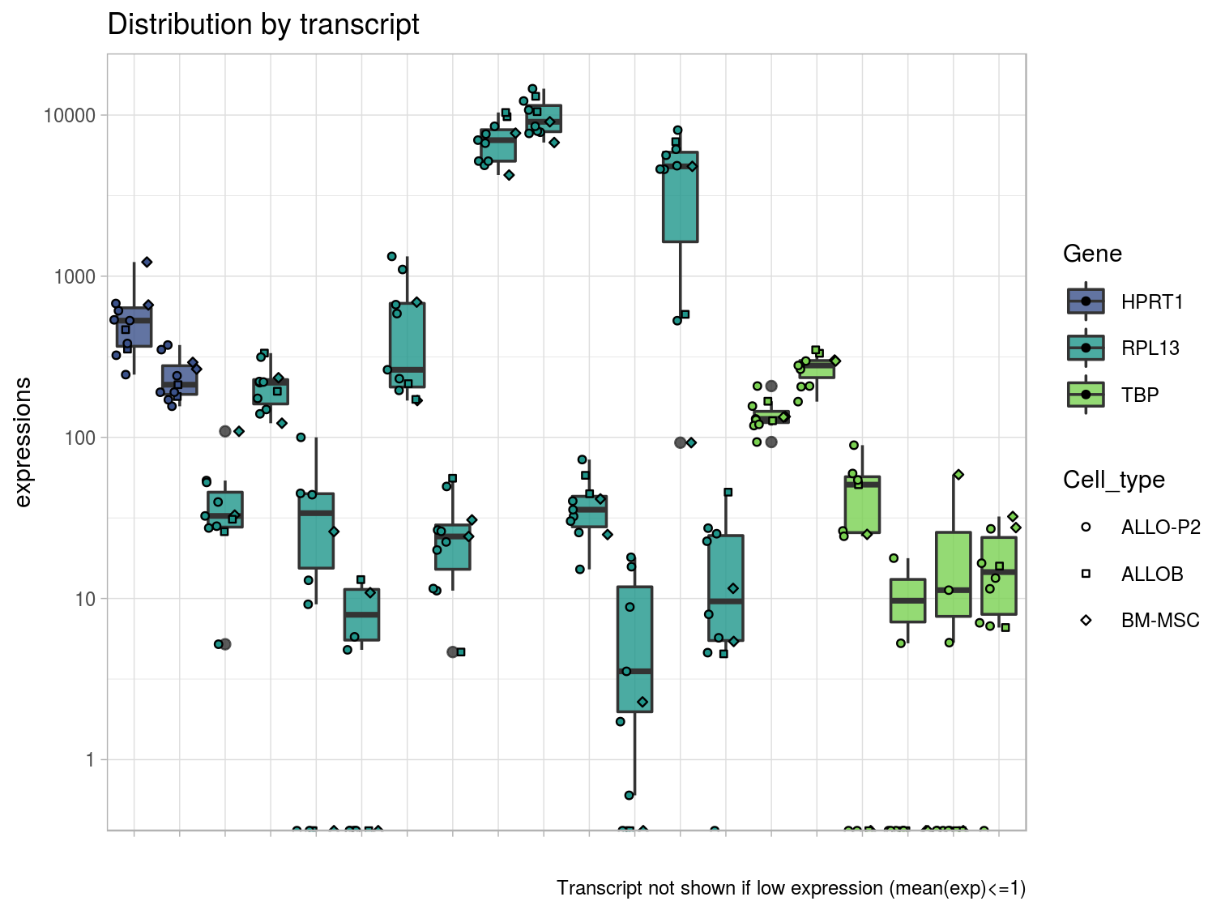
Normalization

Slide 17
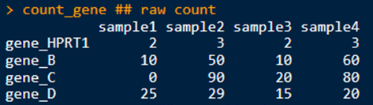
Normalization
#### Normalisation by 1 gene ---- count_gene <- matrix( data = c( 2,3,2,3, 10,50,10,60, 0,90,20,80, 25,29,15,20 ), nrow = 4, ncol = 4, byrow = TRUE) row.names(count_gene) <- c("gene_HPRT1","gene_B","gene_C","gene_D") colnames(count_gene) <- c("sample1", "sample2","sample3", "sample4")
vec_norm_bySample <- count_gene[grep("_HPRT1$",rownames(count_gene)),] ## vector of normalisation
count_gene_norm <- sweep(x = count_gene, MARGIN = 2, STATS = vec_norm_bySample, FUN = "/")
## ready to be analysed
# count_gene_norm <- count_gene_norm[-grep("_HPRT1$",rownames(count_gene)), ]

Slide 18
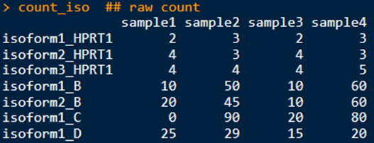
Normalization
#### Normalisation by transcripts : use geometric mean ---- count_iso <- matrix( data = c( 2,3,2,3, 4,3,4,3, 4,4,4,5, 10,50,10,60, 20,45,10,60, 0,90,20,80, 25,29,15,20 ), nrow = 7, ncol = 4, byrow = TRUE)
row.names(count_iso) <- c(
"isoform1_HPRT1", "isoform2_HPRT1", "isoform3_HPRT1",
"isoform1_B", "isoform2_B","isoform1_C","isoform1_D«
) colnames(count_iso) <- c("sample1", "sample2","sample3", "sample4")
Notes:
MB

Slide 19
Normalization
#### Normalisation by transcripts : use geometric mean ---- tab_norm_iso <- count_iso[grep("_HPRT1$", rownames(count_iso)), , drop = FALSE] %>% t() %>% as.data.frame() %>% rownames_to_column(var = "SampleID") %>% select(names(.)[c( TRUE, # keep SampleID colMeans(x = .[, -c(1)]) > 1 ## to remove iso with low expression )] )
tab_norm_iso[, "geo_fac"] <- apply(X = tab_norm_iso[, -c(1)], MARGIN = 1, FUN = function(x) { x[x <= 0] <- 1 return(exp(mean(log(x)))) })
vec_normTr_bySample <- tab_norm_iso[, "geo_fac"] ## vecteur de normalisation
names(vec_normTr_bySample) <- tab_norm_iso[, "SampleID"] ## avec les memes noms de samples
count_iso_norm <- sweep(x = count_iso, MARGIN = 2, STATS = vec_normTr_bySample, FUN = "/")
## ready to be analysed # count_iso_norm <- count_iso_norm[-grep("_HPRT1$",rownames(count_iso_norm)), ]

Slide 20
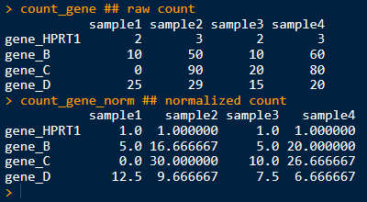
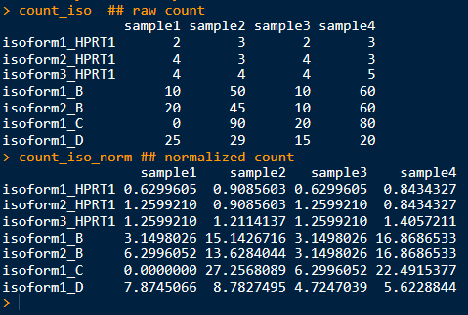
Normalization
Notes:
MB

Slide 21

Normalization
Aim : $↓$ technical bias / remove non biological variation
With house keeping genes:
Those genes should have steady level of expression across all samples, So we can use them to calibrate our counting data
Without house keeping genes, e.g.:
Quantile normalization
Median of ratio(implemented in {DESeq2}, based on a sample-specific normalization factor and estimated by the median of the ratios of RSEM counts.
Trimmed Mean of M value (TMM, implemented in {edgeR})
Counts TPM
Notes:
Médiane des ratios (DESeq2)
Calculer la moyenne géométrique de chaque gène et obtenir un pseudo « échantillon » de référence
Calculer les fold changes de chaque échantillon par rapport au psuedo réf pour chaque gène
La médiane de FC de chaque échantillon est considérée comme le FC des gènes non DE =>facteur de normalisation
Diviser le comptage brut par ce facteur
TMM: Samples/observations that have the closest average expressions to mean of all samples is considered as reference samples

Slide 22

Differential expression analysis
Aim: Identify over/under-expressed genes or transcripts
Model in DESeq2: generalized linear model (GLM)
Statistic test
Null hypothesis (H0): the gene expression level between two (or more) conditions are equal
p-value: probability of getting the same value of the test if the null hypothesis was true
Fold change (FC)
$$FC=\frac{mean\left(cond1\right)−mean(cond2)}{min⁡(mean\left(cond1\right),mean\left(cond2\right))}$$
Log2(FC) > 0: over-expressed
Log2(FC) = 0: no change
Log2(FC) < 0: under-expressed
Notes:
H0: les niveaux d'expression d'un gène entre 2 condition sont égaux
probabilité d’obtenir la même valeur du test si l’hyp nulle était vraie
On espère donc pouvoir rejeter l’hyp nulle si p-valeur < 0,05 et conclure que les 2 niveaux d’expression sont différents
=> Si p<0,05, moins de 5% de chance d’obtenir le même résultats par hasard, donc on peut rejeter H0, niveau d’expression entre les 2 conds est significativement différent

Slide 23
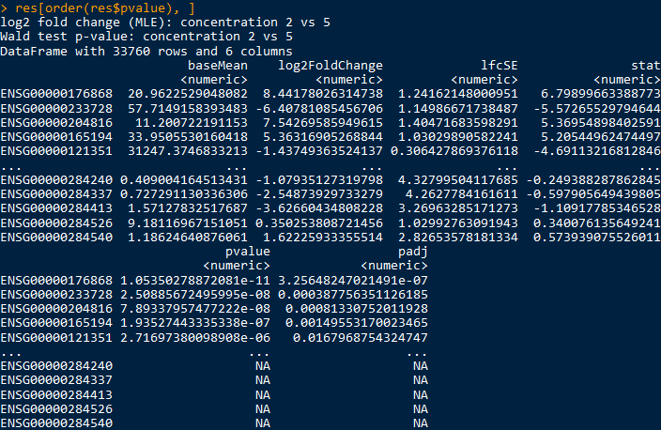

Differential expression analysis
Run DESeq2::DESeq()
## differential expression analysis
dds <- DESeq2::DESeq(object = dds)
### extract results res <- DESeq2::results(
object = dds, pAdjustMethod = "fdr", contrast = c("concentration", "2", "5"), lfcThreshold = 0, cooksCutoff = 0.99, independentFiltering = FALSE,
... )
Notes:
P.Val na : If within a row, all samples have zero counts,, If a row contains a sample with an extreme count outlier, If a row is filtered by automatic independent filtering,
This function performs a default analysis through the steps:
estimation of size factors: estimateSizeFactors
estimation of dispersion: estimateDispersions
Negative Binomial GLM fitting and Wald statistics: nbinomWaldTest
DESeq2(): appelle la fonction d’analyse
Results(): récupère les résultats
Object: un objet DESeqDataSet
pAjustMethod: méthode pour ajuster les p-valeurs brutes
Contrast: spécifier quelle comparaison à extraire
Un vecteur de 3 éléments: nom du facteur, les 2 niveaux
Une liste de 2 vecteurs
lfcThreshold: une valeur non négative pour indiquer s’il faut filtrer les gènes avec un tel seuil de log2FC
altHpothesis: hypo alternative customisé
cooksCutoof: distance de cook pour filtrer l’échantillon extrême, seuil par défaut est 99% quantile de la distribution Fisher, si au moins un échantillon dépasse ce seuil, la pvaleur de la ligne est définie en NA
independentFiltering: si le filtrage indépendant doit être appliqué, Deseq fait un filtre sur les gènes peu exprimés afin de ne pas impacté la correction de test multiple
Res columns:
baseMean: mean of normalized counts for all samples
lfcSE: standard error of log2FoldChange
stat: Wald statistic
padj: FDR adjusted p-values

Slide 24
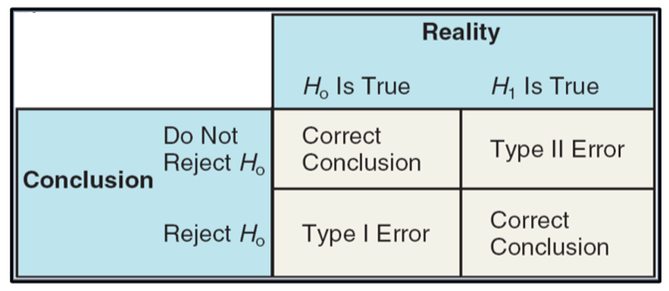


Multiple testing correction
4 results false positive: Type-I error $α$ false negative: Type-II error $β$ True positive and True negative.
By doing n independent tests, reject $H0_{i}$ when $pv_{i}≤α$.
But if we consider the whole of n tests, the number of false positive obtain by chance increases with n.
To minimize this inflation of false positive, the idea is to choose a threshold more stringent, not based on the Type-I error of each test (usually $α=0,05$), but based on the global amount of errors made over the n tests.
Examples
Bonferroni (fwer Family Wise Error Rate) : very stringent. Control the fact of wrongly reject at least once the null hypothesis. Benjamini Hochberg (fdr False Discovery Rate) : Control the expected proportion of false positive.
(Source Méthodes statistiques pour l'analyse des données génétiques d'association à grande échelle, Mickael Guedj)
Notes:
Si l’on réalise ces n tests de façon indépendante, on rejette classiquement $H0_{i}$ lorsque $pv_{i}≤α$. Mais lorsque l’on prend en compte l’ensemble de ces n tests, le nombre de faux-positifs obtenus par chance augmente avec n. Afin de minimiser cette inflation de faux-positifs, l’idée est de choisir un seuil de décision plus stringent qui ne sera plus fixé à partir du risque d’erreur de type-I attribué à chaque test, mais plutôt fondé sur le contrôle de quantités plus adaptées et qui reposent sur le nombre d’erreurs générées par l’ensemble des n tests.

Slide 25
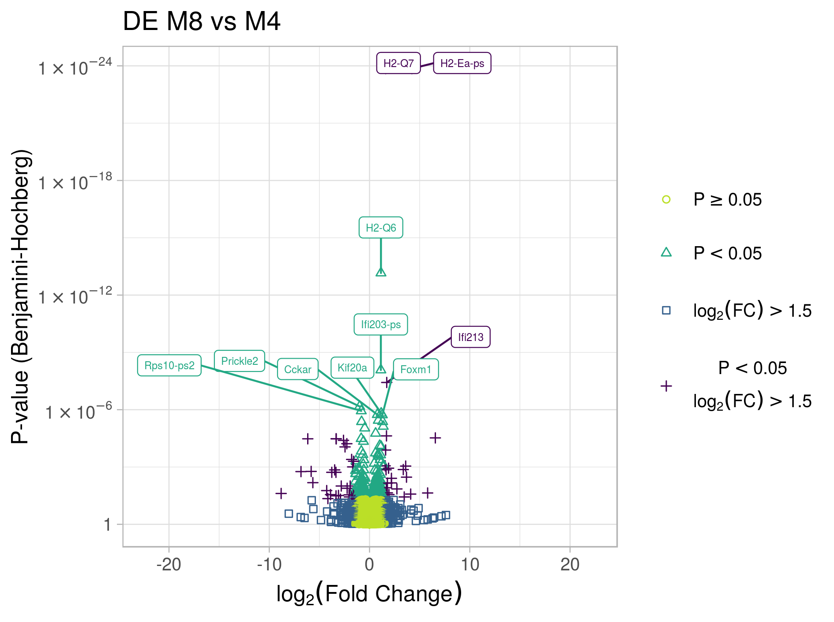
Graph
Volcano plot
The Fold Change (FC) or ratio measure the variation of the gene expression between 2 conditions
Values are log2 transformed. More interpretable.
Log2(FC) > 0: gene over-expressed
Log2(FC) = 0: no change
Log2(FC) < 0: gene under-expressed

Slide 26
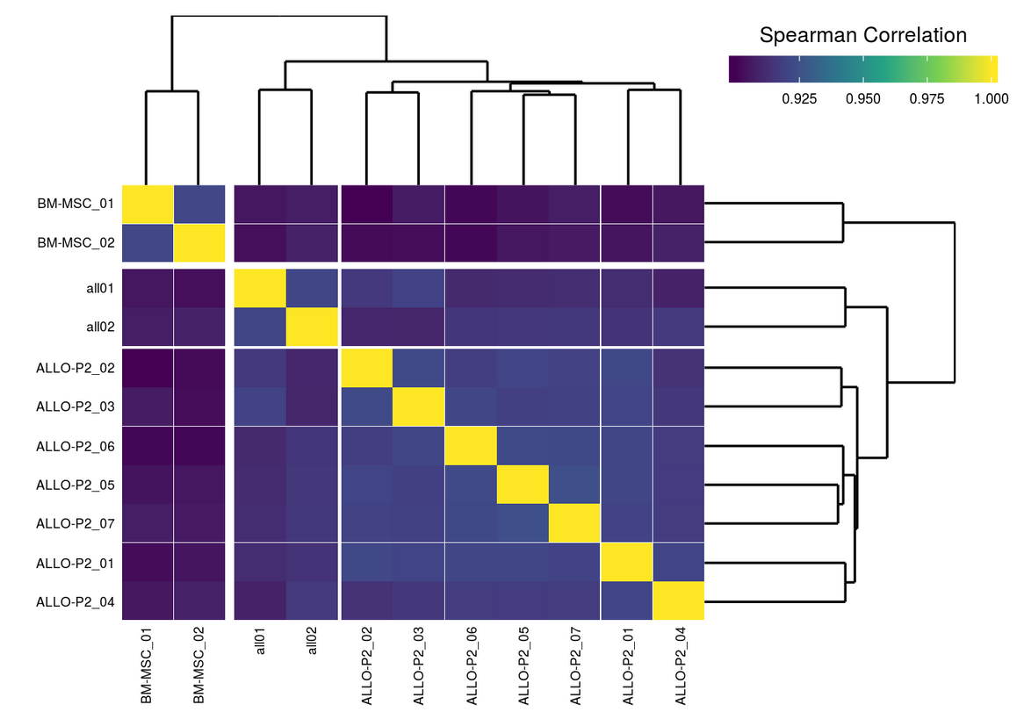
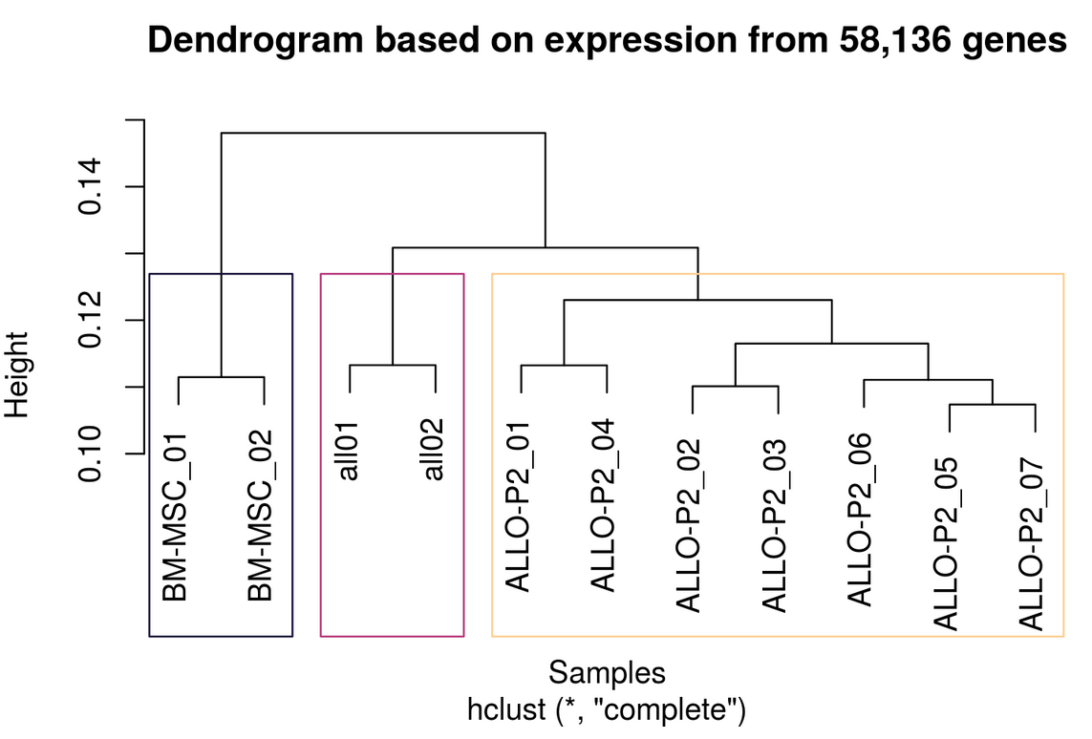
Further analyses …
Correlation between samples
Notes:
Un coefficient de corrélation calcule dans quelle mesure deux variables tendent à changer ensemble.
Le coefficient décrit l'importance et le sens de la relation.
La corrélation de Pearson évalue la relation linéaire entre deux variables continues.
La corrélation de Spearman évalue la relation monotone entre deux variables continues ou ordinales. Dans une relation monotone, les variables ont tendance à changer ensemble, mais pas forcément à une vitesse constante. Le coefficient de corrélation de Spearman est fondé sur les valeurs classées pour chaque variable plutôt que sur les données brutes.
Method distance : "ward.D", "ward.D2", "single", "complete", "average"

Slide 27
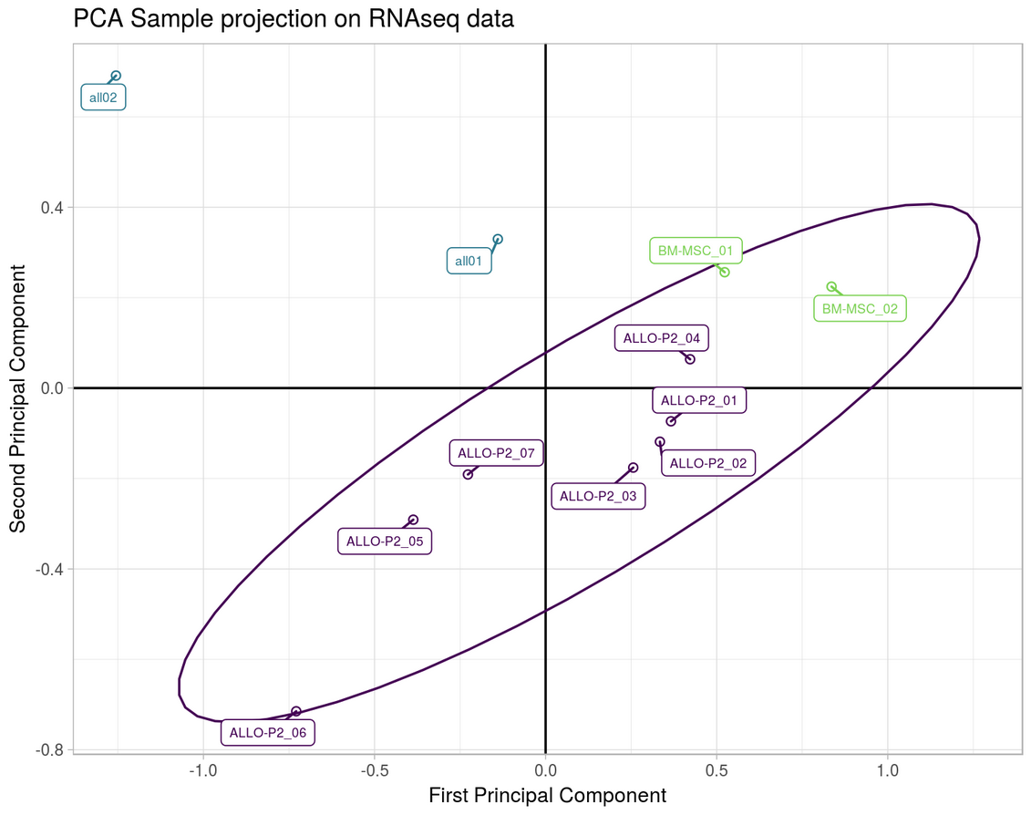
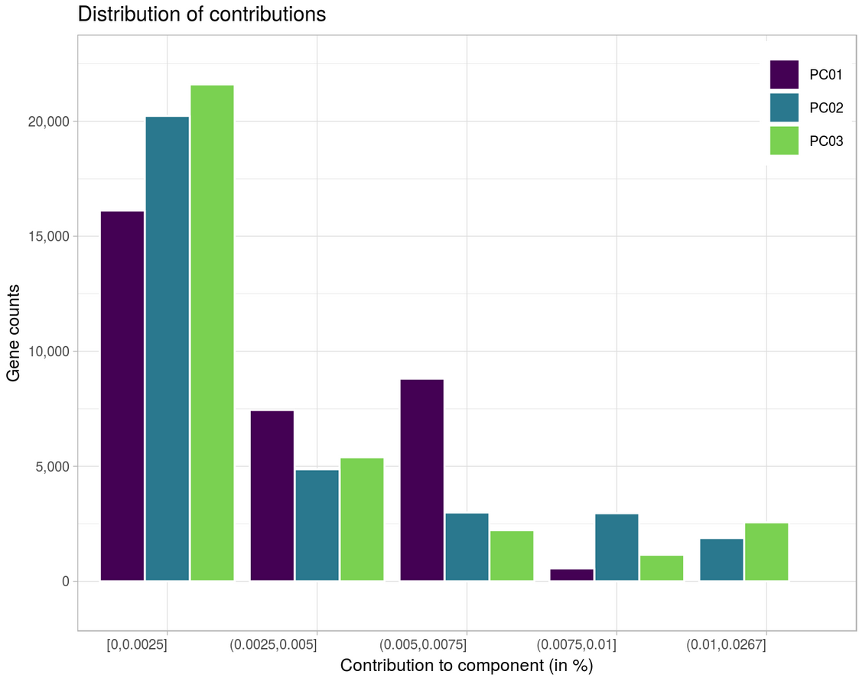
Further analyses …
PCA
Reduce dimension and discriminate samples in a orthogonal plane

Slide 28
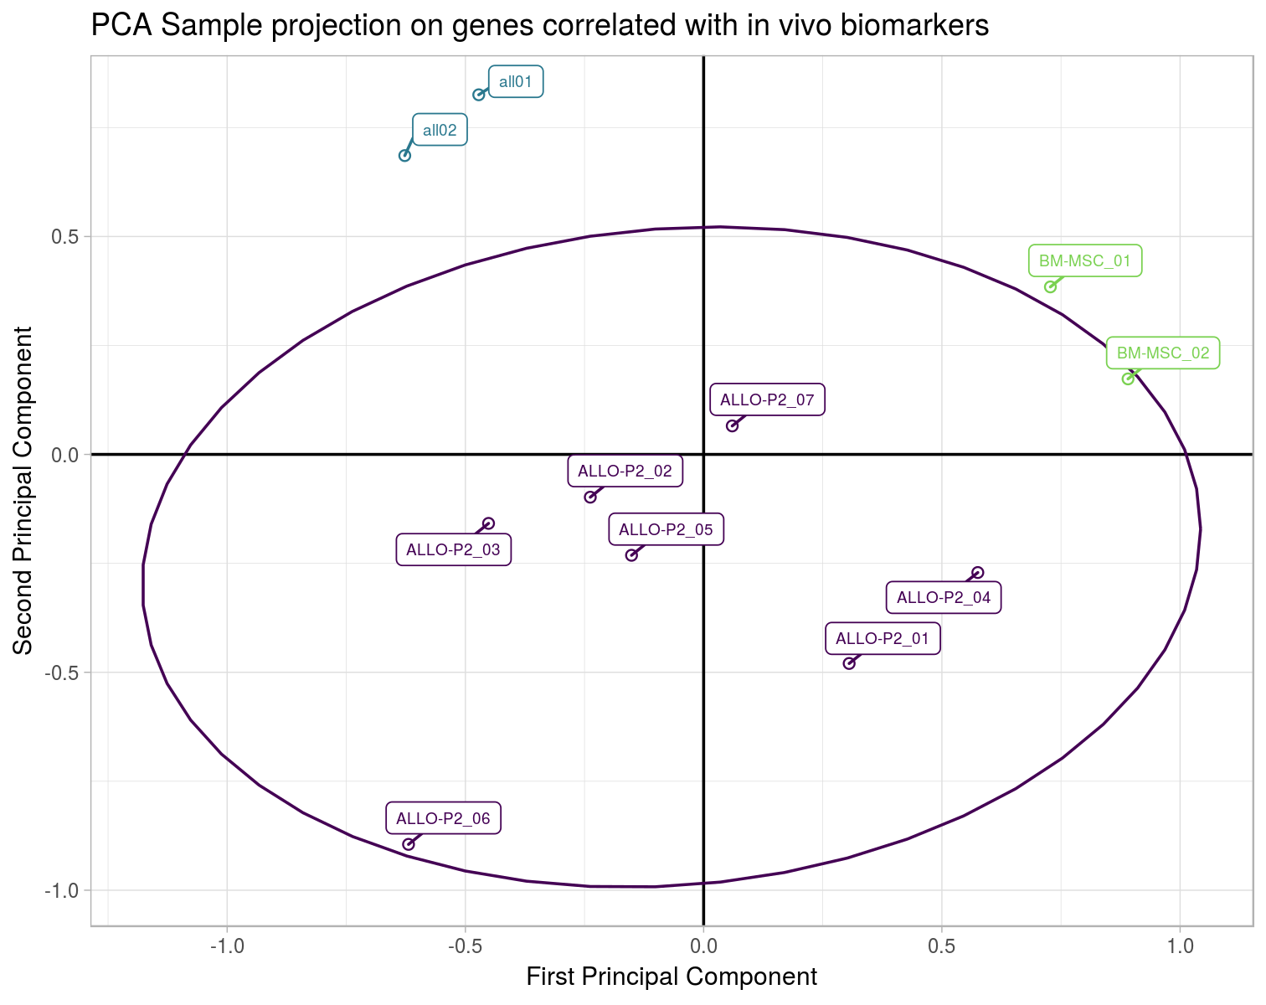
Further analyses …
To identify in vivo biomarker
The spearman correlation is computed between in vivo measures and RNA-seq data. The goal is to explain variation in the biomarkers that can be attributed to variation in gene expression.
regression analyses are use to quantify the strength of this relationship.
PCA on genes significantly correlated with in vivo biomarkers
Notes:
Aide restreindre la sélection de gène d’intérêt

Slide 29
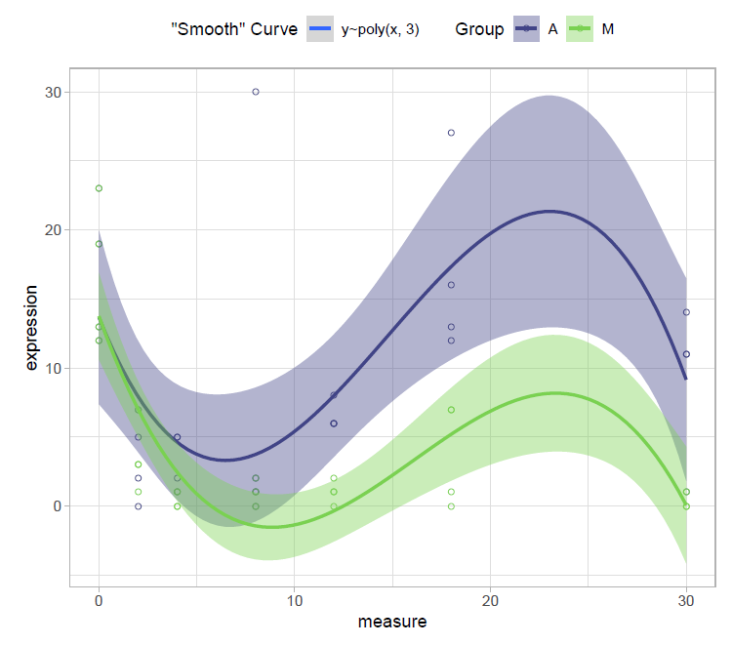
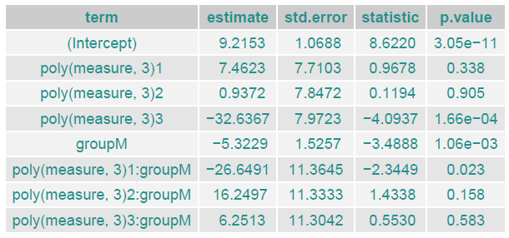

Further analyses …
Kinetics
lm(expression ~ group + poly(measure,3) + poly(measure,3):group)
$$expression function of$$
group + $measure+measure^{2}+ measure^{3} and$ interaction ($measure+measure^{2}+ measure^{3}$) knowing group
Notes:
Evolution de l’expression à diffèrent temps de mesures

Slide 30
Further analyses …
Classification (and Correlation between genes)
Supervised
Hierarchical classification (ascending / descending)
Unsupervised
K-means => need to give a priori the number of clusters
t-Distributed Stochastic Neighbor Embedding (t-SNE)
Enrichment analysis
Database:
The Gene Ontology Consortium (GO): hierarchical relationship of genes
Kyoto Encyclopedia of Genes and Genomes (KEGG): gene pathway
R packages, e.g.:
{ RDAVIDWebService }, { clusterProfiler }

Slide 31
References
WANG, Zhong, GERSTEIN, Mark, et SNYDER, Michael. RNA-Seq: a revolutionary tool for transcriptomics. Nature reviews genetics, 2009, vol. 10, no 1, p. 57.
LOVE, Michael I., SONESON, Charlotte, et ROBINSON, Mark D. Importing transcript abundance datasets with tximport. dim (txi. inf. rep $ infReps $ sample1), 2017, vol. 1, no 178136, p. 5.
LOVE, Michael, ANDERS, Simon, et HUBER, Wolfgang. Differential analysis of count data–the DESeq2 package. Genome Biol, 2014, vol. 15, no 550, p. 10.1186.
DESeq2 vignette: http://www.bioconductor.org/packages/devel/bioc/vignettes/DESeq2/inst/doc/DESeq2.html
TPM / RPKM / FPKM: https://www.rna-seqblog.com/rpkm-fpkm-and-tpm-clearly-explained/

Slide 32
Thank you, Any questions ?

