Slide 1








t-distributed Stochastic Neighbor Embedding (t-SNE) algorithm
Mathilde Boissel UMR 1283 (INSERM) UMR 8199 (CNRS) (Université de Lille / Institut Pasteur de Lille / CHU Lille) (Épi)génomique Fonctionnelle et Physiologie Moléculaire du Diabète et Maladies Associées E.G.I.D - FR 3508 (CNRS / Université de Lille 2 / Institut Pasteur de Lille / CHRU) European Genomics Institute for Diabetes E-mail: mathilde.boissel@univ-lille.fr / mathilde.boissel@cnrs.fr
06/04/2020

Slide 2
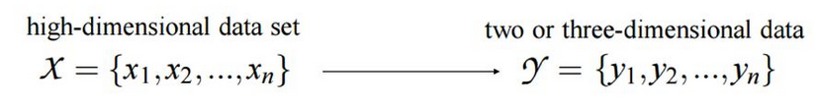
Concept : t-SNE.
“… is a technique for dimensionality reduction that is particularly well suited for the visualization of high-dimensional datasets.” https://lvdmaaten.github.io/tsne/
The aim of dimensionality reduction is to preserve as much of the significant structure of the high-dimensional data as possible in the low-dimensional map.
L. Van Der Maaten https://lvdmaaten.github.io/tsne/
Notes:
https://lvdmaaten.github.io/tsne/

Slide 3
Concept : t-SNE.
“… is a technique for dimensionality reduction that is particularly well suited for the visualization of high-dimensional datasets.”
The aim of dimensionality reduction is to preserve as much of the significant structure of the high-dimensional data as possible in the low-dimensional map.
≠ from Principal Components Analysis (PCA; Hotelling, 1933) and multidimensional scaling (MDS; Torgerson, 1952, also known as Principal Coordinates Analysis “PCoA”) which are linear techniques that focus on keeping the low-dimensional representations of dissimilar datapoints far apart. (the variance is maximized) “For high-dimensional data that lies on or near a low-dimensional, non-linear manifold it is usually more important to keep the low-dimensional representations of very similar datapoints close together, which is typically not possible with a linear mapping.”
L. Van Der Maaten https://lvdmaaten.github.io/tsne/
Notes:
https://lvdmaaten.github.io/tsne/
JMLR 2008

Slide 4
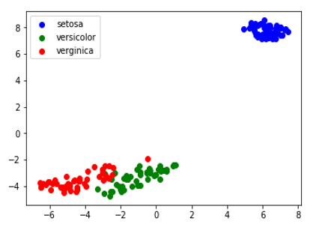
Concept : t-SNE.
“ also revealing global structure such as the presence of clusters at several scales. ”
The aim of clustering is to group a set of objects in the same group (called a cluster) given similarities measures.
L. Van Der Maaten https://lvdmaaten.github.io/tsne/
So it belongs to the “unsupervised learning” algorithm that looks for underlying patterns in a data set with no pre-existing labels
Notes:
Quote image : https://blog.paperspace.com/dimension-reduction-with-t-sne/

Slide 5
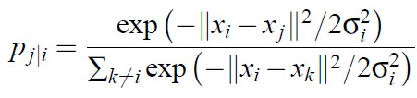
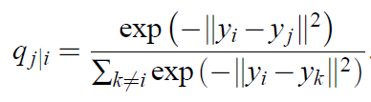

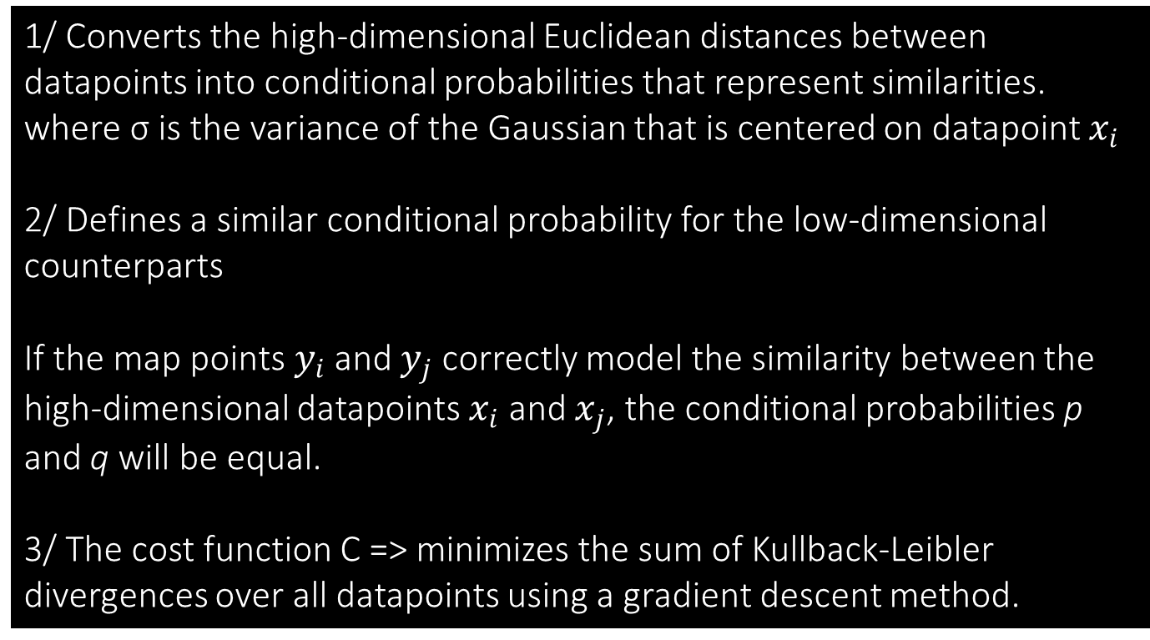
Stochastic Neighbor Embedding (SNE)
Minimize an objective function that measures the discrepancy between similarities in the data and similarities in the map
1/ Converts the high-dimensional Euclidean distances between datapoints into conditional probabilities that represent similarities. where σ is the variance of the Gaussian that is centered on datapoint $x_{i}$
2/ Defines a similar conditional probability for the low-dimensional counterparts
If the map points $y_{i}$ and $y_{j}$ correctly model the similarity between the high-dimensional datapoints $x_{i}$ and $x_{j}$, the conditional probabilities p and q will be equal.
3/ The cost function C => minimizes the sum of Kullback-Leibler divergences over all datapoints using a gradient descent method.
the Kullback-Leibler divergence
Notes:
1/ SNE converts the pair-wise Euclidean distances between paints into a probability density Pj|i
P = Similarities of data points in high dimension
2/ Q = Similarities of data points in low dimension
3/ SNE aims to find a low-dimensional data representation that minimizes the mismatch between p and q. In other words, the SNE cost function focuses on retaining the local structure of the data in the map
If we were able to perfectly preserve all the similarities in the data, Pji and qji will be equivalent.
SNE focuses on preserving the local structure of the data

Slide 6
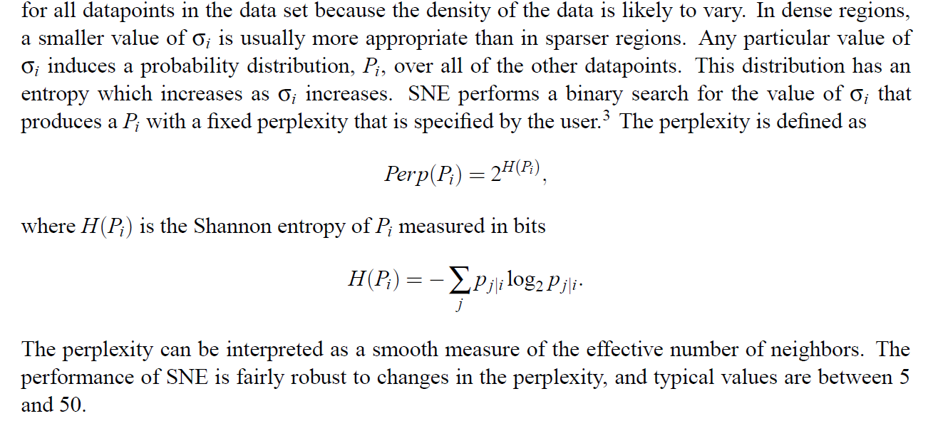
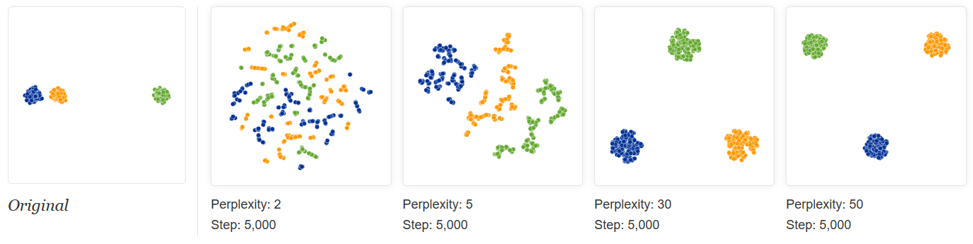
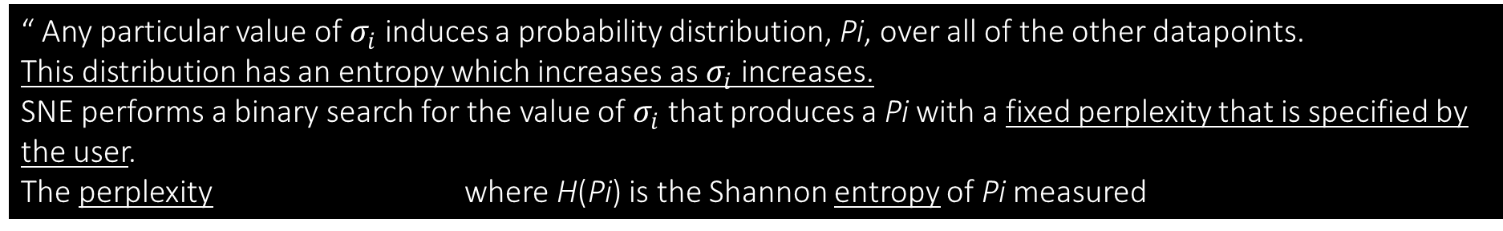
Stochastic Neighbor Embedding (SNE)
“ Any particular value of $σ_{i}$ induces a probability distribution, Pi, over all of the other datapoints. This distribution has an entropy which increases as $σ_{i}$ increases. SNE performs a binary search for the value of $σ_{i}$ that produces a Pi with a fixed perplexity that is specified by the user.
The perplexity where H(Pi) is the Shannon entropy of Pi measured
The performance of SNE is fairly robust to changes in the perplexity, and typical values are between 5 and 50. ”
Perplexity : can be interpreted as a smooth measure of the effective number of neighbors
(information) Entropy : measure of disorder or uncertainty in a system
Notes:
Entropy : Pub in The Bell System Technical Journal in 1948 by C. E. Shannon. DOI : 10.1002/j.1538-7305.1948.tb01338.x
Pb : must be parameter by the user : « Good visualisation require good choice of paramters » !
Quote image : https://distill.pub/2016/misread-tsne/

Slide 7
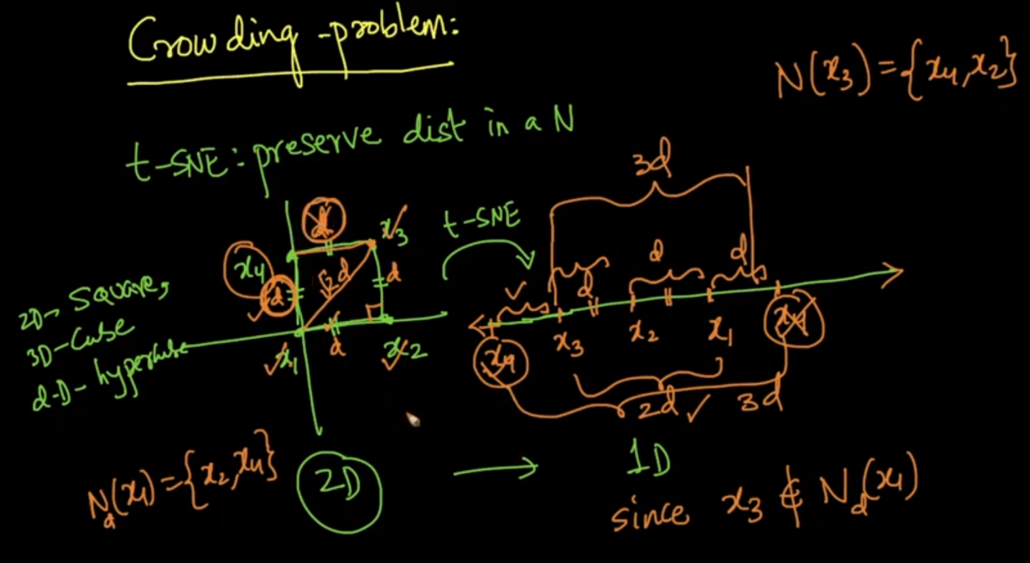
Problems
“it is impossible to preserve distances in all the neighborhoods”
“ Crowding problem ” :
“the area of the two-dimensional map that is available to accommodate moderately distant datapoints will not be nearly large enough compared with the area available to accommodate nearby datapoints.”
Points tend to “crowd” together in the center of the map
Watch this video for simple example: https://www.youtube.com/watch?v=hMUrZ708PFk
Kullback-Leibler divergence is asymmetric :
“ Because the Kullback-Leibler divergence is not symmetric, different types of error in the pairwise distances in the low-dimensional map are not weighted equally ”
Notes:
https://www.youtube.com/watch?v=hMUrZ708PFk
“In other words, the SNE cost function focuses on retaining the local structure of the data in the map (for reasonable values of the variance of the Gaussian in the high-dimensional space,).
Additionally, it is very difficult (computationally inefficient) to optimize this cost function.” quote :https://www.analyticsvidhya.com/blog/2017/01/t-sne-implementation-r-python/
To crowd : s’attrouper, se bousculer, se presser les uns contre les autres.

Slide 8
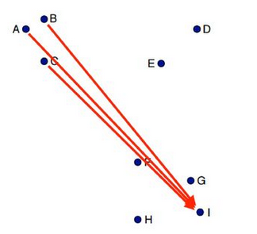
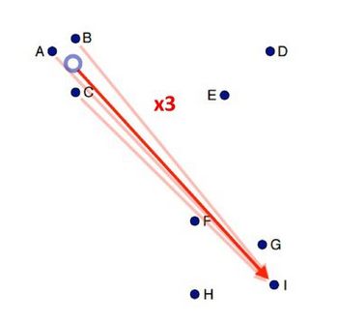
t-SNE : How is different from SNE ?
(1) it uses a symmetrized version of the SNE cost function with simpler gradients
“ [Symmetric SNE …] allows a moderate distance in the high-dimensional space to be faithfully modeled by a much larger distance in the map and, as a result, it eliminates the unwanted attractive forces between map point ” ➔ “ Natural way of alleviating the crowding problem ” Van der Maaten & Hinton, 2008, Journal of Machine Learning Research
Many of the paiwise interactions between points are very similar
Approximate similar interactions by single interaction
➔ Scalability optimization of the descending gradient with the Barnes-Hut Approximation
Van der Maaten, 2014, Journal of Machine Learning Research
https://slideplayer.com/slide/12695684/
Notes:
The cost function used by t-SNE differs from the one used by SNE in two ways:
“t-SNE” aims to alleviate these problems with 2 main differences
=> alleviate the crowding problem and enable to make optimization of the descending gradient by approximation …

Slide 9
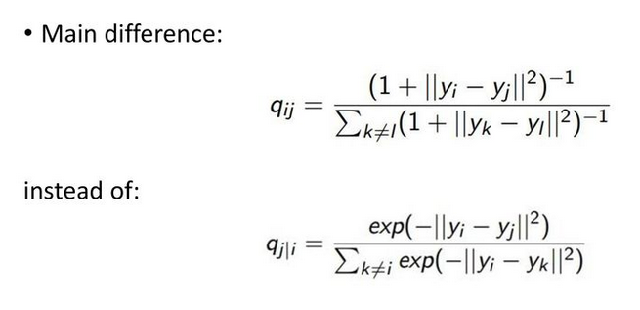
t-SNE : How is different from SNE ?
(2) it uses a Student-t distribution rather than a Gaussian to compute the similarity
between two points in the low-dimensional space.
“ A computationally convenient property is that it is much faster to evaluate the density of a point under a Student t-distribution than under a Gaussian because it does not involve an exponential. ”
Van der Maaten & Hinton, 2008, Journal of Machine Learning Research
Notes:
Second point :
t-SNE => Here, same idea (than SNE) but under the Student t-distribution “closely related to the Gaussian distribution, as the Student t-distribution is an infinite mixture of Gaussians. A computationally convenient property is that it is much faster to evaluate the density of a point under a Student t-distribution than under a Gaussian because it does not involve an exponential.”

Slide 10
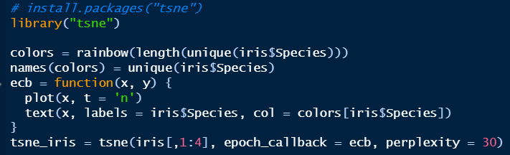
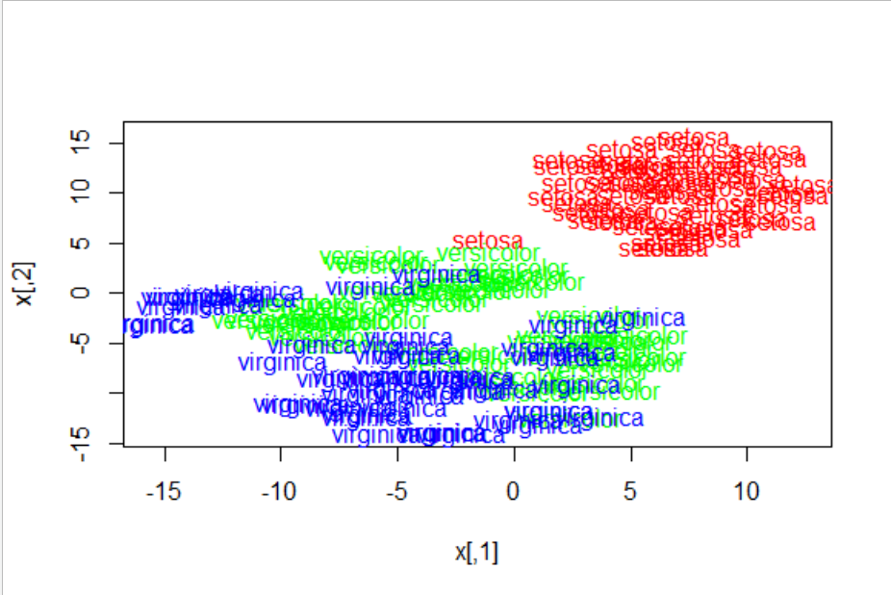
R implementation.
tsne (published in 2016-07-15, Version: 0.1-3) A "pure R" implementation of the t-SNE algorithm.
https://scwn.wordpress.com/2010/02/20/new-t-sne-package-for-r/
https://cran.r-project.org/web/packages/tsne/index.html
Notes:
https://www.r-bloggers.com/quick-and-easy-t-sne-analysis-in-r/
https://bioconductor.org/packages/devel/bioc/html/M3C.html

Slide 11
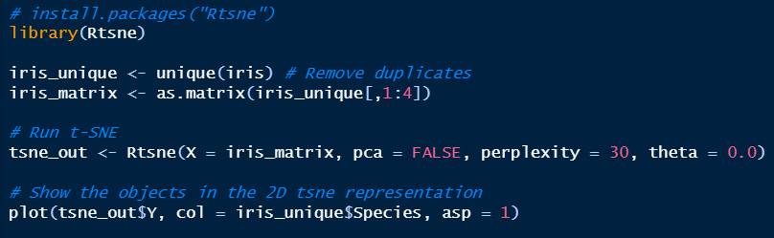
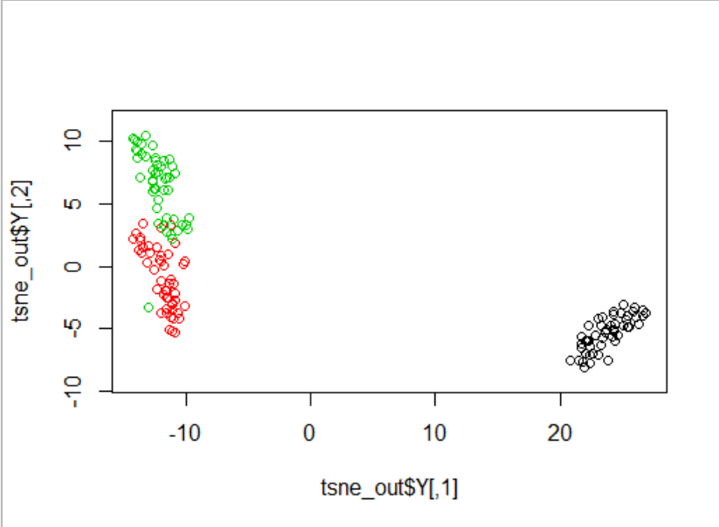
R implementation.
Rtsne (published in 2018-11-10, Version: 0.15) Wrapper for the C++ implementation of Barnes-Hut t-Distributed Stochastic Neighbor Embedding. t-SNE is a method for constructing a low dimensional embedding of high-dimensional data, distances or similarities. Exact t-SNE can be computed by setting theta = 0.0.
https://www.analyticsvidhya.com/blog/2017/01/t-sne-implementation-r-python/

Slide 12
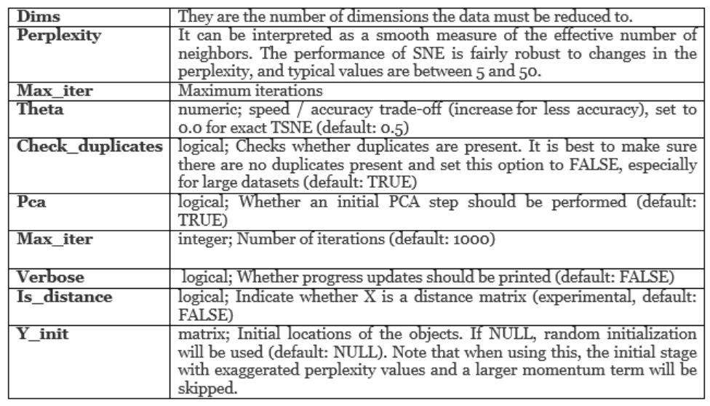
R implementation.
Rtsne
https://www.analyticsvidhya.com/blog/2017/01/t-sne-implementation-r-python/

Slide 13

Sources.
https://lvdmaaten.github.io/tsne/
L.J.P. van der Maaten and G.E. Hinton. Visualizing High-Dimensional Data Using t-SNE. Journal of Machine Learning Research 9(Nov):2579-2605, 2008.
L.J.P. van der Maaten. Learning a Parametric Embedding by Preserving Local Structure. In Proceedings of the Twelfth International Conference on Artificial Intelligence & Statistics (AI-STATS), JMLR W&CP 5:384-391, 2009.
L.J.P. van der Maaten and G.E. Hinton. Visualizing Non-Metric Similarities in Multiple Maps. Machine Learning 87(1):33-55, 2012.
L.J.P. van der Maaten. Accelerating t-SNE using Tree-Based Algorithms. Journal of Machine Learning Research 15(Oct):3221-3245, 2014.
Images : https://blog.paperspace.com/dimension-reduction-with-t-sne/ https://distill.pub/2016/misread-tsne/
https://www.youtube.com/watch?v=hMUrZ708PFk
https://www.analyticsvidhya.com/blog/2017/01/t-sne-implementation-r-python/
https://slideplayer.com/slide/12695684/
Notes:
Same paper in wiki words …
https://wiki.math.uwaterloo.ca/statwiki/index.php?title=visualizing_Data_using_t-SNE

Slide 14


