Slide 1
Coronavirus 2020
GIS and Health Analysis
Michael Borowski

Slide 2
A scary start to 2020
More than 1 million cases of coronavirus have been reported in the US. (Hammond, 2020)
This has led to a nation wide stay at home order which also forced many businesses to temporarily close doors.
More than 30 million Americans have filed initial unemployment claims since the middle of March 2020. (Hammond, 2020)
This pandemic has led to global implications and has been hard on the market.
This ongoing virus has led to many questions and insecurities.

Slide 3

A look at Philadelphia
This research project looks to analyze patterns of positive Coronavirus case clustering according to population rates and maps the data to offer statistics and insight of the areas being most affected.
This project looks at Zip Code level data and the City of Philadelphia’s reporting of coronavirus testing.

Slide 4
Data
Population data-
Explore Census Data. (n.d.). Retrieved from https://data.census.gov/
Coronavirus Data-
Testing and data: Department of Public Health. (n.d.). Retrieved from https://www.phila.gov/programs/coronavirus-disease-2019-covid-19/testing-and-data/
Zip Code layer-
Zip Codes. (2014, December 8). Retrieved from https://www.opendataphilly.org/dataset/zip-codes

Slide 5
Methods- conforming data
The Coronavirus data was downloaded as csv files for the dates of March 31st and April 21st.
These files were exported in ArcMap and the attribute tables were altered to conform to joining fields under specific column types.
March 31st data required replicating Zip Code field as string
April 21st was in string and duplicated that field as a long type to use as a unique ID when creating the spatial weight matrix.
The data was joined to the Zip Code polygon via appropriate Zip Code columns and kept only matching records.
A field was created dividing the positive test results by zip code population.

Slide 6
Methods- analyzing clusters
Spatial Weight Matrixes were created in ArcMap using the unique ID Zip fields and CONTIGUITY_EDGES_CORNERS as the Conceptualization of Spatial Relationships.
A spatial autocorrelation report was created using the positive case per population fields and the matrixes created above.
A local clustering analysis was mapped using the cluster and outlier analysis in ArcMap passing in the same parameters as in the Spatial autocorrelation.
Then limited the output to show only high-high and low-low clusters.

Slide 7
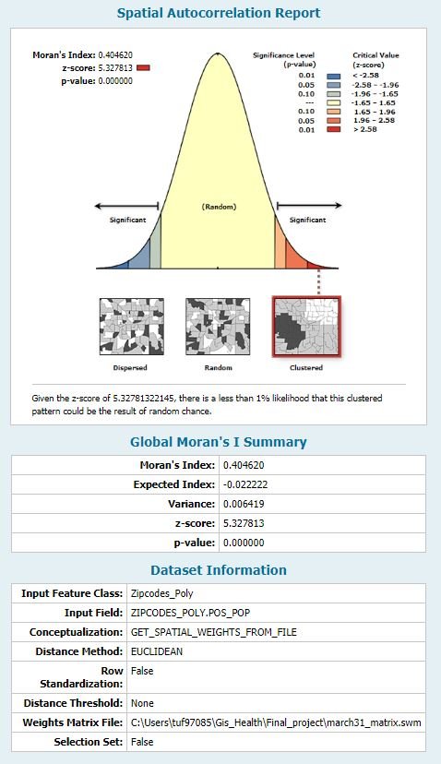
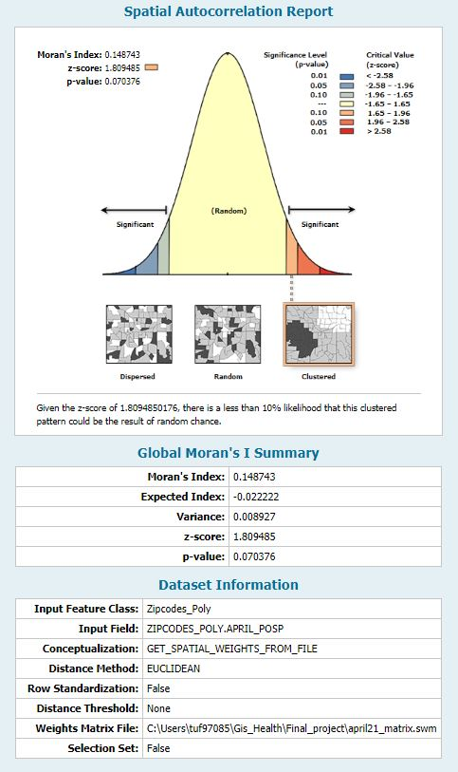
Spatial Autocorrelation
March 31st
April 21st

Slide 8
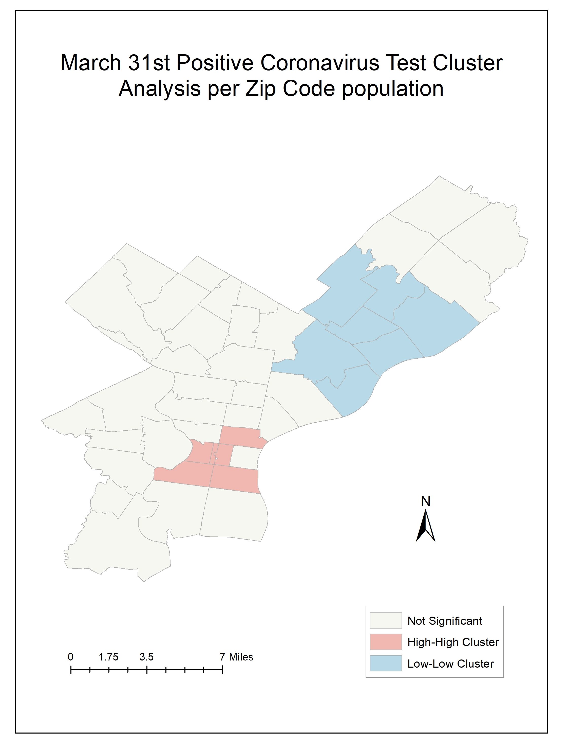
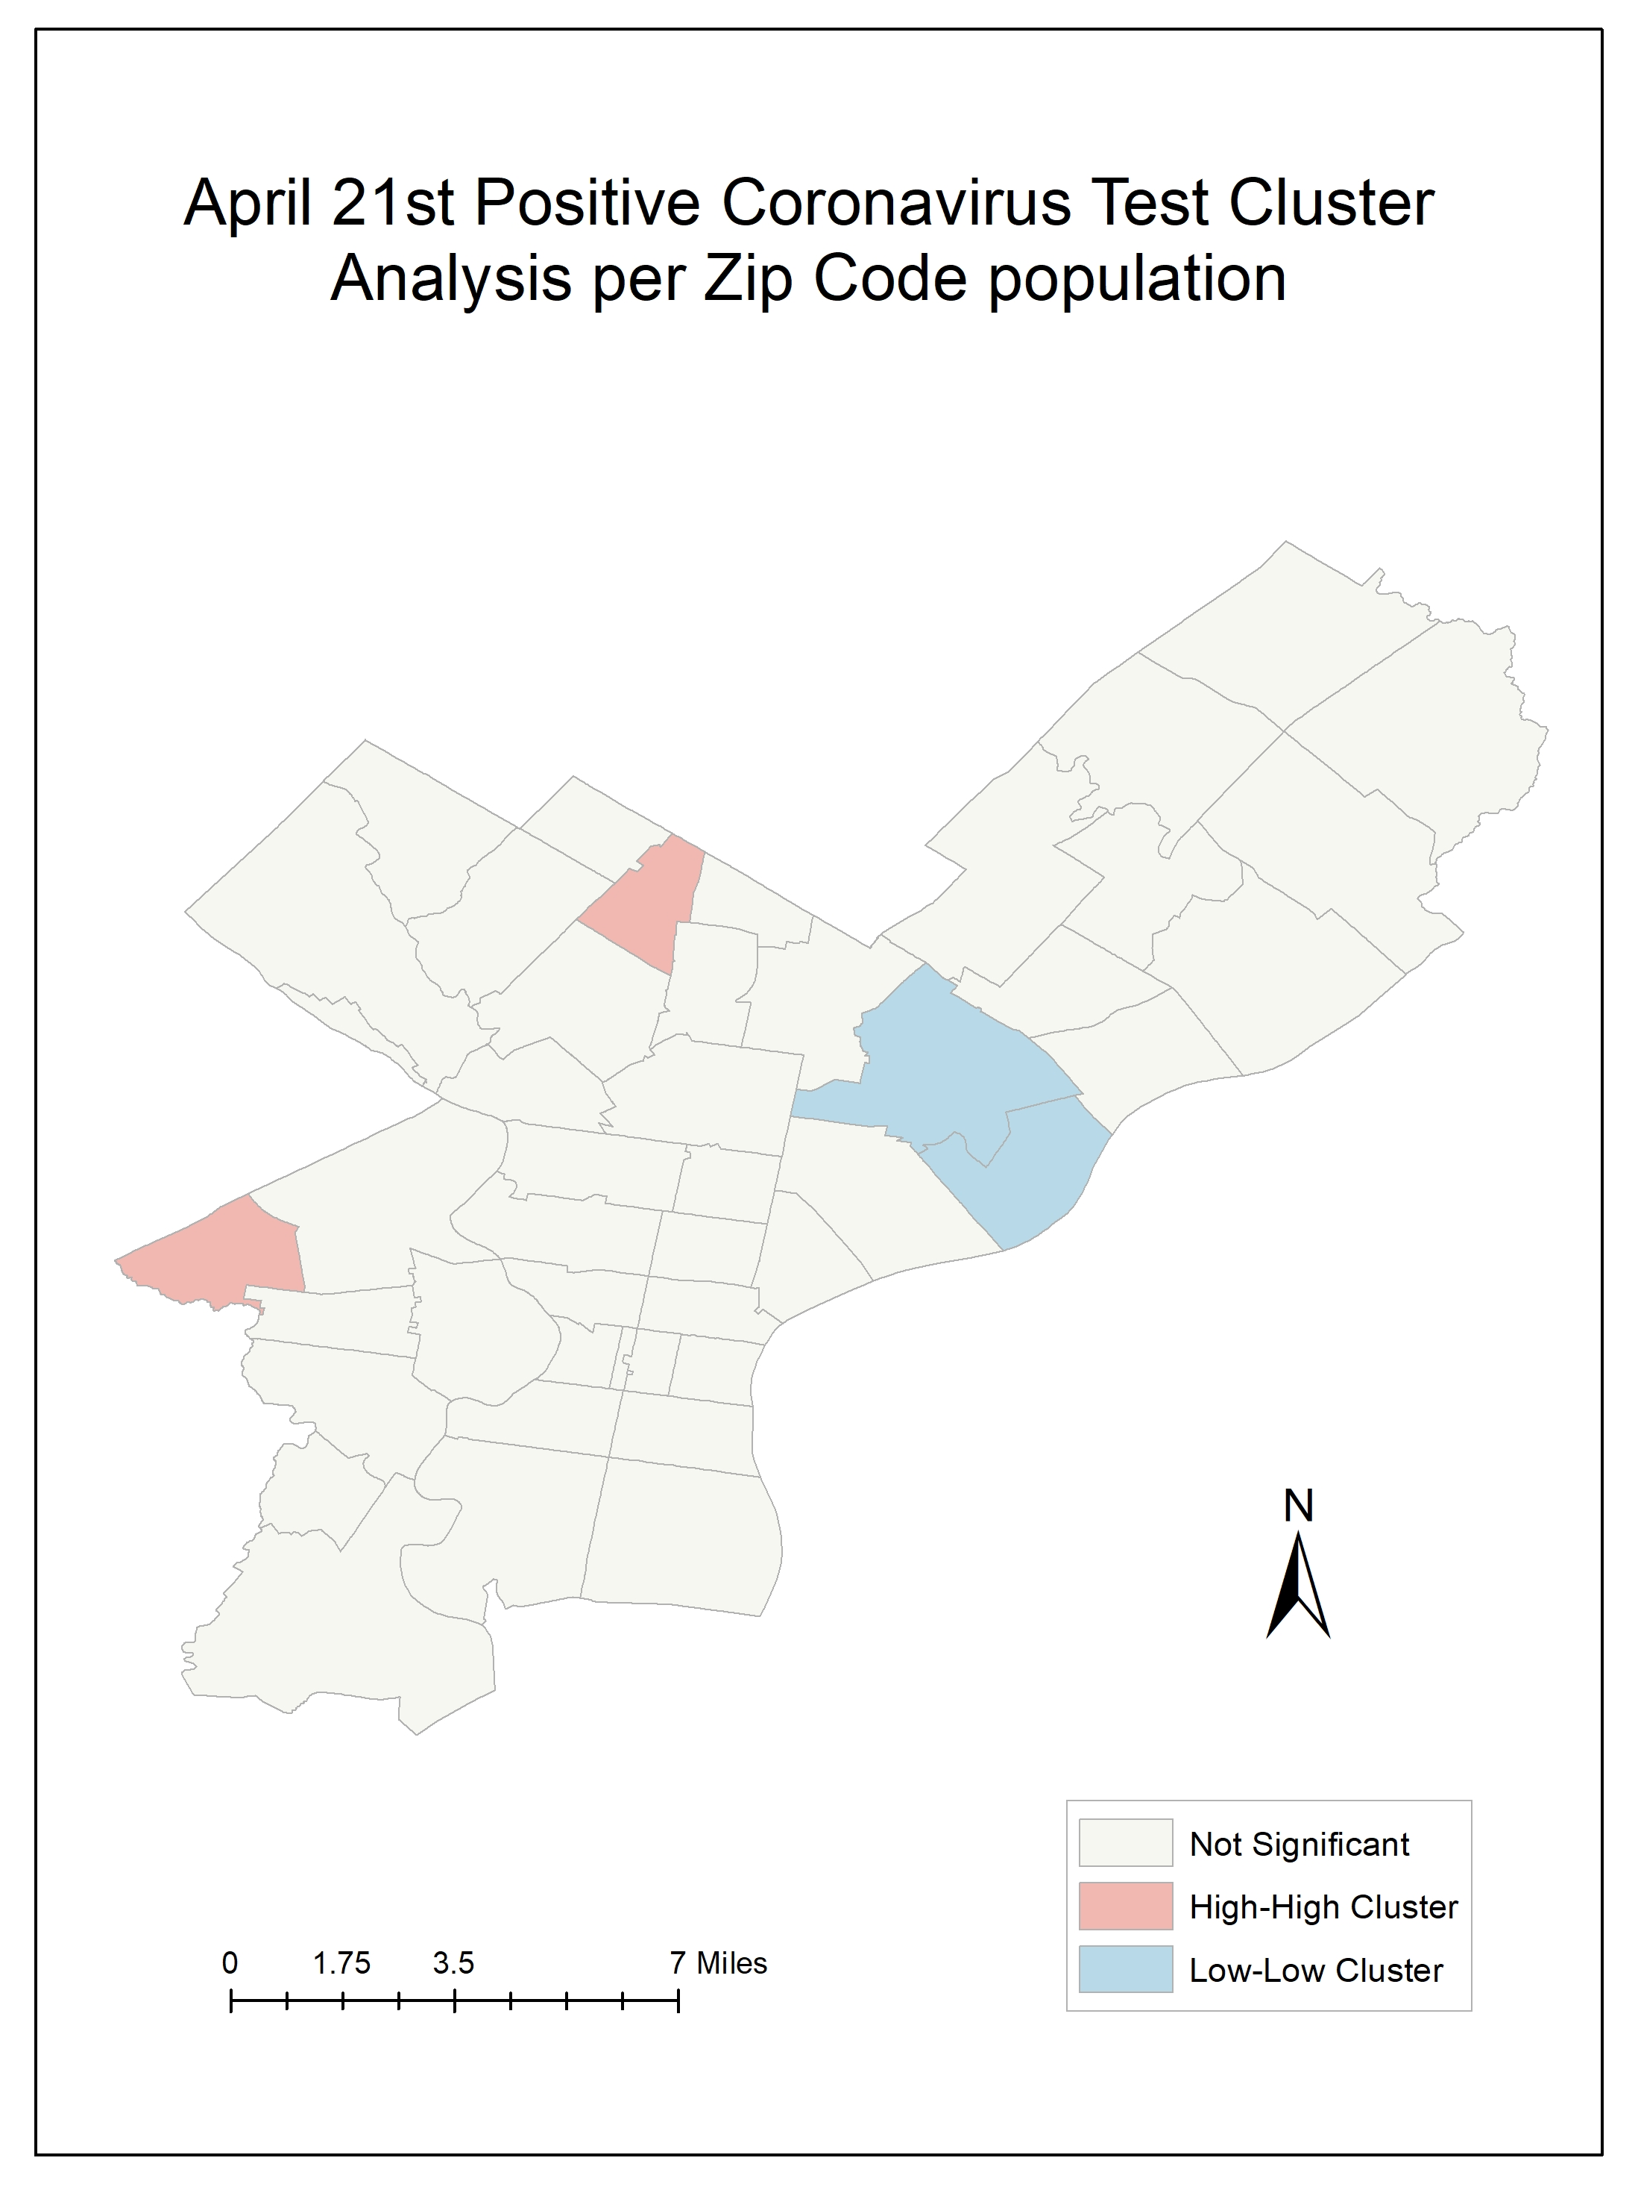
Cluster Maps

Slide 9
Creating informative web maps
In python, the folium extension was used to create choropleth maps.
The code reads the joined shp file containing the zip code poly data, the population data, and the coronavirus data from both dates to create two choropleth layers with data provided in a tooltip pop-up.
file:///C:/Users/tuf97085/Gis_Health/Final_project/choropleth.html

Slide 10
Future Final Steps
Fix double legends
Host on Github

Slide 11
Sources
Hammond, E., & Hayes, M. (2020, April 30). US coronavirus update: Number of cases exceed 1 million. Retrieved from https://www.cnn.com/us/live-news/us-coronavirus-update-04-30-20/index.html

