Slide 1

Homeless not Hopeless
December 14th, 2021
NYC College of Technology

Slide 2

Who am I?
Mustapha Bouchaqour
Data Science student at NYC College of Technology 2020-2022
Pure math major at City College of New York 2017-2019
Linkedin
GitHub

Slide 3
Agenda
Welcome & Introductions
Overview of the data I’ll be exploring and questions I’ll be trying to answer
Some interesting visualization
Q&A

Slide 4
Why this project?
The goal of this project is to investigate some factors that lead to the homelessness problem in New York City.
Greatly negatively impacts individuals and is detrimental to society overall.
There are almost 600,000 homeless individuals nationally, including families and children.
There are over 90,000 homeless only in New York state.

Slide 5
What I am trying to solve.
How much in average are the monthly rent within the 5 boroughs of NYC? (Bronx)
How much percentage (of their income) are people in low income paying for rent? (Families with children)
Investigating children in shelters
What is the leading borough of children in shelters?
Where are the shelters in NYC? (using map)
How would I improve this project further?

Slide 6

Homelessness_Study
Data sources:
NYC open data website:
Boroughs & families in shelters
District & Shelters
Most of dataset obtained from the website: Citizens Committee for Children.
Housing and Homelessness and Economic condition:
Median Monthly rent,
severe rent burden,
Median Income,
DHS_Daily_Report
Link to Data

Slide 7
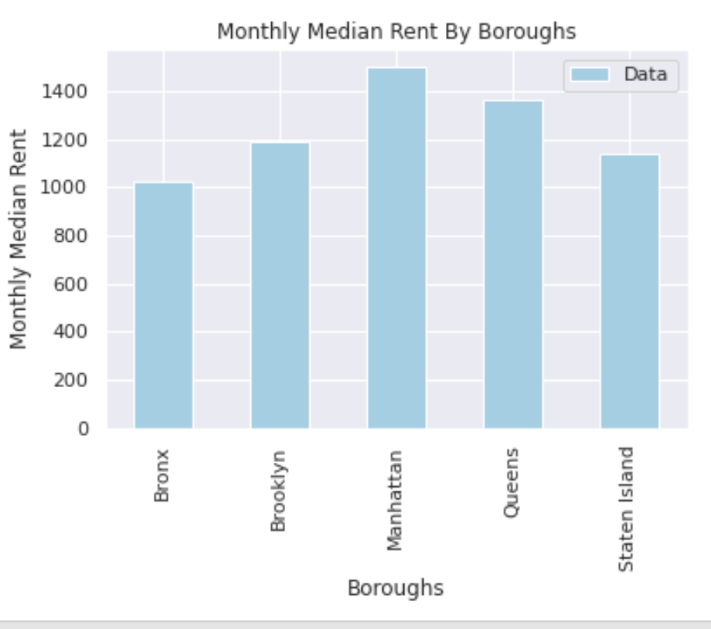
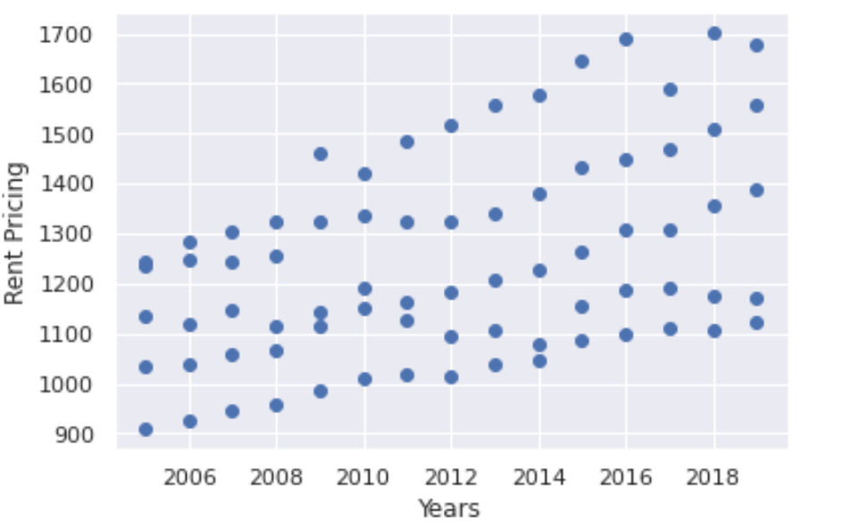
Homelessness_Study
How much in average are the monthly rent within the 5 boroughs of NYC? (Bronx)
Average 1-bedroom rent: $1,200
Income to afford that rent: $28,800
The increasing price of rent
Housing is STILL not affordable

Slide 8
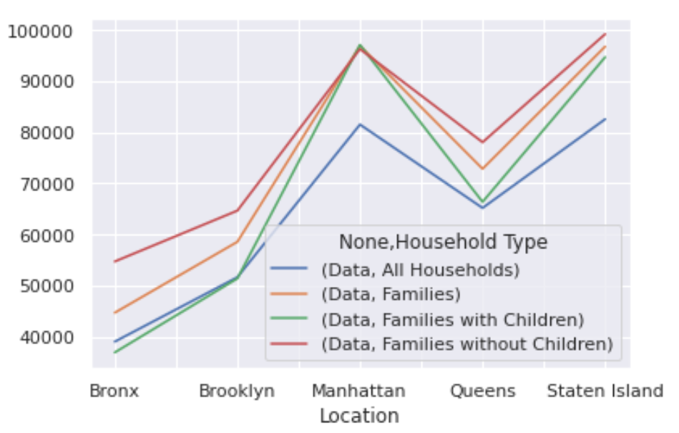
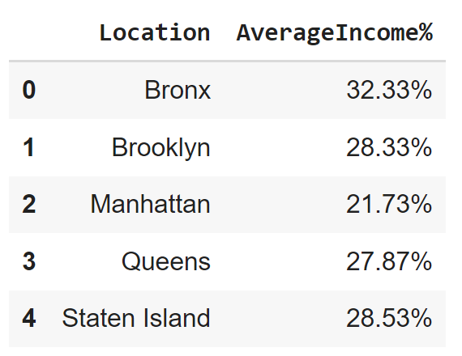
Homelessness_Study
How much percentage (of their income) are people in low income paying for rent? (Families with children)
Families with Children: Bronx<$37,000
%_Income: 32.33% from income goes to rent
Typical example: Bronx - Families with children

Slide 9
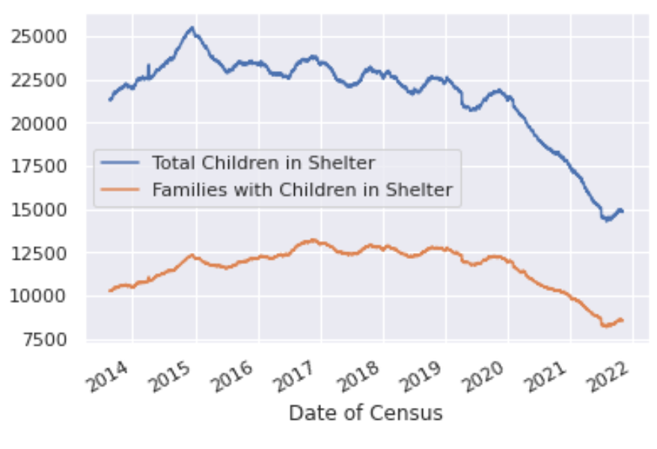
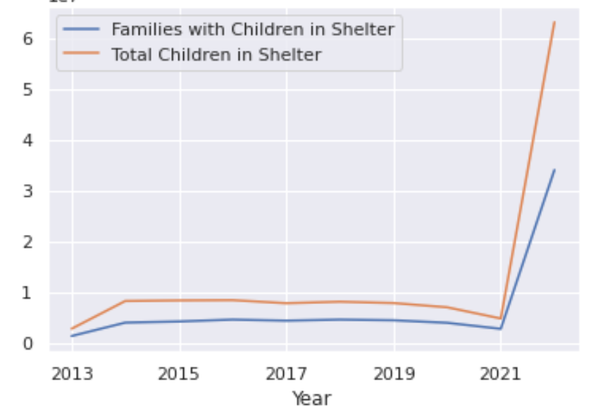
Homelessness_Study
Investigating children in shelters
Decreasing number of children in shelters
Some changes occurred in 2021, I’ll investigate this point further.

Slide 10
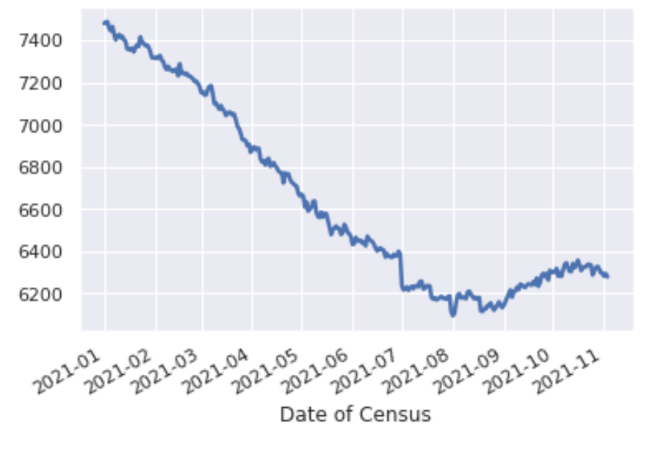
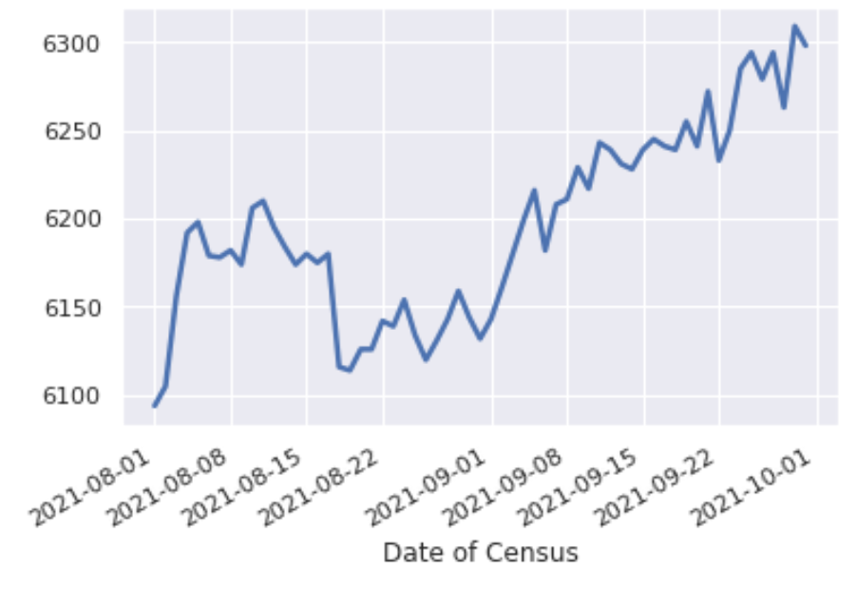
Homelessness_Study
Investigating children in shelters
What can we say:
Families are able to allocate themselves in normal housing.
(They are not homeless anymore)
Shelter conditions are not good.
Shelter size is not adjusted.
They are in the street.

Slide 11
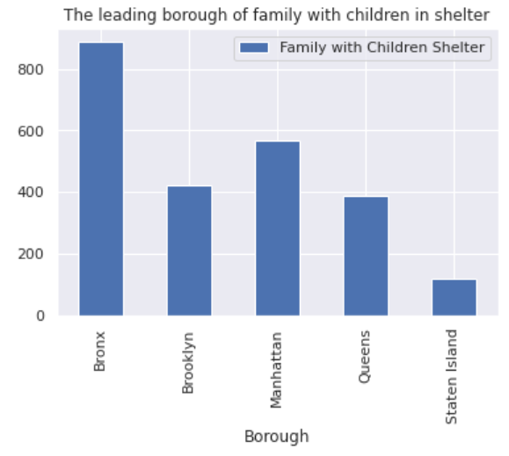
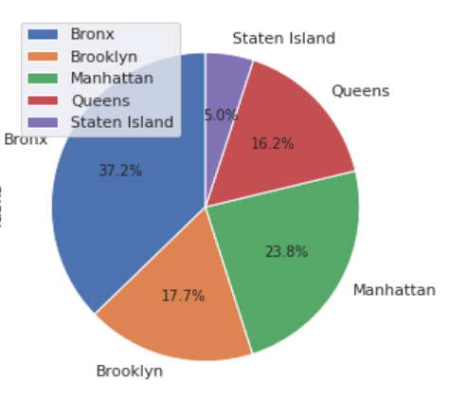
Homelessness_Study
What is the leading borough of children in shelters?
What can we say:
Families with children in shelters are more likely to be distributed within the Bronx and manhattan compared to other boroughs.

Slide 12
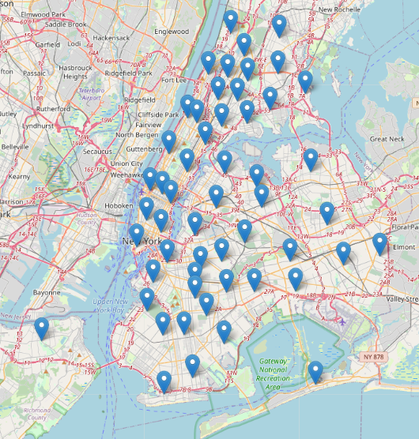
Homelessness_Study
Distributed Shelters within NYC
What can we say:
As we can see from the map that there are around 60 shelters distributed within nyc

Slide 13
Homelessness_Study
How would I improve this project further?
The challenges
The improvements:
Data
Not enough
Uncleaned
Using geographical approach
Investigating further facts that lead to homelessness such as:
Mental illness and the lack of needed services
Substance abuse and the lack of needed services
Unemployment

Slide 14
Homelessness_Study
What can we do about this?
Invest in youth programming and housing
Increase investment in affordable housing
Increase access to jobs that pay a living wage
Increase state funding for rental subsidies
‘An Ounce of Prevention Is
Worth a Pound of Cure’
Benjamin Franklin

Slide 15

Homelessness_Study
Tech Stack:
Python: Programming language
Pandas: Read/process data
Seaborn: Statistical graphs
GeoPandas / Folium: Geographic maps
Numpy: Data calculation
Matplotlib: Visualization
Future used:
Plotly / Plotly Express: Visualization
Plotly Dash: Dashboard of our data
Heroku: Website hosting
Gunicorn: Environment for website hosting

