Slide 1
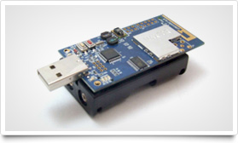
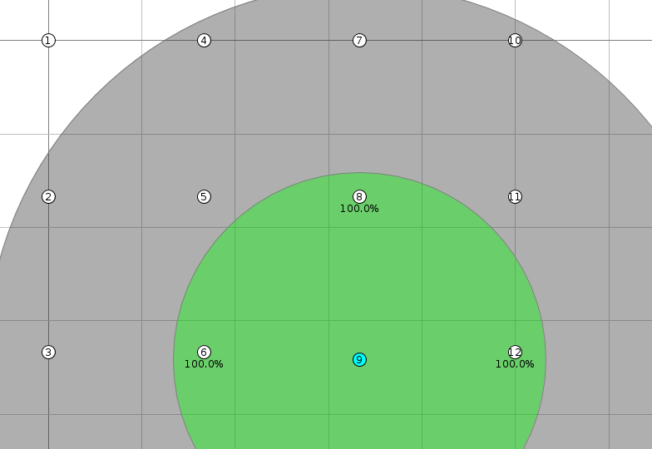

Towards Debugging of Wireless Sensor Networks
Abstract
Debugging tools are vital for developers to produce reliable software, however traditional tools are less useful when developing software for new system paradigms such as wireless sensor networks. As wireless sensor networks become increasing prevalent in our lives it will become ever more important that the software they are running works reliably and to do this debugging tools will be required. This project investigates how predicates can be specified and checked on wireless sensor node and how errors can be reported to a base station.
Background
Wireless Sensor Networks (WSNs) are becoming increasingly prevalent due to decreasing hardware costs and hardware size. Therefore, it is important that we consider issues with them now, so we are prepared for when they become widely used. A major issue with any system is that it may contain bugs, fortunately, there are many well known methodologies for detecting and eliminating bugs. However, in distributed systems there are additional challenges to overcome and there are additional challenges to overcome with WSNs due to the energy constrained environment they work in.
Predicate Specification
One of the requirements of our project is that we wished to specify predicates to be checked, not just at compile time, but also at run time. The main reason is that the needs of a system will change over time.
We explored a variety of methods of specifying predicates for evaluation, with an aim to enable an expressive syntax. However, we found that existing solutions – such as eLua (Embedded Lua) [CITE] and Wren [CITE] – were not suitable due to their high resource requirements or lack of desired features.
Thus, we implemented our own predicate-based scripting language that provided the features we wanted, and the ability to run on the limited resources available. We designed a syntax that enabled us to target nodes and utilise built in functions to iterate over sets of nodes when evaluating first-order predicates.
In order to realise this, we have implemented a parser, assembler and virtual machine. The base application will compile new predicates and transmit the assembled bytecode to nodes for execution.
As an example of a predicate specified in our language, the following snippet will check no nodes within a two-hop neighbourhood have clashing slots. This is a property that should hold in systems using the TDMA (time division multiple access) MAC protocol.
Algorithms
HSEND
Tree Aggregation
Clustering
using Neighbours(2) as twohopn in
@(x : twohopn ~
slot(x) != slot(this))
∀x ϵ Neighbours(2) ⋅
slot(x) ≠ slot(this)
Listing 1. A predicate in our custom language and the same predicate in first order logic
Issues Encountered
Project Management
Name | Role
Matthew Bradbury | Group Leader
Tim Law | Developer and Researcher
Ivan Leong | Developer and Tester
Daniel Robertson | Project Manager
Amit Shah | Technical leader
Joe Yarnall | Developer and Tester
Second Term Plan
Predicate Specification
Improve dynamic specification
Reduce energy usage
Visualisation Tool
Provide more information
Better predicate checking integration
Performance
Investigate where the best place to evaluate a predicate is
Perform performance testing using physical nodes
References

