Slide 1
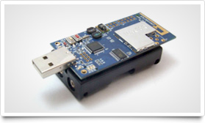
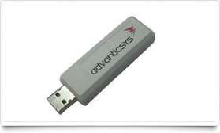
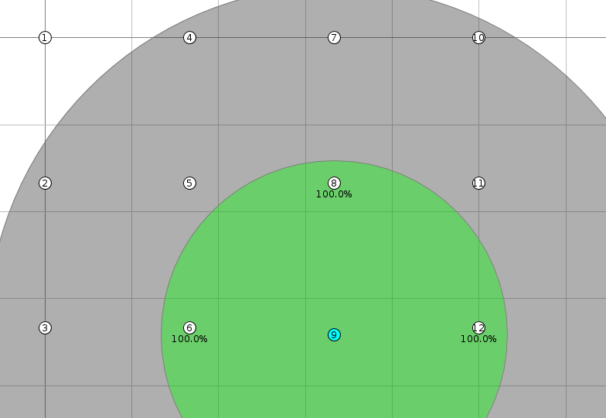

Towards Debugging of Wireless Sensor Networks
Background
Wireless Sensor Networks (WSNs) are a collection of small computing devices equipped with a radio (for wireless communication), sensors (to get information on the environment) and a battery to power the device. As these devices are not attached to the mains power we need to make sure that we do as little energy intensive work (eg. Receiving/Transmitting data) as possible to lengthen the lifetime and usefulness of the network.
As energy is a limiting factor, the software developed for WSNs typically trade reliability for decreased energy usage. That means that very special care must be taken to develop programs that behave well and continue to behave well under real world conditions.
Motivation
When WSNs are initially deployed, they are in an optimal configuration, but as time goes on, hardware may fail, changing the configuration of the network. This means that parts of the network may need to be reconfigured. Knowing when to reconfigure the network is difficult, thus there is a need to be able to detect sub-optimal configurations.
Project Aims
Due to the importance of debugging tools developing any software and the difficulty in developing distributed systems, we want to create a useful set of tools to assist in debugging WSN applications. This includes:
A way to check that certain properties in the network hold
A way to visualise as much of the network state as possible
Test predicate checker on algorithms that represent real world applications
Visualisation and Interface Tool
We are developing a GUI to control our project, which will run on a computer and interface with the base station. It's main features will be predicate creation and deployment, and network visualisation. Monitoring a new predicate will simply involve writing a predicate in our custom scripting language, and submitting it using the GUI for evaluation in the network .
In order to visualise the WSN and the state of the attached predicates, we have two main views in mind. The first is simply a list of predicates, colour coded by their current status, enabling the user to see at a glance any problems that arise. The second will be a network graph, showing the spatial relationships between nodes, associated clustering hierarchies, and generally provide a more visual representation of the WSN and attached predicates.
HSEND
H-SEND [5] is a framework for detecting faults in WSNs, designed to minimise energy consumption. It differs from related algorithms by being capable of handling very large WSNs.
Our implementation allows the sending of a predicate message from a base station to a target node, who will then begin the evaluation process. This can involve several aspects, such as local predicate checking, or the evaluation of predicates the require information from multiple nodes.
With our implementation, we initially focused on evaluating fixed, compile time predicates and reporting the results back to the base station. This was further expanded to allow checking of compile-time predicates that require information from neighbouring nodes. Further abstractions of the framework will allow us to specify run-time predicates, and have the information relayed using the same underlying network stack.
Further work will involve integrating the message sending with neighbour detection algorithms and clustering to allow for much more efficient message sending. This will involve researching where it is best to evaluate predicates in a network in order to minimise energy and time usage.
Neighbour Discovery
A key requirement for a wireless sensor networks is reliably knowing who your neighbours are, this can be useful for a great many applications including among others clustering and predicate evaluation.
Contiki contains a built in module for neighbour discovery but it only handles half of the problem, communication. In order for each node to maintain a reliable list of it's neighbours, we decided to implement a wrapper module around the core Contiki module. Our module maintains a list of neighbour nodes and checks periodically to make sure that no new nodes have joined the network or that old nodes have left.
Testing and Integration
In order to test our implementations we are using the Contiki simulation tool Cooja [7]. We considered using TinyOS, however found that Contiki was more modern, and had better documentation of its APIs. Unfortunately, simulators can not simulate real world environments hence the need to test on physical hardware to evaluate algorithm performance, and network conditions. Simulators are, however, useful for testing large scale networks.
There is a need to bridge the gap between a desktop application, and the networked nodes. This can be done with the use of a dongle to act as a base station, allowing the desktop application to receive data form the network, and send out new predicates to be evaluated.
This module will be used as part of our debugging API where it will be used to implement n-hop predicate evaluation and visualisation.
An example of the algorithm is shown to the right. Here Node 9 has three nodes in its wireless transmission range (Nodes 6, 8 and 12). The Contiki API will be used to discover these nodes.
The grey area shows the range at which Node 9 could interfere with other transmissions. Nodes in the green area can communicate with Node 9.
Project Management
Figure 1: The Wireless Sensor Node
Figure 2: The Base Station Dongle
Algorithms
When developing software for WSNs, there are several algorithms that are commonly used to perform certain tasks. So, in order to test that our solution is applicable to real world code, we have developed some of these algorithms for us to specify and check predicates for.
Tree Aggregation
Clustering
As two of the key constraints in a WSN are energy consumption and bandwidth, we made it a priority to minimise the number of messages sent through the network; clustering is perhaps the most widely-used strategy for achieving this.
Using features suggested by the Low-Energy Adaptive Clustering Hierarchy (LEACH) [1], we devised two clustering algorithms; a basic cluster for small networks, and a hierarchical cluster (with variable depth) which can be scaled up arbitrarily.
The basic clustering algorithm simply elects all nodes within radio range of the sink as cluster-heads (CHs); all other nodes send data to their closest CH which application-dependent processing before forwarding them on to the sink. Hierarchical clustering extends this by specifying some depth D such that, if the shortest discovered route to a node’s CH is D hops, that node becomes a cluster-head itself.
For this project we allocated roles as shown in the table to the right. We met weekly to discus our progress as well as allocate tasks to each team member for the week.
We liaised with other academics and PhD students to assist in our project, and allocate time when we could have access to the wireless sensor nodes.
Namex | Role
Matthew Bradbury | Group Leader
Tim Law | Developer and Researcher
Ivan Leong | Developer and Tester
Daniel Robertson | Project Manager
Amit Shah | Technical Leader
Joe Yarnall | Developer and Tester
A common task is to have every node in a network send data to the sink, whilst having some aggregation function performed on that data. To minimise the number of retransmissions the network is orangised as a tree. In this tree a node will collect child node’s data and perform some function over that data , once all children’s information is received the aggregated result will be sent to the parent of that node. Eventually the sink will receive and aggregate information from its children. Common applications for this algorithm is to calculate the average temperature over the area monitored by the sensor network.
Specifying Predicates
One of the requirements of our project is that we wished to specify predicates to be checked, not just at compile-time, but also at run-time. The main reason is that the needs of a system will change over time.
We explored a variety of methods of specifying predicates for evaluation, with an aim to enable an expressive syntax. However, we found that existing solutions – such as eLua (Embedded Lua) [3] and Wren [2] – were not suitable due to their high resource requirements or lack of desired features.
Thus, we implemented our own predicate-based scripting language that provided the features we wanted, and the ability to run on the limited resources available. We designed a syntax that enabled us to target nodes and utilise built in functions to iterate over sets of nodes when evaluating first-order predicates.
In order to realise this, we have implemented a parser, assembler and virtual machine. The base application will compile new predicates and transmit the assembled bytecode to nodes for execution.
As an example of a predicate specified in our language, the following snippet will check that there exists a cluster head within D hops of the current node. This is a predicate that will be used in hierarchical clustering.
Issues Encountered
We have not encountered too many unforeseen issues with the project so far. However those we have encountered were more problematic than we originally thought they would be:
Learning to work in a different development environment (different language, unfamiliar APIs)
Difficulty thinking and develop in a distributed non-error free environment (where messages may be lost)
Second Term Plan
Predicate Specification
Improve run-time definition and evaluation
Reduce energy usage
Visualisation Tool
Provide more information
Better predicate checking integration
Performance
Investigate where the best place to evaluate a predicate is
Perform performance testing using physical nodes
In both cases, nodes will either send sensor data to their cluster-head, where aggregates and application predicates will be evaluated (e.g. average temperature over a cluster’s area), or send the information requested by a predicate message (for example, checking that no node has two CHs).
using Neighbours(D) as Dhopn in
#(x : Dhopn ~ isCH(x))
∃x ϵ Neighbours(D) ⋅ isCH(x)
Listing 1. A predicate in our custom language and the same predicate in first order logic
References
Hector Garcia-Molina, Frank Germano, and Walter H. Kohler. Debugging a distributed computing system. Software Engineering, IEEE Transactions on, SE-10(2):210{219, March 1984. ISSN 0098-5589. doi: 10.1109/TSE.1984.5010224.
Douglas Herbert, Vinaitheerthan Sundaram, Yung-Hsiang Lu, Saurabh Bagchi, and Zhiyuan Li. Adaptive correctness monitoring for wireless sensor networks using hierarchical distributed run-time invariant checking. ACM Transactions on Autonomous and Adaptive Systems (TAAS), 2(3):8, sep 2007. ISSN 1556-4665. doi: 10.1145/1278460.1278462
Fredrik Osterlind. A sensor network simulator for the contiki os. Technical report, SICS publications database [http://eprints.sics.se/perl/oai2] (Sweden), 2006.
J.N. Al-Karaki and A.E. Kamal. Routing techniques in wireless sensor networks: a survey. Wireless Communications, IEEE, 11(6):6{28, dec. 2004. ISSN 1536{1284. doi: 10.1109/MWC.2004.1368893.
Darius Bacon. Wren. Online, 2010. URL https://github.com/darius/wren
eLua Project. LTR (Lua Tiny RAM) in eLua. Online, 2011. URL http://www.eluaproject.net/doc/v0.8/en_arch_ltr.html

