Slide 1
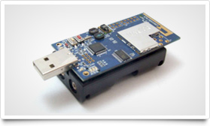
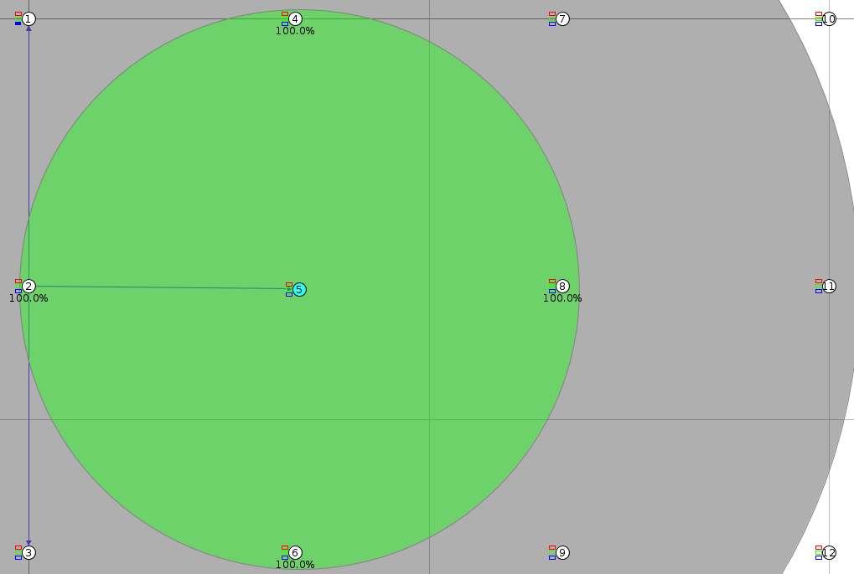

Towards Debugging of Wireless Sensor Networks
Abstract
Debugging tools are vital for developers to produce reliable software, however traditional tools are less useful when developing software for new system paradigms such as wireless sensor networks. As wireless sensor networks become increasing prevalent in our lives it will become ever more important that the software they are running works reliably and to do this debugging tools will be required. This project investigates how predicates can be specified and checked on wireless sensor node and how errors can be reported to a base station.
Predicate Specification
We explored a variety of methods of specifying predicates for evaluation, with an aim to enable an expressive syntax, and flexibility with regards to deploying new predicates across the network at runtime.
Existing literature seemed to primarily rely on specifying the predicates at compile-time [hsend paper], which was not a suitable approach for us, as it simultaneously prevented us from adding new predicates at runtime, and also constrained the predicate syntax to a format that was easily convertible to C.
We explored options such as eLua (embedded Lua), however even with patches aimed at minimising RAM usage [ltr], this was still infeasible. Other lightweight scripting languages such as [wren] did not provide the expressive power we wanted.
We eventually decided it would be easier to simply implement our own predicate-based scripting language that provided the features we wanted, and was able to run on the limited resources available. We designed a syntax that enabled us to target nodes and utilise built in functions to iterate over sets of nodes when evaluating first-order predicates.
As an example of a predicate specified in our language, the following snippet will check no nodes within a two-hop neighbourhood have clashing addresses:
[insert example here, can't find bradbury's file with them]
In order to realise this, we have implemented a parser, assembler and virtual machine. The base application will compile new predicates and transmit the assembled code to nodes for execution.
Project Management
Problems
Algorithms
HSEND -
Name | Role
Matthew Bradbury | Group Leader
Tim Law | Developer and Researcher
Ivan Leong | Developer and Tester
Daniel Robertson | Project Manager
Amit Shah | Technical leader
Joe Yarnall | Developer and Tester
Background
Wireless Sensor Networks (WSNs) are becoming increasingly prevalent due to decreasing hardware costs and hardware size. Therefore, it is important that we consider issues with them now, so we are prepared for when they become widely used. A major issue with any system is that it may contain bugs, fortunately, there are many well known methodologies for detecting and eliminating bugs. However, in distributed systems there are additional challenges to overcome and there are additional challenges to overcome with WSNs due to the energy constrained environment they work in.
Second term plans

