Slide 1
SLAIT
Secure Language Assembly Inspector Tool
Milestone 1
Dr. Marius Silaghi
Michael Bratcher
Maria Linkins-Nielsen

Slide 2
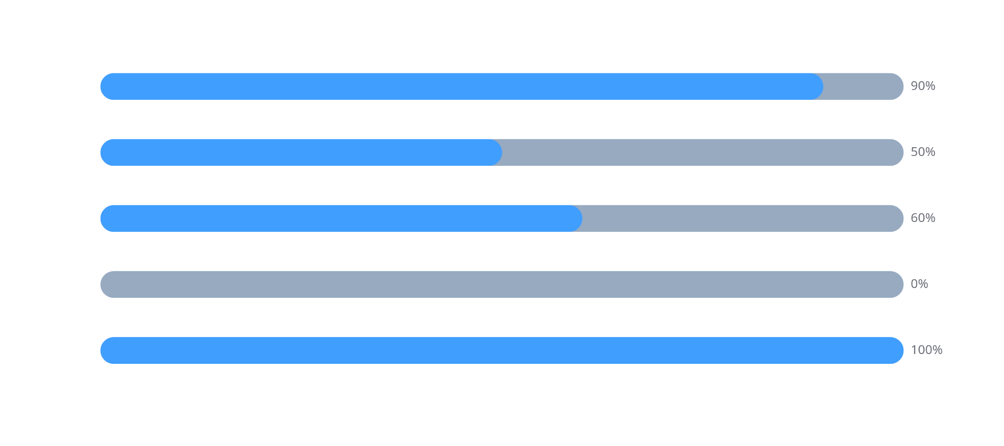
Current Milestone Progress
Tool Decision
Hello World Demos
Technical Challenges
Frontend-Backend
Documentation

Slide 3
Task Discussion
Tool Decisions
Frontend: Angular Selected and functional
Backend : Docker container challenges (Windows vs. Linux)
Hello World Demos
Frontend demo completed
Backend demo delayed by Docker issues
Technical Challenges
Docker configuration - partial success
Ensuring flagged code correct -> next phase
Frontend-Backend Communication
Blocked due to lack of backend access
Documentation

Slide 4
Team Contribution
Maria
Michael
Frontend development (Angular demo, components, GUI)
Authored Requirements, Design Documents
Backend tool comparison and Docker testing
Compilation testing for x86 code
API setup - planned for next phase

Slide 5

Front-End Demo

Slide 6
Milestone 2 Plan
Backend Access (shared)
Frontend visualization of results - Michael
Finalize container environment - Maria
Enhance GUI - Michael
Confirm container/API integration - Maria

Slide 7
Summary & Next Steps
Progress made: frontend demo, documentation
Key challenges: Windows docker, backend access
Next milestone focus: container finalization, API communication, visualization

