Slide 1
Blood Donation Prediction and Blood Group Distribution Analysis
Course: INSY 8413 - Introduction to Big Data Analytics
Date: 04/08/2025

Slide 2
Introduction (The Problem)
Blood is essential for emergency care, surgeries, and disease treatment.
Some regions have low donation rates; others donate frequently.
This imbalance risks shortages and waste.
Goal: Use data to understand and improve donation patterns in Malaysia.

Slide 3
What We Did (Methodology)
Collected real-world donation data from all states.
Cleaned data (removed duplicates, filled missing values).
Analyzed blood donation trends by blood group and region.
Applied Machine Learning:
- Cluster states based on donation behavior
- Predict high-donation states
Visualized insights using an interactive Power BI dashboard.

Slide 4
Key Findings
Blood type O is most donated; type AB is least.
Selangor, Johor, Perak are top donating states.
Seasonal trends: donations vary by month/year.
3 clusters of states identified by donation behavior:
- High donation
- Moderate donation
- Low, unstable donation

Slide 5
Machine Learning Results
Clustering (K-Means):
- Grouped states into 3 behavior types
- Silhouette Score: 0.62 (shows meaningful separation)
Classification (Logistic Regression):
- Predicted high-donation states with 78% accuracy
- Metrics: Precision = 80%, F1-score = 77%

Slide 6
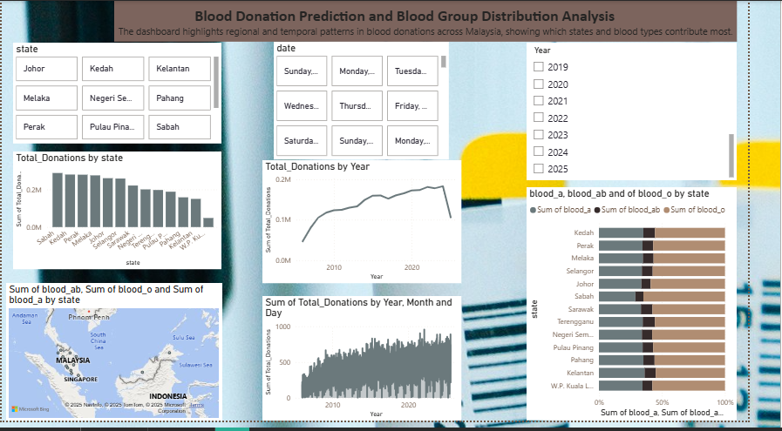
Power BI Dashboard Highlights
Slicers: Filter by state, blood group, year.
Charts: Line (trends), bar (comparisons), map (clusters).
Drill-downs: Explore donation patterns over time.
Tooltips & cards show predictions and totals.
Designed for use by hospitals and health ministries.

Slide 7
Recommendations
Focus campaigns in low-performing states (Cluster 2).
Promote donation of AB blood group.
Use dashboard regularly to monitor progress.
Customize donation drives based on regional data.

Slide 8
Future Work
Connect with hospitals in real-time to collect live donation data.
Forecast future donation needs using time-series models (e.g., Prophet, ARIMA).
Add external factors like population size, holiday seasons, and campaigns to improve predictions.
Scale the solution to cover larger regions or a national-level blood management system.

Slide 9
Thank you for your time and attention.

