Slide 1

Amazon DynamoDB
Presented By:
João Neto, Sana Imtiaz and Muhammad Bilal

Slide 2
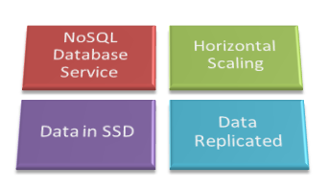
Introduction
Database type: Key-value stores
Fully managed NoSQL database service by Amazon

Slide 3
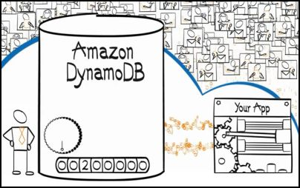
Features
Scalable
Fast Performance
Easy Administration
Fault-tolerant
Flexible
Efficient Indexing

Slide 4
Features
Strong consistency
Secure
Monitoring
Amazon Elastic MapReduce Integration
Amazon Redshift Integration

Slide 5
Data model concepts
Tables
Items
Attributes
Except for the primary key, DynamoDB is schema-less.
Each item can have any number of attributes.
An attribute can be single valued or multivalued set.

Slide 6
Data model concepts
Primary keys
Hash type primary key
Hash and range type primary key
Secondary Indexes
DynamoDB data types
Scalar data types
Multivalued data types

Slide 7
Supported Operations
Table operations
Item operations
Query and Scan
Data Read and Consistency considerations
Conditional updates and concurrency control

Slide 8
Thank you!

