Slide 1
Software developer
Danielius Karalius | SEWD | MCCC 2025/2026

Slide 2

What does a Software Developer do?
Research, design, and develop software applications using different programming languages
Not only this, but they’re responsible for debugging and troubleshooting programs
They are also responsible for maintenance to any code created

Slide 3

Education
At the bare minimum:
  Associate’s degree
Recommended:
  Bachelor’s degree
  Coding boot camps
  Professional certifications
  Source (MLA 9): Staff, Coursera. “How to Become a Software Developer (with or without a Degree).” Coursera, 2025, www.coursera.org/articles/how-to-become-a-software-developer?msockid=0ea10a710bc168f1115d1c3c0aef690c. Accessed 6 Nov. 2025.

Slide 4



Skills
Important soft skills:
  Communication
  Emotional Intelligence
  Adaptability
  Creativity
  Problem solving
  Patience
  Self-awareness
  Time management
  Negotiation
  Collaboration
  Leadership

Slide 5

Salary ($$$)
Entry-Level Range: $99,654
Mid-Career Range: $104,938
Senior-Level Range: $127,617
  Source: https://www.ziprecruiter.com/Salaries/Senior-Software-Developer-Salary-in-Mentor,OH
  Source: https://www.ziprecruiter.com/Salaries/Entry-Level-Software-Developer-Salary-in-Mentor,OH
  Source: https://www.salary.com/research/salary/listing/mid-level-software-developer-salary

Slide 6
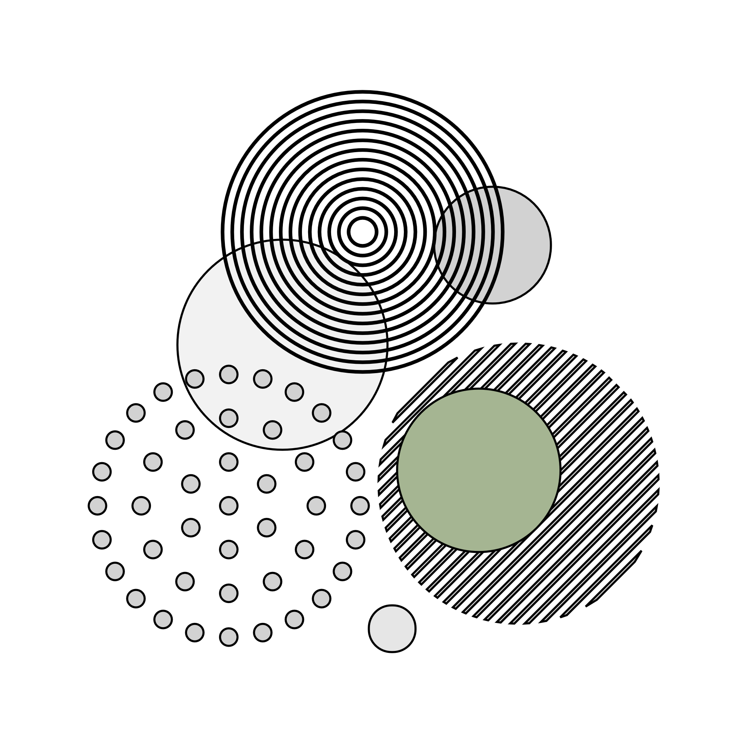
Job Outlook
Growth Rate (10 Years): 18%
Demand Level: 17%
According to bls.gov: “Overall employment of software developers… is projected to grow… much faster than the average for all occupations”
U.S. BUREAU OF LABOR STATISTICS. “Software Developers, Quality Assurance Analysts, and Testers.” Bls.gov, U.S. Bureau of Labor Statistics, 18 Apr. 2025, www.bls.gov/ooh/computer-and-information-technology/software-developers.htm.

Slide 7

Coursework Connection
Programming
Web Design
AI/Machine Learning
Software Developers do have to know programming languages (& how to program)
Web Design might not be a main focus for SD, but it’s still a handy skill to have
AI and Machine Learning are a must have in order to develop a fundamental understanding of certain technologies

Slide 8
Trends (Excel)
Source: https://www.bls.gov/ooh/computer-and-information-technology/computer-programmers.htm#tab-1

Slide 9

Closing Thoughts
A very diverse career
Could go from analyzing data structures to debugging a new project that your boss requests to have done by the end of the month

