Slide 1
When Should a Small Language Model Say “I Don’t Know”?
A compute-aware two-stage abstainer for Qwen2.5-0.5B on SQuAD 2.0
CISC7021 Applied Natural Language Processing · Group presentation
Student A: data · evaluation · M1 / M3 · two-stage method | Student B: interface · M2 / M4 · experiments
1 / 10
Notes:
开场 10 秒：抛问题——模型答不出来的时候，会不会说“我不知道”？我们用一个 0.5B 的小模型来测，并设计了“先看一眼、拿不准再多想几次”的两阶段方法。我是 A，负责数据、评测和两阶段；B 负责接口、M2/M4 和实验。

Slide 2
The problem, in one sentence
A model that always answers cannot tell you when it is guessing
Abstention
the model may decline to answer instead of guessing
Small models
are over-confident exactly where they are unreliable
Cost
checking every answer with 5 samples is 5× the inference
Same model, same confidence:
“Who wrote Hamlet?” → Shakespeare ✓
“Who directed the 1994 film?” (not in the context)
→ Steven Spielberg ✗
Illustrative example.
SQuAD 2.0: half of the questions are unanswerable by construction.
2 / 10
Notes:
30 秒：什么叫拒答——模型可以说“我不知道”，而不是硬编。小模型的问题是在它不可靠的地方反而很自信。右边这个例子是示意：同一个模型，能答的答对，不能答的照样编一个。SQuAD 2.0 里一半题就是这种不可答的。

Slide 3
How others do it
Four families of abstention methods
Token probability
confidence from log-probs of the answer
Kadavath et al. 2022 · Jiang et al. 2021
Verbalized uncertainty
ask the model how sure it is
Lin et al. 2022 · Xiong et al. 2024
Sample consistency
same answer across samples = confidence
Kuhn et al. 2023 · Xiong et al. 2024
Abstention tuning
fine-tune the model to say “I don’t know”
Zhang et al. 2024 (R-Tuning)
Gap: validated mostly on ≥7B models. Small models are more over-confident, and consistency costs 5× inference.
3 / 10
Notes:
30 秒：前人四类方法——看 token 概率、让模型自己说、多次采样看一致性、微调让它学会拒答。但这些基本都在 7B 以上的模型上验证；小模型更过度自信，而且多次采样很贵。这就是我们的切入点。

Slide 4
Data and evaluation protocol
Comparable numbers, not cherry-picked thresholds
1,000 questions per split: 500 answerable + 500 unanswerable (seed 42)
Thresholds tuned on val only; test scored once
Coverage = share answered · Selective accuracy = accuracy on answered
Overall accuracy = correct answers + correct refusals
Always-abstain baseline = 50.0% ← the line to beat
4 / 10
Notes:
35 秒：1000 题，一半可答一半不可答。阈值只在验证集上选，测试集只跑一次，避免在测试集上挑好看的数。注意“全部拒答”就有 50 分，因为一半题本来没答案——所有方法都要跟这条线比。

Slide 5
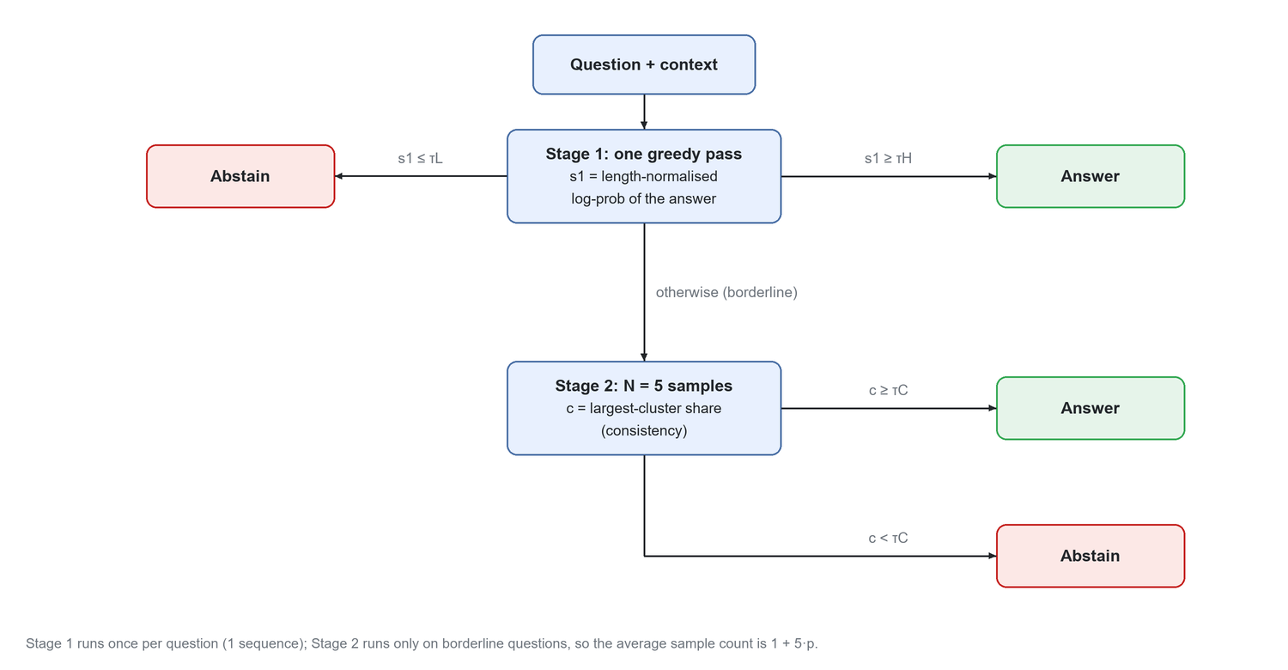
Three methods, one cost axis
M1 and M3 are baselines; the two-stage abstainer is ours
M1 · single pass
mean token log-prob of one greedy answer
M3 · 5 samples
largest-cluster share (consistency)
Two-stage · ours
M1 screens; only borderline questions pay for M3
5 / 10
Notes:
40 秒：M1 只看一眼，用 token log-prob 当把握；M3 采 5 次看答案一不一致。我们的两阶段：先一次推理筛，很有把握直接答，完全没把握直接拒，只有中间那批才花 5 次——平均成本 1+5p。

Slide 6
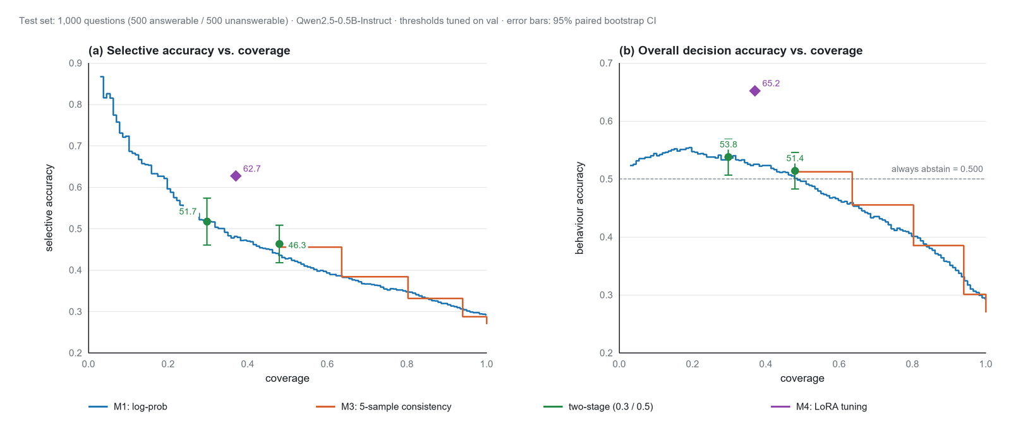
Results at fixed coverage
Selective accuracy and overall accuracy against coverage
At 0.5 coverage: M1 42.8 · M3 45.6 · two-stage 46.3 · M4 (LoRA) 62.7 at 37% coverage (selective accuracy, %)
6 / 10
Notes:
40 秒（B 讲）：两条曲线是 M1 和 M3，绿点是两阶段在 0.3 / 0.5 覆盖率上的操作点。左边看“答的题里多准”，右边看“整体决策多对”，虚线是全部拒答的 50 分基线。

Slide 7
What the confidence signals can and cannot do
Two real questions from the 1,000-question test split
Detect a wrong answer (answerable)
0.79 / 0.82
AUROC, M1 / M3
Answerable — answers, and is right
“What is the name of the desert city?”
model: Palm Springs (log-prob −0.016)
Detect an unanswerable question
0.60 / 0.57
AUROC, M1 / M3
Unanswerable — answers anyway
“Who was a pioneer in 1948?”
model: Boris Trakhtenbrot (log-prob −0.027)
Nearly the same confidence, opposite outcomes — a threshold on confidence alone cannot separate them.
7 / 10
Notes:
30 秒：左边两个 AUROC 说明信号能判“答得对不对”（0.79/0.82），但判不了“该不该答”（0.60/0.57）。右边两道真题：第一道该答、答对了；第二道原文没有答案、它照样用几乎一样的置信度答了个人名。这就是为什么覆盖率一高就压不住错误。

Slide 8
The two-stage gain is compute, not accuracy
Average sequences per question on the test split
Method | Coverage | Samples / question | Wall clock
M1 | 0.30 | 1.00 | 0.18 s
M3 (k=5) | 0.48 | 5.00 | 0.32 s
Two-stage | 0.30 | 2.23 | 0.25 s
Two-stage | 0.50 | 3.58 | 0.34 s
−28% samples
at the same quality
Sampling is batched: 5 samples cost ≈1.8× wall clock, not 5× — the saving is in samples, not seconds.
8 / 10
Notes:
25 秒：0.5 覆盖率时两阶段和 M3 质量持平，采样 3.58 对 5，少 28%。要说清楚：采样是批量并行的，5 次只花 1.8 倍墙钟，所以省的是采样数/显存，不是秒数。

Slide 9
Takeaways
What worked, what did not
M4 (LoRA abstention tuning) is the strongest: 65.2% overall at 37% coverage, 15 points above always-abstain
Training-free methods are capped at 49–54% overall — they cannot tell answerable from unanswerable
Among training-free ones the two-stage matches M3 at 0.5 coverage with 1.90 vs 5.00 samples (k=3); more samples do not help
Limitations: M3 cannot go below 48% coverage; M2-idk almost never refuses (77% coverage); calibration not applied
9 / 10
Notes:
30 秒（B 讲）：最重要的结论是 M4——微调过的模型 37% 覆盖率下有 65.2% 的整体准确率，比“全部拒答”高 15 个点，明显强于所有免训练方法。免训练的 M1/M3/两阶段都卡在 50% 附近，因为判不了“该不该答”。两阶段的价值只剩“同质量省采样”。局限：M3 到不了 0.3 覆盖率，M2-idk 几乎不拒答。

Slide 10
Who did what
Both members can answer questions on the whole pipeline
Student A
• Data pipeline and fixed splits
• Evaluation protocol and metrics
• M1 / M3 baselines
• Two-stage abstainer + thresholds
• Statistics, figures, report §1–4
Student B
• Unified inference interface (SLM)
• M2 verbal confidence, M4 LoRA fine-tuning
• Experiment runs and case analysis
• Report §5, video and code repository
Questions?
10 / 10
Notes:
10 秒：分工一句话带过，然后进入提问。

