Slide 1

FACEMOJI
TEAM4
곽준호 김선준 박지호 박종석

Slide 2
Project Idea

Slide 3

image source : unsplash.com

Slide 4
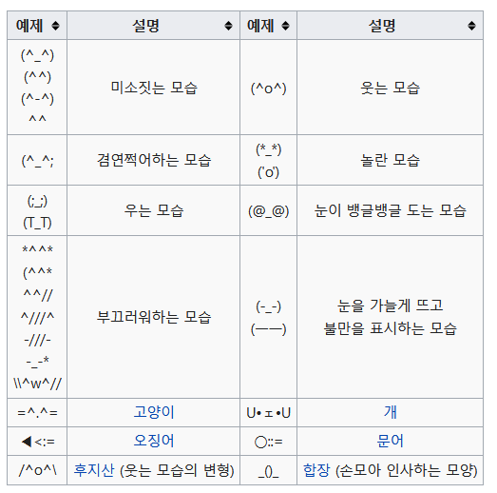
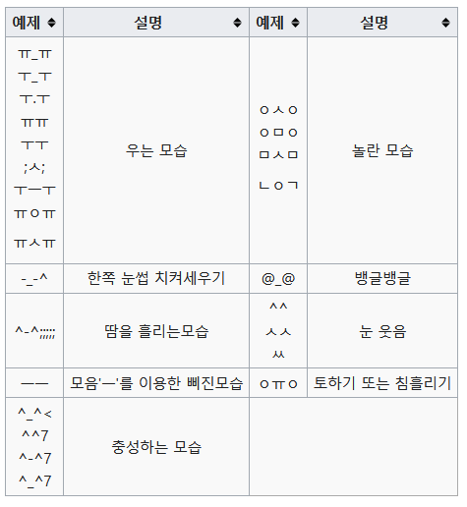
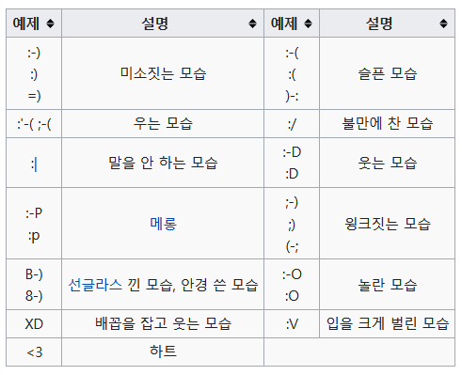

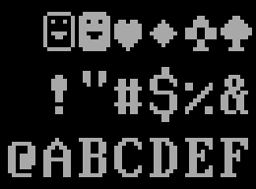
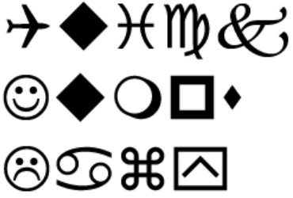

reference : wikipedia

Slide 5
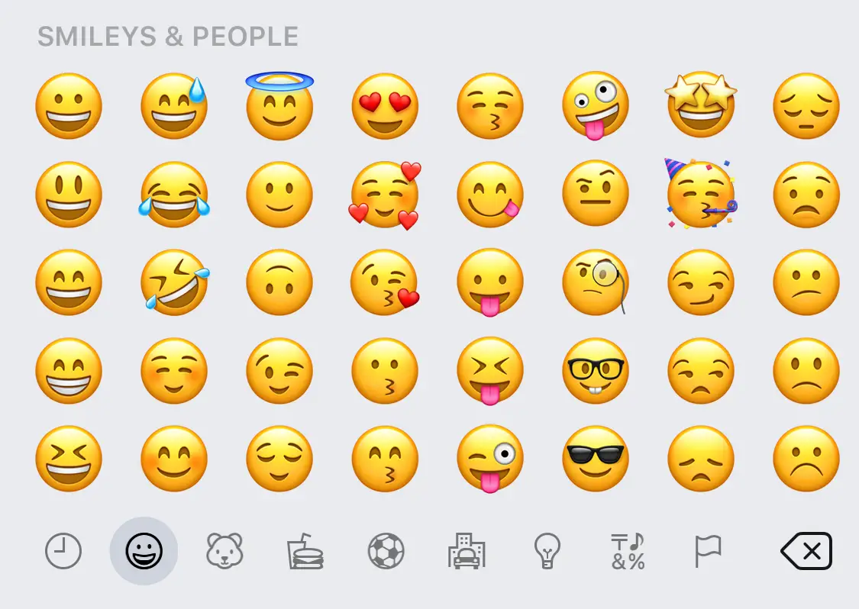

Slide 6
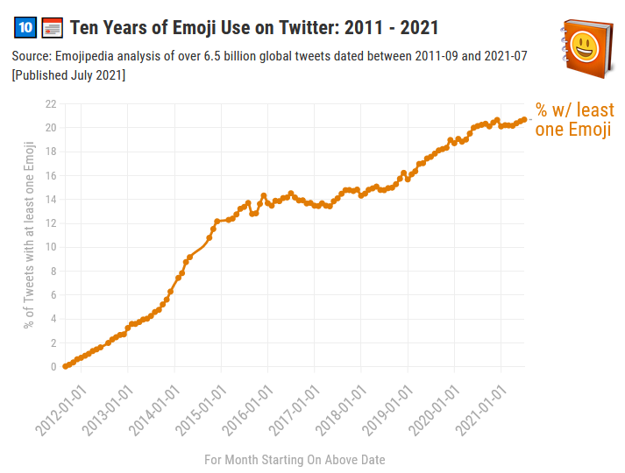
92% of the online population uses emoji daily.
Emojis are processed by the brain as non-verbal information.
Comments and shares in SNS increase by 33% when emojis are present.
Reference : https://blog.emojipedia.org/emoji-use-at-all-time-high.

Slide 7
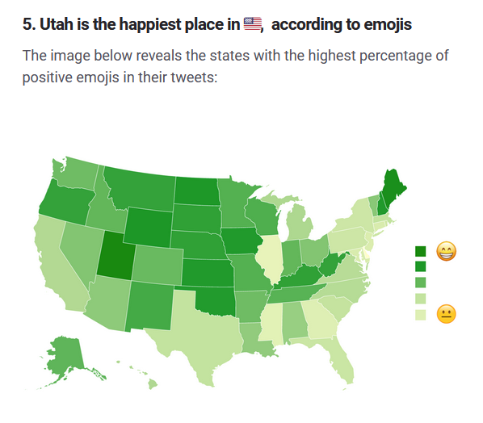
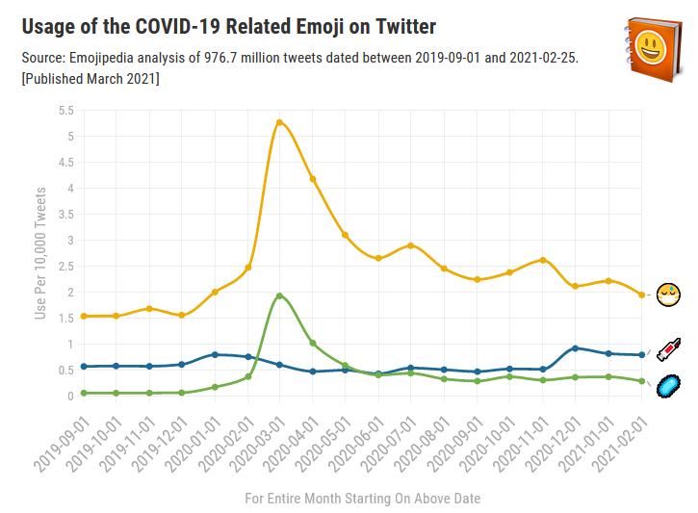
Reference : https://blog.emojipedia.org/one-year-on-bored-of-the-pandemic/

Slide 8

emoji = global standard
Reference : https://blog.emojipedia.org/one-year-on-bored-of-the-pandemic/

Slide 9
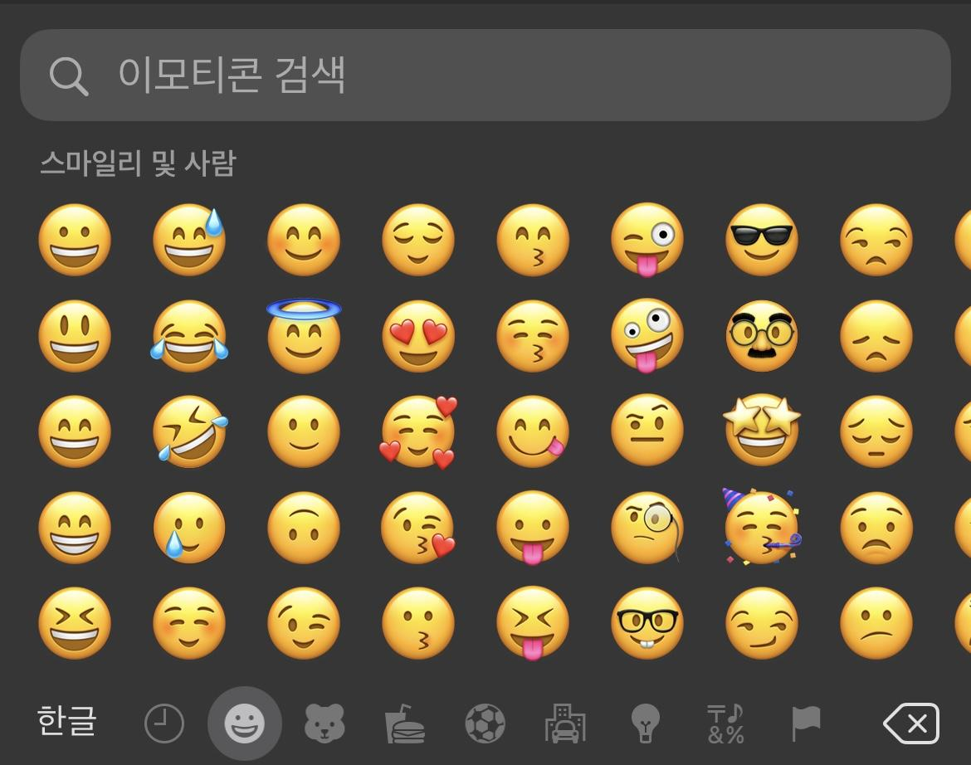
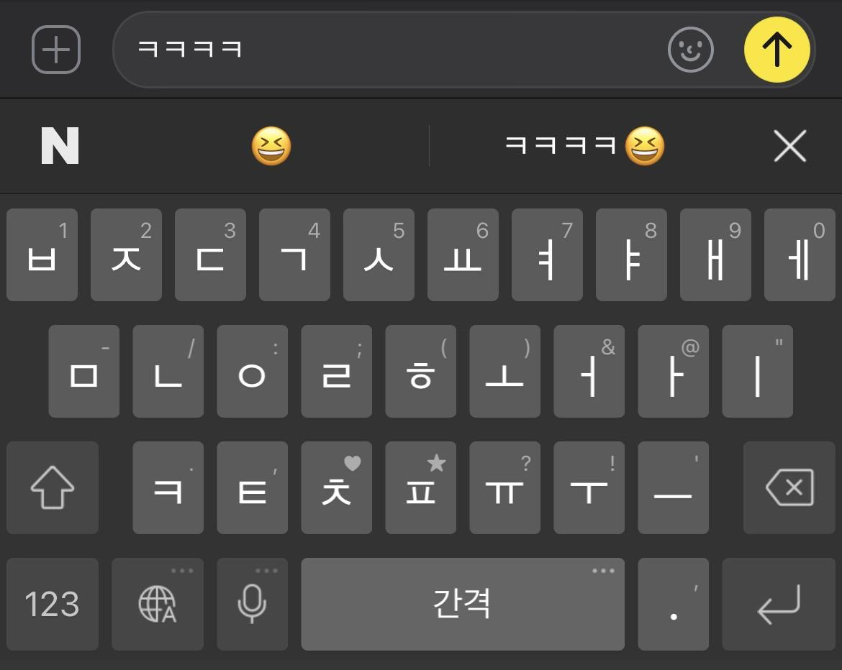
But...
poor, naive, primitive, boring interface

Slide 10
But...
poor, naive, primitive, boring interface
need to know
the name of emoji
in advance
limited emotions
&
limited emojis

Slide 11
But...
poor, naive, primitive, boring interface
Can’t we do better?
need to know
the name of emoji
in advance
limited emotions
&
limited emojis

Slide 12


Key Components of Our Approach
ML based Face Detection
Graph Structured Emoji Classification

Slide 13
Target Users
Creature of Habits
Emotionally-Drained
Elderly
Young

Slide 14
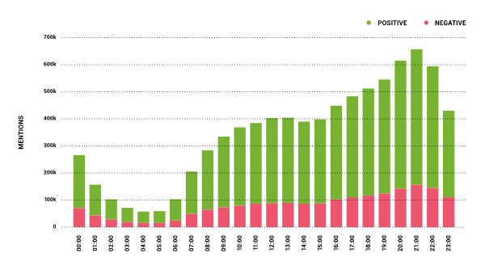
Target Users
Creature of Habits
Emotionally-Drained
Elderly
Young

Slide 15
Target Users
Creature of Habits
Emotionally-Drained
Elderly
Young

Slide 16
Demo

Slide 17
Demo
Basic Keyboard, with Camera Feature Integrated.
Analyzing Real Time Video and Extract Facial Information

Slide 18
System Architecture Overview

Slide 19

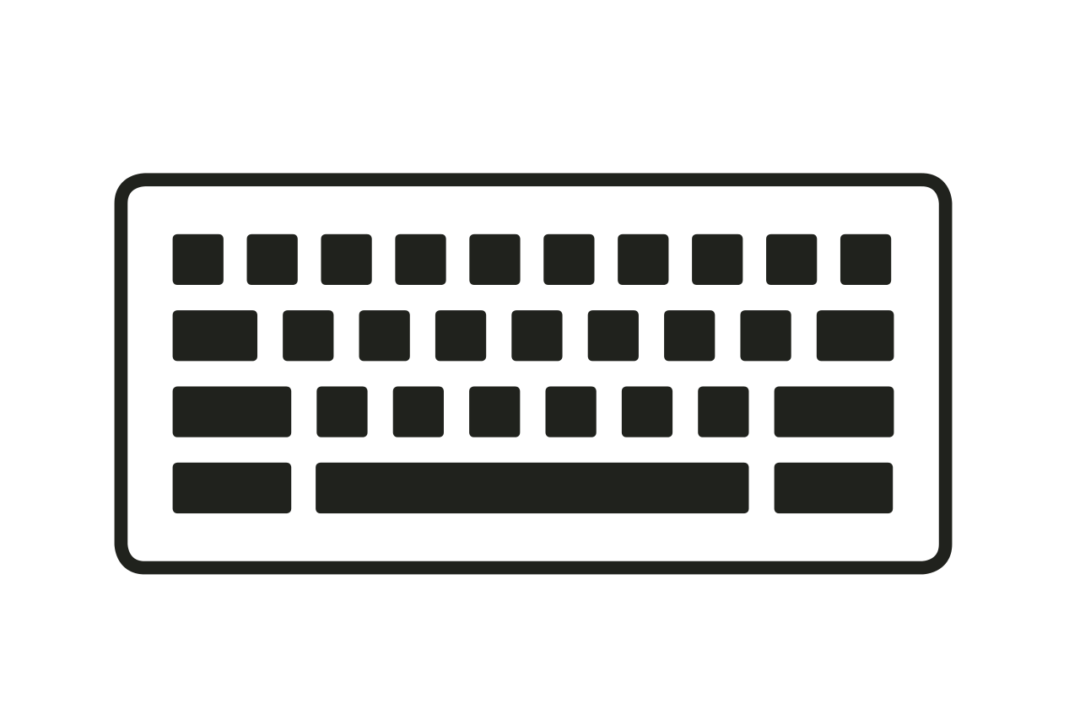








Slide 20



normal input
one emoji
&
adjacent emojis
Keyboard Service
BFS
Graph
Traversal
Engine
Graph Structured
Emoji Database
input
touch input
video input
single emoji
facial features
Emoji Mapping Engine
Face Analyzer

Slide 21













emoji graph would be like...

Slide 22
Key Technical Challenges & Solutions

Slide 23
Challenge & Solution
Challenge As Hangul letter is combination of consonants and vowels, naïve implementation of keyboard makes Hangeul output separated, such as “안녕” into “ㅇㅏㄴㄴㅕㅇ”.
Solution We designed 4-states automata. Each state represents initial state, 초성이 들어온 상태, 중성이 들어온 상태, and 종성이 들어온 상태. This states enable proper processing of consonants and vowels in Hangul.

Slide 24
Challenge & Solution
Challenge With a class which inherits AppCompatActivity, it is impossible to make a keyboard application that is usable in other applications.
Solution
We made an application as a service form. We defined a class which inherits InputMethodService, and processed keyboard input with currentInputConnection object.

Slide 25
Challenge & Solution
Challenge KeyboardCamera class is not a context and does not have a lifecycle, which does not fit with CameraX api.
Solution
We made KeyboardCamera class include a ‘service’ to have a class, and inherit LifecycleOwner interface to have a lifecycle.

Slide 26
Challenge & Solution
Challenge It is difficult to keep the text erased by pressing and holding the backspace button.
Solution
We added onTouchListener, and made action_down event to keep erasing the text. In order to add feedback to the backspace button, we had to modify isPressed property of the view programmatically.

Slide 27
Challenge & Solution
Challenge It is impossible to pass face information to FaceContourOverlay in FaceAnalyzer class, which is necessary to display face to screen.
Solution We made an abstract interface in FaceAnalyzer class. Then, we added createFaceDetector function which returns FaceAnalyzer instance, and passed face information with implementing abstract interface.

Slide 28
Challenges to be Addressed
Mapping face detection results to single emoji.
Make graph of emojis with respect to their similarity in meaning & context.

Slide 29
Project Schedule

Slide 30
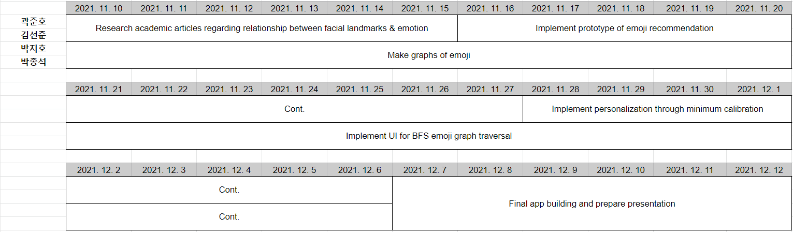
Timeline

Slide 31
Final Deliverable

Slide 32
Final Deliverable
A Keyboard app with novel emoji interface.
The interface first receives video input of face.
Then it recommends corresponding emoji, with several similar emojis.
User can select specific emoji, and choose whether to
continue traverse from that emoji
or type that emoji
User can personalize recommendation engine.

Slide 33
Success Criteria

Slide 34
Success Criteria
Accuracy
Intended emoji should be recommended with 80% accuracy.
Searching specific emoji in mind should be done in at most three step.
Latency
Face detection should be done in 1 second.
Latency of processes other than face detection should be negligible.
UI/UX
Graph traversal should be done in intuitive manner.

Slide 35
Questions?

