Slide 1
NX11 - Fasteners
Named Faces

Slide 2


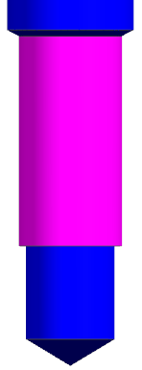
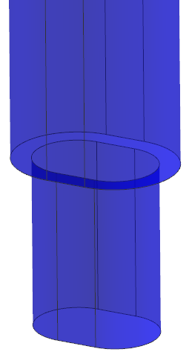


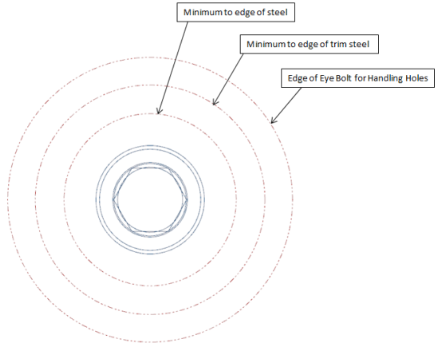
SHCS – Reference Sets
BODY
TAP & SHORT TAP
HARD_TAP_CLR
SLOT_CBORE
CBORE
CLR_SCREW_HEAD
BODY_EDGES

Slide 3

SHCS_BODY
SHCS_BODY_TOP
SHCS_BODY_HEAD_DIA
SHCS_BODY_HEAD_DEPTH
SHCS_BODY_CHECK_DIA
SHCS_BODY_CHECK_DEPTH
SHCS_BODY_THREAD_DIA
SHCS_BODY_BOTTOM

Slide 4
SHCS_CBORE
SHCS_CBORE_TOP
SHCS_CBORE_HEAD_DIA
SHCS_CBORE_DEPTH
SHCS_CBORE_HOLECHART
SHCS_CBORE_BOTTOM

Slide 5
SHCS_TAP & SHORT_TAP
SHCS_TAP_TOP
(SHCS_SHORT_TAP_TOP)
SHCS_TAP_HOLECHART
(SHCS_SHORT_TAP_HOLECHART)
SHCS_TAP_DEPTH
(SHCS_SHORT_TAP_DEPTH)
SHCS_TAP_DRILL_DIA
(SHCS_SHORT_TAP_DRILL_DIA)
SHCS_TAP_BOTTOM
(SHCS_SHORT_TAP_BOTTOM)

Slide 6
SHCS_HARD_TAP_CLR
SHCS_HARD_TAP_CLR_TOP
SHCS_HARD_TAP_CLR_CLR
SHCS_HARD_TAP_CLR_CLR_BOTTOM
SHCS_HARD_TAP_CLR_HOLECHART
SHCS_HARD_TAP_CLR_DEPTH
SHCS_HARD_TAP_CLR_DIA
SHCS_HARD_TAP_CLR_BOTTOM

Slide 7
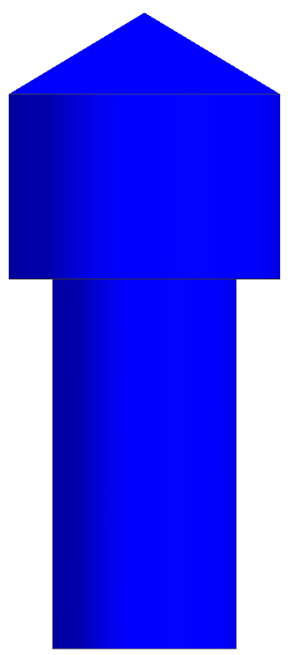
SHCS_CLR_SCREW_HEAD
SHCS_CLR_SCREW_HEAD_TOP
SHCS_CLR_SCREW_HEAD_DIA
SHCS_CLR_SCREW_HEAD_DEPTH
SHCS_CLR_SCREW_HEAD_THREAD
SHCS_CLR_SCREW_HEAD_BOTTOM

Slide 8
SHCS_SLOT_CBORE
SHCS_SLOT_CBORE_TOP
SHCS_SLOT_CBORE_HEAD_FLAT2
SHCS_SLOT_CBORE_HEAD_RADIUS2
SHCS_SLOT_CBORE_DEPTH
SHCS_SLOT_CBORE_THREAD_FLAT2
SHCS_SLOT_CBORE_THREAD_RADIUS2
SHCS_SLOT_CBORE_BOTTOM
SHCS_SLOT_CBORE_HEAD_FLAT1
SHCS_SLOT_CBORE_HEAD_RADIUS1
SHCS_SLOT_CBORE_THREAD_FLAT1
SHCS_SLOT_CBORE_THREAD_RADIUS1

Slide 9

SHCS BODY EDGES
BODY_EDGE_MINIMUM
BODY_EDGE_TRIM_STEEL
BODY_EDGE_EYE_BOLT

Slide 10
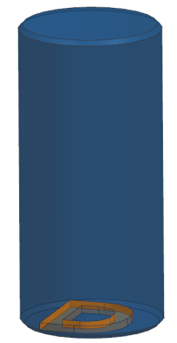
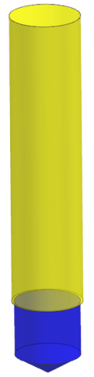

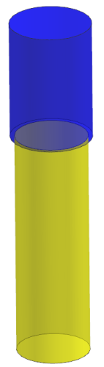
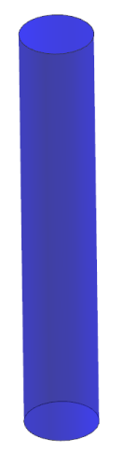

Dowels – Reference Sets
BODY
REAM & REAM_SHORT
BLIND_REAM
CBORE
CLR_HOLE
BODY_EDGE

Slide 11

DWL_BODY
DWL_BODY_TOP
DWL_BODY
DWL_BODY_BOTTOM

Slide 12

DWL_CBORE
DWL_CBORE_TOP
DWL_CBORE_CLR_DIA
DWL_CBORE_CLR_DEPTH
DWL_CBORE_HOLECHART
DWL_CBORE_BOTTOM

Slide 13

DWL_REAM & REAM_SHORT
DWL_REAM_TOP
DWL_REAM_SHORT_TOP
DWL_REAM_HOLECHART
DWL_REAM_SHORT_HOLECHART
DWL_REAM_DEPTH
DWL_REAM_SHORT_DEPTH
DWL_REAM_DRILL_DIA
DWL_REAM_SHORT_DRILL_DIA
DWL_REAM_BOTTOM
DWL_REAM_SHORT_BOTTOM

Slide 14

DWL_CBORE_CLR
DWL_CBORE_CLR_TOP
DWL_CBORE_CLR_DIA
DWL_CBORE_CLR_BOTTOM

Slide 15
DWL_BLIND_REAM
DWL_BLIND_REAM_TOP
DWL_BLIND_REAM_DRILL_DIA_TOP
DWL_BLIND_REAM_DEPTH_TOP
DWL_BLIND_REAM_HOLECHART
DWL_BLIND_REAM_DEPTH_BOTTOM
DWL_BLIND_REAM_DRILL_DIA_BOTTOM
DWL_BLIND_REAM_BOTTOM

Slide 16

DWL_BODY_EDGE
BODY_EDGE_MINIMUM
BODY_EDGE_TRIM

Slide 17
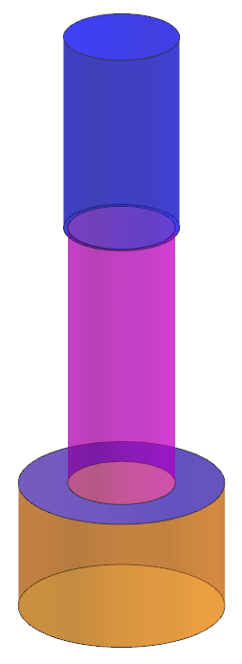
Jig Jacks TSG
JJ_CLR_TOP
JJ_CLR_DIA
JJ_CLR_DEPTH
JJ_CLR_HOLECHART
JJ_LOCATOR_DEPTH
JJ_LOCATOR_DIA
JJ_LOCATOR_BOTTOM

Slide 18
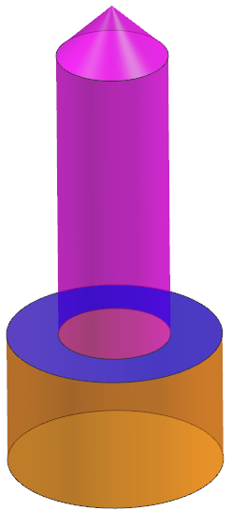
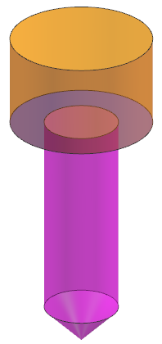
JJ_CBORE_BLIND
JJ_BLIND_TOP
JJ_BLIND_HOLECHART
JJ_BLIND_LOCATOR_DEPTH
JJ_BLIND_LOCATOR_DIA
JJ_BLIND_LOCATOR_BOTTOM
JJ_BLIND_OPP_LOCATOR_TOP
JJ_BLIND_OPP_LOCATOR_DIA
JJ_BLIND_OPP_LOCATOR_DEPTH
JJ_BLIND_OPP_HOLECHART
JJ_BLIND_OPP_BOTTOM

Slide 19
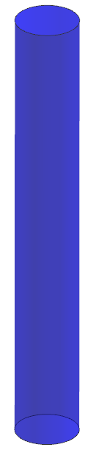
JJ_CLR_HOLE
JJ_CLR_HOLE_TOP
JJ_CLR_DIA
JJ_CLR_HOLE_BOTTOM

Slide 20
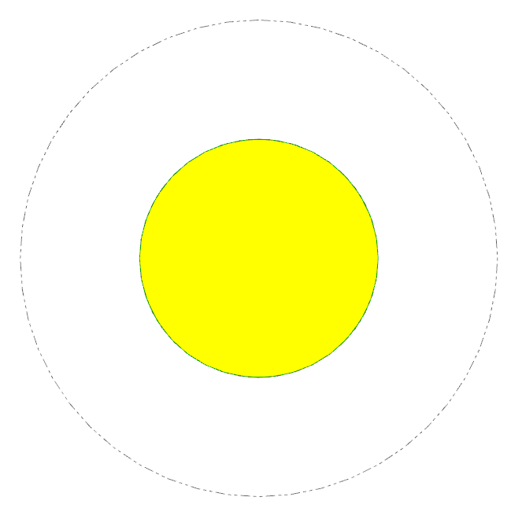
JJ_BODY_EDGE
JJ_LOCATOR_EDGE
JJ_MOVE_FACE

Slide 21
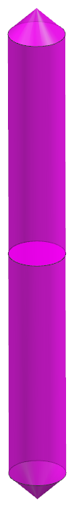
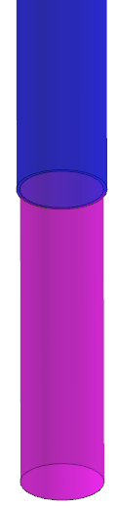
JackScrews – Reference Sets
CBORE
CBORE_BLIND
CBORE_BLIND_OPP

