Slide 1

NX 11 Transition
Toolbars Re-Organized
Ufunc Updates
0Library
Preferences / Settings
New Functionality

Slide 2
CTS Custom - Re-Organized
NX9 – CTS Custom
Design – Components – Grid – Ufunc - Utility
NX11 – CTS Custom
Simulation – Layout – Design - Utility

Slide 3
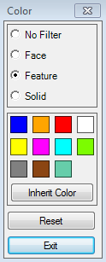
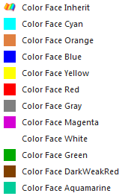
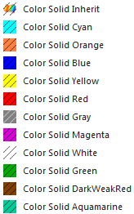
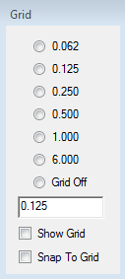
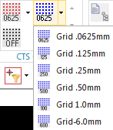
Ufunc Updates
NX9
NX11
Color
Color Face & Color Solid
Grid
Removed
Cbore Wave Subtract - Use Add Fasteners
Tap Wave Subtract - Use Add Fasteners
Undo Cbore Wave Subtract - Use Add Fasteners
Check Jig Jacks – In Design Check
ExportDesign – In AssemblyExportData
Notes:
Grid preference?

Slide 4
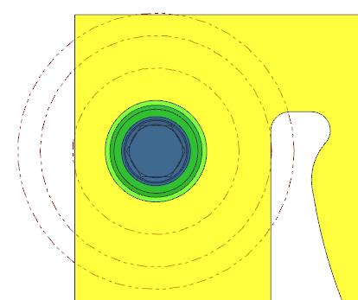
Design Check
Replaces CheckJigJacks
Future Enhancement?
Design Check Start
Validate Jig Jacks Start
Found 2 components with Jig Jacks.
Passed: 2
Validate Folder Locations Start
Found 86 individual parts loaded in assembly.
Passed: 86
Failed: 0
Validate Component Names
Found 29 individual components loaded in assembly.
Passed: 29
Failed: 0
Validate Cbore Depths
Parts: 2
Passed: 1
Failed: 1
5816-010-100
Design Check End
0hr:0min.5sec.586mil-sec
Check to non trim edges?
Check to Trim Edges?
Idea’s?
Red – Failed
Yellow – Caution (+.050)
Green - Passed
Notes:
Other Design Check idea’s?

Slide 5
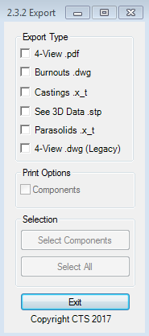
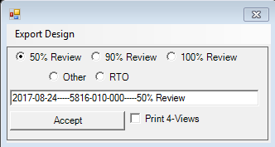
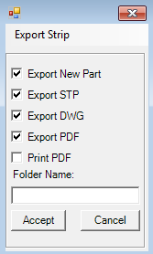
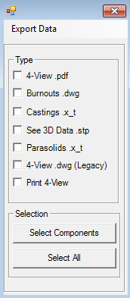
Assembly Export Data
NX9
NX11
After NX11 rollout
Notes:
Do example files shown ever need to be exported? No

Slide 6
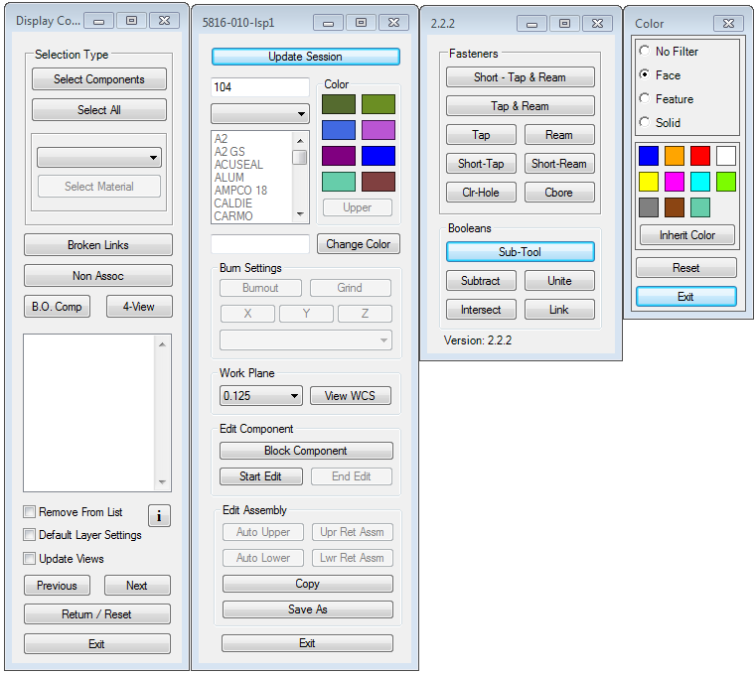
Startup Ufuncs
NX9 Startup
Set a filter for Change Displayed Part.
Turned of string mode in Basic Curves
NX11 Startup Ufuncs
Opens 4 Ufuncs at once
  CycleComponents
  ComponentBuilder
  AddFasteners
  Color
Added String Mode Off
Turns of String mode in Basic Curves
Notes:
Do example files shown ever need to be exported? No

Slide 7
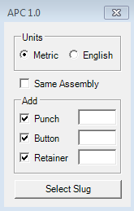
Pierced Data + Add Pierce Components
Pierced Data
  Saves a datum csys at the center of selected slugs and names them.
  Must be run from “XXXX-XXX-blank” or “XXXX-XXX-layout”.
Add Pierce Components
  Adds selected pierce components (Punch, Button & Retainer) to selected slugs. The button and punch will be aligned to selected slugs and placed at the correct "Z" axis location. The punch and retainer are constrained, so if the punch moves the retainer will move with it and the ball seat angle is constrained.
  If you want to use an existing punch, button and/or retainer, type the detail# here. If text box is left blank the program uses the next available detail# in current assembly.

Slide 8
Job Loader
Can be used to load old jobs.
  Loads library components from 0Library
  Loads all suppressed components from 0Library.

Slide 9
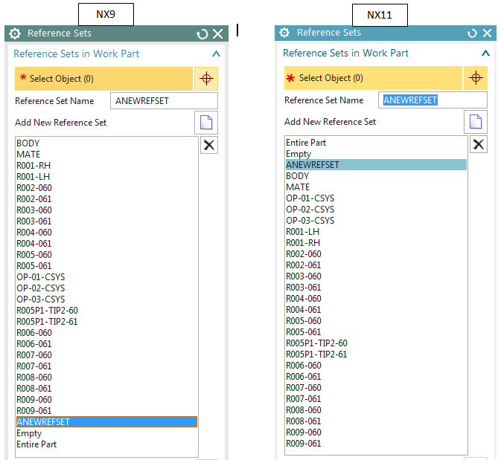
Reference Sets – Alphanumeric Sorting
R0XXXXX…
Pre-named reference sets are no longer needed.

Slide 10
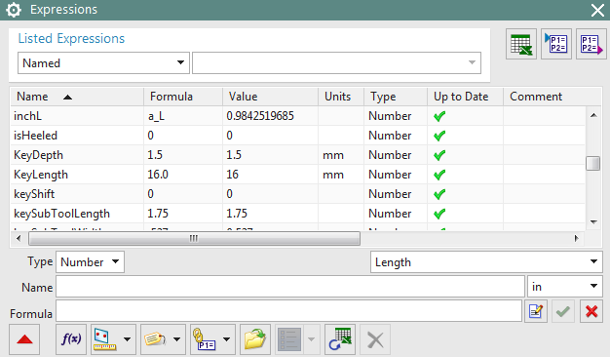
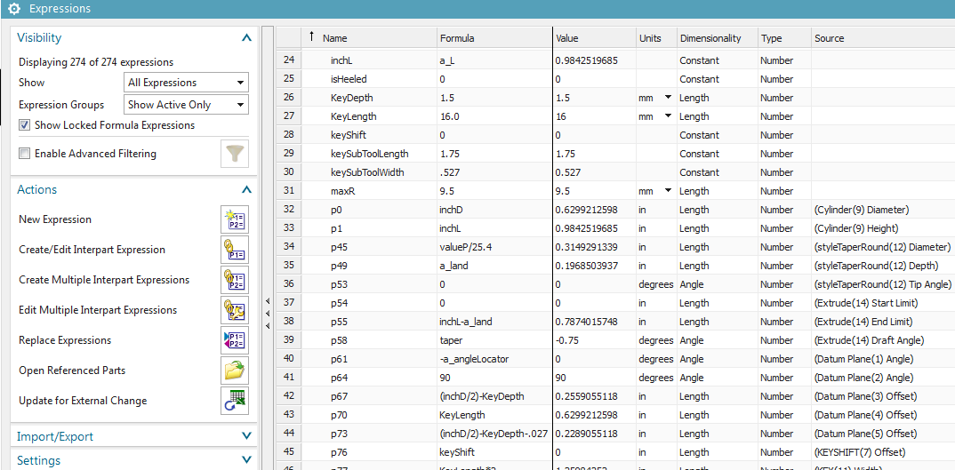
Expressions
NX9
NX11

Slide 11
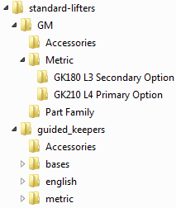
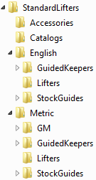
Library
NX9 – 0Components
  Will be removed after NX11 rollout
NX11 – 0Library
  Created so we can transition to NX11 gradually
  Consistent Folder Naming
  Added “Library” attribute to all library components

Slide 12
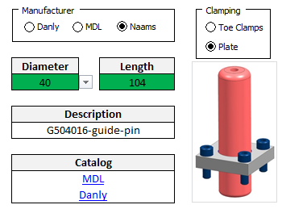
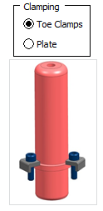
Guide Pin Clamping
Smart Danly-MDL-Naams Demountable Metric

Slide 13
Keyboard Customization
File – Customize (bottom right corner), or “Control+1”
  In Categories: field select “Window”, In Commands: field select “Change Displayed Part…”
  Enter “Ctrl+Shift+D” in Press new shortcut key: field and select “Assign”
If you customized your keyboard shortcuts in NX9
  In NX9, go to Customize Keyboard and select “Report” to get all shortcut s
  In NX11, customize keyboard to your preferences

Slide 14

Palettes
File – Preferences – Palettes
  Open Palette button
    Browse to “U:\nxFiles\Palettes0Library” and select (one at a time)
      smartComponentsMetric.pax
      addComponentMetric.pax
      addAssembliesMetric.pax
      smartComponentsEnglish.pax
      addComponentEnglish.pax
      addAssembliesEnglish.pax
      Tables.pax
    CTS Palettes button on the CTS Help tab will add the above palettes automatically.

Slide 15
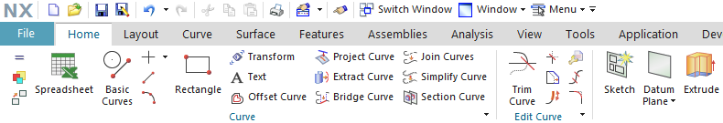
Roles
Your NX9 roles have been copied into NX11
  This means that your icon layout from NX9 will come into NX11.
  These are some of the settings that will still need to be changed per user preferences:
    Preferences – Selection
    Preferences – User Interface – Layout & Resource Bar
    Customize (Ctrl+1) – Icons/Tooltips tab

Slide 16
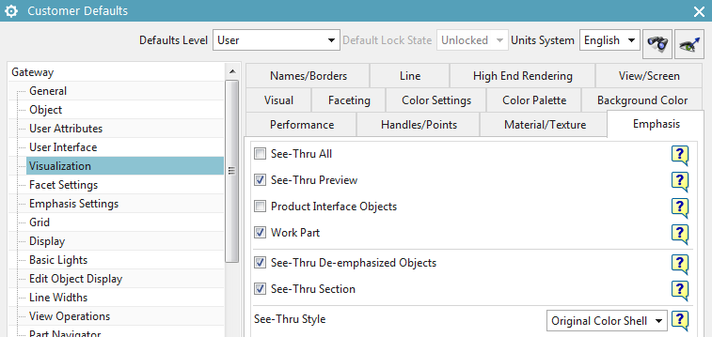
Customer Defaults – User Preference

Slide 17
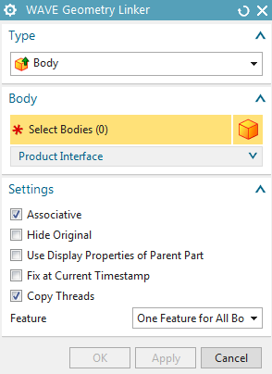
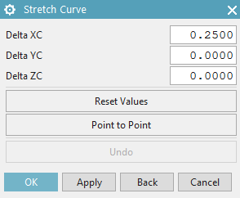
Known Issues
Make sure this is checked OFF
If on it still causes fasteners to become modified
Apply now causes model to immediately update
Right click – Properties… Occasionally produces message “There are no Properties defined for the selected object”
We need to be able to reproduce this and send to GTAC.

Slide 18
New Functionality
Isolate in New Window
https://community.plm.automation.siemens.com/t5/NX-Design-Knowledge-Base/NX-11-0-1-Isolate-in-New-Window/ta-p/389309
Combine
https://community.plm.automation.siemens.com/t5/NX-Design-Knowledge-Base/Introducing-Combine-in-NX-11-0-1/ta-p/391455
Renew Feature:
https://docs.plm.automation.siemens.com/tdoc/nx/11/nx_help#uid:index_whatsnew:id1241822:xid718232:xid1183080:xid1096244
New Modeling Commands:
https://docs.plm.automation.siemens.com/tdoc/nx/11/nx_help#uid:index_whatsnew:id1241822:xid718232:xid1183080
YouTube
https://www.youtube.com/watch?v=Rv9ln8HKxis&list=PL1m1vu8_quoANFmv4FNxNl6Cr6G3AFPzG&index=5

Slide 19

We are here to help…

