Slide 1


Slide 2
General Facts
Running time: 106 minutes
Age rating: FSK6
Director: Chris Columbus
Publishing year: 2015
Budget: 88-129 million $
Box office: 244.9 million $

Slide 3
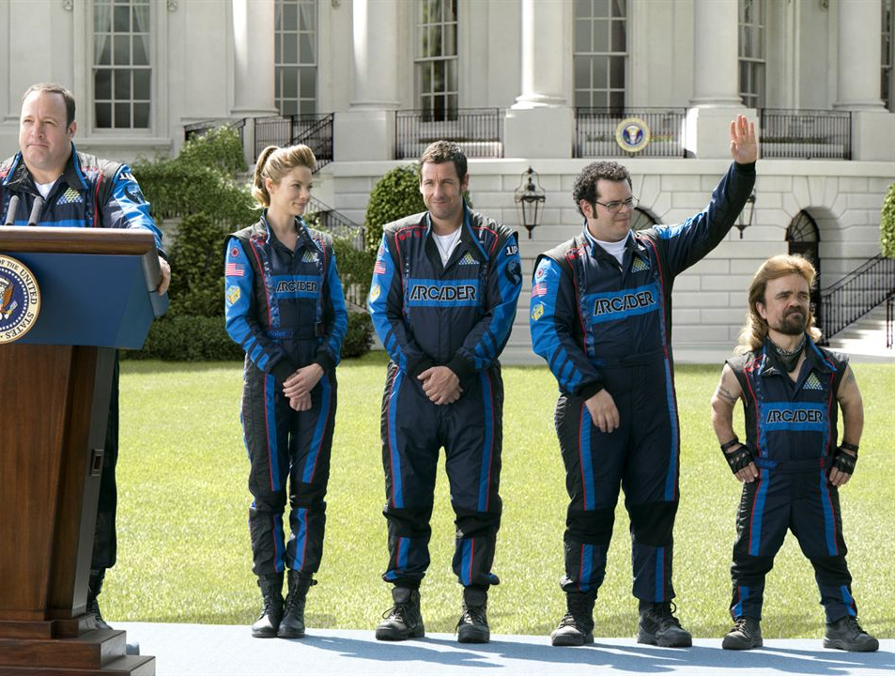
Main characters
President Will Cooper (Kevin James)
Violet Van Patten (Michelle Monaghan)
Sam Brenner (Adam Sandler)
Ludlow “the Wonder kid” Lamonsoff (Josh Gad)
Eddie „the Fireblaster“ Plant (Peter Dinklage)

Slide 4
Plot
Sam and Will Arcade Championship
Sam looses in Donkey Kong
US-Army base attacked
Sam works at the home of Violet Van Patten
In White House Sam talking to President Will Cooper
Sam and Ludlow train Navy SEALs the game
Pac-Man in New York
Huge attack in Washington D.C.

Slide 5
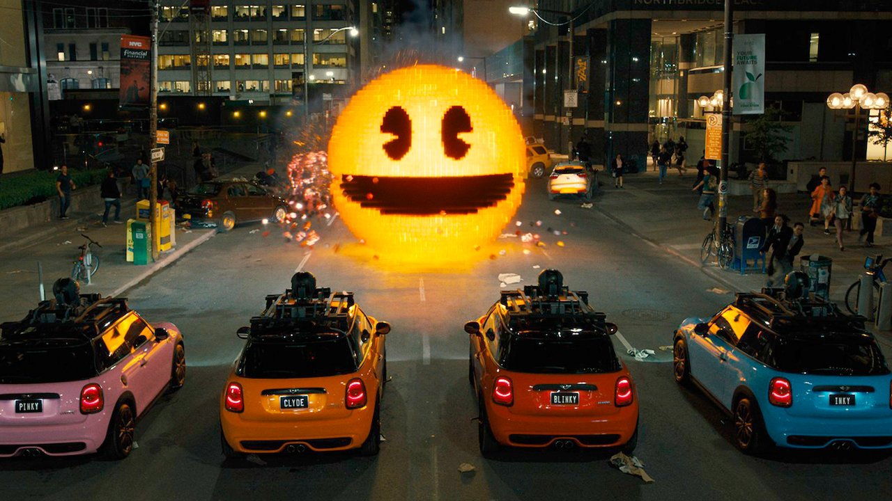
My favourite Scene

Slide 6
Pros
Special effects
Animations

Slide 7
Cons
Some Scenes a bit stretched
CGI sometimes very bright
Big time jumps

Slide 8
Recommendation
Yes when you like old Arcade games mixed with an action movie!

Slide 9
Thank you for listening!

