Slide 1
Kubernetes 101: Enough for an Interview
Aaron Chamberlain
August 25th at Tracy Developers

Slide 2
What is Kubernetes?

Slide 3
What is Kubernetes?
“Kubernetes (K8S) is an open-source system for automating deployment, scaling, and management of containers.“
                -Source: kubernetes.io

Slide 4
Wait, what is a container?

Slide 5
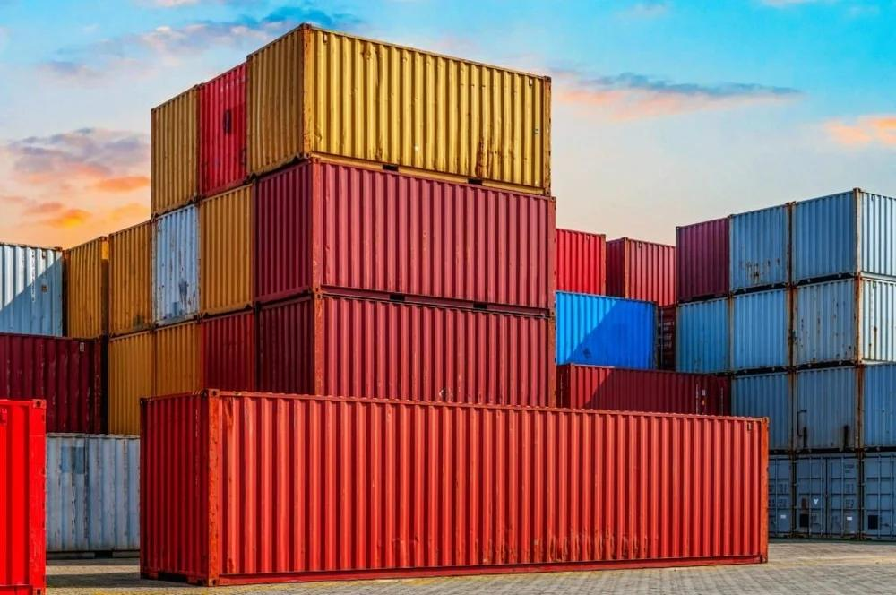
This thing?

Slide 6
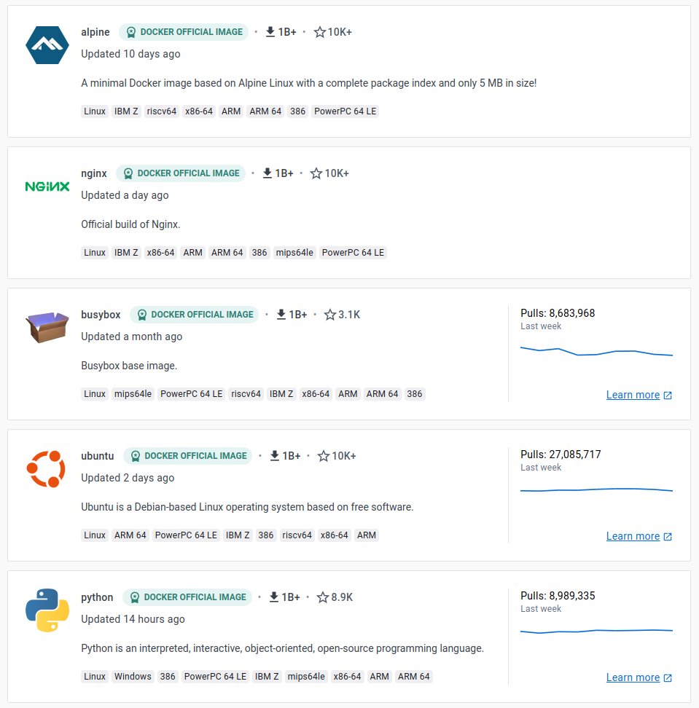
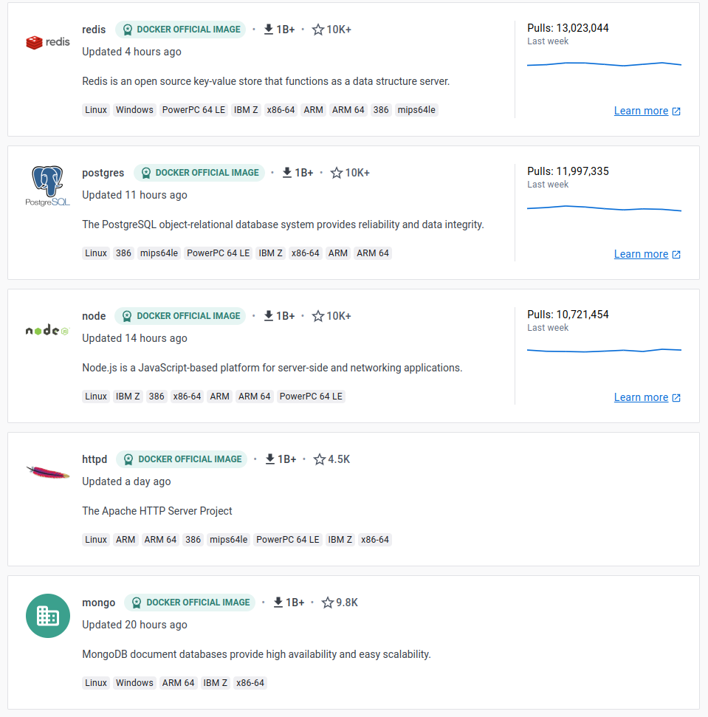
More like this thing.

Slide 7
What is a container?
“A container is a standard unit of software that packages up code and all its dependencies so the application runs quickly and reliably from one computing environment to another.“
-Source: docker.com/resources/what-container

Slide 8
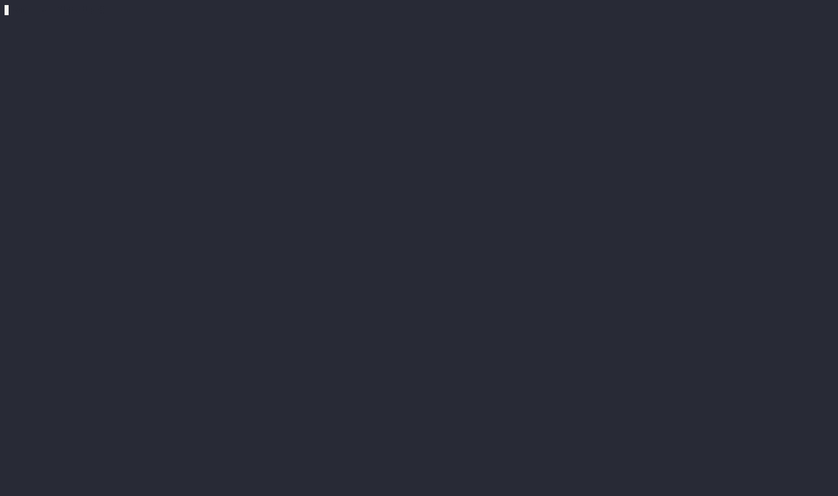
An example of pulling and running MongoDB

Slide 9
So how did we get here?

Slide 10
In the beginning.
Infrastructure architecture, capacity, and security were an afterthought.
We had to bring down websites for maintenance.
Development practices were lacking.
  No tests, no source control.

Slide 11
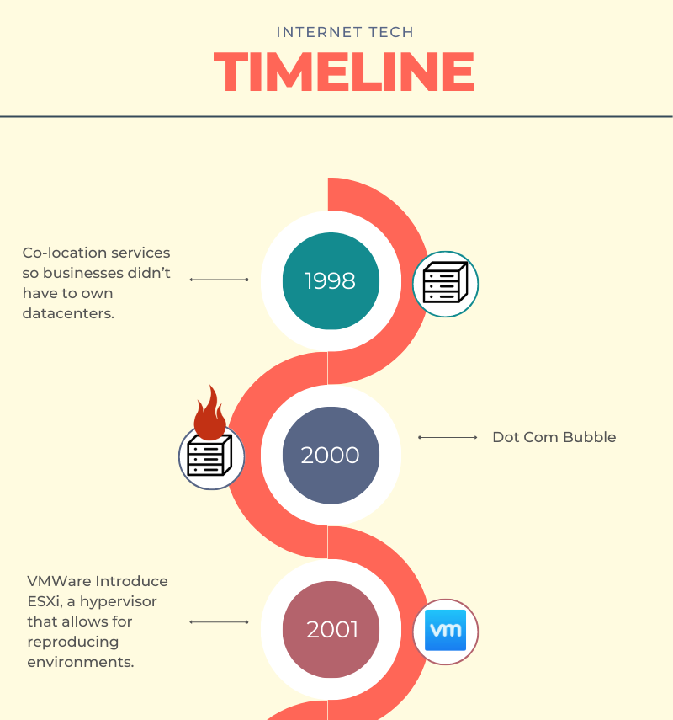

Slide 12
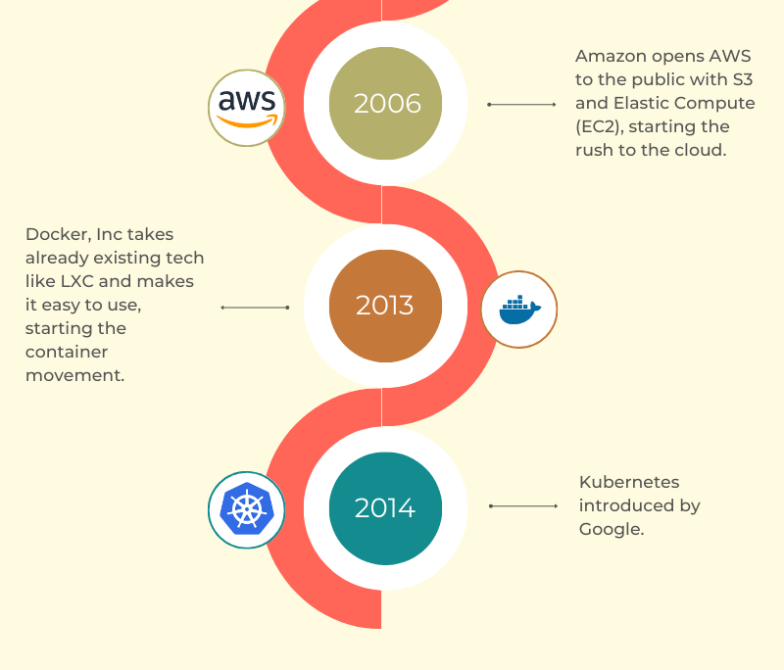

Slide 13
So why do we need Kubernetes?

Slide 14
Why Kubernetes?
It will keep containers running for you.
It can scale them automatically under load.
It can run across thousands of servers.
You can do canary deployments of new code.
It handles complex storage and networking.
It standardizes infrastructure processes and concepts.

Slide 15
Workshop

