Slide 1

Oxylyzer: Pulse Oximetry Analysis with an Android Application
Notes:
fedora

Slide 2
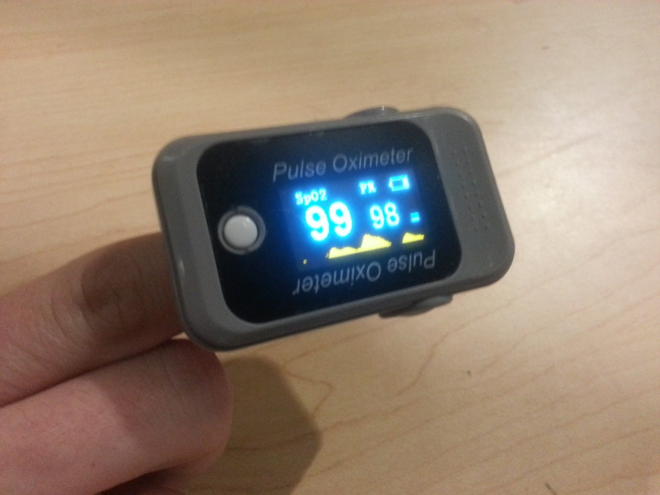

Introduction to Pulse Oximetry
Uses a finger clip called a Pulse Oximeter
Finds oxygen saturation in blood
Tells you your BPM
Pulse Oximeter
Notes:
More on how later –
fedora

Slide 3
Use of Pulse Oximetry
Used in anesthesiology
Athletic training
Diagnosis of Sleep Apnea
Notes:
Use in Anesthesiology: Patients under anesthesia must undergo continuous physiological monitoring to ensure their safety and due to pulse oximetrys non-invasive methods, it’s the best way to monitor oxygen saturation. Anesthesiologists are able to determine how effectively their heart, lungs and circulatory system are working together.
Athletic Training: athletes often use pulse oximeters to ensure whether they are getting adequate oxygenation during exercise – avoid hypoxia (oxygen deprivation).
Diagnosis of sleep apnea: using oxygen saturation to determine apena events (at least 10 seconds of a continuous drop in oxygen saturation) overnight.
fedora

Slide 4
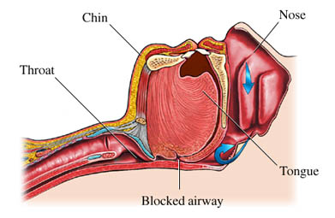
What is Sleep apnea?
Blockage of the airway while sleeping because of:
Upper throat muscles relax during sleep causing airway to become partially or completely blocked (most common)
Naturally small airway
Large neck
Tongue blockage
Notes:
Having a large neck includes tissue crowding along the airway and corresponds to increased fat tissue in the body overall – people who are obsese are more likely to have sleep apnea.
fedora

Slide 5

Dangers of Sleep Apnea
Constantly woken up
Causes fatigue during the day
Extremely dangerous to people with heart disease
Notes:
Constantly woken up: subconsciously, most people are unaware of being disturbed during sleep due to the brain automatically signaling your body to readjust the muscles in your airway to allow breathing again.
Extreme fatigue: is a result of constantly being woken up, the next day the person feels as though they havent’ slept much
Dangerous to people with heart disease: inconsistent breathing has a negative impact on the heart as it has to work harder to counter the lack of oxygenation, and then regulate once more as the saturation increases.
dylan

Slide 6
Other Options for Diagnosing
Polysomnography
Expensive
Have to spend overnight in a hospital
Invasive
Most accurate
Notes:
Most accurate because it takes into account all variables required for proper scoring of an apnea event. This includes, EEG, ECG, oxygen saturation, eye movements, leg movements and nasal airway pres
sure.
akshay

Slide 7
Motivation
Pulse oximeters cost much less, non-invasive, and can be used at home
Portable
Few existing Android applications
None of the existing applications include, data analysis, questionnaires, data exportation, and report generation
Polysomnography is not significantly better
Notes:
-Current android applications for sleep apnea: are informative (guides), only incorporate questionnaires or only analyze apnea events using sound.
-polysomnography is not significantly better, but is still heralded as the golden standard due to its incorporation of multiple variables.
chris

Slide 8
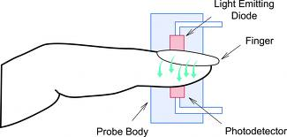
How a Pulse Oximeter Works
Sends out a red and infrared light
Calculates the absorption of haemoglobin
Notes:
The device clips onto the end of your index finger and radiates invisible infrared light and visible red light into the finger. Oxygenated blood and deoxygenated blood there absorb different amounts of these lights. By calculating the difference between these two, the pulse oximeter measures how much oxygen is in your blood.
michael

Slide 9
Oxylyzer: Overview
Receives data from Bluetooth oximeter
Presents and saves oxygen and pulse level graphs
Saves history
Exportable data file
Comprehensive questionnaire
Creates easily readable report
Notes:
chris

Slide 10
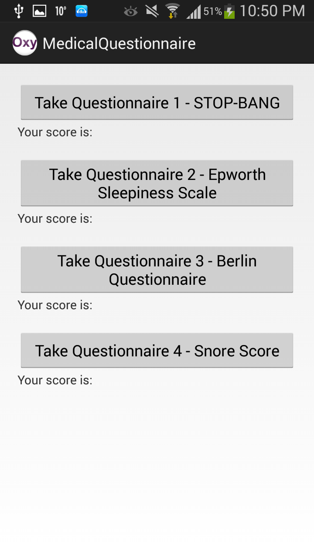
Oxylyzer: Questionairres
STOP-BANG
Epworth Sleepiness Scale
Berlin Sleep Questionnaire
Snore Score
Notes:
akshay

Slide 11
Oxylyzer: Report
Report is a comprehensive compilation of all the data retrieved
It includes an analysis of likelihood of apnea from questionnaire results as well as data
Very user friendly and easily readable
Notes:
dylan

Slide 12
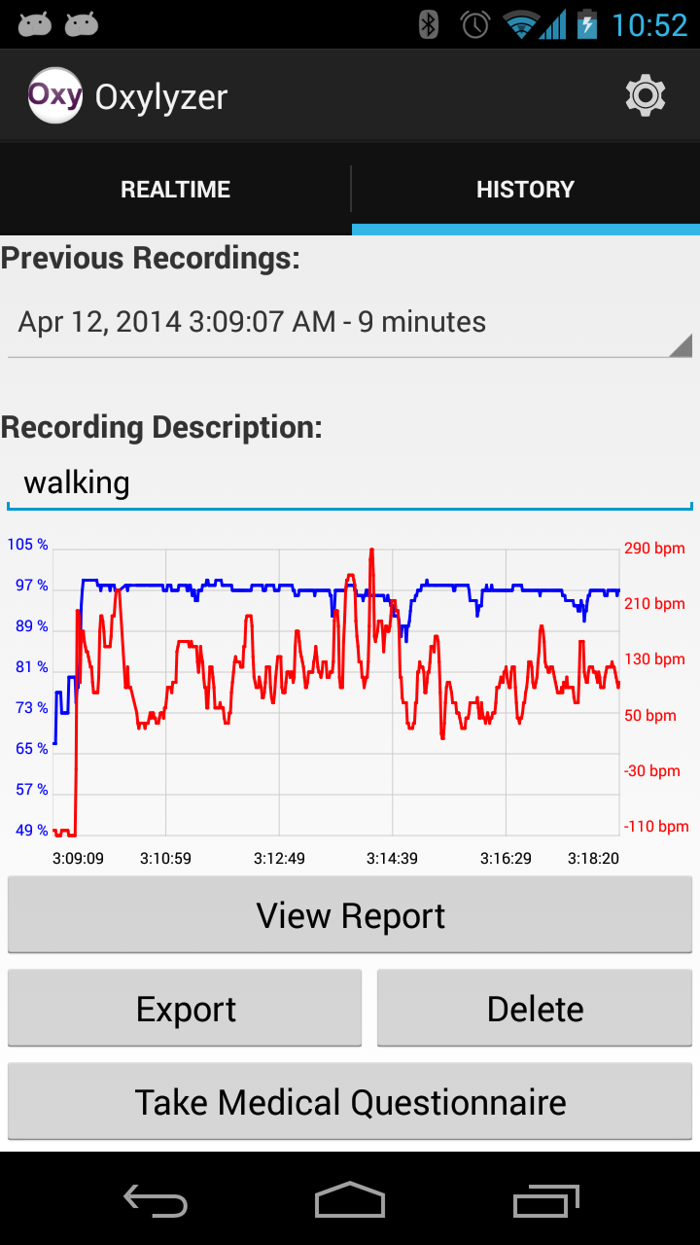
Oxylyzer: History
Each night that data is taken it saves this as a recording
These recording are easily chosen from a list of previous recordings and the graphs are displayed
Notes:
chris

Slide 13
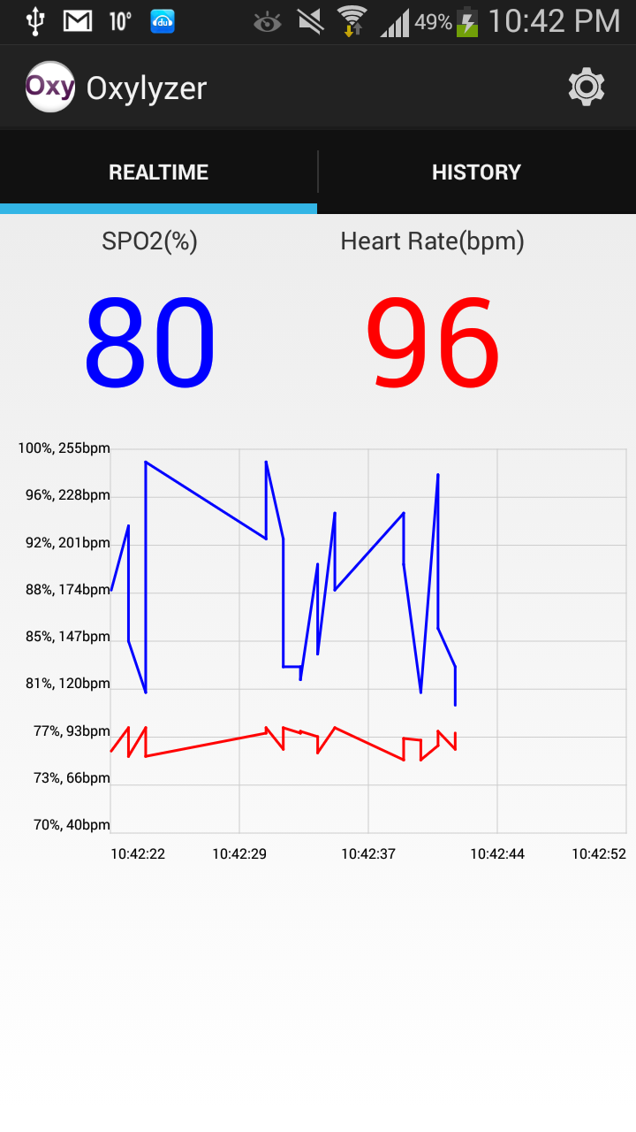
Oxylyzer: Real-time
Shows graphs of oxygen levels and heat rate in 2 separate graphs
Displays the value of oxygen saturation out of 100%
Displays current BPM
Notes:
michael

Slide 14
Further Development
Recording snoring and sync with suspected apnea events
Use the phones accelerometer to detect movement and rule out possible false recordings
Help people use the results to adjust their CPAP pressure
Use data to help people with sport training
Notes:
dylan

Slide 15
Conclusion
Pulse oximeters are a cheaper and more convenient option than polysomnography
Most comprehensive Pulse Oximeter android application available
Notes:
akshay

Slide 16
Thanks!
Questions?

