Slide 1
Property Investment Explorer and Analysis
By Michael McGuigan

Slide 2

About The Business
Who?
Real estate investment firm looking to expand
New investor looking for a point of entry
Seasoned investor looking for new location
Where?
United States
Established rental markets
Cash flow business
Long term holdings

Slide 3
Zillow Housing Data
Property Values
ZHVI – Zillow Home Value Index
All homes, time series
Property Value Forecasts
ZHVF – Zillow Home Value Forecast
All homes, 1 year forecast
Rentals
ZORI – Zillow Observed Rent Index
All homes, time series

Slide 4
About The Data - Variables
Property Values
Price
Size rank
Zip code
State
City
Metro
County
Monthly Dates
Each as new column
Rentals
Monthly rent
Size rank
Zip code
City, State
Monthly Dates
Each as new column
Property Value Forecasts
Appreciation
Zip code
State
City
County
Date

Slide 5
Business Objective & Questions
Business Objective:
Invest in a property at a new location for cash flow income.
Business Questions:
What is the most profitable zip code?
How much rent can I charge?

Slide 6
Methodology
Metric for comparing profitability
Revenue = Rental Income + Appreciation
Profit = Revenue – Expenses
Expenses: down payment, mortgage payment, management fee, taxes, closing costs, renter vacancy, etc.
Ignore expenses → proportional to home value
Profit Score = Revenue / Price
Data Explorer in Shiny App
Interactive map viewer to find zip codes with highest profit score
Plot views that adjust with the map
Table view for searching, sorting and filtering that links to the map

Slide 7
Methodology
Detailed Analysis in R-markdown
Clean & join data
EDA → exploratory data analysis
Linear regression → predict future rental income based on forecasted property values
Check assumptions

Slide 8
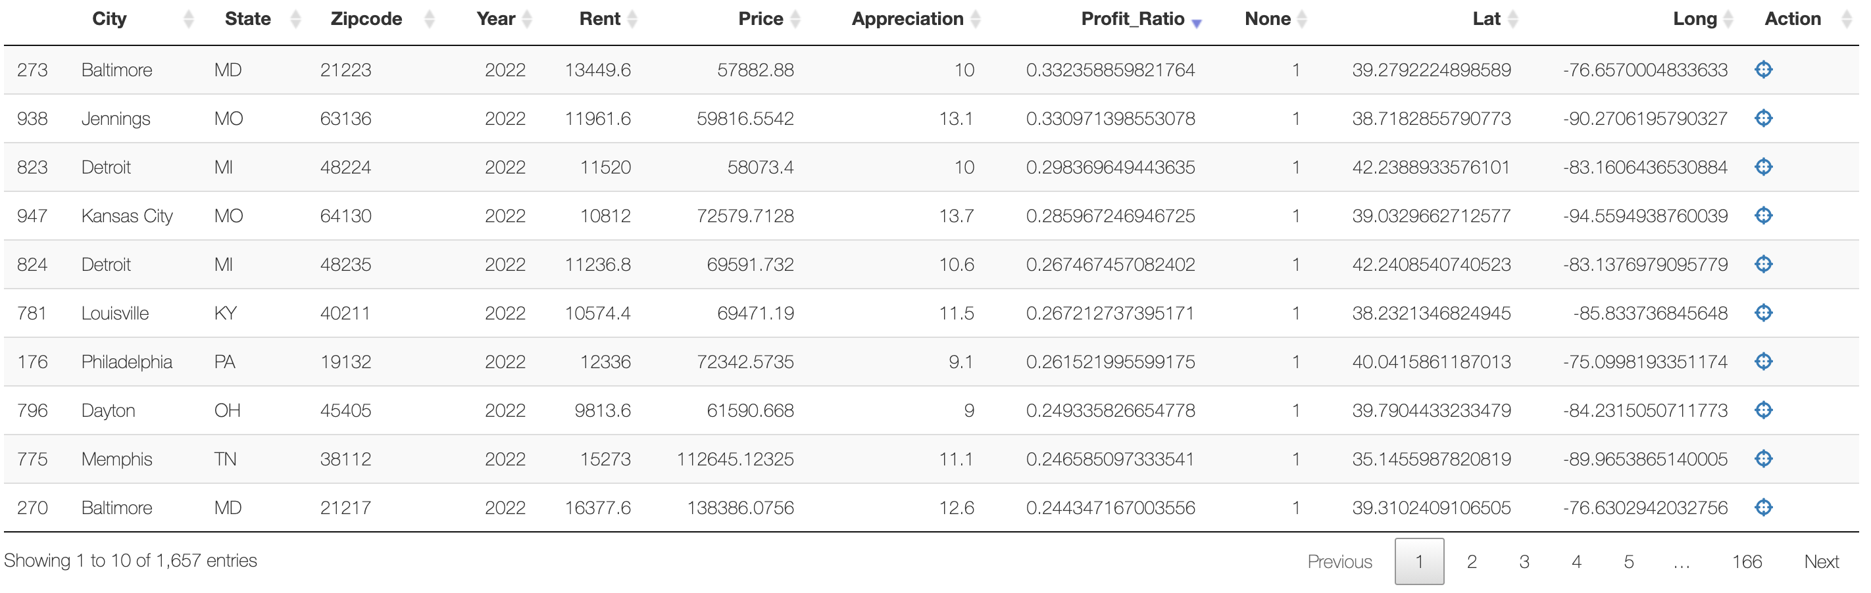
Findings – Shiny App link:
Top 10 most profitable zip codes in the United States for the year 2022
Cheaper properties made the top 10 list
More profit can be made by investing in multiple properties vs one large property

Slide 9
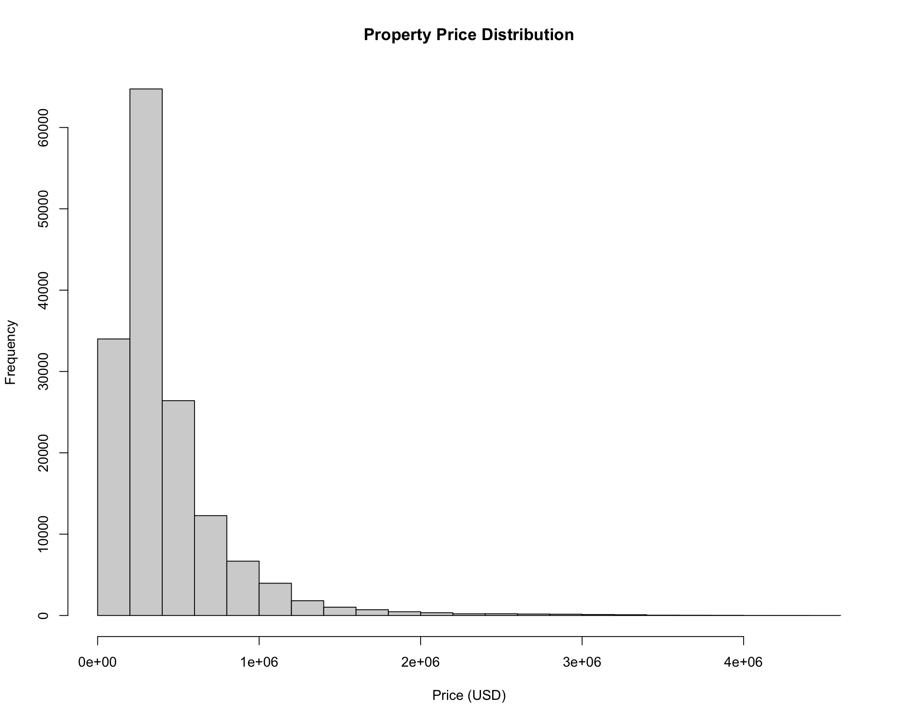
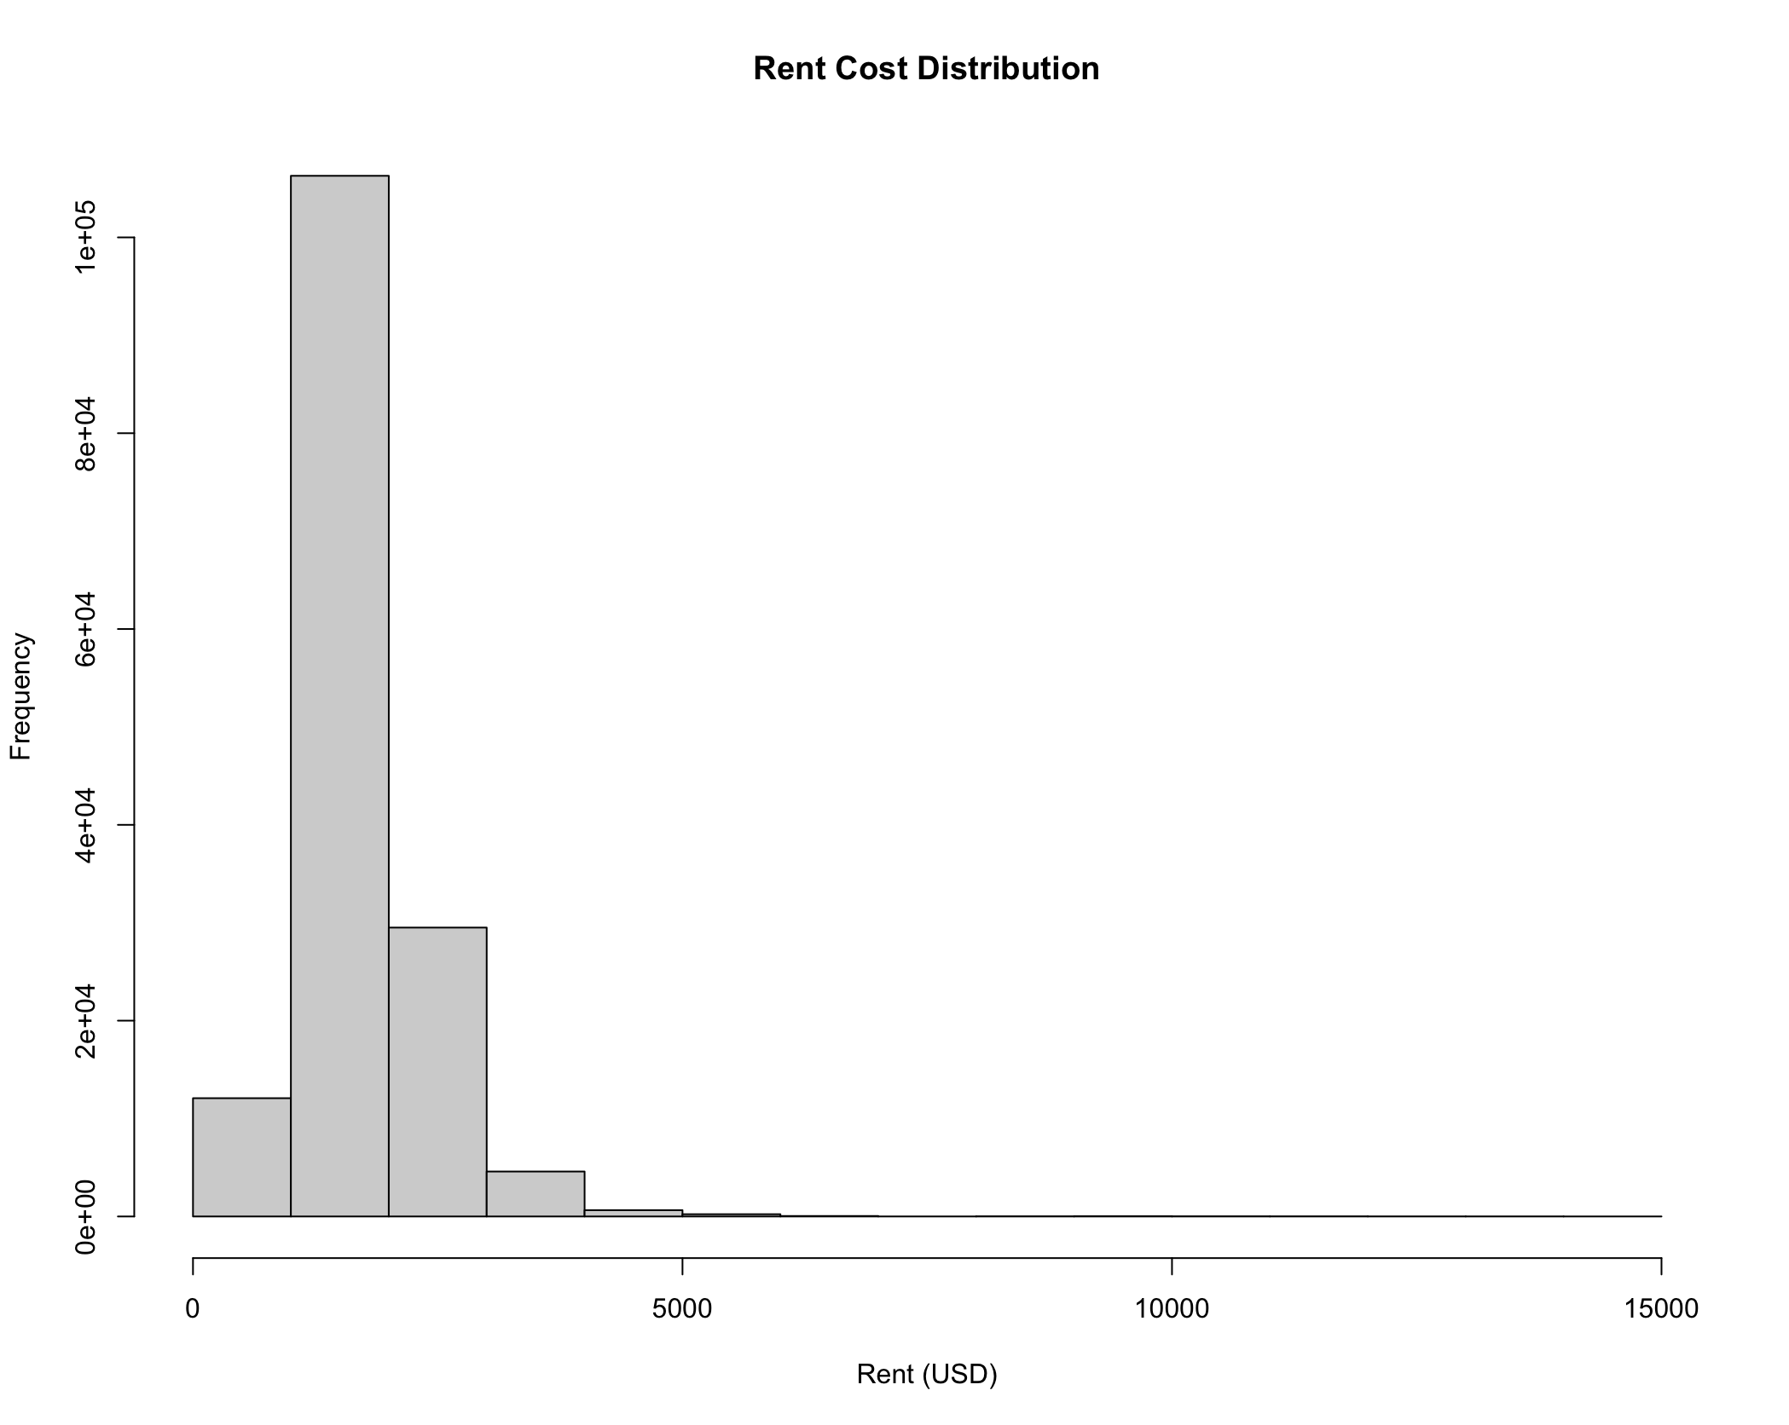
Findings - EDA
Both distributions appear to skew right
Apply Box-Cox transformation

Slide 10
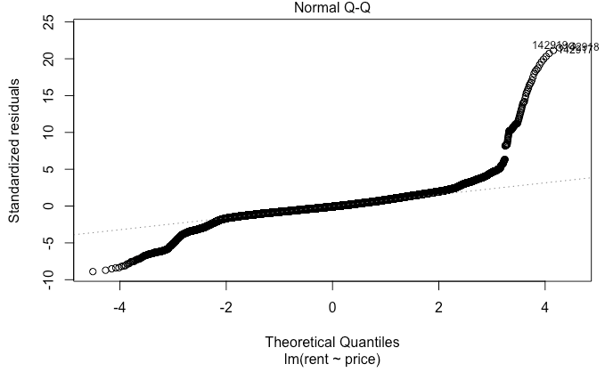
Findings – Linear Regression
Initial Linear Regression:
Rent = 1.514e⁻⁰³(Price) + 1,203
P-values < 2e⁻¹⁶
R² = 0.7118
Significant P-value, but bad assumptions
Data does not look linear

Slide 11
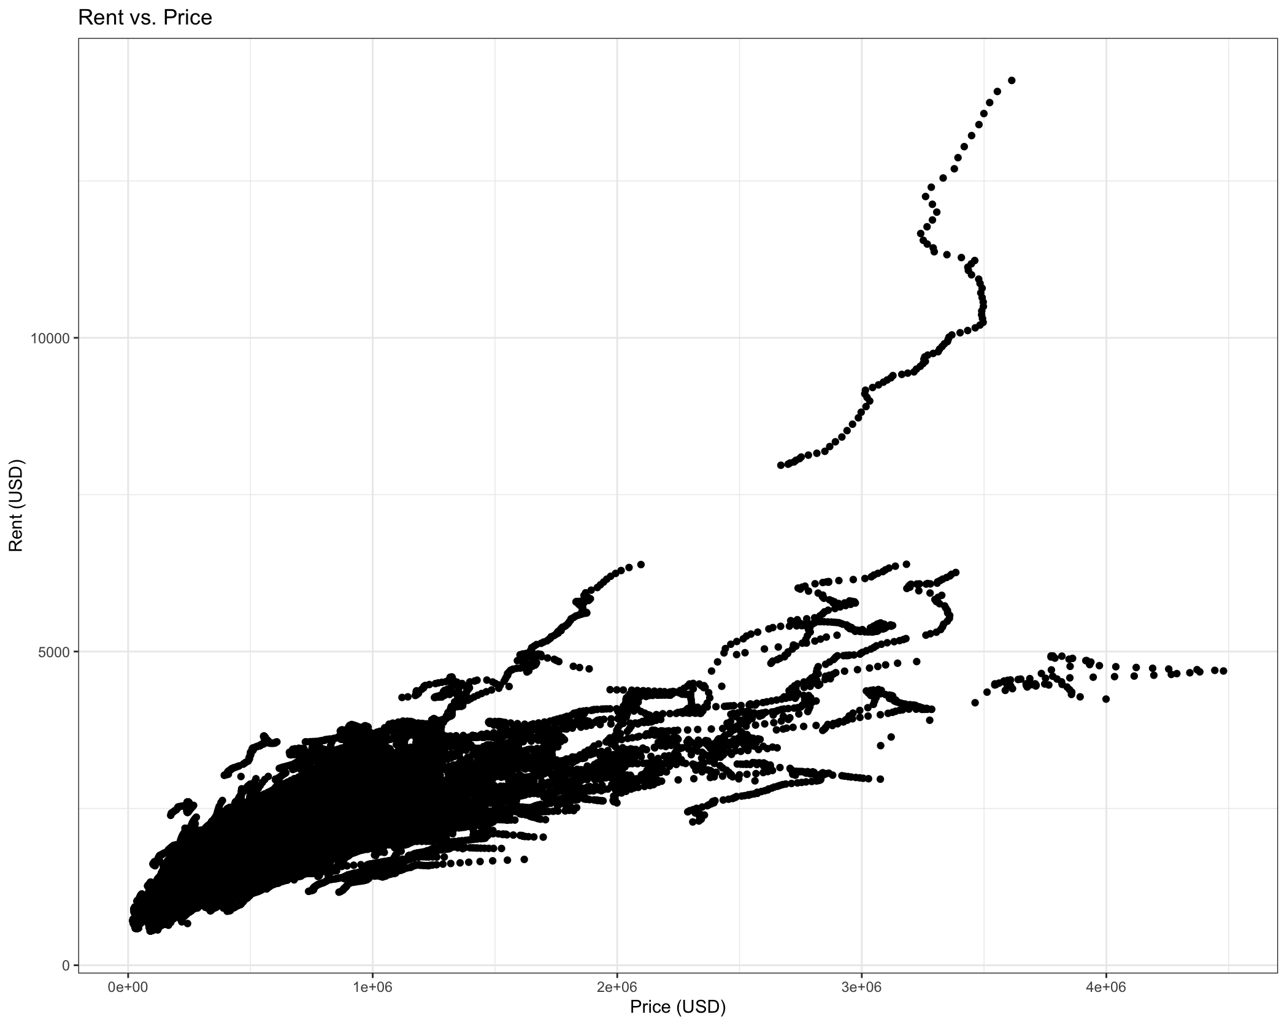
Findings – Rent vs. Price
Scatter plot of Rent vs Price
Rent above $7,000 / month
Price above $3.5 million
One zip code in Los Angeles, CA accounts for all rent above $7,000
One zip code in San Jose, CA accounts for all homes above $3.5 million with low rent

Slide 12
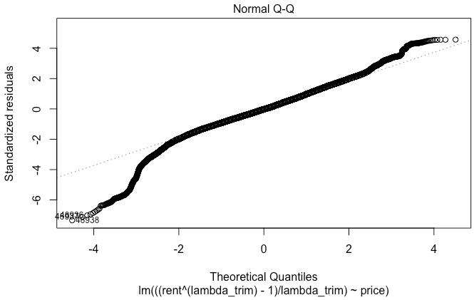
Findings – Linear Regression
With Box-Cox Transformation and outliers removed:
(Rent)^{0.545} = 4.654e⁻⁰⁵(Price) + 81.60
P-values < 2e⁻¹⁶
R² = 0.6738
Significant P-value
Assumptions look better

Slide 13
Conclusion & Next Steps
Conclusion:
The most profitable zip code is 21223 in Baltimore, MD with a forecasted typical value of $57,882.88 and forecasted typical rent of $13,449.60 per year.
Cheaper properties resulted in higher profitability given the same amount invested.
Variability in rent increases with property value.
Next Steps:
Repeat the analysis with instance values instead of ‘typical’ values
Add a risk factor (crime, flooding, etc.)
Include expenses and time value of money in profitability metric

Slide 14
Thank you!
Questions?

