Slide 1
Analyzing the Modern NFL Running Back
Kevin Kannappan and Michael Gallaspy

Slide 2

The dataset
Kaggle dataset based on NFL’s Next Gen Stats
Positions of running backs (RBs) at time of handoff
Speed, orientation, direction of RBs
Yards gained by play
Assume that RB orientation is direction of play
Normalize dataset so that direction of play is always to the right

Slide 3
The tasks
Audience: fans, team personnel, researchers
Traditional analysis focuses on outcomes (yards gained)
Our focus is on using data to formulate hypotheses about how/why outcomes are achieved.
What teams are most effective at running plays?
What spatial trends can be seen on the field?
What trends do individual RBs have?

Slide 4
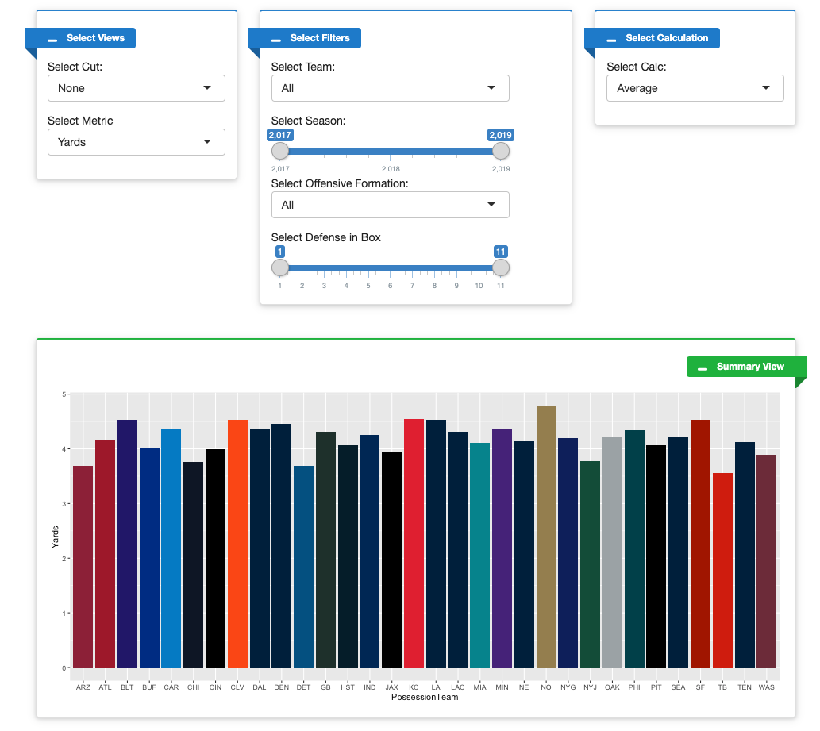
Solution 1 - Summary view
Highly interactive dashboard permits filtering by several metrics
Selected metrics are displayed in a bar chart aggregated by team
The visualization can be transformed into a stacked bar chart by selecting a “cut” that changes the aggregation to be per season or down.

Slide 5
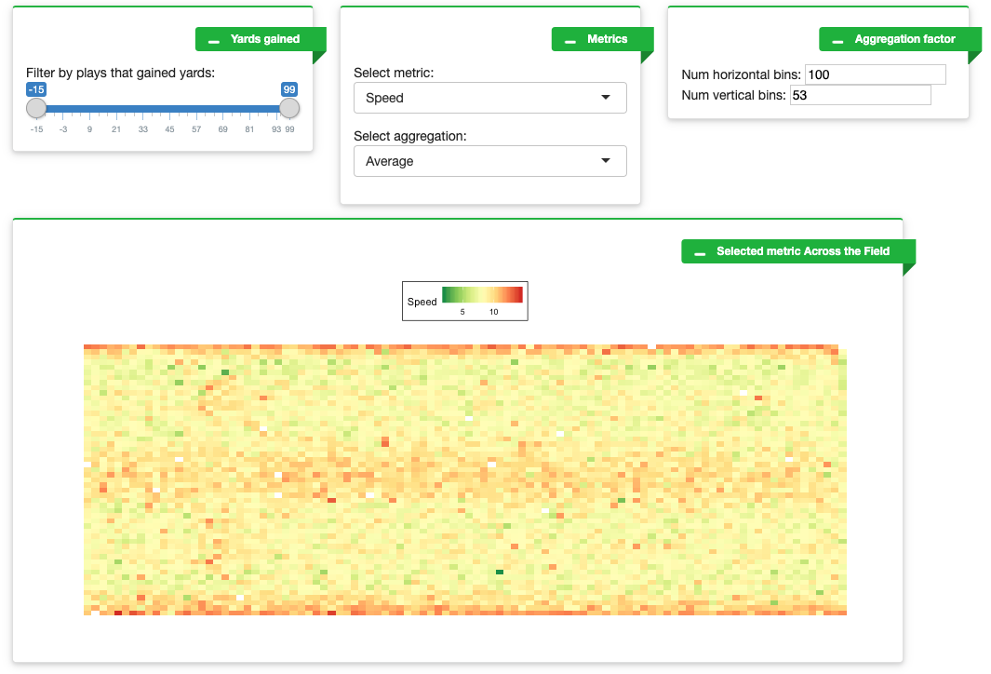
Solution 2 - Field heatmap
Visualizes play and RB characteristics via position and color channels.
Interactive dashboard permits dynamic scale for spatial aggregation
Data set can be filtered and aggregation modality selected for a variety of tasks.

Slide 6
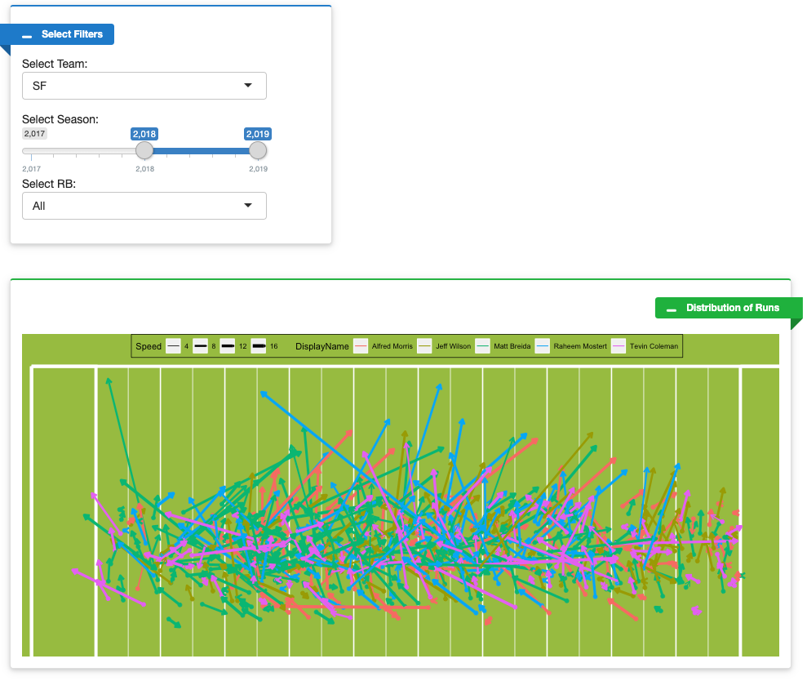
Solution 3 - RB runs
Plots trajectories of RBs using arrow glyphs.
End of arrow glyph is approximated from initial orientation (actual end not in dataset).
Filtering permits visualization of selected teams or individual RBs across various seasons.

