Slide 1
The new PowerPoint Slide library is here!
Modern design, many targeted layouts, easy to use. The new template offers many options for creating presentations with a uniform and modern look.
The following slides offer an ideal basis for beautifully designed presentations. Simply copy complete slides or individual elements from this file.
As of April 23, 2025
The images included are placeholders

Slide 2
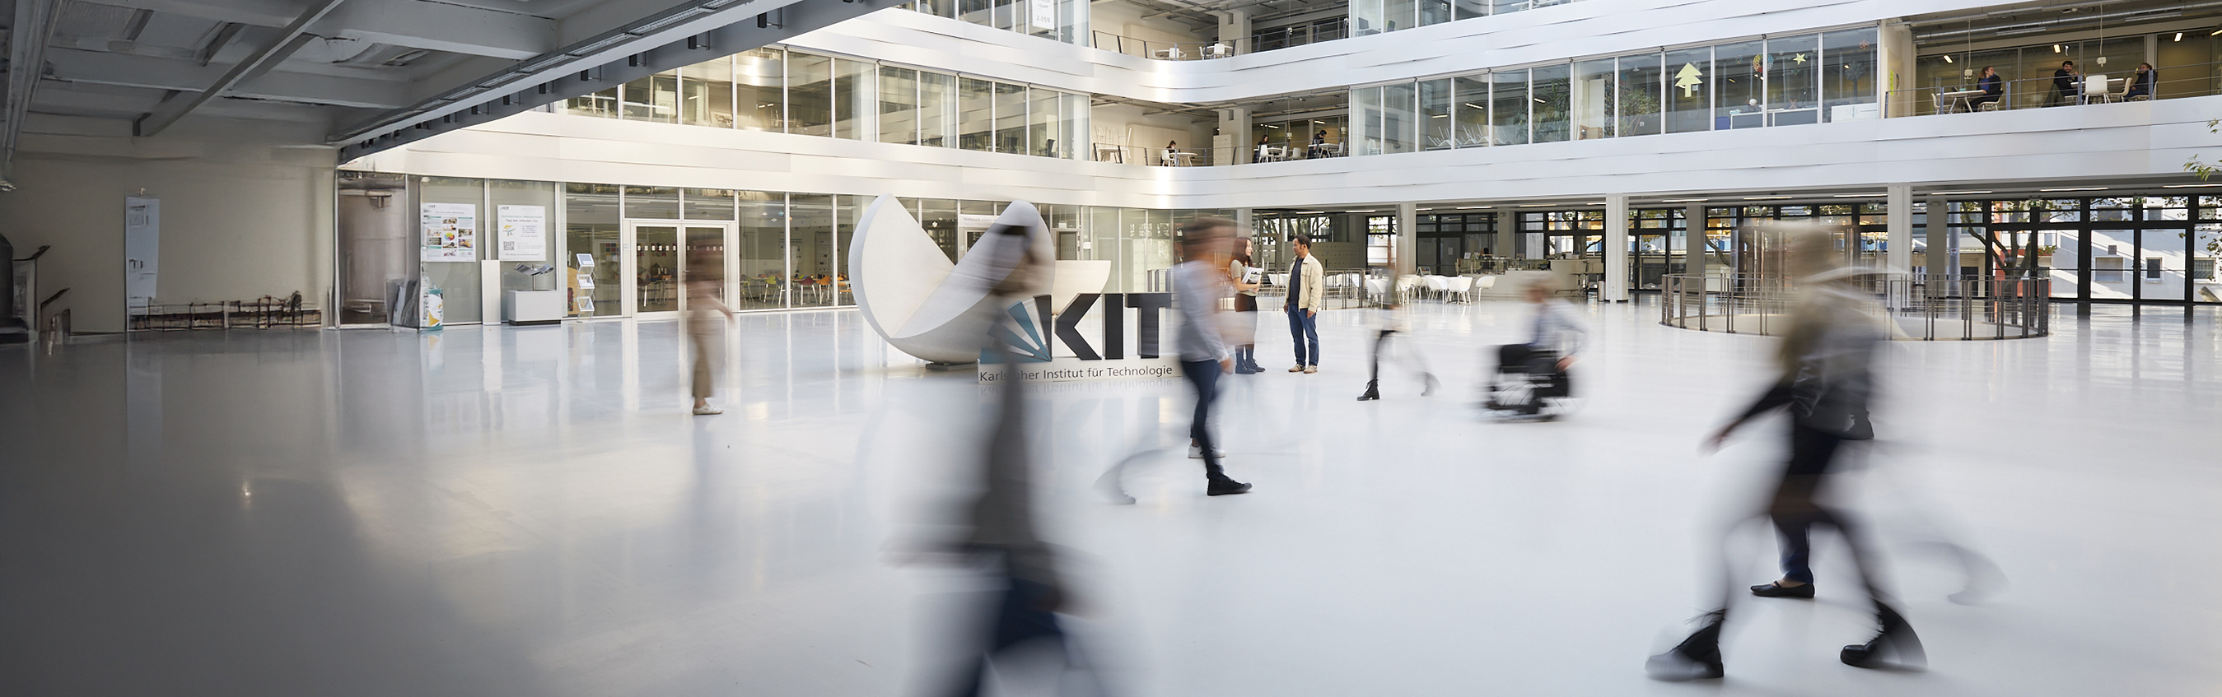
Slide library
Designed slides and elements for easy creation of presentations.

Slide 3


Design Elements
Highlight Boxes
Lines
Text box
Highlight Box
Highlight Box
Standard text box with bullet point
Standard text box with bullet point
Standard Box
Standard Box
Highlight Box
Highlight Box
© Image source top
Highlight Box
1
1
© Image source bottom
Source: I am a dummy text. And I've always been a dummy text

Slide 4

























































Design Elements - Pictograms

Slide 5
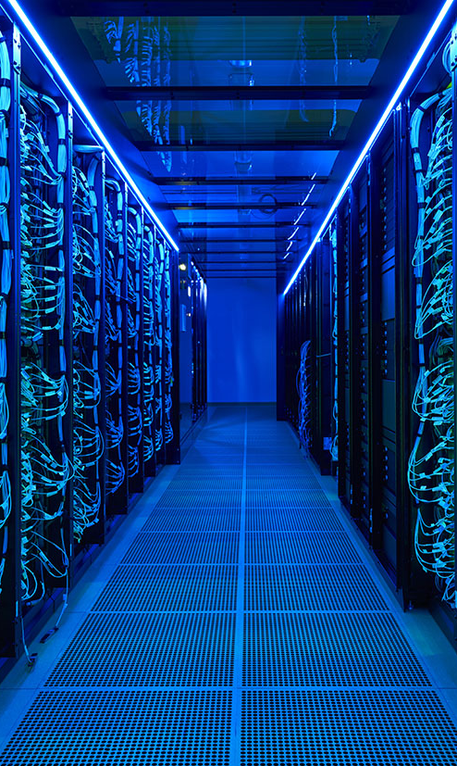
Title of the Presentation
Placeholder
Name, Date

Slide 6
Title of the Presentation
Placeholder
Name, Date

Slide 7

Title of the Presentation
Placeholder
Name, Date

Slide 8
Title of the Presentation
Placeholder
Name, Date

Slide 9
Slide Title
I am a dummy copy. And I’ve been a dummy copy since my birth.
It took me a long time to realize what it means to be a dummy copy: you make no sense. You stand out now and then by being completely out of context.
But does that make me a bad copy?
I know that I’ll never stand a chance of appearing in the Economist
But does that make me any less important? I’m a dummy! But I enjoy being a copy.

Slide 10
Slide Title
I am a dummy copy. And I’ve been a dummy copy since my birth.
It took me a long time to realize what it means to be a dummy copy: you make no sense. You stand out now and then by being completely out of context.
But does that make me a bad copy?
I know that I’ll never stand a chance of appearing in the Economist
But does that make me any less important? I’m a dummy! But I enjoy being a copy.
I am a dummy copy. And I’ve been a dummy copy since my birth.
It took me a long time to realize what it means to be a dummy copy: you make no sense. You stand out now and then by being completely out of context.
But does that make me a bad copy?
I know that I’ll never stand a chance of appearing in the Economist
But does that make me any less important? I’m a dummy! But I enjoy being a copy.
But does that make me any less important? I’m a dummy! But I enjoy being a copy
But does that make me any less important? I’m a dummy! But I enjoy being a copy

Slide 11
Slide Title
I am a dummy copy. And I’ve been a dummy copy since my birth.
It took me a long time to realize what it means to be a dummy copy: you make no sense. You stand out now and then by being completely out of context.
But does that make me a bad copy?
I know that I’ll never stand a chance of appearing in the Economist
But does that make me any less important? I’m a dummy! But I enjoy being a copy.
Placeholder

Slide 12
Slide Title
I am a dummy copy. And I’ve been a dummy copy since my birth.
It took me a long time to realize what it means to be a dummy copy: you make no sense. You stand out now and then by being completely out of context.
But does that make me a bad copy?
I know that I’ll never stand a chance of appearing in the Economist
But does that make me any less important? I’m a dummy! But I enjoy being a copy.
Placeholder

Slide 13
Slide Title
Placeholder
It took me a long time to realize what it means to be a dummy copy: you make no sense. You stand out now and then by being completely out of context.
But does that make me a bad copy?
I know that I’ll never stand a chance of appearing in the Economist

Slide 14
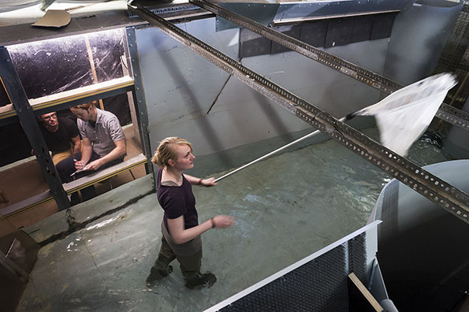
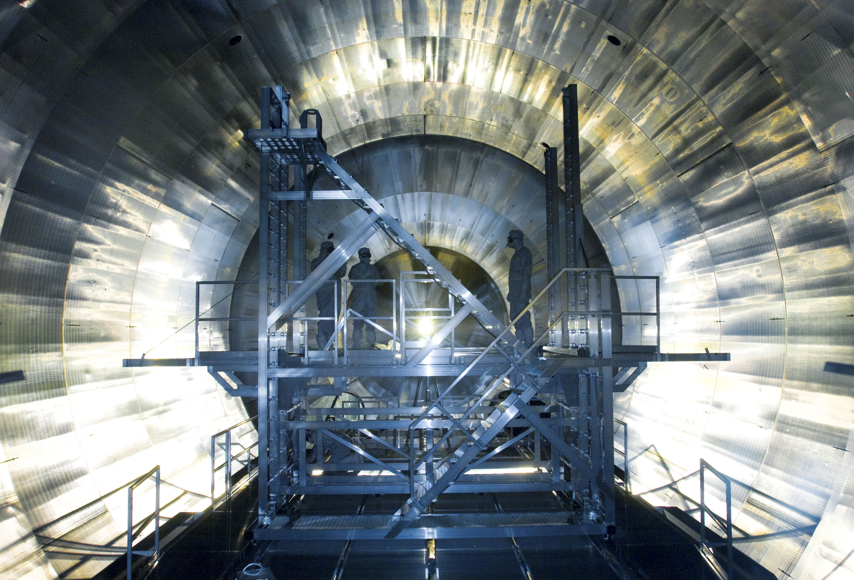
Slide Title
Placeholder
It took me a long time to realize what it means to be a dummy copy: you make no sense.
It took me a long time to realize what it means to be a dummy copy: you make no sense.
It took me a long time to realize what it means to be a dummy copy: you make no sense.

Slide 15

Slide Title
It took me a long time to realize what it means to be a dummy copy: you make no sense. You stand out now and then by being completely out of context.
But does that make me a bad copy?
I know that I’ll never stand a chance of appearing in the Economist
But does that make me any less important? I’m a dummy! But I enjoy being a copy.
Placeholder

Slide 16

Slide Title
Placeholder
It took me a long time to realize what it means to be a dummy copy: you make no sense. You stand out now and then by being

Slide 17
Slide Title
Source: I am a dummy text. And I've always been a dummy text

Slide 18
Slide Title
Source: I am a dummy text. And I've always been a dummy text

Slide 19
Slide Title
Source: I am a dummy text. And I've always been a dummy text

Slide 20
Slide Title
Source: I am a dummy text. And I've always been a dummy text

Slide 21
Slide Title
Source: I am a dummy text. And I've always been a dummy text

Slide 22
Slide Title
I am a dummy copy. And I’ve been a dummy copy since my birth.
It took me a long time to realize what it means to be a dummy copy: you make no sense. You stand out now and then by being completely out of context.
But does that make me a bad copy?
I know that I’ll never stand a chance of appearing in the Economist
But does that make me any less important? I’m a dummy! But I enjoy being a copy.
Source: I am a dummy text. And I've always been a dummy text

Slide 23
Slide Title
I am a dummy copy. And I’ve been a dummy copy since my birth.
It took me a long time to realize what it means to be a dummy copy: you make no sense. You stand out now and then by being completely out of context.
But does that make me a bad copy?
I know that I’ll never stand a chance of appearing in the Economist
But does that make me any less important? I’m a dummy! But I enjoy being a copy.
Market shares 65,8 %
Source: I am a dummy text. And I've always been a dummy text

Slide 24
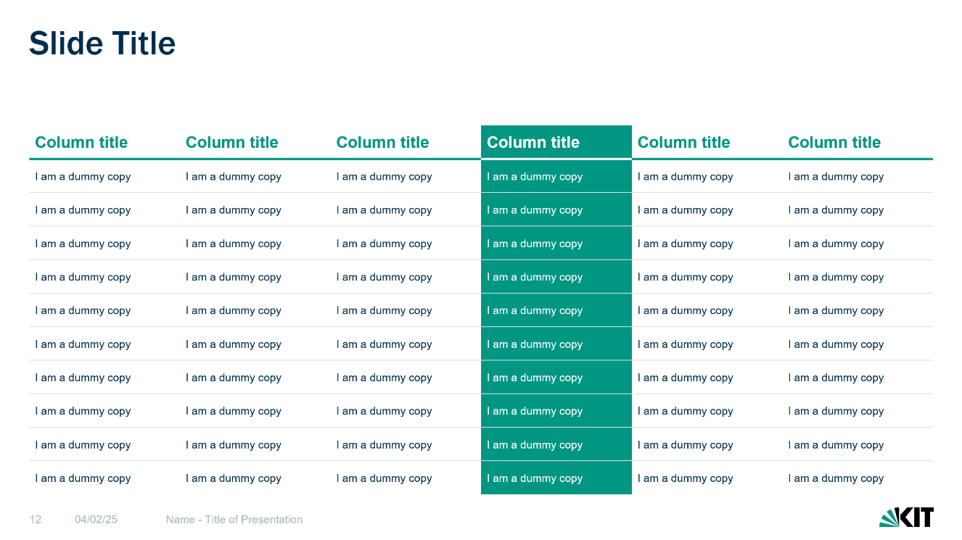
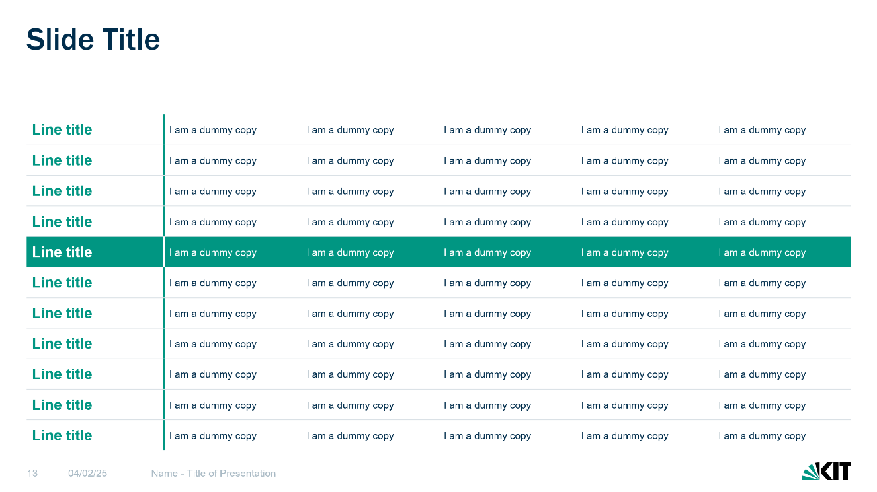
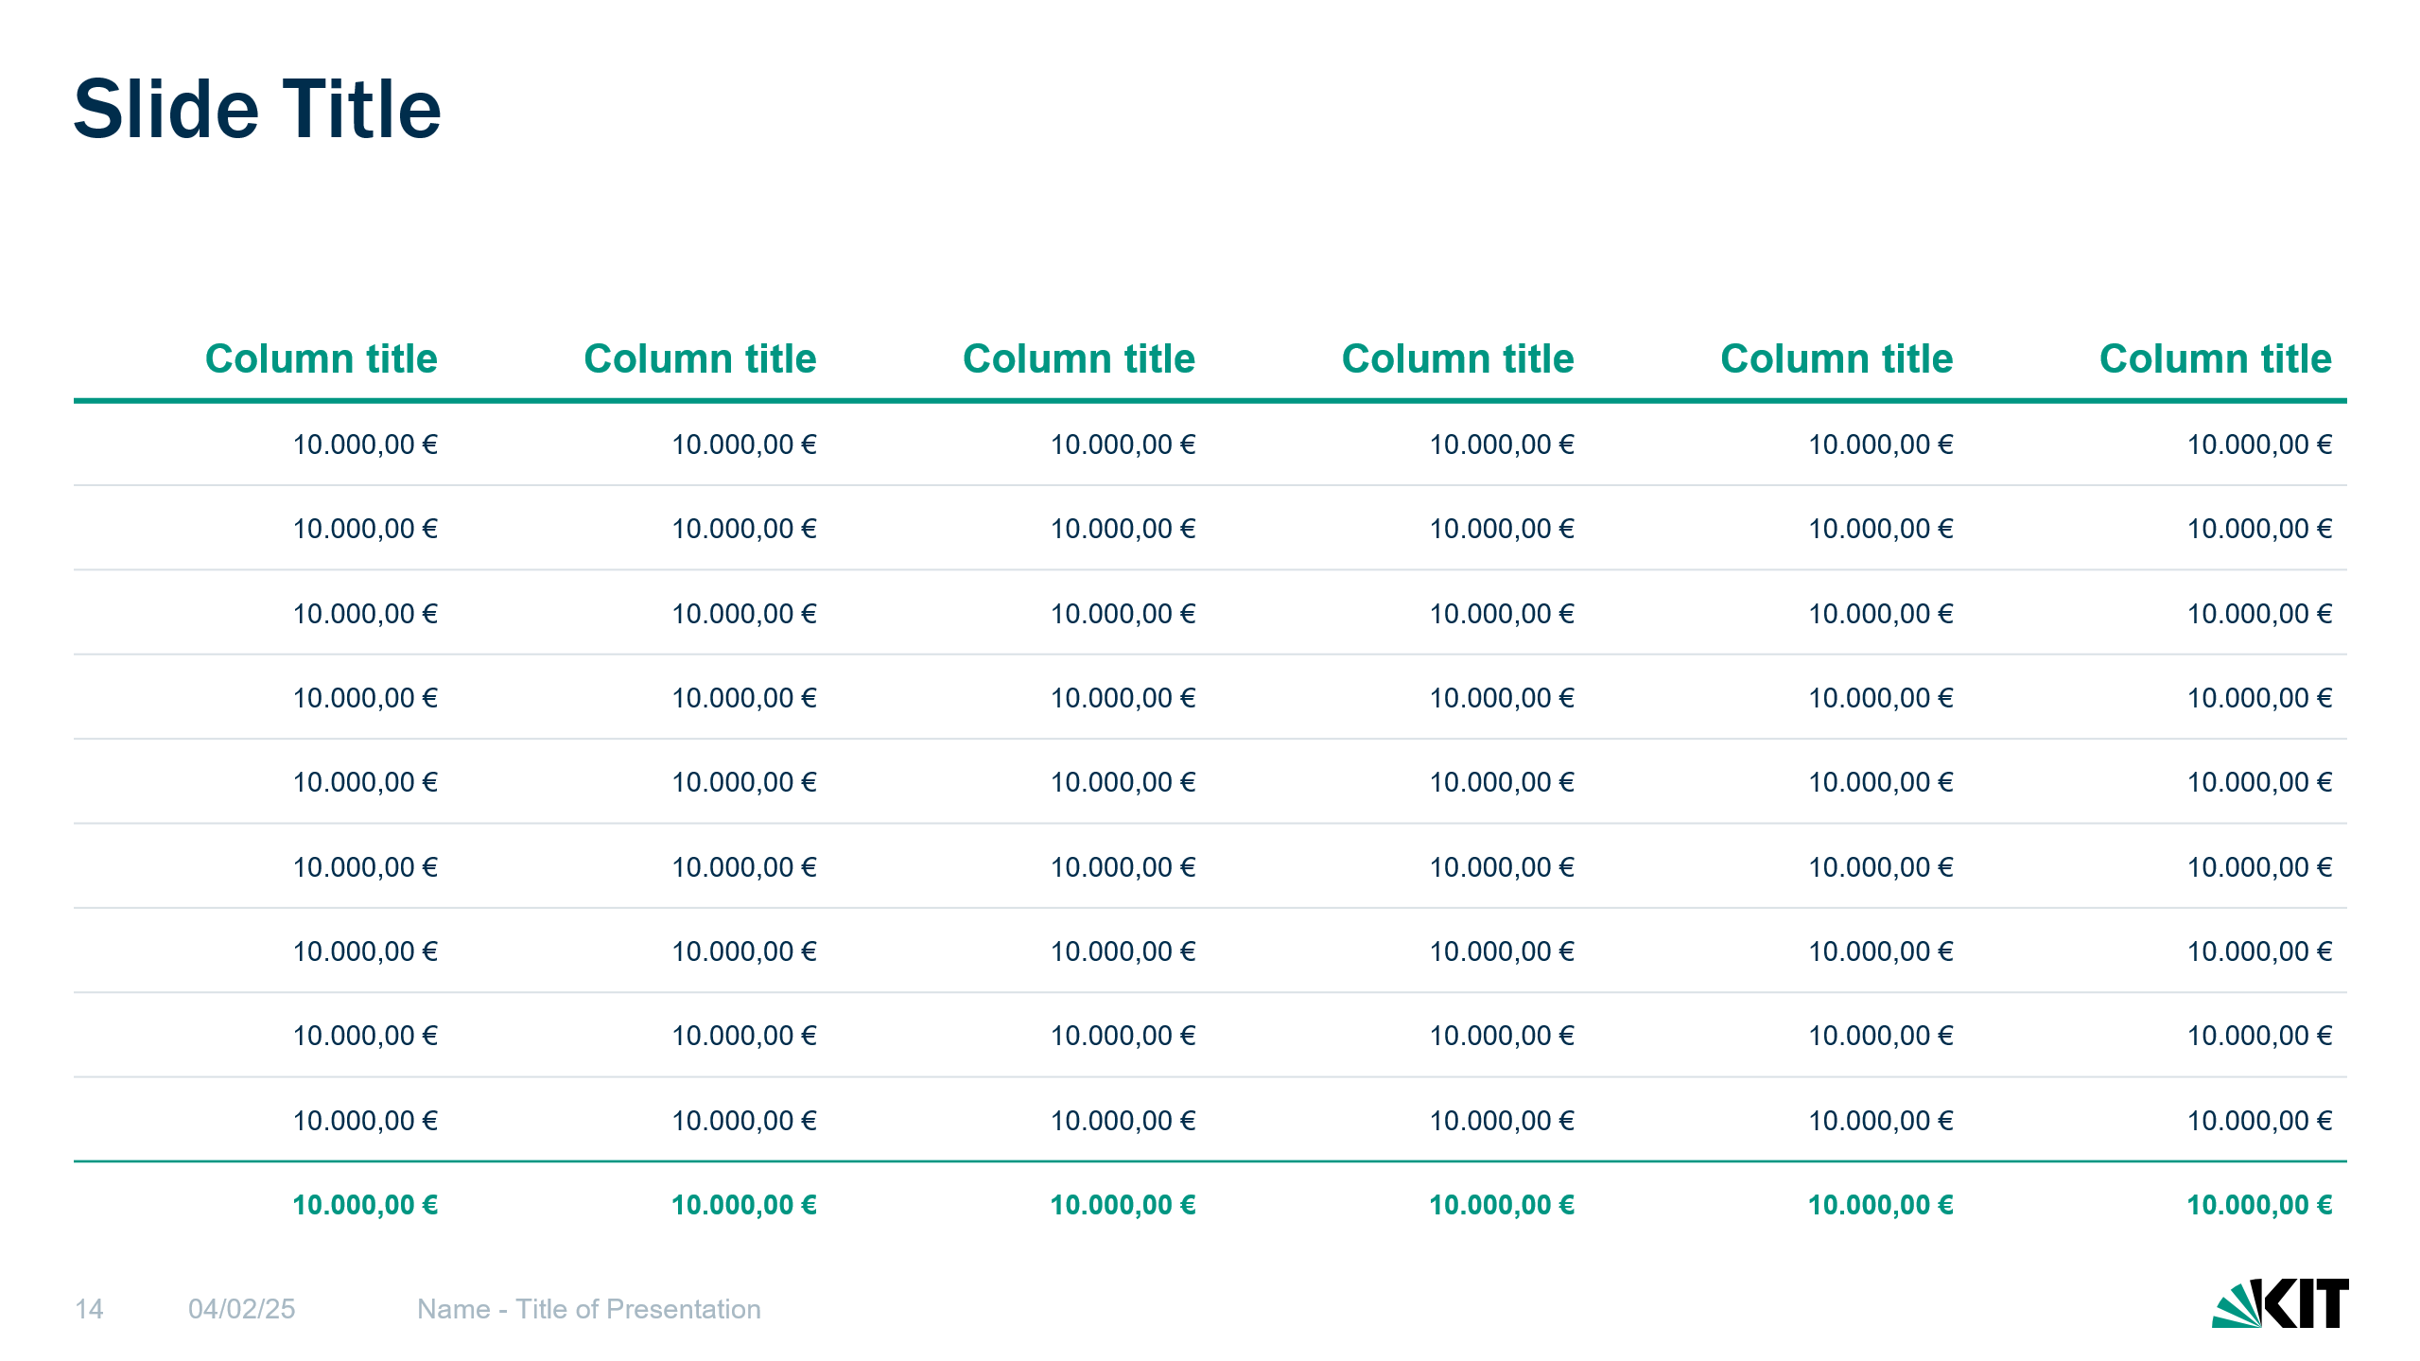
Tables
After filling the table, it can make sense to highlight important content.
The best way to do this is to color individual cells, columns or rows.
Text on colored cells must always be colored white. Totals can be highlighted with a colored line and colored, bold font.

Slide 25
Slide Title
Column title | Column title | Column title | Column title | Column title | Column title
I am a dummy copy | I am a dummy copy | I am a dummy copy | I am a dummy copy | I am a dummy copy | I am a dummy copy
I am a dummy copy | I am a dummy copy | I am a dummy copy | I am a dummy copy | I am a dummy copy | I am a dummy copy
I am a dummy copy | I am a dummy copy | I am a dummy copy | I am a dummy copy | I am a dummy copy | I am a dummy copy
I am a dummy copy | I am a dummy copy | I am a dummy copy | I am a dummy copy | I am a dummy copy | I am a dummy copy
I am a dummy copy | I am a dummy copy | I am a dummy copy | I am a dummy copy | I am a dummy copy | I am a dummy copy
I am a dummy copy | I am a dummy copy | I am a dummy copy | I am a dummy copy | I am a dummy copy | I am a dummy copy
I am a dummy copy | I am a dummy copy | I am a dummy copy | I am a dummy copy | I am a dummy copy | I am a dummy copy
I am a dummy copy | I am a dummy copy | I am a dummy copy | I am a dummy copy | I am a dummy copy | I am a dummy copy
I am a dummy copy | I am a dummy copy | I am a dummy copy | I am a dummy copy | I am a dummy copy | I am a dummy copy
I am a dummy copy | I am a dummy copy | I am a dummy copy | I am a dummy copy | I am a dummy copy | I am a dummy copy

Slide 26
Slide Title
Line title | I am a dummy copy | I am a dummy copy | I am a dummy copy | I am a dummy copy | I am a dummy copy
Line title | I am a dummy copy | I am a dummy copy | I am a dummy copy | I am a dummy copy | I am a dummy copy
Line title | I am a dummy copy | I am a dummy copy | I am a dummy copy | I am a dummy copy | I am a dummy copy
Line title | I am a dummy copy | I am a dummy copy | I am a dummy copy | I am a dummy copy | I am a dummy copy
Line title | I am a dummy copy | I am a dummy copy | I am a dummy copy | I am a dummy copy | I am a dummy copy
Line title | I am a dummy copy | I am a dummy copy | I am a dummy copy | I am a dummy copy | I am a dummy copy
Line title | I am a dummy copy | I am a dummy copy | I am a dummy copy | I am a dummy copy | I am a dummy copy
Line title | I am a dummy copy | I am a dummy copy | I am a dummy copy | I am a dummy copy | I am a dummy copy
Line title | I am a dummy copy | I am a dummy copy | I am a dummy copy | I am a dummy copy | I am a dummy copy
Line title | I am a dummy copy | I am a dummy copy | I am a dummy copy | I am a dummy copy | I am a dummy copy
Line title | I am a dummy copy | I am a dummy copy | I am a dummy copy | I am a dummy copy | I am a dummy copy

Slide 27
Slide Title
Column title | Column title | Column title | Column title | Column title | Column title
10.000,00 € | 10.000,00 € | 10.000,00 € | 10.000,00 € | 10.000,00 € | 10.000,00 €
10.000,00 € | 10.000,00 € | 10.000,00 € | 10.000,00 € | 10.000,00 € | 10.000,00 €
10.000,00 € | 10.000,00 € | 10.000,00 € | 10.000,00 € | 10.000,00 € | 10.000,00 €
10.000,00 € | 10.000,00 € | 10.000,00 € | 10.000,00 € | 10.000,00 € | 10.000,00 €
10.000,00 € | 10.000,00 € | 10.000,00 € | 10.000,00 € | 10.000,00 € | 10.000,00 €
10.000,00 € | 10.000,00 € | 10.000,00 € | 10.000,00 € | 10.000,00 € | 10.000,00 €
10.000,00 € | 10.000,00 € | 10.000,00 € | 10.000,00 € | 10.000,00 € | 10.000,00 €
10.000,00 € | 10.000,00 € | 10.000,00 € | 10.000,00 € | 10.000,00 € | 10.000,00 €
10.000,00 € | 10.000,00 € | 10.000,00 € | 10.000,00 € | 10.000,00 € | 10.000,00 €
10.000,00 € | 10.000,00 € | 10.000,00 € | 10.000,00 € | 10.000,00 € | 10.000,00 €

Slide 28
Slide Title
Step 1
I am a dummy copy. And I’ve been a dummy copy since my birth.
It took me a long time to realize what it means to be a dummy copy: you make no sense. You stand out now and then by being completely out of context.
Step 2
I am a dummy copy. And I’ve been a dummy copy since my birth.
It took me a long time to realize what it means to be a dummy copy: you make no sense. You stand out now and then by being completely out of context.
Step 3
I am a dummy copy. And I’ve been a dummy copy since my birth.
It took me a long time to realize what it means to be a dummy copy: you make no sense. You stand out now and then by being completely out of context.

Slide 29
Slide Title
Step 1
I am a dummy copy.
It took me a long time to realize what it means to be a dummy copy: you make no sense. You stand out now and then by being completely out of context.
Step 2
I am a dummy copy.
It took me a long time to realize what it means to be a dummy copy: you make no sense. You stand out now and then by being completely out of context.
Step 3
I am a dummy copy.
It took me a long time to realize what it means to be a dummy copy: you make no sense. You stand out now and then by being completely out of context.
Step 4
I am a dummy copy.
It took me a long time to realize what it means to be a dummy copy: you make no sense. You stand out now and then by being completely out of context.

Slide 30
Slide Title
Step 1
I am a dummy copy.
It took me a long time to realize what it means to be a dummy copy.
Step 2
I am a dummy copy.
It took me a long time to realize what it means to be a dummy copy.
Step 3
I am a dummy copy.
It took me a long time to realize what it means to be a dummy copy.
Step 4
I am a dummy copy.
It took me a long time to realize what it means to be a dummy copy.
Step 5
I am a dummy copy.
It took me a long time to realize what it means to be a dummy copy.
Step 6
I am a dummy copy.
It took me a long time to realize what it means to be a dummy copy.

Slide 31
Slide Title
Step 1
I am a dummy copy. And I’ve been a dummy copy since my birth.
Step 2
I am a dummy copy. And I’ve been a dummy copy since my birth.
Step 3
I am a dummy copy. And I’ve been a dummy copy since my birth.
Step 4
I am a dummy copy. And I’ve been a dummy copy since my birth.
Step 5
I am a dummy copy. And I’ve been a dummy copy since my birth.
Step 6
I am a dummy copy. And I’ve been a dummy copy since my birth.
Step 7
I am a dummy copy. And I’ve been a dummy copy since my birth.
Step 8
I am a dummy copy. And I’ve been a dummy copy since my birth.

Slide 32
Slide Title
33 %
I am a dummy copy. And I’ve been a dummy copy since my birth.
33 %
I am a dummy copy. And I’ve been a dummy copy since my birth.
33 %
I am a dummy copy. And I’ve been a dummy copy since my birth.
33 %
I am a dummy copy. And I’ve been a dummy copy since my birth.

Slide 33
Slide Title
I am a dummy copy. And I’ve been a dummy copy since my birth.
I am a dummy copy. And I’ve been a dummy copy since my birth.
I am a dummy copy. And I’ve been a dummy copy since my birth.
dummy copy
I am a dummy copy. And I’ve been a dummy copy since my birth.
I am a dummy copy. And I’ve been a dummy copy since my birth.
I am a dummy copy. And I’ve been a dummy copy since my birth.

Slide 34
Slide Title
January 2025
February 2025
March – May 2025
June – July 2025
August – October 2025
November – December 2025
I am a dummy copy.
It took me a long time to realize what it means to be a dummy copy.
I am a dummy copy.
It took me a long time to realize what it means to be a dummy copy.
I am a dummy copy.
It took me a long time to realize what it means to be a dummy copy.
I am a dummy copy.
It took me a long time to realize what it means to be a dummy copy.
I am a dummy copy.
It took me a long time to realize what it means to be a dummy copy.
I am a dummy copy.
It took me a long time to realize what it means to be a dummy copy.

Slide 35
Slide Title
 | CW 1 | CW 2 | CW 3 | CW 4 | CW 5 | CW 6 | CW 7 | CW 8 | CW 8 | CW 10 | CW 11 | CW 12
Dummy copy
Dummy copy
Dummy copy
Dummy copy
Dummy copy
Dummy copy
Dummy copy
Dummy copy
Dummy copy
Dummy copy
Legend
Legend
Legend

Slide 36
Slide Title
Name
Position, title or function
Name
Position, title or function
Name
Position, title or function
Name
Position, title or function
Name
Position, title or function
Name
Position, title or function
Name
Position, title or function
Name
Position, title or function
Name
Position, title or function
Name
Position, title or function
Name
Position, title or function
Name
Position, title or function
Name
Position, title or function
Name
Position, title or function
Name
Position, title or function
Name
Position, title or function
Name
Position, title or function
Name
Position, title or function
Name
Position, title or function
Name
Position, title or function
Name
Position, title or function
Name
Position, title or function
Name
Position, title or function
Name
Position, title or function

Slide 37
Slide Title
Name
Name
Position, title or function
Name
Position, title or function
Name
Name
Name
Position, title or function
Name
Position, title or function
Name
Position, title or function
Name
Position, title or function
Name
Position, title or function
Name
Position, title or function
Name
Position, title or function
Name
Position, title or function
Name
Position, title or function
Name
Position, title or function
Name
Position, title or function
Name
Position, title or function
Name
Position, title or function
Name
Position, title or function
Name
Position, title or function
Name
Position, title or function
Name
Position, title or function
Name
Position, title or function
Name
Position, title or function
Name
Position, title or function
Name
Position, title or function
Name
Position, title or function
Name
Position, title or function
Name
Position, title or function
Name
Position, title or function
Name
Position, title or function
Name
Position, title or function
Name
Position, title or function
Name
Position, title or function

Slide 38
Slide Title
I am a dummy copy. And I’ve been a dummy copy since my birth.
It took me a long time to realize what it means to be a dummy copy: you make no sense. You stand out now and then by being completely out of context.
Dummy copy
Dummy copy
Dummy copy
Karlsruhe
Dummy copy
Dummy copy
Karlsruhe
Dummy copy

Slide 39

Contact
Placeholder
Name
Position, title or function
+49 000 1234567
info@kit.edu
Karlsruher Institut für Technologie
Kaiserstraße 12 76131 Karlsruhe Germany

Slide 40

Team
Placeholder
Name
Position, title or function
Name
Position, title or function
Name
Position, title or function
Name
Position, title or function

Slide 42
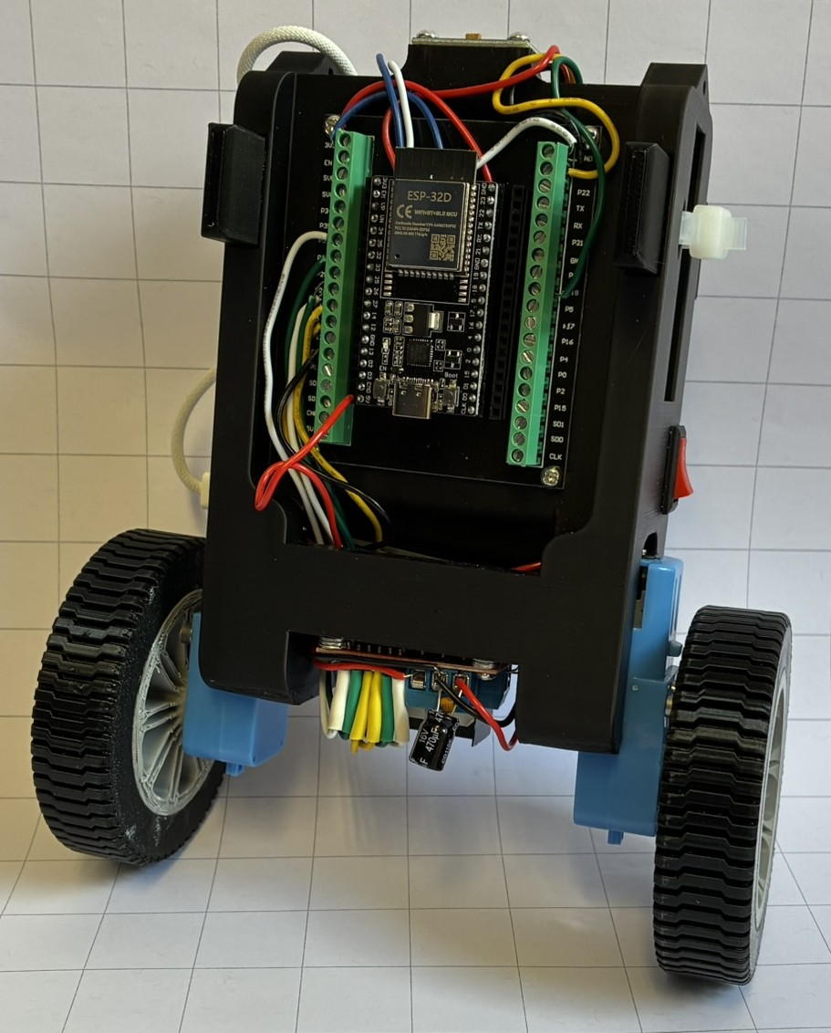
Title of the Presentation
Jan Fritze
Marius Carrier
Notes:
Begrüßen und ziel und grund prinzip erklären

Slide 43

Aufbau und technische Umsetzung des Roboters
Notes:
Der Roboter verhält sich wie ein inverses Pendel. Da sein Schwerpunkt oberhalb der Radachse liegt, würde er ohne aktive Regelung umfallen. Deshalb muss eine erkannte Neigung unmittelbar durch eine passende Radbewegung ausgeglichen werden.Kippt der Roboter nach vorne oder hinten, erkennt der Roboter diese Bewegung und berechnet daraus ein Motorsignal, sodass die Räder in Richtung der Kippbewegung fahren. Dadurch wird der Aufstandspunkt unter den Schwerpunkt verschoben und der Roboter kann sich wieder aufrichten.In diesem Kapitel wird der von uns gebaute Roboter vorgestellt. Zunächst werden in Kapitel \ref{Komponentenauswahl} die ausgewählten Komponenten beschrieben. Anschließend wird in Kapitel \ref{Schaltkreis und Energieversorgung} auf den elektrischen Aufbau und die Energieversorgung eingegangen. Abschließend wird in Kapitel \ref{Funktionsweise des Roboters} die Funktionsweise der Programmierung des Roboters erklärt.
We are strong in fundamental research, and we are pioneers in future-oriented fields, such as energy, information technology, climate and environment, as well as health technologies.
This research and pioneering work are the basis for a sustainable future and for transfer and innovation. ->

Slide 44

Komponentenauswahl
ESP32 als zentrale Steuereinheit
Ausreichende Rechenleistung und integriertes WLAN zur drahtlosen Parametrierung und Datenausgabe.
MPU-6500 zur Winkelmessung
Misst Beschleunigung und Winkelgeschwindigkeit. Daraus wird der Neigungswinkel für den PID-Regler bestimmt.
L298N-Motortreiber als H-Brücke
Ermöglicht die Ansteuerung der Motoren, da der ESP32 die benötigten Motorströme nicht direkt liefern kann.
Mechanischer Aufbau
Motoren mit 1:90-Übersetzung für höheres Drehmoment. Gehäuse aus PLA und Räder aus TPU im 3D-Druck gefertigt.
Bauteile
ESP32D
TT-Motor
MPU-6500
L298N
Batterie
NTC 5D-7
Schalter
ELKO 470
104 Keramikkondensator
PD-Trigger

Slide 45
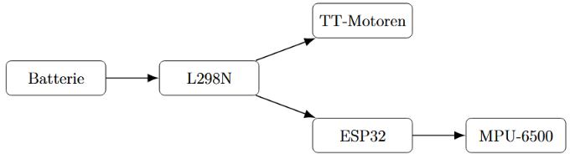
Schaltkreis und Energieversorgung
L298N als zentraler Leistungsknoten
Der L298N versorgt die Motoren mit 9 V und stellt gleichzeitig 5 V für den ESP32 bereit.
Platzsparendes Design
Durch die Kombination aus Spannungsversorgung und Motoransteuerung kann der elektrische Aufbau kompakt gehalten werden.
Mögliche Beeinflussung der Steuerung
Störungen aus dem Motorzweig können Spannungseinbrüche verursachen und die Steuerungselektronik beeinflussen.

Slide 46
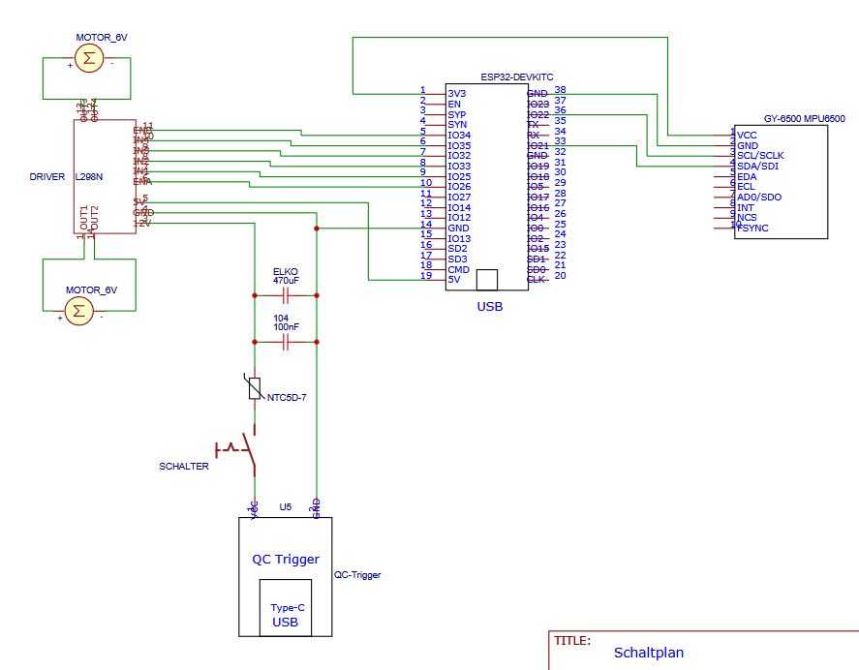
Schaltkreis und Energieversorgung
PD-Trigger zur Spannungsfestlegung
Der PD-Trigger fordert von der USB-C-Power-Delivery-Quelle eine Ausgangsspannung von $9~\mathrm{V}$ für den Leistungsteil des Roboters an.
Kondensatoren zur Spannungsstabilisierung
Ein 100-nF-Keramikkondensator reduziert schnelle Störungen, während ein 470-$\mu$F-Elektrolytkondensator kurzzeitige Spannungseinbrüche bei Laständerungen abschwächt.
NTC zur Begrenzung des Einschaltstroms
Da die Kondensatoren beim Einschalten zunächst ungeladen sind, kann ein hoher Stromstoß entstehen. Der NTC 5D-7 begrenzt diesen Anfangsstrom.
Robusterer Betrieb
Die Schutzmaßnahmen verhindern Störungen nicht vollständig, verringern aber das Risiko von Spannungseinbrüchen, gestörten Sensordaten und Fehlfunktionen des ESP32.

Slide 47
Programmierung
Messung und Kalibrierung des Neigungswinkels
Der Neigungswinkel ist die zentrale Eingangsgröße der Regelung.
Der MPU-6500 erfasst dafür Beschleunigung und Winkelgeschwindigkeit.
Der Beschleunigungssensor liefert einen stabilen Referenzwinkel, reagiert aber empfindlich auf Vibrationen und Bewegungen.
Das Gyroskop erkennt schnelle Winkeländerungen, ist jedoch langfristig driftanfällig.
Ein Komplementärfilter kombiniert beide Signale zu einem schnellen und stabilen Winkelwert.
Dadurch kann die Motoransteuerung ab einem Neigungswinkel von 30° deaktiviert werden.

Slide 48

Programmierung
Berechnung der Stellgröße mit dem PID-Regler
Der ESP32 berechnet aus dem Neigungswinkel die Stellgröße für die Motoren.
Grundlage ist der Regelfehler zwischen Sollwinkel und gemessenem Istwinkel.
Kippt der Roboter nach vorne oder hinten, bestimmt der Fehler Richtung und Stärke der Motoransteuerung.
Der PID-Regler setzt sich aus drei Anteilen zusammen: Rückstellung, Korrektur bleibender Abweichungen und Dämpfung schneller Bewegungen.

Slide 49
Programmierung
Erweiterte Anpassung der Motoransteuerung
Bei kleinen PWM-Werten bewegen sich die Motoren wegen Reibung, Trägheit und Getriebespiel oft noch nicht zuverlässig.
Der Code hebt kleine Stellgrößen deshalb zunächst auf einen höheren Startwert an.
Nach dem Anlaufen darf der PWM-Wert wieder auf einen niedrigeren Haltewert sinken.
Dadurch werden sicheres Anlaufen und feinfühlige Regelung nahe der Gleichgewichtslage kombiniert.
Bei größeren Winkelfehlern wird der P-Anteil ab 7° zusätzlich progressiv verstärkt.
So reagiert der Roboter bei kleinen Auslenkungen weich, bei kritischen Schieflagen aber deutlich stärker.
Die Stellgröße wird abschließend auf den zulässigen PWM-Bereich begrenzt.

Slide 50
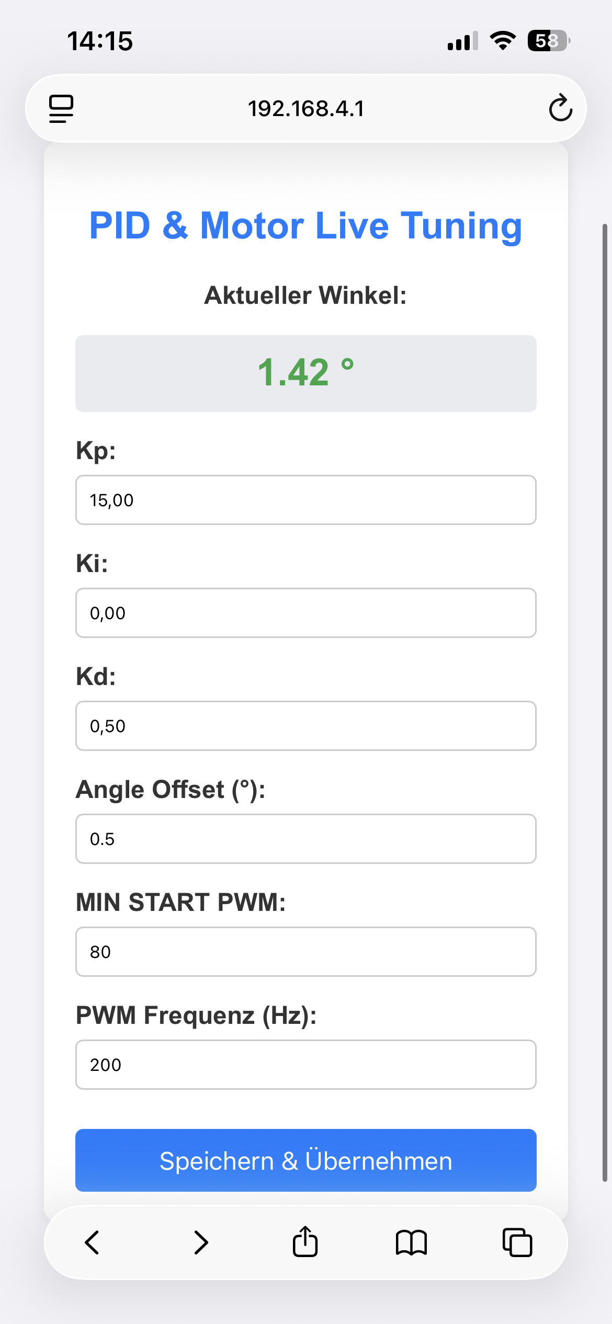
Programmierung
Einfluss der Regelungsfrequenz und PWM-Frequenz
Der PID-Regler arbeitet mit 200 Hz und berechnet alle 5 ms einen neuen Motorbefehl.
Eine hohe Regelungsfrequenz ermöglicht eine schnelle Reaktion auf Kippbewegungen.
Zu hohe Frequenzen verstärken jedoch Messrauschen und können von den Motoren mechanisch nicht sinnvoll umgesetzt werden.
Die PWM-Frequenz legt fest, wie schnell das Motorsignal ein- und ausgeschaltet wird.
Mit 200 Hz entstehen längere Impulse, die das Anlaufen kleiner Gleichstrommotoren erleichtern.
Die Frequenz ist ein Kompromiss zwischen sicherem Anlauf, ruhigem Motorlauf und hörbarem Motorgeräusch.
Nach der Auslegung wurden die Parameter praktisch abgestimmt, um schnelles und stabiles Einregeln zu erreichen.

