Slide 1
The new PowerPoint Slide library is here!
Modern design, many targeted layouts, easy to use. The new template offers many options for creating presentations with a uniform and modern look.
The following slides offer an ideal basis for beautifully designed presentations. Simply copy complete slides or individual elements from this file.
As of April 23, 2025
The images included are placeholders

Slide 2
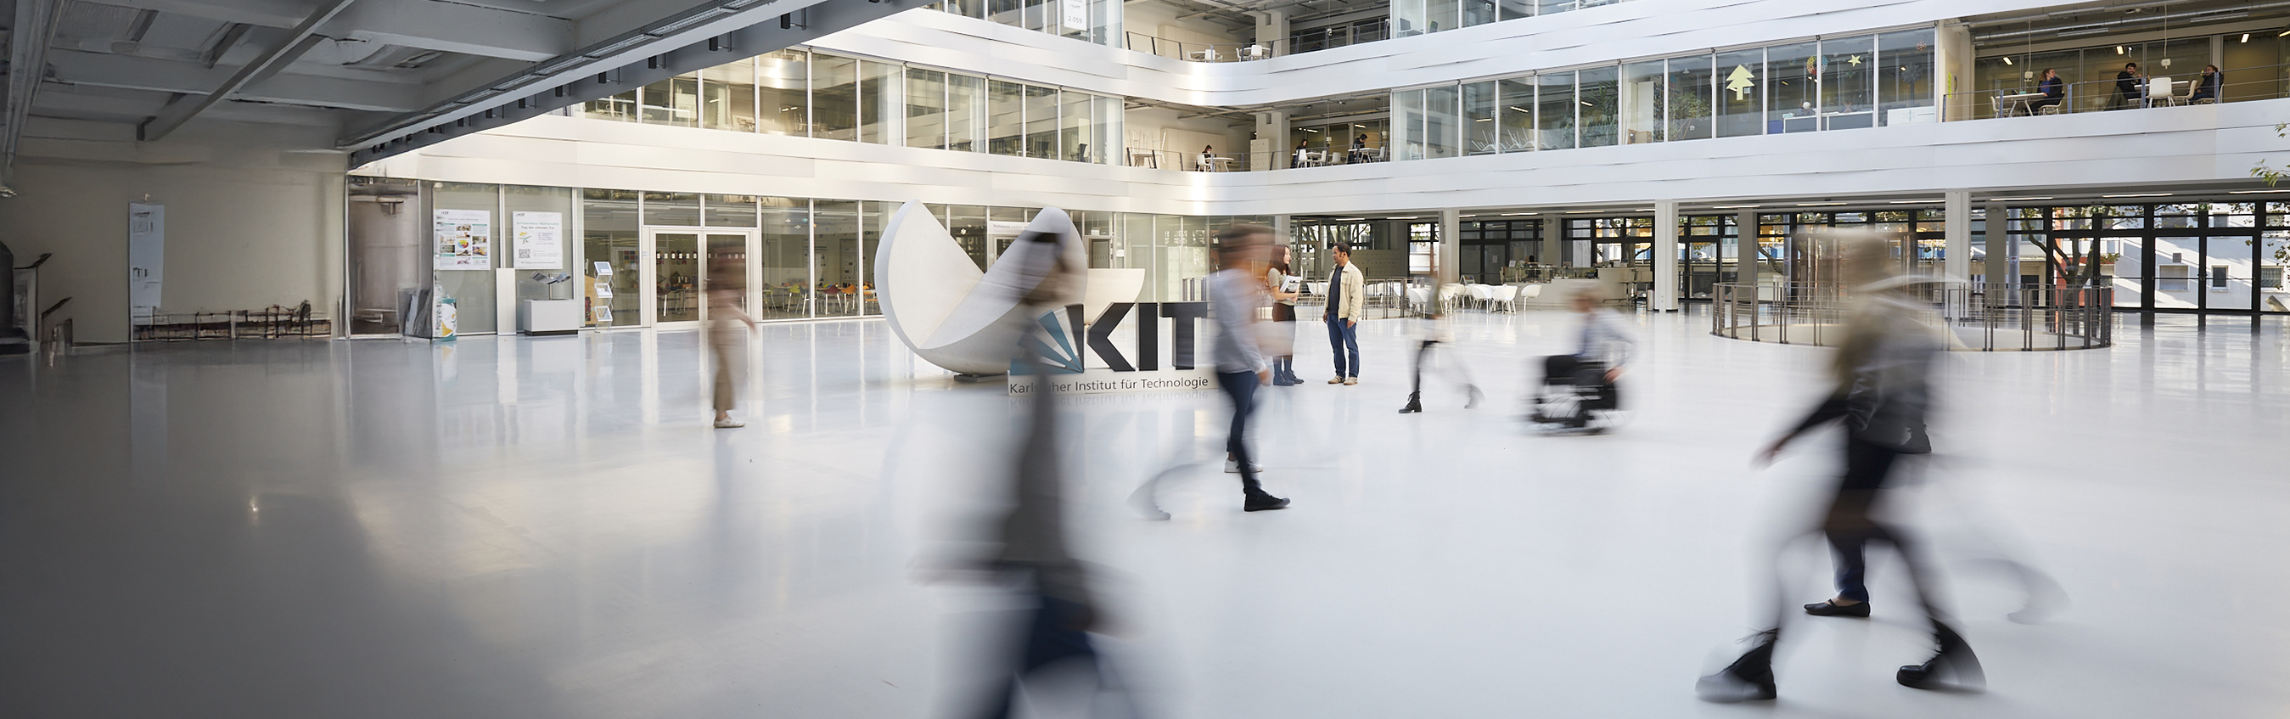
Slide library
Designed slides and elements for easy creation of presentations.

Slide 3


Design Elements
Highlight Boxes
Lines
Text box
Highlight Box
Highlight Box
Standard text box with bullet point
Standard text box with bullet point
Standard Box
Standard Box
Highlight Box
Highlight Box
© Image source top
Highlight Box
1
1
© Image source bottom
Source: I am a dummy text. And I've always been a dummy text

Slide 4
























































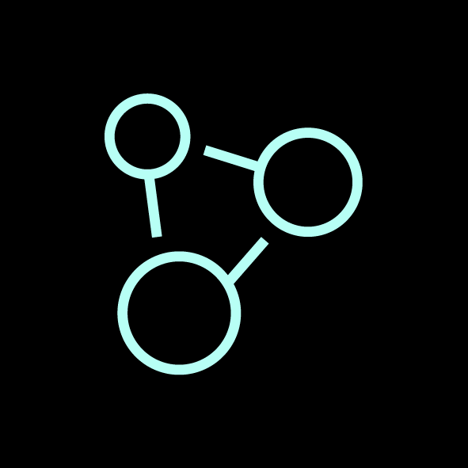
Design Elements - Pictograms

Slide 5

Title of the Presentation
Placeholder
Name, Date

Slide 6
Title of the Presentation
Placeholder
Name, Date

Slide 7

Title of the Presentation
Placeholder
Name, Date

Slide 8
Title of the Presentation
Placeholder
Name, Date

Slide 9
Slide Title
I am a dummy copy. And I’ve been a dummy copy since my birth.
It took me a long time to realize what it means to be a dummy copy: you make no sense. You stand out now and then by being completely out of context.
But does that make me a bad copy?
I know that I’ll never stand a chance of appearing in the Economist
But does that make me any less important? I’m a dummy! But I enjoy being a copy.

Slide 10
Slide Title
I am a dummy copy. And I’ve been a dummy copy since my birth.
It took me a long time to realize what it means to be a dummy copy: you make no sense. You stand out now and then by being completely out of context.
But does that make me a bad copy?
I know that I’ll never stand a chance of appearing in the Economist
But does that make me any less important? I’m a dummy! But I enjoy being a copy.
I am a dummy copy. And I’ve been a dummy copy since my birth.
It took me a long time to realize what it means to be a dummy copy: you make no sense. You stand out now and then by being completely out of context.
But does that make me a bad copy?
I know that I’ll never stand a chance of appearing in the Economist
But does that make me any less important? I’m a dummy! But I enjoy being a copy.
But does that make me any less important? I’m a dummy! But I enjoy being a copy
But does that make me any less important? I’m a dummy! But I enjoy being a copy

Slide 11
Slide Title
I am a dummy copy. And I’ve been a dummy copy since my birth.
It took me a long time to realize what it means to be a dummy copy: you make no sense. You stand out now and then by being completely out of context.
But does that make me a bad copy?
I know that I’ll never stand a chance of appearing in the Economist
But does that make me any less important? I’m a dummy! But I enjoy being a copy.
Placeholder

Slide 12
Slide Title
I am a dummy copy. And I’ve been a dummy copy since my birth.
It took me a long time to realize what it means to be a dummy copy: you make no sense. You stand out now and then by being completely out of context.
But does that make me a bad copy?
I know that I’ll never stand a chance of appearing in the Economist
But does that make me any less important? I’m a dummy! But I enjoy being a copy.
Placeholder

Slide 13
Slide Title
Placeholder
It took me a long time to realize what it means to be a dummy copy: you make no sense. You stand out now and then by being completely out of context.
But does that make me a bad copy?
I know that I’ll never stand a chance of appearing in the Economist

Slide 14
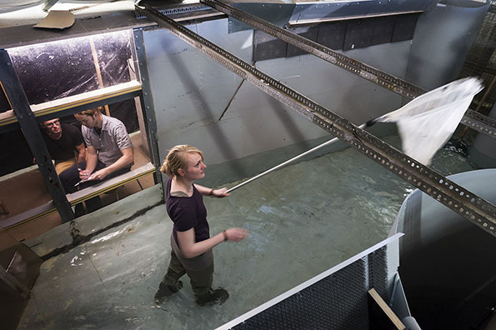
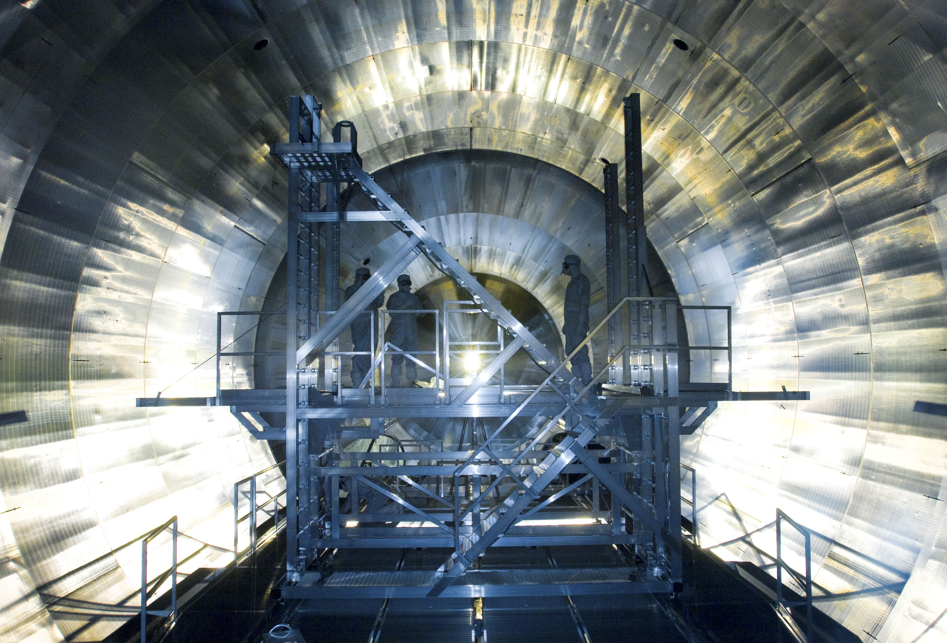
Slide Title
Placeholder
It took me a long time to realize what it means to be a dummy copy: you make no sense.
It took me a long time to realize what it means to be a dummy copy: you make no sense.
It took me a long time to realize what it means to be a dummy copy: you make no sense.

Slide 15

Slide Title
It took me a long time to realize what it means to be a dummy copy: you make no sense. You stand out now and then by being completely out of context.
But does that make me a bad copy?
I know that I’ll never stand a chance of appearing in the Economist
But does that make me any less important? I’m a dummy! But I enjoy being a copy.
Placeholder

Slide 16

Slide Title
Placeholder
It took me a long time to realize what it means to be a dummy copy: you make no sense. You stand out now and then by being

Slide 17
Slide Title
Source: I am a dummy text. And I've always been a dummy text

Slide 18
Slide Title
Source: I am a dummy text. And I've always been a dummy text

Slide 19
Slide Title
Source: I am a dummy text. And I've always been a dummy text

Slide 20
Slide Title
Source: I am a dummy text. And I've always been a dummy text

Slide 21
Slide Title
Source: I am a dummy text. And I've always been a dummy text

Slide 22
Slide Title
I am a dummy copy. And I’ve been a dummy copy since my birth.
It took me a long time to realize what it means to be a dummy copy: you make no sense. You stand out now and then by being completely out of context.
But does that make me a bad copy?
I know that I’ll never stand a chance of appearing in the Economist
But does that make me any less important? I’m a dummy! But I enjoy being a copy.
Source: I am a dummy text. And I've always been a dummy text

Slide 23
Slide Title
I am a dummy copy. And I’ve been a dummy copy since my birth.
It took me a long time to realize what it means to be a dummy copy: you make no sense. You stand out now and then by being completely out of context.
But does that make me a bad copy?
I know that I’ll never stand a chance of appearing in the Economist
But does that make me any less important? I’m a dummy! But I enjoy being a copy.
Market shares 65,8 %
Source: I am a dummy text. And I've always been a dummy text

Slide 24
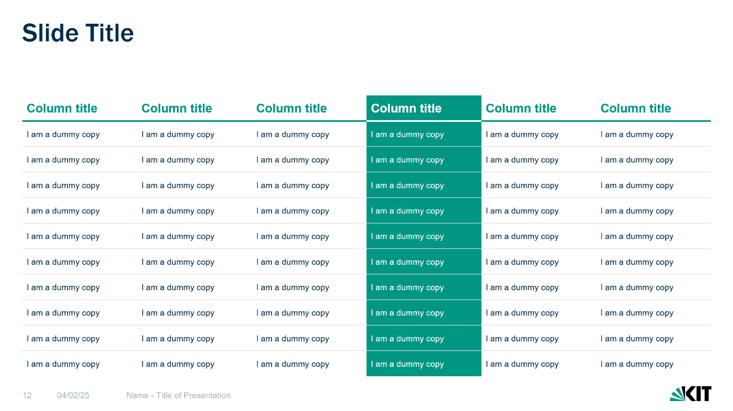
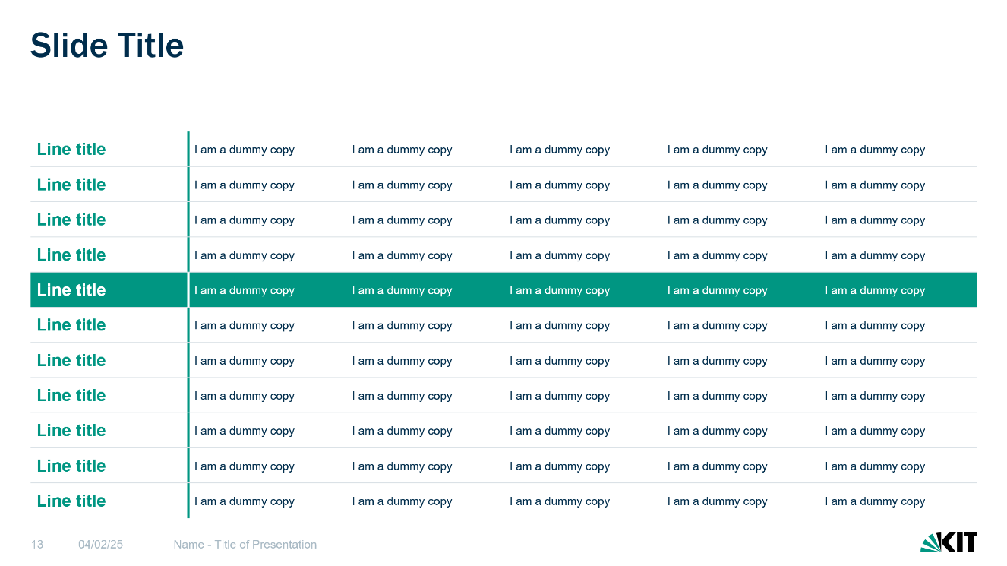
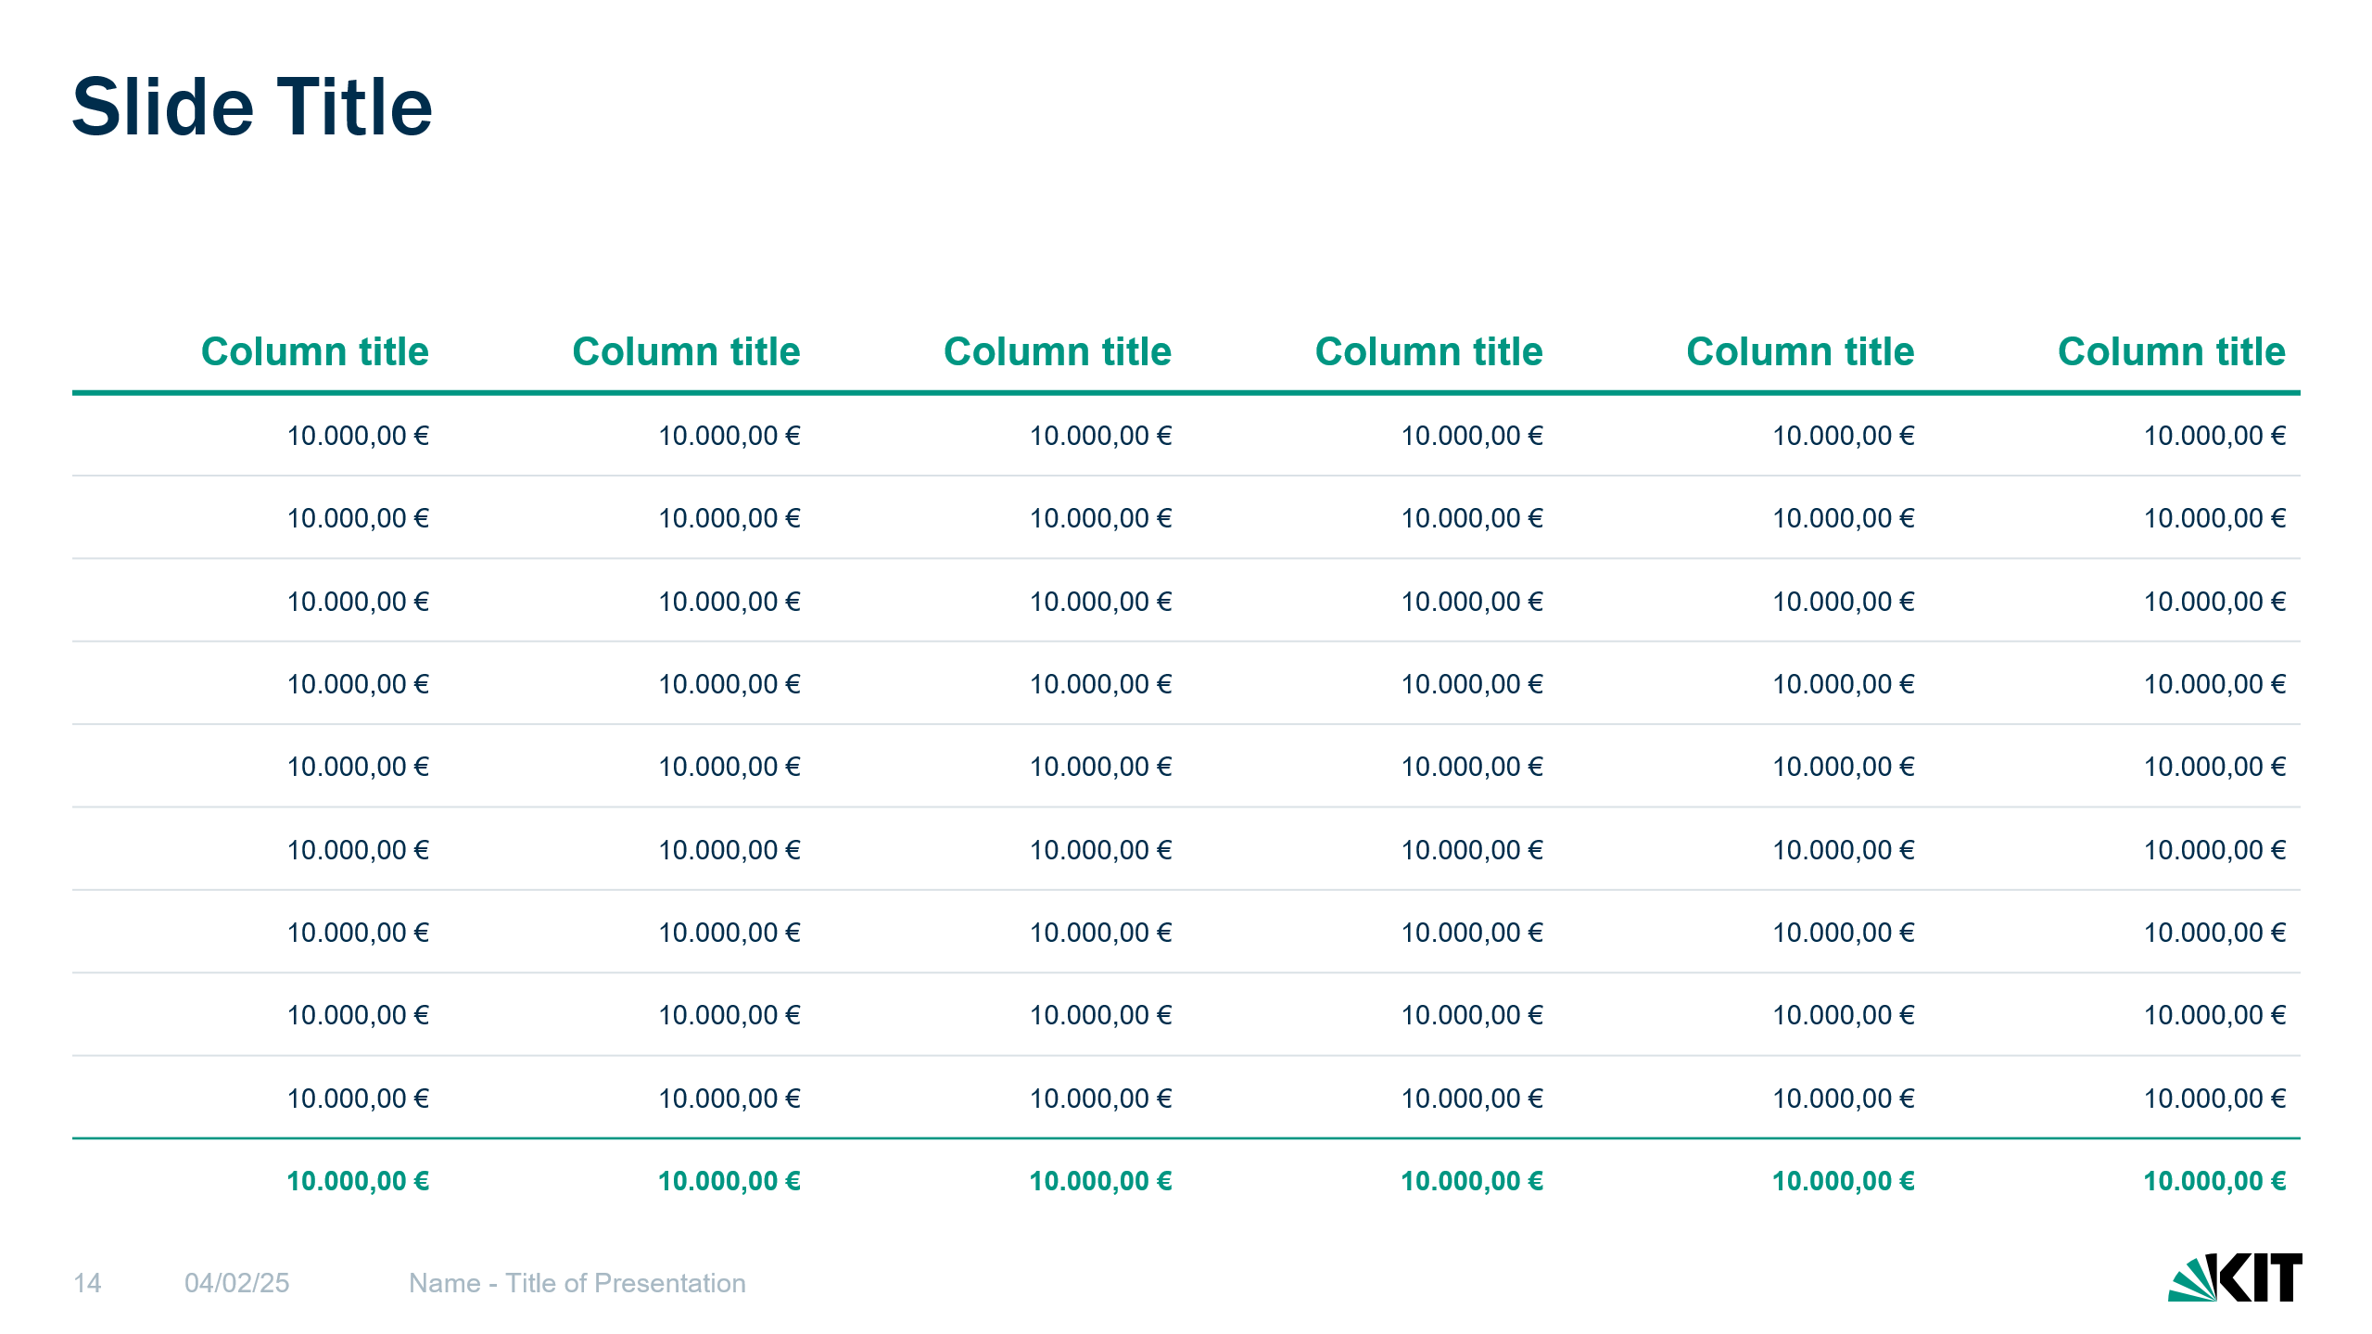
Tables
After filling the table, it can make sense to highlight important content.
The best way to do this is to color individual cells, columns or rows.
Text on colored cells must always be colored white. Totals can be highlighted with a colored line and colored, bold font.

Slide 25
Slide Title
Column title | Column title | Column title | Column title | Column title | Column title
I am a dummy copy | I am a dummy copy | I am a dummy copy | I am a dummy copy | I am a dummy copy | I am a dummy copy
I am a dummy copy | I am a dummy copy | I am a dummy copy | I am a dummy copy | I am a dummy copy | I am a dummy copy
I am a dummy copy | I am a dummy copy | I am a dummy copy | I am a dummy copy | I am a dummy copy | I am a dummy copy
I am a dummy copy | I am a dummy copy | I am a dummy copy | I am a dummy copy | I am a dummy copy | I am a dummy copy
I am a dummy copy | I am a dummy copy | I am a dummy copy | I am a dummy copy | I am a dummy copy | I am a dummy copy
I am a dummy copy | I am a dummy copy | I am a dummy copy | I am a dummy copy | I am a dummy copy | I am a dummy copy
I am a dummy copy | I am a dummy copy | I am a dummy copy | I am a dummy copy | I am a dummy copy | I am a dummy copy
I am a dummy copy | I am a dummy copy | I am a dummy copy | I am a dummy copy | I am a dummy copy | I am a dummy copy
I am a dummy copy | I am a dummy copy | I am a dummy copy | I am a dummy copy | I am a dummy copy | I am a dummy copy
I am a dummy copy | I am a dummy copy | I am a dummy copy | I am a dummy copy | I am a dummy copy | I am a dummy copy

Slide 26
Slide Title
Line title | I am a dummy copy | I am a dummy copy | I am a dummy copy | I am a dummy copy | I am a dummy copy
Line title | I am a dummy copy | I am a dummy copy | I am a dummy copy | I am a dummy copy | I am a dummy copy
Line title | I am a dummy copy | I am a dummy copy | I am a dummy copy | I am a dummy copy | I am a dummy copy
Line title | I am a dummy copy | I am a dummy copy | I am a dummy copy | I am a dummy copy | I am a dummy copy
Line title | I am a dummy copy | I am a dummy copy | I am a dummy copy | I am a dummy copy | I am a dummy copy
Line title | I am a dummy copy | I am a dummy copy | I am a dummy copy | I am a dummy copy | I am a dummy copy
Line title | I am a dummy copy | I am a dummy copy | I am a dummy copy | I am a dummy copy | I am a dummy copy
Line title | I am a dummy copy | I am a dummy copy | I am a dummy copy | I am a dummy copy | I am a dummy copy
Line title | I am a dummy copy | I am a dummy copy | I am a dummy copy | I am a dummy copy | I am a dummy copy
Line title | I am a dummy copy | I am a dummy copy | I am a dummy copy | I am a dummy copy | I am a dummy copy
Line title | I am a dummy copy | I am a dummy copy | I am a dummy copy | I am a dummy copy | I am a dummy copy

Slide 27
Slide Title
Column title | Column title | Column title | Column title | Column title | Column title
10.000,00 € | 10.000,00 € | 10.000,00 € | 10.000,00 € | 10.000,00 € | 10.000,00 €
10.000,00 € | 10.000,00 € | 10.000,00 € | 10.000,00 € | 10.000,00 € | 10.000,00 €
10.000,00 € | 10.000,00 € | 10.000,00 € | 10.000,00 € | 10.000,00 € | 10.000,00 €
10.000,00 € | 10.000,00 € | 10.000,00 € | 10.000,00 € | 10.000,00 € | 10.000,00 €
10.000,00 € | 10.000,00 € | 10.000,00 € | 10.000,00 € | 10.000,00 € | 10.000,00 €
10.000,00 € | 10.000,00 € | 10.000,00 € | 10.000,00 € | 10.000,00 € | 10.000,00 €
10.000,00 € | 10.000,00 € | 10.000,00 € | 10.000,00 € | 10.000,00 € | 10.000,00 €
10.000,00 € | 10.000,00 € | 10.000,00 € | 10.000,00 € | 10.000,00 € | 10.000,00 €
10.000,00 € | 10.000,00 € | 10.000,00 € | 10.000,00 € | 10.000,00 € | 10.000,00 €
10.000,00 € | 10.000,00 € | 10.000,00 € | 10.000,00 € | 10.000,00 € | 10.000,00 €

Slide 28
Slide Title
Step 1
I am a dummy copy. And I’ve been a dummy copy since my birth.
It took me a long time to realize what it means to be a dummy copy: you make no sense. You stand out now and then by being completely out of context.
Step 2
I am a dummy copy. And I’ve been a dummy copy since my birth.
It took me a long time to realize what it means to be a dummy copy: you make no sense. You stand out now and then by being completely out of context.
Step 3
I am a dummy copy. And I’ve been a dummy copy since my birth.
It took me a long time to realize what it means to be a dummy copy: you make no sense. You stand out now and then by being completely out of context.

Slide 29
Slide Title
Step 1
I am a dummy copy.
It took me a long time to realize what it means to be a dummy copy: you make no sense. You stand out now and then by being completely out of context.
Step 2
I am a dummy copy.
It took me a long time to realize what it means to be a dummy copy: you make no sense. You stand out now and then by being completely out of context.
Step 3
I am a dummy copy.
It took me a long time to realize what it means to be a dummy copy: you make no sense. You stand out now and then by being completely out of context.
Step 4
I am a dummy copy.
It took me a long time to realize what it means to be a dummy copy: you make no sense. You stand out now and then by being completely out of context.

Slide 30
Slide Title
Step 1
I am a dummy copy.
It took me a long time to realize what it means to be a dummy copy.
Step 2
I am a dummy copy.
It took me a long time to realize what it means to be a dummy copy.
Step 3
I am a dummy copy.
It took me a long time to realize what it means to be a dummy copy.
Step 4
I am a dummy copy.
It took me a long time to realize what it means to be a dummy copy.
Step 5
I am a dummy copy.
It took me a long time to realize what it means to be a dummy copy.
Step 6
I am a dummy copy.
It took me a long time to realize what it means to be a dummy copy.

Slide 31
Slide Title
Step 1
I am a dummy copy. And I’ve been a dummy copy since my birth.
Step 2
I am a dummy copy. And I’ve been a dummy copy since my birth.
Step 3
I am a dummy copy. And I’ve been a dummy copy since my birth.
Step 4
I am a dummy copy. And I’ve been a dummy copy since my birth.
Step 5
I am a dummy copy. And I’ve been a dummy copy since my birth.
Step 6
I am a dummy copy. And I’ve been a dummy copy since my birth.
Step 7
I am a dummy copy. And I’ve been a dummy copy since my birth.
Step 8
I am a dummy copy. And I’ve been a dummy copy since my birth.

Slide 32
Slide Title
33 %
I am a dummy copy. And I’ve been a dummy copy since my birth.
33 %
I am a dummy copy. And I’ve been a dummy copy since my birth.
33 %
I am a dummy copy. And I’ve been a dummy copy since my birth.
33 %
I am a dummy copy. And I’ve been a dummy copy since my birth.

Slide 33
Slide Title
I am a dummy copy. And I’ve been a dummy copy since my birth.
I am a dummy copy. And I’ve been a dummy copy since my birth.
I am a dummy copy. And I’ve been a dummy copy since my birth.
dummy copy
I am a dummy copy. And I’ve been a dummy copy since my birth.
I am a dummy copy. And I’ve been a dummy copy since my birth.
I am a dummy copy. And I’ve been a dummy copy since my birth.

Slide 34
Slide Title
January 2025
February 2025
March – May 2025
June – July 2025
August – October 2025
November – December 2025
I am a dummy copy.
It took me a long time to realize what it means to be a dummy copy.
I am a dummy copy.
It took me a long time to realize what it means to be a dummy copy.
I am a dummy copy.
It took me a long time to realize what it means to be a dummy copy.
I am a dummy copy.
It took me a long time to realize what it means to be a dummy copy.
I am a dummy copy.
It took me a long time to realize what it means to be a dummy copy.
I am a dummy copy.
It took me a long time to realize what it means to be a dummy copy.

Slide 35
Slide Title
 | CW 1 | CW 2 | CW 3 | CW 4 | CW 5 | CW 6 | CW 7 | CW 8 | CW 8 | CW 10 | CW 11 | CW 12
Dummy copy
Dummy copy
Dummy copy
Dummy copy
Dummy copy
Dummy copy
Dummy copy
Dummy copy
Dummy copy
Dummy copy
Legend
Legend
Legend

Slide 36
Slide Title
Name
Position, title or function
Name
Position, title or function
Name
Position, title or function
Name
Position, title or function
Name
Position, title or function
Name
Position, title or function
Name
Position, title or function
Name
Position, title or function
Name
Position, title or function
Name
Position, title or function
Name
Position, title or function
Name
Position, title or function
Name
Position, title or function
Name
Position, title or function
Name
Position, title or function
Name
Position, title or function
Name
Position, title or function
Name
Position, title or function
Name
Position, title or function
Name
Position, title or function
Name
Position, title or function
Name
Position, title or function
Name
Position, title or function
Name
Position, title or function

Slide 37
Slide Title
Name
Name
Position, title or function
Name
Position, title or function
Name
Name
Name
Position, title or function
Name
Position, title or function
Name
Position, title or function
Name
Position, title or function
Name
Position, title or function
Name
Position, title or function
Name
Position, title or function
Name
Position, title or function
Name
Position, title or function
Name
Position, title or function
Name
Position, title or function
Name
Position, title or function
Name
Position, title or function
Name
Position, title or function
Name
Position, title or function
Name
Position, title or function
Name
Position, title or function
Name
Position, title or function
Name
Position, title or function
Name
Position, title or function
Name
Position, title or function
Name
Position, title or function
Name
Position, title or function
Name
Position, title or function
Name
Position, title or function
Name
Position, title or function
Name
Position, title or function
Name
Position, title or function
Name
Position, title or function

Slide 38
Slide Title
I am a dummy copy. And I’ve been a dummy copy since my birth.
It took me a long time to realize what it means to be a dummy copy: you make no sense. You stand out now and then by being completely out of context.
Dummy copy
Dummy copy
Dummy copy
Karlsruhe
Dummy copy
Dummy copy
Karlsruhe
Dummy copy

Slide 39

Contact
Placeholder
Name
Position, title or function
+49 000 1234567
info@kit.edu
Karlsruher Institut für Technologie
Kaiserstraße 12 76131 Karlsruhe Germany

Slide 40

Team
Placeholder
Name
Position, title or function
Name
Position, title or function
Name
Position, title or function
Name
Position, title or function

Slide 42
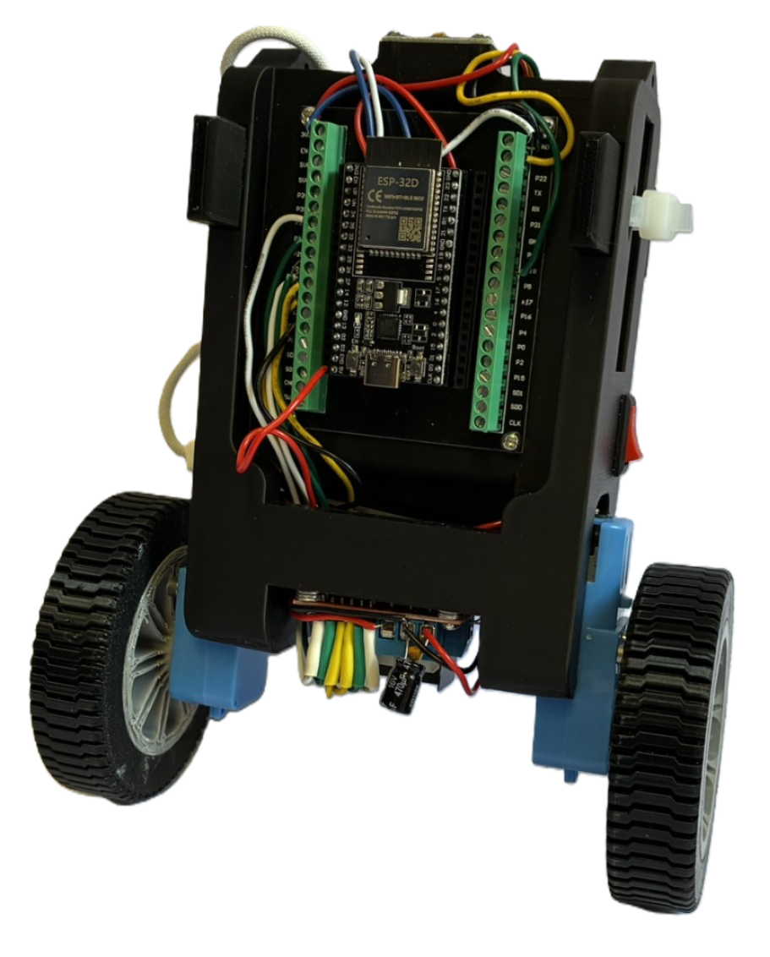
Selbstbalancierender Roboter
Jan Fritze
Marius Carrier
Notes:
Der Roboter verhält sich wie ein inverses Pendel. Da sein Schwerpunkt oberhalb der Radachse liegt, würde er ohne aktive Regelung umfallen.
Deshalb muss eine erkannte Neigung unmittelbar durch eine passende Radbewegung ausgeglichen werden.
Kippt der Roboter nach vorne oder hinten, erkennt der Roboter diese Bewegung und berechnet daraus ein Motorsignal, sodass die Räder in Richtung der Kippbewegung fahren.
Dadurch wird der Aufstandspunkt unter den Schwerpunkt verschoben und der Roboter kann sich wieder aufrichten

Slide 43
Gliederung
Aufbau und technische Umsetzung
Komponentenauswahl
Schaltplan
Programmierung
IMU
Regelkreis
Motorsteuerung
Live-Tuning
Ergebnisse
Ausblick

Slide 44

Aufbau und technische Umsetzung

Slide 45

Komponentenauswahl
ESP32D als zentrale Steuereinheit
Ausreichende Rechenleistung und integriertes WLAN
MPU-6500 zur Winkelmessung
Misst Beschleunigung und Winkelgeschwindigkeit
L298N-Motortreiber
Ermöglicht die Ansteuerung der Motoren, da der ESP32D die benötigten Motorströme nicht direkt liefern kann
H-Brücke ermöglicht Umpolarisierung der Motorenspannung
Motoren
Motoren mit 90:1-Übersetzung für niedrigere Drehzahl
Bauteile
ESP32D
TT-Motor
MPU-6500
L298N
Powerbank
NTC 5D-7
Schalter
ELKO 470
104 Keramikkondensator
PD-Trigger
Notes:
Hier seht ihr eine List aller Elektrischen Bauteile
Wir werdend jetzt im laufe der Präsentation, der Grund für die Auswahl der Komponenten sowie deren Wirkung erklären
Anfangen tue ich mit dem prinzipiellen Aufbau
ESP32D ist wie das ESP32 nur das es bereits eine integrierte Antenne hat.
Das haben wir ausgewählt, weil der eigentliche Steuerungsalgorithmus, nicht sonderlich komplex ist
Jedoch brauchen wir die WLAN-Funktion wie wir später zeigen werden
Um kippen zu registrieren nutzen wir den MPU-6500
Die L298N ist sehr wichtig, für die Nutzung der Motoren, da weder kann die ESP32D die nötigen Motorströme liefern, um die Motoren anzutreiben, noch könnte er die Spannung umpolarisieren um die Richtung der Motoren zu wechseln
Für die Motoren haben wir uns für Motoren mit einer Übersetzung von 90:1 entschieden, was uns eine feine Regulierung der Umdrehungen erlaubt

Slide 46
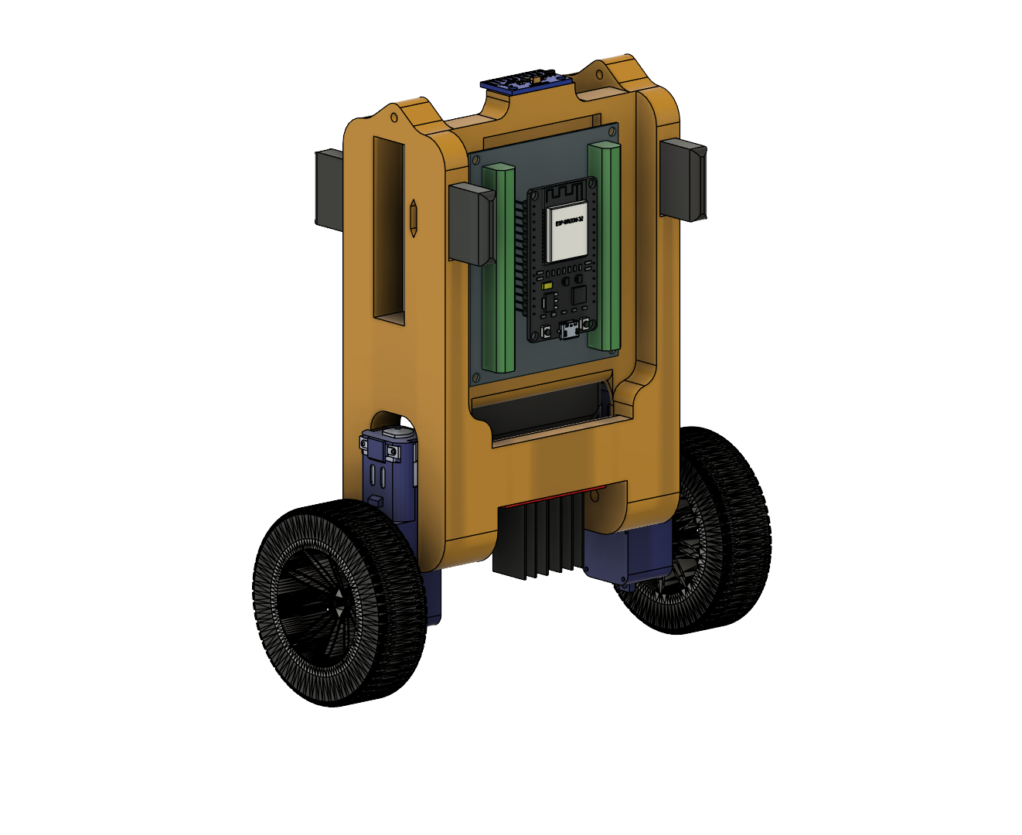
Das Konzept

Slide 47
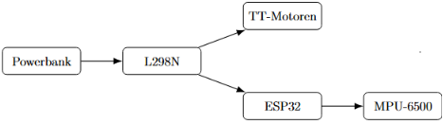
Schaltplan und Energieversorgung
Powerbank als Spannungsquelle
Kann 5 oder 9 Volt liefern
PD-Trigger fordert 9 Volt an
L298N als zentraler Leistungsknoten
Zwei Spannungslevel
Interner Spannungsregler: 5 V für Logik
9 V direkt für Motoren
ESP32 über 5 V Ausgang des L298N
Gemeinsame Masse
MPU-6500
Über 3,3 V des ESP32 versorgt
Platzsparendes Design
Kombination aus Spannungswandler und Motoransteuerung
Verzicht auf Step Down Converter

Slide 48
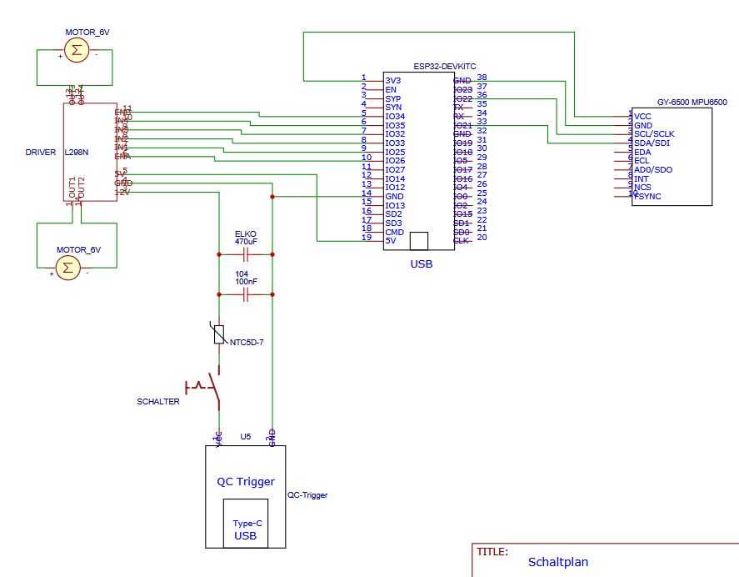
Schaltplan und Energieversorgung
Kondensatoren zur Spannungsstabilisierung
100-nF Keramikkondensator:
Kompensiert hochfrequente Störungen
470-μF Elektrolytkondensator:
Gleicht kurzzeitige Spannungseinbrüche bei Laständerungen aus
Problem mit Kondensatoren
Kondensatoren beim Einschalten zunächst ungeladen
Verhält sich kurzzeitig wie ein Kurzschluss
Hoher Einschaltstrom
NTC zur Begrenzung des Einschaltstroms
NTC 5D-7 in kaltem Zustand Nominalwiderstand von 5 Ohm
Erwärmt sich nach dem Einschalten
Widerstand sinkt stark ab → geringer Spannungsabfall während des Betriebs
Robusterer Betrieb
Verringern Risiko von Spannungseinbrüchen und Fehlfunktionen des ESP32

Slide 49
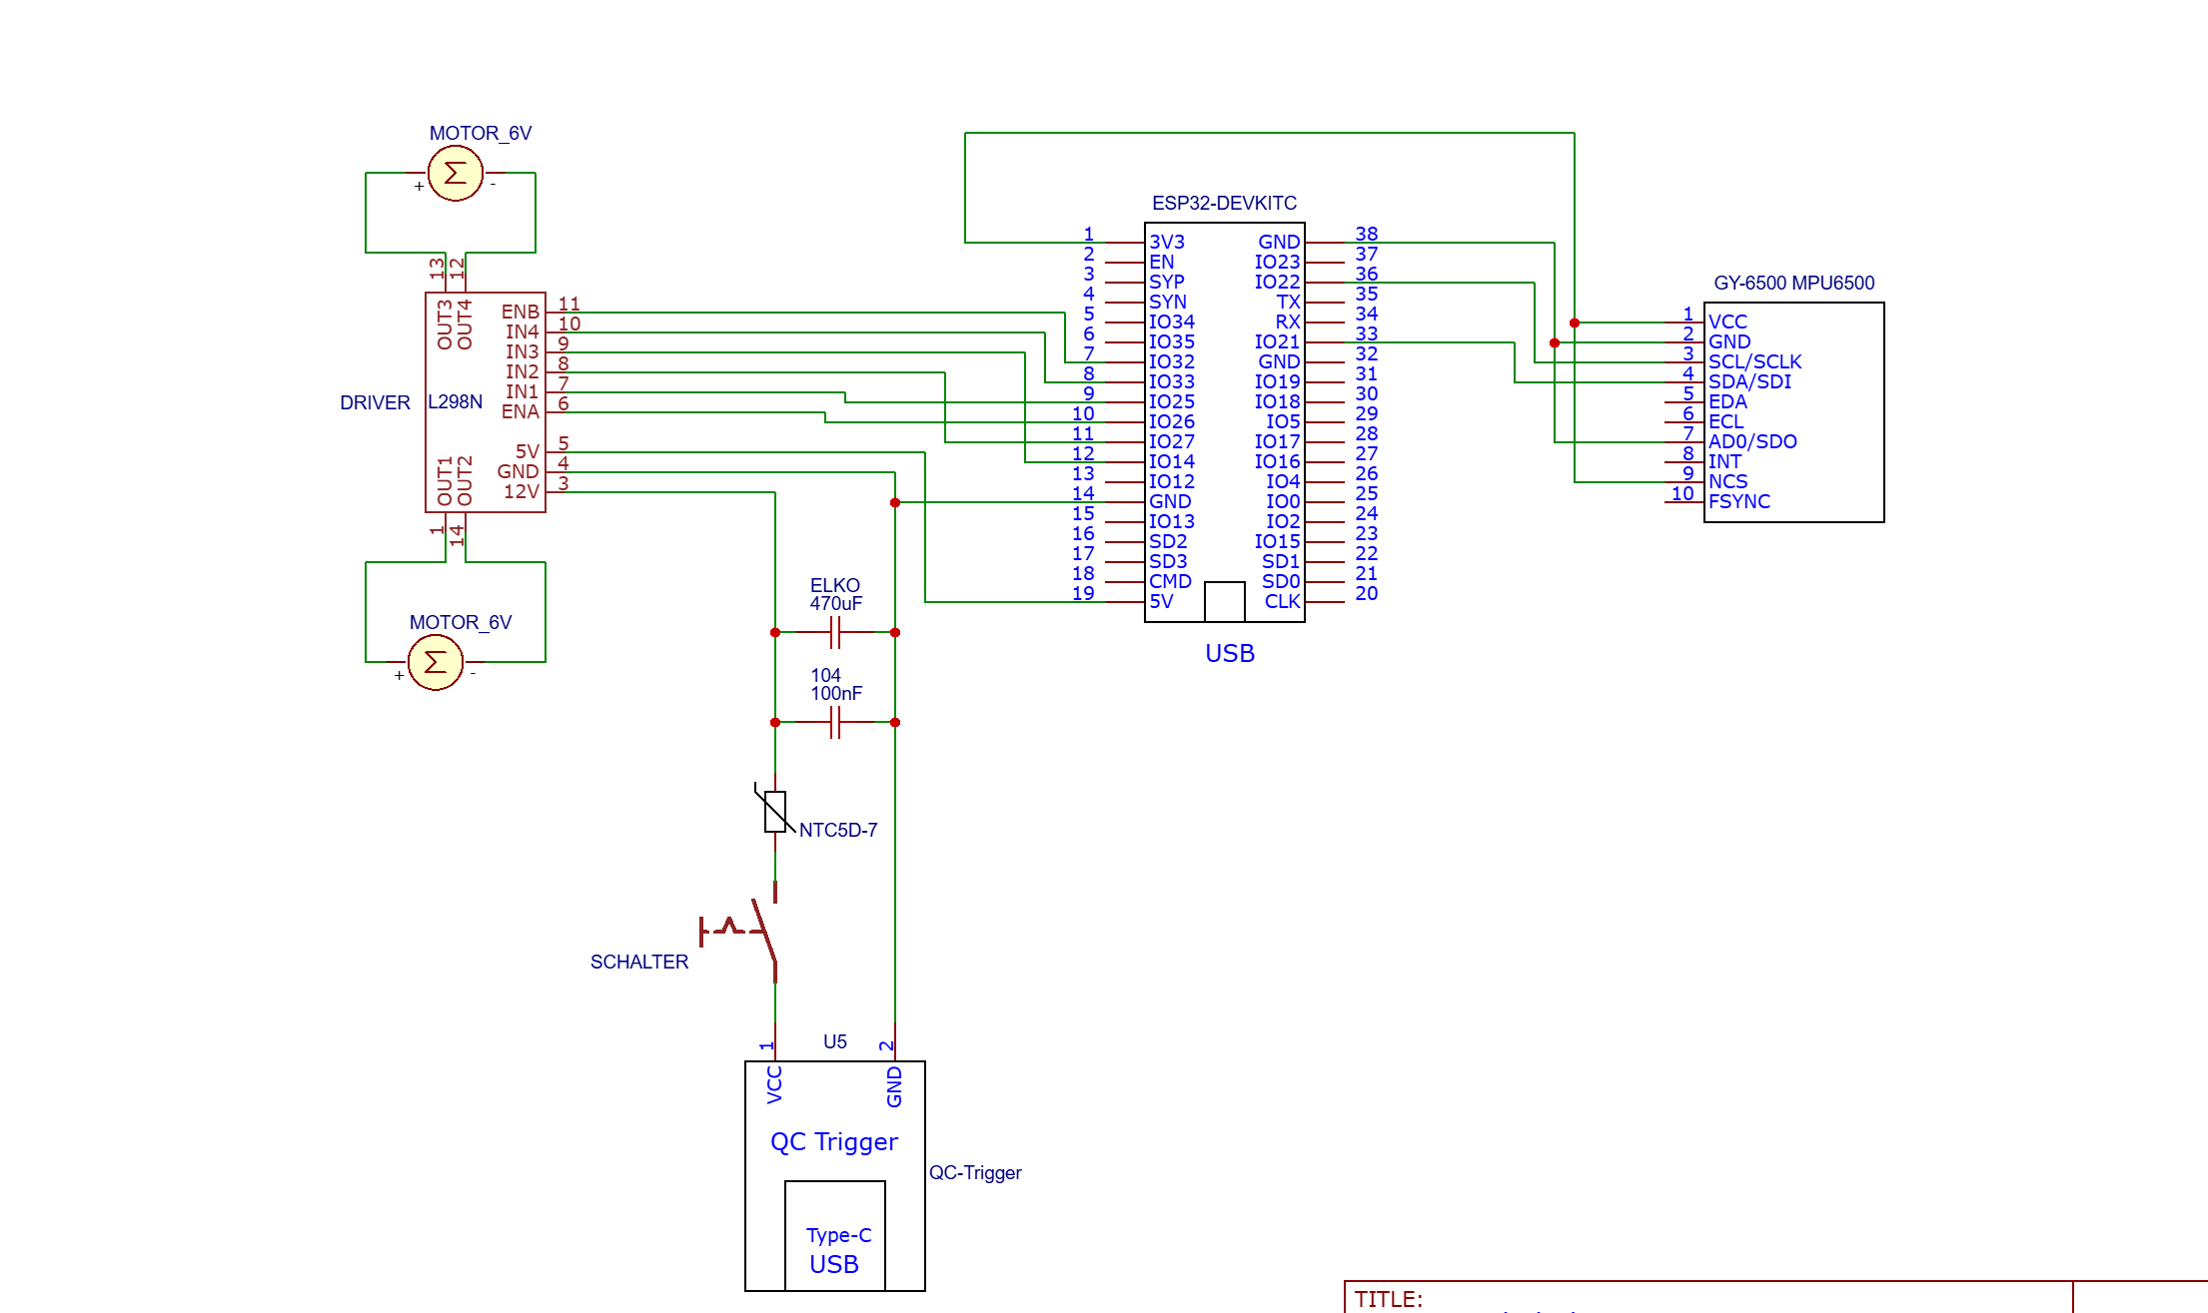

Slide 50
Der fertige Roboter

Slide 51
Programmierung

Slide 52
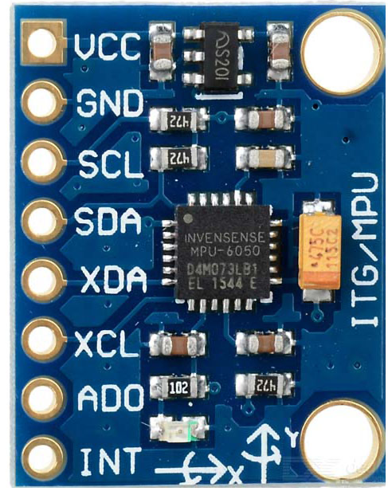
Programmierung
Messung und Kalibrierung des Neigungswinkels
Der MPU-6500 erfasst dafür Beschleunigung und Winkelgeschwindigkeit.
Der Beschleunigungssensor liefert einen stabilen Referenzwinkel, reagiert aber empfindlich auf Vibrationen und Bewegungen.
Das Gyroskop erkennt schnelle Winkeländerungen, ist jedoch langfristig driftanfällig.
Ein Komplementärfilter kombiniert beide Signale zu einem schnellen und stabilen Winkelwert.
Vor dem Regelbetrieb wird das Gyroskop mit 500 Messungen kalibriert.
Tiefpassfilter um Rauschen zu minimieren
M. Carrier J. Fritze – Selbstbalancierender Roboter
Notes:
Der Beschleunigungssensor misst die Beschleunigung des Roboters und kann dadurch die Richtung der Erdbeschleunigung erfassen.
Aus dieser Richtung lässt sich ein Neigungswinkel berechnen.
Dieser Winkel ist langfristig stabil, wird jedoch durch Bewegungen, Vibrationen und Beschleunigungen des Roboters gestört.
Das Gyroskop misst dagegen die Winkelgeschwindigkeit.
Durch Integration dieser Winkelgeschwindigkeit über die Zeit kann die Änderung des Winkels sehr schnell erfasst werden.
Dieser Wert eignet sich daher besonders gut für schnelle Bewegungen.
Gyroskops hat jedoch Drift.
Kleine Messfehler werden bei der Integration über die Zeit aufsummiert, wodurch der berechnete Winkel langsam vom tatsächlichen Winkel abweicht.
Komplementärfilter:
Winkel überwiegend aus der Winkelgeschwindigkeit des Gyroskops berechnet und durch den Winkel aus dem Beschleunigungssensor korrigiert.
Der Gyroskopanteil sorgt somit für eine schnelle Reaktion, während der Beschleunigungssensor den Winkel langfristig stabilisiert.
Vor dem Regelbetrieb wird das Gyroskop kalibriert.
Dafür muss der Roboter beim Einschalten ruhig gehalten werden.
Während der Kalibrierung werden 500 Messwerte aufgenommen und gemittelt, um so den Gyroskop-Offset zu bestimmt.
Dieser Offset beschreibt den Messfehler des Gyroskops im ruhenden Zustand und wird anschließend von den weiteren Messwerten abgezogen.
Winkelgeschwindigkeit wird außerdem tiefpassgefiltert, um Messrauschen und schnelle Sprünge im Signal zu reduzieren.

Slide 53


Programmierung
Berechnung der Stellgröße mit dem PID-Regler
Grundlage ist der Regelfehler zwischen Sollwinkel und gemessenem Istwinkel.
Der PID-Regler setzt sich aus drei Anteilen zusammen: Rückstellung, Korrektur bleibender Abweichungen und Dämpfung schneller Bewegungen.
Bei größeren Winkelfehlern wird der P-Anteil ab 7° zusätzlich progressiv verstärkt.
So reagiert der Roboter bei kleinen Auslenkungen weich, bei kritischen Schieflagen aber deutlich stärker.
Die Stellgröße wird abschließend auf den zulässigen PWM-Bereich begrenzt.
M. Carrier J. Fritze – Selbstbalancierender Roboter
Notes:
Zur Regelung nutzen wir einen PID-Regler
Unser Eingangswert ist die Istwinkel und user Fehler ist die Differenz zwischen Soll und Ist winkel
Um die Anteile nochmal zu überfliegen, haben wir hier den linearen Rückstellungswert, Korrektur bleibender Abweichungen und Dämpfung schneller Bewegungen.
Da das Kippmoment des Roboters jedoch nicht, linear ist, haben wir ab 7° ebenfalls einen nicht linearen Korrektur Term eingesetzt.
Dies erlaubt uns bei kleinen Auslenkung fein zu justieren während wir gleichzeitig bei großen Auslenkung, große Korrektur Möglichkeiten haben
Damit die Ergebnisse im Definiertenbereich bleiben, wird die Ausgabe des PWM-Reglers auf -/+ 25 beschränkt

Slide 54
Programmierung
Einfluss der Regelungsfrequenz und PWM-Frequenz
Regelkreis – 200 Hz (berechnet alle 5 ms einen neuen Motorbefehl)
Hohe Regelungsfrequenz ermöglicht schnelle Reaktion
Zu hohe Frequenzen
verstärken Messrauschen
können von Motoren mechanisch nicht sinnvoll umgesetzt werden
PWM-Frequenz – 200 Hz
Legt fest, wie schnell das Motorsignal ein- und ausgeschaltet wird
Bei 200 Hz entstehen längere Impulse
Erleichtern das Anlaufen kleiner Gleichstrommotoren
Wahl der Frequenzen
Kompromiss zwischen sicherem Anlauf, ruhigem Motorlauf und hörbarem Motorgeräusch
M. Carrier J. Fritze – Selbstbalancierender Roboter

Slide 55
Programmierung
Motoransteuerung - Probleme
Mechanisches Getriebespiel (Backlash):
ca. ± 2° Leerlauf um Totpunkt
kleine Korrektursignale laufen ins Leere
Hohes Losbrechmoment:
Hohe innere Reibung
Motoren laufen erst ab einem PWM-Wert von ca. 80 bis 100 an
Konsequenz:
klassische, lineare PID-Regelung versagt im Nahbereich des Nullpunkts
Kleine Steuersignale → Motoren bewegen sich nicht
M. Carrier J. Fritze – Selbstbalancierender Roboter

Slide 56
Programmierung
Motoransteuerung - Lösungsstrategien
Maßnahme 1: Stufenförmige Mindest-PWM
Künstliche Anhebung des minimalen Stellsignals knapp über die Haftreibungsgrenze
Verhindert das träge, unkorrigierte Umkippen des Roboters bei minimalen Winkelfehlern
Allerdings: Ruckartiges Anfahren und hohe Mindestdrehzahl
Maßnahme 2: Dynamische Kickstart-Logik
Beim Anfahren der Motoren
Bei abruptem Richtungswechsel oder aus dem Stillstand
Für genau 7 Zyklen: mit voller Mindest-PWM angesteuert
Mechanisches Spiel im Getriebe wird instantan übersprungen und das Losbrechmoment sofort überwunden
Danach: Ansteuerung mit niedrigerem PWM-Wert möglich (40 bis 50)
Ermöglicht geringere Drehzahlen und feinfühligeres Einregeln der Ruhelage
M. Carrier J. Fritze – Selbstbalancierender Roboter

Slide 57
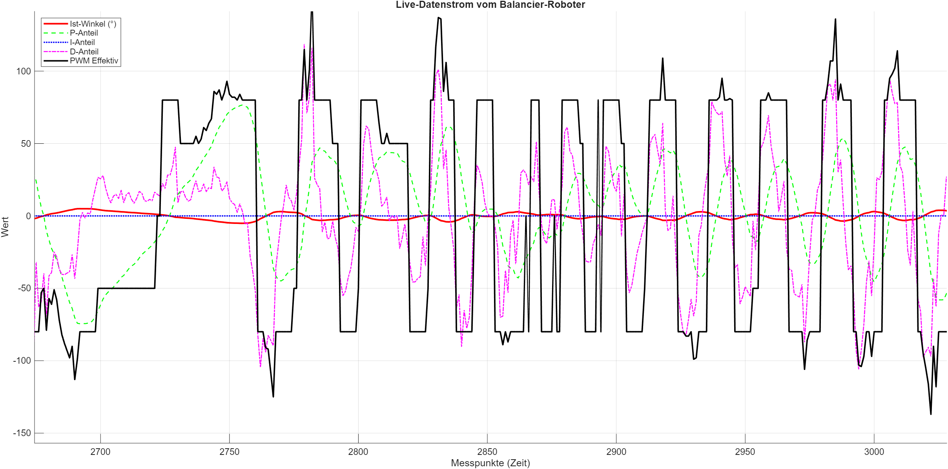
Programmierung
Motoransteuerung - Ergebnis
Ergebnis: Verbesserung der Systemdynamik
Haftreibung überwinden
Realisierung geringerer Drehzahlen
Sicherheitsabschaltung
Bei Überschreiten eines Fehlers von 30° werden die Motoren abgeschaltet
M. Carrier J. Fritze – Selbstbalancierender Roboter

Slide 58
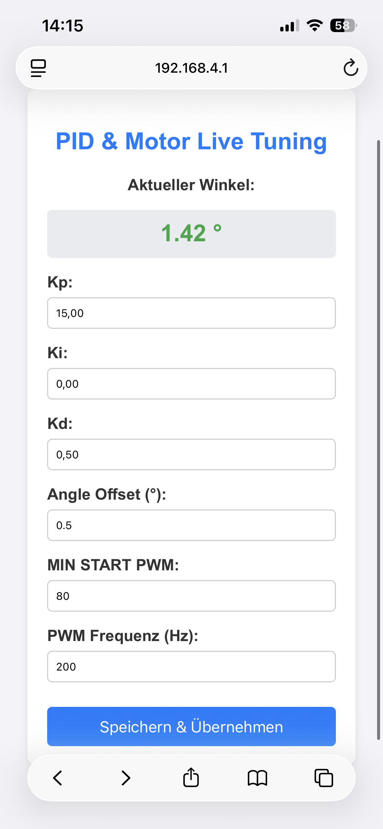
Programmierung
Live-Tuning
Der ESP32D stellt einen Webserver bereit, der über einen Browser aufgerufen werden kann
Für sparsamen Ressourcenumgang wird im Hauptloop nur überprüft ob eine Veränderung vorgenommen wurde
Vorteile:
Um den tatsächlichen Schwerpunkt zu finden wird das Live-Tuning benötigt
Ohne Live-Tuning wäre die richtige Kalibrierung schwerer umsetzbar
Ermöglicht eine schnellere Anpassung der Parameter, wodurch die Auswirkungen der Änderungen direkt sichtbarer werden
Zeitersparnis, da das Programm nach Parameteränderungen nicht erneut geflasht werden muss
M. Carrier J. Fritze – Selbstbalancierender Roboter
Notes:
Wie ich am anfang erwähnt hatte nutzen wir die WLAN möglichkeit des ESP32D.
Der nutzen sieht wie folgt aus, das ESP32D erstellt einen Webserver, auf dem sich der User mit einem Notmalen Web browser einwählen kann
Hier können die daten dann live verändert werden, wo bei die Werte nicht jedesmal im loop durchgegangen werden, sondern im Hauptloop nur überprüft wird, ob werte verändert wurden
Vorteile:
Während die Kalibierung sehr nett ist, ist der Schwerpunkt des Roboters überhaupt nicht bei 0°
Was wir also machen, ist den Robtor in seinen Schwerpunkt bringen, der Schwerpunkt über die Anzeige Ablesen, und dann mit dem Angel offset den Sollwinkel anpassen
Dies wäre ohne Live Anpassung nicht machbar, weil jedesmal wenn wir flushen die Kalibierung ein bisschen anders ist und dementsprechend eine Kalibierung auf dem Laptop überhaupt nicht möglich wäre
Außerdem hat uns dies, bei der Parameterfindung geholfen, da wir die Parameter verändern konten und dann live mit verfolgen konnten, welchen einfluss dies auf das Verhalten des Roboters hatte
Auch abesehen von der verbesserten Wahrnebarkeit der Parameterveränderungen war es auch eine Große Zeitersparniss das ESP32D nicht für jeder änderung neu flushen zumüssen

Slide 59
Ergebnisse

Slide 60
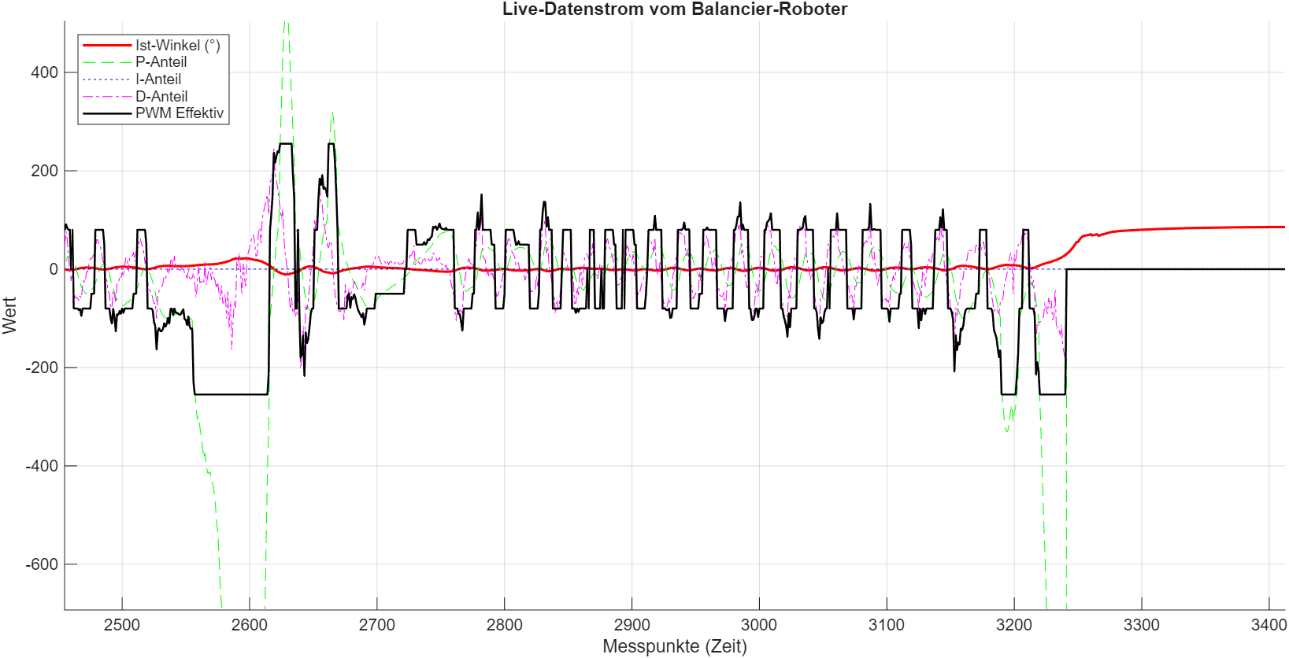
Regelungstechnische Analyse mittels MATLAB
Serielle Datenpipeline zur Regelanalyse aufgebaut
Ausgabe der unskalierten PID-Anteile (P, I, D) und des Stellsignals u(t)
Synchrone UART-Übertragung mit 200 Hz Schleifenfrequenz
Grafische Auswertung der Systemantworten in MATLAB
Unterstützung bei der Optimierung der Regelparameter
Präzise Identifikation und Isolation komplexer Regelfehler
Daten für spätere Analyse als CSV gespeichert
M. Carrier J. Fritze – Selbstbalancierender Roboter

Slide 61
Ergebnisse und Systemverhalten
Final verwendete Parameter
K_{p}: 15.0
K_{i}: 0.0
K_{d}: 0.5
Winkel-Offset: 0.0°
Mindest-PWM: 80
PWM-Frequenz: 200 Hz
Es konnte keine dauerhafte Stabilisierung des Roboters erreicht werden
Fehlerbild
Temporäre Stabilisierung um die Ruhelage
Kontinuierliches Aufschaukeln
Unkontrollierter Ausbruch zu einer Seite kann nicht mehr abgefangen werden
M. Carrier J. Fritze – Selbstbalancierender Roboter

Slide 62
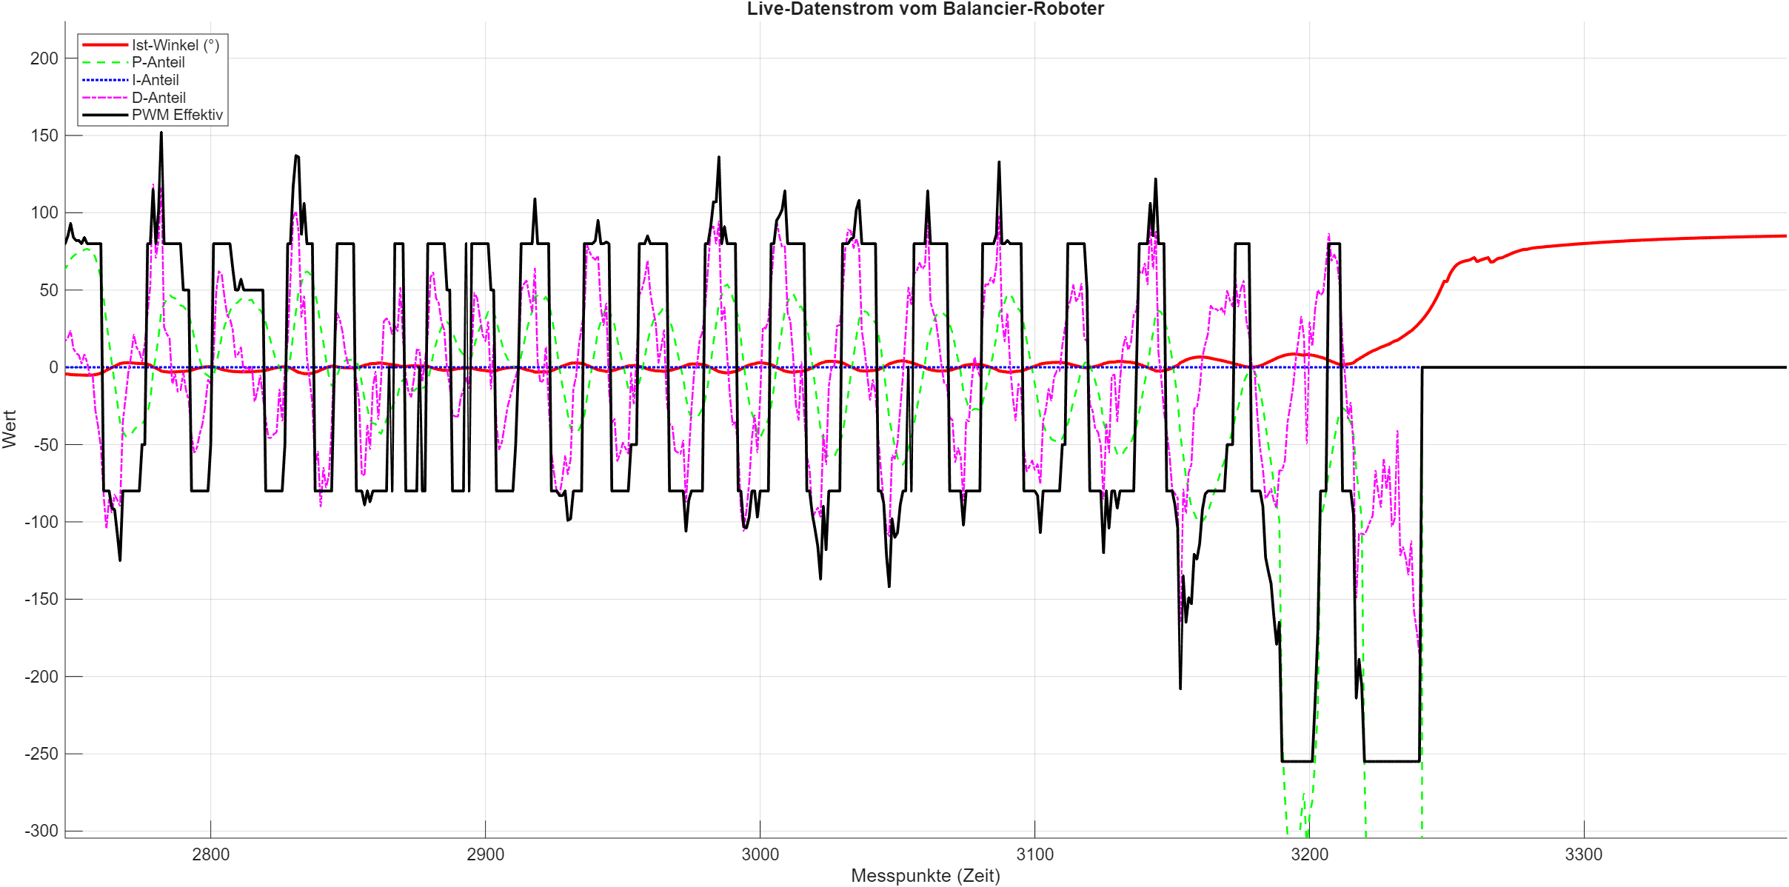
Ergebnisse und Systemverhalten
M. Carrier J. Fritze – Selbstbalancierender Roboter

Slide 63
Ausblick

Slide 64
Ausblick und Optimierungspotenziale
Optimierung der Aktuatorik
Reduzierung des Getriebespiels
Dynamisches Anlaufverhalten
Drehzahlreserven
Mechanisches Design und Massenverteilung
Erhöhung des Massenträgheitsmoments
Geometrische Anpassung
Fazit
Interessantes Projekt, um theoretisches Wissen auf die Praxis zu übertragen
Theorie der Regelungstechnik scheitert an Unwägbarkeiten des mechanischen Systems
M. Carrier J. Fritze – Selbstbalancierender Roboter
Notes:
Reduzierung des Getriebespiels:
Hohes Spiel
Kleine Regelseganle werden dadurch nicht auf die Räderübertragen
Planetenrad getriebe oder Schrittmotoren wären besser
Dynamisches Anlaufverhalten:
Die nächsten beiden punkte sind symptom der selben Ursache, die Motoren sind nicht schnell genug.
Sie brauchen eine Hohe PWM circa. 100 um eine erste reaction zu zeigen und danach fehlt spielraum
Das ist auf der einen Seite bessere Motoren und auf der anderen Seite ein geringeres übersetzungsverhältniss
Erhöhung des Massenträgheitsmoments
Invertiertes pendel, lässt sich Leichter regeln um so langsamer es fällt.
Schwere Komponenten nach oben
Geometrische Anpassung
Größere Räder

