Slide 1
Azure Monitoring Hackathon
Azure Monitor

Slide 2
Agenda – Day 1
9 – 9:30 AM: Kickoff & Introductions
9:30 - 10:30 AM: Deploy lab
10:30 – 10:45 AM: Break
11 am - Noon: Azure Security & Management and Monitoring Overviews
Noon – 1 PM: Lunch
1 – 3 PM: Azure Monitor and Alert Rule Challenges
3 – 3:15 PM: Break
3:15 – 5 PM: Monitoring and Alert Rule Automation Challenge

Slide 3
Agenda – Day 2
9 – 9:30 AM: Team Sync (what did you learn from Day 1?, how did it go?, blocked?)
9:30 – 10:15 AM: Log Analytics Overview
10:15 – 10:30 AM: Break
10:30 – Noon: Log Analytics Challenges Start
Noon – 1 PM: Lunch
1 – 3 PM: Log Analytics Dashboard Challenge
3 – 3:15 PM: break
3:15 – 5 PM: Log Analytics Challenges (complete)

Slide 4
Agenda – Day 3
9 – 9:30 AM: Team Sync up (what did you learn from Day 2?, how did it go?, blocked?)
9:30 – 10:15 AM: App Insights Overview
10:15 – 10:30 AM: Break
10:30 – Noon: App Insights Challenges Start
Noon – 1 PM: Lunch
1 – 3 PM: App Insights Challenges Continues
3 – 4 PM: Plan & Whiteboard Monitoring for existing Application

Slide 5
Monitoring Hackathon Setup
Deploy Infra using PowerShell \ CLI and an ARM Template
Setup Azure Module on Windows PowerShell https://docs.microsoft.com/en-us/powershell/azure/install-azurerm-ps?view=azurermps-6.9.0
Setup Azure CLI https://docs.microsoft.com/en-us/cli/azure/install-azure-cli?view=azure-cli-latest
Install Visual Studio Code and Extensions (depending on your tool of choice)
Azure Resource Manager Tools - https://marketplace.visualstudio.com/items?itemName=msazurermtools.azurerm-vscode-tools
ARM snippets - https://marketplace.visualstudio.com/items?itemName=artofshell.armsnippet
PowerShell - https://marketplace.visualstudio.com/items?itemName=ms-vscode.PowerShell
Azure CLI Tools – https://marketplace.visualstudio.com/items?itemName=ms-vscode.azurecli
Download Azure Monitoring Hackathon Setup Guide and follow the instructions https://github.com/rkuehfus/AzureMonitoringHackathon/raw/master/Student/Guides/Azure%20Monitoring%20Hackathon%20Deployment%20Guide.docx

Slide 6
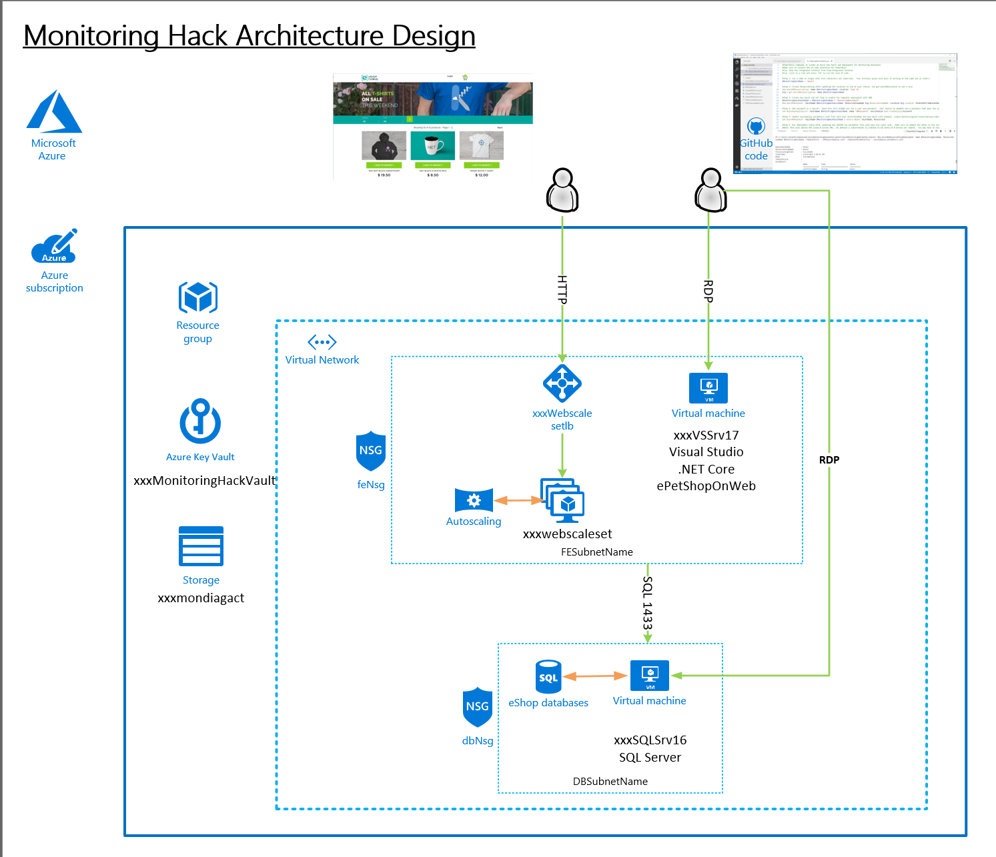
Should look like this ☺

Slide 7
Monitoring and Alert Rule Challenge
Create an empty database called “tpcc” on the SQL Server Note: Use SQL Auth with the username being sqladmin and password being whatever you used during deployment
From the ARM template, send the below guest OS metric to Azure Monitor for the SQL Server
Add a Performance Counter Metric for
Object: SQLServer:Databases
Counter: Active Transactions
Instance:tpcc
Hint: https://docs.microsoft.com/en-us/azure/monitoring-and-diagnostics/metrics-store-custom-guestos-resource-manager-vm
Download and Install HammerDB tool on the Visual Studio VM (instructions are in your Student\Guides\Day-1 folder for setting up and using Hammerdb.
www.hammerdb.com
Use HammerDB to create transaction load
From Azure Monitor, create a graph for the SQL Server Active Transactions and Percent CPU and pin to your Azure Dashboard
From Azure Monitor, create an Action group, to send email to your address
Create an Alert if Active Transactions goes over 40 on the SQL Server tpcc database.
Create an Alert Rule for CPU over 75% on the Virtual Scale Set that emails me when you go over the threshold. Note: In the Student\Resources\Loadscripts folder you will find a CPU load script to use.
First team to send me both alerts wins the challenge!!
Good luck!

Slide 8
Monitoring and Alert Rule Automation Challenge
Update the parameters file and deployment script for the GenerateAlertRules.json template located in the AlertTemplates folder
Add the names of your VMs and ResouceId for your Action Group
Deploy the GenerateAlertRules.json template using the sample PowerShell script (deployAlertRulesTemplate.ps1) or create a Bash script (look at the example from the initial deployment)
Verify you have new Monitor Alert Rules in the Portal or from the command line (sample command is in the deployment script)
Modify the GenerateAlertsRules.json to include “Disk Write Operations/Sec” and set a threshold of 20
Rerun your template and verify your new Alert Rules are created for each of your VMs
First team to me a screenshot of the new Alert Rules wins the challenge!!
Good luck!

Slide 9
Log Analytics Setup Challenge
Create a new Log Analytics Workspace
From the portal, connect SQL Server to your workspace.
Modify the ARM template to automatically connect your VM Scale Set to the workspace. Then redeploy template and verify the Web and SQL servers are connected
Connect the Azure Activity Log, NSG, LB, Key Vault and Storage Account (Events)
Add the following solutions: Activity Log Analytics, Service Map, Key Vault, Agent Health, Azure SQL Analytics, and Network Performance Monitor.
Add the standard performance counters, Application and System Event logs and IIS logs.
Deploy Service Map agents to Web Scale Set VMs and SQL Servers
Create a FE and BE group in Service Map
Generate DB load using HammerDB from the Visual Studio Server and view the results in Service Map
First Team to email me a screenshot with the Visual Studio Server detected by your Scale Set and detected by Service Map wins the challenge. Good luck!

Slide 10
Log Analytics Dashboard Challenge
Write a performance query that renders a time chart for the last 4 hours for both of the Web Servers and the SQL Server for the following perf metrics. Save each query to your favorites.
Processor Utilization: Processor / % Processor Time
Memory Utilization: Memory / % Committed Bytes In Use
Disk Utilization (IO): Disk Reads/sec and Disk Writes/sec
Create a heartbeat query for Web and SQL Server
Create a Log Analytics Solution
Use your heartbeat query for the Overview tile
Use your performance queries to create a line chart & list for Processor, Memory and Disk (Reads & Writes).
First Team to email me a screenshot with your Solution wins the challenge. Good luck!

Slide 11
Application Insights Challenges
Create an Application Insights Workspace
In Visual Studio, Install the Application Insights SDK in the eShopOnWeb Web Project in the Solution
Run the eShopOnWeb Web project and check out the App Insights tooling
Add the updated Application Insights NuGet package to v2.5.1, test again
Publish eShopOnWeb Web project to both Web Servers in the scaleset
Create a URL Ping test targeting the eShopOnWeb URL to Monitor Availability
Create an autoscale rule on your scaleset based on the total Server requests metric
Generate load using the URL load script in the Loadscripts folder
Trip the exception that has been added and setup an alert for it.
Find the exception in App Insights (Tip: try to change your password)
Create Alerts based on Availability and exceptions
First Team to email me an alert of the exception and a screenshot with your scaleset scale out based on the App Insights metric wins the challenge. Good luck

Slide 12
Reference

Slide 13
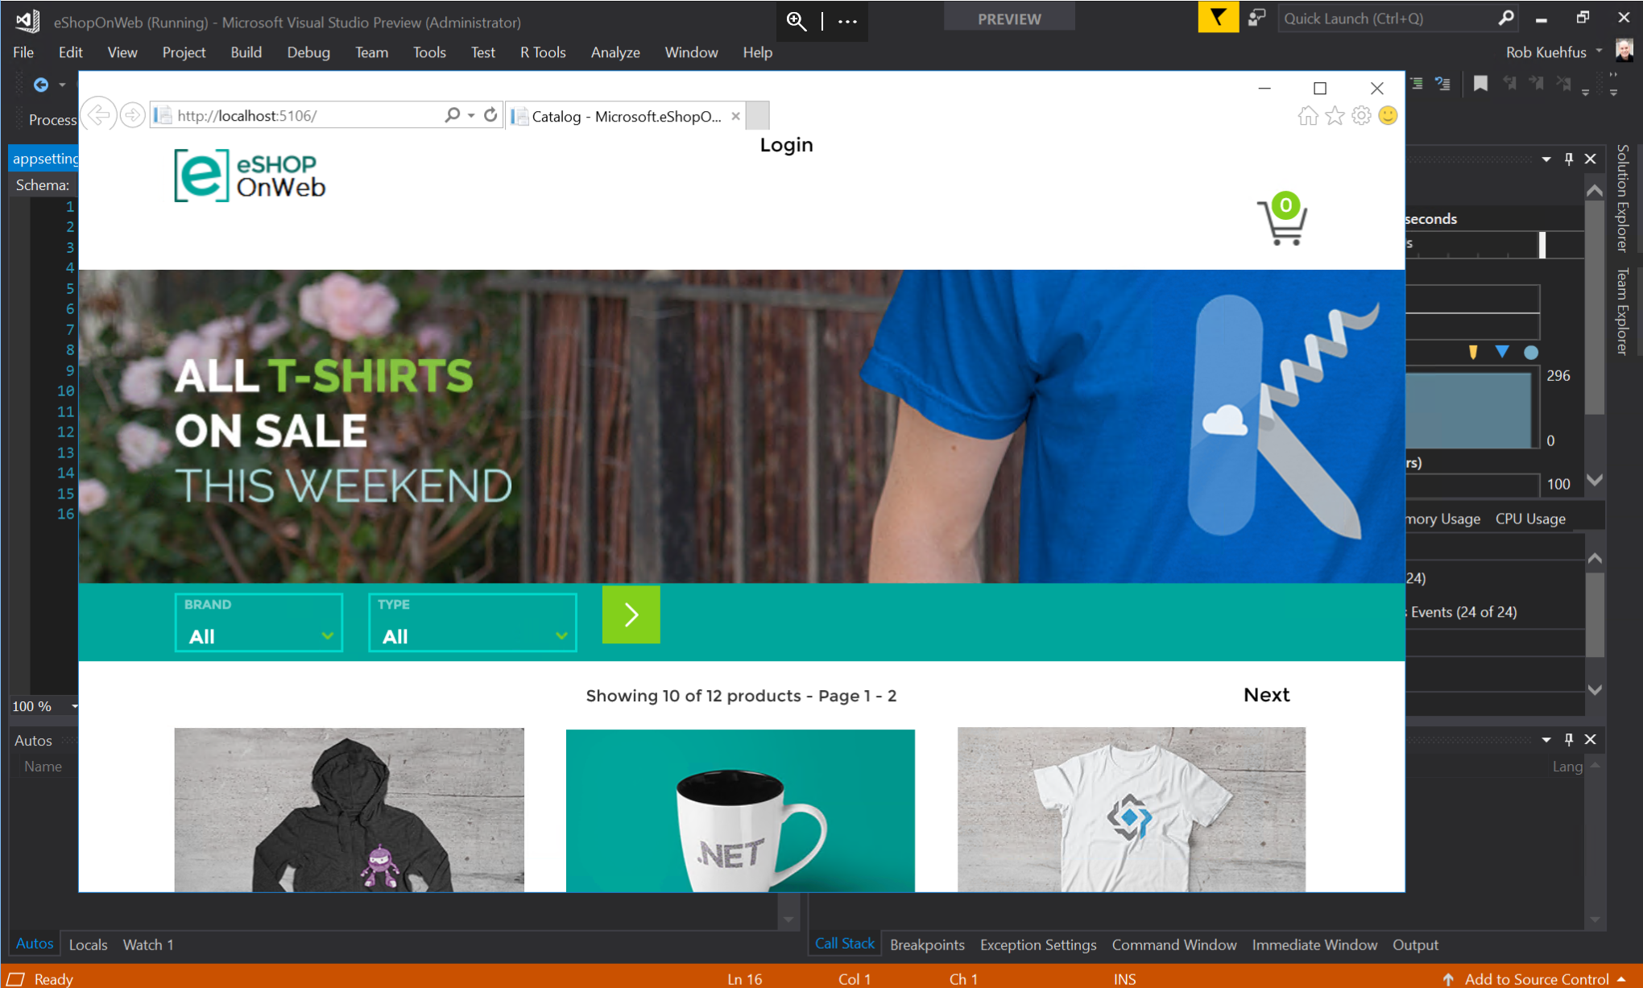
Should look like this ☺

Slide 14
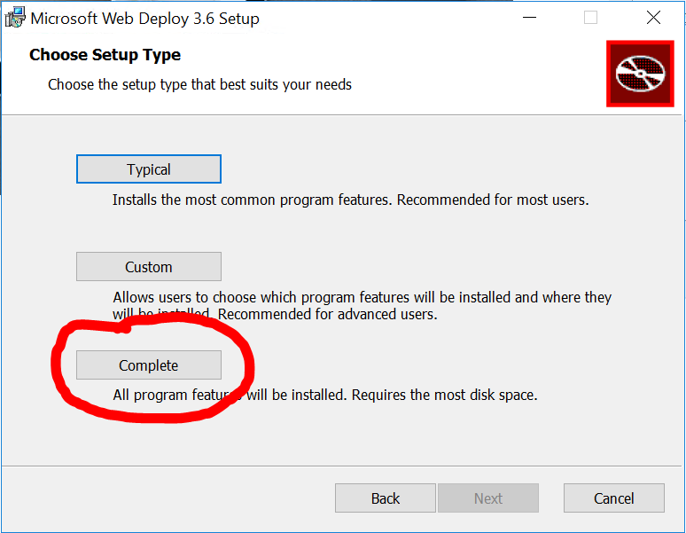
Application Insights – Additional Setup
On both IIS Servers (Web0 and Web1)
.NET Core Windows Server Hosting bundle https://www.microsoft.com/net/download/thank-you/dotnet-runtime-2.1.0-windows-hosting-bundle-installer
Install Web deploy with the Complete Setup →
https://www.microsoft.com/en-us/download/details.aspx?id=43717
Restart IIS when complete
Notes:
.NET Core SDK - https://www.microsoft.com/net/download/thank-you/dotnet-sdk-2.1.300-windows-x64-installer
.NET Core Windows Server Hosting bundle https://go.microsoft.com/fwlink/?linkid=844461
Install .NET Core Runtime
https://www.microsoft.com/net/download/dotnet-core/runtime-2.0.7
TODO –
Create PS script for the installs and add to ARM Template

Slide 15
Monitoring Hackathon eStoreOnWeb Setup
From the Visual Studio VM
Open the eShopOnWeb solution in VS located in C:\eshoponweb\eShopOnWeb-master
On the Github page for the eShopOnWeb follow the instructions under Configuring the sample to use SQL Server
Change the project startup to Web from Infrastructure
Test application
Notes:
"ConnectionStrings": {
"CatalogConnection": "Server=estoredb01;Integrated Security=false;User ID=sqladmin;Password=P@ssw0rd123!!;Initial Catalog=Microsoft.eShopOnWeb.CatalogDb;",
"IdentityConnection": "Server=estoredb01;Integrated Security=false;User ID=sqladmin;Password=P@ssw0rd123!!;Initial Catalog=Microsoft.eShopOnWeb.Identity;"
},

