Slide 1
Scrum Master
The Team’s Servant Leader
Organized by
Michael B. Carey

Slide 2
Getting Started
Maintain a High Level of Respect
Be Present
Manage Your Communication Devices
Notes:
Ask yourself, what makes you feel safe? Do you have rules to help you create order in your life? What rules could you implement in your life to help you feel safe?
Maintain a High Level of Respect
You have your own opinions, and you choose whether or not to express them. You will never be forced to do anything that you do not want to do. Please allow others this same level of respect.
Be Present
It is very easy to get distracted. Keep your mind in the room and don’t let it leave before your body does. Please step out of the room to respond to texts or phone calls.
Manage Your Communication Devices
You are responsible for the way you communicate with others. One communication device is your phone. Please be sure it is silenced and not distracting. This rule also applies to your voice. Managing your voice means controlling what you say, when, and to whom.
Bump the person next to you and say, “I’ll respect you till dinner.” Ok bump the other person… “I’ll respect you till dinner.”
Can we all agree to these rules? Can I get a YES?! ☺

Slide 3
Scrum Master Training - Presentation
What am I going to get from this presentation?
Why is it important to me?
How will I benefit from this?
Notes:
There is going to be a level of participation in this presentation. But don’t worry, if you don’t want to participate you don’t have to.
This presentation is going to cover details about the Scrum Master role in the Agile-Scrum process.
You will understand the ins and outs of being a Scrum Master and the importance of it.
You will also gain enough knowledge that if you haven’t been a Scrum Master before that you could function in that role by the end of this class.

Slide 4
Scrum Team Structure
Stakeholders
Product Owner
Scrum Master
Development Team
Notes:
Lets get started with some definitions
Stakeholders
This role varies slightly but is typically the top level business executives who drive high level initiatives for the company.
Product Owners
Translate the high level initiatives into actionable items that a scrum team can accomplish. This position is high visibility. It requires the PO to communicate with upper level management to gather requirements and specifications to accomplish the business needs. This job is made more difficult when priorities shift often making it important that both the PO and Stakeholders are in constant communication as to the priorities of the business.
Scrum Master
This position can be a very difficult one to fulfil as it requires a number of skills in order to facilitate the smooth flow of work between the PO and Dev / Scrum Team. A Scrum master must be a servant leader and someone who as clout within the company space. Relationships is the financial exchange that a Scrum Master must have in order properly fulfil their work effectively.
Though it is possible for a Scrum Master to also be one of the Scrum Team members their effectiveness will increase if they are able to fully dedicate their time to the role.
It is also important that a Scrum Master understand all roles in the Agile process so that they can be a coach and mentor to any role within the full team structure.
Development / Scrum Team
A cross functional group of engineers that are committed to the delivery of the stakeholder and product owner’s requests.
What is a full Scrum Team Structure look like?
Developers
QA
Database
Other

Slide 5
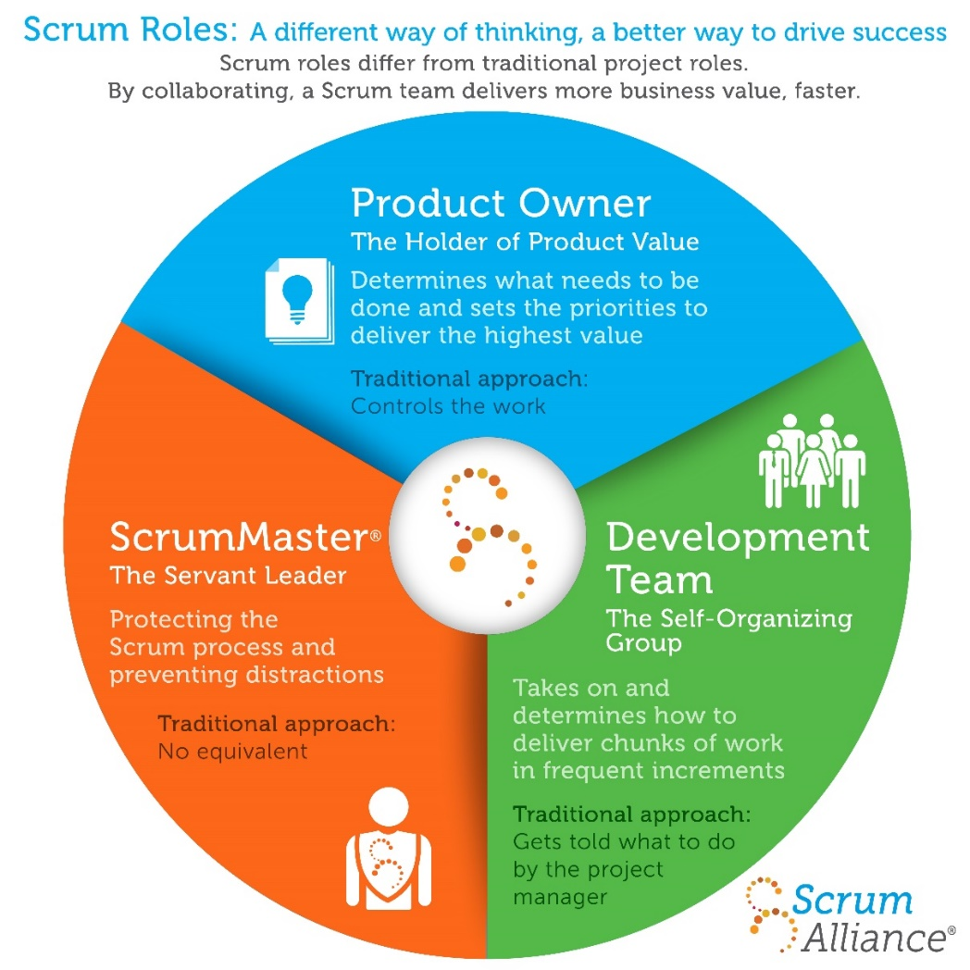
Scrum Roles
Product Owner
The Holder of Product Value
Development Team
The Self-Organizing Group
Scrum Master
The Servant Leader
Notes:
Product Owner
Determines what needs to be done and sets the priorities to deliver the highest value.
Traditional approach: Controls the Work.
Development Team
Takes on and determines how to deliver chunks of work in frequent increments.
Traditional approach: Gets told what to do by the project manager.
Scrum Master
Protecting Scrum process and preventing distractions
Traditional approach: No equivalent
Stakeholder
Where do they fit in this process?
*** READ *** You cannot mix Scrum Master and Product Owner
PO / SM roles are, essentially, mutually exclusive. A PO is technically adversarial to the Scrum Team and the SM is the protector of the Scrum Team. A Scrum Master must be the team’s coach, mentor, and advocate. Whereas the PO creates work for the Scrum Team to do which creates a different relationship. Having a PO / SM role would be in essence a Project Manager. PO’s create work and require that work be completed this can create a demand style relationship between the Dev Team and the person filling the split PO/SM role.
A PO can also be thought of as a Customer coming into a store and the Scrum Team to provide the service.
Should the Customer dictate the store owner’s process on how the customer’s need is to be fulfilled?
No, the customer should provide their needs & wants and allow the store owner to define the process to meet those needs.
Having a Dev as a SM will work.
Rotating the SM role through team members is a good way to help team members understand and adopt the Agile / Scrum process.
Rotate on a per sprint or every other sprint basis. (Team Decides)

Slide 6
Stakeholder – Intro Questions
What do you think a Stakeholder Does?
What is their major contribution to the Scrum Team?
What area of project management does the Stakeholder own?
Notes:
https://www.knowledgehut.com/blog/agile-management/agile-scrum-roles-responsibilities
Stakeholders:
The Stakeholder has to keep a healthy relationship with the Product Owner in order to share every detail regarding his project.
The Stakeholder is responsible for conveying his wishes and concerns to the product owner or else the product owner would not be responsible for his project quality and time duration.
The Stakeholder has to provide regular input to queries from the Product Owner.
Prioritizing the work affectively with the Product Owner is another job that the Stakeholder has to do to ensure his project development.
Keep taking updates or keep giving updates regarding any change in the plans.

Slide 7
Product Owner – Intro Questions
What do you think a Product Owner Does?
What is their major contribution to the Scrum Team?
What area of project management does the Product Owner own?
Notes:
https://www.knowledgehut.com/blog/agile-management/agile-scrum-roles-responsibilities
Product Owner:
The product owner is responsible for conveying the vision of the stakeholders to the team.
They have the authority to alter the scope.
The Product Owners are responsible for the return on investment (ROI) that is why they occupy an authoritative position in the firm.
Because they convey the vision of the stakeholders that is why they are the voice of the stakeholders.
Not only with the team, but they also communicate with the stakeholders about progress and problems.
Provides strategy and direction for the project
Vision, Product Roadmap, Release Goal, Sprint Goal
Organizes and prioritizes Product Backlog
Business interface on requirements & status
Decides on release date for completed functionality
Full time member
The project is NOT an additional duty
Presents Scum Team accomplishments at Sprint Review

Slide 8
Scrum Master – Intro Questions
What do you think a Product Owner Does?
What is their major contribution to the Scrum Team?
What area of project management does the Scrum Master own?
Notes:
https://www.knowledgehut.com/blog/agile-management/agile-scrum-roles-responsibilities
Scrum Master:
The Scrum Master is considered to be the top-dog in every organization because companies usually hire them and don’t treat them as permanent employ that is why they are with no authority.
It is their duty to remove all the hindrance or obstruction in the way of achieving any goal.
It is also their role to enforce scrum ceremonies and processes.
They are the ones who commit to goals and deadlines on behalf of the team.

Slide 9
Scrum Team – Intro Questions
What do you think a Scrum Team Does?
What is their major contribution?
What area of project management does the Scrum Team own?
Notes:
https://www.knowledgehut.com/blog/agile-management/agile-scrum-roles-responsibilities
Scrum Team:
The Scrum Team is responsible for all the activities that lead them towards their sprint goals.
They have to work with the Scrum Master to prioritize the items from the product backlog in the sprint planning.
Once committed, it is their responsibility to fulfil the commitment and deliver the agreed results on time with great quality.
The Scrum Master is not responsible for keeping his team organized that is they it is the duty of the Scrum Team to get self-organized.
They have to be agile in the office and have to attend every standup and other ceremonies.
They have to participate in all the meetings despite their nature and have to ensure that all the findings of the meetings are getting practically addressed in the project.

Slide 10
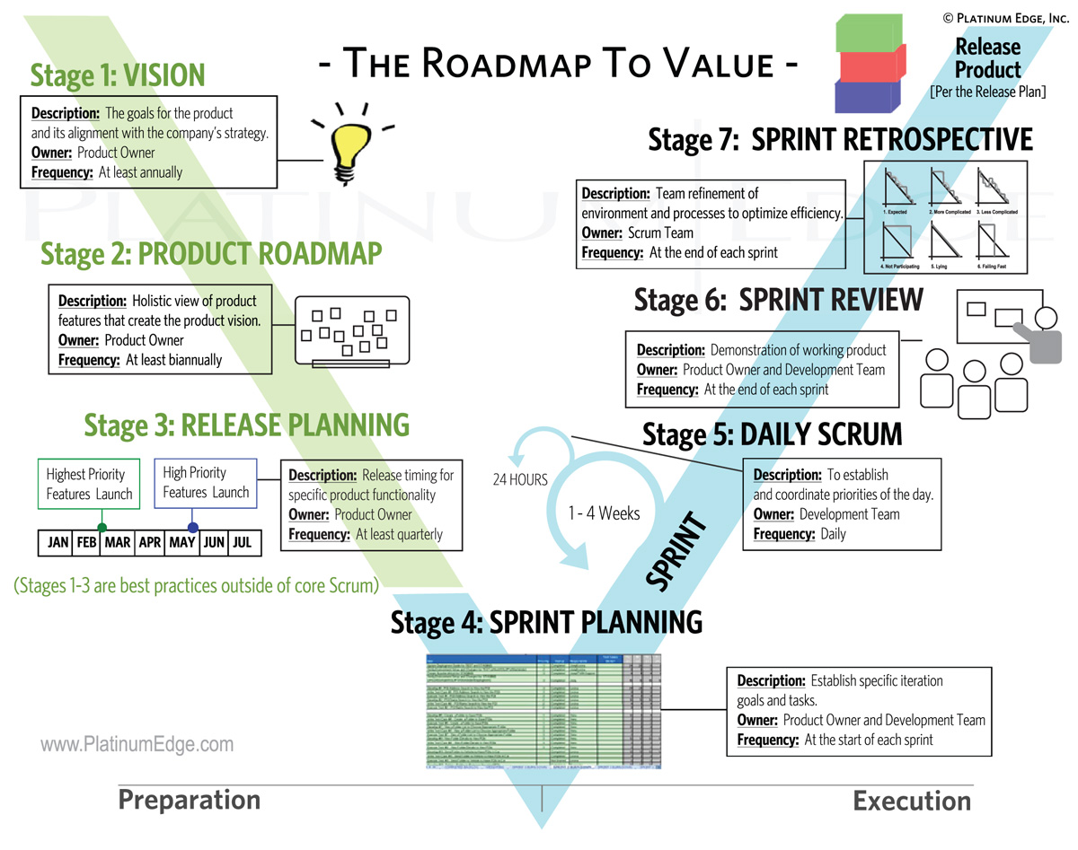
A Holistic View
Notes:
Vision
Product Roadmap
Release Planning
Sprint Planning
Daily Scrum
Sprint
Sprint Review
Sprint Retrospective

Slide 11
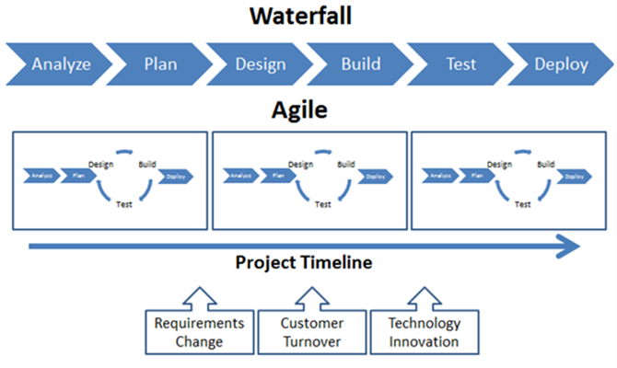
Approach Comparison

Slide 12
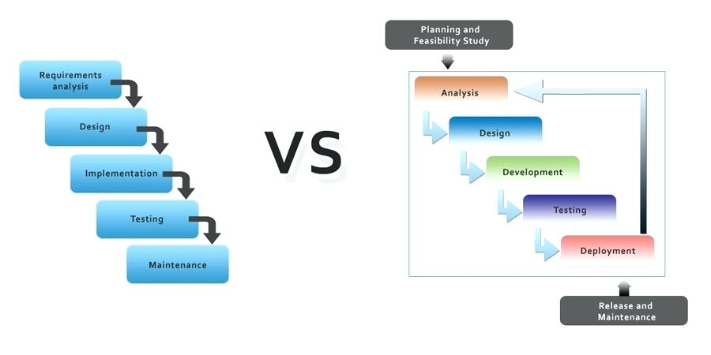
Waterfall vs. Scrum
Notes:
PO Planning and Requirements Gathering – T-Shirt size
Design and Refinement. Create Acceptance criteria and complete scope of work
Development Assigns Story points and begins development
QA Designs tests based on acceptance criteria
QA Tests or develops tests that are then run
Documentation and Training get involved to know what to write and train on
Deployment prep and documentation and training is executed

Slide 13
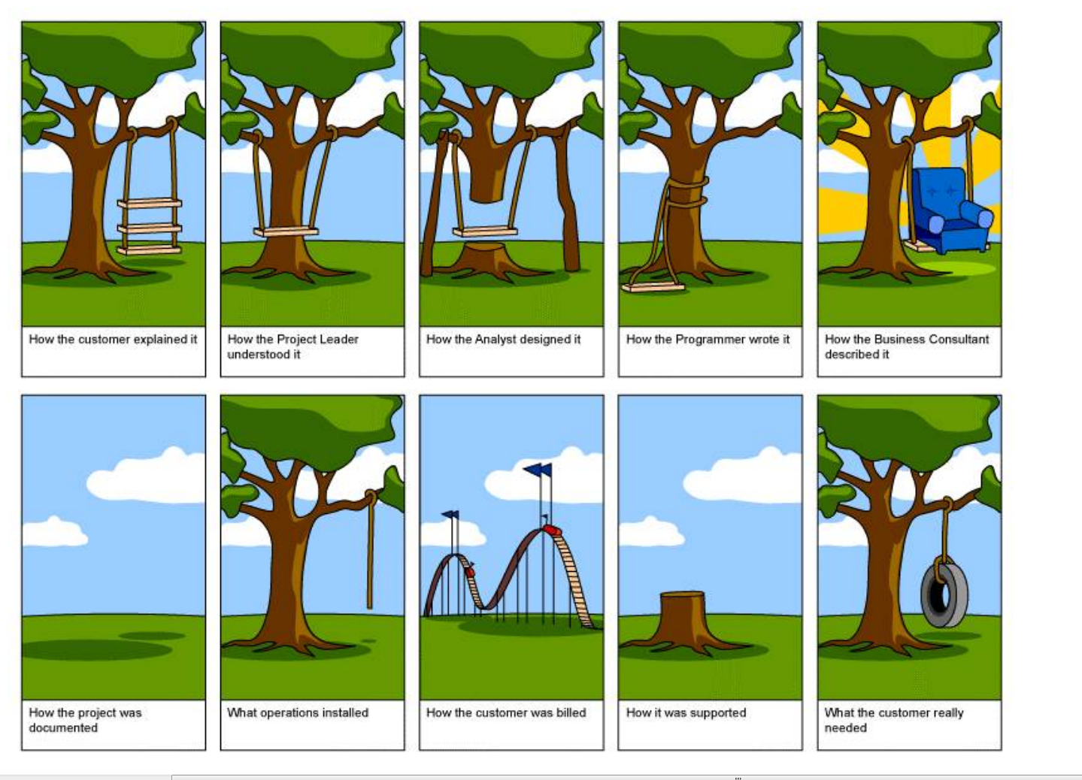
Gathering Requirements – Waterfall?
Notes:
Great cartoon example of waterfall style requirements gathering.
This is what we want to avoid. Falling into this pattern of development costs the team and company.

Slide 14
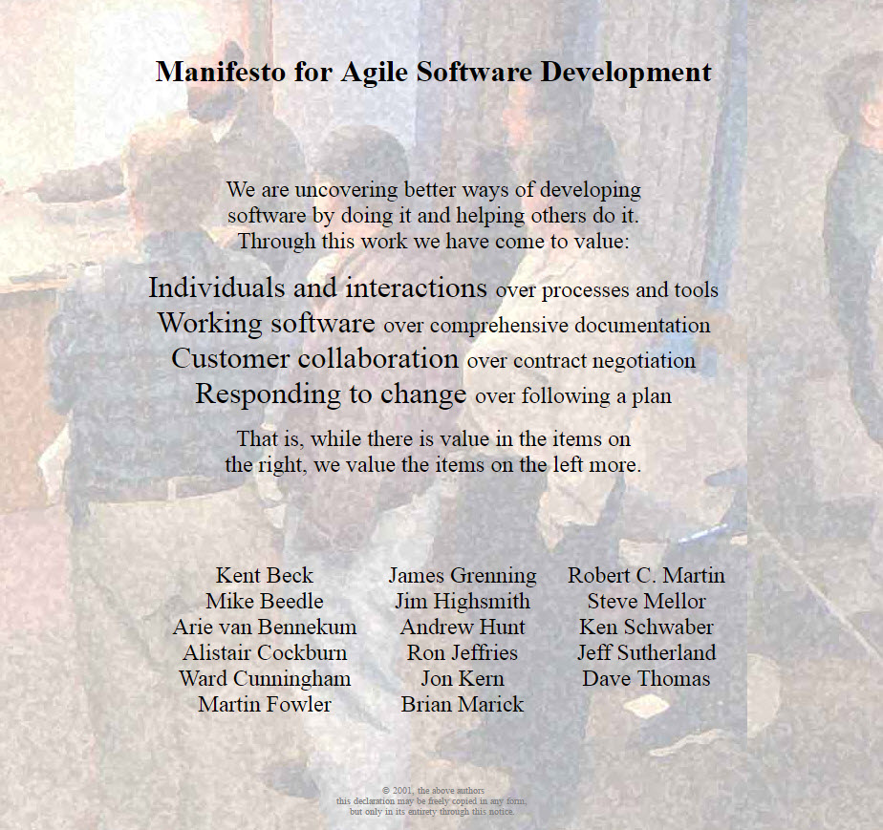

Slide 15
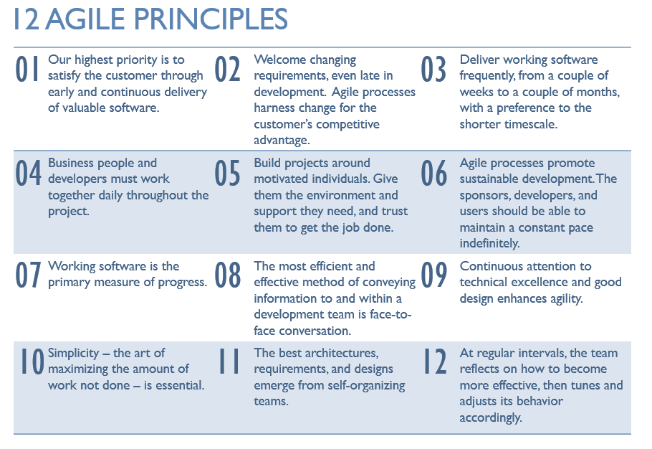
Notes:
Which one of the 12 Agile Principles would be the easiest to implement?
Why?
Which one of the Agile Principles would be the most difficult to implement?
Why?
How would you enable the most difficult principle on your team?

Slide 16
The 5 Scrum Values
Commitment
Focus
Openness
Respect
Courage
Notes:
Commitment
Be willing to commit to a goal. Scrum provides people all the authority they need to meet their commitments.
Focus
Do your job. Focus all of your efforts and skills on doing the work you’ve committed to doing. Don’t worry about anything else.
Openness
Scrum keeps everything about a project visible to everyone.
Respect
Individuals are shaped by their background and their experiences. It is important to respect the different people who comprise a team.
Courage
Have the courage to commit, to act, to be open, and to expect respect.

Slide 17
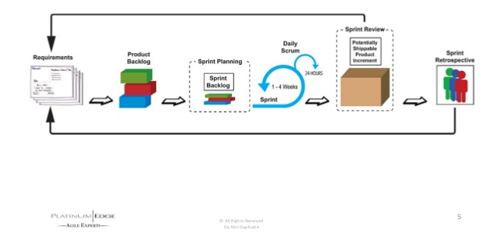
Simplified Scrum Overview

Slide 18
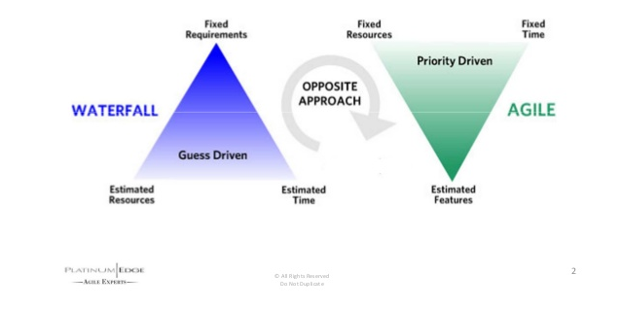
Fundamental Paradigm Shift

Slide 19
Five Roles
Product Owner
Development Team
Scrum Master
(Stakeholders)
(Scrum Mentor)

Slide 20
Six Artifacts
(Vision)
Product Backlog
(Product Roadmap)
(Release Plan)
Sprint Backlog
Product Increment

Slide 21
Seven Activities
(Project Planning)
Product Backlog Refinement
(Release Planning)
Sprint Planning
Daily Scrum
Sprint Review
Sprint Retrospective

Slide 22
Scrum Master
How is a Scrum Master different than a Project Manager?
What Project Manager skills are still useful in a Scrum environment?
What area of project management does the Scrum Master own?
Notes:
A1:
Servant Leader
A2:
Removing Roadblocks
A3:
Communication
Procurement
Risk

Slide 23
Roles: Scrum Master
Coach who is responsible for enacting Scrum values and practices
Coaches Product Owner, Development Team, Project Stakeholders
Removes Impediments
Tactically, and more importantly, strategically
Notes:
In order for Scrum Masters to be effective in their duties they need to have clout
Scrum Masters also are responsible for “Herding Smart Proud Cats”
Relationships is the currency of the Scrum Master

Slide 24
Roles: Scrum Master Cont.
Shields development team from external interferences
Daily driver of velocity increases
Facilitates interactions
Product Roadmap, Release Planning, Sprint Planning & Execution
Consensus building within the Scrum Team
Fosters close cooperation with functions interfacing with the Scrum Team
Notes:
In order for Scrum Masters to be effective in their duties they need to have clout
Scrum Masters also are responsible for “Herding Smart Proud Cats”
Relationships is the currency of the Scrum Master

Slide 25
A Holistic View
Notes:
Vision
Product Roadmap
Release Planning
Sprint Planning
Daily Scrum
Sprint
Sprint Review
Sprint Retrospective

Slide 26
Artifact: Product Roadmap
Holistic, yet digestible, view of features that enable product vision
Highest priority features are released first
Produced by Product Owner

Slide 27
Artifacts: Product Backlog
The project’s “To Do” list
All scope items, regardless of level of detail is in the Product Backlog
Ordered, not just Prioritized
What is known, is written, with the expectation that discovery will lead to changes
A Scrum Team will spend about 10% of its time doing Product Backlog Refinement
Owned by the Product Owner

Slide 28
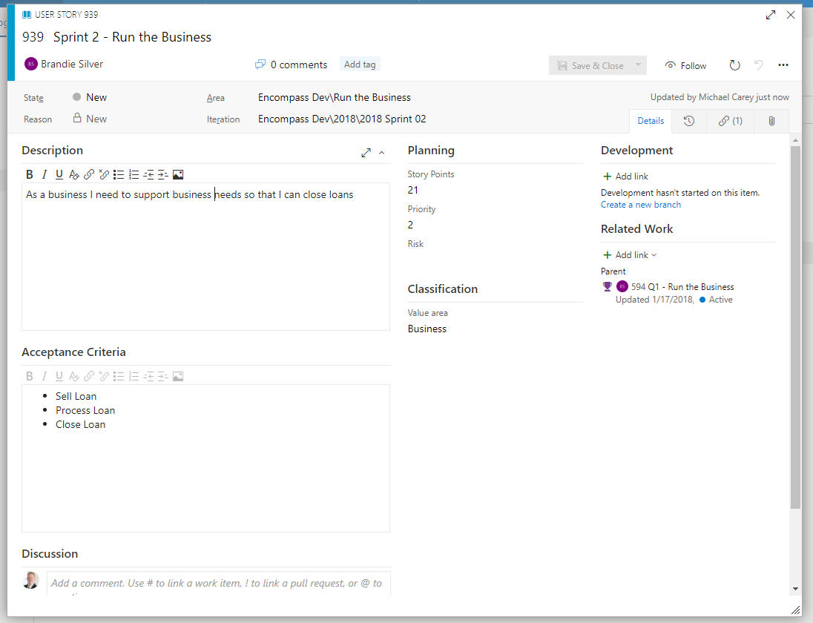

Slide 29
INVEST in Good User Stories
Independent
Negotiable
Valuable
Estimable
Small
Testable
Notes:
Independent
Does not need other user stories to implement
Negotiable
Generates conversations, adjustable user stories
Valuable
Features, not tasks
Written in the user’s language
Estimable
Small
Half a sprint or less for one Dev Team member
Dev team only commits to a goal not to a fixed number marked in the sand
Testable
Not too subjective

Slide 30
User Story Format
As a <user>,
I want to <action>,
So that <result>
When I do this: <action>
This happens: <result>
When I do this: <action>
This happens: <result>
Notes:
Let’s create some user stories
Once created let’s trade
Looking at the person’s user stories:
Are they written from the users’ perspective?
No technical jargon
Could you break the user story down further?
How could it be done?
Can you write an acceptance test to validate the user story is completed correctly?
If not, what would you need?

Slide 31
Roles: The Development Team
Ideally 7 +/- 2 people
Cross-functional
It’s about skills, not titles
What can I contribute today?
How can I expand my contribution in the future?
Self-organizing & self-managing
Ownership
Directly accountable for creating deliverables

Slide 32
Reasons Dev Teams Like Scrum
Success is clearly defined (Sprint Goal + Acceptance Criteria)
Only accept user stories when there is acceptance criteria
Dev teams can focus on delivering results in their own way
Product Owners communicate directly with team and provide timely feedback
Increase team recognition (Sprint Review)
Systematic knowledge building system (Sprint Retrospective)
Scrum builds empowered, motivated, self directed teams

Slide 33
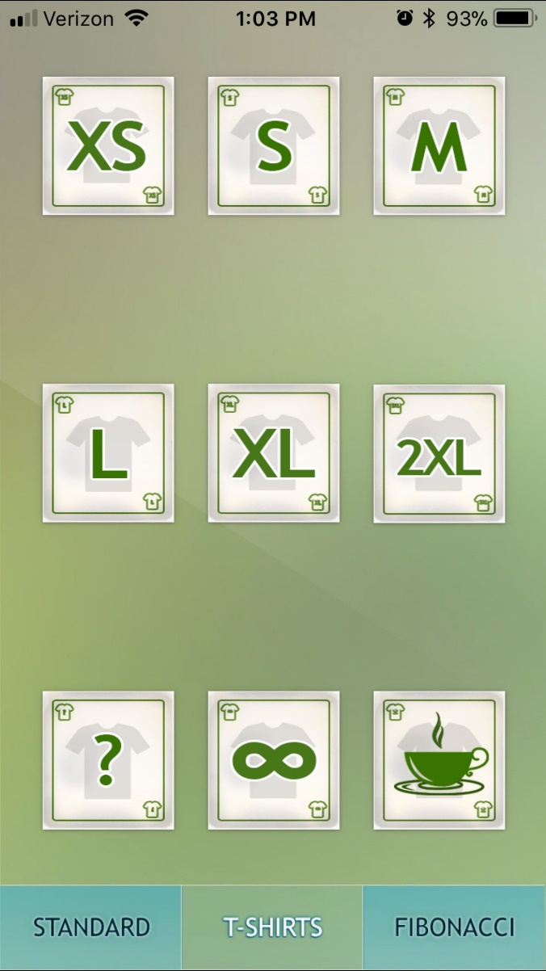
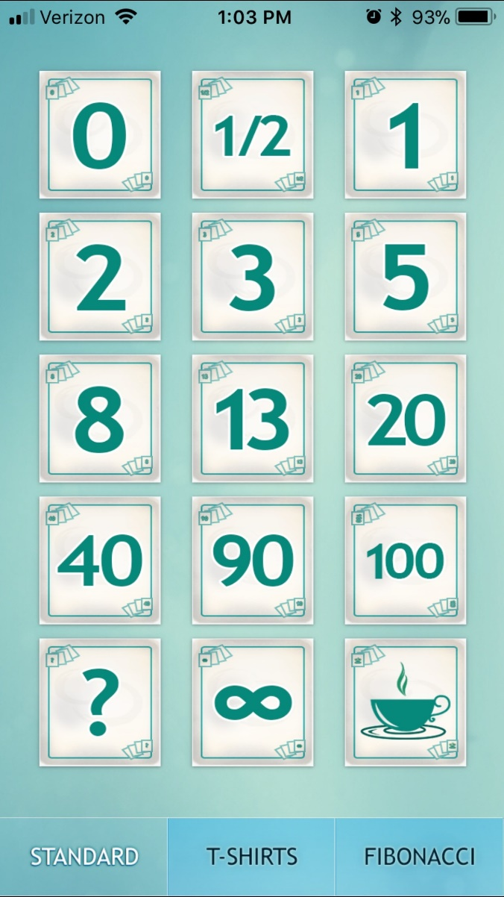
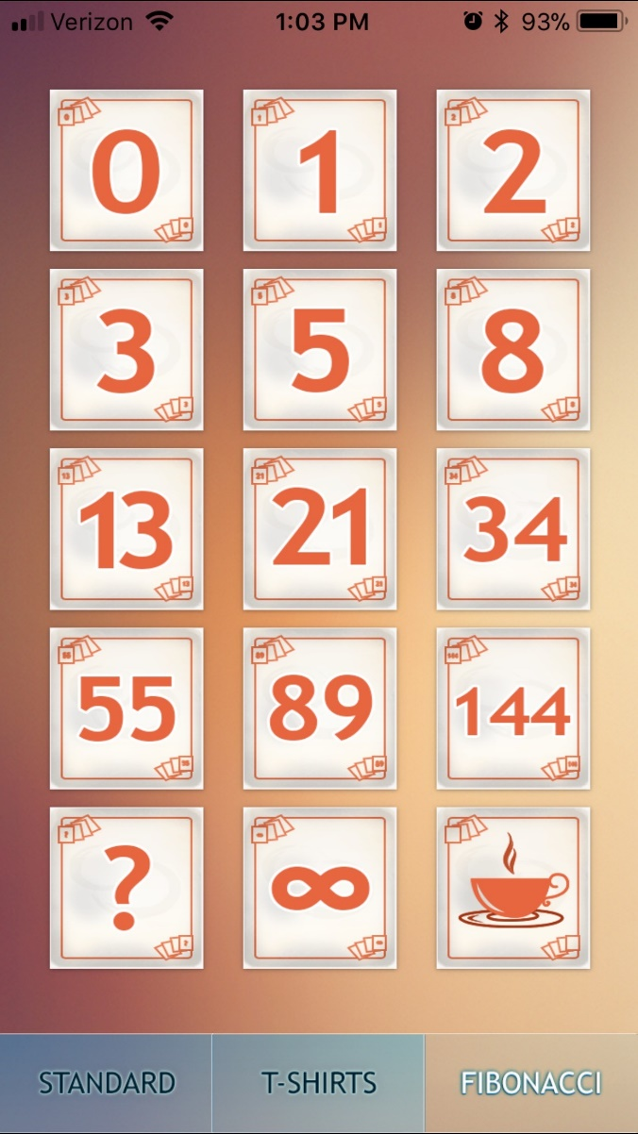
Backlog Estimation

Slide 34
What is Estimation Poker?
A relative estimation technique
Accuracy over precision
Based on Fibonacci number sequence
Done by the Dev Team members who will do the work
Self corrects for specific team idiosyncrasies
Leverages Scrum’s “Apples to Apples” dynamic
Enables more accurate long-term planning

Slide 35
How to Play Estimation Poker
Product Owner explains story
Each Dev Team member selects a card (don’t show it)
Together, all Dev Team members show their card
If different, the HIGH and LOW estimators briefly explain their choice and assumptions
The Product Owner provides additional information as necessary
The Dev Team iterates the process, usually up to three times, until consensus is reached
Notes:
Gather written user stories previously done we’re going to finish filling them out.
Play the game with those present in the meeting.
Mark the points / etc. per card.

Slide 36
Affinity Estimating – Quantification
XS = 1 Point
Small = 2 Points
Medium = 3 Points
Large = 5 Points
XL = 8 Points
EPIC = Product Owner needs to break down story

Slide 37
Affinity Estimating – Quantification Cont.
Completable User Story
User Story 1 – 8
Feature
User Story 13 – 34
Epic
User Story 55 – 144

Slide 38
Definition of Done
Agreement between Dev Team and PO
Works in which Environment and at what level of integration?
Which tests have been passed?
Level of Documentation
May be different for Sprints vs. Releases
Notes:
Agreement between Dev Team and PO
Works in which Environment and at what level of integration?
Which tests have been passed?
Unit
Functional / System
Performance / Load
Security
Level of Documentation
xDocs
User Docs
Maintenance Docs
May be different for Sprints vs. Releases

Slide 39
A Holistic View
Notes:
Vision
Product Roadmap
Release Planning
Sprint Planning
Daily Scrum
Sprint
Sprint Review
Sprint Retrospective

Slide 40
Artifact: Release Planning
Initial focal point for the team to mobilize around
Targeting the minimal set of marketable features
Highest priority features are released first
Plan one Sprint at a time
Done put specific user stories into future Sprints
Owned by the Product Owner
So what does the Scrum Master do during this meeting?
Notes:
Owned by the Product Owner
So what does the Scrum Master do during this meeting?
(Facilitate the smooth flow of the meeting)
Determine if one of the Sprints should be a “Release Sprint”

Slide 41
A Holistic View
Notes:
Vision
Product Roadmap
Release Planning
Sprint Planning
Daily Scrum
Sprint
Sprint Review
Sprint Retrospective

Slide 42
Events: Sprint Planning
Time boxed – 2 hours for each week of sprint
Phase I
Dev Team and Product Owner set sprint goals and subset of Product Backlog to work on
Phase II
Dev Team figures out how to achieve sprint goals and develops Sprint Backlog
Ideally, tasks are accomplishable in a day.

Slide 43
Events: Sprint
A consistent time box that allows the team to get into a development rhythm
Includes Sprint Planning, the Daily Scrums (Standup), Development Time, Sprint Review, and Sprint Retrospective
Must be less than 4-weeks in duration
Enables development speed (velocity) to be used for long-term planning
Once established, changing the Sprint will make previous empirical data largely irrelevant

Slide 44
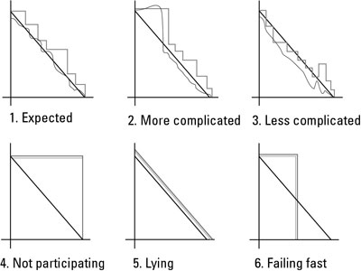
Sprint Burn Down

Slide 45
A Holistic View
Notes:
Vision
Product Roadmap
Release Planning
Sprint Planning
Daily Scrum
Sprint
Sprint Review
Sprint Retrospective

Slide 46
Events: Daily Scrum
Often done standing
3 Statements
This is what I did yesterday
This is what I can do today
These are the things impeding me
Time boxed to 15 minutes
For coordination, not problem solving
Whole world is invited to listen
Only Dev Team members, Scrum Master, and Product Owner can talk.
Notes:
If there are Impediments a Scrum Master should seek to help remove them
If other people want to communicate with the Dev Team they should go through the Product Owner if they are not directly related to the active Scrum Team (Pigs Only)

Slide 47
A Holistic View
Notes:
Vision
Product Roadmap
Release Planning
Sprint Planning
Daily Scrum
Sprint
Sprint Review
Sprint Retrospective

Slide 48
Events: Sprint Review
Product Owner Presents
Sprint Goal
What the Scrum Team accomplished during the Sprint
Dev Team demonstrates the working product
Only approved user stories from the closing Sprint
Is a demo of working functionality
Time boxed to 1-hour for each week of Sprint duration
Informal
Minimal prep time rule
No PowerPoint slides
No rigged demos

Slide 49
A Holistic View
Notes:
Vision
Product Roadmap
Release Planning
Sprint Planning
Daily Scrum
Sprint
Sprint Review
Sprint Retrospective

Slide 50
Events: Sprint Retrospective
Three Questions:
What went well?
What would we like to change?
How can we implement that change?
Action, no rational focused
Time boxed – 45 minutes for each week of Sprint
Done after every Sprint
Whole team participates
Scrum Master
Product Owner
Dev Team
If Team desires, possibly customers and others

Slide 51
Scrum Master
The Scrum Master is a facilitator.
The Scrum Master is a coach.
The Scrum Master helps the team remove impediments.
The Scrum Master should be a servant-leader.
The Scrum Master is the framework custodian.

Slide 52
Three Models of Distributed Teams
Isolated Scrums – Scrum team is isolated across geographies. (Code is common between all)
Distributed Scrum of Scrums – Scrum teams are isolated across geographies and integrated by a Scrum of Scrums that meets across geographies.
Integrated Scrums – Scrum teams are cross-functional with members distributed across geographies. Scrum of Scrums still occur.

Slide 53
10 Steps to Success
Conduct implementation strategy
Build awareness and excitement
Identify pilot project
Train the team
Develop product backlog and estimates
Identify metrics
Run sprint with coaching safety net
Gather feedback and improve
Mature
Scale

Slide 54
10 Common Pitfalls
Cargo Cult Agile / Double Work Agile
Lack of training
Ineffective Product Owner
Lack of automated testing
Lack of professional transition support
Inappropriate physical environment
Poor team selection
Discipline slips
Lack of support for learning (blame game)
Tweaking / Dilute till dead
Notes:
Using hours in any user story Estimations
Assigning tasks directly to developers
Lack of Acceptance Criteria
Set Delivery Goals without Acceptance Criteria
Scrum Fall
No Scum Master present as advocate for team
PO Acting as Scrum Master

Slide 55
Credits
Platinum | Edge
Scrum Alliance
Select Images from Google Search

