Slide 1
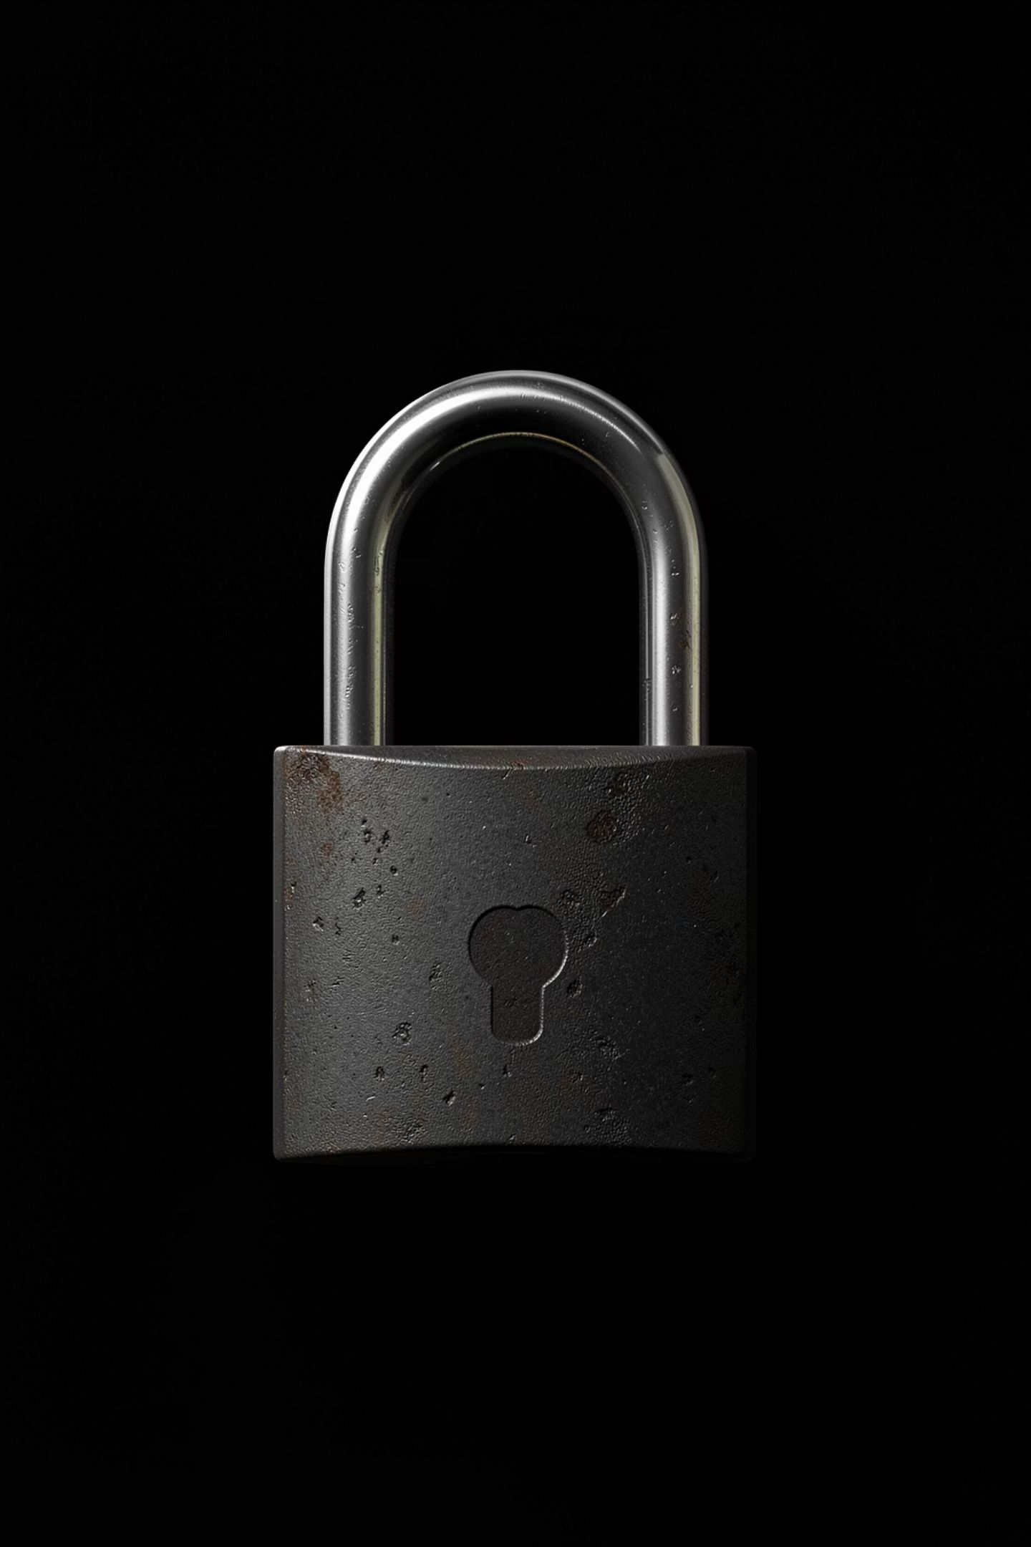
No Phones
During the Quiz
Long Quiz: Units 9–11 | English for MICE Industries

Slide 2
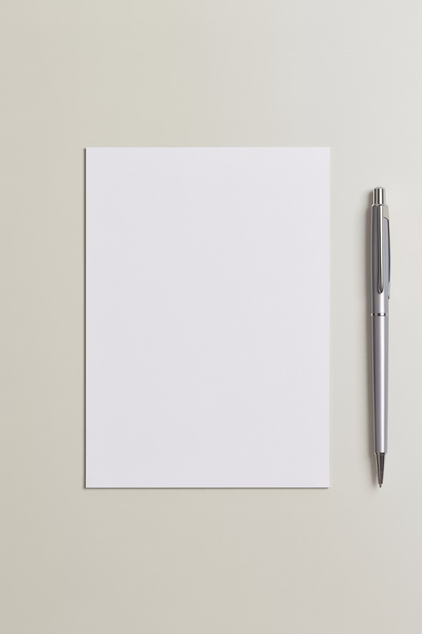
Today's Quiz
Units Covered
Total Points
Units 9, 10, and 11
40 points
Weight
Treated the same as your Final Exam

Slide 3
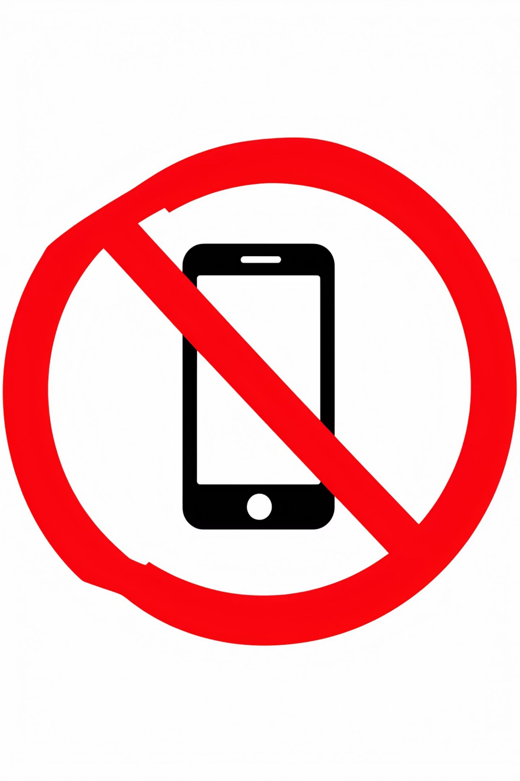
The Rule
No phones during the quiz.
Phones OFF and in your bag.
Not on the desk. Not in your pocket.
Same rule as the real Final Exam.

Slide 4
Why This Matters
This quiz counts as Final Exam practice.
Using your phone during this quiz is the same as using it during the real Final Exam.
Practice honest, phone-free testing now, so you are ready for the real one.

Slide 5


Before We Start
Phone OFF and in your bag
Only your pen and your quiz paper on the desk
Need something? Raise your hand, do not check your phone
A phone seen or used during the quiz may result in losing points or failing the quiz.

Slide 6
You've Got This 💪
You already studied Units 9–11.
Trust what you know, not your phone.
Good luck!

