Slide 1

Test Automation
TC 8
Pipeline runs all tests
All tests must pass
Notes:
(INTRO SLIDE – NO SPEAKER NOTES)

Slide 2


Why?
Users want working software …
We want automated deployment …
So we must automate testing.
Notes:
Welcome back!
We've talked about needing to ship code faster to users that's high quality.
Where does test automation firt into that?
Users want software to work and we need to know that before we deploy.
If we want to automate the deployment, then we must automate the tests, too.
This is part of the movement to 'shift left'.
In agile, especially Extreme Programming, we do everything earlier.
Rather than start testing after we deploy our best guess, we test before deploy.
We want more confidence - earlier - that our code will work live

Slide 3
Two kinds of test in this context
Development Tests (CI)
“Is it coded right?”
Deployment Tests (CD)
“Is it running right?”
Notes:
Thinking of our process as a software assembly line, CI happens first and is about building the software product. Deployment happens afterwards and is about getting that product out to users. Most of us work on Software as a Service web sites, so for us, deployment is taking our software and running it on a server farm. It follows that some tests are more useful in the CI stage, some more useful to test deployment.

Slide 4
Development tests
Static Analysis
“Are the rules obeyed?”
Unit Tests
“Is the logic right?”
Integration Tests
“Is it wired right?”
UI Tests
“Is the look and feel right?”
Functional Tests
“Is it behaving right?”
TC 9
Notes:
You covered these in a previous bootcamp. The key point is that your CI tests tell you that your code is good enough to deploy.

Slide 5
Continuous Integration - Tools
Static Analysis: So Many! Which have you used?
Unit: JUnit, TestNG, AssertJ, RSpec, Jest, PHPUnit
Integration: Cucumber
UI: Selenium, Protractor, WinRunner
Functional: Cucumber, Fitnesse
https://en.wikipedia.org/wiki/List_of_tools_for_static_code_analysis
.
Notes:
A quick reminder of the kinds of test tools you will see for the various test stages.

Slide 6

Already Working
Your CI tests should already be working!
TDD: Keep builds green
Don't push broken code to master
See Red? Revert or Forward Fix
Notes:
These tests should already be working. That's part of the TDD cycle you learned in previous bootcamps. Timebox problems then revert. Get back to green quickly. It impacts others Story: At AutoTrader, we had a 'Traffic Cone of Shame' taken by a build-breaker

Slide 7

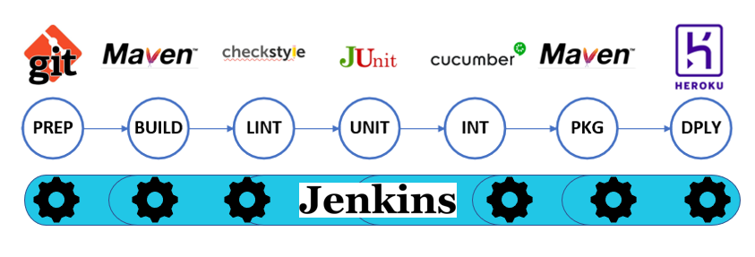
Bootcamp Pipeline
Notes:
“Here is the pipeline again – for the next few sessions we will be tackling the test stages: Static Analysis, Unit testing and Integration testing.
Starting with Lint! “ [instructor goes to next slide]

Slide 8

Lint
Notes:
The first tool invented was called ‘Lint’ as the man who created it compared it to removing the unwanted fluff that builds up on clothes, in washing machines etc
Now it has become a generic term, a verb, even.

Slide 9

Static Analysis Tools
Checking your code for Syntactical Correctness
Basic language errors : mis-placed or missing punctuation
Dangerous and non-portable constructs
Unused variables
Unreachable code
These are flagged as POSSIBLE defects
Notes:
Language specifications, including those for C and C++, are often loosely written.
A static analysis tool called lint can help you find dangerous and non-portable constructs in your code before your compiler turns them into run-time bugs.
Think of it like a spelling and grammar check for your code.
Lint is a tool similar to a compiler in that it parses source files
These are flagged as POSSIBLE defects – your judgment as a
developer is needed to make a ruling on whether or not the warnings are pointing to a genuine fault.

Slide 10

Exercise 3 Add Static Analysis tests to Jenkins
Adding Warnings Next Generation Plugin to Jenkins.
Creating a pipeline stage ‘Analysis’ and calling Checkstyle.
You need a new Jenkins command called recordIssues →
Reviewing the warnings found.
More info about recordIssues here
https://jenkins.io/doc/pipeline/steps/warnings-ng/
recordIssues(
enabledForFailure: true,
tools: [checkStyle()]
)

Slide 11
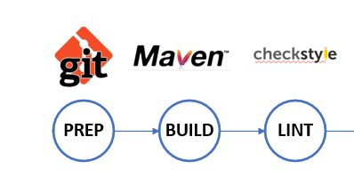
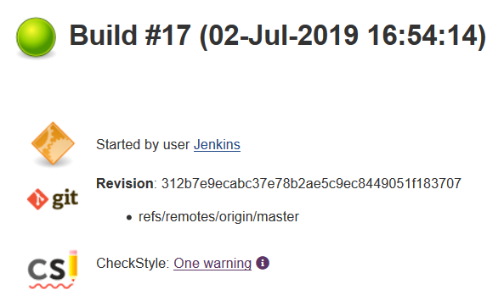
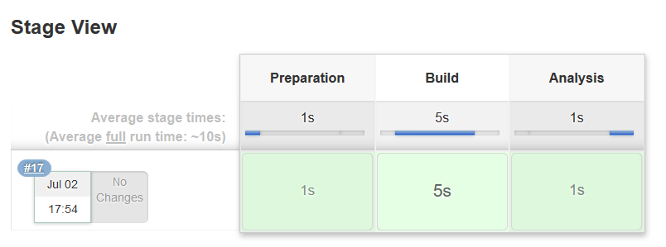
Exercise 3 What you get.

Slide 12

Unit Testing Revisited
You’ve all learned what they are and how to create them – but how do they fit into an overall test strategy?
Catch bugs early
Provide Documentation
Test Reports
Notes:
Catches bugs early – place unit tests before our integration tests
Provides Documentation - Feeds into the Agile philosophy of necessary and sufficient documentation. Also - Developers looking to learn what functionality is provided by a unit and how to use it can look at the unit tests to gain a basic understanding of the unit’s interface (API).
Provides test reports – Audit and QA is often vital for commercial software! Far more important than
Real world extreme example- every time we released new embedded code to your electricity meters – i.e. nationwide to millions of home, the manufacturer would have to submit all the software test reports to the government that proved they would behave as planned and were safe to use. There were 900 functional tests in a typical audit report: every single one of which had to pass. No way you could do that by hand – took 3 months to run by hand.

Slide 13
Exercise 4 Adding JUnit stage to Jenkins
Create a new pipeline stage called UNIT
Inside it, place the code as shown here →
This uses maven to run Junit tests (created in advance).
try {
sh "'${mvnHome}/bin/mvn' test "
}
catch (err) {
currentBuild.result = 'FAILURE'
throw err
}

Slide 14
Exercise 4 Creating a test report
JUnit will create a test report for you.
Just include the following code to your stage (shown here in blue). →
try {
sh "'${mvnHome}/bin/mvn' test "
}
catch (err) {
currentBuild.result = 'FAILURE'
throw err
}
finally {
junit 'target/surefire-reports/TEST-*.xml'
}

Slide 15

Tea Break

Slide 16

Integration Testing
Unit tests passing ✅
Next: Integration Tests
verify app wired correctly
New pipeline stage
Notes:
Unit tests all pass, so we move on to running integration tests.
These will have run very quickly and give us a basic confidence in our app.
Next up: Integration tests. You covered these in the last bootcamp.
These tests confirm that the separate application components are wired toegther right.
We run these as a separate pipeline step to give us granular feedback

Slide 17
Exercise 5 Add Cucumber tests to Jenkins
Add new pipeline stage called ‘Int’
Run the Maven command to execute the Cucumber integration tests, shown opposite
mvn verify –DskipUnitTests=true

Slide 18
Day 1 Retro
Happy
Confused
Sad

