Slide 1
IACV Project F08 sıngle vıew 8 ball pool wıth contınuıty correctıon
By: Mustafa Çağatay Sipahioğlu
10899801 - 220591

Slide 2
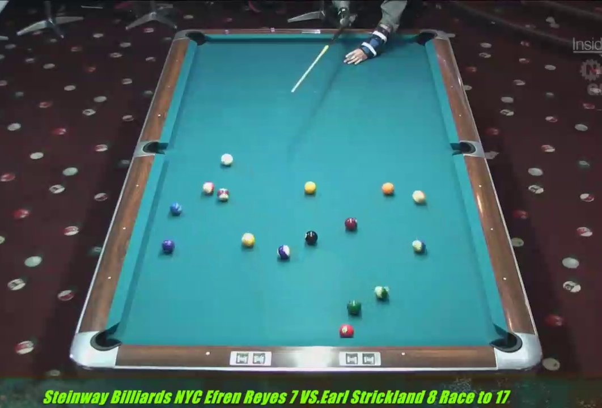
Problem Statement
Taking a single view video of an 8 Ball Pool Game
Detect & Classify the Balls
Find the Game State

Slide 3
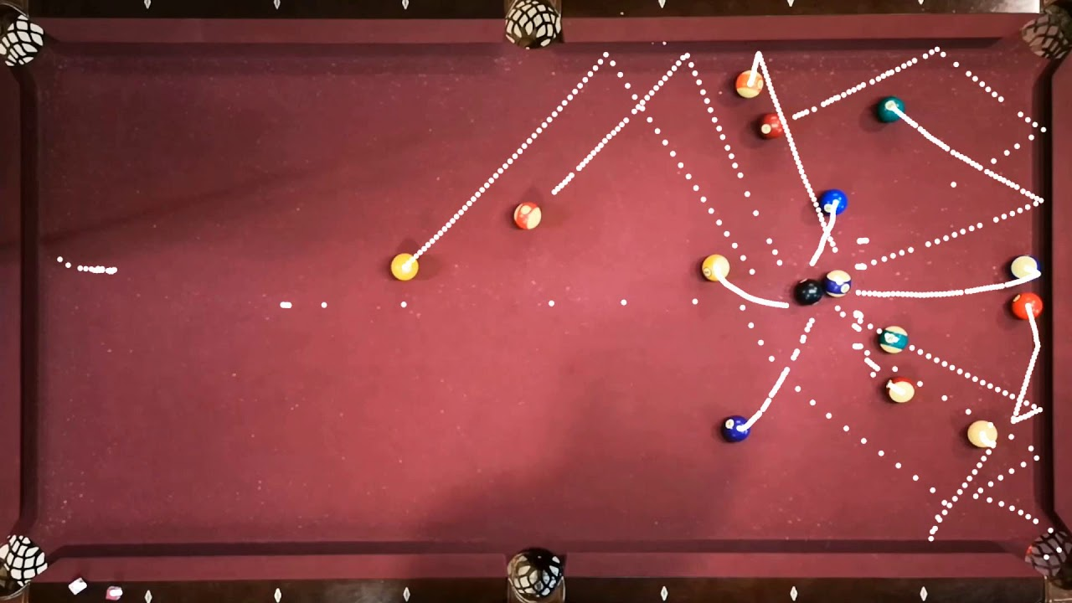
State of the Art
This is simply a object detection and classification problem: ML Models
Near perfect performance when done right
Requires too much processing
Hard to develop

Slide 4
Our Approach
Use a simple, deterministic detection & classification model.
Tune some parameters
Focus on the ball tracking aspect to improve continuous performance of the model.

Slide 5
Performance Variables
A video is simply a set of consequent frames. To analyse the video we must first get these frames.
We have first created a sampling code to sample a frame every sampling_period seconds from the video.
Lower period -> More samples -> Better Ball Tracking BUT Longer Runtime
Sample a frame every 0.1 seconds. (The default for a 30fps video is 0.033 s.)
We will work on the image of the table. We have the option to enlarge or contract the image before processing it.
More enlarged image -> More pixels between the ball images -> Contour detection works better BUT More Computational Load
Take the width of the rectified table as 1440px. (About 2x enlargement)

Slide 6
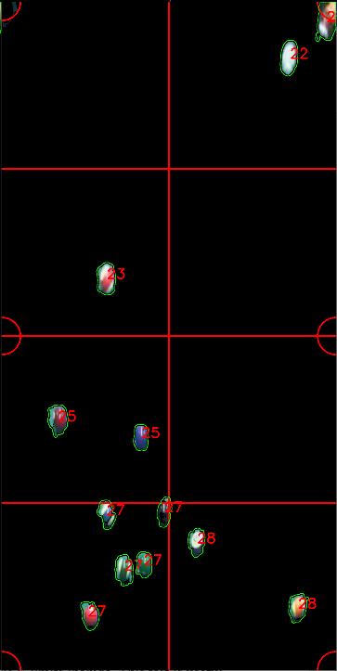
Define a Ball
Class: Cue (C) , 8 Ball (8) , Solid (O) , Striped (||)
State: Positional sector on the table --->
Inside octant: State= 21-28
Next to hole: State= 11-16
Center: of the smallest enclosing circle.
Contour: Pixel array defining the perimeter.
Image: Image of only the ball on the table.
Luminance: Average LAB luminance of pixels.
Color Ratio: Colored Pixels / Whiteish Pixels

Slide 7

Define a Ball
Class: Cue (C) , 8 Ball (8) , Solid (O) , Striped (||)
State: Positional sector on the table
Inside octant: State= 21-28
Next to hole: State= 11-16
Center: of the smallest enclosing circle.
Contour: Pixel array defining the perimeter.
Image: Image of only the ball on the table. --->
Luminance: Average LAB luminance of pixels.
Color Ratio: Colored Pixels / Whiteish Pixels

Slide 8
Chapter 1: Detecting and Classifying Balls

Slide 9
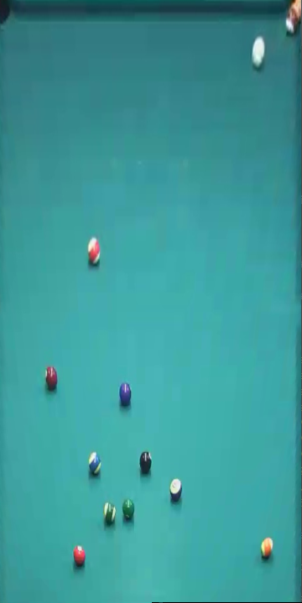
Detection & Classification
Step 1: Extract and Rectify the Table
Focus only on the workspace
Make the balls have similar dimensions

Slide 10
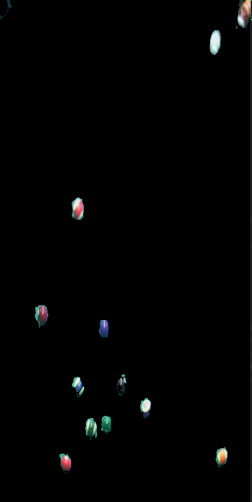
Detection & Classification
Step 2: Remove the Table Cloth
Use a color range mask to eliminate green tones
Focus only on the balls
Make contour detection much easier

Slide 11
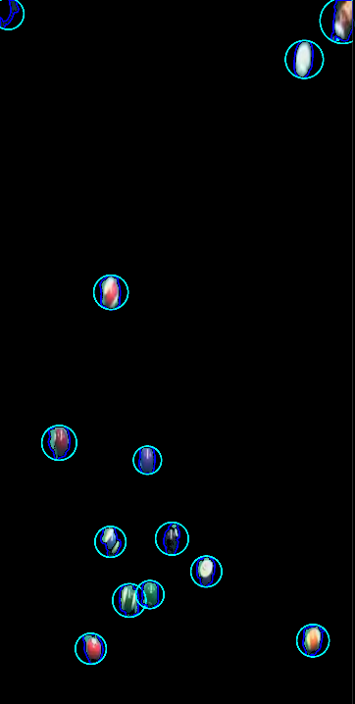
Detection & Classification
Step 3: Detect Contours
Contour is the physical space the ball occupies
Calculate physical parameters from the contour
Radius ( of the enclosing circle)
Center ( of the enclosing circle)
Aspect Ratio ( of the enclosing rectangle)
Area
Filter the ball-like contours:
Radius in tuning range
Aspect ratio – Square-ish
Area in tuning range

Slide 12
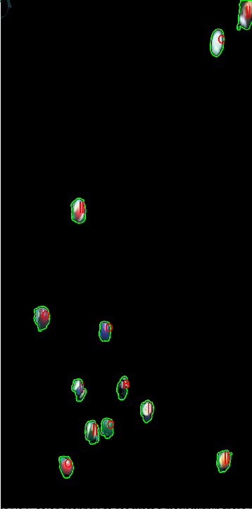
Detection & Classification
Step 4: Classify the Ball-Like Contours
Luminance Classification
Hole < 8 Ball < Solid < Striped < Cue
Delete ‘Hole’ class contours.
Best for classifying Hole, 8 Ball, Cue
The lighting near the top of the table is brighter than near the bottom of the table.
Striped and Solid Balls can have similar Lumini.
Color Ratio Classification
Cue < Striped < Solid < 8 Ball
Best for differentiating Solid, Striped Balls

Slide 13
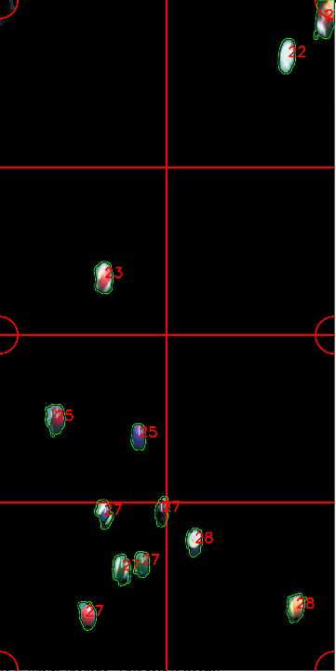
Detection & Classification
Step 5: Check Classification Feasibility
Multiple ‘C’ detected:
Only the highest luminance is ‘C’ rest are ‘||’
Multiple ‘8’ detected:
Only the lowest luminance is ‘8’ rest are ‘O’
Impossible extra ‘O’ detected:
Look at the low color ratio ‘O’s.
The highest luminance one should be a ‘||’
Impossible extra ‘||’ detected:
Look at the high color ratio ‘||’s.
The lowest luminance one should be a ‘O’

Slide 14
Chapter 2: Continuity of Stationary Balls

Slide 15
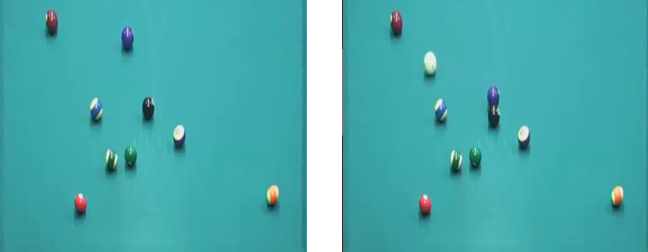
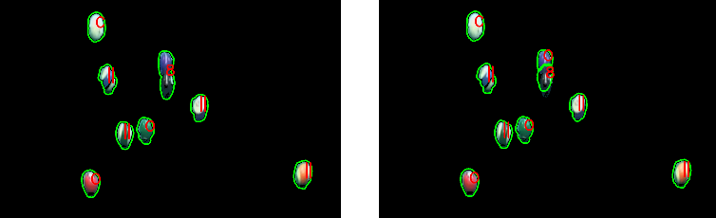
Continuity of Stationary Balls
Motive: Be able to detect very close balls as 2 separate balls.
Method: Remember balls that are stationary, detect new balls from the changing part of the image between frames.

Slide 16
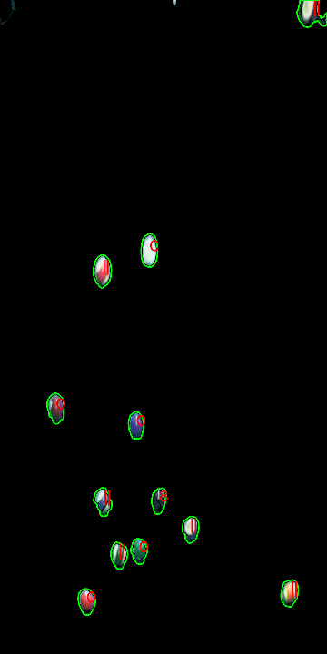
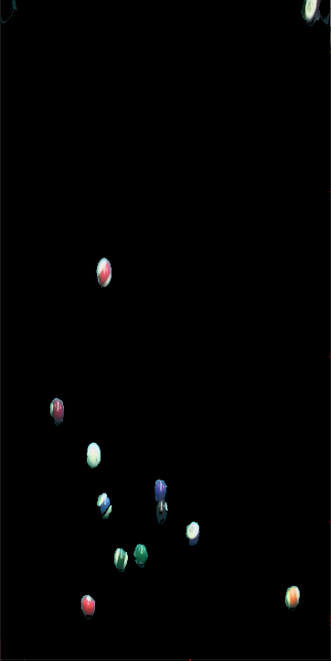
Continuity of Stationary Balls
Step 1:
Check Which Balls in the Before Frame Didn’t Move

Slide 17
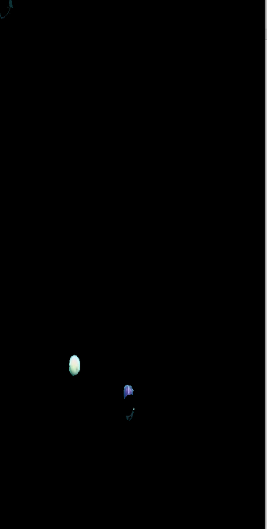
Continuity of Stationary Balls
Step 2:
Remove the Stationary Balls from the new image.

Slide 18
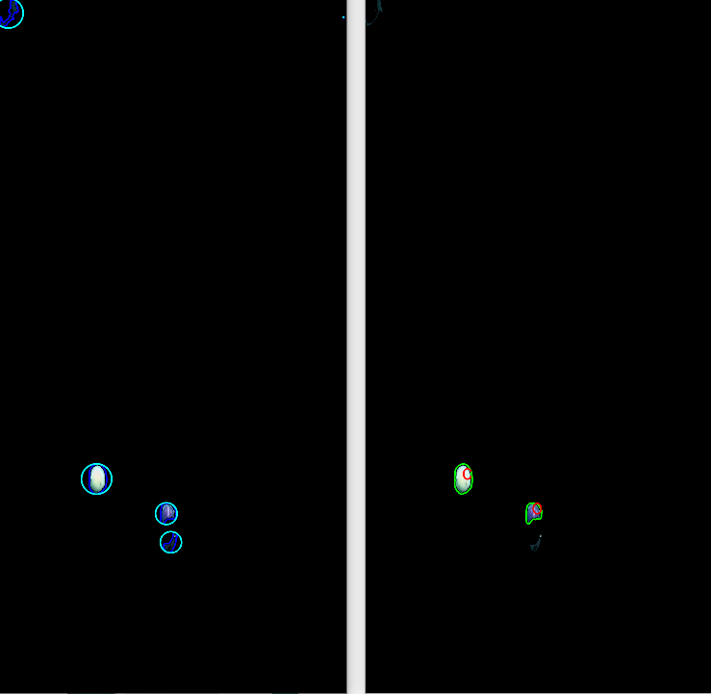
Continuity of Stationary Balls
Step 3:
Detect the balls.
(Now we will detect only the moved balls)

Slide 19
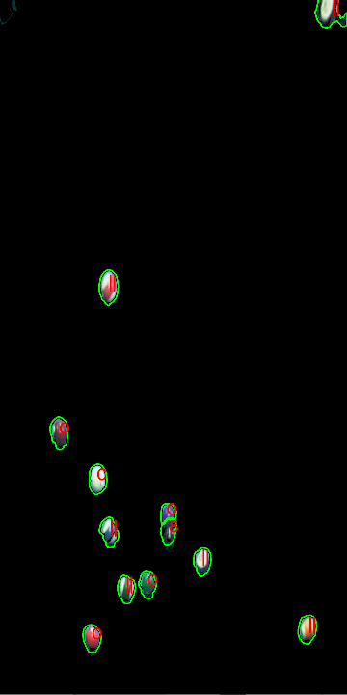
Continuity of Stationary Balls
Step 4:
Combine the stationary balls and the detected moved balls to detect all the balls in the frame.
(Including the balls that are left behind other balls: see the purple solid ball behind the 8 Ball)

Slide 20
Chapter 3: Continuity of Moving Balls

Slide 21
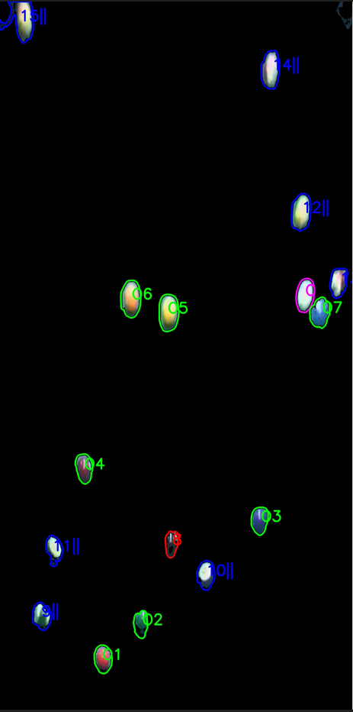
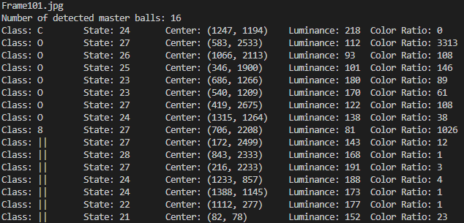
Continuity of Moving Balls
Step 1: Master Balls
Master Ball = De Facto Numbered Ball
Update the Master Balls using the new frame.
Try matching master balls to the balls in new frame.

Slide 22
Continuity of Moving Balls
Step 2: Match Stationary Balls to Masters
If the saved image of a master ball didn’t change, this ball didn’t move.
Match it to itself.

Slide 23
Continuity of Moving Balls
Step 3: Find the Moved Balls
Remove the stationary balls from the new frame.
Now, Detected balls = Moved Balls.

Slide 24
Continuity of Moving Balls
Step 4: Match the Slightly Moved Balls
If a moved ball’s center is still in the contour of a master ball: match this moved ball to that master ball.

Slide 25
Continuity of Moving Balls
Step 5: Match the Noticeably Moved Balls
If there are multiple moved and matched balls that need matching:
Calculate the distance between each moved-master ball combination. Match them starting from the closest.

Slide 26
Continuity of Moving Balls
Step 6: If Moved Balls Still Need Matching:
These must belong to some master balls that were not detected before. (Populate the master balls with the excess moved balls)
Also works as a correction mechanism for master balls mistakenly classified to be potted.

Slide 27
Continuity of Moving Balls
Step 7: If Master Balls Still Need Matching:
There are not enough balls on the table. These master balls were either potted (If they were near a hole sectors 1_) or they are set to be undetected.
We will look for these master balls again in the next frames and correct our verdict if we are mistaken.

Slide 28
Continuity of Moving Balls
Step 9: Make Sure the Cue Ball is Detected
The classification of the cue ball works great and it is almost guaranteed to always be on the table. We check our master balls in case a cue ball was matched to the wrong master ball. (Happens due to stationary continuity if it strikes a ball very fast and stops in the striked ball’s former position)

Slide 29
Conclusion
Achieved results:
Extract, rectify, mask (remove table cloth) of an 8 Ball Pool Table.
Detect contours, filter ball-like contours.
Deterministically classify balls. (Depending on luminance and or color ratio of a ball)
Differentiate and track each of the 16 balls separately, in the following cases:
A ball stayed stationary.
A ball moved only slightly.
A ball moved noticeably.
A ball was potted.
Do self-correction for classes of a ball when a ball becomes undetected-detected again.

Slide 30
Future Work
Better image pre-processing: Improve classifier performance.
Better contour detection: Correctly detect balls during breaking or in fast shots involving multiple close-by balls.
Better ball classification: If we had a very reliable classifier we wouldn’t have to implement this good of a ball tracking algorithm to make sure we classify balls correctly.
Ball classification history: We do not implement class correction to a continuously tracked ball. So it is imperative for us to have detected that ball correctly in the beginning or we would have to hope that we will get to redetect it to reclassify it.
A mechanism where the mode of the detected class history is checked every once in a while for classification corrections could be implemented.

Slide 31
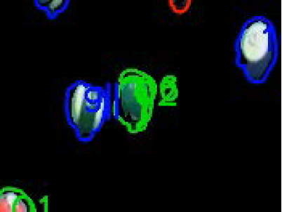
Future Work
Find the visual center of a concave contour: Pole of inaccessibility problem, needed in case the centroid of a concave contour ends up inside a convex contour.

Slide 32
Final Result
This project takes an 8 Ball Pool game video shot in a stationary single-view And it demonstrates how a simple tuned deterministic vision model can be used to keep track of the game state using the continuity between frames and game logic.

Slide 33
Q&A

