Slide 1
M2M Service Architecture (2) 物聯網服務架構(二)
行動寬頻尖端技術跨校教學聯盟
國立交通大學資訊工程系
Department of Computer Science
National Chiao Tung University
October 20, 2016

Slide 2
Outline
M2M Service Capabilities Framework
REST Architectural Style for M2M
Resource-Based M2M Communications
Notes:
大綱
1. M2M服務功能框架
2. REST架構風格的M2M
3. 基於資源的M2M通訊

Slide 3
Resource-Based M2M Communications
Notes:
基於資源的M2M通訊

Slide 4
Resource-based Information Model
All entities in the oneM2M System, such as AEs, CSEs, data, etc. are represented as resources.
A resource structure is specified as a representation of such resources. Such resources are uniquely addressable via a Uniform Resource Identifier (URI).
A given Resource is of one of the defined Resource Types.
The Resource Type determines the semantics of the information in the Resource
Notes:
基於資源的信息模型
oneM2M系統中的所有實體（如AE，CSE，資料等）都表示為資源。
資源結構被指定來表示這樣的資源,這樣的資源可以透過URI來做唯一的定址。
一個給定的資源是在定義的資源型態中的一種。
資源型態決定資源裡信息的語義。

Slide 5
Properties of Resources
Resources can be Created, Read, Updated or Deleted to manipulate the information.
Resources are organized in a tree-like structure and connected by links.
Addressing all resources and associated attributes through unique URI.
Structured URI based on the chain of child-parent relationship
Flat URI made of a unique identifier addressable via the base root
Notes:
資源特性
可以對資源做Create, Update, Read, Delete 來操作信息。
資源被組織成一個樹狀的結構 借由鏈接連結。
通過唯一URI定址所有資源和關聯的屬性。

Slide 6
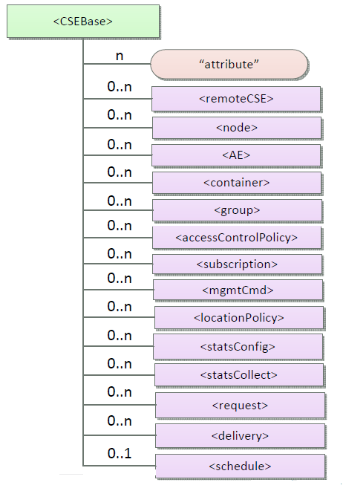
oneM2M Resource Structure (1)
Resource Type | Description
CSEBase | The structural root for all the resources that are residing on a CSE
remoteCSE | Represents a remote CSE registered on the registrar CSE identified by the CSEBase resource
node | Represents specific Node information
AE | Stores information about the AE. It is created as a result of successful registration of an AE with the registrar CSE
container | Shares data instances among entities. Used as a mediator that takes care of buffering the data to exchange "data" between AEs and/or CSEs.
group | Stores information about resources of the same type that need to be addressed as a Group
accessControlPolicy | It controls "who" is allowed to do "what" and the context in which it can be used for accessing resources
subscription | represents the subscription information related to a resource.
Notes:
oneM2M 資源結構(1)
CSEBase –所有駐留在CSE上的資源的結構根
remoteCSE-表示向CSEBase資源標識的CSE上註冊的遠程CSE
node-表示特定節點信息
AE-存儲有關AE的信息。 它是向CSE成功註冊AE的結果而創建的
container-在實體之間共享數據實例。 用作調解器，負責緩衝數據以在AE和/或CSE之間交換“數據”。
group-存儲有關需要作為群組處理的相同類型的資源的信息
accessControlPolicy-它控制“誰”被允許做“什麼”以及它可以用於訪問資源的context
Subscription-表示與資源相關的訂閱信息

Slide 7
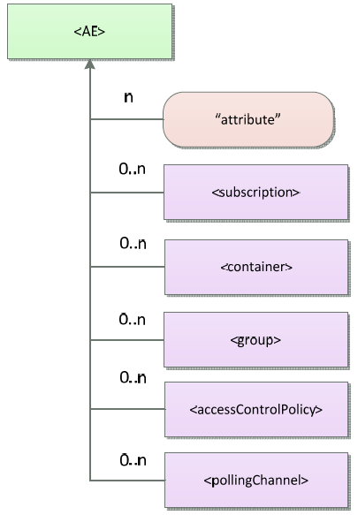
oneM2M Resource Structure (2)
Resource Type (Cont.) | Description
mgmtCmd | Management Command resource represents a method to execute management procedures required by existing management protocols.
locationPolicy | Includes information to obtain and manage geographical location. It is only referenced within a container, the contentInstances of the container provide location information
statsconfig | Stores configuration of statistics for applications
StatsCollect | Defines triggers for the IN-CSE to collect statistics for applications
request | Expresses/access context of an issued Request
delivery | Forwards requests from CSE to CSE
schedule | Contains scheduling information for delivery of messages
pollingChannel | Represent a channel that can be used for a request-unreachable entity
Details in “Table 9.6.1.1-1 Resource Types” of oneM2M-TS0001
Notes:
oneM2M 資源結構(2)
mgmtCmd-管理命令資源表示執行現有管理協議所需的管理過程的方法。
locationPolicy-包括獲取和管理地理位置的信息。 它只在容器中引用，容器的contentInstances提供位置信息
statsconfig-存儲應用程式的統計信息配置
statsCollect-定義IN-CSE為應用程式收集統計信息的觸發器
request-表達/訪問已發出請求的上下文
delivery-向CSE轉發來自CSE的請求
schedule-包含用於傳遞訊息的調度信息
pollingChannel-表示可用於請求不可到達實體的通道

Slide 8
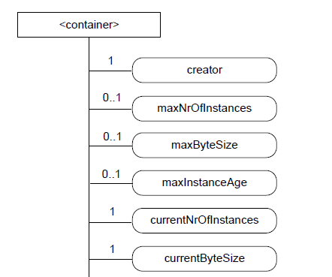
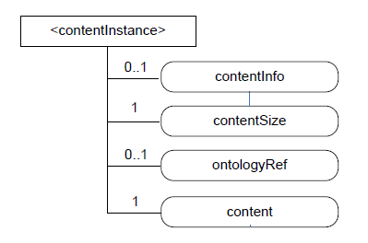
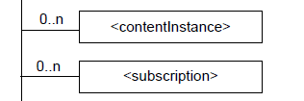
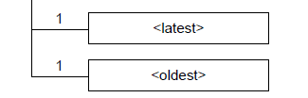
oneM2M Resource Structure (3)
Container & ContentInstance
where the actual data is stored!
Notes:
oneM2M 資源結構(3)
Container & ContentInstance :儲存實際的資料

Slide 9
Resource Categories
oneM2M identifies three categories of resources:
Normal resources
include the complete set of representations of data which constitutes the base of the information to be managed.
Virtual resources
used to trigger processing and/or retrieve results, but they do not have a permanent representation in a CSE.
Announced resources
a resource at a remote CSE that is linked to the original resource that has been announced, and it maintains some of the characteristics of the original resource.
Notes:
資源分類
oneM2M識別三類資源
一般資源(Normal resources) :包含資料的表示的完整集合,而這些資料的表示是構成要被管理的信息的基礎。
虛擬資源(Virtual resources):用於觸發處理和/或取得結果,但是它們在CSE中不具有永久表示。
公告資源(Announced resources): 在遠端CSE的資源,其鏈接到已經公告的原始資源，並且其維持原始資源的一些特性。

Slide 10
Virtual Resource or Attribute
Virtual resource or a virtual attribute is used to trigger processing and/or retrieve results, but they do not have a permanent representation in a CSE, for example:
FanOutPoint virtual resource is used for addressing bulk operations to all the resources that belong to a group.
Latest/Oldest virtual resources are pointers to the actual latest and oldest Content Instance in a Container.
Notes:
虛擬的資源或屬性
虛擬的資源或是虛擬的屬性是用於觸發處理和/或取得結果,但是它們在CSE中不具有永久表示, 例如：
-FanOutPoint 虛擬資源:是用來對屬於一個組的所有資源執行批次操作。
-Latest/Oldest 虛擬資源: 指向實際上在Container裡最新和最舊的ContentInstance。

Slide 11
Resource Addressing
The address of a resource is a string that uniquely identifies the targeted resource within the scope of a request.
Requests can have 3 different scopes:
CSE-relative, the request is originated within the same CSE as the targeted resource.
SP-relative, the request is originated within the same M2M Service Provider domain as the targeted resource, but at different CSE.
Absolute, the request is originated within an M2M Service Provider domain, but the target resource resides in a different M2M Service Provider domain.
Notes:
資源定址
資源的地址是字串,用來識別請求範圍內的目標資源。
請求有三種不同的範圍:
- CSE-relative: 請求與目標在相同CSE
- SP-relative: 請求與目標是相同的M2M服務提供商,但是在不同的CSE
- Absolute: 請求與目標是在不同的M2M服務提供商

Slide 12
Resource Addressing (cont’d)
Two different methods for addressing a resource:
Hierarchical URI (structured)
Non-Hierarchical URI (non-structured)
Each addressing method can have three variants depending on the scope of the request:
 | CSE-relative | SP-relative | Absolute
Hierarchical | streetX/houseY/roomZ/temp123 | /MN-CSE-02/streetX/houseY/roomZ/temp123 | //m2m.com/MN-CSE-02/streetX/houseY/roomZ/temp123
Non-Hierarchical | temp123 | /MN-CSE-02/temp123 | //m2m.com//MN-CSE-02/tempe123
Notes:
資源定址（cont’d）
兩種不同定址方法:
Hierarchical URI(結構化的)
Non-Hierarchical URI (非結構化的)
根據請求的範圍，每種定址方法可以有三種變體

Slide 13
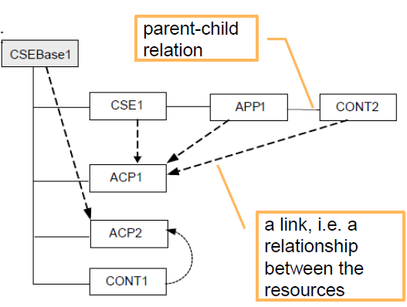
Relationship between Resources
Two types of relationships: parent-child and link
Origin Resource type | Destination Resource type | Relationship type
Any (e.g. AE, container) | Access Control Policy | Link (access Control Policy ID)
CSEBase or remoteCSE | node | Link (nodeLink)
node | CSEBase or remoteCSE | Link (hosted CSE Link or CSEBase)
a child resource of any resource type | a parent resource of any resource type | Link (parent-ID)
a parent resource of any resource type | a child resource of any resource type | Parent-Child
mgmtObj | mgmtObj | Link (mgmtLink)
Source: oneM2M TS-0001
Notes:
資源間的關係
兩種類型的關係: parent-child (父-子) 和 link(鏈接)

Slide 14
Normal Resource Types (1)
Access Control Policy
Content Instance
AE
Container
CSE Base
Delivery
Event Config
Exec Instance
Group
Location Policy
Latest (virtual)
Fan Out Point (virtual)
mgmtCmd
mgmtObj
M2m Service Subscription Profile
Node
Oldest (virtual)
Polling Channel
Polling Channel URI (virtual)
Remote CSE
Notes:
一般資源型態(1)
此頁列了一般的資源型態有那些,其中標示以下的資源型態為虛擬
Latest
Fan Out Point
Oldest
Polling Channel URI

Slide 15
Normal Resource Types (2)
Request
Schedule
Service Subscribed Node
Service Subscribed App Rule
Stats Collect
Stats Config
Subscription
Notes:
一般資源型態(2)
此頁繼續列了一般的資源型態有那些

Slide 16
Resource Type Specializations
Used by Communication Management and Delivery Handling or Device Management CSFs
ActiveCmdhPolicy
Area Network Device Info
Area Network Info
Battery
cmdhBuffer
cmdhDefaults
cmdhEcDefParamValues
cmdhDefEcValue
cmdhLimits
cmdhNetworkAccessRules
cmdhNwAccessRule
cmdhPolicy
Device Capability
Device info
Event Log
Firmware
Memory
Reboot
Software
Notes:
資源型態專業化
此頁列出的被通信管理和傳輸處理或裝置管理的CSFs使用

Slide 17
oneM2M Communication Concepts Subscribe Notify
Data is often provided in irregular intervals.
To alleviate the need for constant polling, a subscribe/notify mechanism is used.
Notifications can be twofold:
Synchronous (long polling)
Asynchronous (server capable client)
Application Entity
Subscribe
Notify
Common Service Entity
(CSE)
Notes:
oneM2M通訊概念
訂閱 通知
資料通常以不規則的間隔被提供。
為了減輕不斷輪詢的需要 ,訂閱/通知機制被使用。
通知可以是雙重:
-同步
-非同步

Slide 18
M2M End to End Communication High Level Overview
Network Application on Infrastructure Node
e.g. Visualization GUI
Infrastructure Node CSE (IN-CSE)
M2M Server
For a simple end to end example consider the following scenario:
A Device application, for example a SmartMetering Sensor is connected to a local M2M gateway.
A Network Application, e.g. a SmartMeter GUI is connected to a IN-CSE for visualizing sensor data.
Middle Node CSE (MN-CSE)
M2M Gateway
Device Application on Application Node (AN)
M2M Device e.g. Sensor
Notes:
M2M端到端通訊
高階層概述
對於簡單的端到端範例,考慮以下情形：
一個裝置應用(DA), 例如SmartMetering感測器連接到本地端M2M閘道。
一個網路應用(NA) ,例如智能儀表GUI連接到IN-CSE，用於視覺化感測器資料。

Slide 19
M2M End to End Communication High Level Overview
Network Application on Infrastructure Node
e.g. Visualization GUI
Register
Registration Phase
NA and DA register at their respective local CSEs.
The MN-CSE registers at the IN-CSE
Infrastructure Node CSE (IN-CSE)
M2M Server
Register
Middle Node CSE (MN-CSE)
M2M Gateway
Register
Device Application on Application Node (AN)
M2M Device e.g. Sensor
Notes:
M2M端到端通訊
高階層概述
註冊階段
NA 和 DA 分別向它們的本地端CSE註冊。
MN-CSE向IN-CSE註冊。

Slide 20
M2M End to End Communication High Level Overview
Network Application on Infrastructure Node
e.g. Visualization GUI
Announcement
MN-CSE announces local applications towards the IN-CSE.
Infrastructure Node CSE (IN-CSE)
M2M Server
Announce
Middle Node CSE (MN-CSE)
M2M Gateway
Device Application on Application Node (AN)
M2M Device e.g. Sensor
Notes:
M2M端到端通訊
高階層概述
公告
MN-CSE 向IN-CSE公告本地端的應用。

Slide 21
M2M End to End Communication High Level Overview
Network Application on Infrastructure Node
e.g. Visualization GUI
Retrieve / Subscribe
The NA retrieves information on existing applications -> receives information about the sensor DA
If neccessary, the request is retargeted by the IN-CSE to the MN-CSE
Subsequently, the NA subscribes to the DA‘s data in order to be notified when new data arrives.
Infrastructure Node CSE (IN-CSE)
M2M Server
Retarget
Middle Node CSE (MN-CSE)
M2M Gateway
Source: Tutorial from FOKUS
Device Application on Application Node (AN)
M2M Device e.g. Sensor
Notes:
M2M端到端通訊
高階層概述
NA取得現有應用程式的信息 ->取得關於感測器DA的信息。
如果有需要 要求可以被IN-CSE重定目標到MN-CSE。
以後, 為了當新的資料到來時能夠被通知,NA訂閱DA的資料。

Slide 22
M2M End to End Communication High Level Overview
Network Application on Infrastructure Node
e.g. Visualization GUI
Notify
Periodically, the sensor DA pushes metering data to the local gateway.
This is done by creating a „contentInstance“
The incoming data is announced towards the IN-CSE.
The NA is notified about the incoming data.
Infrastructure Node CSE (IN-CSE)
M2M Server
Announce
Middle Node CSE (MN-CSE)
M2M Gateway
Create
Device Application on Application Node (AN)
M2M Device e.g. Sensor
Notes:
M2M端到端通訊
高階層概述
感測器DA周期性的傳送偵測到的資料到本地端閘道。
透過創造contentInstance來完成。
這些收到的資料也被公告給IN-CSE。
NA被通知關於這些收到的資料。

Slide 23
M2M Service Subscription (1)
An M2M Service is the marketable service offered to M2M users, e.g. device management, data exchange, etc.
M2M Service Subscription establishes a link between
One or more AEs;
One or more M2M Nodes,
One or more roles associated with an M2M Service Subscription as well as subscriber defined groups (used for access control policies).
In each M2M Service, one or multiple M2M Service role(s) shall be defined by the M2M Service Provider.
Notes:
M2M服務訂閱(1)
It shall be possible for an M2M Service Providers to define their own services and roles
M2M服務提供商應該可以定義自己的服務和角色
M2M服務是向M2M用戶提供的可銷售服務，例如， 設備管理，數據交換等
M2M服務訂閱建立之間的鏈接
一個或多個AE
一個或多個M2M Node
與M2M服務訂閱相關聯的一個或多個角色以及訂戶定義的群組（用於access control policies）。
在每個M2M服務中，一個或多個M2M服務角色將由M2M服務提供商定義。

Slide 24
M2M Service Subscription (2)
An M2M Service subscription role is defined as a set of privileges pertaining to a resource types which are associated with M2M Service.
The M2M Subscriber subscribes as one or multiple roles within the M2M Services, depending upon which role(s) the M2M Subscribers are interested in.
An M2M Service Subscription shall be used for the following purposes:
Serve as a basis for authorization for resource operations.
Serve as the basis for charging.
Identify which Nodes are part of this M2M Service Subscription.
Notes:
M2M服務訂閱(2)
M2M服務訂閱角色被定義為屬於與M2M服務相關聯的資源類型的一組特權
M2M訂戶作為M2M服務內的一個或多個角色來訂閱，這取決於M2M訂戶感興趣的角色。
M2M服務訂閱將用於以下目的：
作為資源操作的基礎
作為收費的基礎
標識哪些Nodes是此M2M服務訂閱的一部分

Slide 25
General Communication Flow
The general flow is based on the use of Request and Response messages.
The message applies to communications such as:
between an AE and a CSE (Mca reference point); and
among CSEs (Mcc reference point).
Such communications can be initiated either by the AEs or by the CSEs depending upon the operation in the Request message.
Notes:
一般通訊流程
一般流程基於請求和響應消息的使用。
消息適用於:
AE和CSE之間的通訊
- CSEs之間
這種通訊可以由AE或由CSE根據請求消息中的操作來發起。

Slide 26
Request
The Request from an Originator to a Receiver includes the following parameters:
ri: Request Identifier.
to: URI of the target resource for the operation.
fr: Identifier representing the Originator.
cn: resource content to be transferred.
role: optional, required when role based access control is applied (associated text and procedure TBD).
op: operation to be executed: Create (C), Retrieve (R), Update (U), Delete (D), Notify (N)
Notes:
請求
從發起者到接收者的請求包括以下參數
ri：請求識別碼
to：操作的目標資源的URI
fr：表示發起者的識別
cn：要傳輸的資源內容
role：選擇性的，在應用基於角色的訪問控制時需要（關聯文本和過程TBD）
op：要執行的操作：創建（C），檢索（R），更新（U），刪除（D），通知（N）

Slide 27
Types of Requests
Four Classic REST Operations:
1. CREATE: Create child resources.
2. RETRIEVE: Read the content of the resource.
3. UPDATE: Write the content of the resource.
4. DELETE: Delete the resource.
Two Extended Operations:
1.NOTIFY: indicate a change of a resource for a subscription. Variant of RETRIEVE/UPDATE.
2.EXECUTE: for executing a management command/task which is represented by a resource, corresponding to an UPDATE method without payload data.
Notes:
請求的類型
四種經典REST操作：
1. CREATE：創建子資源。
2. RETRIEVE：讀取資源的內容。
3. UPDATE ：寫入資源的內容。
4. DELETE：刪除資源。
兩個擴展操作：
1.NOTIFY：指示訂閱的資源的更改。 RETRIEVE / UPDATE的變體。
2.EXECUTE：用於執行由對應於沒有有效載荷資料的UPDATE方法的資源表示的管理命令/任務。

Slide 28
Response
The Response from a Receiver to the Originator includes the following parameters:
rs: response code: This parameter indicates whether the operation was successful, unsuccessful or is an acknowledgement
ri: Request Identifier. The ri in the Response shall match the ri in the corresponding Request.
cn: (conditional) resource content.
Notes:
響應
從接收者到發起者的響應包括以下參數：
rs：響應代碼：此參數指示操作是成功，不成功還是確認
ri：請求識別碼。 響應中的ri應匹配相應請求中的ri。
cn：（有條件的）資源內容。

Slide 29
Primitive Mapping
Primitives are service layer messages transmitted over the Mca and Mcc reference points
Primitives are data structures that a specific procedure requests or answers in both originator and receiver entities.
A primitive shall consist of:
control part
optional content part: user data
Designed for Scalability, Extensibility and Efficiency
Notes:
Primitive 映射
Primitives是通過Mca和Mcc參考點傳輸的服務層消息
Primitives是特定過程在發起者和接收者實體中請求或應答的資料結構。
一個Primitive應包含:
控制部分
選擇性內容部分:使用者資料
為可擴展性，可延伸性和效率而設計

Slide 30
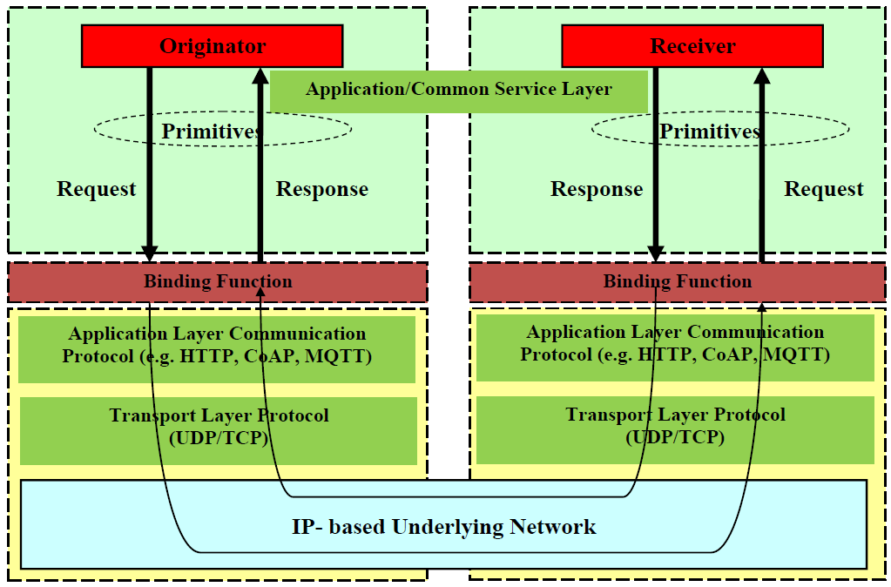
Primitive Mapping
Source: oneM2M TS-0004
Notes:
Primitive 映射
發起者傳送請求給接收者依序經過
1. Application/Common Service Layer 應用/通用服務層
2. Binding function 綁定功能
3. Application Layer Communication Protocol 應用層通信協議
4. Transport Layer Protocol 傳輸層協議
5. IP-based Underlying NetWork 基於IP的底層網絡
6. Transport Layer Protocol 傳輸層協議
7. Application Layer Communication Protocol 應用層通信協議
8. Binding function 綁定功能
9. Application/Common Service Layer 應用/通用服務層
接收者以同樣方式傳送響應給對應的發起者

Slide 31
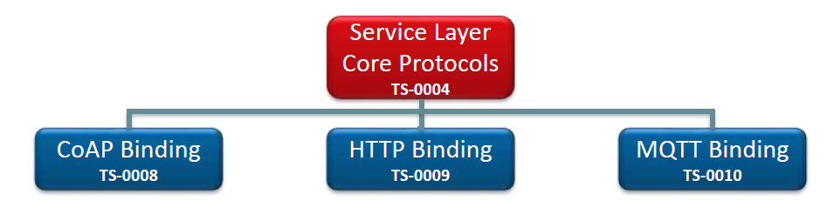
Protocol Binding
Notes:
協議綁定
Service Layer Core Protocols服務層核心協議
-CoAP 綁定
-HTTP 綁定
-MQTT 綁定

Slide 32
<xxx Resource> Primitives
xxxCreateRequest
xxxCreateResponse
xxxRetrieveRequest
xxxRetrieveResponse
xxxUpdateRequest
xxxUpdateResponse
xxxDeleteRequest
xxxDeleteResponse
xxxNotifyRequest
xxxNotifyResponse
Notes:
<xxx 資源> Primitives
此頁舉例列出 Primitive 類型

Slide 33
HTTP Binding for Primitives
Source: TS-0009-HTTP_Protocol_Binding
Notes:
Primitives的 HTTP 綁定
Primitive 類型對應 HTTP方法
xxxRetrieveRequest: GET或對POST的響應（對通信通道的長輪詢）
xxxUpdateRequest: PUT或對POST的響應（對通信信道的長輪詢）
xxxCreateRequest: POST或對POST的響應（對通信信道的長輪詢）
xxxDeleteRequest :DELETE或對POST的響應（對通信信道的長輪詢）
xxxExecRequest:POST（無主體）或對POST的響應（對通信通道的長輪詢）
xxxNotifyRequest::POST（異步通知）或響應POST（對通知信道的長輪詢）或對POST的響應（對通信信道的長輪詢）

Slide 34
Concluding Remarks (1)
In this section, we first give an overview of oneM2M Common Service Functions (CSFs) framework.
We go over each of 12 M2M CSFs.
Next, a detailed discussion on REST architectural style is given including topics on REST constraints, REST resources, REST interfaces and REST basic operations.
Then, REST architectural style specific to M2M is elaborated.
Notes:
結語 ( 1 )
．在本章，一開始我們先概述oneM2M 通用服務功能 (CSFs) 框架。
．介紹了oneM2M定義的十二種M2M通用服務功能。
．下一步，進一步論述REST架構風格的細節，包含以下主題：REST限制、REST資源、REST介面和REST基本操作。
．接著，詳述M2M的REST架構風格規範。

Slide 35
Concluding Remarks (2)
Lastly, the architectural ideas of resource-based M2M communications are explained. Under this architecture, M2M resources are represented as a data model of tree structure.
We explain this tree structure and the general communication flow used to manipulate this resource tree.
Finally, protocol binding that maps interface primitives to protocol messages is explained.
Notes:
結語 ( 2 )
．最後，闡明基於資源的M2M通訊其架構概念。在此架構下，M2M資源被表示成具有樹狀結構的資料模組。
．我們解釋了用來操作資源樹的樹狀結構以及一般通訊流程。
．最後，也解釋了介面primitives 映射到協議消息之間的協議綁定。

