Slide 1
M2M Core Networks 物聯網核心網路
行動寬頻尖端技術跨校教學聯盟
國立交通大學資訊工程系
Department of Computer Science
National Chiao Tung University
October 25, 2016

Slide 2















M2M Core Networks
Client Applications
M2M Area Network
M2M Core Network
M2M
Device
Service
Capabilities
M2M
Gateway
Service
Capabilities
M2M
Network
Service
Capabilities
M2M
Gateway
M2M Applications
M2M Device Domain
M2M Network Domain
M2M Application Domain
Notes:
M2M核心網路–本單元主要討論M2M對電信核心網路的衝擊及電信核心網路如何做最佳化來支援M2M應用

Slide 3
Outline
M2M Impact to Core Networks
Core Network Optimization for M2M
Impact of Low Power Wide Area Network (LPWAN)
Notes:
大綱
M2M對核心網路造成的影響
將核心網路依M2M的需求作最佳化
對低功耗廣域網路的影響

Slide 4
M2M Impact to Core Networks
Notes:
M2M對核心網路造成的影響

Slide 5
M2M Impact to Core Networks Outline
M2M Communication Scenarios
Which Network to Use: Fixed or Mobile?
Characteristics of M2M Communications
Impact to Core Networks
Cost Reduction Requirement
Value-Added Services Requirement
Numbering, Identifiers, and Addressing Requirement
Notes:
M2M對核心網路造成的影響
大綱
‧M2M通訊情景
‧要使用哪種網路：固定或是行動？
‧M2M通訊特徵
‧對核心網路造成的影響
–降低成本需求 –加值服務需求 –編號、識別碼和編址需求

Slide 6
M2M Communication Scenarios
Network Communication Scenarios
Machine-to-machine
Machine-to-server
Machine-to-gateway-to-server
Machine Communication Scenarios
Rarely send data and device-originated only
Rarely send data but have to be reachable
Continuously need to send and receive data
Occasionally need to send data
High-bandwidth data such as video surveillance
Low-bandwidth data such as meter reading
Notes:
M2M通訊情景
‧網路通訊情景
–機器對機器
–機器對伺服器
–機器對閘道對伺服器
‧機器通訊情景
–很少傳送資料和設備發起限定 –很少傳送資料但是設備要在控制可及範圍內 –需要不斷的傳送和接收資料 –偶爾需要傳送資料 –高頻寬資料，如視頻監控 –低頻寬資料，如儀表資料 (電表、水表等)

Slide 7
Which Network to Use: Fixed or Mobile?
Mobile network is the choice because
The cost of connecting M2M devices to a fixed network (wiring and cabling to each device) could be very expensive.
A large percentage of M2M applications involves mobile devices (e.g. connected car, eHealth)
Global roaming can be supported by the mobile network.
However, need to ensure the ubiquitous coverage of a mobile network.
Notes:
固定式或行動式?
行動網路式的選擇因為
連接M2M裝置到固定式網路(連接線路到每一個裝置)的花費可以非常昂貴
很大比例的M2M應用包含M2M行動裝置
行動網路支援國際漫遊
然而，需要確保行動網路是處處存在的

Slide 8
Characteristics of M2M Communications
M2M communications can be characterized by their
Data Volume,
QoS Requirements,
Time Sensitivity and
Communication Direction.
The network needs to be designed to deal with device/application diversities.
Notes:
M2M通訊的特徵
M2M通訊可被下列特性所描繪
資料量
QoS需求
時間敏感性
通訊方向
網路需要設計解決裝置/應用的多樣性

Slide 9
Impact to Core Networks (1) Cost Reduction Requirement
M2M communications have to be low-cost (per device). Thus the cost to provide M2M communications by operators has to be reduced to a minimum.
To meet this requirement, we need to first understand cost drivers and network cost components of M2M communications.
Notes:
核心網路的衝擊
花費降低需求
M2M通訊對每個裝置而言必須低成本。因此廠商提供M2M通訊的花費必須要被減到最低
為了達到這個要求，我們需要先了解M2M通訊的成本動因和網路花費組成

Slide 10
Cost Reduction Requirement Cost Drivers and Network Cost Components
Cost Drivers
Number of group-based subscriptions
Number of simultaneously attached devices
Number of simultaneous always on data connections
Number of data sessions
Volume of data throughput
Network Cost Components
SIM cards; E.164 numbers; HLR capacity
Mobility context data in network node
Session context data in network node
Signaling for mobility management and connection setup
Radius/Diameter capacity
Radio capacity etc.
Notes:
花費減低需求
成本動因和網路花費組成
成本動因
群組基準的訂閱數
同時接上的裝置數
總是資料連接同步數
資料通話數
資料生產量
網路花費組成
SIM卡;E.164數;HLR容量
網路節點中的行動資料
網路節點中的通話資料
行動控制訊號和連結建立
Radius/Diameter容量
無線容量等等

Slide 11
Cost Reduction Methods
Group-based Communications
Network Resource Reduction for Idle Devices
Network Signaling Reduction
Avoidance of Peaks in User Data
Separate Network for M2M
Notes:
花費減少方法
群組基準通訊
減少空閒裝置使用的網路資源
減少網路訊號量
避免使用者資料尖峰
分開網路給M2M

Slide 12
Group-Based Communications
Types of Group-Based Communications
Group-based subscription and charging
Group-based policing
Group-based triggering
Issues of Grouping M2M Devices
Allowing devices belong to multiple groups complicates subscription and profile management.
3GPP allows only one group for each subscription.
Notes:
群組基準通訊
群組基準通訊的類型
群組基準的訂閱和付費
群組基準的政策
群組基準的觸發
M2M裝置群組的問題
允許裝置屬於多個群組使訂閱和組態管理更複雜
3GPP只允許每一個訂閱一個群組

Slide 13
Network Resource Reduction for Idle Devices
Devices that are idle but attached to the network still keep their session context or mobility management context.
Trade-off between
saving network resources by removing these device contexts and
adding the signaling overhead of reattaching and reconnecting these devices for sending data.
Notes:
減少空閒裝置網路資源
裝置連接上網路但是空閒中的仍會保持他們的通話內容或行動控制內容
取捨取決於
移除這些裝置內容可以節省網路資源
然而却增加為了再一次接上和再一次連接這些裝置所需的訊號傳送負擔

Slide 14
Network Signaling Reduction
In M2M communications, the ratio between the amount of network signaling and the amount of use data transmitted is relatively high.
Ways to reduce network signaling:
Charge not only data but signaling of M2M devices.
Exchange no mobility management signaling when devices are not moving.
Keep devices detached when they have no data to send.
Keep devices connected if they frequently send data
Send small data along with the signaling message.
Notes:
減少網路訊號
在M2M通訊中，網路訊號的數量和要傳輸的資料量比相對是比較高的
減少網路訊號的方法
M2M裝置不單對資料也要對訊號傳輸收費
當裝置沒有在移動時不要交換移動控制訊號
當它們沒有資料要送時，保持裝置分離
當它們很常送資料時，保持裝置連接
跟著訊號訊息送一些資料

Slide 15
Avoidance of Peaks in User Data
This is for operators to move the data transmission of M2M devices from peak hours of mobile networks by providing lower-rate or other incentives.
3GPP proposes the notion of “time-controlled” where an M2M device can only send data during a particular access grant time interval.
Need to randomize access from M2M devices within the access grant time interval to avoid collision.
Notes:
避免使用者資料高峰
這是讓廠商提供低速率或其他動機把M2M裝置的資料傳輸從行動網路的尖峰時段移開
3GPP提議”時間控制”的標記法，M2M裝置只可以在特定同意使用的時間區間中送資料
再同意使用的區間內使用M2M裝置必須隨機存取避免碰撞

Slide 16
Separate Networks for M2M
Two scenarios
Separate both core and access networks for H2H and M2M communications
Only separate core networks for M2M communications
Core networks designed specifically for M2M
Dedicated Core Network Central Equipment such as
Dedicated HLR: avoid congestion and overload from massive number of devices wanting to register on network at same time
Dedicated GGSN: customized for M2M
Specific GGSN Access Point Name (APN) for handling M2M traffic
Notes:
M2M分離網路
兩種方案
為H2H和M2M通訊分離核心和存取網路
只分離M2M通訊的核心網路
核心網路特別為M2M設計
核心網路專用的中心配備如
專用HLR:避免在大量裝置同時想在同一時間註冊網路時產生阻塞和過載
特定的GGSN進入節點(Access Point Name, APN) 來處理M2M流量

Slide 17
Impact to Core Networks (2) Value-Added Services Requirement
The examples value-added services that operators must provide for M2M communications
QoS and Priority Differentiation
Charging and Subscription Management
Device Management
Connection Monitoring
Fraud Control
Secure Connection
Notes:
核心網路衝擊
附加價值服務需求
廠商必須提供給M2M通訊的附加服務例子
QoS和優先度差異
收費和訂閱管理
裝置管理
連接監控
欺騙控制
安全連接

Slide 18
QoS Differentiation
QoS for mobile networks should be applicable for serving diverse M2M services
For example, QCI (QoS Class Identifier) for LTE is defined as follows.
Notes:
QoS差異
行動網路的QoS應該對廣泛的M2M服務都是可用的
舉例來說，LTE的QCI(QoS Class Identifier)如下

Slide 19
Priority Differentiation
Another differentiation control In LTE is ARP, standing for "Allocation and Retention Priority".
ARP is used during two procedures: during admission or allocation (setup signaling) of the bearer and during lifetime of the bearer, when new bearer is to be admitted/allocated (The existing bearer may be deallocated to make space for new bearer).
Also at handover, ARP may be applied to decide which bearer can be dropped from bearers allocated to a UE.
ARP has three sub-parameters: priority level (1 thru 15), preemption capability (capable to preempt/not capable to preempt), and preemption vulnerability (preemptable /not preemptable).
Notes:
優先度差異
另一個LTE差異控制是ARP，代表”Allocation and Retention Priority”(分配和保留優先度)
ARP是在兩個步驟被使用:進入許可或分配通道和通道生命週期的時候(設置訊號)，當新的通道被允許/分配，原本存在的通道為了產生新的空間給新通道可能被取消分配
再轉移基地台時，ARP也被使用去決定哪一個分配給UE的通道可以被取消
ARP有三個子參數:優先度等級(1~15)，先取得能力 (可先取得能力/不可先取得能力)，先取得權被取消 (可被取消/不可被取消)

Slide 20
Charging and Subscription Management
What operators need to provide include:
Customer management for group charging and subscription
Flexibility for device subscription and management by M2M application owners (no provisioning until the device is purchased)
Remote management of SIM cards (e.g. over-the-air provisioning with subscription details)
Flexible choices of mobile operators by customers
Notes:
繳費和訂閱控制
廠商需要提供包括:
群體繳費和訂閱顧客管理
M2M應用擁有者裝置訂閱和管理的彈性(裝置被購買前不分配)
SIM卡的遠端管理(無線分配訂閱細節)
顧客對行動廠商的彈性選擇

Slide 21
Device Management (New!)
Operators can provide values by
Initial activation of M2M devices
Continuous remote management of M2M devices
Support of device management protocols defined in OMA (Open Mobile Alliance) DM (Device Management) and BBF (Broadband Forum) TR-069.
Notes:
裝置管理 (新功能)
廠商可以提供的價值
初始激活M2M裝置
連續遠端控制M2M裝置
支持被定義在OMA(Open Mobile Alliance)DM(Device Management)和BBF(Broadband Forum)TR-069的裝置管理協定

Slide 22
Connection Monitoring (New!)
Need to ensure device connectivity is always in good condition.
How to detect any anomaly without producing too much signaling overhead is a challenge.
Connectivity status may include loss of connectivity, removal of a SIM card, roaming outside a particular area, or potential fraud etc.
The events can be reported to M2M applications for appropriate actions.
Notes:
連線監控
需要確保裝置的連接性總是在好的情況
如何不產生太多訊號就察覺任何異狀是個挑戰
連線狀態可能包括遺失連線、移除SIM卡、在特定地區外漫遊或潛在的欺騙等等
事件可以報告給M2M應用處理以執行對應的動作

Slide 23
Fraud Control
Detection of fraud can be an important value-added service by mobile operators. Examples for detection:
A device suddenly transmits more data than usual.
A device changes its location unexpectedly.
Etc.
Prevention of fraud potentially include
Restrict the validity of SIM with certain types of device.
Restrict the connectivity of devices to limited addresses.
Restrict the functioning of devices to specific locations
Etc.
Notes:
欺騙控制
偵測欺騙對行動商而言是一個重要的附加服務，舉例來說
一個裝置突然傳送比往常還多的資料
一個裝置無預警的改變它的位址
等等…
預防欺騙可能性包括
限制SIM在特定種類的裝置有效
限制裝置的連接在有限的位址
限制裝置在特定地點運行
等等…

Slide 24
Secure Connection
Mobile operators support data transport security over mobile networks such as encryption for data transmitted over the radio interface and IP VPN for the interface between M2M gateway and server.
In addition, operators also need to support end-to-end security for M2M applications at the application level.
Notes:
安全連接
行動廠商支援行動網路安全資料運輸如無線介面資料傳送加密和M2M閘道器和伺服器間IP VPN介面
此外，廠商也需要在應用層支援M2M應用的點對點安全傳輸

Slide 25
Impact to Core Networks (3) Numbering, Identifiers, and Addressing Requirement
E.164 Numbers
IMSI Identifiers
IMEI Identifiers
ICCID Identifiers
IP Addresses
Notes:
核心網路影響
編號，標識和定址需求
E.164數
IMSI標識
IMEI標識
ICCID標識
IP位址

Slide 26
E.164 (or MSISDN) Numbers
National Significant Number
CC – Country Code
NDC – National Destination Number
SN – Subscriber Number
CC
NDC
SN
1-3 digits
International Subscriber Number
15 digits
In M2M communications where majority of communications is data,
a telephone number is not needed strictly.
Nevertheless, an E.164 number is needed for billing, provisioning and
for over-the-air device and SIM management in mobile networks.
Thus there is an urgent shortage of numbers for M2M unless alternatives
are developed for E.164.
Options available include
IMSI and IP address
Fully Qualified Domain Name (FQDN).
SIP URI
Notes:
E.164(or MSISDN數)
M2M通訊中主要是資料傳輸，一個電話號碼嚴格來說不需要
儘管如此，行動網路中一個E.164數對於收費、分配、無線裝置和SIM管理是需要的
因此直到E.164被停止使用以前，M2M需急切解决E.164數的不足
有可能的取代選項包含
IMSI和IP位址
Fully Qualified Domain Name(FQDN)
SIP URI

Slide 27
IMSI Identifiers
MCC –Mobile Country Code
MNC – Mobile Network Code
MSIN – Mobile Subscription
identification Number
MCC
MNC
MSIN
3 digits
2-3 digits
9-10 digits
IMSI (International Mobile Station Identifier) is used in mobile networks
to identify a particular subscription.
9 digits for MSIN can only support up to 10 million subscriptions.
So it is best to have 10 digits for MSIN (up to 100 million subscriptions)
If still not sufficient, an operator may need to take more than one MNC codes.
IMSI thus is under stretch.
Notes:
IMSI 標識
IMSI(International Mobile Station Identifier)被用在行動網路辨識特定訂閱
9位元MSIN只可以支持最多1000萬的訂閱者
所以MSIN最好有10位元(最多1億訂閱者)
如果仍然不夠，廠商可能要拿多於一個MNC碼
IMSI因此不太夠M2M用

Slide 28
IMEI Identifiers
TAC –Type Allocation Code
SNR – Serial Number
CD – Check Digit/Spare Digit
TAC
SNR
CD
8 digits
6 digits
1 digit
TAC –Type Allocation Code
SNR – Serial Number
SVN – Software Version Number
TAC
SNR
SVN
8 digits
6 digits
2 digits
The IMEI (International Mobile Equipment Identity and Software Version)
numbers are used to identify individual mobile devices.
TAC identifies a particular model of mobile device.
However, with 6-digit SNR the maximum number of devices of a single type
Is only 1 million.
To escape this limit, multiple TACs may be allocated to the same type of
devices.
Notes:
IMEI標誌符
IMEI(International Mobile Equipment Identity and Software Version)數用來識別個別的移動裝置
TAC識別行動裝置特定的模組
然而，對6digits 而言，SNR單一種類裝置最大數只有一百萬
為了不要受這個限制，多個TACs可能被份配到相同種類的裝置

Slide 29
ICCID Identifiers
Issuer Identification Number
4-7 Digits
Major
Industry
Identifier
Country
Code
Issuer
Identifier Number
Individual Account
Identification Number
Check
Digit
2 digits
1-3 digits
1-4 digits
12-15 digits
1 digit
Integrated Circuit Card Identifier (19 digits)
The ICCID (International Circuit Card Identifier) identifies individual UICCs
(Universal Identify Chip Cards).
There are at least 12 digits for every issuer identification number. This is
adequate for M2M applications.
Notes:
ICCID識別符
ICCID(International Circuit Card Identifier)識別每一個UICCs(Universal Identify Chip Cards)
每一個發佈者有至少12位元可使用的識別數，這對M2M應用而言是足夠的

Slide 30
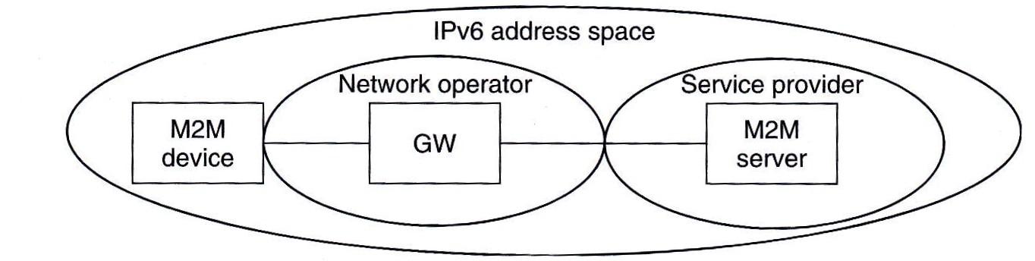
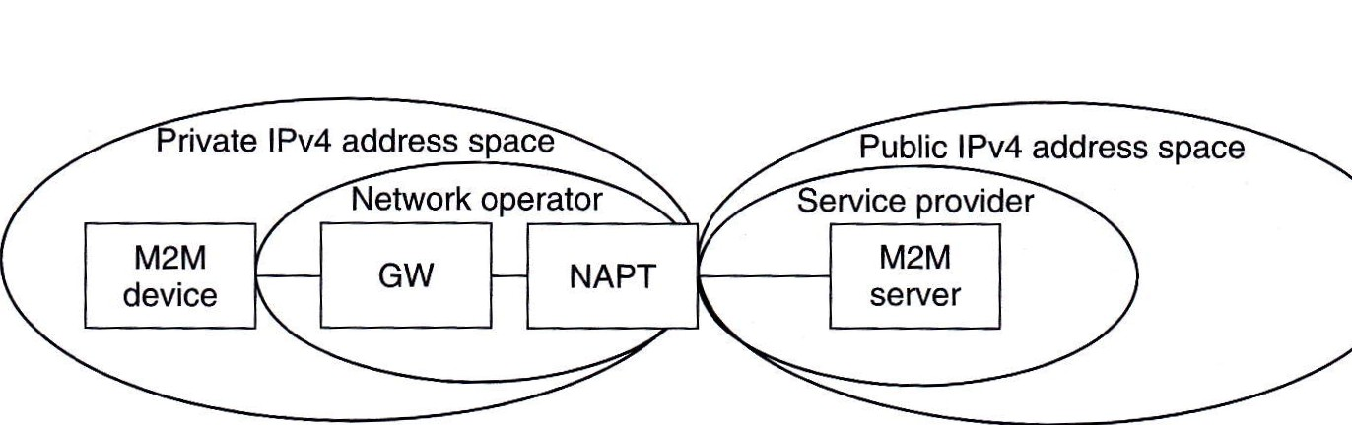
IP Addresses
IPv6 Scenario
IPv4 Scenario
(V) Device->Server
(V) Server->Device
(V) Device->Server
(X) Server->Device
V: OK
X: Special solution required
Source: M2M Communications: A Systems Approach, Wiley, 2012
Notes:
IP位址
IPv6方案
(V)裝置->伺服器
(V)伺服器->裝置
IPv4方案
(V)裝置->伺服器
(X)伺服器->裝置

Slide 31
Core Network Optimization for M2M
Notes:
針對M2M的核心網路最佳化

Slide 32
Core Network Optimization for M2M
Triggering Optimization
Overload and Congestion Control
3GPP Standardization
Notes:
針對M2M的核心網路最佳化
‧觸發最佳化 ‧超載和擁塞控制
‧3GPP標準

Slide 33
Triggering Optimization Outline
What is triggering?
Triggering mechanisms defined by 3GPP 23.888
Triggering using Mobile-Terminated SMS
Triggering using IMS message
Triggering using cell broadcast (CBS)
Triggering via HSS and non-access stratum (NAS) signaling
Triggering via network-requested PDP context establishment
Notes:
觸發最佳化
大綱
‧什麼是觸發？
‧3GPP 23.888所定義的「觸發機制」
–用移動設備接收簡訊來作觸發
–用IMS訊息來作觸發
–用區域廣播來作觸發
–透過HSS與非接入層信令來作觸發
–透過網路要求的PDP內容建立來作觸發

Slide 34
What Is Triggering?
To enable network-originated communications while the network only supports device-originate communications
Trigger Device
M2M
Device
M2M
Network
Setup Connection
Notes:
什麼是觸發？
‧當網路只支援設備發起通訊時，使網路發起通訊成為可能

Slide 35
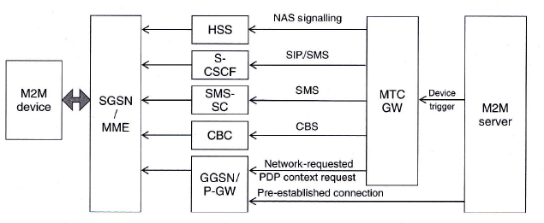
Triggering Mechanisms Defined by 3GPP
Source: M2M Communications: A Systems Approach, Wiley, 2012
3GPP defines a machine-type communication gateway (MTC GW) that will act
as an entry point in the mobile network for control messages from M2M servers
to M2M devices.
Notes:
3GPP所定義的「觸發機制」
‧3GPP定義一個機器型別通訊閘道(MTC GW)，在行動網路中，扮演M2M伺服器傳給M2M設備的控制訊號的入口點

Slide 36
Status of Devices When Being Triggered
The devices can be
Connected with IP Address known to the server
Connected without IP Address known to the server
Attached but not connected
Unattached (unreachable)
Each requires different methods of triggering.
Notes:
被觸發時，設備的狀態
‧設備可以是 –經IP地址連接，Server 知道 Device 的 IP地址 –經IP地址連接，Server 不知道 Device 的 IP地址
–處於可建連線狀態，但還沒經IP地址連接 –處於無法建連線狀態（不可及） ‧每一個都需要不同的觸發方式

Slide 37
Information in Triggering Message
The identify of the target M2M device
The identity of the application
A request counter
(option) IP address (or FQDN)/port number of application server
(option) An urgency indicator
(option) A validity timer
(option) The target area
(option) Application-specific information
Notes:
觸發訊息中包含的資訊
‧目標M2M設備的識別 ‧應用程序的識別 ‧請求計數器 ‧（選項）IP地址（或FQDN）/應用程序伺服器的埠號 ‧（選項）迫切性指標 ‧（選項）有效計時器 ‧（選項）目標區域 ‧（選項）應用程序特定的資訊

Slide 38
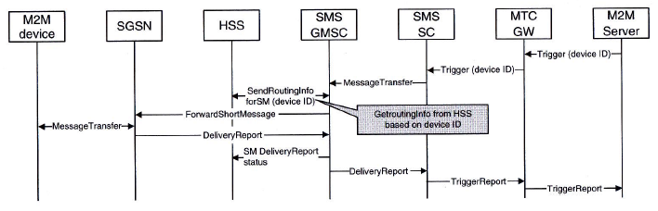
Triggering using Mobile-Terminated SMS
Source: M2M Communications: A Systems Approach, Wiley, 2012
The M2M device identify can be an IMSI or an MSISDN replacement.
But security is a major concern.
Notes:
用移動設備接收簡訊來作觸發
‧M2M設備的識別可以是IMSI或是MSISDN之替代
‧但是安全性是主要關心項目

Slide 39
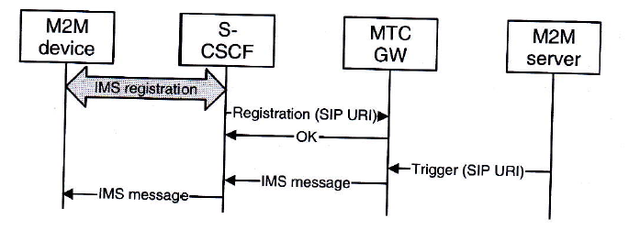
Triggering using IMS Message
Source: M2M Communications: A Systems Approach, Wiley, 2012
The MTC GW is viewed as an IMS Application Server.
But an M2M device has to maintain an IMS session which is too heavy for M2M communications.
Notes:
用IMS訊息來作觸發
‧將MTC GW視為IMS應用程序伺服器
‧但是M2M設備需要維護IMS會話，這對M2M通訊來說太沉重

Slide 40
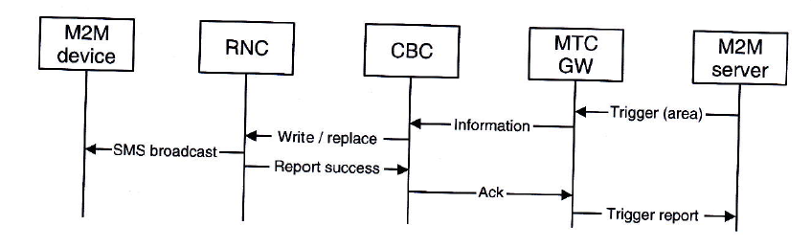
Triggering using Cell Broadcast
Source: M2M Communications: A Systems Approach, Wiley, 2012
The M2M Server uses Cell Broadcast Center (CBC) to broadcast the trigger message within an indicated area.
The M2M device matched the identification will respond.
Notes:
用區域廣播來作觸發
‧M2M伺服器用區域廣播中心(CBC)來廣播觸發訊息到指定區域
‧與識別相符合的M2M設備會回應

Slide 41
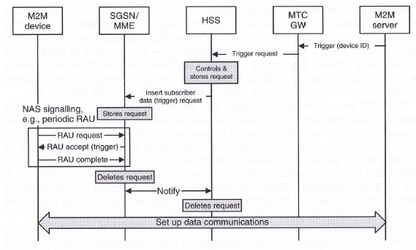
Triggering via HSS and Non-Access Stratum (NAS) Signaling
Source: M2M Communications: A Systems Approach, Wiley, 2012
The triggering message is piggybacked on RAU (Routing Area Update) Accept message.
Notes:
透過HSS與非接入層信令來作觸發
‧觸發訊息被夾帶在路由區域更新(RAU)接受訊息中

Slide 42
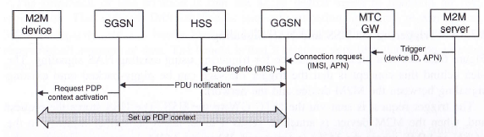
Triggering via Network-Requested PDP Context Establishment
Source: M2M Communications: A Systems Approach, Wiley, 2012
Use IMSI as the device ID in the network
Use network-requested PDP (Packet Data Protocol) context establish to trigger the device.
Notes:
透過網路要求的PDP內容建立來作觸發
‧在網路中用IMSI作為設備的ID
‧用網絡請求的封包資料協定(PDP)上下文建立來觸發設備

Slide 43
Overload and Congestion Control
Network Overload Control for Mobile Devices Configured with “Low-Access Priority”
Generic Mobility Management Congestion Control for Core Network
Selective Throttling of Downlink Low-Priority Traffic Received for M2M Devices in idle Mode
Application-Specific Congestion Control
Optimization to Prevent Overload from Network Reselection
Extended Access Barring
Notes:
超載和擁塞控制
‧針對被設定為低存取優先權的行動設備的網絡超載控制
‧針對核心網的一般行動管理擁塞控制
‧替處於閒置模式的M2M設備接受下行低優先權流量的選擇性節流 ‧應用程序特定的擁塞控制 ‧最佳化來防止網絡重選造成的過載
‧延伸存取控制機制

Slide 44
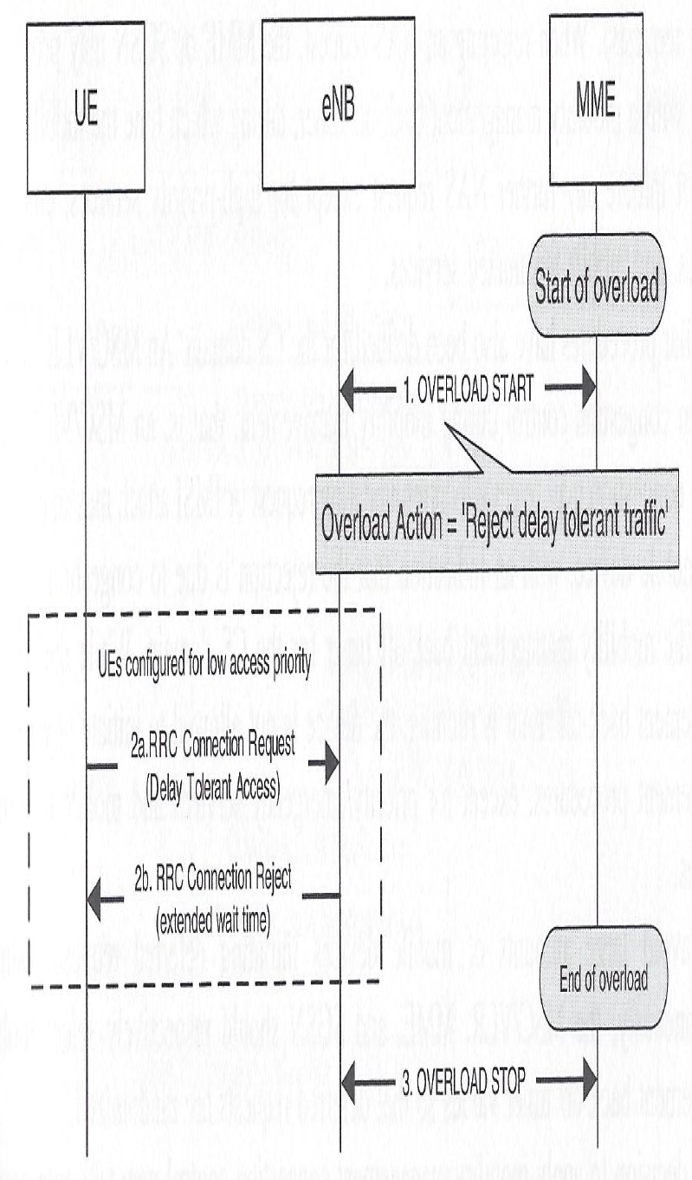
Network Overload Control for Mobile Devices Configured with “Low-Access Priority”
Source: M2M Communications: A Systems Approach, Wiley, 2012
To control the impact of M2M communications, M2M devices can be configured with “Low-Access Priority”
Notes:
針對被設定為低存取優先權的行動設備的網絡超載控制
‧為了控制M2M通訊造成的影響，M2M設備可以被設置為“低存取優先權”

Slide 45
Generic Mobility Management Congestion Control for Core Network
An MME (or SGSN) may reject mobility management (i.e. Non-Access Stratum (NAS)) signaling from M2M devices (i.e. attach, tracking area update or routing area update request etc.)
When rejecting such requests, the MME will provide M2M devices with a mobility management back-off timer to avoid collision of re-attempts.
Notes:
針對核心網的一般行動管理擁塞控制
‧MME（或SGSN）可能拒絕從M2M設備傳送過來的行動管理（即非接入層（NAS））信令(即可及、追蹤區域更新或路由區域更新請求……等)
‧當拒絕這樣的請求，MME將提供M2M設備一個行動管理退回計時器，以避免重新嘗試時產生碰撞。

Slide 46
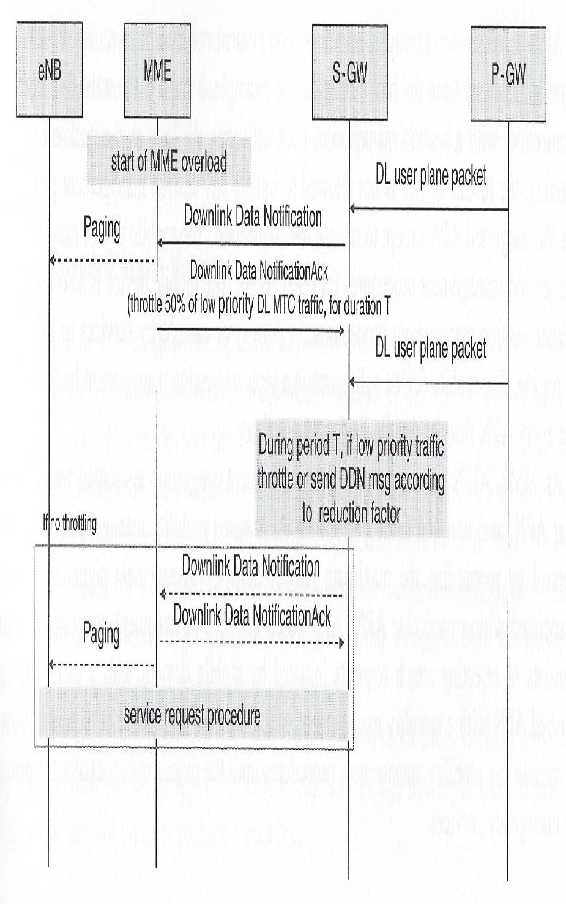
Selective Throttling of Downlink Low-Priority Traffic Received for M2M Devices in idle Mode
Source: M2M Communications: A Systems Approach, Wiley, 2012
MME can ask S-GW to throttle downlink low-priority traffic for a
time period T according to a reduction factor.
Notes:
替處於閒置模式的M2M設備接受下行低優先權流量的選擇性節流
‧MME可以請S-GW在根據一個簡化系數的一段時間週期T下，對下行低優先權流量作節流

Slide 47
Application-Specific Congestion Control
Deal with signaling congestion associated with a particular APN (Access Point Name).
The APN in LTE/EPC identifies a Packet Data Network Gateway (P-GW) and defines the Packet Data Network (PDN) to which the UE requests connectivity.
Using APNs, traffic from M2M applications can be identified.
When congestion occurs, M2M traffic then can be rejected based on particular APNs.
Notes:
應用程序特定的擁塞控制
‧對一個特定接入點名稱（APN）的信令擁塞處理
‧在LTE/ EPC中的APN標識一個封包數據網路閘道（P-GW）並定義UE請求連線的封包數據網路（PDN）
‧使用APN能識別從M2M應用程序發出的流量
‧當擁塞發生時，基於特定APN可以拒絕M2M流量

Slide 48
Optimization to Prevent Overload from Network Reselection
When searching for a network fails, all M2M devices in the same network may simultaneously reselect an alternative network for connectivity. This causes overload to the alternative network.
Need to carefully select the timer so that the search for network won’t expire too early to attempt a reselection.
Notes:
最佳化來防止網絡重選造成的過載
‧「尋找一個網路」這個行為失敗時，在同一網路中的所有M2M設備為了連線可能同時重新選擇替代網路，導致替代網路發生過載。 ‧需要謹慎選擇定時器，使網路搜索將不會太早逾期，而開始嘗試重選

Slide 49
Extended Access Barring
A process to allow the operator to control M2M device-originated access attempts.
This may be useful also in preventing overload from network re-selection.
EAB may be applicable only to roaming mobile devices or devices not in their preferred networks.
Notes:
延伸存取控制機制
‧一套程序，允許業者控制M2M設備發起的存取嘗試。
‧用來防止網路重選造成的過載也很有用
‧EAB可能只適用於漫遊行動設備或沒有位在自身首選網路中的設備

Slide 50
Network Optimization for MTC – 3GPP Standardization
3GPP WG SA1 established a work item on network improvement for machine type communications (MTC) in 2008.
Samples of 3GPP documents addressing impact of MTC
TS 22.368, “ Service Requirements for MTC”
TS 22.888, “Study on Enhancements for MTC”
TR 23.888, “System Improvements in MTC”
TS 23.682, “Architecture Enhancements to Facilitate Communications with Packet Data Networks and Applications”
TS 33.868, “Security Aspects of Machine-Type Communications”
TS 23.401 & TS 22.011 on Core Network Optimization
TS 22.011 on Access Network Optimization
Etc.
Notes:
MTC的網路最佳化–3GPP標準
‧3GPP WG SA1在2008年為了機器類型通訊（MTC）的網路改善，成立了一個工作項目
‧解決MTC影響的3GPP文件樣本：
–TS 22.368：“MTC的服務需求”
–TS 22.888：“增強MTC的研究”
–TR 23.888：“MTC的系統改進”
–TS 23.682： “架構增強用以促進與封包數據網路及應用程序間的通訊”
–TS 33.868： “機器類型通訊的安全性問題” –TS 23.401&TS 22.011：核心網路最佳化 –TS 22.011：存取網路最佳化
–其它

Slide 51
Network Optimization Features for MTC in 3GPP Releases 10 and 11
Release 10
Extended access barring
Low-access priority indicators in radio-resource control
Extended wait timers in radio resource control
Throttling of downlink data notification requests
APN-based congestion control
Generic core network mobility management control
Optimizations to prevent overload from PLMN reselection
Release 11
Triggering optimization and triggering architecture
Addressing optimizations and removal of dependency on telephone numbers
Notes:
3GPP Releases 10與11中，MTC網路最佳化的特徵
‧Release 10： –延伸存取控制機制 –無線資源控制中的低存取優先權指標
–無線資源控制中的延長等待定時器
–下行數據通知請求的節流 –基於APN的擁塞控制 –通用核心網路行動管理控制 –最佳化，用來防止PLMN重選造成的過載 ‧Release 11 –觸發最佳化和觸發架構
–編址最佳化和清除電話號碼的相依

Slide 52
Impact of Low Power Wide Area Network (LPWAN)
Notes:
對低功耗廣域網路的影響

Slide 53
Low Power Wide Area Network (LPWAN)
Non 3GPP Unlicensed Networks (already deployed)
E.g. LoRaWAN, Sigfox, Neul and Nwave (based on Weightless–N) etc.
Most of these networks take advantage of ISM (industrial, scientific, and medical) unlicensed frequency bands.
3GPP Licensed Networks Evolution (released in 3GPP Rel. 13; under development)
eMTC – LTE-M (M: MTC - machine type communication) evolution
NB-IoT (evolved from NB-CIoT and NB-LTE)
EC-GSM
Notes:
低功耗廣域網路
非3GPP非授權網絡（已部署）
--例如。 LoRaWAN，Sigfox，Neul和Nwave（基於Weightless-N）等
--這些網絡中的大多數利用ISM（工業，科學和醫療）未授權頻帶。
3GPP授權網絡演進（在3GPP Rel.13中發布;正在開發中）
--eMTC-LTE-M（M：MTC-機器類型通信）演進
--NB-IoT（從NB-CIoT和NB-LTE演進）
--EC-GSM

Slide 54
Importance of LPWAN
5G
802.11ac
802.11ad
802.11n
High
Bandwidth
4G
802.11a
802.11b
802.11g
3G
Zigbee/ 802.15.4
VSAT
BLE
WBAN
802.15.6
LPWAN
Low
Bandwidth
WPAN 802.15.3
RFID/
NFC
Short Range
Long Range
Notes:
低功耗廣域網路的重要性在於他們可提供傳統的無線技術無法涵蓋的範圍，即能以低功耗，來提供廣域網路的功能！
傳統的無線網路只能提供 (1) 短距離高頻寬、(2)短距離低頻寬、或 (3)長距離高頻寬。

Slide 55
Non 3GPP LPWAN
Notes:
非3GPP低功耗廣域網路

Slide 56
LoRaWAN (1)
Target key requirements of Internet of things such as secure bi-directional communication, mobility and localization services.
Typically laid out in a star-of-stars topology in which gateways is a transparent bridge relaying messages between end-devices and a central network server in the backend.
All end-point communication is generally bi-directional, but also supports operations such as multicast, enabling software upgrade over the air or other mass distribution messages to reduce the on-air communication time.
Communication between end-devices and gateways is spread out on different frequency channels and data rates. Data rates range from 0.3 kbps to 50 kbps. The LoRaWAN network server is managing the data rate and RF output for each end-device individually by means of an adaptive data rate (ADR) scheme.
Source: LoRa Website
Notes:
LoRa 由IBM及SemTech開發，LoRaWAN是一種LPWAN(Low Power Wide Area Network)的規範，LoWaWAN的協定是針對low cost去進行優化。
- LoRa主要針對物聯網的需求去做制定，像是雙向通訊、行動性，以及在地化服務。
使用的是星對星的拓樸，閘道是透明的橋接器，負責轉送終端裝置間的訊息，另外在後端有個中央的網路伺服器。
所有終端點的通訊是雙向的，但也有支援多播(multicast) 軟體升級以及大量分散的訊息，去減少通訊時間。
終端裝置與閘道間的通訊是分散在不同頻率的頻道，並且擁有不同的資料傳輸率(0.3 kbps~50 kbps)，LoRaWAN的網路伺服器可以管理資料傳輸率以及頻率使用。

Slide 57
LoRaWAN (2)
Secure communications by several layer of encryption: Unique Network key (EUI64) on network level, Unique Application key (EUI64) for end to end security on application level and Device specific key (EUI128).
Support three classes of end-point devices:
Bi-directional end-devices (Class A): Devices require downlink communication from the server shortly after the end-device has sent an uplink transmission.
Bi-directional end-devices with scheduled receive slots (Class B): In addition to the Class A random receive windows, Class B devices open extra receive windows at scheduled times.
Bi-directional end-devices with maximal receive slots (Class C): End-devices of Class C have nearly continuously open receive windows.
Source: LoRa Website
Notes:
利用多層的加密達成安全的通訊
支援三種終端裝置
Class A 雙向終端裝置: 裝置在進行上傳後需要等待伺服器端的下載通訊
Class B 雙向終端裝置(有排程的接收): 裝置需要在排程時間開起額外的接收window
Class C雙向終端裝置(有最大排程的接收): 裝置幾乎有連續開起接收window

Slide 58
SIGFOX
SIGFOX provides a tailor-made solution for low-throughput IoT/M2M applications.
Designed for IoT/M2M devices characterized by:
Up to 140 messages per device per day
Payload size for each message is 12 bytes
Wireless throughput up to 100 bits per second
Based on Ultra-Narrow Band (UNB) technology such as unlicensed ISM radio bands (in Europe, 868MHz; in the US, 915MHz)
Cellular scope at an average range of about 30-50km in rural areas and in urban areas between 3 and 10km.
Deployment in Netherlands, France, the UK, Spain and San Francisco in the US.
Notes:
SIGFOX 的雙向網路基於實現裝置互連的超窄頻帶 (UNB) 無線通訊技術，這項技術是以極低功耗和頻譜效率提供可擴展及高容量網路的關鍵。這項技術在每天處理數十億條消息的網路中是必不可少的。
Reference: http://www.ti.com.tw/news/newsdetail.asp?scid=TIA-15027
SIGFOX針對物聯網應用的低傳送量設計解決方案-
針對物聯網裝置有幾個設計
每天每個裝置最高可達140個訊息
每個訊息的傳遞資料量為12 bytes
無線的傳輸量最高可達每秒100 bits
基於Ultra-Narrow Band (UNB)提供的科技例如 unlicensed ISM radio bands (in Europe, 868MHz; in the US, 915MHz)
網路涵蓋範圍在鄉間約為30-50 km，在都市則可達3-10 km
部署在荷蘭、法國、英國、西班牙，以及美國的舊金山

Slide 59
Neul
Neul provides a highly-scalable ubiquitous wide area wireless connectivity solution, providing deep indoor coverage, 10-15 year battery life at low cost and the ubiquity of security without awkward configuration.
Based on Weightless-N (based on ISM bands), also a UNB technology.
Deployed and trialed in Milton Keynes of the UK.
Acquired by Huawei on September 22, 2014 at $25M.
Notes:
- Neul 提供高可擴充性獨特的廣域無線網路連線解決方案，提供室內的無線網路涵蓋範圍，在低耗下10-15年的電池壽命，以及不用繁雜的設定就可以全面提供安全性。
- 基於Weightless-N(基於ISM頻帶)，以及超窄頻帶 (UNB)
在英國的米爾頓凱恩斯佈署並且試用
在2014年九月22號被華為以2500萬美元買下

Slide 60
Nwave (1)
Nwave employs advanced de-modulation techniques to its network to co-exist within the ISM bands with other radio technologies without the risk of collisions and capacity problems.
Unlike some other IoT communications technologies that require the use of a mesh network, UNB is highly scalable, allowing for high capacity networks with a simple star architecture, whereby devices communicate directly with base station transceivers.
Nwave ensures that data sent over its networks are secure, so its platform is suitable for use in applications where data privacy and security are critical.
Source: Nwave Website
Notes:
- Nwave採用了先進的解調製技術到其網絡的ISM頻帶並與其他無線電技術共存。
不同於其他的物聯網通訊技術需要使用網狀網路，UNB具有高度可擴充性，能夠使用簡單的星狀拓樸(裝置可以直接與基地台進行通訊)去擁有高承載量的網路。
Nwave確保資料透過他的網路傳遞是安全的，因此它的平台是適合給資料需要高度隱私安全的應用程式。

Slide 61
Nwave (2)
Nwave technology operates a Weightless-N Smart City network in London.
Operating in sub-1GHz, license-exempt ISM spectrum using ultra narrow band (UNB) technology, Weightless-N offers best-in-class signal propagation characteristics, leading to excellent range of several kilometers, even in challenging urban environments such as the city of London.
Very low power consumption provides end points with exceptionally long battery life measured in years from small conventional cells.
Both terminal hardware and network costs are also minimized with leading edge design.
Source: Nwave Website
Notes:
Nwave在倫敦運作一個Weightless-N智慧城市的網路。
運作在低於1GHz，使用UNB技術免許可證的ISM頻譜，Weightless-N提供最一流的信號傳播特性，即使在複雜的城市(例如倫敦)環境下也擁有數公里的傳播範圍。
超低功耗提供終端裝置雖然使用傳統電池，卻能夠擁有特別長的電池壽命。
終端硬體、網路成本皆達到最低化。

Slide 62
Comparion among LoRaWAN, NWave, Neul and Sigfox
 | LoRa | NWave | Neul | Sigfox
Architecture & Topology | Star-of-stars topology | Star Topology | Star Topology | Star Topology
Wireless Technologies *Adaptive Data Rate | Spread spectrum, ADR* 0.3-50kbps, ISM band, point-to-point and multicast | UNB, Nwave software-defined radio, in sub-GHz license-exempt spectrum | ISM band (868/902MHz), TV white space, or licensed sub-GHz | UNB, ISM band, payload 12 bytes, up to 100 bps, Sigfox protocol
Base Station Functionality | 3~8/15~45 Km, 1M nodes | 10~30 Km, 1M nodes | NeulNET, 10 Km | 3~10/ 30 ~50Km/1Mn
BS and Device Cost | B $4980 Euros 3 class devices | D < $8 | D (Iceni) $4 | B 3000 Euros D < US$3
Security Support | Network/ application/ device keys | NWave security | AES | AES
Backend Support | Backend server | Backend server | Data cloud (NaaS), billing, DM, OSS/BSS | Sigfox OSS/BSS
Applications | Healthcare, Tracker, agriculture, lighting | Smart parking, smart meter, smart agriculture | Waste mgmt., Pest control, wind energy | Car theft detector, water meter, valve control
Standards | LoRaWAN | Weightless-N, 30k~100k bps | Weightless-N, -W, -P (P: 16Mbps)
Deployment Field | USA, France, Netherlands | London, UK | Smart city - Milton Keynes, UK | Netherlands, France, UK, Spain and USA
Notes:
LoRaWAN, NWave, Neul and Sigfox四者之間的比較

Slide 63
3GPP LPWAN
Notes:
3GPP低功耗廣域網路

Slide 64
LTE-M
A study for low-cost LTE is on-going in 3GPP since September 2011. Release 12 has specified LTE Cat0 (LTE-M) and Release 13 evolves to eMTC.
Main goal of the study is to reduce cost of LTE devices to be utilized for M2M.
Identified approaches include:
Reduction of Bandwidth
Hardware simplification
Reduction of Transmit Power
Reduction of Peak Rate
Source: 3GPP
Notes:
從2011九月起3GPP就在針對low-cost LTE進行研究
- 在Release 12他們已經提出LTE Cat0，另外在Release 13制定LTE-M
針對這項研究目前主要的目標是去減少LTE裝置為了M2M進行優化的成本
辨識裝置的方法
減少頻寬
硬體設備的簡化
減少傳輸功率
降低最高速率

Slide 65
LTE-M for 3GPP Rel. 12
Antennas
Only 1 receive antenna compared to 2 antennas for other device categories
Transport block size
Send or receive up to 1000 bits of unicast data per sub-frame
Reduce the max data rate to 1 Mbps in both the uplink and the downlink
Duplex
Half duplex FDD devices are supported as an optional feature
Source: 3GPP
Notes:
到2015三月的計畫
3GPP在Release 12針對LTE-M的更新
天線
在其他分類中使用2個接收天線，但在Cat0中只使用一個接收天線
傳輸區塊大小
單點傳送/接收最高可達每一子框架1000bits
降低上傳/下載之最高資料傳輸率至每秒1Mb
雙工
可以選用半雙工頻分雙工裝置
在Release 12中讓LTE-Advanced能夠支援MTC/M2M應用
(MTC: machine type communication)
他們將傳送/接收用頻率及時間去分割，結合了全雙工的頻分雙工及時分雙工
半雙工是指終端設備同時利用頻率及時間，將資料的傳送和接收分開，以何種雙工模式操作則視終端裝置的能力而定

Slide 66
eMTC for 3GPP Rel. 13
Objectives
Long battery life: ~10 years of operation with 5 Watt Hour battery
Low device cost: comparable to that of GPRS/GSM devices
Extended coverage: >155.7 dB maximum coupling loss (MCL)
Variable rates: ~10 kbps to 1 Mbps depending on coverage needs
Deployment
Can be deployed in any LTE spectrum
Coexist with other LTE services within the same bandwidth
Support FDD, TDD and half duplex (HD) modes
Reuse existing LTE base stations with software update
Source: 3GPP
Notes:
目標
電池壽命長：使用5瓦小時電池工作約10年
低的設備成本：與GPRS / GSM設備相當
擴展覆蓋：> 155.7 dB最大耦合損耗（MCL）
可變速率：根據覆蓋需要，〜10 kbps至1 Mbps
部署
可以部署在任何LTE頻譜
與同一帶寬內的其他LTE服務共存
支持FDD，TDD和半雙工（HD）模式
重用現有的LTE基站與軟件更新

Slide 67
eMTC for 3GPP Rel. 13 (Cont.)
Main PHY/RF Features
Narrowband operation with 1.08 MHz bandwidth
Frequency hopping with narrowband retuning for frequency diversity
TTI bundling/repetition to achieve large coverage enhancements
New UE power class of 20 dBm
Further cost reduction beyond Cat 0 (no wideband control channel, reduced TM support, reduced HARQ)
Source: 3GPP
Notes:
主要PHY / RF特性
窄帶工作帶寬為1.08 MHz
具有用於頻率分集的窄帶重調諧的跳頻
TTI綁定/重複以實現大覆蓋增強
新的UE功率等級為20 dBm
進一步降低成本超過Cat 0（無寬帶控制信道，減少的TM支持，減少的HARQ）

Slide 68
NB-IoT
Objectives
Even lower cost than eMTC
Extended coverage: 164 dB maximum coupling loss
Long battery life: 10 years with 5 Watt Hour battery
Support for massive number of devices: ~50,000 per cell
Main simplification
Reduced data rate/bandwidth, mobility support and further protocol optimizations
NB-IoT supports 3 modes of operation:
Stand-alone: utilizing stand-alone carrier, e.g. spectrum currently used by GERAN systems as a replacement of one or more GSM carriers
Guard band: utilizing the unused resource blocks within a LTE carrier’s guard-band
In-band: utilizing resource blocks within a normal LTE carrier
Source: 3GPP
Notes:
目標
甚至比eMTC成本低
擴展覆蓋：最大耦合損耗為164 dB
長電池壽命：10年與5瓦小時電池
支持大量設備：每個單元約50,000個
主要簡化
降低數據速率/帶寬，移動性支持和進一步的協議優化
NB-IoT支持3種操作模式：
獨立：使用獨立的載波，例如。 頻譜，由GERAN系統當前使用，作為一個或多個GSM載波的替代
保護頻帶：利用LTE載波的保護頻帶內的未使用資源塊
帶內：利用正常LTE載波內的資源塊

Slide 69
NB-IoT (Cont.)
Main PHY features
Narrow band support of 180 kHz
Supports two modes for uplink
Single tone with 15 kHz and/or 3.75 kHz tone spacing
Multiple tone transmissions with 15 kHz tone spacing
No support of Turbo code for the downlink
Single transmission mode of SFBC for PBCH, PDSCH, PDCCH
New narrowband channels:
NPSS, NSSS, NPBCH, NPDCCH, NPDSCH, NPUSCH, NPRACH
Main radio protocol Features
Single HARQ process
Only RLC AM mode with simplified status reporting
Two PDCP options:
SRB 0 and 1 only. No AS security (NAS security is used instead). PDCP operating in transparent mode.
SRB 0, 1, 2 and one DRB. AS security, which is cached upon RRC connection release.
For PDCP option 2, RRC connection suspend/resume procedures to maintain AS security context.
Significantly reduced broadcast system information
Source: 3GPP
Notes:
主PHY功能
180 kHz的窄帶支持
支持上行鏈路的兩種模式
具有15kHz和/或3.75kHz音調間隔的單音調
具有15 kHz音調間隔的多音調傳輸
不支持Turbo碼用於下行鏈路
用於PBCH，PDSCH，PDCCH的SFBC的單一傳輸模式
新窄帶通道：NPSS，NSSS，NPBCH，NPDCCH，NPDSCH，NPUSCH，NPRACH
主要無線協議特性
單HARQ過程
只有具有簡化狀態報告的RLC AM模式
兩個PDCP選項：
僅SRB 0和1。 沒有AS安全（使用NAS安全）。 PDCP工作在透明模式。
SRB 0,1,2和一個DRB。 AS安全，其在RRC連接釋放時被緩存。
對於PDCP選項2，RRC連接暫停/恢復過程來維護AS安全上下文。
顯著減少廣播系統信息

Slide 70
EC-GSM-IoT
Objectives
Long battery life: ~10 years of operation with 5 Wh battery
Low device cost compared to GPRS/GSM devices
Extended coverage:
164 dB MCL for 33 dBmUE,
154 dB MCL for 23 dBmUE
Variable rates:
GMSK: ~350bps to 70kbps depending on coverage level
8PSK: up to 240 kbps
Support for massive number of devices: ~50,000 per cell
Improved security compared to GSM/EDGE
Source: 3GPP
Notes:
目標
電池壽命長：10年左右使用5Wh電池
與GPRS / GSM設備相比，設備成本低
擴展覆蓋：
164 dB MCL for 33 dBmUE，
154 dB MCL，為23 dBmUE
可變速率：
GMSK：根據覆蓋級別，〜350bps至70kbps
8PSK：高達240 kbps
支持大量設備：每個單元約50,000個
與GSM / EDGE相比，提高了安全性

Slide 71
EC-GSM-IoT (Cont.)
Main PHY Features
New logical channels designed for extended coverage Repetitions to provide necessary robustness to support up to 164 dB MCL
Overlaid CDMA to increase cell capacity (used for EC-PDTCH and EC-PACCH)
Other Features
Extended DRX (up to ~52min)
Optimized system information (i.e. no inter-RAT support)
Relaxed idle mode behavior (e.g. reduced monitoring of neighbor cells)
2G security enhancements (integrity protection, mutual authentication, mandate stronger ciphering algorithms)
NAS timer extensions to cater for very low data rate in extended coverage
Storing and usage of coverage level in SGSN to avoid unnecessary repetitions over the air
Source: 3GPP
Notes:
主要PHY特性
新的邏輯通道設計用於擴展
覆蓋重複以提供必要的魯棒性，支持高達164 dB的MCL覆蓋CDMA增加小區容量（用於EC-PDTCH和EC-PACCH）
其他特性
擴展DRX（高達〜52min）
優化的系統信息（即，沒有RAT間支持）
寬鬆的空閒模式行為（例如，相鄰小區的減少的監視）
2G安全增強（完整性保護，相互認證，強制加密算法）
NAS定時器擴展以滿足擴展覆蓋中的非常低的數據速率
在SGSN中存儲和使用覆蓋級別，以避免空中不必要的重複

Slide 72
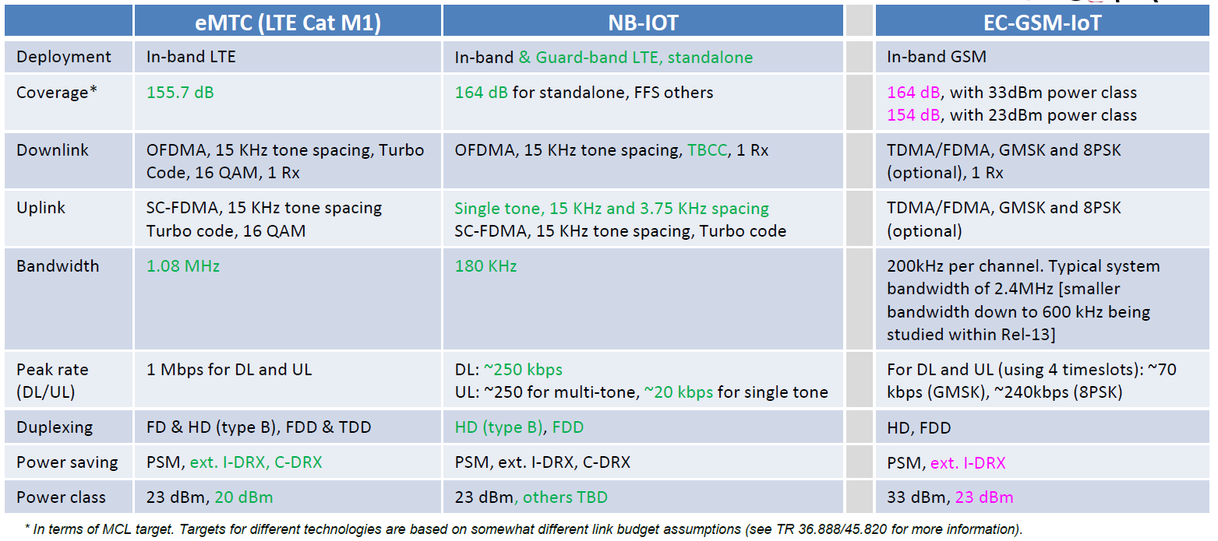
Comparison among eMTC, NB-IoT and EC-GSM-IoT
Source: 3GPP
Notes:
eMTC, NB-IoT 和 EC-GSM-IoT三者之間的比較

Slide 73

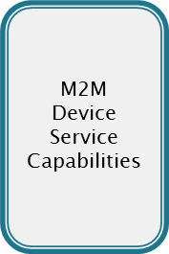

LPWAN Impact to M2M Core
Client Applications
LPWAN
M2M
Network
Service
Capabilities
M2M Applications
M2M Devices
M2M Network Domain
M2M Application Domain
LPWAN enables IoT devices to connect to backend systems
without a gateway!
Notes:
LPWAN 對於M2M Core的影響
LPWAN不靠閘道器使IoT設備能夠連接到後端系統

Slide 74
Summary
M2M impact to Core Network in
Cost Reduction Requirement
Value-Added Services Requirement
Numbering, Identifiers, and Addressing Requirement
To best serve M2M, Core Network also requires some new optimization for overload and congestion control.
LPWAN is emerging as an alternative to the M2M Core.
Notes:
總結
‧M2M對核心網路的影響：
–成本降低需求
–增值服務需求
–編號、識別與定址需求
‧為了提供M2M最好的服務，核心網路針對過載和擁塞控制也要求一些新的最佳化
‧

