Slide 1
Lab 3: OM2M/REST API & Node-RED
行動寬頻尖端技術跨校教學聯盟
物聯網核心技術及應用專題 Key Technologies of IOT and their Applications
國立交通大學資訊工程系
Department of Computer Science
National Chiao Tung University
November 8th, 2016

Slide 2
Outline
High Level Architecture.
RESTful Operations on the Resource Tree using PostMan.
Creating Application, Descriptor Container, Data Container, Descriptor ContentInstance, Data ContentInstance. (Checkpoint 1)
Creating and Testing a Subscription. (Checkpoint 2)
RESTful Operations on the Resource Tree using Node-RED.
Creating a Middle Node-Application Entity with Node-RED Part I. (Checkpoint 3)
Creating a Middle Node-Application Entity with Node-RED Part II. (Checkpoint 4)
Extending the Middle Node-Application Entity with HTTP Server Capabilities. (Checkpoint 5)
Creating a subscription resource to a container in Middle Node-Application Entity using Node-RED. (Checkpoint 6)

Slide 3

High Level Architecture
MN-AE
(Middle Node-Application Entity)
MN-CSE
(Middle Node- Common Services Entity)
IN-CSE
(Infrastructure Node-Common Services Entity)
IN-AE
(Infrastructure Node-Application Entity)

Slide 4
RESTful Operations on the Resource Tree using PostMan
Start the OM2M IN-CSE
IN-CSE product directory :
org.eclipse.om2m/org.eclipse.om2m.site.mn-cse/target/products/mn-cse/linux/gtk/x86_64
Open a terminal, go to the product directory and input the command:
$ sh start.sh
After starting it successfully, you will see “CSE Started”
Start the OM2M MN-CSE
MN-CSE product directory :
org.eclipse.om2m/org.eclipse.om2m.site.mn-cse/target/products/mn-cse/linux/gtk/x86_64
Open another terminal, go to the product directory and input the command:
$ sh start.sh
After starting it successfully, you will see “CSE Started”

Slide 5
RESTful Operations on the Resource Tree using PostMan
Retrieve a resource:
HTTP Response:
URL | http://127.0.0.1:8282/~/mn-cse
Method | GET
Header | X-M2M-Origin : admin:admin
Body | (empty)
Field | Value
Status | 200 OK
Body | <?xml version="1.0" encoding="UTF-8"?> <m2m:cb xmlns:m2m="http://www.onem2m.org/xml/protocols" rn="mn-name"> <ty>5</ty> <ri>/mn-cse</ri> <ct>20160628T124737</ct> <lt>20160628T124737</lt> <acpi>/mn-cse/acp-832322075</acpi> <cst>1</cst> <csi>mn-cse</csi> <srt>1 2 3 4 5 9 14 15 16 17 23</srt> <poa>http://127.0.0.1:8282/</poa> </m2m:cb>

Slide 6
RESTful Operations on the Resource Tree using PostMan
Create a "MY_SENSOR" Application (1/2)
Send an HTTP POST request with the following parameters to create a "MY_SENSOR" application (MN-AE) on the gateway.
ty=2 for AE
X-M2M-NM: the name of the resource
URL | http://127.0.0.1:8282/~/mn-cse
Method | POST
Header | X-M2M-Origin: admin:admin Content-Type: application/xml;ty=2 X-M2M-NM: MY_SENSOR
Body | <om2m:ae xmlns:om2m="http://www.onem2m.org/xml/protocols"> <api>app-sensor</api> <lbl>Type/sensor Category/temperature Location/home</lbl> <rr>false</rr> </om2m:ae>

Slide 7
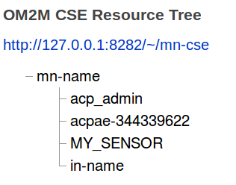
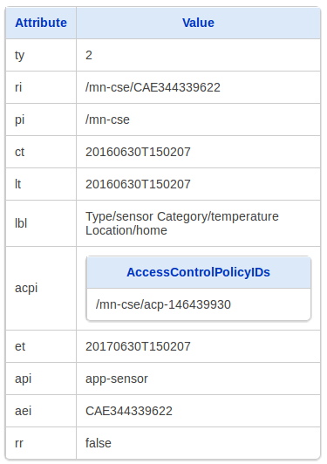
RESTful Operations on the Resource Tree using PostMan
Create a "MY_SENSOR" Application(2/2)
You will get Status 201 Created in Postman
Check the created application on the OM2M Resource Tree Tool.

Slide 8
RESTful Operations on the Resource Tree using PostMan
Create a DESCRIPTOR Container(1/2)
Send an HTTP POST request with the following parameters to create a "DESCRIPTOR" container resource under the "MY_SENSOR" application.
URL | http://127.0.0.1:8282/~/mn-cse/mn-name/MY_SENSOR
Method | POST
Header | X-M2M-Origin: admin:admin Content-Type: application/xml;ty=3 X-M2M-NM: DESCRIPTOR
Body | <om2m:cnt xmlns:om2m="http://www.onem2m.org/xml/protocols"> </om2m:cnt>

Slide 9
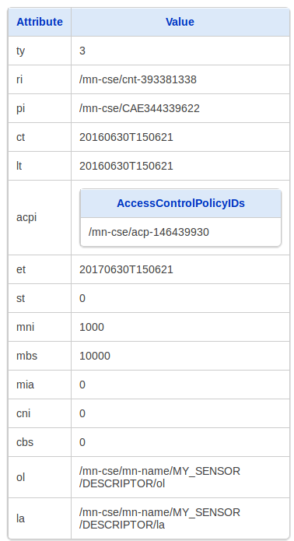
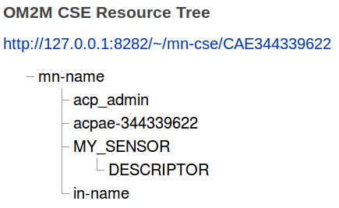
RESTful Operations on the Resource Tree using PostMan
Create a DESCRIPTOR Container (2/2)
Check the created container on the OM2M Resource Tree Tool.

Slide 10
RESTful Operations on the Resource Tree using PostMan
Create a DESCRIPTOR ContentInstance (1/2)
Send an HTTP POST request with the following parameters to create a descriptor content instance resource under the "DESCRIPTOR" container.
URL | http://127.0.0.1:8282/~/mn-cse/mn-name/MY_SENSOR/DESCRIPTOR
Method | POST
Header | X-M2M-Origin: admin:admin Content-Type: application/xml;ty=4
Body | <om2m:cin xmlns:om2m="http://www.onem2m.org/xml/protocols"> <cnf>message</cnf> <con> &lt;obj&gt; &lt;str name=&quot;type&quot; val=&quot;Temperature_Sensor&quot;/&gt; &lt;str name=&quot;location&quot; val=&quot;Home&quot;/&gt; &lt;str name=&quot;appId&quot; val=&quot;MY_SENSOR&quot;/&gt; &lt;op name=&quot;getValue&quot; href=&quot;/mn-cse/mn-name/MY_SENSOR/DATA/la&quot; in=&quot;obix:Nil&quot; out=&quot;obix:Nil&quot; is=&quot;retrieve&quot;/&gt; &lt;/obj&gt; </con> </om2m:cin>
Notes:
https://wiki.eclipse.org/OM2M/one/REST_API

Slide 11
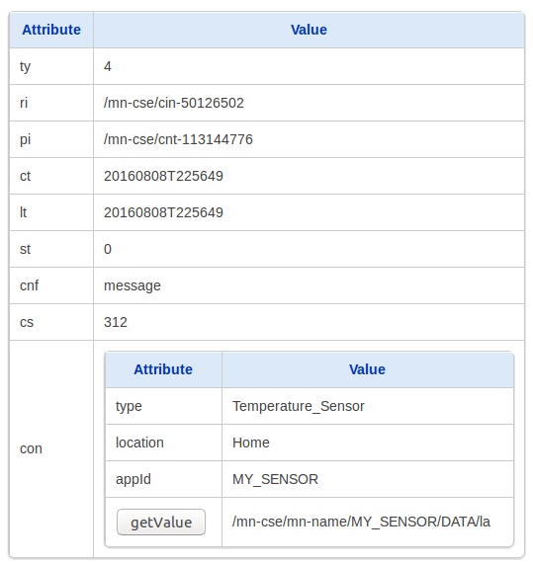
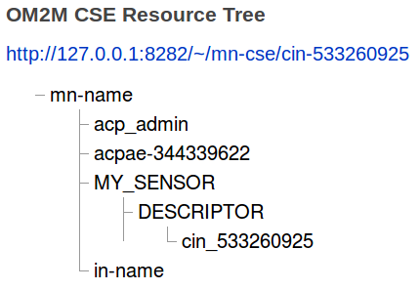
RESTful Operations on the Resource Tree using PostMan
Create a DESCRIPTOR ContentInstance (2/2)
Check the created content instance on the OM2M Resource Tree Tool.

Slide 12
RESTful Operations on the Resource Tree using PostMan
Create a DATA Container (1/2)
Send an HTTP POST request with the following parameters to create a "DATA" container resource under the "MY_SENSOR" application.
URL | http://127.0.0.1:8282/~/mn-cse/mn-name/MY_SENSOR
Method | POST
Header | X-M2M-Origin: admin:admin Content-Type: application/xml;ty=3 X-M2M-NM: DATA
Body | <om2m:cnt xmlns:om2m="http://www.onem2m.org/xml/protocols"> </om2m:cnt>

Slide 13
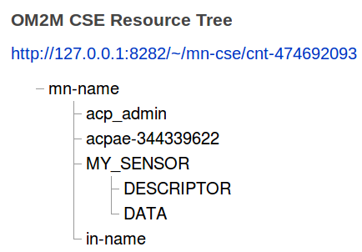
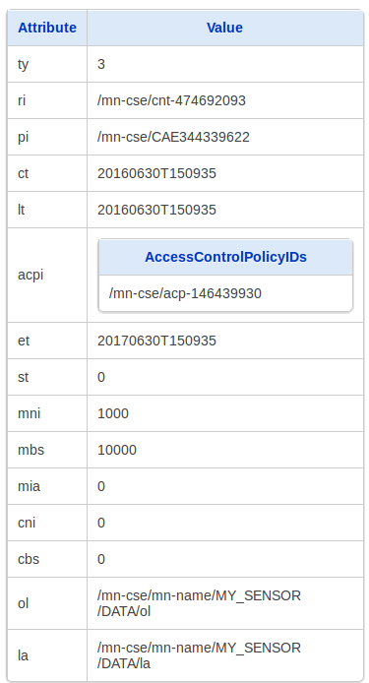
RESTful Operations on the Resource Tree using PostMan
Create a DATA Container (2/2)
Check the created container on the OM2M Resource Tree Tool.

Slide 14
RESTful Operations on the Resource Tree using PostMan
Create a DATA ContentInstance (1/2)
Send an HTTP POST request with the following parameters to create a data “ContentInstance” resource under the "DATA" container.
URL | http://127.0.0.1:8282/~/mn-cse/mn-name/MY_SENSOR/DATA
Method | POST
Header | X-M2M-Origin: admin:admin Content-Type: application/xml;ty=4
Body | <om2m:cin xmlns:om2m="http://www.onem2m.org/xml/protocols"> <cnf>message</cnf> <con> &lt;obj&gt; &lt;str name=&quot;appId&quot; val=&quot;MY_SENSOR&quot;/&gt; &lt;str name=&quot;category&quot; val=&quot;temperature &quot;/&gt; &lt;int name=&quot;data&quot; val=&quot;27&quot;/&gt; &lt;int name=&quot;unit&quot; val=&quot;celsius&quot;/&gt; &lt;/obj&gt; </con> </om2m:cin>

Slide 15
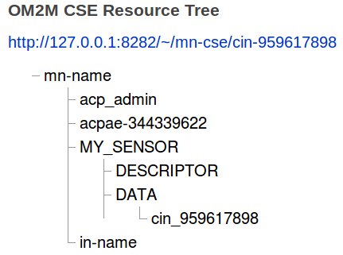
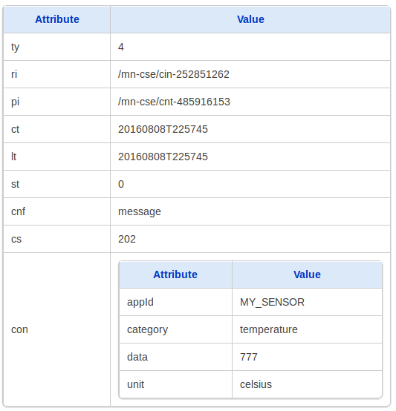
RESTful Operations on the Resource Tree using PostMan
Create a DATA ContentInstance (2/2)
Check the created ContentInstance on the OM2M Resource Tree Tool.

Slide 16
CHECKPOINT 1!

Slide 17
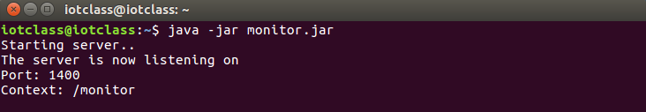
RESTful Operations on the Resource Tree using PostMan
Subscribe to MY_SENSOR Data(1/5)
Open a terminal window.
Move to monitor folder : /home/iotclass
Start the Monitor server using the following command:
java –jar monitor.jar
Monitor is a Web Application that listens for HTTP Post requests at port=1400 and context=/monitor.

Slide 18
RESTful Operations on the Resource Tree using PostMan
Subscribe to MY_SENSOR Data (2/5)
Send an HTTP POST request with the following parameters to create a “SUBSCRIPTION" resource for receiving asynchronous notifications from "MY_SENSOR" application when “MY_SENSOR” gets new data.
The monitor server listening URL (http://127.0.0.1:1400/monitor) should be added on the “nu" tag of the subscription representation.
URL | http://127.0.0.1:8282/~/mn-cse/mn-name/MY_SENSOR/DATA
Method | POST
Header | X-M2M-Origin: admin:admin Content-Type: application/xml;ty=23 X-M2M-NM: SUB_MY_SENSOR
Body | <m2m:sub xmlns:m2m="http://www.onem2m.org/xml/protocols"> <nu>http://localhost:1400/monitor</nu> <nct>2</nct> </m2m:sub>

Slide 19
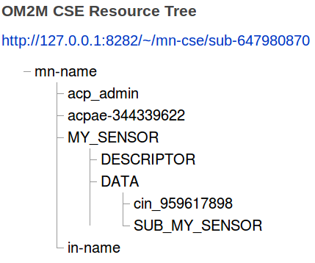
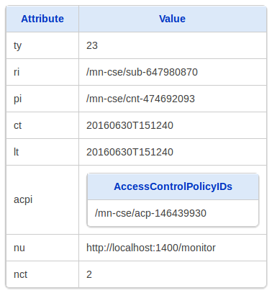
RESTful Operations on the Resource Tree using PostMan
Subscribe to MY_SENSOR Data (3/5)
Check the created subscription on the OM2M Resource Tree Tool.

Slide 20
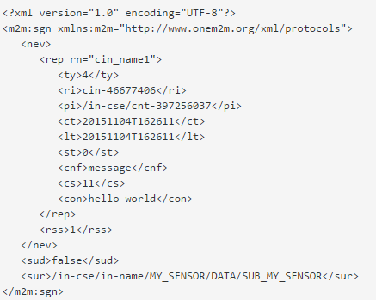
RESTful Operations on the Resource Tree using PostMan
Subscribe to MY_SENSOR Data (4/5)
Insert data on “MY_SENSOR” application (See slide 14). Inserting new data in the ContentInstance of DATA container will trigger a notification event.
The new event is published to subscribers by the Gateway via HTTP POST Notification (an example of an XML Object returned to subscribers is shown below).

Slide 21
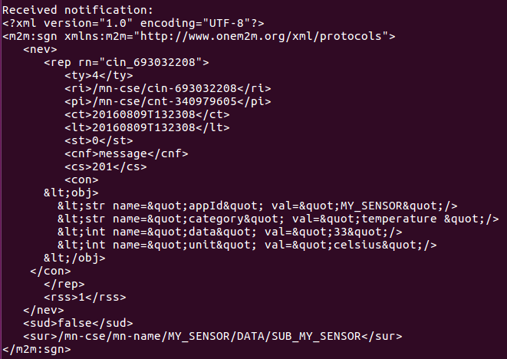
RESTful Operations on the Resource Tree using PostMan
Subscribe to MY_SENSOR Data (5/5)
The Monitor receives a "Notify" resource including the new "ContentInstance".
Remember that the "Notify" resource has a generic structure to support notifications for other type of resources such as “AE", "Container", "Group", AccessControlPolicy, etc.

Slide 22
CHECKPOINT 2!

Slide 23
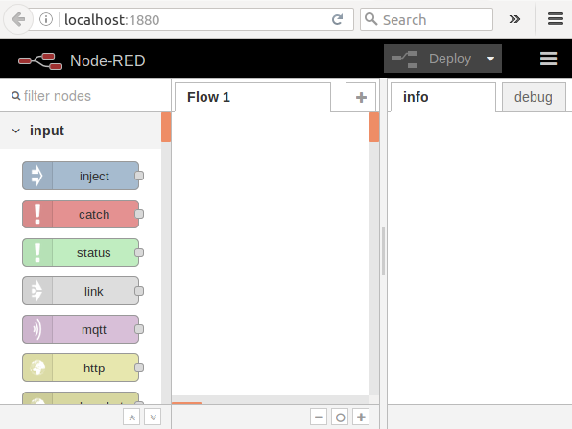
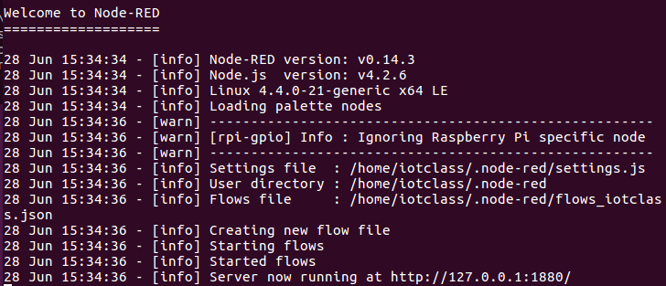
Creating a MN-AE with Node-RED Part I
Start the Node-RED
Open a new terminal and input the command:
$ sudo node-red -vv
Open http://localhost:1880

Slide 24
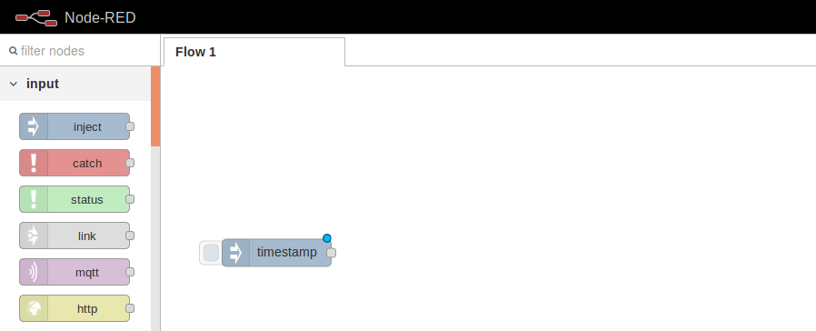
Creating a MN-AE with Node-RED Part I
From the “input” library, drag and drop an “Inject” object into the designer area.

Slide 25
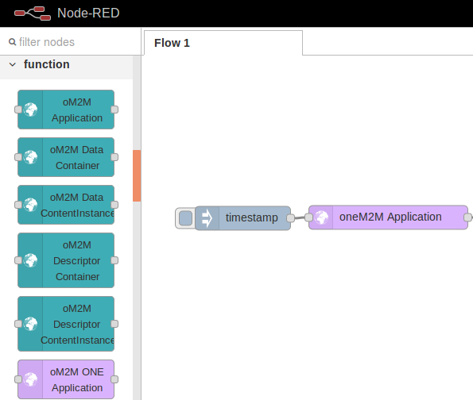
Creating a MN-AE with Node-RED Part I
From the “function” library, drag and drop an “oM2M ONE Application” object into the designer area.

Slide 26
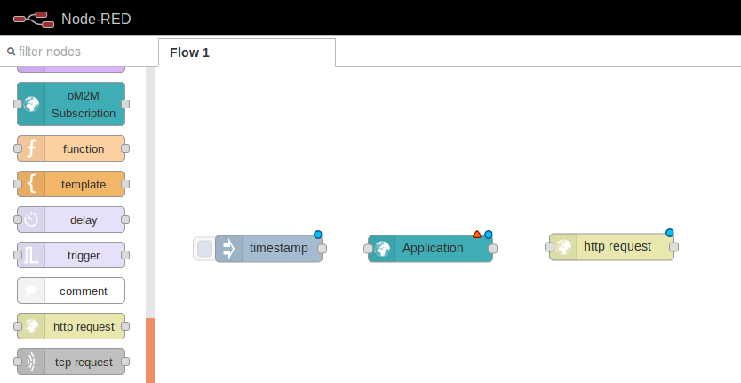

Creating a MN-AE with Node-RED Part I
From the same “function” library, drag and drop an “http request” object into the designer area.

Slide 27
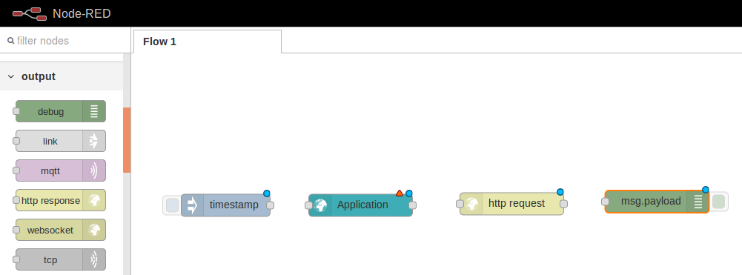
Creating a MN-AE with Node-RED Part I
From the “output” library, drag and drop a “debug” object into the designer area.

Slide 28
Creating a MN-AE with Node-RED Part I
Connect the vertices of each object (node) using a drag and drop movement.
Connect all vertices as shown in the picture below.

Slide 29
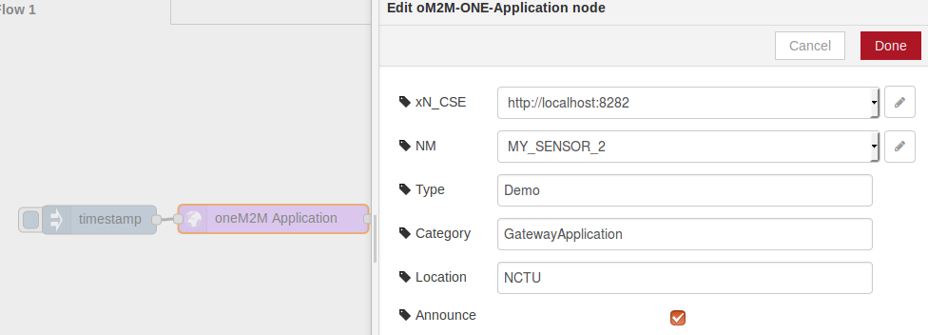
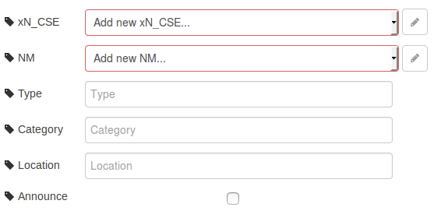
Creating a MN-AE with Node-RED Part I
Double click on the “oneM2M Application” object. A new window is shown. Click on the pen icon (edit xN_CSE attribute contents).

Slide 30
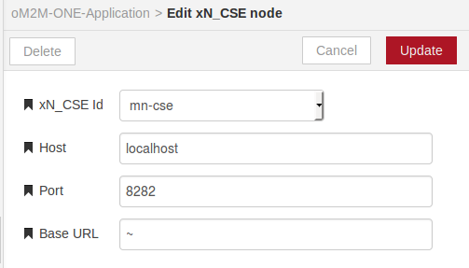

Creating a MN-AE with Node-RED Part I
Complete the form “Add new xN_CSE node” according to the information shown in the picture below.

Slide 31
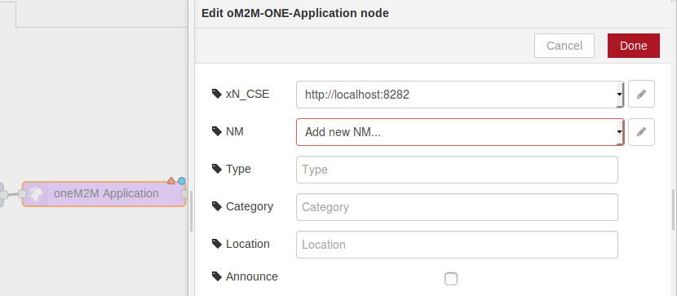
Creating a MN-AE with Node-RED Part I
Choose “http://localhost:8282” from the xN_CSE list (You just created this item in step 7).
Click on the pen icon for editing “NM”.

Slide 32
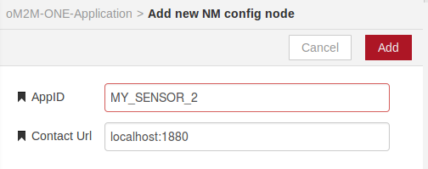
Creating a MN-AE with Node-RED Part I
Complete the form “Add new NM config node” with the information shown in the picture below. Click Add.

Slide 33
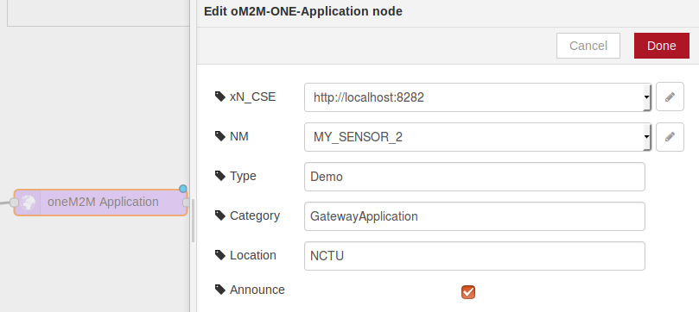
Creating a MN-AE with Node-RED Part I
Choose “MY_SENSOR_2” from the NM list (You just created this item in step 10).
Complete the form “Edit oM2M-ONE-Application node” with the information shown in the picture below.

Slide 34
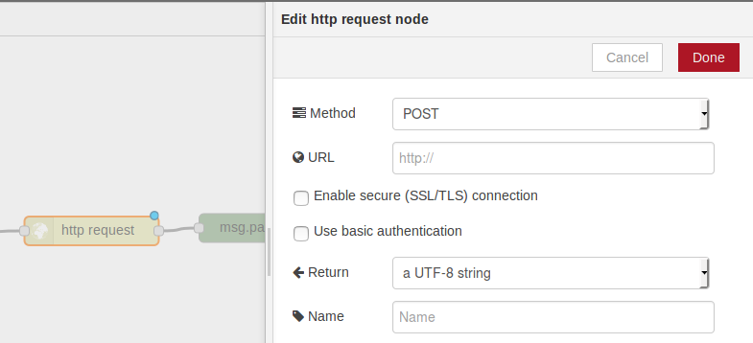
Creating a MN-AE with Node-RED Part I
Double click on the “http request” object. A new window is shown.
Choose “POST” from the Method list.

Slide 35
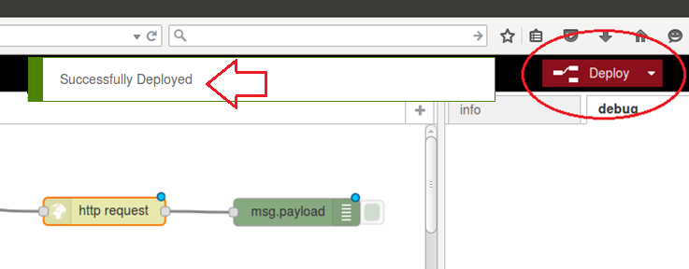
Creating a MN-AE with Node-RED Part I
15. Click on “Deploy” to compile and build you application.

Slide 36

Creating a MN-AE with Node-RED Part I
16. Click on the button shown below in order to execute our application.
Click Here!

Slide 37
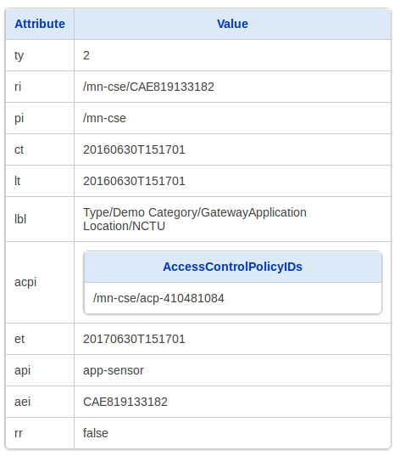
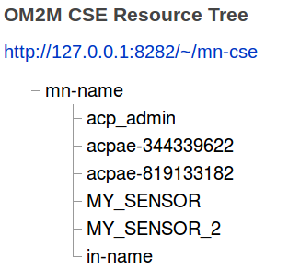
Creating a MN-AE with Node-RED Part I
Open OM2M Resource Tree Navigation Tool for MN-CSE and find our newly created application.

Slide 38
CHECKPOINT 3!

Slide 39
Creating a MN-AE with Node-RED Part II
[TASKS]
Use Node-RED oM2M components to create:
(Hint: Repeat the steps of the previous exercise to complete these tasks.)
Descriptor Container
Descriptor Content Instance

Slide 40
Creating a MN-AE with Node-RED Part II
[TASKS]
Use Node-RED oM2M components to create:
Data Container
Data Content Instance (See details for “My Data" on next page).

Slide 41
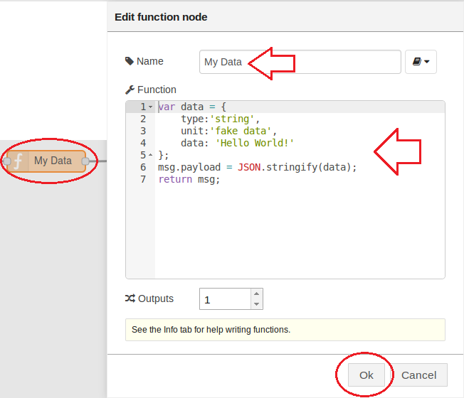
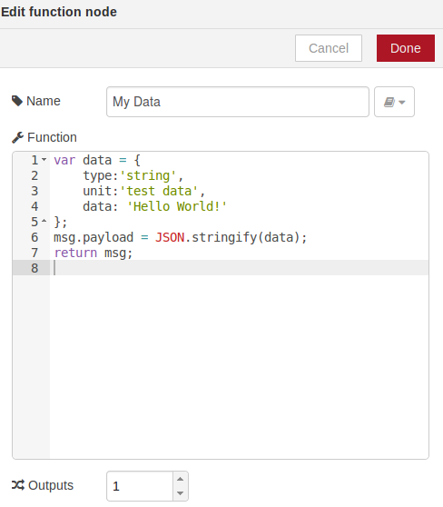
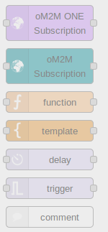
Creating a MN-AE with Node-RED Part II
Details for “My Data” object:
Use a “function” object. Double click on it and fill out the form according to the picture.
CODE (Copy and Paste)
return msg; var data = {
type:'string',
unit:'test data',
data: 'Hello World!'
};
msg.payload = JSON.stringify(data);

Slide 42
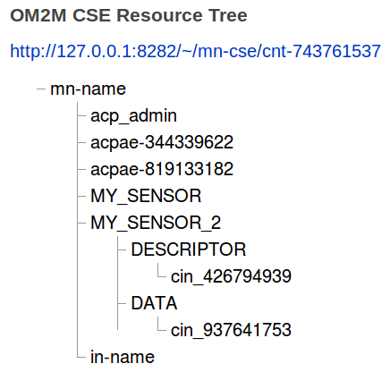
Creating a MN-AE with Node-RED Part II
Use the OM2M Resource Tree Tool, verify that your data has been successfully saved into the MN-CSE.

Slide 43
CHECKPOINT 4!

Slide 44
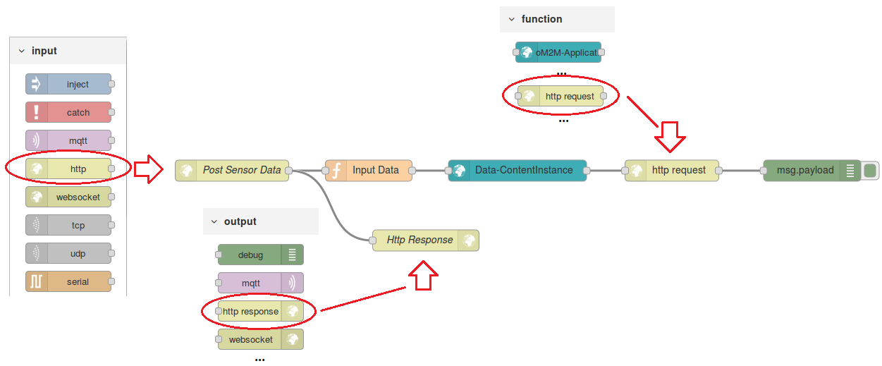

Extending the MN-AE with HTTP Server Capabilities
Draw the components according to the picture.
“http” object from “input” box → Creates an HTTP server listening for one of the following HTTP methods: GET, POST, PUT, or DELETE.
“http response” from “output” box → Returns the response to the client.
“http request” from “function” box → Executes an HTTP request.

Slide 45
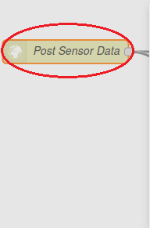
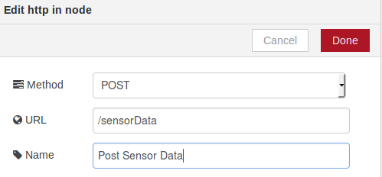
Extending the MN-AE with HTTP Server Capabilities
2. Double Click on the “Post Sensor Data” object and fill out the form according to the picture.
With this configuration, we are creating a server that listens for HTTP POST requests in the following address: http://localhost:1880/sensorData.
Remember that http://localhost:1880 is the address of Node-RED. All other web services that we create are opened under the Node-RED address.

Slide 46
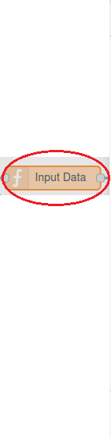
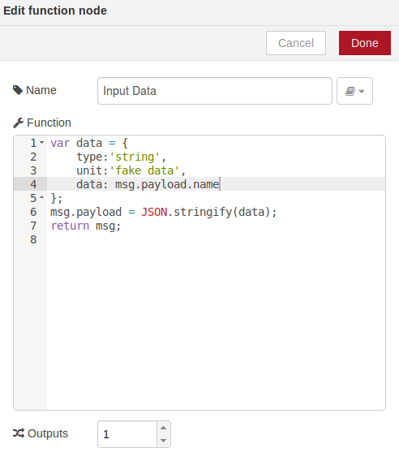
Extending the MN-AE with HTTP Server Capabilities
3. Double Click on the “Input Data” object and fill out the form according to the picture.
We first arrange a Json object with the appropriate format for sending it to our platform. And then,
We read the value of the variable “name”. This server expects a variable called “name” in the POST request.
CODE (Copy and Paste)
var data = {
type:'string',
unit:'fake data',
data: msg.payload.name
};
msg.payload = JSON.stringify(data);
return msg;

Slide 47
Extending the MN-AE with HTTP Server Capabilities
4. The remaining components should be configured in a similar way to the previous exercise.
[TASKS]
In order to test our server, please send an HTTP POST (using Postman) to http://localhost:1880/sensorData. You must include a JSON object similar to this example: {“name”: “TYPE YOUR NAME HERE”} in the body of the request. In Postman, set the data type to “application/json”, no need to add Authentication Information.
Use the OM2M Resource Tree Tool, verify that your data has been successfully saved into the MN-CSE.
Notes:
Postman 的json body要注意 “”符號有沒有error

Slide 48
CHECKPOINT 5!

Slide 49

Creating a subscription resource to a container in MN-AE using Node-RED
Add a new flow to your workspace.
From the general menu, located in the right up corner of the workspace, choose “+” .

Slide 50
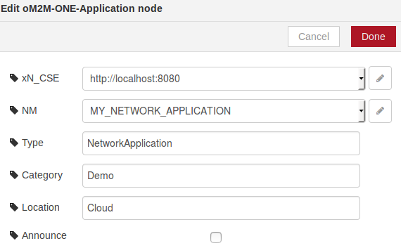
Creating a subscription resource to a container in MN-AE using Node-RED
2. Create a IN-AE in the IN-CSE.
Use the “oM2M ONE Application” object to create a new application.
xN_CSE: xN_CSE Id= in-cse, Host = localhost, port = 8080,
NM: AppID = MY_NETWORK_APPLICATION,
Type = NetworkApplication, Category = demo, Location = Cloud.

Slide 51
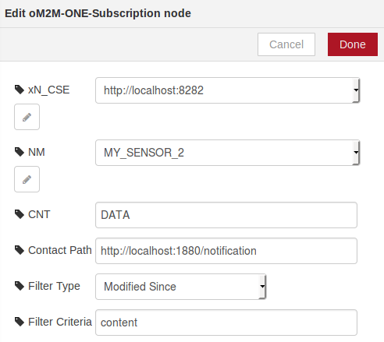
Creating a subscription resource to a container in MN-AE using Node-RED
3. Create a subscription from the IN-AE into the MN-AE for receiving notification when new data is saved into MN-AE.
Use an “oM2M ONE Subscription” object to create a new subscription.
Complete the form according to the picture below.

Slide 52
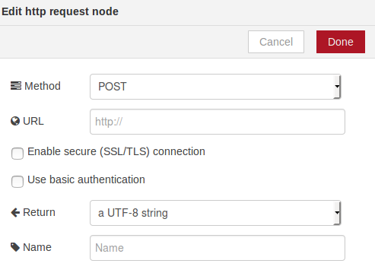
Creating a subscription resource to a container in MN-AE using Node-RED
4. Complete the “http request” object according to the picture.

Slide 53
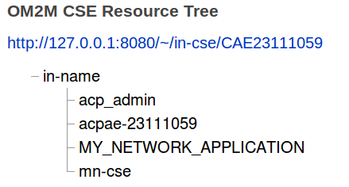
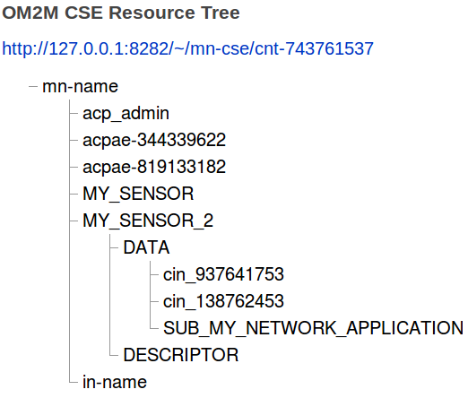
Creating a subscription resource to a container in MN-AE using Node-RED
5. Verify that the subscription to MY_SENSOR application has been created successfully into the MN-CSE resource tree.

Slide 54
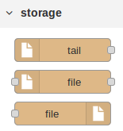


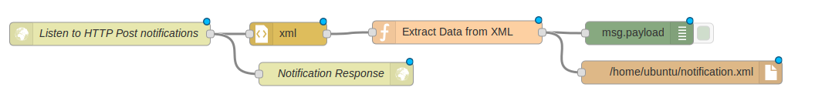




Creating a subscription resource to a container in MN-AE using Node-RED
6. Create a web service listening for notifications.
Draw the components according to the picture.

Slide 55
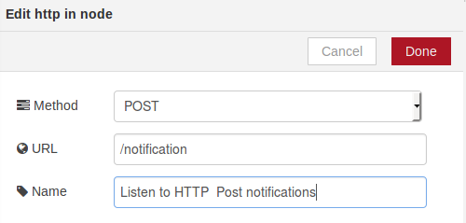
Creating a subscription resource to a container in MN-AE using Node-RED
7. Double click on the “Listen to HTTP Post notifications” object and complete its form according to the picture.

Slide 56
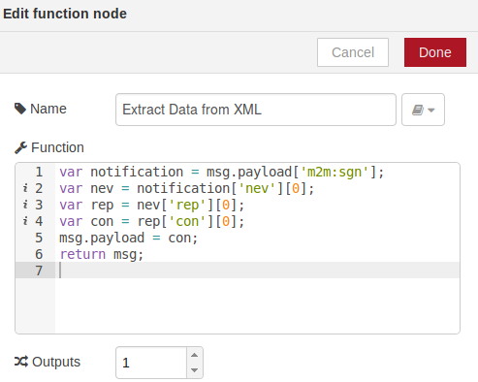
Creating a subscription resource to a container in MN-AE using Node-RED
8. Double click on the “Extract Data from XML” object and complete its form according to the picture.
CODE (Copy and Paste)
var notification = msg.payload['m2m:sgn'];
var nev = notification['nev'][0];
var rep = nev['rep'][0];
var con = rep['con'][0];
msg.payload = con;
return msg;

Slide 57
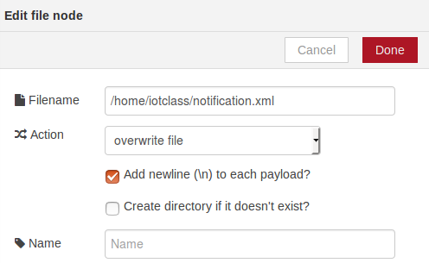

Creating a subscription resource to a container in MN-AE using Node-RED
9. Double click on the “/home/iotclass/notification.xml” object and complete its form according to the picture.
10. Change the name of http response to “Notification Response”
11. The remaining objects don’t need extra configuration.

Slide 58
Creating a subscription resource to a container in MN-AE using Node-RED
At this moment we have created a web service which is listening to HTTP POST requests in the following address: http://localhost:1880/notification.
Every time a new ContentInstance is created into the DATA container of “MY_SENSOR_2” MN-AE (new data is inserted), a notification message will be sent automatically to the address listed above.
Remember:
In order to insert new data to “MY_SENSOR_2” MN-AE make an HTTP POST (using Postman) to the address http://localhost:1880/sensorData including a JSON object similar to {“name”: “TYPE YOUR NAME HERE”}, no Authentication Information is needed. (You already did this on slide 47).

Slide 59

Creating a subscription resource to a container in MN-AE using Node-RED
[TASKS]
Extend your Network Application, creating an HTTP GET web service in order to retrieve the content of the XML file which is the result of the previous exercise.
Hints:
Use the following components of Node-RED
Your output should be similar to the picture in the below.
Notes:
Read XML File via HTTP GET: GET, /notification

Slide 60
CHECKPOINT 6!

Slide 61

Creating a IN-AE with subscription to a MN-AE using Node-RED
4. Finding the URL of the MN-AE Data Container via NSCL.
Since our GA and its Data Container are announced into the NSCL, we can easily find their URLs using the OM2M Resource Tree Tool.
We are interested in the “link” attribute: gscl/applications/MY_SENSOR/containers/DATA.
In this way, the final subscription address that we are interested in is:
GSCL Context + Container Address + contentInstances/subscriptions
http://localhost:8181/om2m/gscl/applications/MY_SENSOR/containers/DATA/contentInstances/subscriptions

