Slide 1
Artificial Intelligence: An Overview (1)
Jiun-Wei Liou
Ming-Chi University of Technology

Slide 2
Full course overview (1)
Topics and timeline
Topic | Course Date | Discussion Date | Lecturer
AI Overview | 10/13, 10/15 | 10/19 | Jiun-Wei Liou
Machine Learning Essential | 10/20, 10/22, 11/03 | 10/27, 11/05 | Ching-Shih Tsou
AI in Smart Grid | 11/10, 11/12 | 11/17 | Yu-Hsiu Lin
Face and Image Recognition and Application | 11/19, 11/24, 11/26, 12/01, 12/08 | 12/03 | Chuang-Jan Chang & Meng-Jey Youh
Group Presentation | None | 12/10 | All

Slide 3
Full course overview (2)
Relation of introduction and later courses
Data Science
Machine Learning Essential
Machine Learning
AI in smart grid
Artificial Intelligence
ANN
Image and Face Recognition and Application
Deep Learning
CNN
RNN

Slide 4
Outline
Artificial Intelligence: Concept
Artificial Intelligence: History
Artificial Intelligence: Categorization
Artificial Intelligence: Applications

Slide 5
What is Artificial Intelligence
Definition from problem solving steps
Ask a good question
Convert question to functional form
Collect historical dataset(s)
Build a learning machine for function approximation.
Train the learning machine by using historical dataset(s) and find results.

Slide 6
Ask a Good Question
What is a good question for AI?
What will be the weather at school tomorrow?
What will be the lowest temperature at school tomorrow?
Better question is proportion to ability of implementation.

Slide 7
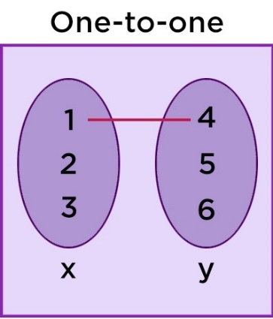
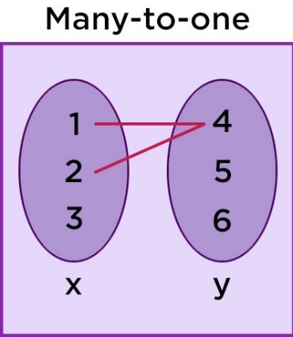
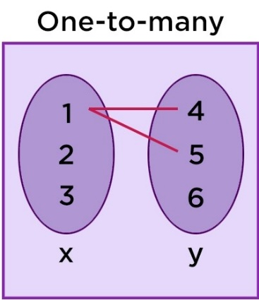
Convert Question to Functional Form
Why functional form?
Conversion of question in previous slide:
Function
Function
Not function
Input
Output
Date
Function
Lowest temperature at school

Slide 8
Collect Historical Dataset
Historical lowest temperature information:
Data usage
Avoid using all data for training.
Data splits: training data, validation data (optional), and testing data.
Training data: For training purpose.
Validation data: For model validation.
Testing data: For performance estimation
Example split of dataset for learning: train: valid: test = 7: 2: 1.
Date | Temp
20xx-0x-uu | 29.5
20xx-0x-uv | 27.6
20xx-0x-uw | 28.8
… | …
20xx-0x-uz | 29.3

Slide 9
Build Learning Machine
In fact, it is really too hard to predict lowest temperature from date only.
In this stage, we can have lots of methods for building learning machine which will be discussed later.
For different methods, different parameters will be needed for model to predict corresponding output.
In this example, linear regression will be applied.
Input
Output
Date
Linear regression
Lowest temperature at school
Function

Slide 10
Train the Learning Machine
Training Process
Input
Learning Machine
Output
Date
Linear regression
Lowest temperature at school
Estimated temperature
Valid
Linear regression
Training
Error by difference
Validation temperature output
Feedback update
Training temperature output
Validation Performance
Training Performance
Testing
Linear regression
Estimated temperature
Error by difference
Testing Performance
Test temperature output

Slide 11
Other possible definitions
Artificial Intelligence by target:
Ability to utilize language.
Ability to understand abstract concept.
Capability for solving problems only human can solve.
Self-enhancement.
In fact, this is the initial definition in 1956 workshop at Dartmouth College.
Assumption: Every aspect of learning or any other feature of intelligence can in principle be so precisely described that a machine can be made to simulate it.

Slide 12
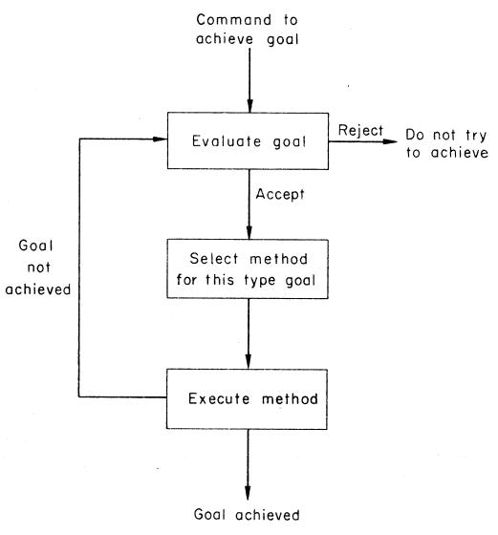
History of Artificial Intelligence
The first rise and fall of AI
McCulloch & Pitts (1943): Neuron model as basis of neural networks.
Turing test (1950): Test for one machine’s ability to exhibit intelligent behavior.
Focus: Knowledge Representation, Reasoning.
Applications: ELIZA (chatbot) and General Problem Solver.
Reason for falling: Face NP(Non-deterministic Polynomial) problems which were considered hard to solve for computer.

Slide 13
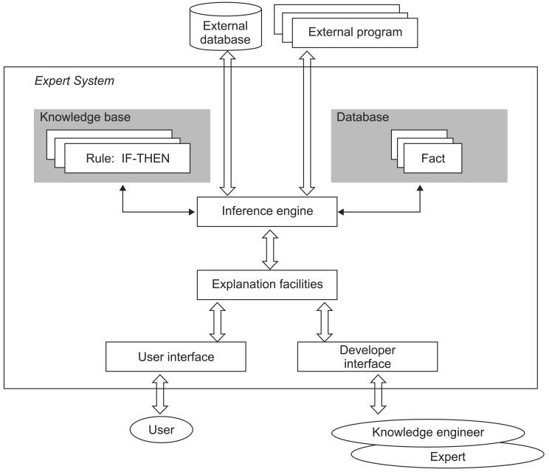
History of Artificial Intelligence
The second rise and fall of AI
Expert System.
Focus: Integrate expert’s domain knowledge into computer by rule-based inference.
Application: MYCIN, EMYCIN and DENTRAL.
Reason for falling: Time consuming building, limited application, cannot really learn concepts, and effect of expertise.

Slide 14
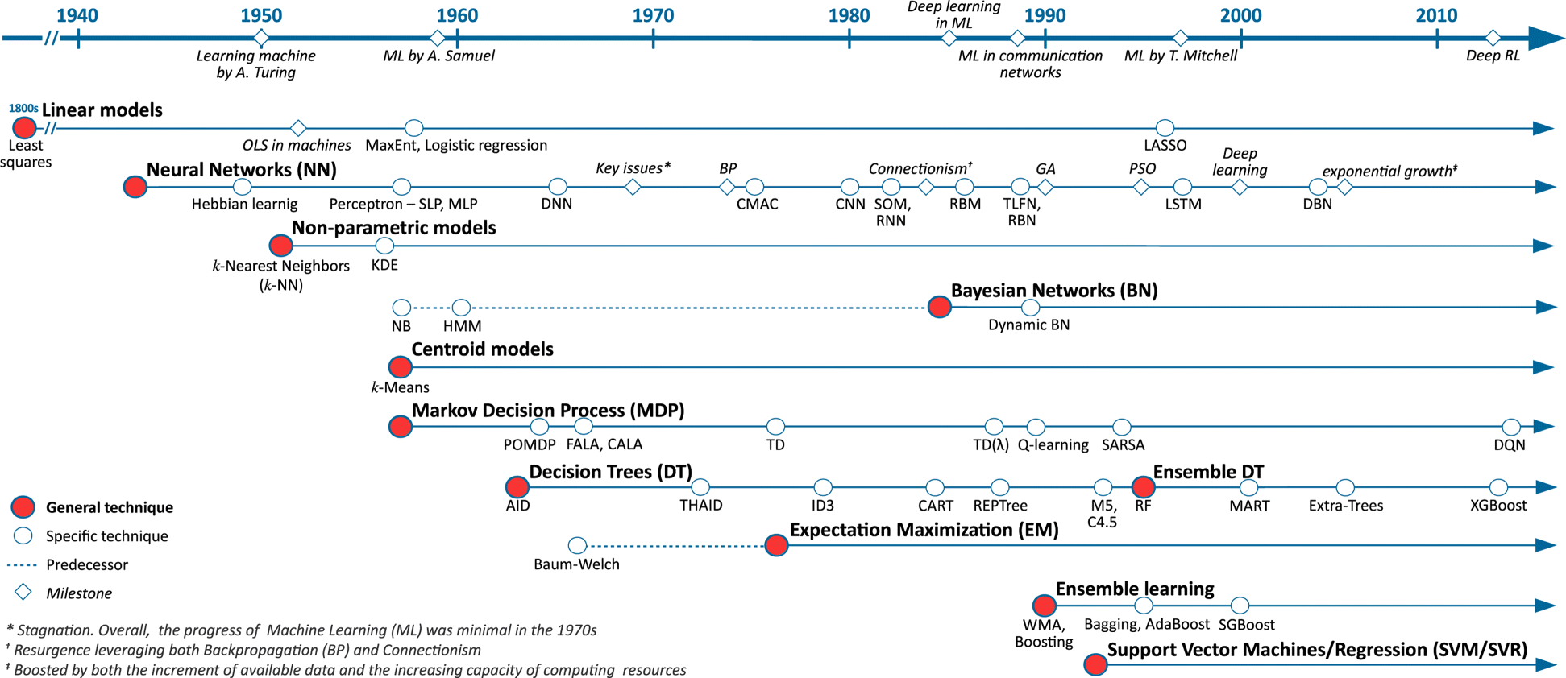
History of Artificial Intelligence
The third rise of AI
Machine Learning methods and Neural Networks.

Slide 15
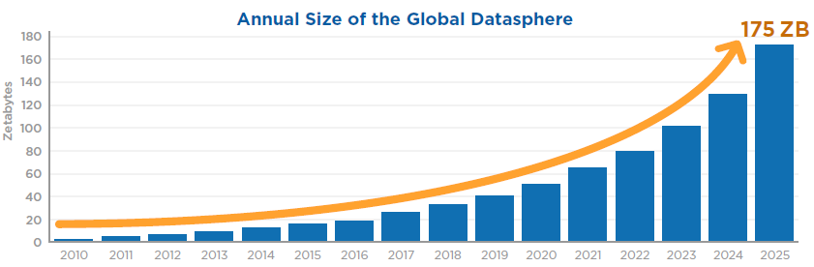
History of Artificial Intelligence
The third rise of AI
2. Availability of Large Volume of Data

Slide 16
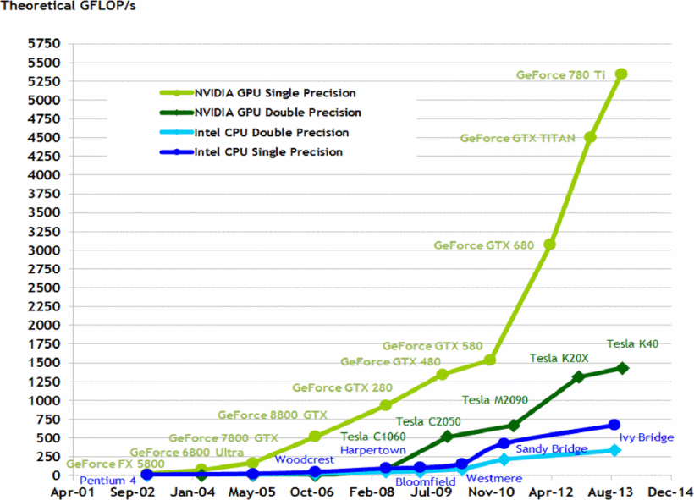
History of Artificial Intelligence
The third rise of AI
3. Computational power of computer finally can manage complex software, large data and learning model or agents.

Slide 17
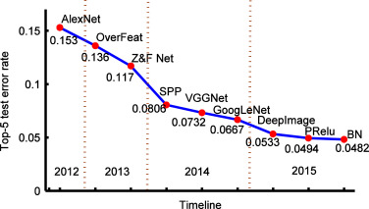
History of Artificial Intelligence
The third rise of AI
4. Focus1: Deep Learning on ImageNet for leap of classification accuracy. (Human level ~ 5% error rate.)
5. Focus2: Winning games over professional human.
6. Applications: Introduced Later.
Year | Event
1997 | IBM Deep Blue win chess over Kasparov (2-3-1)
2013 | Japanese Shogi AI defeat Professional Team (3-1-1)
2016 | AlphaGo win GO over Lee Sedol (4-0-1)

Slide 18
Summary of History
Reason of previous AI failure:
Complex software: hard to implement.
Insufficient computational power available.
Collection difficulty of large volume of data.
What AI still cannot achieved currently:
Propose a “good question.”
Create a “learning machine” from scratch.

Slide 19
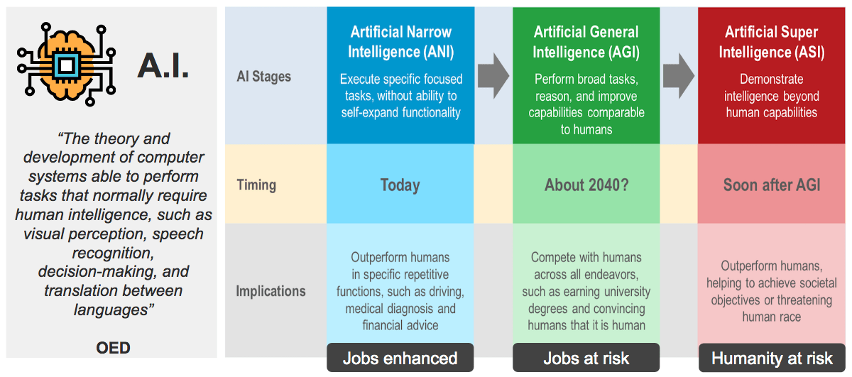
Categorization of AI
Based on capability:
Weak AI => Narrow AI
Strong AI => General AI
Super AI

Slide 20
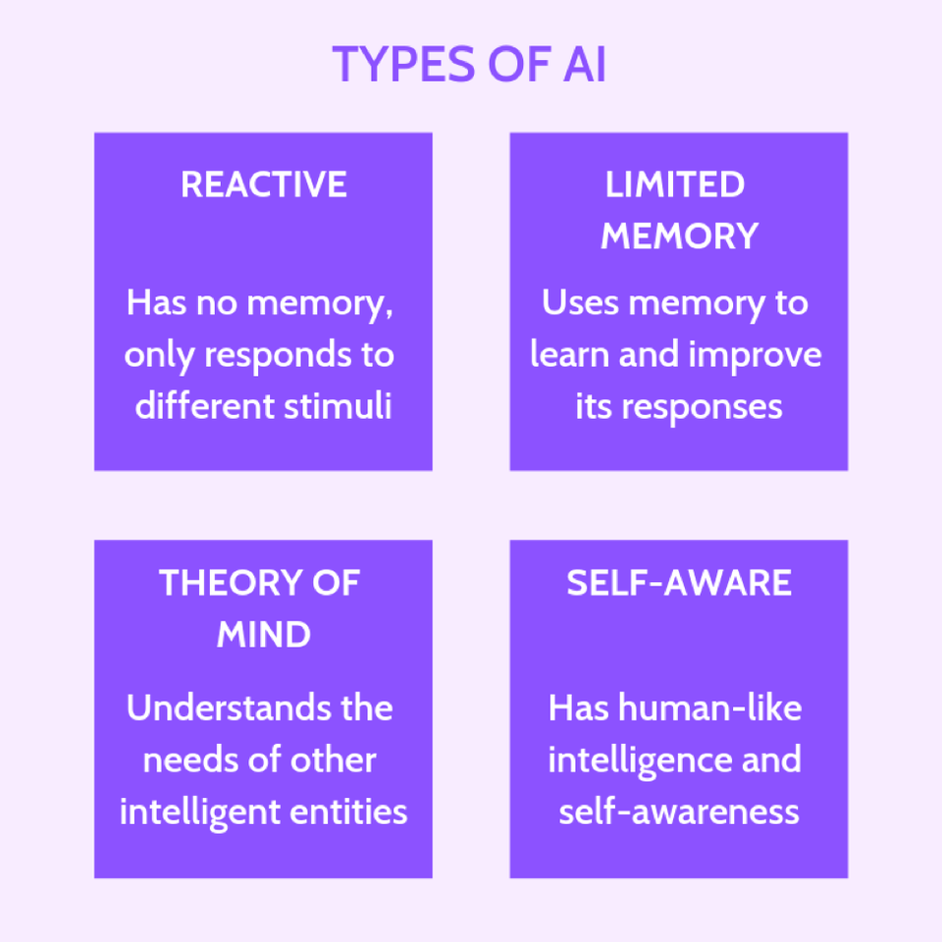
Categorization of AI
Based on Functionality
Reactive Machine
Limited Memory
Theory of Mind
Self-Aware
Implicit relation of definition

Slide 21
Categorization of AI
Based on Machine Learning Styles:
Supervised Learning
Unsupervised Learning
Semi-supervised Learning
Reinforcement Learning

Slide 22
Supervised Learning and Unsupervised Learning
Difference from Classification and Clustering
Clustering | Classification
Unsupervised data | Supervised data
Does not highly value training sets | Does highly value training sets
Works solely with unlabeled data | Involves both unlabeled and labeled data
Aims to identify similarities among data | Aims to verify where a datum belongs to
Specifies required change | Does not specify required improvement
Has a single phase | Has two phases
Determining boundary conditions is not paramount | Identifying the boundary conditions is essential in executing the phases
Does not generally deal with prediction | Deals with prediction
Mainly employs two algorithms | Has a number of probable algorithms to use
Process is less complex | Process is more complex

Slide 23
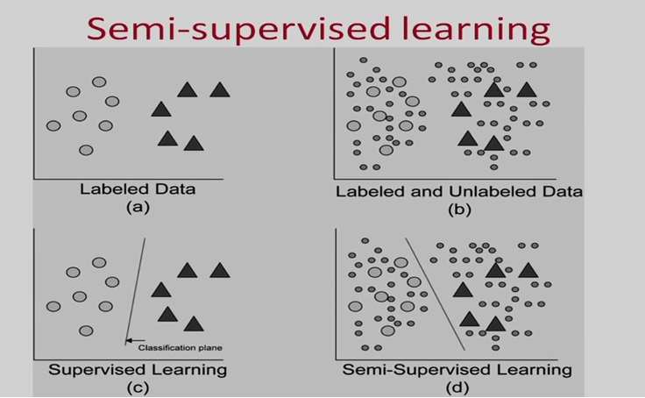
Semi-supervised Learning
Some of data with labels to train others.

Slide 24
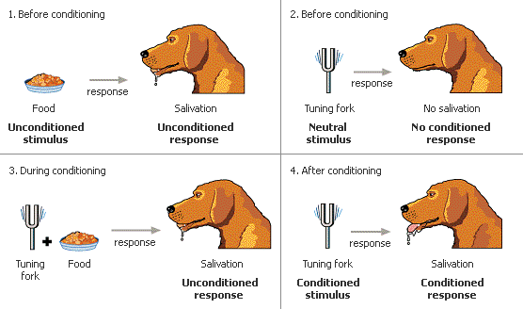
Reinforcement Learning
Behavioristic Psychology: Pavlov’s Dog.
Learning Machine becomes Agents.
Learning from Environment

Slide 25
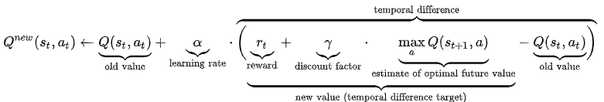
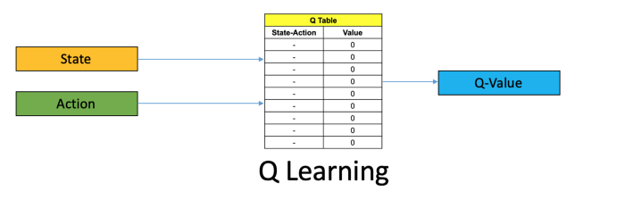
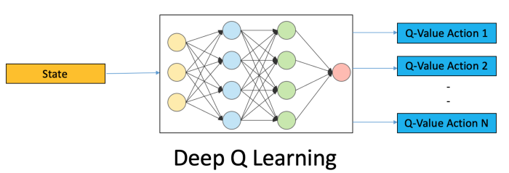
Reinforcement Learning
Q-learning introduction
Reward as function of State and Action.
From lookup table to deep networks.

Slide 26
Reinforcement Learning
Examples
Cart poles
Mountain Car
Mu-Zero (for games)

Slide 27
Categorization of AI
Based on Concepts for Next Lecture
Data Science
Machine Learning
Deep Learning

Slide 28
Application of AI
Image Processing
Language Processing
Logistic Reasoning
Recommendation System
Medical Application, Disease Detection or Health Care

Slide 29
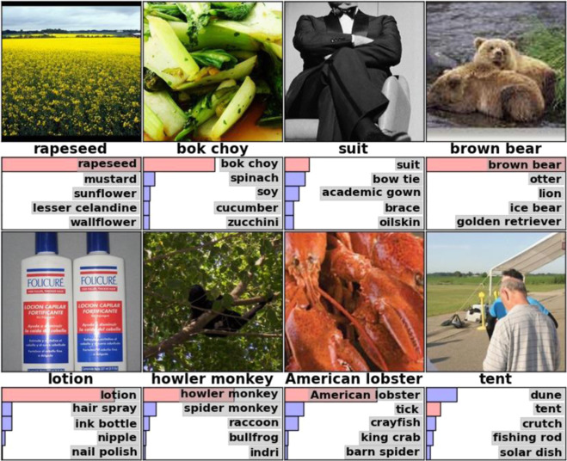
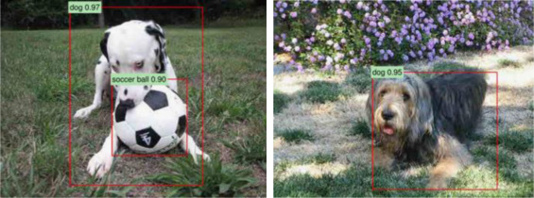
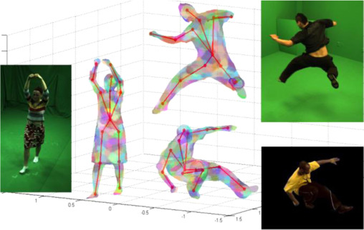
Image Processing
Application of image processing
Image classification
Object recognition
Action recognition

Slide 30
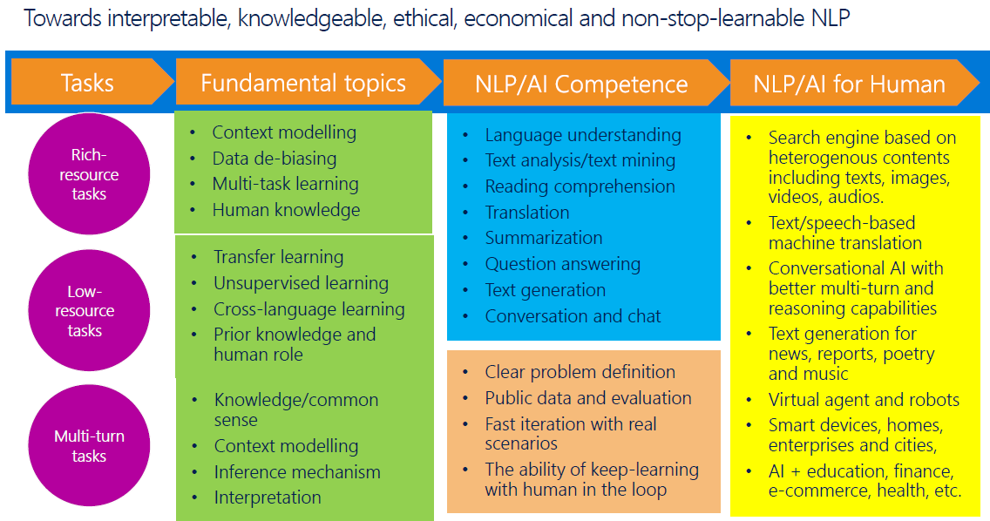
Language Processing

Slide 31
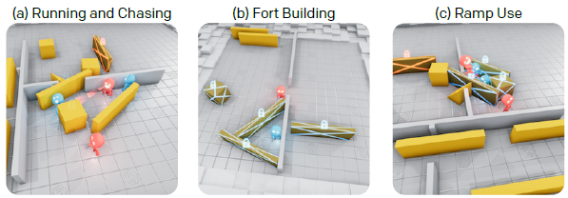
Logistic Reasoning
Game playing
Chess/Shogi/GO
Multi-agent collaboration (hide-and-seek)

Slide 32
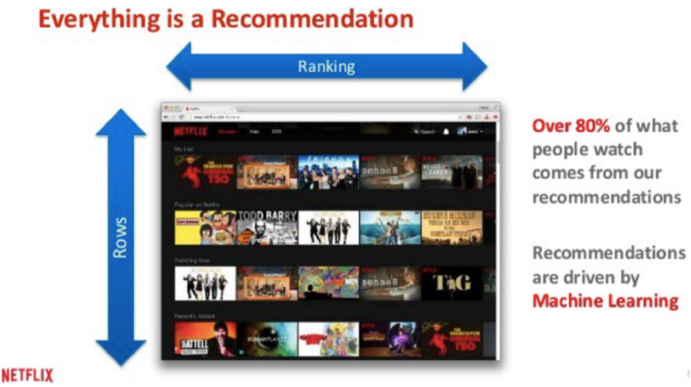
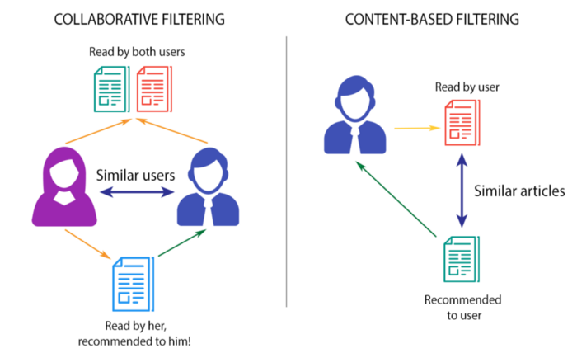
Recommendation System
Recommend products to consumers.

Slide 33
Medical Applications
Diabetes from Retinal Fundus
Other medical image applications on MRI:

