Slide 1
FreeRTOS
Oct. 7. 2024.
Hoseok Lee

Slide 2
Agenda
Introduction
What is RTOS
RTOS vs GPOS
FreeRTOS Heap Memory Management
Heap1
Heap2
Heap3
Heap4
Hap5

Slide 3

Introdunction
FreeRTOS is a real-time operating system (RTOS) designed for embedded systems. It is widely used in microcontroller-based devices and applications requiring reliable, deterministic performance with low memory and power consumption. Developed as an open-source project, FreeRTOS is lightweight and provides a scalable, easy-to-use API for managing tasks, timing, synchronization, and inter-task communication.
Key features of FreeRTOS
Task Management
Deterministic Execution
Low Memory Footprint:
Inter-task Communication
Portability
FreeRTOS is commonly used in applications like IoT, automotive systems, medical devices, and industrial automation due to its reliability, portability, and real-time capabilities.

Slide 4
What is RTOS?
RTOS enables ‘predictable computing’ and guarantees ‘Timing-based’ action of applications that are running on RTOS.
RTOS meets the requirement such as time constraints and computation in a given time.
RTOS support Real Time Applications (RTAs). For example,
Not fast executing apps
Time deterministic apps
Small deviation of response time called soft real time
Hard Real time
RTOS can be described as “Operating System that enables applications running on it meet time-constraints.

Slide 5
RTOS vs GPOS
Real Time Operating System (RTOS)
Task that have high priority preemptive CPU
High Priority > Low Priority
Low Throughput
Latency is almost constant
Priority Inversion
General Purpose Operating System (GPOS)
High throughput
Fairness Policy
Latency vary
E.g., Window, MacOS
For time-constraints apps, GPOS is a bad choice. Since, although RTOS has low throughput property, it guarantees time-based execution.
Throughput: The amount of work completed or processed within a given period of time. For example, If Apps that have 5 or 6 priority is in stan-by for running, make Apps that have higher priority delayed, then give lower priority apps fair execution chance.

Slide 6
FreeRTOS - Heap Memory Management
What is Heap?
Heap memory is a scheme for accessing RAM in a CPU or Microprocessor dynamically. Here, I want to emphasize the terms ‘Dynamic’ and ‘RAM’. Unlike the ‘Stack’, which is allocated statically as a memory region in RAM, the Heap is a memory region allocated dynamically during program runtime. If you have experience with using ‘malloc()’ and ‘free()’, you’ll understand this concept.
Advantages
Whenever an application or you require it, you can reserve Heap memory with different sizes. This is one of the biggest advantages of using the Heap.
The Heap is shared by all software functions, but it requires the programmer to manage Heap memory, which can be complex.
Disadvantages
The implementation of accessing Heap memory may vary based on different operating systems and CPUs.
Heap is prone to Memory Leakage (Memory Fragmentation) since the required Heap size will differ every time. This is one reason why your computer may slow down as you use the device. To address this problem, Java provides an ‘Automatic Garbage Collection’ function.
Heap has slower access times compared to the Stack.

Slide 7
FreeRTOS - Heap Memory Management
FreeRTOS provides
Statically allocated RAM
A statically allocated heap makes FreeRTOS appear to consume a lot of RAM because the heap becomes part of the FreeRTOS data.
Dynamically allocated RAM
FreeRTOS has implemented pvPortMalloc() and vPortFree() for dynamic memory allocation, instead of using malloc() and free() from the C standard library. The main reasons are:
The implementation of malloc() and free() is relatively large, making it unsuitable for the small size of embedded systems.
Using the C library functions may cause memory fragmentation in the embedded system.
The linker configuration and debugging may be more difficult with the C library functions.
5 type of Heap (Heap1, Heap2, Heap3, Heap4, Heap5)

Slide 8
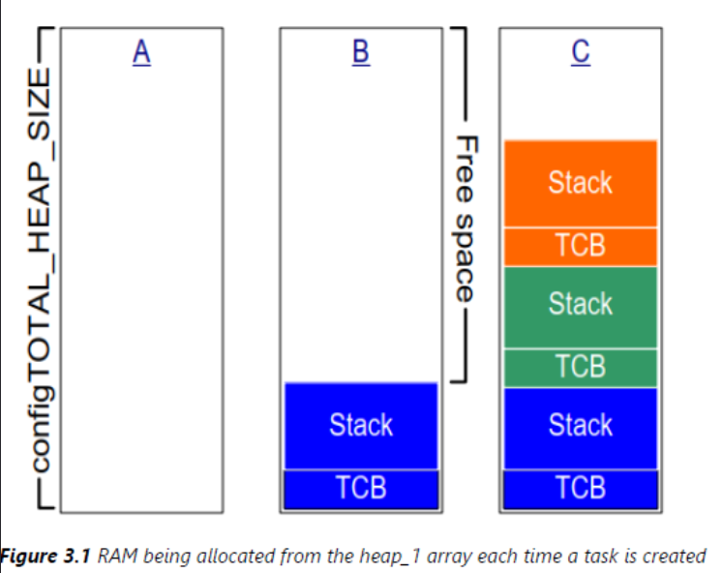
FreeRTOS – Heap1
Heap_1 is a basic heap implementation.
Heap_1 only creates tasks and other kernel objects before starting the FreeRTOS scheduler.
This means that memory is allocated only before the application starts, and the allocated memory remains for the application’s lifetime

Slide 9
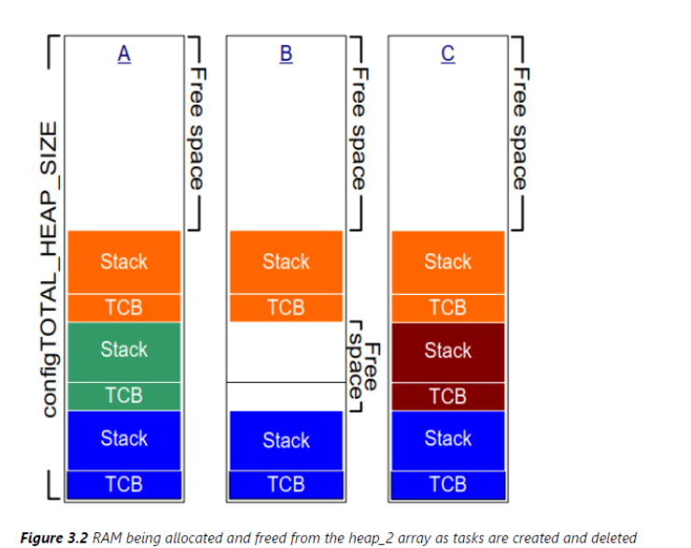
FreeRTOS – Heap2
Heap_2 is superseded by Heap_4, which is an enhanced version of Heap_2. FreeRTOS does not recommend using Heap_2 for new designs.
Heap_2 uses the best-fit algorithm to allocate memory. For example, if pvPortMalloc() requests 20 bytes of RAM, and the available RAM blocks are 5 bytes, 25 bytes, and 100 bytes, FreeRTOS will choose the 25-byte RAM block. It then divides it into a 20-byte block and a 5-byte block, returning the pointer to the 20-byte block. The remaining 5-byte block will be used in the future.
Note that Heap_2 does not combine adjacent free blocks into a single large block.

Slide 10
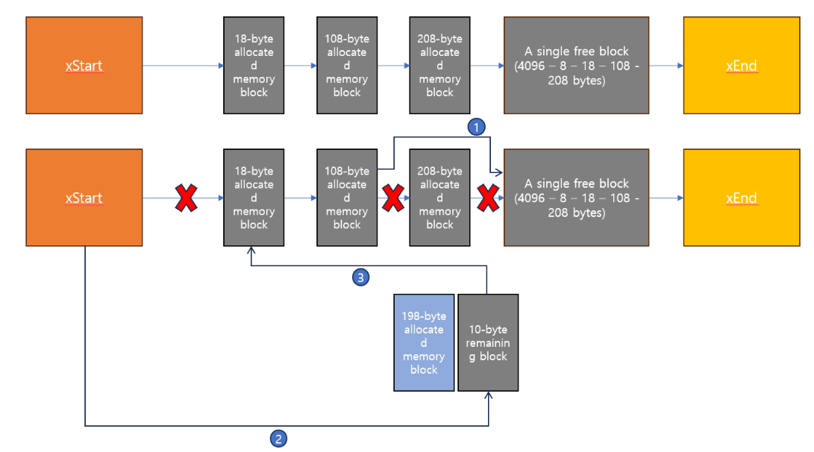
FreeRTOS – Heap2, Best Fit Algorithm
‘Best-fit’ algorithm that Heap2 has adopted is vulnerable to memory leakage problem, since the algirhtm does not combine the adjecent free memory blocks into one large free block
Free Blocks are managed by a single linked list.
Ascending order in size

Slide 11
FreeRTOS – Heap3
Malloc and Free library of C

Slide 12
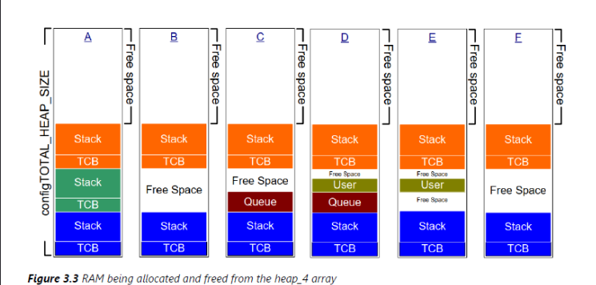
FreeRTOS – Heap4
Heap_4 subdivides an array into smaller blocks, and the array should be statically allocated and dimensioned by configuration.
Heap_4 uses ‘first-fit algorithm’ to allocate memory. For example, if pvPortMalloc() requests 20 bytes of RAM, and the available RAM blocks are 5 bytes, 200 bytes, and 100 bytes, FreeRTOS will choose the 200-byte RAM block. It then divides it into a 20-byte block and a 180-byte block, returning the pointer to the 20-byte block. The remaining 180-byte block will be used in the future.
Minimize memory fragments.

Slide 13
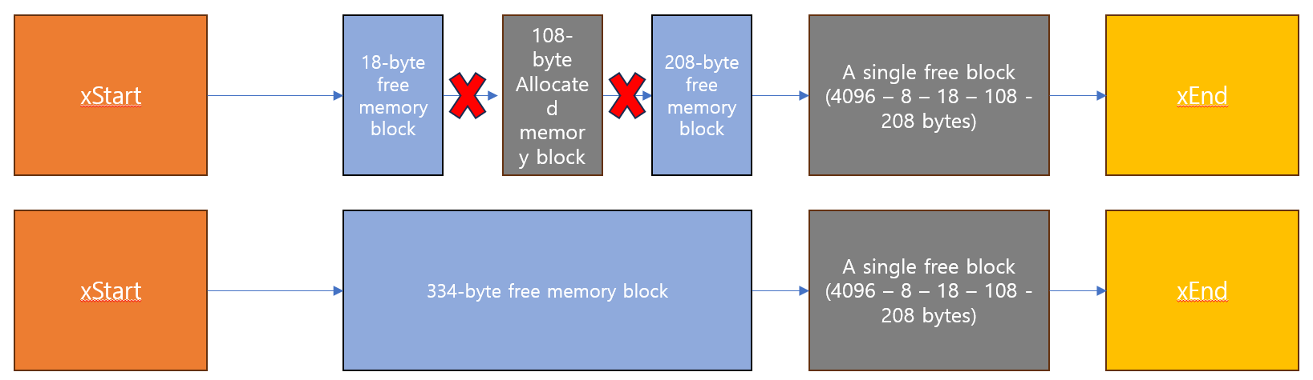
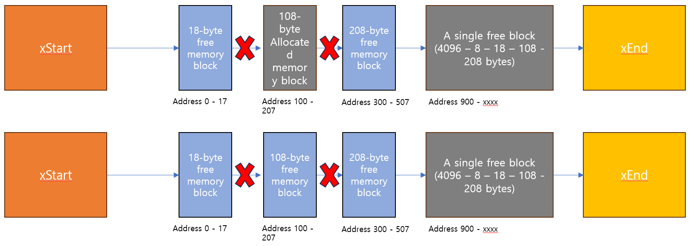
FreeRTOS – Heap4, First Fit Algorithm
pvPortAlloc is similar to Heap2, but PvPortFree is differen
case1
case2

Slide 14
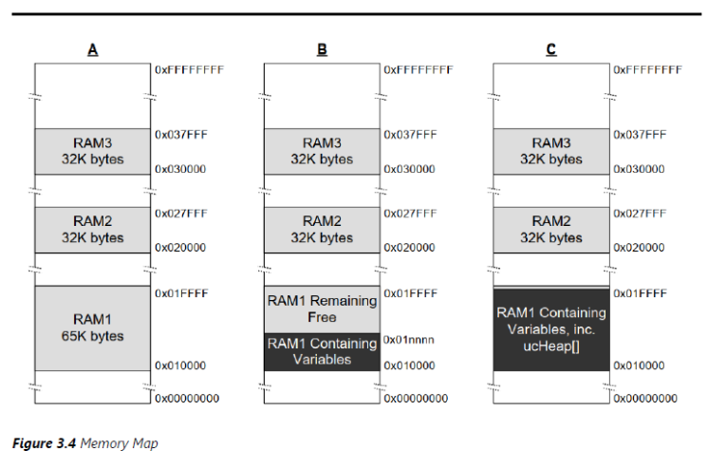
FreeRTOS – Heap5
Heap_5 uses the same allocation algorithm as Heap_4.
Heap_5 links multiple separated physical memory spaces. But it does not combine the multiple memory seperated physically into a single large block
Heap_5 is useful when the RAM provided by the system on which FreeRTOS is running does not appear as a single contiguous block in the system’s memory map.

Slide 15


