Slide 1
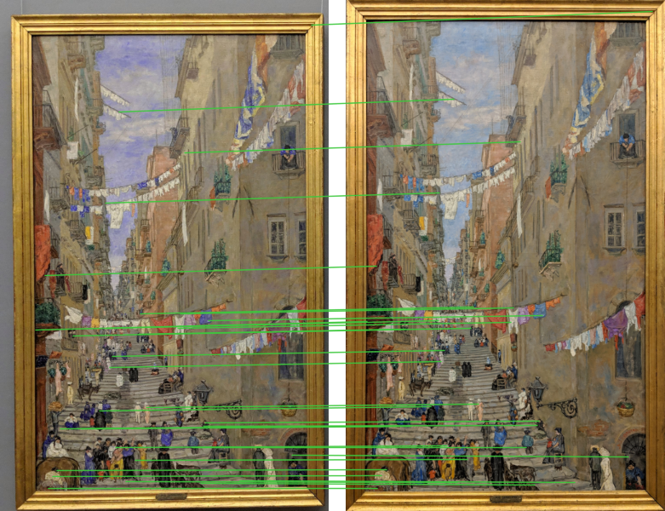
Finding museum paintings by their keypoints
C1 project · Final presentation · Team 4
Martí · Li Boquian · Maren · Max Mira
Notes:
Team 4. We focus on week 4, local features, and show how it builds on the previous weeks. Each member presents one part.

Slide 2
Keypoints beat texture on the harder query set
0.974
mAP@1 and mAP@5 on QSD1-W4
Week 3 on the same set: 0.923
38 / 39
entries right: 29 paintings + 10 unknown photos, one painting lost
10 / 10
unknown photos discarded
F1 0.952 (P 0.909, R 1.000)
Week 3 has no discard of its own: we added a threshold optimised with the same F1 criterion.
Notes:
The result first. On QSD1-W4 we reach 0.974, with mAP@1 equal to mAP@5, against 0.923 for our best week-3 system. That is 38 of 39 entries against 36, so the gain on this small set is modest. Handling unknown queries is what moves the score most: both systems are near 0.7 without it. Later we show that the difference is much clearer on independent data.

Slide 3
From global histograms to verified local matches
Week 1
Week 2
Week 3
Week 4
0.900
0.967
1.000
0.974
mAP@1
mAP@1
mAP@1
mAP@1
1D colour histograms
3D histograms + background
Texture + two paintings
Keypoints + unknowns
HSV and CIELab, illumination normalised, chi-square and Hellinger
YCrCb spatial pyramid. Wall model removes the background
Median denoising. Fusion of LBP, DCT, wavelet and Gabor
SIFT, ratio test, RANSAC. Queries below the inlier threshold are discarded
Week 4 still uses the week-3 denoising and segmentation.
Development scores. Each week has its own query set, so the values are not directly comparable. Week 2 is QSD1 (QSD2: 1.000).
Notes:
The global scheme is always query by example: describe, compare, rank. Each week changed the descriptor and made the queries harder. Week 3 reached 1.000 on its development sets, so those sets no longer separated methods. Week 4 adds non-cropped photos with up to two paintings, colour changes, noise, and queries that are not in the database. Do not read 1.000 to 0.974 as a loss: the set is harder.

Slide 4
Every match must agree on one homography
1
Denoise
median 3×3 twice, only if impulses are found
2
Keypoints
DoG + SIFT, up to 2000, longest side 800 px
3
Tentative matches
nearest neighbours, Lowe ratio 0.75, one to one
4
Verify
RANSAC homography, implausible models rejected
5
Score
inliers per BBDD image: rank them, or return [[-1]] below T = 25
Image 4 with BBDD 161: 1163 inliers.
Notes:
Task 1 and Task 2. We tested three options: SIFT, RootSIFT and ORB. Appearance alone gives tentative matches; the geometry decides. A flat painting seen from another point of view must follow one homography, so wrong matches rarely agree. Cross-check gave no improvement and took longer, so it is not used. The search is exhaustive and the seed fixed, so results repeat exactly. The BBDD features are cached and a test run takes about one minute.

Slide 5
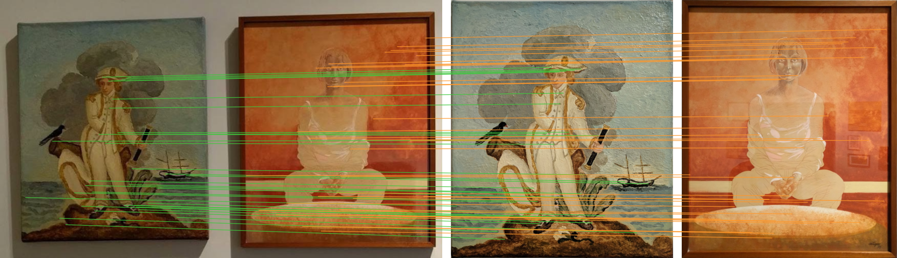
Segmentation only fixes the layout
Segments: a white mat looks like the wall, so image 28 loses a painting and both slots.
Whole photo: sequential RANSAC finds both, but a lone match can land in the wrong slot (image 16).
Hybrid: match the whole photo, and use segments only to place what is missing.
Notes:
Up to two paintings per photo. Matching the whole photo, then removing the inliers of the first painting, finds both paintings without any segmentation. The metric is positional: a painting in the wrong slot loses both entries. So we keep the week-3 segmentation only for the layout. This is the single change that moved us most, from 0.923 to 0.974.

Slide 6
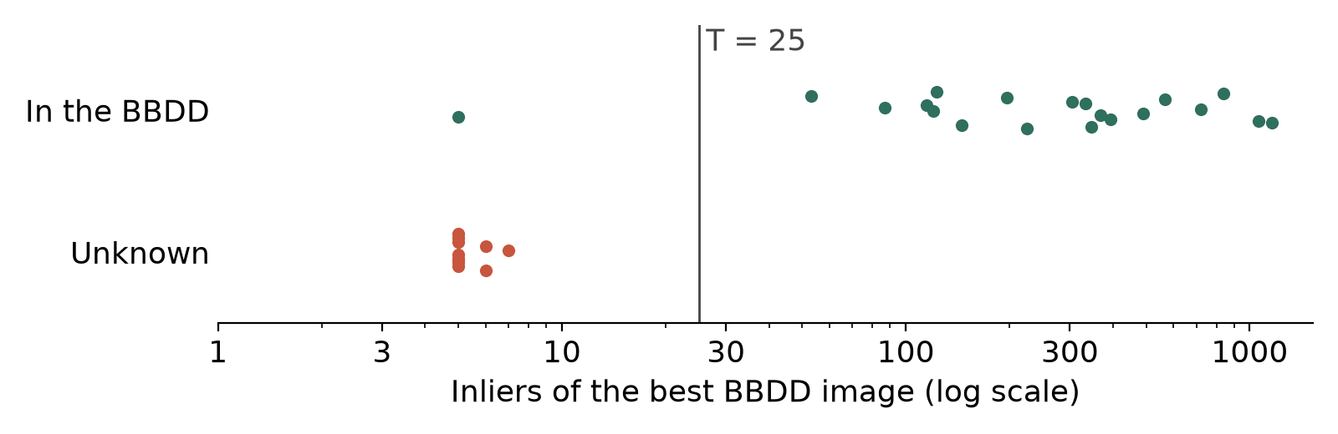
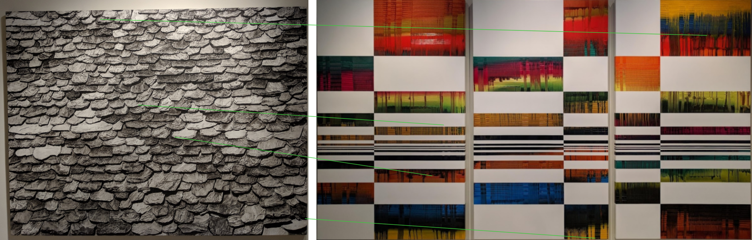
Inlier count separates unknown queries
Unknown: 7 inliers at most.
Known: 53 or more, except painting 128.
Threshold: every T in (7, 53] gives the best F1 on QSD1-W4, 0.952.
T = 25: the best of that range on independent data.
Bottom image: best match of an unknown query, 4 inliers with no geometric sense.
Notes:
Task 2, part two. A query is unknown when its best score is below T. We optimise F1 with unknown as the positive class. All 10 unknowns are discarded. The single false alarm is painting 128, a known one, which gives P 0.909 and R 1.000. F1 alone does not fix T, because a wide range ties. The next slide shows how we chose inside it.

Slide 7
QSD1-W4 ties, independent data picks SIFT
QSD1-W4 cannot decide
SIFT, RootSIFT and ORB all give mAP 0.974 and leave-one-out F1 0.952.
ORB reaches F1 1.000 through one photo: 9 inliers against 7.
Our check
60 photos from QSD1-W3 and QSD2-W3.
Known: the full BBDD. Unknown: the right paintings removed.
SIFT vs RootSIFT is one photo: weak evidence.
BBDD near-duplicates (179 / 219, 13 / 52) explain the top simulated-unknown scores.
Notes:
On the development set the three descriptors tie, so we needed another criterion. The week-3 sets have ground truth and were not used to design the week-4 pipeline, although week 3 itself was developed on them. Removing the right painting from the database simulates an unknown query. SIFT is the only option with no false known at T = 25. ORB finds more paintings but accepts more wrong ones. The texture system of week 3 misses 30 percent of the known queries at its threshold. This is the clearest evidence in favour of keypoints.

Slide 8
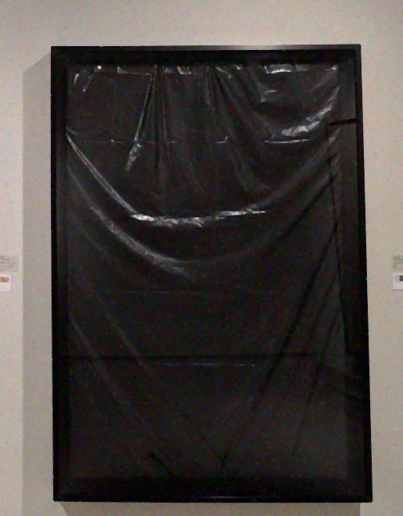
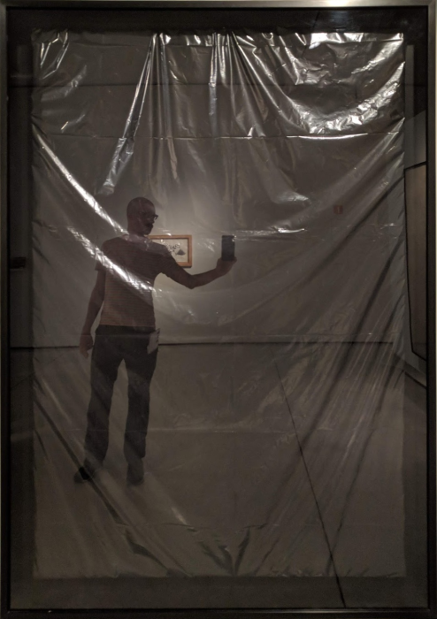


Flat, reflective paintings remain out of reach
What fails
Painting 128: reflections change between photos. Only 5 inliers, so it is discarded as unknown.
Painting 11: its fine texture vanishes. Right with 7 inliers, below T, only thanks to the layout rule: 0.026 of mAP.
Query, image 8
BBDD 128
What could fail on the test
Mixed photos: a known and an unknown painting together give a ranking, not [-1]. QSD1-W4 has none.
Small sample: 10 unknown photos, 4 of them repeating 2 paintings.
Query, image 16
BBDD 11
Notes:
Being honest about the limits. Painting 128 has plastic with changing reflections, and the database image even shows the photographer reflected. Painting 11 has almost no structure at this scale. Local features need local structure, so these cases fail by nature. We expect the test score to be lower than the development score.

Slide 9
Verification is what made retrieval reliable
Geometry over appearance
Earlier work still counts
Do not trust a tie
Inliers put known and unknown queries far apart: 53 or more against 7 or fewer, with one exception.
Week-3 denoising and segmentation stay in the pipeline, used only where they help.
When a small set cannot separate methods, independent data can: it chose both the descriptor and T.
Notes:
Three takeaways. Thank you, we are happy to take questions.

