Slide 1

Deep learning classification
Module: C3
Group: 7
Students: Cristian Gutiérrez
Iñaki Lacunza
Marco Cordón

Slide 2
Index
Understanding network topology
Task 1: MLP (+ Overfit remedies)
Task 2: Get features from MLP
Task 3: Get features from Patches MLP
Comparing features: learnt vs handcrafted
Task 4: MLP & SVM
Task 5: Patches MLP & BoVW + SVM
Results
Conclusions

Slide 3
Understanding network topology (mlp_MIT_8_scene)
First Task: Add/Change layers
From the code given at `mlp_MIT_8_scene.py` we have different parameters that we can tune in to reach last week’s accuracies:
Layers: we tested up to 5 layers, each layer divides by 2 the number of units.
# Units: altering not only the depth but the width of the NN.
Image Size: currently images are 32x32, other sizes has been tried.
Optimizers: [sgd, adam]
In terms of the metrics, we will be guided by the validation set which grabs images from the test set.
Input Layer | 1st Layer | 2nd Layer | 3rd Layer | 4th Layer | 5th Layer | i-th Layer | Clf Layer
3072 feat | 2048 units | 1024 units | 512 units | 256 units | 128 units | # units / 2 | 8 units

Slide 4
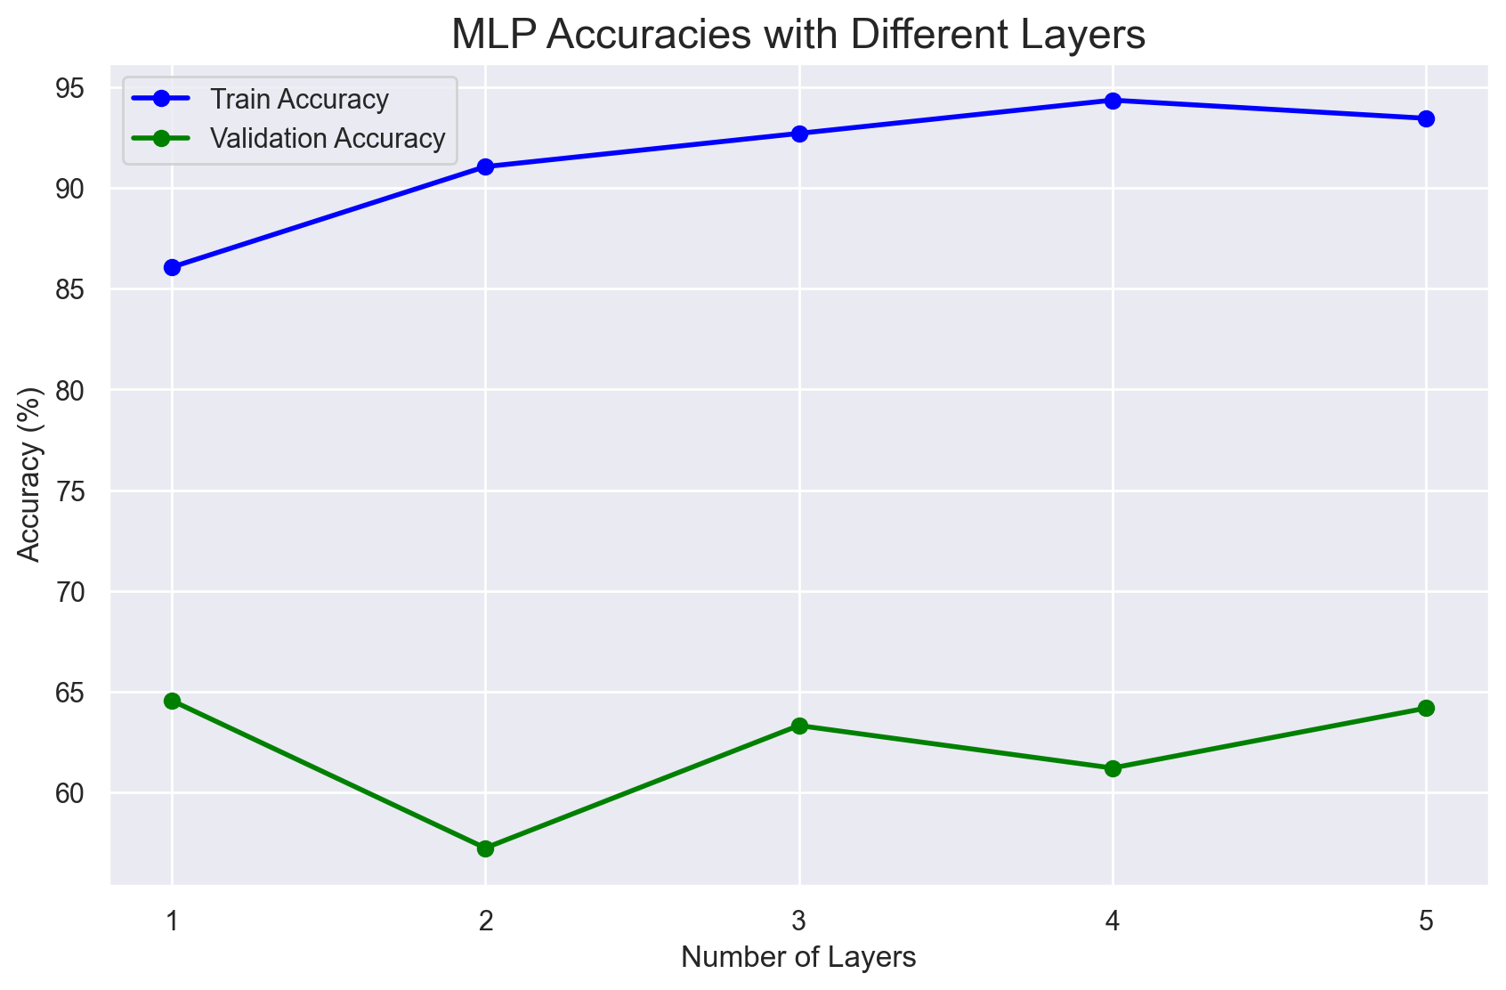
Understanding network topology (mlp_MIT_8_scene)
Add/Change layers
We will make runs for different number of layers (up to 5). All the experiment will run with 50 epochs and the same hyperparameters (we do not change other parameters).
Adding more layers does not improve our validation score.
Because our train score improves and our validation score fluctuates we can say the NN is overfitting!

Slide 5
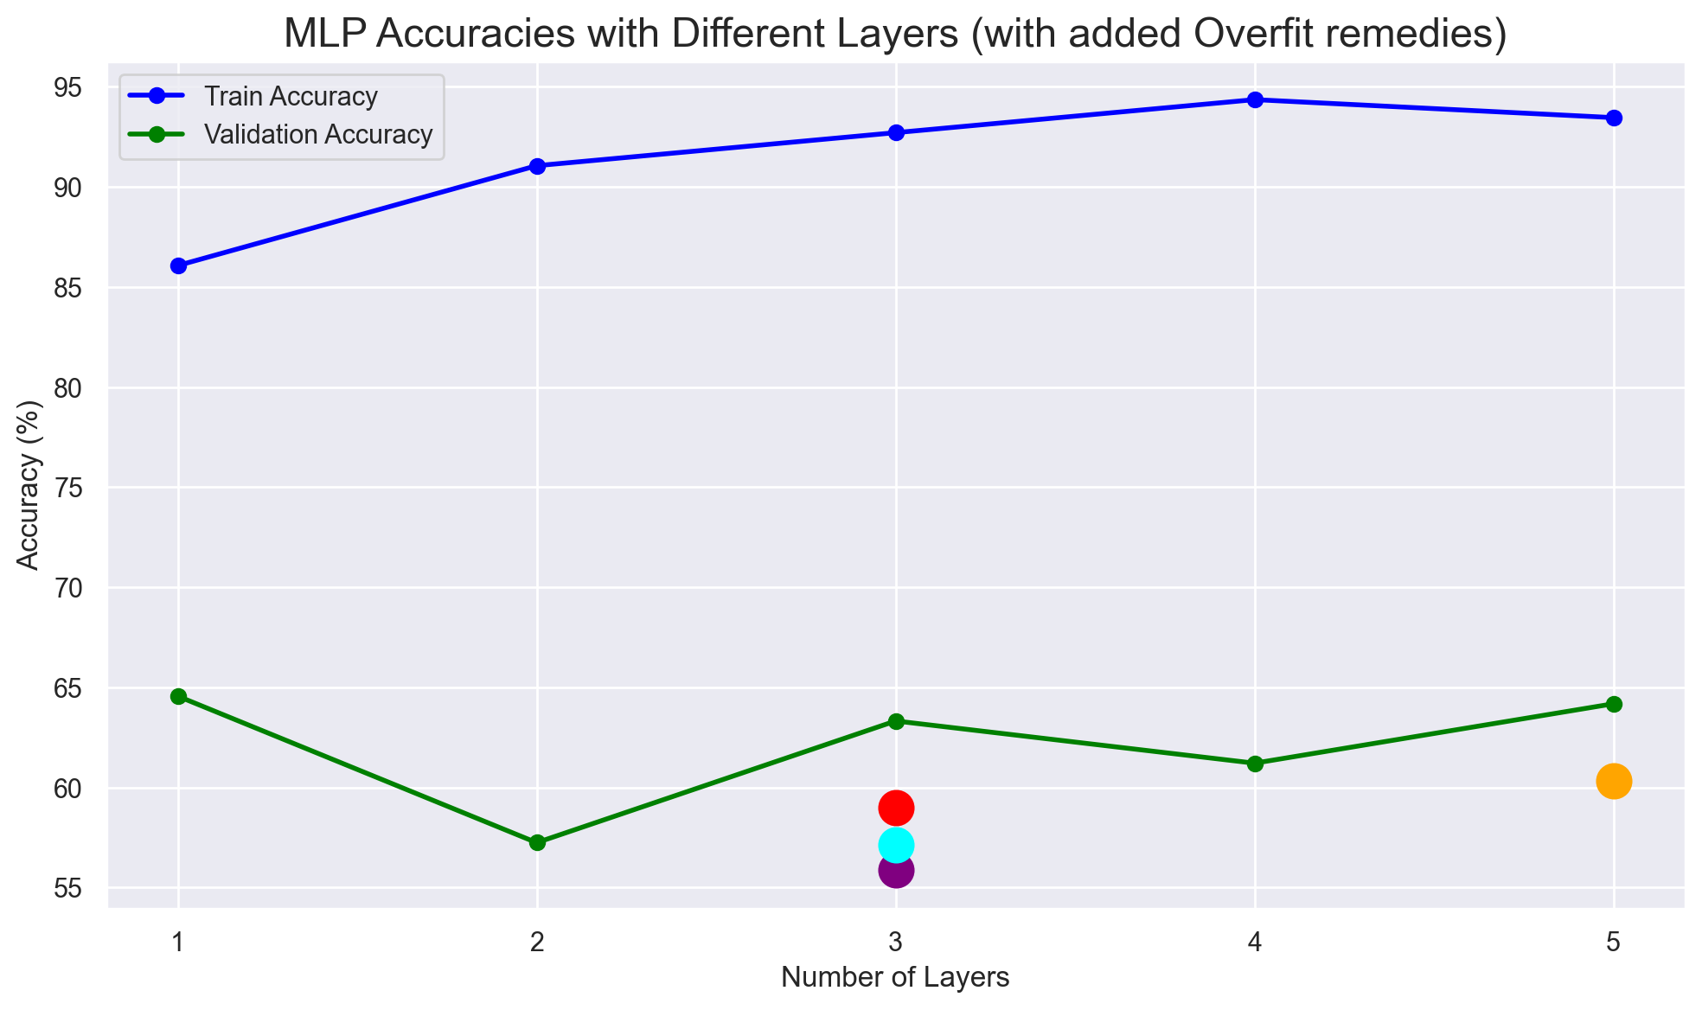
Understanding network topology (mlp_MIT_8_scene)
Overfitting remedies
We tried several independent approaches to solve this overfitting:
Increase image size to 256.
Use Adam optimizer.
Reduce the neural units.
(3 Layers, 512 -> 256 -> 128)
Add L2 regularization. (= 0.001)
Neither of the remedies seems to be solving the overfitting we have, as there is still a big gap between train and validation accuracy.

Slide 6
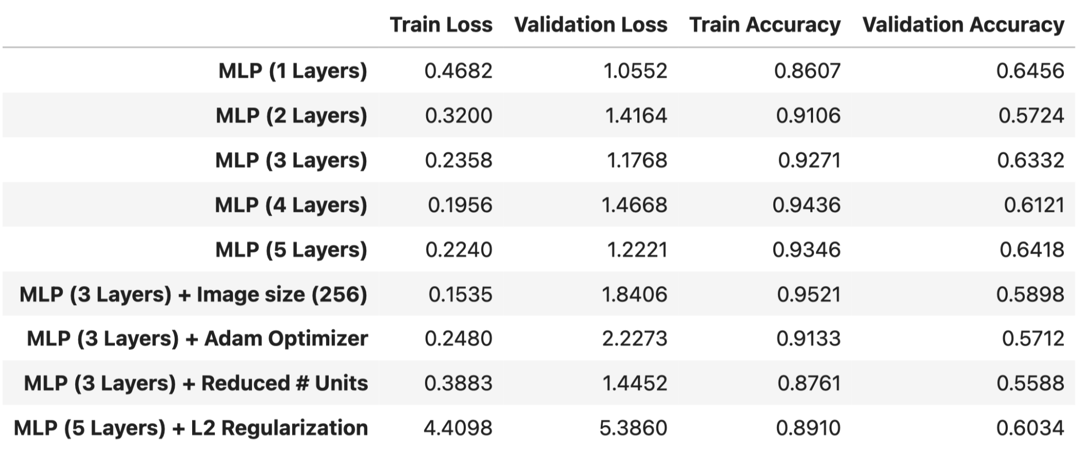
Understanding network topology (mlp_MIT_8_scene)
Results
The MLP still is under overfitting conditions, as the training accuracy keeps increasing but the validation accuracy fluctuates.
Overfitting remedies like changing the image size, adding L2 regularization or even using other optimization techniques such as Adam have not given positive results.

Slide 7
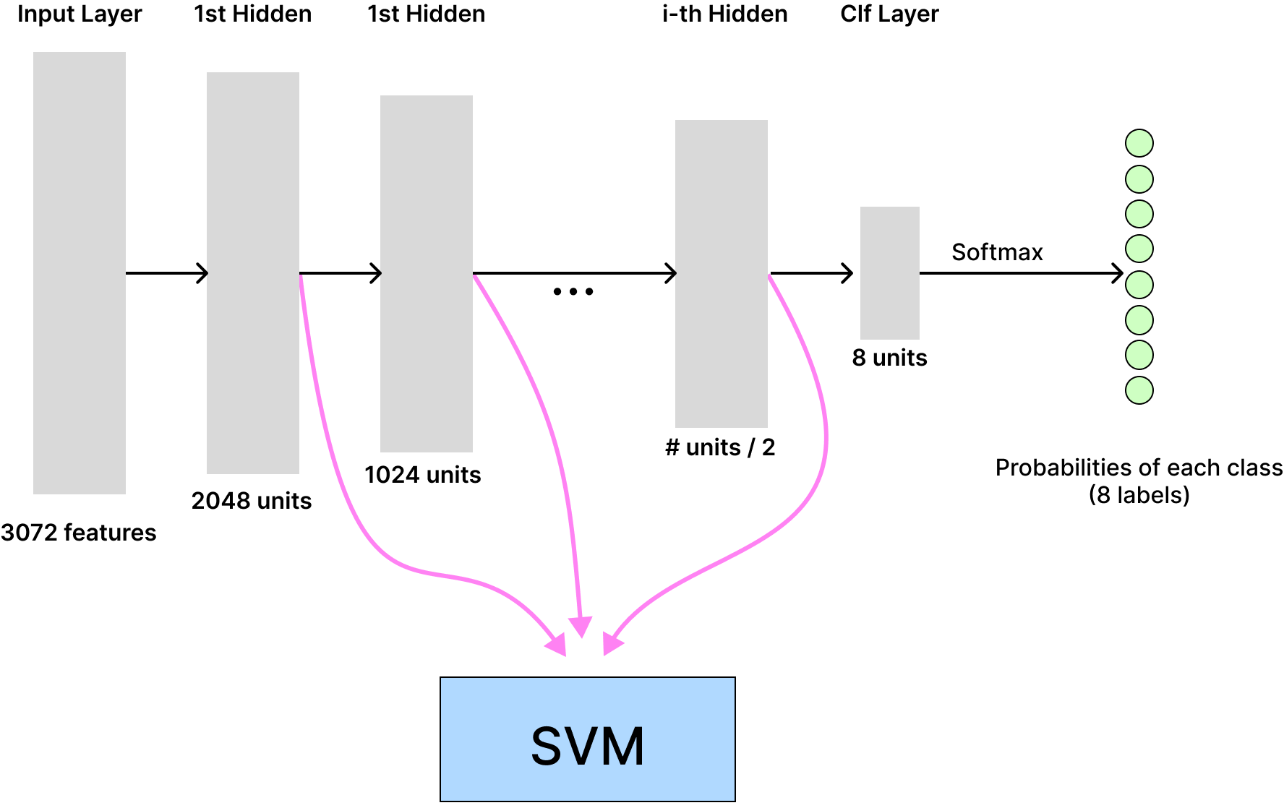
Understanding network topology (mlp_MIT_8_scene)
Second Task: Given an image, get the output of a given layer
We implemented the code to extract the features of all the hidden layers of the MLP, so that later on we can test how SVM performs with each of the hidden features.
In order to get the features from the hidden layers, we’ve used the given code using `model.get_layer(layer_names[i]).output` tensorflow line of code, just iterating through the hidden layers.
This way, since each layer works by transforming the outputs of the previous layers, we were able to analyze separately deep features of different complexities.

Slide 8
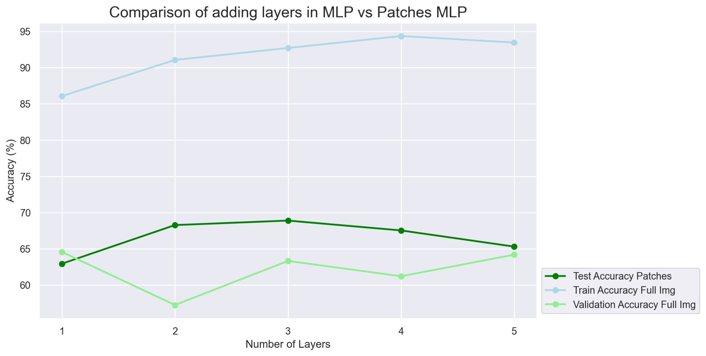
Understanding network topology (patch_based_mlp)
Third task: Merge multiple outputs from a single image
The code at `patch_based_mlp.py` first splits the image into patches of 64x64, each of them goes through the network and later on are merged.
If we plot the test accuracy for the patch based MLP we see a great improvement w.r.t. the full-sized model.
Still, we are not reaching Week 1 results just yet.

Slide 9
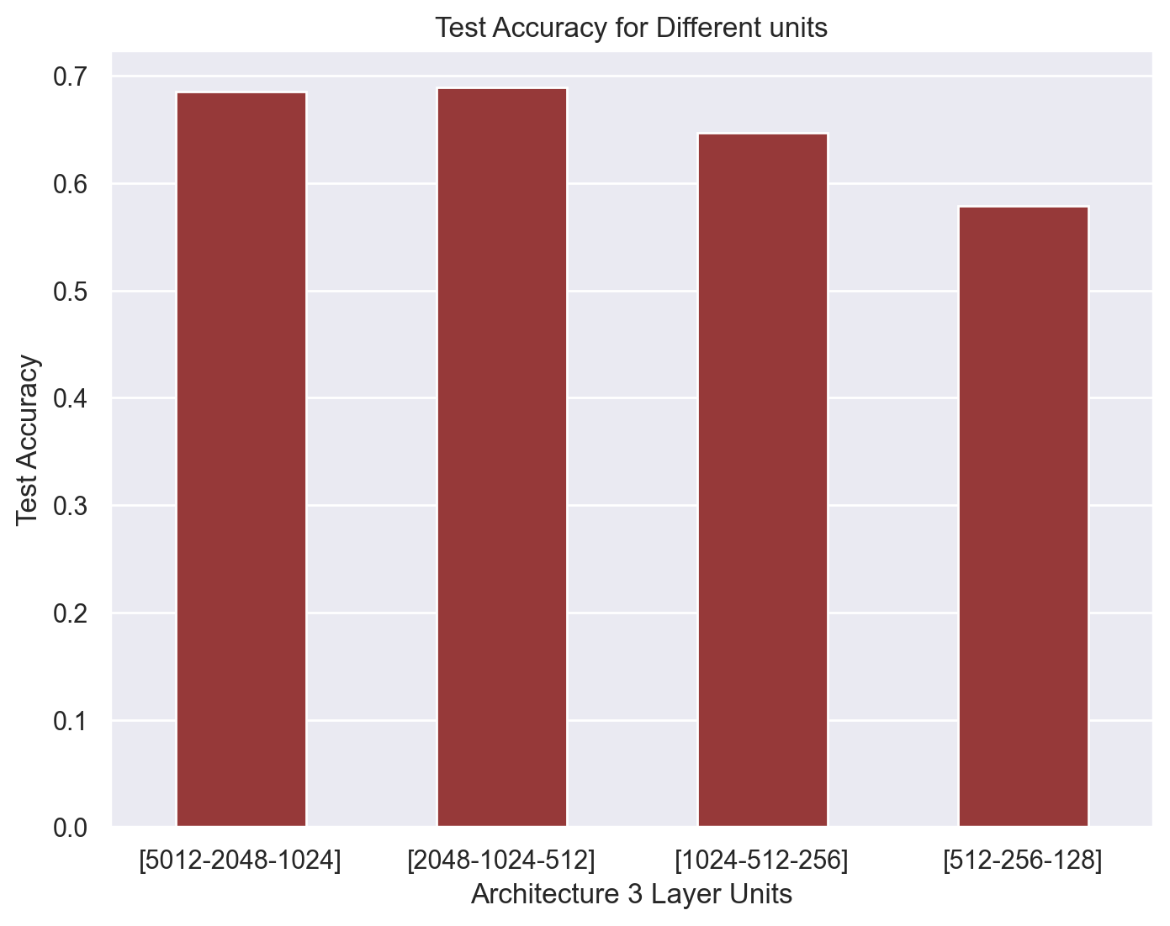
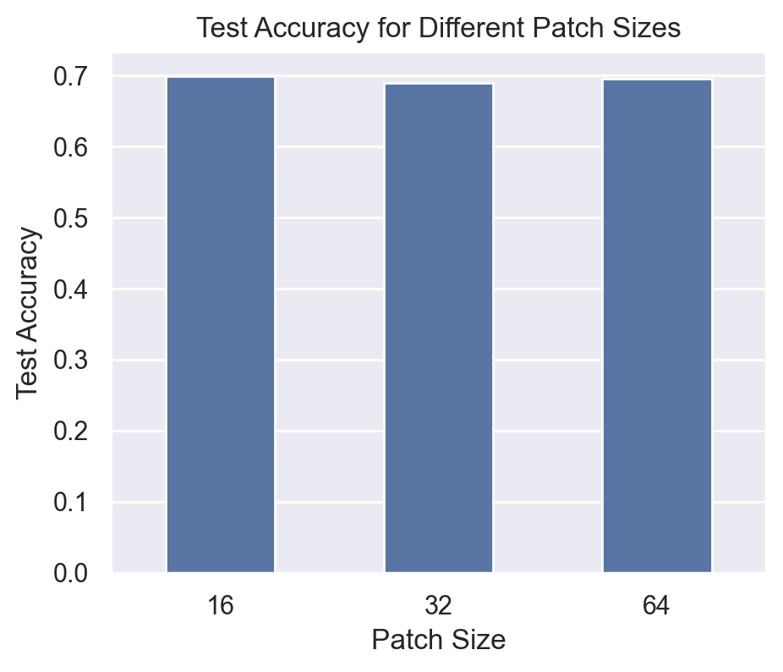
Understanding network topology (patch_based_mlp)
Number of Patches
Different # units
The number of patches does not affect the results. Thus we will stay with the intermediate value of 32 patch size.
Because we are still under overfitting conditions, we tried reducing the # of units, but it does not affect positively either.
(using 3 layers)
(using 3 layer model with 32 patch size)

Slide 10
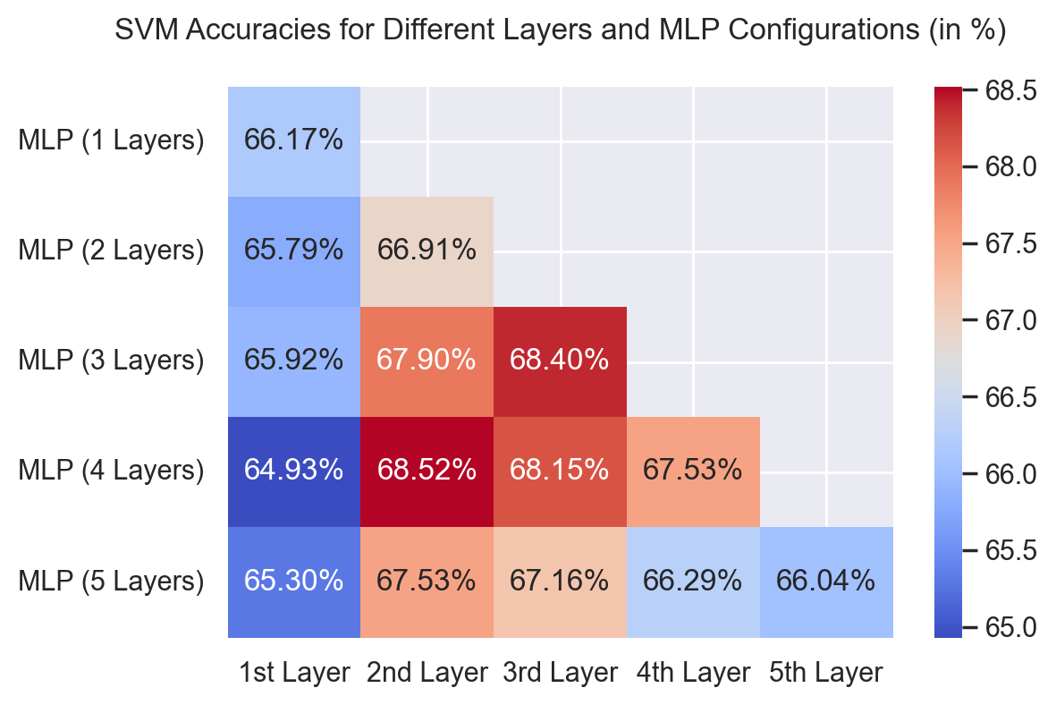
Comparing features: learnt vs handcrafted
Fourth task: Extract a single feature from an input and apply to SVM
In this task, we get outputs of all the hidden layers from our full-size MLP of Task 1 and use them as features for our previous week SVM model.
We tested with the MLPs of different layers. From each model we obtained the best SVM accuracy from all the layers. The results are better but not enough (as week 1).
(As we can see, not always the best features are from the last hidden layer!!!)

Slide 11
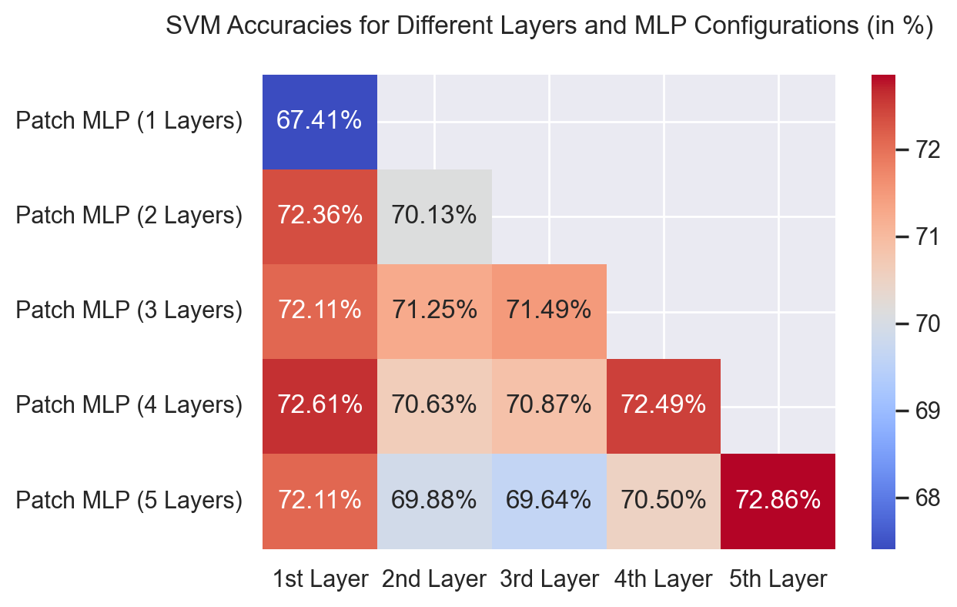
Comparing features: learnt vs handcrafted
Fifth task: Extract multiple features from an image and apply BoW
Similarly, as we did in Task 4, we will grab all the hidden layers and test for each of them. As we’ve proven that the best features are not always on the last hidden layer.
Through an Optuna objective function, we were able to determine the best `codebook_size = 621` for our BoVW creation (analyzing codebook sizes between 25 and 700).
Furthermore, we’ve noticed that by including `Standard Scaler` to normalize our BoVW features, we obtain greater SVM accuracies.

Slide 12
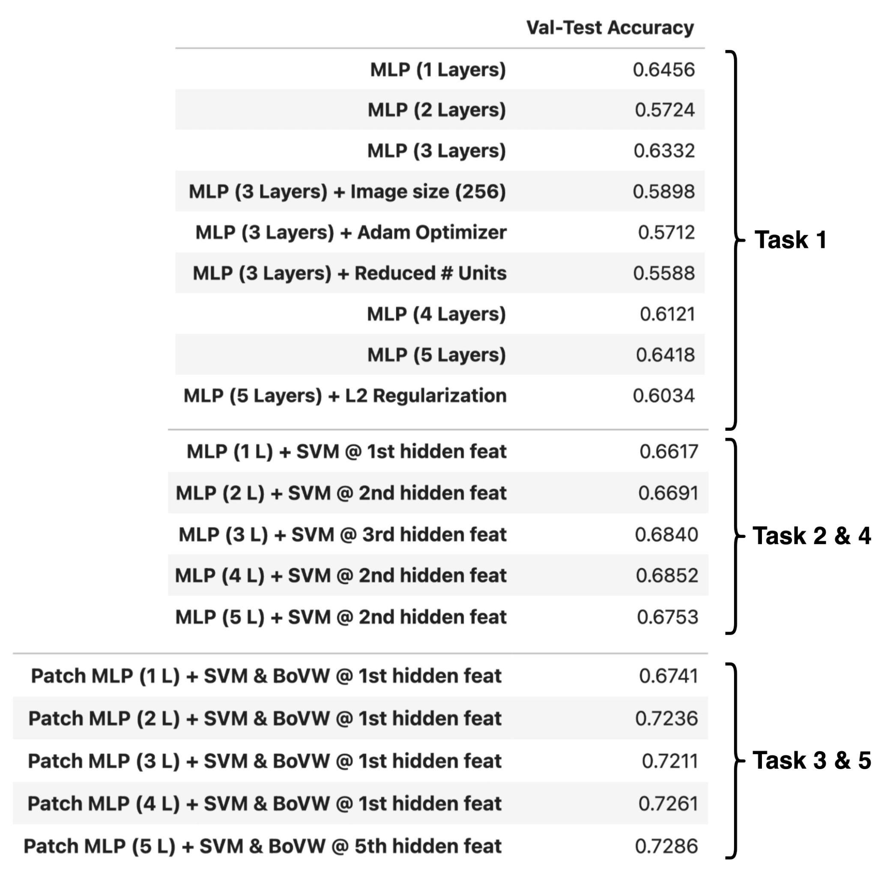
Results
< Best Params >
Patch Based MLP (5 Layers)
Patch Size = 32
Features = 5th hidden layer
BoVW with k = 621
Standard Scaler
SVM with kernel = RBF

Slide 13
Conclusions
Overfitting plays a crucial role, and we know that it is not able to generalize knowledge because a different number of remedies applied (reducing the # of units, adding layers, using patched images, using L2 regularization, other optimizers…) have not corrected this behaviour.
Using patches greatly improves the overfitting but still performs way below the train accuracies achieved with the original MLP. Adding layers improved the results. Reducing units and the number of patches does not affect the results.
SVM and BoVW worked better but not as well as in Week 1. In some cases the best hidden features were not the ones on the last layer, but on other layers.
Adding Standard Scaler onto the BoVW worked extremely well, moreover, we’ve tried setting up the `n_clusters` variable dependent on the # hidden units, but it worked better by setting it fixed to optuna’s optimized value: `n_clusters = 621`.

