Slide 1

Demographic Table and Subgroup Summary Macro %TABLEN

Slide 2
%TABLEN
Generates a data summary table formatted in a manner typically employed for summarizing baseline characteristics in research manuscripts.
Provides summaries for five distinct types of variables:
Continuous
Discrete
Date
Survival
Logistic regression/Binomial
Outputs the same style table to RTF, HTML, PDF, EXCEL and Power Point.
Many options for flexibility.
Contains error checking, documentation, and cleans up after itself.
Jeffrey Meyers, Mayo Clinic
Jeffrey Meyers, Mayo Clinic

Slide 3
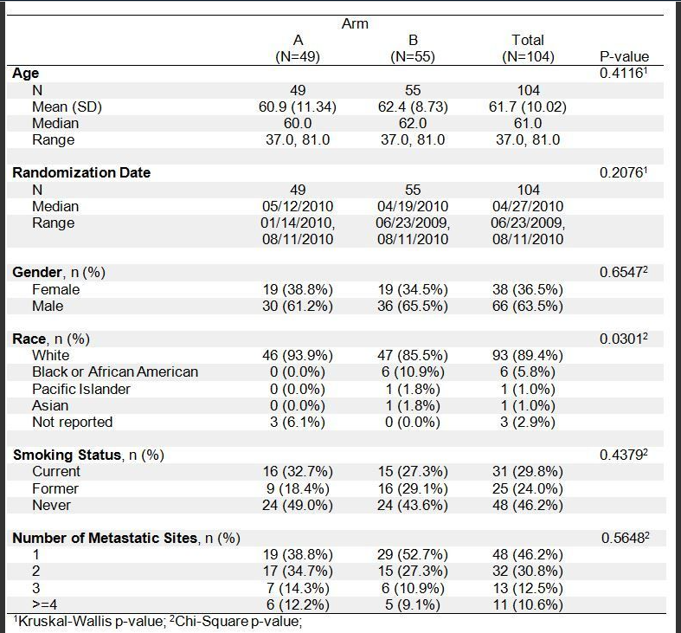
%TABLEN Output
%tablen(data=example, by=arm, var=age date_on sex race1 smoke_st num_met, type=1 3 2, outdoc=~/ibm/example1.rtf);
Jeffrey Meyers, Mayo Clinic

Slide 4
Macro Required Parameter
Data: user input dataset to summarize
VAR: space delimited list of variables to summarize.
TYPE
1=Continuous variable
2=Discrete variable
3=Date variable
4=Survival variable
5=Logistic regression/binomial variable
The most recently used TYPE value is retained to prevent unnecessary repetition of value
Example: VAR=age gender smoking_stat race
TYPE=1 2 2 2 is equivalent to TYPE=1 2 as the last 2 will carry forward
Jeffrey Meyers, Mayo Clinic

Slide 5
Options for comparison and subgrouping
BY: a variable to split distributions into multiple columns and allows p-value comparisons.
COLBY (Column-BY): The COLBY option allows the tables to be nested into subgroups in multiple columns.
%TABLEN(DATA=example, COLBY=sex, COLBYORDER=2 1, COLBYLABEL=Gender, …)
COLBYORDER: reorders the COLBY variable values.
Default is unformatted values
Numbers correspond to original order (1=Female, 2=Male)
COLBYLABEL: changes COLBY variable label
ROWBY( Row-BY): Same as COLBY but in rows instead columns.
%TABLEN(DATA=example, ROWBY=sex, ROWBYORDER=2 1, ROWBYLABEL=Gender, …);
ROWBYORDER: reorders the ROWBY variable values.
Default is unformatted values
Numbers correspond to original order (1=Female, 2=Male)
ROWBYLABEL: changes ROWBY variable label
Each value of ROWBY has its own header with counts
Jeffrey Meyers, Mayo Clinic

Slide 6
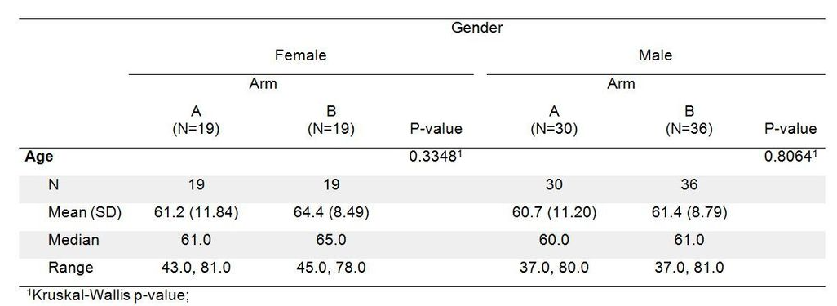
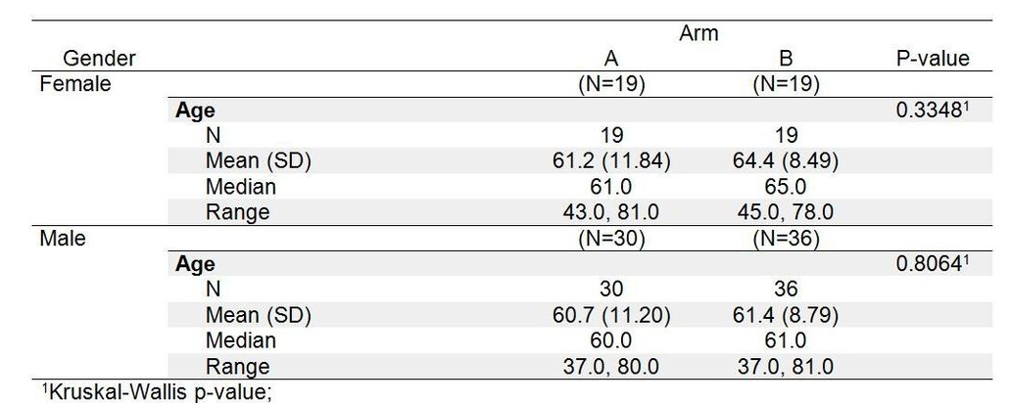
Options for comparison and subgrouping
COLBY (Column-BY):
ROWBY( Row-BY):
Jeffrey Meyers, Mayo Clinic

Slide 7
Numeric and Date type variables
CONTDISPLAY or DATEDISPLAY macro-options are used to summarize the numeric variable.
The options that are controlled by CONTDISPLAY are shown below.
N: Number of non-missing records
NMISS: Number of missing records
N_NMISS: Combines N and NMISS as N (NMISS)
MEAN: Mean of the distribution
SD: Standard Deviation of the distribution
MEAN_SD: Combines Mean and SD as MEAN (SD)
MEDIAN: Median of the distribution
RANGE: Range of the distribution as MIN, MAX
IQR: Interquartile range of the distribution as Q1, Q3
MEDIAN_RANGE: Combines Median and Range as MEDIAN (MIN, MAX)
MEDIAN_IQR: Combines Median and IQR as MEDIAN (Q1, Q3)
Jeffrey Meyers, Mayo Clinic

Slide 8
Numeric and Date type variables
P-values are available for either numeric or date type variables by listing one of the following numbers in the PVALS macro-option:
If BY variable is present
0 = No p-value
1 = Kruskal-Wallis
2 = Exact Kruskal-Wallis (long calculation times)
3 = Wilcoxon rank sum
4 = Exact Wilcoxon rank sum (long calculation times)
5 = ANOVA F-test
6 = Equal variance two sample t-test
7 = Unequal variance two sample t-test
If BY variable is not present
0 = No p-value
1 = Student T-Test
2 = Sign Rank
Jeffrey Meyers, Mayo Clinic

Slide 9
Discrete Type Variables
The discrete type variables can summarize by using below options
DIS_DISPLAY: Determines if counts, percentages or both are shown.
DIS_ORDER: Allows the user to change the default order of the variable values.
The default order is the sorted unformatted values.
The user can specify a numeric list of the ordered values to change them.
For example, the variable GENDER might have the values 'Male' and 'Female' which would have the default order of Female and then Male. The user can specify DIS_ORDER=2 1 in order to change the order to Male then Female.
Multiple variables can be distinguished with the pipe (|) symbol: DIS_ORDER=2 1|3 1 2|2 1 3.
This option can be used to limit how many values are shown.
For example, with gender if DIS_ORDER=1 then only Females will be shown. This can be useful to save vertical space in the table.
DIS_INCMISS: Determines whether missing values are included as a valid value for percentages.
DIS_PRINTMISS: Determines if number of missing values are printed.
Jeffrey Meyers, Mayo Clinic

Slide 10
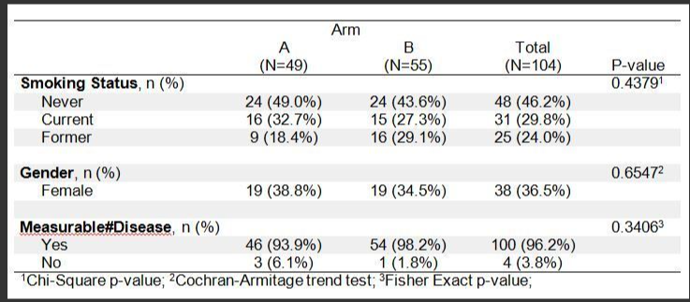
Discrete Type Variables
The following P-values are available with the following codes in PVALS:
0 = No p-value
1 = Chi-square
2 = Fisher's exact
3 = Cochran-Armitage trend test (Either BY or VAR must have 2 levels only)
Example :
%TABLEN(data=example, by=arm, var=smoke_st sex dz_g, type=2, pvals=1 3 2, dis_order=3 1 2|1|)
Jeffrey Meyers, Mayo Clinic

Slide 11
Survival Regression Analysis
The %TABLEN performs univariate survival analysis.
Survival Analysis options:
SURV_STAT: Matches a survival event variable to the time variable listed in the VAR list.
CEN_VL: Determines the value representing the non-event. This must be numeric.
TIMELIST: Specifies time-points for Kaplan-Meier event-free rates. Unique time-points can be specified for each survival type variable.
SURVDISPLAY: The SURVDISPLAY option controls which statistics are shown and the order with the following keywords:
Jeffrey Meyers, Mayo Clinic

Slide 12
Survival Regression Analysis
N: Number of patients
EVENTS: Number of events
EVENTS_N: Combines N and Events as EVENTS/N
MEDIAN: Kaplan-Meier survival median and 95% CI
HR: Cox model hazard ratio and 95% CI
COXPVAL: Cox model Wald p-value comparing parameters
TIMELIST: Kaplan-Meier time-point event-free rates and 95% CI
REFERENCE: designates reference value for hazard ratios
Jeffrey Meyers, Mayo Clinic

Slide 13
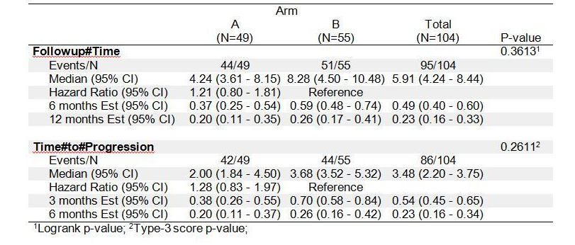
Survival Regression Analysis
The following p-values are available with the specified values in the PVALS option:
0 = No p-value
1 = Logrank
2 = Wilcoxon
3 = Cox model type-3 score
4 = Cox model type-3 likelihood-ratio
5 = Cox model type-3 Wald
%TABLEN(data=example, by=arm, var=fu_time pg_time,type=4, pvals=1 3, surv_stat=fu_stat pg_stat, cen_vl=1, timelist=6 12|3 6, time_units=months, survdisplay=events_n median hr timelist)
Jeffrey Meyers, Mayo Clinic

Slide 14
Logistic Regression Analysis
The %TABLEN performs univariate logistic regression analysis.
Logistic Regression Analysis options:
LOG_EVENT: Determines the event value for the binomial variable in the VAR list.
LOG_BINFMT: Determines if the binomial success rate is calculated as a proportion or percentage.
LOG_DISPLAY: A space delimited list that determines which statistics are displayed as well as the order they are displayed in with the following key words:
Jeffrey Meyers, Mayo Clinic

Slide 15
Survival / Logistic regression analysis
N: Sample size
EVENTS: Number of events or successes.
ODDSRATIO: Logistic regression odds ratio and 95% CI
WALDPVAL: Logistic regression Wald p-value comparing parameters.
BINRATE: Binomial success rate and 95% CI
REFERENCE: determines reference group for odds ratios
Jeffrey Meyers, Mayo Clinic

Slide 16
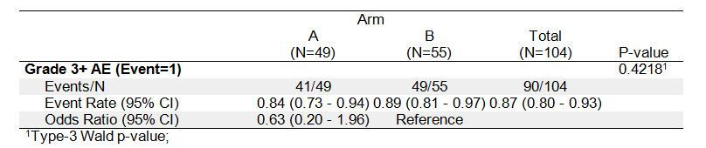
Survival / Logistic regression analysis
The following p-values are available with the specified values in the PVALS option:
When a BY variable is present
0 = No p-value
1 = logistic regression type-3 Wald p-value
When no BY variable is present
0 = No p-value
1 = Chi-square p-value
2 = Fisher's exact p-value
%TABLEN(data=example, by=arm, var=gd3,type=5, pvals=1, log_event=1, log_display=events_n binrate oddsratio)
Jeffrey Meyers, Mayo Clinic

Slide 17
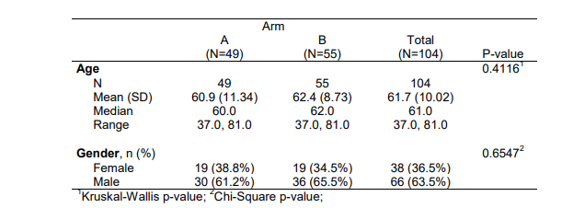
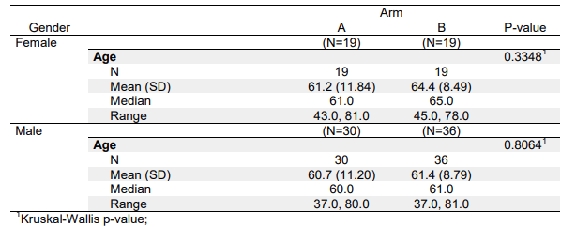
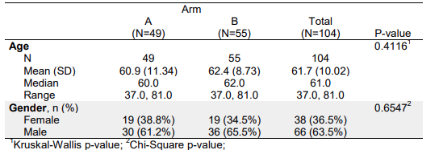
Style Modifiers (Shading)
Table shading can either be disabled, shade alternating rows, or shade alternating variables. The shading is controlled by SHADING parameter in the TABLEN macro call.
SHADING =0 (No Shading) SHADING=1 (Default: Alternate Shading by Row)
SHADING=2 (Enable Shading by Alternate Variable)
Jeffrey Meyers, Mayo Clinic

Slide 18
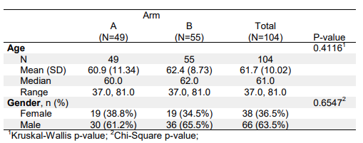
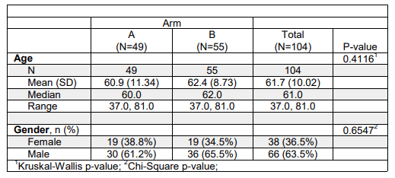
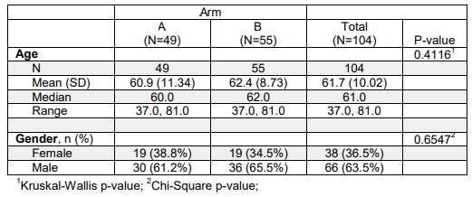
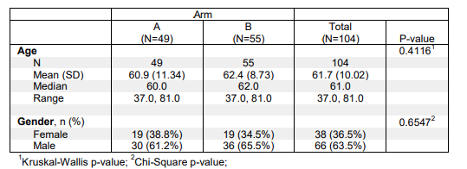
Style Modifiers (Borders)
The amount of cell boarder is controlled by the BORDERDISPLAY .
Boarder=1 (Default) Border=2
Boarder=3 Boarder=4
Jeffrey Meyers, Mayo Clinic
Notes:
BORDERDISPLAY=2 turns on all cell borders, BORDERDISPLAY=3 turns on all cell borders except for title and footnote, and BORDERDISPLAY=4 turns on borders for columns

Slide 19
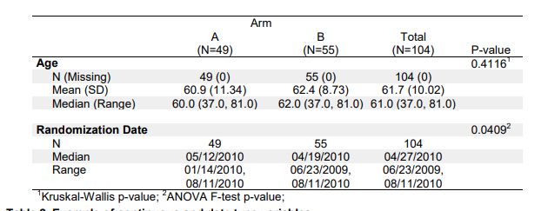
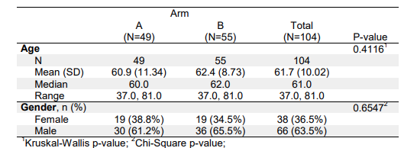
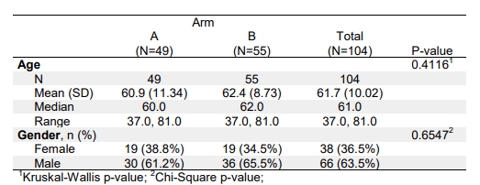
Style Modifiers (Spacing)
The spacing is controlled by SPLIT option in the TABLEN macros.
SPLIT=SPACE (Default) SPLIT=LINE
SPLIT=NONE
Jeffrey Meyers, Mayo Clinic
Notes:
BORDERDISPLAY=2 turns on all cell borders, BORDERDISPLAY=3 turns on all cell borders except for title and footnote, and BORDERDISPLAY=4 turns on borders for columns

Slide 20
Reference
Demographic Table and Subgroup Summary Macro %TABLEN. (2023, July 31). https://communities.sas.com/t5/SAS-Communities-Library/Demographic-Table-and-Subgroup-Summary-Macro-TABLEN/ta-p/634030
Notes:
BORDERDISPLAY=2 turns on all cell borders, BORDERDISPLAY=3 turns on all cell borders except for title and footnote, and BORDERDISPLAY=4 turns on borders for columns

