Slide 1
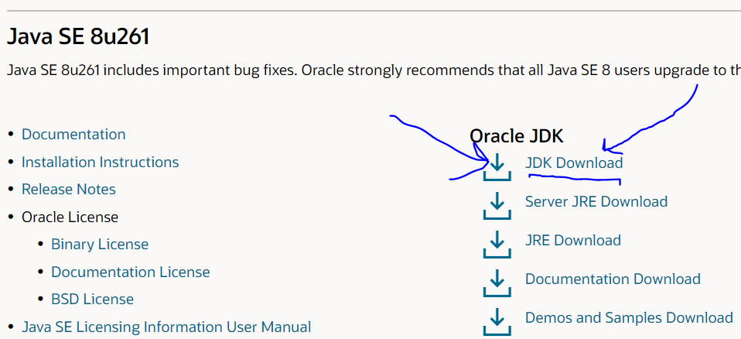
Java SE Development Kit (JDK) Installation
Go here:
https://www.oracle.com/java/technologies/javase-downloads.html
Download the most up-to-date JDK

Slide 2
Java SE Development Kit (JDK) Installation
Download jdk-9.0.4_windows-x64_bin.exe (Note that your version will not be “9.0.4” but something much more recent.)
Double click the file after download complete to begin the installation. Leave all install settings at the defaults.

Slide 3
Java SE Development Kit (JDK) Installation
After installation is complete you need to add java to the PATH:
After installation the javac should be in \Program File\java\jdk1.8.xxxx\bin for 64 bit processor or \Program Files (x86)\java\jdk…\bin
Type in “Environment” in the finder and select this control panel option: “Edit the system environment variables”
When prompted “Do you want to allow this app to make changes to your device”, select “yes”

Slide 4
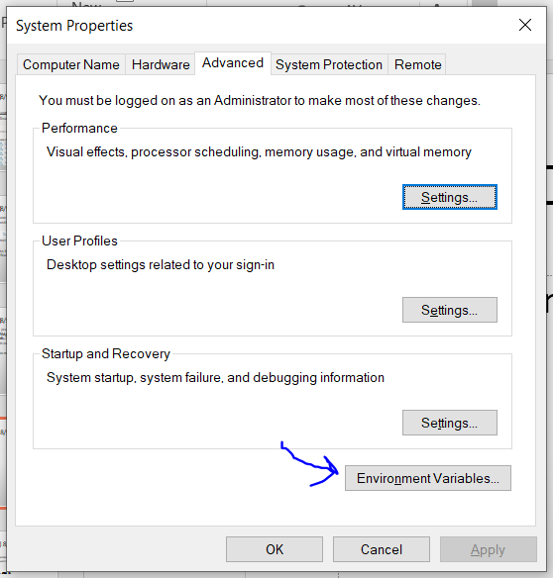
Java SE Development Kit (JDK) Installation
Click on “Environment Variables”

Slide 5
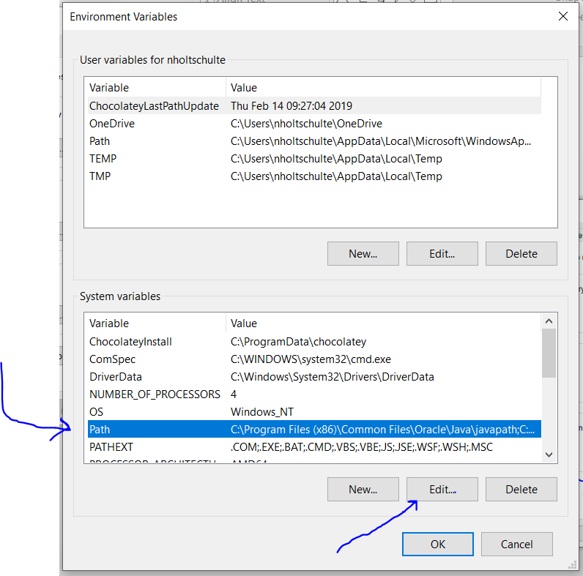
Java SE Development Kit (JDK) Installation
Select Path then Edit

Slide 6
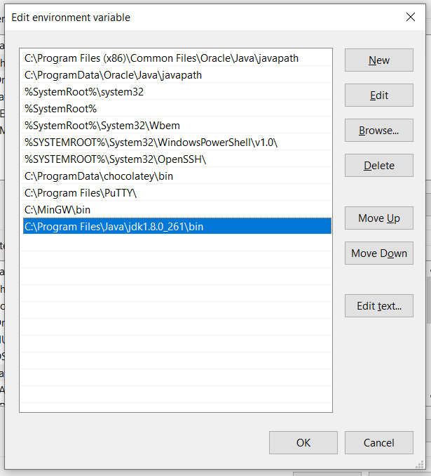
Java SE Development Kit (JDK) Installation
Click New then type in the path to the java bin. For instance, I typed in: C:\Program Files\Java\jdk1.8.0_261\bin
Lastly click Ok, Ok, Ok

Slide 7
Test to make sure it worked
Post Installation: Test Java compiler version
Open Command prompt window.
Issue the following command
javac –version <Enter>
The following should come out on your screen (but with a different number)
javac 9.0.4
Issue the following command
java –version <Enter>
The following should come out on your screen (but with a different number)
java version “9.0.4”

