Slide 1
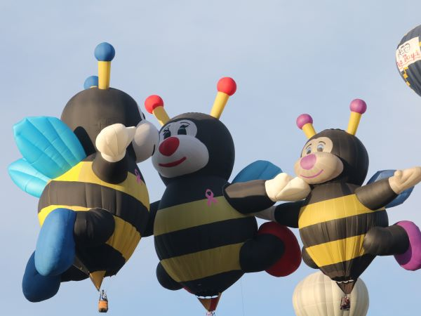
Chapter 9 Object-Oriented Programming: Inheritance
Java How to Program, 11/e

Slide 2
Inheritance
A new class is created by acquiring an existing class’s variables and methods and possibly embellishing them with new or modified capabilities.
In Java, every class has built-in information (variables) and abilities (methods).

Slide 3
Inheritance
Inheritance can save time during development by basing new classes on existing proven and debugged high-quality software.
Inheritance increases the likelihood that a system will be implemented and maintained effectively.

Slide 4
The Java class hierarchy begins with the class Object
Every class directly or indirectly extends (or “inherits from”) Object.
Java supports only single inheritance, in which each class is derived from exactly one direct superclass.

Slide 5
Is-a represents inheritance
An object of a subclass can be treated as an object of its superclass
Has-a represents composition
An object contains as members references to other objects

Slide 6
When creating a class, rather than declaring completely new members, you can designate that the new class should inherit the members of an existing class.
The subclass exhibits the behaviors of its superclass and can add behaviors that are specific to the subclass.
Inheritance is sometimes referred to as specialization.

Slide 7
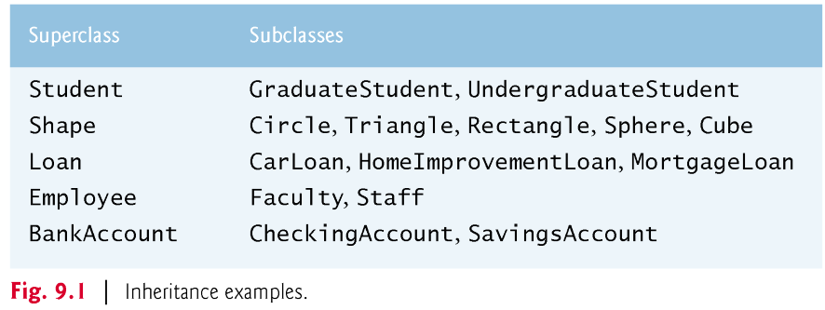
Superclasses and Subclasses
Figure 9.1 lists several simple examples of superclasses and subclasses

Slide 8
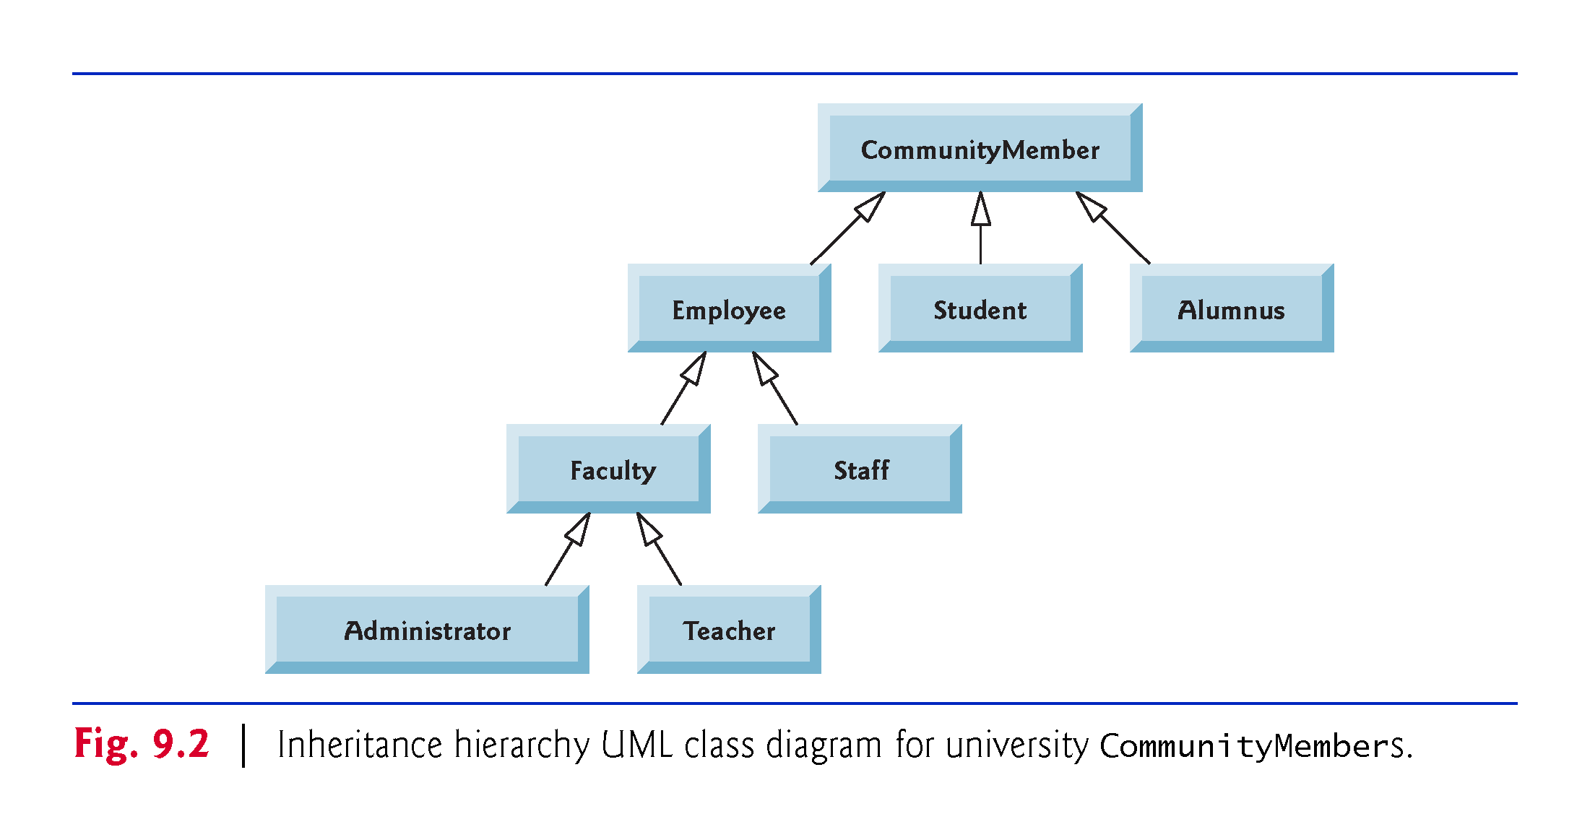
Superclasses and Subclasses
Fig. 9.2 shows a sample university community class hierarchy, also called an inheritance hierarchy.

Slide 9
Superclasses and Subclasses
Each arrow in the hierarchy represents an is-a relationship.
an Employee is a CommunityMember”
“a Teacher is a Faculty member.”
CommunityMember is the direct superclass of Employee, Student and Alumnus and is an indirect superclass of all the other classes in the diagram.

Slide 10
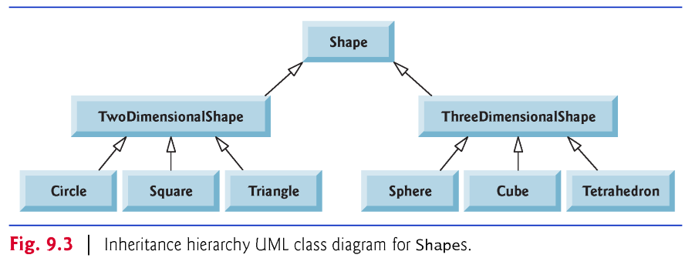
Superclasses and Subclasses
Fig. 9.3 shows a Shape inheritance hierarchy.
A Triangle is a TwoDimensionalShape and is a Shape
ASphere is a ThreeDimensionalShape and is a Shape.

Slide 11
Superclasses and Subclasses
Objects of all classes that extend a common superclass can be treated as objects of that superclass.
Inheritance issues
A subclass can inherit methods that it does not need or should not have.
Even when a superclass method is appropriate for a subclass, that subclass often needs a customized version of the method.
The subclass can override (redefine) the superclass method with an appropriate implementation.

Slide 12
protected Members
A class’s public and protected members are accessible to the object and its subclasses.
A class’s private members are accessible only within the class itself.

Slide 13
protected Members
protected access is an intermediate level of access between public and private.
A superclass’s protected members can be accessed by members of that superclass, by members of its subclasses and by members of other classes in the same package
protected members also have package access.
All public and protected superclass members retain their original access modifier when they become members of the subclass.

Slide 14
protected Members
A superclass’s private members are hidden from its subclasses
They can be accessed only through the public or protected methods inherited from the superclass
When a subclass method overrides an inherited superclass method, the superclass version of the method can be accessed from the subclass by preceding the superclass method name with keyword super and a dot (.) separator.

Slide 15
Relationship Between Superclasses and Subclasses
Inheritance hierarchy containing types of employees in a company’s payroll application
Commission employees are paid a percentage of their sales
Base-salaried commission employees receive a base salary plus a percentage of their sales.
Let’s check the Commission Employees class first, followed by the inheritance between Base-salaries commission employee class and Commission Employee class

Slide 16
Constructors in Subclasses
Instantiating a subclass object begins a chain of constructor calls
The subclass constructor, before performing its own tasks, explicitly uses super to call one of the constructors in its direct superclass or implicitly calls the superclass’s default or no-argument constructor
If the superclass is derived from another class, the superclass constructor invokes the constructor of the next class up the hierarchy, and so on.
The last constructor called in the chain is always Object’s constructor.
Original subclass constructor’s body finishes executing last.

Slide 17
Designing with Composition vs. Inheritance
Inheritance creates tight coupling among the classes in a hierarchy
Changes in superclass implementation can affect the behavior of subclasses, often in subtle ways
Tightly coupled designs are more difficult to modify than those in loosely coupled, composition-based designs
Change is the rule rather than the exception—this encourages composition
In general, use inheritance only for true is-a relationships in which you can assign a subclass object to a superclass reference

Slide 18
Designing with Composition vs. Inheritance
Composition is loosely coupled
When you compose a reference as an instance variable of a class, it’s part of the class’s implementation details that are hidden from the class’s client code
If the reference’s class type changes, you may need to make changes to the composing class’s internal details, but those changes do not affect the client code
If the reference is of a superclass type, you can replace the referenced object with an object of any type that has an is-a relationship with the reference’s class type
Use of a composition approach, typically creates a larger number of smaller classes, each focused on one responsibility. Smaller classes generally are easier to test, debug and modify

